Slide 1
KETOSIS-
CAUSES AND CONSEQUENCES
DR ROSHNI SADARIA

Slide 2
Learning objective
Conceptually: To understand the place of ketone bodies in the energy metabolism of individual
To write the question on :
Write the ketone body synthesis, metabolism and importance of ketone bodies.
Enumerate ketone bodies. How the ketosis and ketonemia is diagnosed ?
Enumerate the clinical conditions with ketosis.

Slide 3
Author/year | Study design | Level | Material and Methods and Results | Outcome
Acid-base and electrolyte disturbances in patients with diabetic ketoacidosis Moses S. Elisaf, Agathoklis A. Tsatsoulis, Kostas P. Katopodis, Kostas C. Siamopoulos Diabetes Research and Clinical Practice Volume 34, Issue 1, September 1996, Pages 23–27 | Observational study | Intermediate | A total of 40 insulin-dependent diabetes mellitus patients (22 male, 18 female), aged 18–61 years with DKA admitted to our hospital during the last 2 years, were studied | Twenty-one patients had a pure metabolic acidosis with an increased serum anion gap, seven had DKA combined with hyperchloremic metabolic acidosis, nine had DKA coexisting with metabolic alkalosis, while three had DKA with a concurrent respiratory alkalosis.

Slide 4
Ketone bodies
Three:
1. Acetone
2 Acetoacetate
3 beta-hydroxybutyrate:
Acetyl CoA is the end product of Beta oxidation of TG
Acetyl CoA is the initiator of Ketone body synthesis.
Obviously, all this happens in mitochondrion.

Slide 5

Ketone Bodies
water-soluble, transportable form of acetyl units. Fatty acids are released by adipose tissue and converted into acetyl units by the liver, which then exports them as ketone bodies.
Acetoacetate, D(-3) –hydroxy butyrate (Beta hydroxy butyrate), and acetone are often referred to as ketone bodies

Slide 6
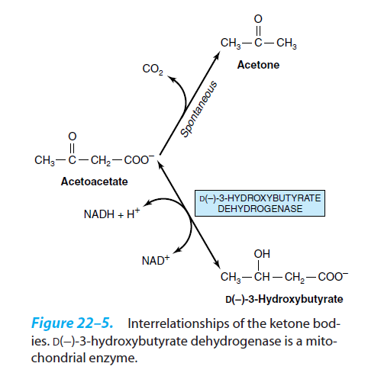
Interrelationship of ketone bodies

Slide 7
Significance
Alternate sources to glucose for energy
Production of ketone bodies under conditions of cellular energy deprivation
Utilization of ketone bodies by the brain

Slide 8
Ketogenesis
Site
Pathway
Regulation

Slide 9
Site of ketogenesis
Ketone bodies are synthesized only in liver

Slide 10
Acetyl-CoA
Acetyl-CoA
CoA-SH
Thiolase
Acetyl-CoA
Acetoacetyl-CoA
HMG-CoA synthase
H₂O
CoA-SH
HMG-CoA
NADH+H⁺
Acetyl-CoA
HMG-CoA lyase
β-Hydroxybutyrate
dehydrogenase
Acetoacetate
CO₂
NAD
Acetone
β-Hydroxybutyrate

Slide 11
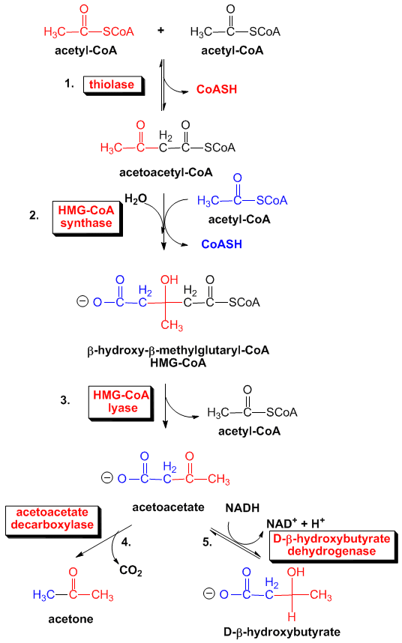

Slide 12

Ketogenesis
Ketogenesis takes place in liver using Acetyl co A as a substrate or a precursor molecule.
Enzymes responsible for ketone body formation are associated mainly with the mitochondria
Steps
Two molecules of acetyl CoA condense to form acetoacetyl CoA. This reaction, which is catalyzed by thiolase, is the reverse of the thiolysis step in the oxidation of fatty acids.

Slide 13
Ketogenesis
Acetoacetyl CoA then reacts with acetyl CoA and water to give 3-hydroxy-3-methylglutaryl CoA (HMG-CoA) and CoASH.
The reaction is catalyzed by HMG co A synthase.
This enzyme is exclusively present in liver mitochondria.
There are two isoforms of this enzyme-cytosolic and mitochondrial.
The mitochondrial enzyme is needed for ketogenesis while the cytosolic form is associated with cholesterol biosynthesis.

Slide 14
Ketogenesis
Both enzymes(HMG CoA Synthase and HMG Co A Lyase) must be present in mitochondria for ketogenesis to take place.
This occurs solely in liver and rumen epithelium,
The sum of these reactions is-
The other two ketone bodies-Acetone and D(-)- 3-Hydroxybutyrate are formed from Acetoacetate, the primary ketone body.

Slide 15
Formation of Acetone
Acetoacetate undergoes a slow, spontaneous decarboxylation to acetone.
The odor of acetone may be detected in the breath of a person who has a high level of acetoacetate in the blood.
“Acetone-breath” has been used as a crude method of diagnosing individuals with untreated Type I diabetes mellitus.

Slide 16
Formation of β-Hydroxy Butyrate
D (-)-3-Hydroxybutyrate (β-Hydroxy Butyrate) is formed by the reduction of acetoacetate in the mitochondrial matrix by D(-)3-hydroxybutyrate dehydrogenase.
D(-)-3-Hydroxybutyrate is quantitatively the predominant ketone body present in the blood and urine in ketosis.
The β-hydroxybutyrate dehydrogenase reaction has two functions:
1) it stores energy equivalent to an NADH in the ketone body for export to the tissues, and
2) it produces a more stable molecule.

Slide 17
Utilization of ketone bodies
Ketone bodies serve as a fuel for extra hepatic tissues
The ketone bodies are water soluble and are transported across the inner mitochondrial membrane as well as across the blood-brain barrier and cell membranes.
They can be used as a fuel source by a variety of tissues including the CNS.
They are preferred substrates for aerobic muscle and heart, thus sparing glucose when they are available.
Tissues that can use fatty acids can generally use ketone bodies in addition to other energy sources.
The exceptions are the liver and the brain.

Slide 18
Utilization of ketone bodies
Ketone bodies are utilized by extrahepatic tissues via a series of cytosolic reactions that are essentially a reversal of ketone body synthesis, the ketones must be reconverted to acetyl CoA in the mitochondria:
Utilization of Beta-hydroxybutyrate
Beta-hydroxybutyrate, is first oxidized to acetoacetate with the production of one NADH (1).
Under conditions where tissues are utilizing ketones for energy production their NAD⁺/NADH ratios are going to be relatively high, thus driving the β-hydroxybutyrate dehydrogenase catalyzed reaction in the direction of acetoacetate synthesis.

Slide 19
Utilization of ketone bodies
2) Coenzyme A must be added to the acetoacetate.
The thioester bond is a high energy bond, so ATP equivalents must be used.
In this case the energy comes from a trans esterification of the CoAS from Succinyl CoA to acetoacetate by Coenzyme A transferase, also called Succinyl co A : Acetoacetate co A transferase, also known as Thiophorase.
The Succinyl CoA comes from the TCA cycle.

Slide 20
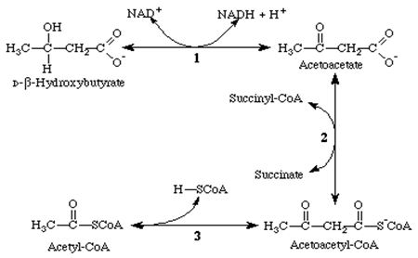
Utilization of ketone bodies
The liver has acetoacetate available to supply to other organs because it lacks the particular CoA transferase and that is the reason that “Ketone bodies are synthesized in the liver but utilized in the peripheral tissues”.

Slide 21
Liver v/s Peripheral tissues for ketones as fuel molecules
The enzyme, Succniyl co A Acetoacetate co A transferase, also known as Thiophorase, is present at high levels in most tissues except the liver.
Importantly, very low level of enzyme expression in the liver allows the liver to produce ketone bodies but not to utilize them.
This ensures that extra hepatic tissues have access to ketone bodies as a fuel source during prolonged fasting and starvation, and
Also, lack of this enzyme in the liver prevents the futile cycle of synthesis and breakdown of acetoacetate.

Slide 22
Regulation of Ketosis
Concept:
Non availability of carbohydrate leads to Excessive utilization of TG to free fatty acids.
Glucagon stimulates Ketosis, Insulin inhibits lipolysis and ketosis.
Increased ratio of Glucagon: insulin promotes ketosis, as in diabetes.

Slide 23
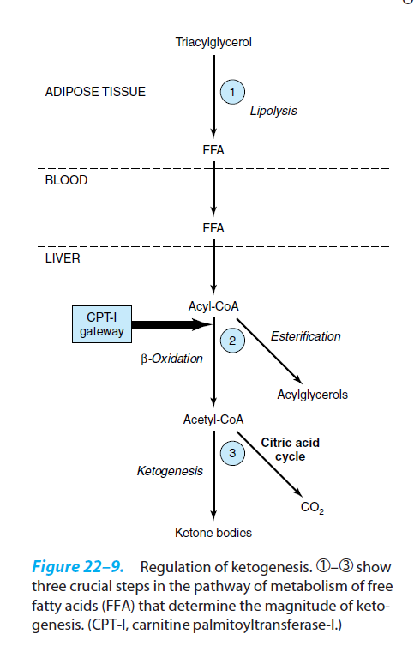
Regulation of ketogenesis
Level 1
INSULIN GLUCAGON
Lipolysis
Level 2
CAT-I
Entry of fatty acid to mitochondria
Level 3
OXALOACETATE
Oxidation of acetyl CoA

Slide 24
Regulation of Ketosis
Ketogenesis is regulated at three steps-
1) Lipolysis in Adipose tissue
Ketosis does not occur unless there is an increase in the level of circulating free fatty acids that arise from lipolysis of triacylglycerol in adipose tissue.
When glucose levels fall, lipolysis induced by glucagon secretion causes increased hepatic ketogenesis due to increased substrate (free fatty acids) delivery from adipose tissue.
Conversely, insulin, released in the well-fed state, inhibits ketogenesis via the triggering dephosphorylation and inactivation of adipose tissue hormone sensitive lipase (HSL).

Slide 25
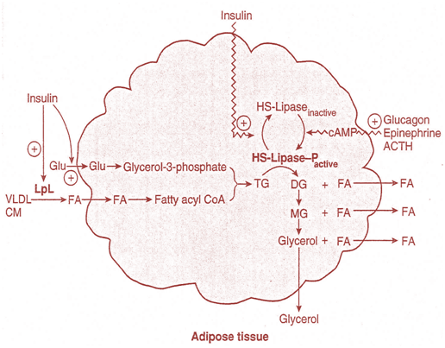
Lipolysis in Adipose tissue
Hormone sensitive lipase exists in two forms inactive dephosphorylated (brought by Insulin) and active phosphorylated form (brought by glucagon, ACTH and catecholamines). Insulin promotes lipogenesis while the other hormones promote lipolysis.

Slide 26
Regulation of Ketosis
2) Fate of fatty acid-free fatty acids are either oxidized to CO₂ or ketone bodies or esterified to triacylglycerol and phospholipids.
There is regulation of entry of fatty acids into the oxidative pathway by carnitine Acyl transferase-I (CAT-I)
Malonyl-CoA, the initial intermediate in fatty acid biosynthesis formed by acetyl-CoA carboxylase in the fed state, is a potent inhibitor of CAT-I .
Under these conditions, free fatty acids enter the liver cell in low concentrations and are nearly all esterified to acylglycerols and transported out of the liver in very low density lipoproteins (VLDL).

Slide 27
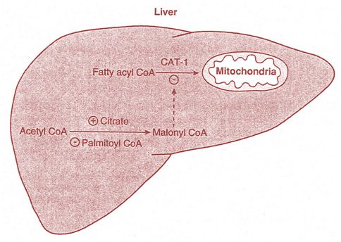
Regulation of CAT-1 activity
CAT-I activity is low in the fed state, leading to depression of fatty acid oxidation. However, CAT-1 activity is higher in starvation, allowing fatty acid oxidation to increase.

Slide 28
Regulation of Ketosis
3) Fate of Acetyl co A
The acetyl-CoA formed in beta-oxidation is oxidized in the citric acid cycle, or it enters the pathway of ketogenesis to form ketone bodies.
As the level of serum free fatty acids is raised, proportionately more free fatty acids are converted to ketone bodies and less are oxidized via the citric acid cycle to CO₂.
Entry of acetyl CoA into the citric acid cycle depends on the availability of Oxaloacetate for the formation of citrate, but the concentration of Oxaloacetate is lowered if carbohydrate is unavailable or improperly utilized.

Slide 29
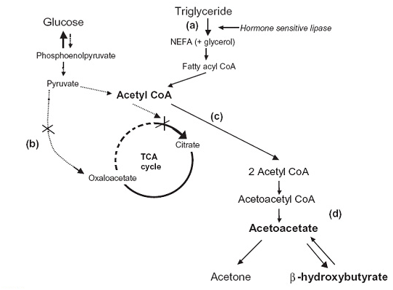
Regulation of Ketosis- Overview
During high rates of fatty acid oxidation, primarily in the liver, large amounts of acetyl-Co A are generated. These exceed the capacity of the TCA cycle, and one result is the synthesis of ketone bodies.

Slide 30
Biological significance of ketone bodies
Ketone bodies serve as a fuel for extra hepatic tissues
Brain
It is metabolically active and metabolically privileged.
The brain generally uses 60-70% of total body glucose requirements, and always requires some glucose for normal functioning.
Under most conditions, glucose is essentially the sole energy source of the brain.
The brain cannot use fatty acids as they cannot cross the blood-brain barrier.
As glucose availability decreases, the brain is forced to use either amino acids or ketone bodies for fuel.

Slide 31
Biological significance of ketone bodies
Acetoacetate and β-hydroxybutyrate are normal fuels of respiration and are quantitatively important as sources of energy.
Heart muscle and the renal cortex use acetoacetate in preference to glucose.
In contrast, the brain adapts to the utilization of acetoacetate during starvation and diabetes. Brain donot use FFA.
In prolonged starvation,75% of the fuel needs of the brain are met by ketone bodies.
Individuals eating diets extremely high in fat and low in carbohydrate, or starving, or suffering from a severe lack of insulin (Type I diabetes mellitus) therefore increase the synthesis and utilization of ketone bodies

Slide 32
Ketonemia
Ketonemia - increased concentration of ketone bodies in blood
It is due to increased production of ketone bodies by the liver rather than to a deficiency in their utilization by extra hepatic tissues.
The production of ketone bodies occurs at a relatively low rate during normal feeding and under conditions of normal physiological status.
Normal physiological responses to carbohydrate shortages cause the liver to increase the production of ketone bodies from the acetyl-CoA generated from fatty acid oxidation.

Slide 33
Causes of Ketosis
Uncontrolled diabetes mellitus
Starvation
Chronic alcoholism
Von- Gierke’s disease
Heavy exercise
Low carbohydrate diet- For weight loss
Glycogen storage disease type 6(Due to phosphorylase kinase deficiency)
Pyruvate carboxylase deficiency

Slide 34
Causes of Ketosis
Prolonged ether anesthesia
Toxemia of pregnancy
Certain conditions of alkalosis
Nonpathologic forms of ketosis are found under conditions of high-fat feeding and
After severe exercise in the post absorptive state.

Slide 35
Clinical Significance-Ketoacidosis
Both β-hydroxybutyrate and acetoacetate are organic acids. and are released in the protonated form, to lower the pH of the blood.
When ketone bodies are released in large quantities the normal pH-buffering mechanisms are overloaded ; the reduced pH, in combination with a number of other metabolic abnormalities results in ketoacidosis.
In severe ketoacidosis, cells begin to lose ability to use ketone bodies also.

Slide 36
Starvation induced ketosis
Prolonged fasting may result
From an inability to obtain food
from the desire to lose weight rapidly, or
in clinical situations in which an individual cannot eat because of trauma, surgery, neoplasms, burns etc.
In the absence of food the plasma levels of glucose, amino acids and triacylglycerols fall,
triggering a decline in insulin secretion and
an increase in glucagon release.

Slide 37
Starvation induced ketosis
The decreased insulin to glucagon ratio, makes this period of nutritional deprivation a catabolic state, characterized by degradation of glycogen, triacylglycerol and protein.
This sets in to motion an exchange of substrates between liver, adipose tissue, muscle and brain that is guided by two priorities-
(i) the need to maintain glucose level to sustain the energy metabolism of brain ,red blood cells and other glucose requiring cells and
(ii) to supply energy to other tissues by mobilizing fatty acids from adipose tissues and converting them to ketone bodies to supply energy to other cells of the body.

Slide 38
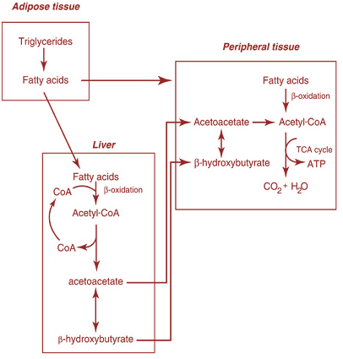
Starvation induced ketosis
In early stages of starvation , heart and skeletal muscle consume primarily ketone bodies to preserve glucose for use by the brain.
After several weeks of starvation, ketone bodies become the major fuel of the brain.

Slide 39
Diabetic Keto- acidosis
Diabetic Ketoacidosis (DKA) is a state of inadequate insulin levels resulting in high blood sugar and accumulation of organic acids and ketones in the blood.
It is a potentially life-threatening complication.
It happens predominantly in type 1 diabetes mellitus,
But can also occur in type 2 diabetes mellitus under certain circumstances.
This may be due to intercurrent illness (pneumonia, influenza, gastroenteritis, a urinary tract infection), pregnancy, inadequate insulin administration (e.g. defective insulin pen device), myocardial infarction (heart attack), stroke or the use of cocaine.
Young patients with recurrent episodes of DKA may have an underlying eating disorder, or may be using insufficient insulin for fear that it will cause weight gain.
In 5% of cases, no cause for the DKA episode is found.

Slide 40
Diabetic Keto- acidosis
DKA results from relative or absolute insulin deficiency combined with counter regulatory hormone excess( Glucagon, Catecholamines, cortisol, and growth hormone).
The decreased ratio of insulin to Glucagon promotes Gluconeogenesis, glycogenolysis, and Ketone body formation in the liver, as well as increases in substrate delivery from fat and muscle (free fatty acids, amino acids) to the liver
The ketone bodies have a low pH and therefore cause metabolic acidosis.
The body initially buffers these with the bicarbonate buffering system, and other mechanisms to compensate for the acidosis, such as hyperventilation to lower the blood carbon dioxide levels.
This hyperventilation, in its extreme form, may be observed as Kussmaul respiration.
Ketones, too, participate in osmotic diuresis and lead to further electrolyte losses

Slide 41
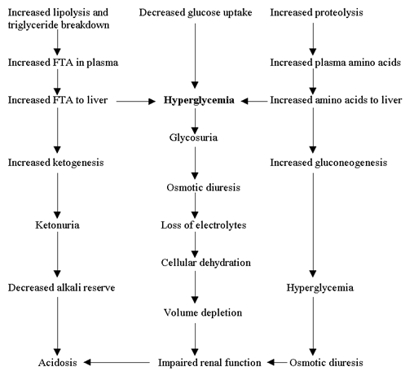
Diabetic Keto- acidosis
Diabetic Ketoacidosis may be diagnosed when the combination of hyperglycemia (high blood sugars), ketones on urinalysis and acidosis are demonstrated.

Slide 42
KETOSIS - causes
Prolonged starvation
Carbohydrate deprivation
Uncontrolled diabetes mellitus
Impaired uptake of glucose by the peripheral tissues

Slide 43
KETOSIS – biochemical findings
Ketonemia
Ketonuria
Acetone breath
Metabolic acidosis
Hyperkalemia

Slide 44
KETOSIS – biochemical diagnosis
β hydroxybutyrate
In plasma
Acetoacetate
In urine
Rothera’s test

Slide 45
KETOSIS – management
Provision of glucose to the tissues
Correction of acid-base and electrolyte imbalance
Starvation – carbohydrate ingestion
Diabetes mellitus – glucose and insulin
Bicarbonate administration
Reverses hyperkalemia

Slide 46
Alcoholic ketoacidosis(AKA)
The following are the 3 main predisposing events:
Delay and decrease in insulin secretion and excess glucagon secretion, induced by starvation
Elevated ratio of the reduced form of nicotinamide adenine dinucleotide (NADH) to nicotinamide adenine dinucleotide (NAD⁺) secondary to alcohol metabolism
Volume depletion resulting from vomiting and poor oral intake of fluids

Slide 47
Alcoholic ketoacidosis(AKA)
The metabolism of alcohol itself is a probable contributor to the ketotic state.
Alcohol dehydrogenase metabolizes alcohol to acetaldehyde in the cytoplasm of hepatocyte mitochondria.
Acetaldehyde is metabolized further to acetic acid by aldehyde dehydrogenase.
Both steps require the reduction of nicotinamide adenine dinucleotide (NAD⁺) to reduced nicotinamide adenine dinucleotide (NADH).
Thus, NAD⁺ is consumed and NADH is generated.

Slide 48
Alcoholic ketoacidosis(AKA)
The decreased ratio of NAD⁺ to NADH has the following implications:
Impaired conversion of lactate to pyruvate with an increase in serum lactic acid levels
Impaired gluconeogenesis because pyruvate is not available as a substrate for glucose production
A shift in the hydroxybutyrate (β-OH) to acetoacetate (AcAc) equilibrium toward β-OH butyrate
In contrast to diabetic ketoacidosis, the predominant ketone body in AKA is β-OH. Routine clinical assays for ketonemia test for AcAc and acetone but not for β-OH.
Clinicians underestimate the degree of ketonemia if they rely solely on the results of laboratory testing.

Slide 49
Alcoholic ketoacidosis(AKA)
Prolonged vomiting leads to dehydration, which decreases renal perfusion, thereby limiting urinary excretion of ketoacids.
Moreover, volume depletion increases the concentration of counter-regulatory hormones, further stimulating lipolysis and ketogenesis.
The pivotal variable appears to be a relative deficiency of insulin.
Individuals with higher insulin levels are more likely to present with the syndrome of alcohol-induced hypoglycemia without ketoacidosis

Slide 50
Alcoholic ketoacidosis(AKA)
Most cases of AKA occur when a person with poor nutritional status due to long-standing alcohol abuse who has been on a drinking binge suddenly decreases energy intake because of abdominal pain, nausea, or vomiting.
In addition, AKA is often precipitated by another medical illness such as infection or pancreatitis.
AKA results from the accumulation of the ketoacids, hydroxybutyric acid, and acetoacetic acid.
Such accumulation is caused by the complex interaction stemming from alcohol cessation, decreased energy intake, volume depletion, and the metabolic effects of hormonal imbalance.

Slide 51
Summary
The ketone bodies (acetoacetate, 3-hydroxybutyrate, and acetone) are formed in hepatic mitochondria when there is a high rate of fatty acid oxidation. The pathway of ketogenesis involves synthesis and breakdown of 3-hydroxy-3-methylglutaryl-CoA (HMG-CoA) by two key enzymes, HMG-CoA synthase and HMG-CoA lyase.
Ketone bodies are important fuels in extrahepatic tissues.
Ketogenesis is regulated at three crucial steps: (1) control of free fatty acid mobilization from adipose tissue; (2) the activity of carnitine acyl ltransferase-I in liver, which determines the proportion of the fatty acid flux that is oxidized rather than esterified; and (3) partition of acetyl-CoA between the pathway of ketogenesis and the citric acid cycle.

