Slide 1

STRUCTURE AND LAB DIAGNOSIS OF HIV

Slide 2
TYPES OF HIV VIRUS
There are two genetically different but related forms of HIV
HIV- 1 : Most common type associated with AIDS in United States , Europe and Central Asia
HIV-2 : Mainly in West Africa , India
Although distinct , they share some common antigens

Slide 3
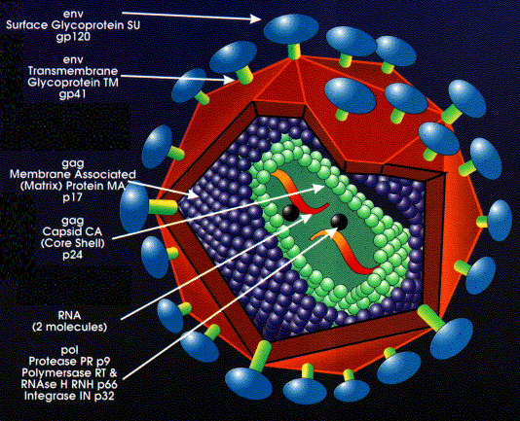
STRUCTURE OF HIV VIRUS
ENVELOPED
RNA RETROVIRUS
Spherical ,90-120 nm in size
Consists of a core surrounded by lipid envelope
Core contains
  Major capsid protein p24
  Nucleocapsid protein
  2 copies of genomic RNA,Viral enzymes

Slide 4
ENVELOPE-
MADE UP OF BI-LIPID MEMBRANE WITH EMBEDDED COMPONENTS
COMPONENTS-
EXTERNAL PORTION GP120
INTERNAL PORTION GP 41
FUNCTION-
TO ATTACH WITH HOST CD4 RECEPTOR
FUSION WITH CELL MEMBRANE

Slide 5
INNER CORE
BOUND BY PROTEIN COAT
EMCOMPASS RNA GENOME
MAIN GENES
GAG,ENV,POL
3 ENZYMES-
REVERSE TRANSCRIPTASE,
INTEGRASE,
PROTEASE

Slide 6
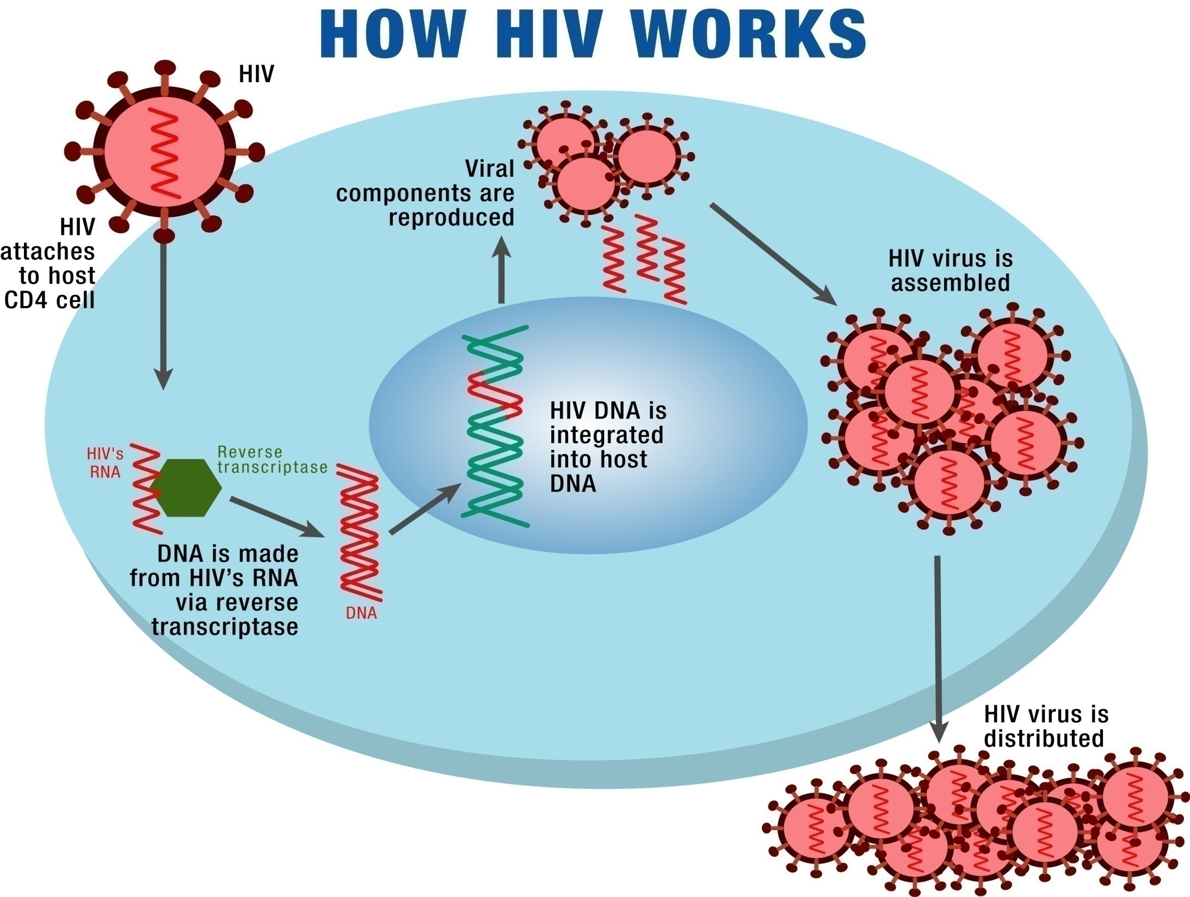

Slide 7
MODES OF TRANSMISSION
Sexual intercourse:0.1 – 3%
Blood transfusion: 90-100%
Perinatal:13-48%
IV drug abuse: 0.3- 0.5 %

Slide 8
MAJOR ABNORMALITIES OF IMMUNE FUNCTION IN AIDS
Lymphopenia
  DECREASED CD4 cell count
  Inversion of CD4:CD8 ratio
Altered T cell function
  Susceptibility to opportunistic infections
  Susceptibility to neoplasms
  Decreased specific cytotoxicity
Polyglonal B cell activation
  Hypergammaglobulinemia
  Inability to mount antibody response to new antigens
Altered monocyte and macrophage function
  Decreased chemotaxis and phagocytosis

Slide 9
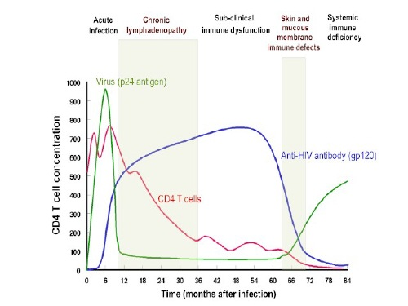

Slide 10
LABORATORY DIAGNOSIS OF
HIV

Slide 11

WHO Objectives of HIV diagnosis
Blood and blood products safety: This is achieved by mandatory testing of all donated blood units and blood products.
Screening of donors of sperms, organs and tissues.
Diagnosis of HIV infection in clinically suspected cases.
Voluntary counselling and testing (VCT).
Epidemiological surveillance using unlinked anonymous HIV testing. Here the result of the test cannot be linked with the identity of the person.
Research and surveys.

Slide 12
Laboratory diagnosis..
Tests for HIV-specific antibodies in serum/plasma:
Screening tests Supplemental tests:
1.Rapid tests 1.Western blot assay
2.ELISA 2.Immunoflourescence test
3.Line immunoassay

Slide 13
Confirmatory tests:
1.Virus isolation
2. Detection of HIV-specific core antigen (p24)
3. Polymerase chain reaction
Tests for HIV- specific antibodies in saliva
Tests for HIV- specific antibodies in urine

Slide 14
Three Formats of HIV Rapid Tests …
Immunoconcentration (flow-through device)
Immunochromatography (lateral flow)
Particle agglutination
Dot blot
Red cell agglutination
Immunodot

Slide 15
How Immunoconcentration Works
The pt serum flow through solid phase capture technique using a porous memb which contains immobilized hiv ag conj to coll gold. a line or dot seen
Internal Control
HIV-1 peptide
HIV-2 peptide

Slide 16
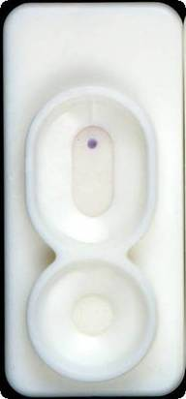
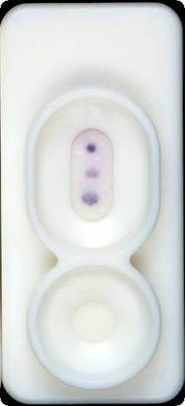
Reading Results …
Non-reactive
Reactive

Slide 17
Immunochromatography (tri-line test)
Add Sample
Whole bld or serum
Test
Line
Control
line
Conjugate
IgG Antibodies
HIV antibodies
Colloidal gold
conjugated to HIV antigen
HIV antigen
Anti-IgG/gold
antibodies

Slide 18
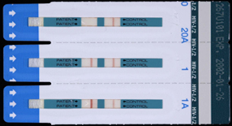
Tests Based on Immunochromatography
Control
HIV Antigen
Sample pad
Specimen Flow
Sample Pad
Control line
Test line

Slide 19
How Particle Agglutination Works
Anti-HIV antibodies bind to the antigen-coated latex particles.
Antigen
Antibody
Lab workers
Health workers

Slide 20
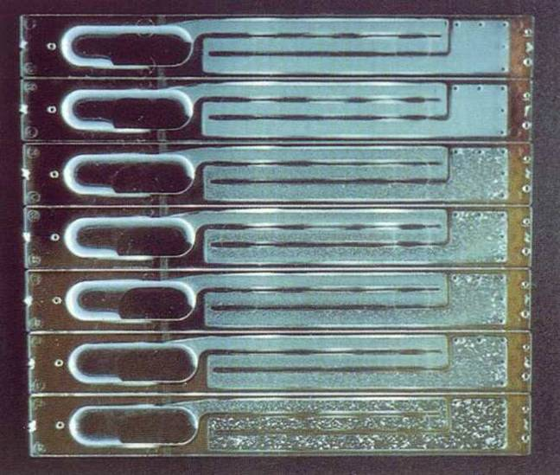
Reading Results
Non-reactive
Weak Reactive
Strong Reactive

Slide 21
Red cell or haemagg assay: hiv ag complexed to rbc pr .when added to pts whole bld,the pts hiv ab coz agg of pts rbc in less than 5 min magnetic bead assay: elisa based methodology with magnetic beads as solid matrix to which hiv ag are conjugated

Slide 22
HIV Rapid Tests: Advantages
Same-day diagnosis and counseling
Robust and easy to use
Test time under 30 minutes
Most require no refrigeration
None or one reagent
Minimal or no equipment required
Minimum technical skill

Slide 23
After the screening…..
All require confirmatory testing
Follow-up testing for persons with
  negative or
  indeterminate confirmatory test results,
  Blood specimen collected 4 weeks after the initial reactive rapid test result.
WHO strategy for combining 2 or more rapid tests to confirm a diagnosis

Slide 24
Enzyme Immunoassays (EIAs)
Quantitative assay to measure HIV antibodies
  Most detect antibodies to HIV-1 and HIV-2
  Antigens coated in microwells
  HIV Antigen / Antibody reaction is detected by color change
  Intensity of color reflects amount of antibody present serum
Some assays can detect both HIV antibody and HIV antigen
SENSITIVITY : 100%
SPECIFICITY : 99.8%

Slide 25
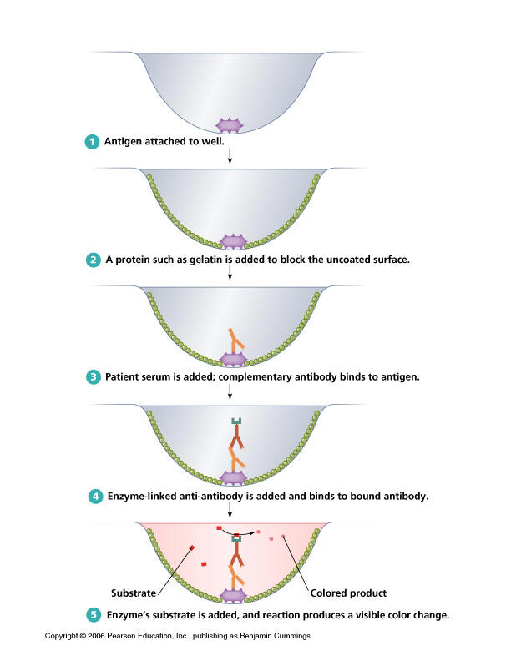
Principle of Enzyme Immunoassays
Proteins or synthetic peptides are immobilized on microtitre plates
Incubate test serum.
Wash
Enzyme-labeled antibody specific for hu-IgG.
Wash.
Substrate changes color
After several incubation and wash steps, a color reaction occurs if HIV antibody is present

Slide 26
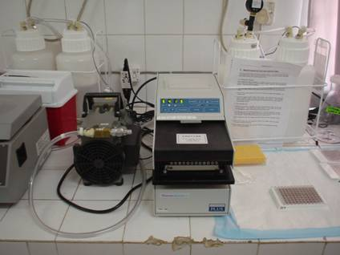
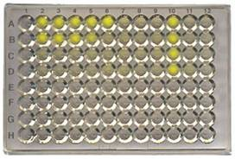
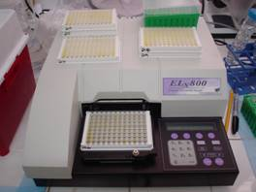
Enzyme ImmunoAssays (EIAs) – Cont’d
An automated reader gives a measurement of optical density (presence of color) for each well
Notes:
Example of multiple factors that can affect testing, e.g., technical skill and required equipment

Slide 27

Western Blot / Line Immunoassays
The Western Blot is the most common test use for confirmation of HIV infection.
Used at referral labs to resolve difficult cases
Specificity > 99.9%
Detects antibodies to specific HIV antigens on cellulose strip
Disadvantage-
Complex
High range of indeterminate results
Expensive
Notes:
h

Slide 28
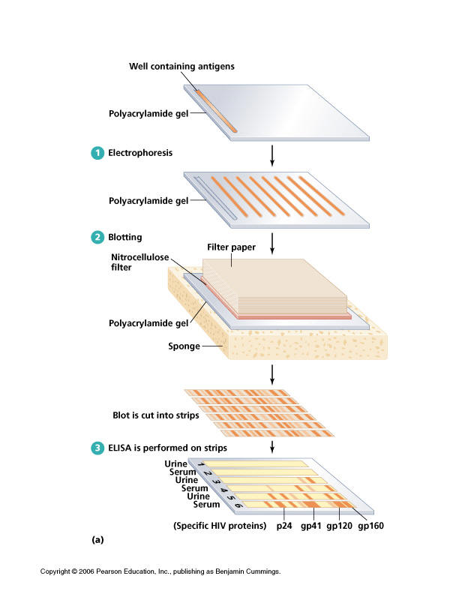

Slide 29
Western blot uses a suspension incubation of patients serum or plasma with a kit based HIV ag to form ag-ab complex.
This complex is the subjected to gel electrophoresis which seperates proteins acc to size and charge over an electrical gradient.
Pr then blotted from gel to nitrocellulose memb before the addition of secondry anti hiv ab conjugated either to alk po4ase or a radioisotope
Pr bands are visualised either by using autoradiography or substrate conversion into coloured product to detect hiv pr specific bands.

Slide 30
Interpretation of Western Blots
  Positive, if bands are present at the site of two or more of the following HIV antigens
  p24 (gag or capsid protein)
  gp41 (envelope protein)
  gp120/160 (envelope protein)
  Negative, if no viral bands
  Indeterminate, if fewer than 2 of the bands
  HIV-2 infection
  Early infection

Slide 31
Immunoflourscent test(ifa)
Serum or plasma is incubated with immortalized human t cell that express hiv ag on cell memb in ass with mhc molecules.
Next addition of sec ab that conj to fitc molecule gives green flourcence with uv lite

Slide 32
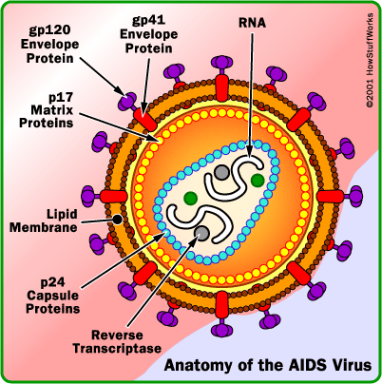
HIV p24 Antigen
Core protein of the virus
ELISA type assay in which microtitre plates contain antibodies to p24 Ag.
Detects p24 antigen before antibody can be detected
    Detected 2 to 3 weeks after HIV infection
    Detected about 6 days before antibody tests become reactive
Used for:
  Diagnosis of pediatric HIV-1 infections
  Blood bank safety (high incidence countries)
  Levels decrease with ART
Notes:
P24 antigen testing can detect HIV infection earlier than any antibody tests
Detected 2 to 3 weeks after HIV infection
Detected about 6 days before antibody tests become positive
They were developed to shorten the window period and decrease the risk of transmission of HIV through blood transfusion.

Slide 33
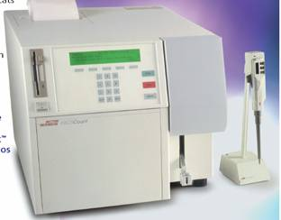
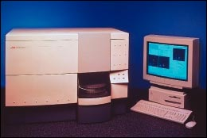
CD4 T-Lymphocyte
CD4 T-lymphocyte counts used for:
  Determining clinical prognosis
  Assessing criteria for antiretroviral therapy
  Monitoring therapy
Manual and automated methods
Issues:
  Requires high level of technical skill for test performance and interpretation
  Properly maintained equipment
Notes:
NOT a substitute HIV antibody testing
Cannot be used to determine whether a person is HIV infected

Slide 34
Viral Load
Quantitative molecular assay measures amount of HIV in blood products using rna or dna based methods
Used to:
  Predict disease progression
  Assist with deciding when to initiate anti-retroviral therapy
  Monitors response to anti-retrovirals
Issues:
  Expensive
  Special facilities
Notes:
Measures the amount of HIV virus in your blood.
NEED TO HIGHLIGHT CHALLENGES FOR IMPLEMENTING THIS TYPE OF TESTING
Demanding molecular techniques
Difficult/complex assays
Need separate dedicated supplies, equipment (including biosafety cabinets), and air conditioned rooms
Concerns over contamination
Experienced technicians required
Kits and reagents are expensive
Need constant source of electrical power
PCR-based technologies susceptible to genetic variation and low copy number

Slide 35
HIV Culture
PBMCs from patients are co-cultured with mitogen-stimulated normal donor PBMCs
Culture supernatant is periodically tested for reverse transcriptase
Specificity and positive predictive value approaching 100% but still needs confirmation by a second culture or PCR
Positive result in 2 weeks, negative in 30 days
Expensive

Slide 36
HIV PCR Test : RNA, DNA
Very sensitive test for detecting specific HIV proviral sequences in PBMCs
Extract DNA from PBMCs
Can detect single provirus from 15,000 PBMCs (100μl newborns, 500μl adults)
Results in ~48 hrs

Slide 37
Indications for DNA PCR test
Repeatedly indeterminate Western blots
Infants born to HIV-positive mothers
Pregnant women who may have had recent exposure to HIV
Individuals recently involved in a very high risk exposure (within the last 72 h) who might be considered for post-exposure prevention treatment
Severe humoral deficiency- end-stage AIDS

Slide 38
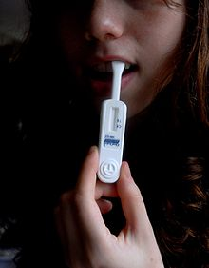
Newer tests…
The blood, plasma or oral fluid is mixed in a vial with developing solution, and the results are read from a sticklike testing device. Usually detects HIV 1 and HIV 2
Ora quick- antibody test ,result in 20 mins The blood, plasma or oral fluid is mixed in a vial with developing solution, and the results are read from a sticklike testing device. Usually detects HIV 1 and HIV 2
Uni-Gold is a rapid HIV antibody test that provides results in 10–12 minutes. A drop of blood is placed on the device with developing solution. Uni-Gold is only FDA approved to test for HIV 1.

Slide 39
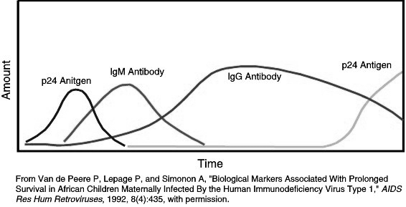

Mean interval from infection to detection
ANTIBODY TESTING: 22 DAYS
P24 ANTIGEN :16 DAYS
NUCLEIC ACID : 12 DAYS

Slide 40
NACO GUIDELINES FOR HIV TESTING
OBJECTIVES OF HIV TESTING:
  Surveillance to monitor trend of HIV infection in a population
  Transfusion safety
  Identification of asymptomatic HIV infection
  Diagnose clinically suspected cases
  Evaluate and monitor cases of occupational exposure
  Research purposes
NO MANDATORY TESTING
CONSENT , COUNSELLING AND CONFIDENTIALITY

Slide 41

THANK YOU

