Slide 1
Digestion and Absorption Of Lipids
Dr. Tejas Shah

Slide 2
Lipids
Lipids are heterogeneous group of water insoluble organic molecules that can be extracted from tissues by non polar solvents.
Major source of energy for the body
Also provide the hydrophobic barriers that permit partitioning of aqueous contents of cells and sub cellular structures.
Fat soluble vitamins have regulatory or coenzyme role in the body.
Prostaglandins and steroid hormones play major roles in the control of body’s homeostasis.
Give shape and contour to the body and protect internal organs by providing a cushioning effect.

Slide 3
Dietary fat Composition
More than 95% are triglycerides, the other are
Cholesterol,
Cholesteryl esters,
Phospholipids, and
Unesterified fatty acids.

Slide 4
Dietary sources of Lipids
Animal Sources
Dairy products- Meat, butter, ghee
Meat and Fish, Pork, eggs
Vegetable Sources
Cooking oils- Sun flower oil, Mustard oil, Ground nut oil
Fats from other vegetable sources

Slide 5
Digestion in Mouth
Hydrolysis of triacylglycerols is initiated by lingual and gastric lipases, which attack the sn-3 ester bond forming 1,2-diacylglycerols and free fatty acids, aiding emulsification.
Lingual lipase:
Secreted by dorsal surface of tongue
Active at low pH (pH 2.0 – 7-5)
optimum pH 4.0-4.5
Ideal substrate-Short chain TGS.
Milk fat contains short chain fatty acids which are esterified at -3 position, thus it is the best substrate for lingual lipase
Enzymatic action continues in stomach
Short chain fatty acids, released are absorbed directly from the stomach wall and enter the portal vein.

Slide 6
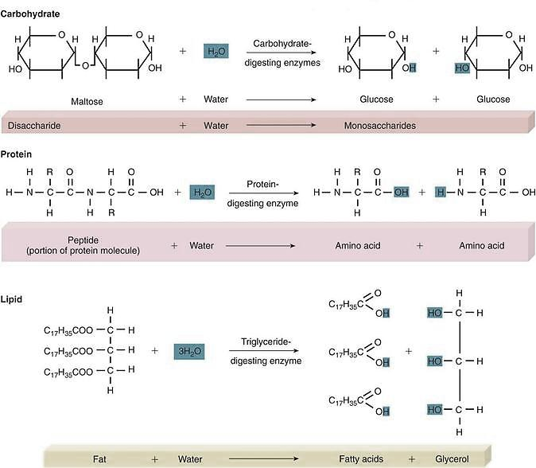
Triglyceride degradation
Triglycerides are degraded by lipases to form free fatty acids and glycerol

Slide 7
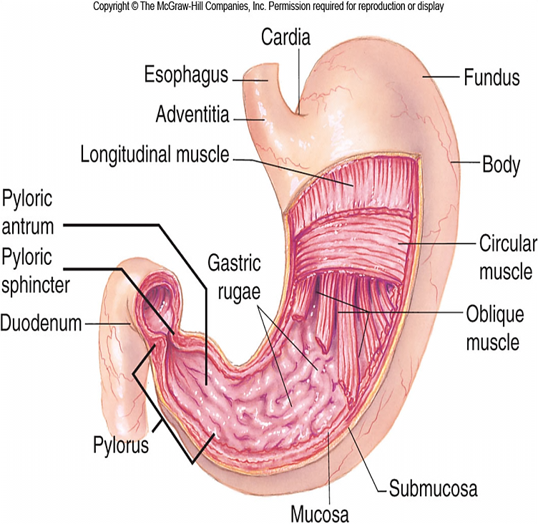
Digestion in Stomach
Gastric Lipase- secreted in small quantities
More effective at alkaline p H (Average p H 7.8)
Requires the presence of Ca⁺⁺
Less effective in stomach due to acidic p H except when intestinal contents are regurgitated in to the gastric lumen
Not effective for long chain fatty acids, most effective for short and medium chain fatty acids
Milk, egg yolk and fats containing short chain fatty acids are suitable substrates for its action

Slide 8
Significance of Lingual and Gastric Lipases
Play important role in lipid digestion in neonates since milk is the main source of energy
Important digestive enzymes in pancreatic insufficiency such as Cystic fibrosis or other pancreatic disorders
Lingual and gastric lipases can degrade triglycerides with short and medium chain fatty acids in patients with pancreatic disorders despite a near or complete absence of pancreatic lipase

Slide 9
Emulsification and digestion
Lipids are hydrophobic, and thus are poorly soluble in the aqueous environment of the digestive tract.
The digestive enzyme, lipase, is water soluble and can only work at the surface of fat globules.
Digestion is greatly aided by emulsification, the breaking up of fat globules into much smaller emulsion droplets.

Slide 10
Emulsification and digestion
Triacylglycerol digestion occurs at lipid-water interfaces
Rate of TAG digestion depends on surface area of this interface which is increased by churning peristaltic movements of the intestine ,
combined with the emulsifying action of bile salts
The critical process of emulsification takes place in the duodenum.

Slide 11
Digestion in small intestine
Major site of fat digestion
Effective digestion due to the presence of Pancreatic lipase and bile salts.
Bile salts act as effective emulsifying agents for fats
Secretion of pancreatic juice is stimulated by-
Passage of acid gastric contents in to the duodenum
By secretion of Secretin, Cholecystokinin and Pancreozymin, the gastro intestinal hormones

Slide 12
Gastro Intestinal hormones
Secretin- Increases the secretion of electrolytes and fluid components of pancreatic juice
Pancreozymin of CCK -PZ stimulates the secretion of the pancreatic enzymes
Cholecystokinin of CCK-PZ- causes the contraction of the gall bladder and discharges the bile in to the duodenum.
Hepatocrinin- Released by intestinal mucosa, stimulates more bile formation which is relatively poor in bile acid content

Slide 13
Contents of Pancreatic Juice
Pancreatic Lipase- For the digestion of triglycerides
Phospholipase A2- for the digestion of Phospholipids
Cholesterol esterase-For the digestion of Cholesteryl esters

Slide 14
Author/year | Study design | Level | Conceptualization | Conclusion
Cholesterol metabolism in the brain Dietschy, John M.; Turley, Stephen DFat-soluble vitamins in patients with chronic pancreatitis (pancreatic insufficiency). Acta Gastro-enterologica Belgica [1996, 59(1):10-14] | Case control study | Intermediate | The fat-soluble vitamin contents in the blood (vitamins A, D, E, and K) were determined in 12 patients with chronic pancreatitis (exocrine pancreatic insufficiency) and in 20 healthy adults by the HPLC and CPBA methods. In addition, 9 g (3 g x 3 times) of high potency pancreatin was given to 11 patients with chronic pancreatitis (CP) for approximately 1 month and changes in the blood fat-soluble vitaminlevels were evaluated before and after the treatment. The mean alpha-tocopherol level in normal individuals was 0.97 mg/dl, while it was significantly reduced in CP patients (p < 0.01). The vitamin A, D, and K levels had also been reduced in patients with CP | These results indicated that CP patients suffer from a latent fat-soluble vitamin deficiency and that the vitamin E level is closely related to a dysfunction of fatdigestion

Slide 15
Bile Salts
Bile salts are required for the proper functioning of the pancreatic lipase enzyme
Bile salts help in combination of lipase with two molecules of a small protein called as Colipase. This combination enhances the lipase activity.
Bile salts also help in the emulsification of fats
TG particle
Colipase
lipase

Slide 16
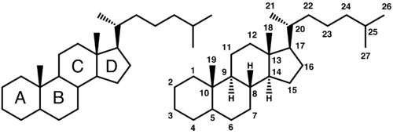
Bile Salts
Bile salts are synthesized in the liver and stored in the gall bladder
They are derivatives of cholesterol
They consist of a sterol ring structure with a side chain to which a molecule of glycine or Taurine is covalently attached by an amide linkage

Slide 17
Bile Salts
Bile salts are formed from bile acids
The primary bile acids are cholic acid (found in the largest amount) and chenodeoxycholic acid .
The primary bile acids enter the bile as glycine or taurine conjugates.
In the alkaline bile, the bile acids and their conjugates are assumed to be in a salt form—hence the term "bile salts.“

Slide 18
Bile Salts
A portion of the primary bile acids in the intestine is subjected to further changes by the activity of the intestinal bacteria.
These include deconjugation and 7-alpha dehydroxylation, which produce the secondary bile acids, deoxycholic acid and lithocholic acid.

Slide 19
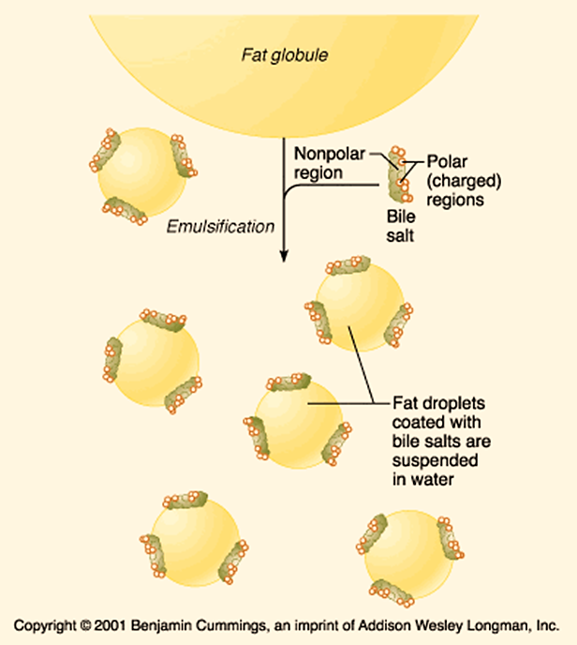
Emulsification by bile salts
Bile salts as emulsifying agents interact with the dietary lipid particles and the aqueous duodenal contents, thereby stabilizing the lipid particles as they become smaller, and preventing them from coalescing.

Slide 20
Triacyl glycerol degradation by pancreatic lipase
Pancreatic lipase is specific for the hydrolysis of primary ester linkages(Fatty acids present at position 1 and 3)
It can not hydrolyze the ester linkages of position -2
Digestion of Triglycerides proceeds by removal of a terminal fatty acid to produce an α,β diglyceride.
The other terminal fatty acid is then removed to produce β mono glyceride.

Slide 21
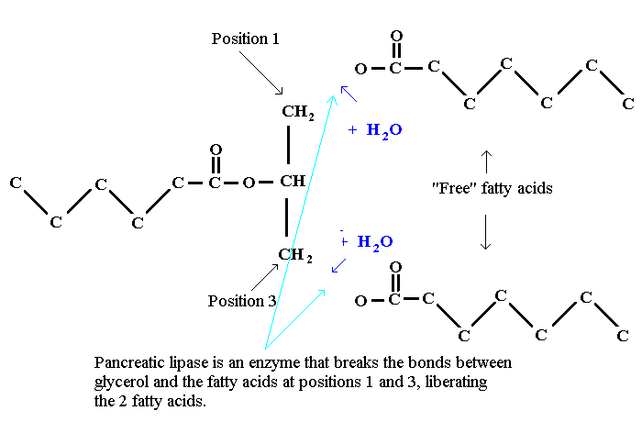
Triacyl glycerol degradation by pancreatic lipase

Slide 22
Triacyl glycerol degradation by pancreatic lipase
The last fatty acid is linked by secondary ester group, hence can not be hydrolyzed by pancreatic lipase.
β- Mono acyl glycerol can be converted to α- Mono acyl glycerol by isomerase enzyme and then hydrolyzed by Pancreatic lipase.
The primary product of hydrolysis are β- Mono acyl glycerol (78%), α- Mono acyl glycerol (6%) with free fatty acids and glycerol (14%)

Slide 23
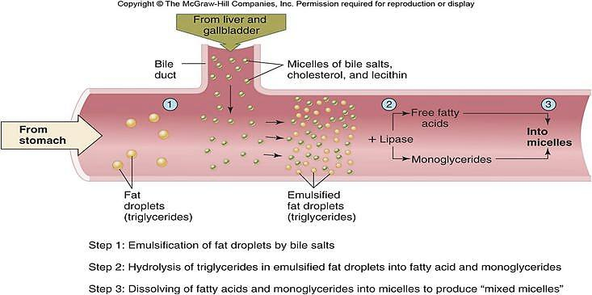
Emulsification and Digestion of Triglycerides

Slide 24
Significance of Pancreatic lipase
The enzyme is present in high concentration in pancreas. Only very severe pancreatic deficiency such as cystic fibrosis results in malabsorption of fats due to impaired digestion.
Orlistat, an antiobesity drug inhibits , gastric and pancreatic lipases, there by decreasing fat digestion and absorption resulting in weight loss.

Slide 25
Absorption of Lipids
Glycerol, short and medium chain fatty acids (Chain length less than 14 carbons) are directly absorbed from the intestinal lumen in to the portal vein and taken to liver for further utilization.
Long chain fatty acids, free cholesterol and β- acyl glycerol together with bile salts form mixed micelles.

Slide 26
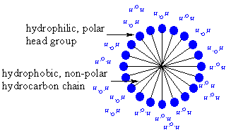
Micelles
Micelles are disk shaped clusters of amphipathic lipids that coalesce with their hydrophobic groups on the inside and their hydrophilic groups on the outside of clusters
Mixed micelles are soluble in the aqueous environment of the intestinal lumen
The micelles approach the brush border membrane of the enterocytes

Slide 27
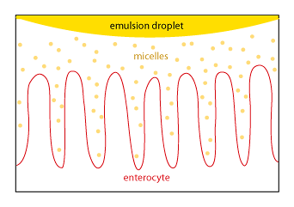
Micelles
Micelles constantly break down and re-form,
It is the monoglycerides and fatty acids that are free in solution that are absorbed, NOT the micelles.
Because of their nonpolar nature, monoglycerides and fatty acids can just diffuse across the plasma membrane of the enterocyte.
Some absorption may be facilitated by specific transport proteins

Slide 28
Resynthesis of Triacyl glycerol and Cholesteryl esters
Within the intestinal epithelium, 1-monoacyglycerols are hydrolyzed to fatty acids and glycerol and 2-monoacylglycerols are re-acylated to triacylglycerols via the monoacylglycerol pathway.
Lysophospholipids are recycled to form phospholipids.
Cholesterol is re acylated to form Cholesteryl esters
Long chain fatty acids are used for esterification to form TGs, phospholipids and cholesteyl esters.
Short and medium chain fatty acid are released in to the portal circulation and are carried by serum albumin to liver.

Slide 29
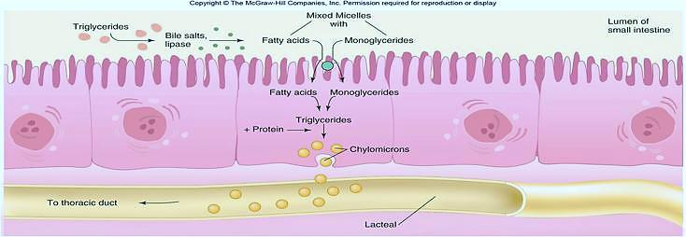
Formation and Transportation of Chylomicrons

Slide 30
Lipid Malabsorption(Steatorrhea)
Lipid malabsorption results in increased lipids including fat soluble vitamins A,D E and K in the feces.
Cause may be pancreatic insufficiency, including cystic fibrosis , chronic diseases of pancreas or surgical removal of pancreas
Shortened bowel, Celiac diseases, sprue or crohn’s disease
May be bile duct obstruction due to gall stones, tumor of head of pancreas, enlarged lymph nodes etc.
Milk and coconut oil are used therapeutically since they contain medium chain fatty acids.

Slide 31
Secretion of lipids from enterocytes
Once inside the enterocyte, monoglycerides and fatty acids are re-synthesized into TAG.
The TAG is packaged, along with cholesterol and fat soluble vitamins, into chylomicrons.
Chylomicrons are lipoproteins, special particles that are designed for the transport of lipids in the circulation.
Chylomicrons are released by exocytosis at the basolateral surface of the enterocytes. Because they are particles, they are too large to enter typical capillaries.
Instead they enter lacteals, lymphatic capillaries that poke up into the center of each villus.
Chylomicrons then flow into the circulation via lymphatic vessels.

Slide 32
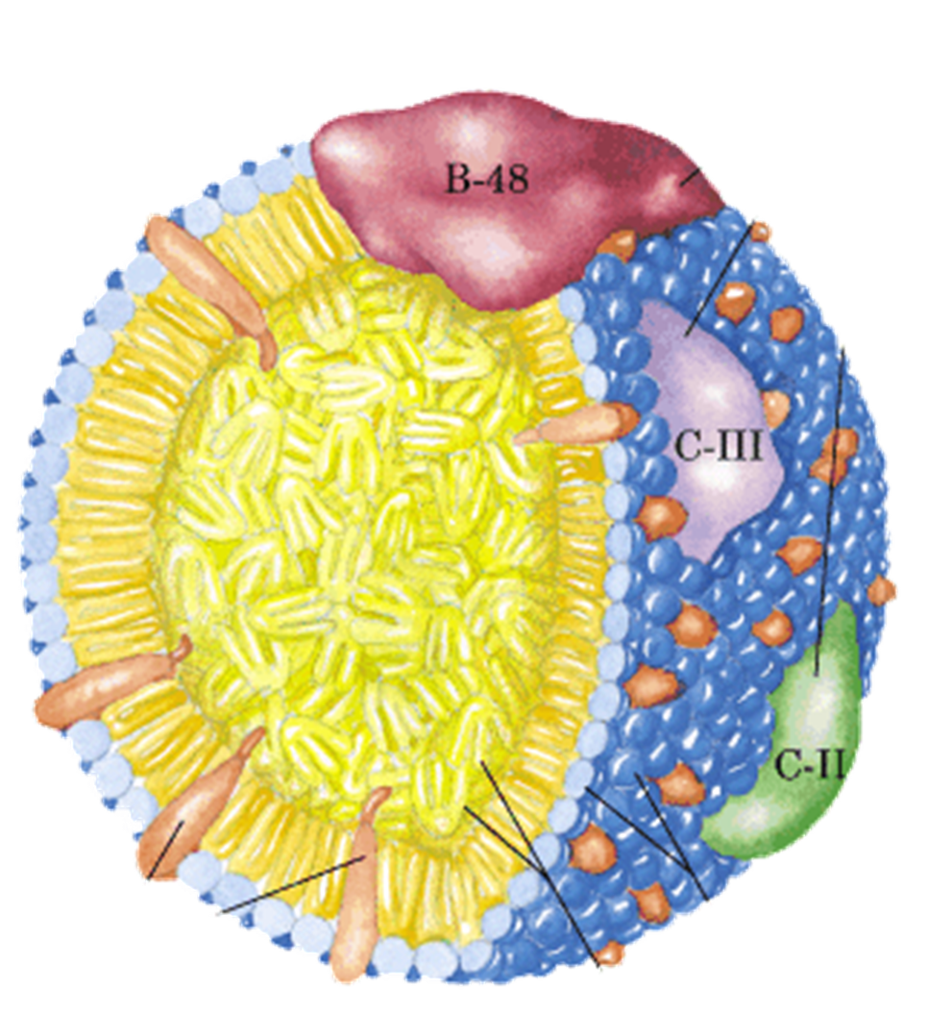
Structure of Chylomicron
  Size: 0.1–1 µm
  Average
  composition
  TG (84%)
  Cholesterol(2%)
  Ester Cholesterol (4%)
  Phospholipid (8%)
  Apo lipoproteins (2%)

Slide 33
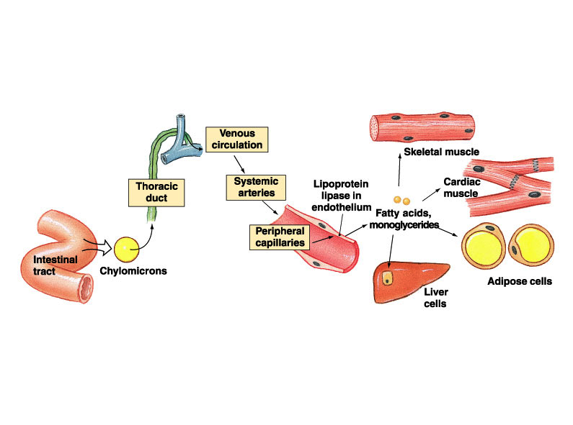
Transport and Utilization of chylomicrons

Slide 34
Clinical significance of Chylomicron synthesis and utilization
Defective synthesis- Due to deficiency of apo-B 48 protein. The triglyceride may accumulate in intestinal cells.
Chyluria- Due to an abnormal connection between urinary tract and lymphatic drainage system of the intestines, forming Chylous fistula. Characterized by passage of Milky urine.
Chylothorax- There is an abnormal connection between pleural space and the lymphatic drainage of small intestine resulting in accumulation of lymph in pleural cavity giving Milky pleural effusion

Slide 35
Physiologically important lipases
Lipase | Site of action | Preferred substrate | Product(s)
Lingual / acid stable lipase | Mouth , stomach | TAGS with medium chain FAS | FFA+DAG
Pancreatic lipase + co-lipase | Small intestine | TAGS with long chain FAS | FFA+2MAG
Intestinal lipase with bile acids | Small intestine | TAGS with medium chain FAS | 2FFA+glycerol
Phospholipase A2 + bile acids | Small intestine | PLs with unsat. FA at position 2 | Unsat FFA lysolecithin
Lipoprotein lipase insulin (+) | Capillary walls | TAGs in chylomicron or VLDL | FFA+ glycerol
Hormone sensitive lipase | Adipose cell | TAG stored in adipose cells | FFA+ glycerol

Slide 36
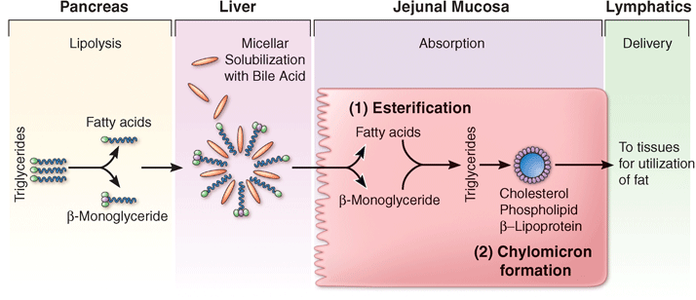
Summary of lipid digestion and Absorption
Chylomicrons deliver absorbed TAG to the body's cells. TAG in chylomicrons and other lipoproteins are hydrolyzed by lipoprotein lipase, an enzyme that is found in capillary endothelial cells. Monoglycerides and fatty acids released from digestion of TAG then diffuse into cells.

