Slide 1
LIPOPROTEINS
DR. TEJAS SHAH

Slide 2
Lipoproteins
Definition:
Molecular complexes that consists of lipids and proteins, Conjugated proteins.
Function as Transport vehicles. For Ch, TG.

Slide 3
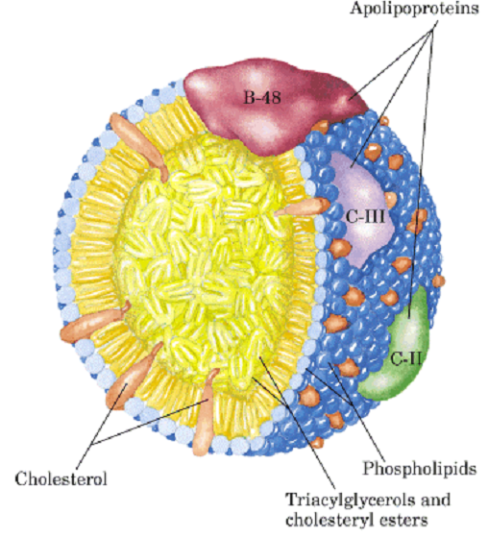
Lipoproteins:
Molecular complexes that consist of:
Cholesterol & it’s Esters
Triacylglycerol
Phospholipids
apoproteins

Slide 4
Classification
Depending upon the presence of Apolipoprotein:
1. Apolipoprotein B containing:
a. Chylomicron
b. VLDL ( Very Low density L)
c. IDL ( Intermediate density L)
d. LDL (Low density L)
2 Apo A Containing :
a.HDL (High density lipoprotein)

Slide 5
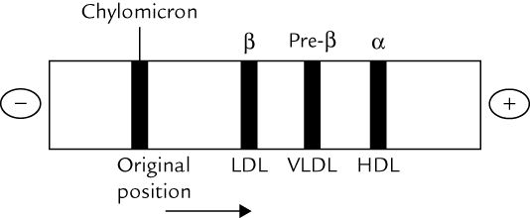
Electrophoretic Pattern

Slide 6
Classification of lipoproteins:
Density | Electrophoretic mobility | Apolipoproteins
Chylomicrons | At origin: Chylomicron | Apo B48, C II, E
Very Low Density Lipoproteins (VLDL) | Pre β: VLDL | Apo B 100, C II, E
Low Density Lipoproteins (LDL) | β : LDL | B 100
Intemediate Density Lipoproteins (IDL) | -- | B 100, E
High Density Lipoproteins (HDL) | α : HDL | A 1, A II ; C I, II, III ; E

Slide 7
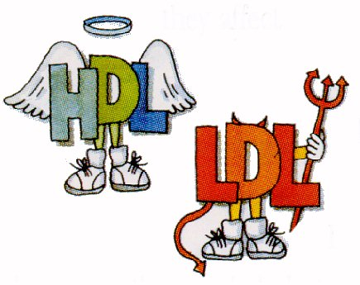
Chylomicrons :
Exogenous TAG
Largest size, slowest to move, Least Density
Highest lipid Least Protein
(LDL):
Bad Cholesterol
Smallest size, Fastest to move, Highest density
Lowest lipid Highest Protein
(VLDL):
Endogenous TAG
(IDL)
(HDL):
Good Cholesterol

Slide 8
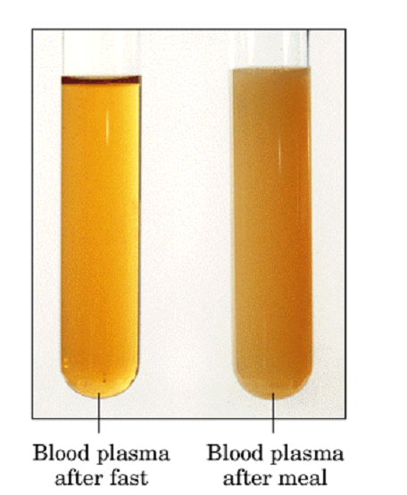
1. Chylomicrons
Transport
Dietary
lipids

Slide 9
Liver
Dietary TG
Nascent
Chylo.
cholesterol
Apo B 48
Apo B48
CE
TG/CE
CE /
TG
CII
FFA
FFA-FABP
TG
micelle
E
HDL
chylomicron
enterocyte
Plasma
Notes:
Fatty acids are absorbed by the apical microvilli of muscosal cells and resterified in the enterocyte (2 monoacylglyercol pathway). Apo B48 is the structural protein of the chylomicron and contain the majority of cholesterol (as cholesteryl ester) found in chylomicrons. Reesterfied TG are added to the chylomicron percurors via the action of a TG transfer protein. Apo B48 is then added. Apo CII is also added. This apoliprotein activates LPL activity. Nascent cylomicrons are assembled in the golgi apparatus and released from the enterocyte to enter the lymphatic system. Eventually chlyomicrons enter the plasma via the left thoracic lymph duct.
Triglycerides and cholesterol esters are concentrated in the core of the chylomicron.

Slide 10
Plasma
TG
B48
FFA
CII
Oxidation
TG/CE
muscle
Lipoprotein
Lipase
E
chylomicron
CII
Lipoprotein
Lipase
B48
FFA
TG/CE
E
FFA
Chylomicron remnant
G3P
liver
Triglyceride
storage
adipose
Notes:
Our chylomicron is destined for the liver. However on its journey this particle will encounter lipoprotein lipase which will hydrolyze TG present in the chylomicron. This will result in an overall reduction in the size of the chylomicron as TG is removed. CII is required for LPL activation. As the CM loses TG CII will then disassociate from the particle and LPL activity will no longer be supported. This particle is now called a chylomicron remnant and is destined for the liver.
Insulin High in Fed State
Fed state – Chylomicron synthesis is high. LPL activity is high. Storage of FFA as TG in adipose is high.
Fasted state- Chylomicron synthesis is low. LPL activity in adipose is low while LPL activity in heart and other muscles remains steady. In addition LPL on surface of heart has a higher affinity (lower Km) for lipoprotein substrates. Therefore TG hydrolysis by the heart is determined by lipoprotein lipase levels (not the concentration of circulating lipoproteins). Heart LPL is saturated, even at low levels of circulating lipoproteins (fasted state). This ensures that the heart has preference for energy.

Slide 11
2. VLDL, IDL & LDL

Slide 12
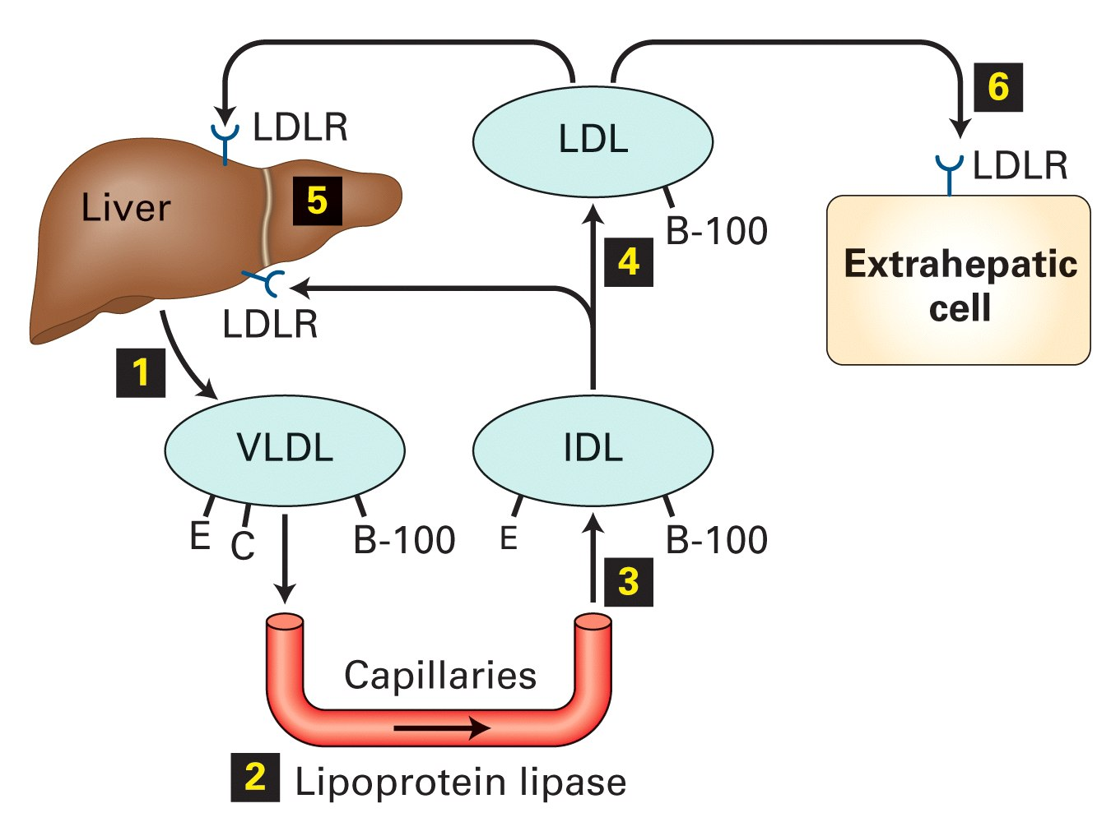
Apo E
Apo C II
FFA

Slide 13
Apo C II & Apo E are donated to VLDL & Chylomicrons by HDL
CETP : Liver; exchange of CE from HDL to VLDL and LDL in exchange for TG

Slide 14
Atherogenic Particles
Apolipoprotein B
MEASUREMENTS:
Non-HDL-C
VLDL
VLDL_{R}
IDL
LDL
Small,
dense
LDL
TG-rich lipoproteins

Slide 15
HDL
Formed in liver as:---
Nascent HDL + Apo A1, C II, E ---- > HDL

Slide 16
Apo A 1 of HDL
Activates Lecithin Cholesterol Acyl Transferase (LCAT)
Within HDL Circulation
Cholesterol Lecithin
Cholesterol Ester Lysolecithin
Within HDL : HDL 3
Circulation : HDL 2
HDL carries this trapped cholesterol to liver → Reverse Cholesterol transport

Slide 17
Functions of HDL:---
Reverse cholesterol transport
Donate Apo C II & E to other LP
Apo A1 : LCAT Activity
Apo C II : Lipo protein Lipase activity

Slide 18
Tangier’s Disease:
  Lipoprotein A Deficiency
HDL absent
Norum’s Disease:
  LCAT Deficiency

Slide 19
Author/year | Study design | Level | Material and Methods and Results | Outcome
Prevalence and expression of familial combined hyperlipidemia in childhood ¹ MD Jean A. Cortner, PhD Paul M. Coates, MA Paul R. Gallagher The Journal of Pediatrics Volume 116, Issue 4, April 1990, Pages 514–519 | Observational study | Intermediate | The objectives of this study were (1) to determine the incidence of dominantly inherited hyperlipoproteinemia in children referred to our medical center because of hyperlipidemia associated with a family history of premature coronary artery disease and (2) to assess the degree of expression in childhood of the most common inherited hyperlipoproteinemia, famillial combined hyperlipidemia | Among 129 families referred to us by area pediatricians, we identified a dominantly inherited hyperlipoproteinemia in 97 of them. Twenty had familial hypercholesterolemia, 65 familial combined hyperlipidemia, 11 hyperapobetalipoproteinemia, and one familial hypertriglyceridemia. As expected, almost half (9/20) of the siblings of probands with familial hypercholesterolemia were affected.

Slide 20
Disorders of lipoproteins
 | Disease | Enzyme defect | Raised LP | Rasised lipid | Treatment
I | Familial lipoprotein deficiency | LPL deficiency | Chylomicron | TAG | Low fat diet
II | Familial hypercholesterolemia | LDL receptor deficiency | LDL | Cholesterol | Low chol. Diet
III | Familial dys β lipoproteinemia | Abnormal Apo E | IDL | TAG & Chol | Low fat diet + Statin
IV | Familial hypertriglyceridemia | Overproduction of TAG | VLDL | TAG | Low fat diet
V | Combined hyperlipidemia | Secondary to DM, Obesity | Chylomicron VLDL | TAG | Low fat diet

Slide 21
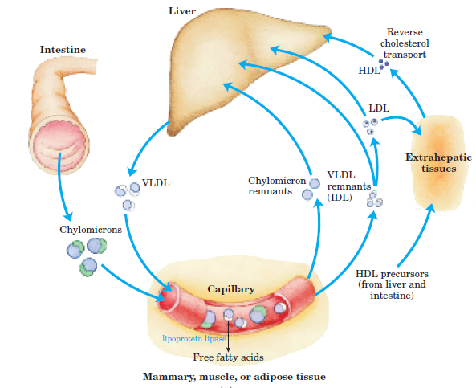
Transport of Cholesterol

Slide 22
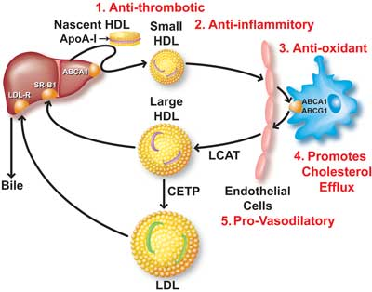
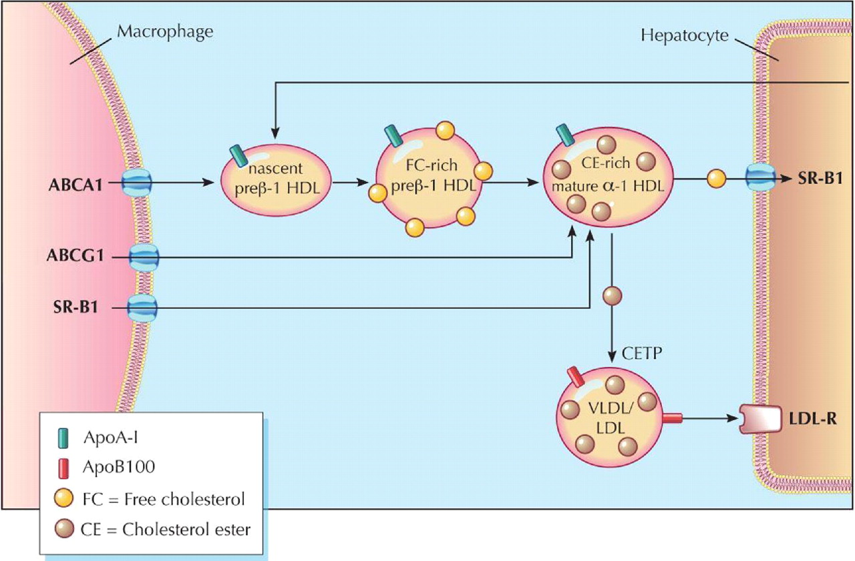
Reverse Cholesterol Transport

Slide 23
Classification of Hyperlipoproteinemia
Types | Plasma lipoprotein | Plasma lipids | Possible metabolic defect
I | Chylomicrons | TG | Deficiency of LPL
IIa | LDL | Cholesterol | Deficiency of LDL receptors
IIb | LDL & VLDL | TG & Cholesterol | Overproduction apo - B
III | IDL | TG & Cholesterol | Abnormality in apo - E
IV | VLDL | TG | Overproduction of TG
V | Chy. & VLDL | TG | _

Slide 24
Control of Hypercholesterolemia
Therapuetic lifestyle changes
  Consumption of PUFA
  Avoid dietary cholesterol
  Plant sterols
  Dietary fibres
  Avoid high carbohydrate diet
Drug therapy
  Bile acid sequestrant
  Nicotinic acid & derivatives
  Fibric acid derivatives
  HMG- CoA reductase inhibitor

