Slide 1

TERBINAFINE
-ANTI FUNGAL AGENT

Slide 2
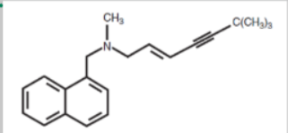
STRUCTURE
Belongs to Allylamine group - naftifine
-terbinafine
Chemical modification of naftifine.
10 – 100 x times more potent than naftifine
Chemical form is terbinafine hydrochloride

Slide 3
MECHANISM OF ACTION
Inhibits enzymes SQUALENE EPOXIDASE ;
Hence - accumulation of squalene - fungistatic action
- decreased synthesis of ergosterol (part of cell membrane – fungicidal action

Slide 4
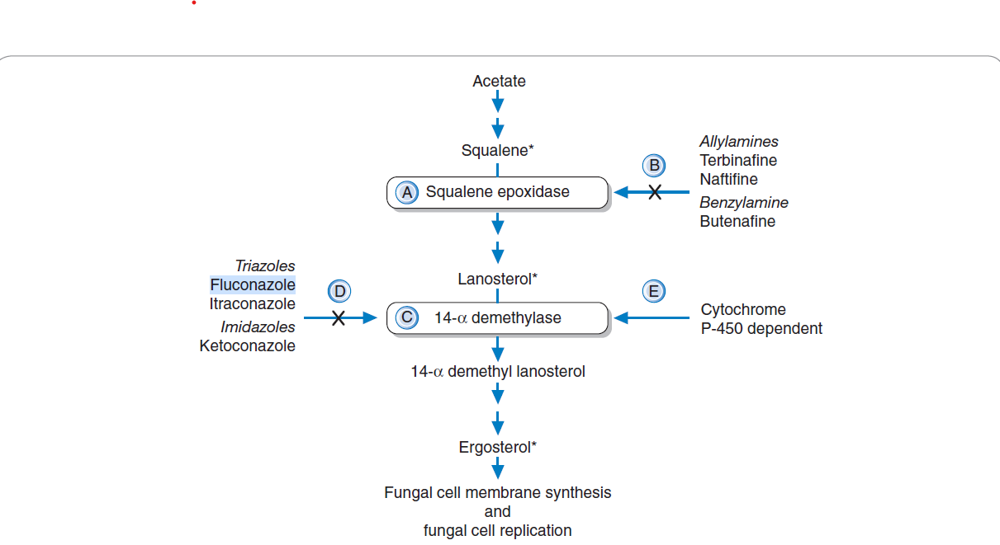

Slide 5
PHARMACOKINETICS
Absorption : 70 – 80 % by gastrointestinal route
Bioavailibility is not affected by food intake
Maximum plasma concentration is achieved in 2 hours
Metabolised by liver
Excretion is by renal route ( in urine and some amount in feces )
Hence, clearance of drug is decreased by 50 % in patients with liver cirrhosis and renal impairment

Slide 6
ACTION THROUGH SKIN , HAIR AND NAIL
Keratinophilic and lipophilic drug ; accumulates in skin , hair , nails .
Drug reaches the surface of skin via blood vessels to dermis and diffuses to epidermis
Drug reaches the hair through sebum into the hair follicle and hair shaft.
It is more effective in endothrix than ectothrix
Drug diffuses both nail matrix and nail bed and reaches nail.

Slide 7
ADVERSE DRUG REACTIONS
Pregnancy category drug B
GI disturbances ( nausea , diarrhea )
Taste disturbances
Skin rashes
Exacerbate SCLE
Rare : erythema multiforme
SJS/TEN

Slide 8
FORMULATIONS
Oral : 250 mg tablet
Tablets can be crushed and sprinkled over food
Topical : 1% cream , lotion . Microemulsion bases solution

Slide 9
USES
FDA approved in
- onychomycosis due to dermatophytes
- tinea capitis [more effective in endothrix than ectothrix infecton]
OFFLABEL used in
- onychomycosis due to candida infection
- Tinea cruris , corporis , imbricata
- P. versicolor
- seborrheic dermatitis
- majochhi’s granuloma

Slide 10
Dose is 250 mg daily x 6-12 weeks
For deep fungal infection there is no clear cut regimen, but effective dosing is 500 -1000 mg
- chromoblastomycosis
- aspergillosis
- sporotrichosis

Slide 11
CAUTIOUSLY TO BE USED IN
Derranged liver or kidney function.

Slide 12
DRUG INTERACTIONS :
CYP2D6 inhibitor; hence drug interactions occur with all other drugs metabolized by CYP2D6 pathway.
Drugs metabolized by terbinafine :
-TCA
-SSRI
-B blockers
-MAO type B inhibitors
- antiarrythmic class 1 C
Hence , dose reduction of these drugs is needed.

Slide 13
-Rifampicin increases the elimination of drug by inducing CYP enzymes. Hence drug levels decrease.

