Slide 1
T “HI STORY” of electromyography
Faculty : Dr. C. Rathore

Slide 2
Inherent movement is the prime sign of animal life.
Man has shown a perpetual curiosity about the organs of locomotion in his own body and in those of other creatures.
Indeed, some of the earliest scientific experiments concerned muscle and its functions.

Slide 3
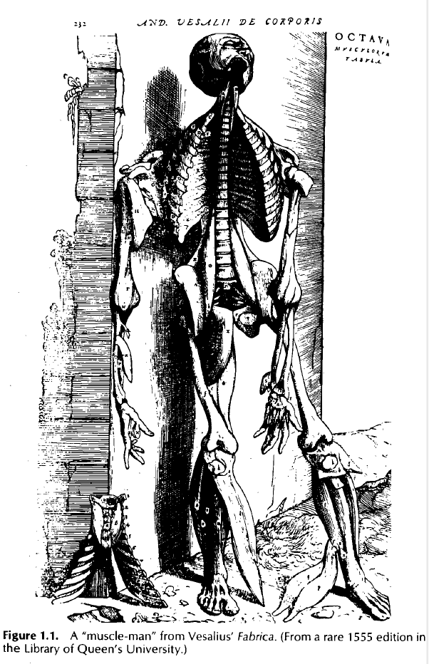
Many of earliest scientists devoted much of their thought to the analysis of muscles and their functions.
So too did the acknowledged "father" of modern anatomy, Andreas Vesalius, whose influence through his monumental work, the Fabrica, extends down to this day.
In one sense, however, the heritage of Vesalius was unfortunate because it stressed the appearance and the geography of dead muscles rather than their dynamics

Slide 4
During subsequent years, a series of scientists gave life back to the muscles.

Slide 5
Whenever the basic question of “what are the muscles doing?” arises, the benefits of EMG become apparent.
EMG allows us to look at the electrical activity responsible for muscle contractions and allows us to measure muscular performance.

Slide 6
Electromyography (EMG)
evaluating and recording the electrical activity produced by skeletal muscles.
EMG is performed using an instrument called an electromyograph, to produce a record called an electromyogram.
An electromyograph detects the electrical potentialgenerated by muscle cells when these cells are electrically or neurologically activated. The signals can be analyzed to detect medical abnormalities

Slide 7
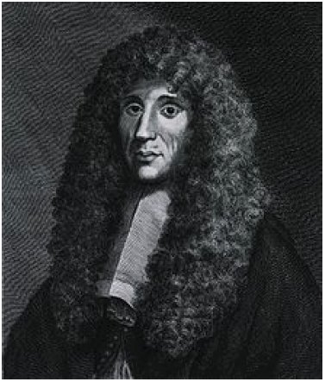
The first logical deduction of muscle-generated electricity was documented by Italian Francesco Redi in 1666.

Slide 8
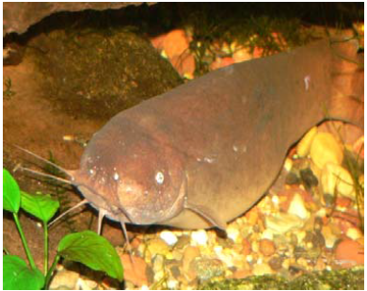
He suspected that the shock of the electric ray fish was muscular in origin
wrote, "It appeared to me as if the painful action of the electric ray was located in these two sickle-shaped bodies, or muscles, more than any other part"

Slide 9
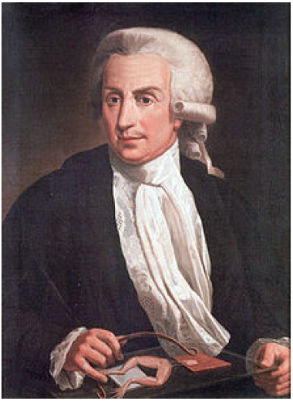
The relationship between electricity and muscle contraction was first observed by Luigti Galvani in 1791

Slide 10
In his epoch making experiments, he depolarized muscles of a frog's legs by touching them with metal rods
This discovery and concept of "animal electricity" is generally acknowledged as representing the birth of neurophysiology, thereby making Galvani the father of this field.
Notes:
Many rushed to confirm Galvani's results and praise his discovery. Among them was

Slide 11
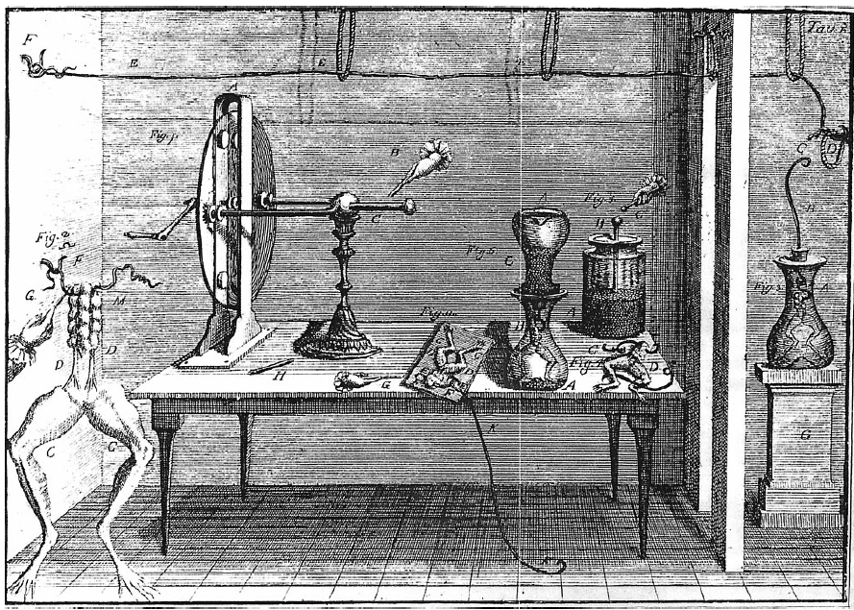
THE SPARK EXPERIMENT
Commentarius
Notes:
In opening his Commentarius, Galvani recounts how he became
interested in the study of the effects of electricity on animals.
He had made a frog preparation (consisting of the inferior limbs
with the crural nerves exposed in their course from the spinal cord
to the limbs, and a metal wire inserted across the vertebral canal).
The frog was at some distance from a charged electrical machine
(Fig. 2). When one of the collaborators, probably Galvani’s wife
Lucia Galeazzi (see Fig. 1 and [34] p. 254) touched delicately with
a lancet the internal crural nerves, all leg muscles started contracting
vigorously ([33], p. 63). Apparently the phenomenon occurred
at the moment in which a spark arose from the electric machine.
Galvani says that he was so impressed by the novelty of the finding
that he decided immediately to verify and explain the phenomenon.
A careful consideration of the importance that Galvani attached

Slide 12
doctrine of“irritability,”
one of the most important conceptual elaborations of 18th century physiology
This doctrine was developed by Albrecht von Haller
the way an organism reacted to an external influence was an expression of its internal functional organization, and was in some way independent of the specific nature of external influence that acted as an “irritation.”
Notes:
doctrine of
“irritability,” one of the most important conceptual elaborations of
18th century physiology. This doctrine was developed by Albrecht
von Haller [41] after the notion (and the word) introduced by
Francis Glisson one century earlier [36]. Implicit in the notion of
irritability was the idea that the way an organism reacted to an
external influence was an expression of its internal functional
organization, and was in some way independent of the specific
nature of external influence that acted as an “irritation.”
1
Accord-ing to Galvani, in the framework of the doctrine of irritability,
external electricity was acting as an excitatory stimulus (as a
trigger we would say now) for the contraction, and not as the direct
“efficient” cause of the observed phenomenon.
2
Galvani’s suspi-cion that external electricity was setting into motion some specific
internal force responsible for the contraction was supported by the
results of other experiments in which he established how small was
the minimal quantity of electrical force of an effective stimulus.
Contraction could be obtained by using a Leyden jar almost
completely discharged so as to be undetectable with the most
sensitive electroscope (see for instance [34] pp. 19, 21, 243, 295).
How could it be that such a tiny electrical force would produce
muscle c

Slide 13
According to Galvani, in the framework of the doctrine of irritability, external electricity was acting as an excitatory stimulus (as a trigger we would say now) for the contraction, and not as the direct“efficient” cause of the observed phenomenon.

Slide 14
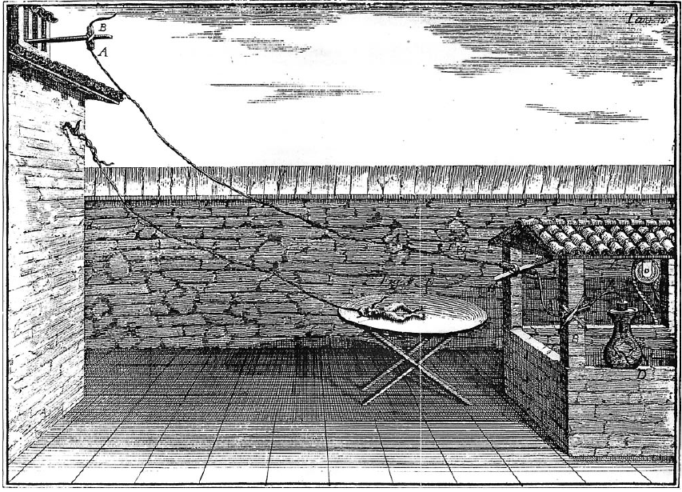
ATMOSPHERIC AND ANIMAL ELECTRICITY
“...incorrespondence of four thunders, contractions not small occurred in all muscles of the limbs, and, as a consequence, not small hops and movements of the limbs. These occurred just at the moment of the lightnings; they occurred well before the thunders when they were produced as a consequence of these ones.”

Slide 15
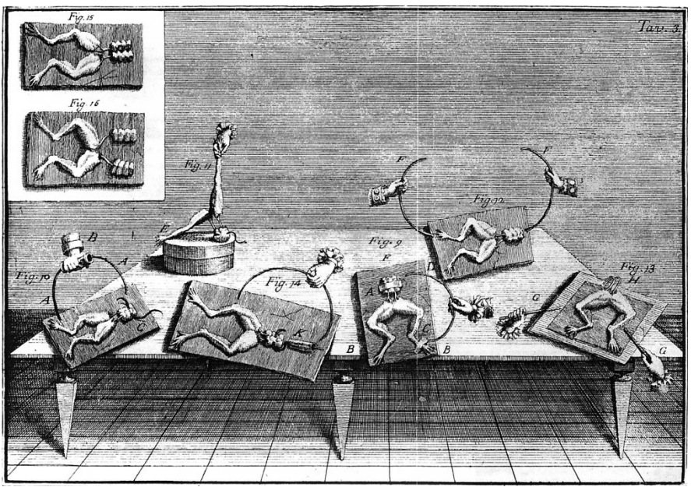
in the atmosphere of a calm day
Notes:
prepared the frogs “in the usual way” and hung them up on the iron railing of the balcony of his house in a clear and calm day and waited.
But nothing happened for a long time.
“tired of the vain waiting” he came near the railing and started manipulating the frogs.
To his great surprise, the contractions appeared when he pushed and pressed, toward the iron bars of the railing, the metallic hooks inserted into the frog spinal cord.
contractions bore no relation with the atmospheric events, however, and they could also be obtained if the experiment was repeated
indoors, “in a closed room,” by substituting the balcony railing with
an iron surface. Therefore, they seemed not to involve atmospheric
electricity

Slide 16
Galvani came to the conclusion that some form of intrinsic electricity was present in the animal
nerve and muscle together, by means of conductive materials, induced contractions by allowing for the flow of this internal electricity.
Galvani referred to such intrinsic electricity as “animal electricity” (animalis electricitas)

Slide 17
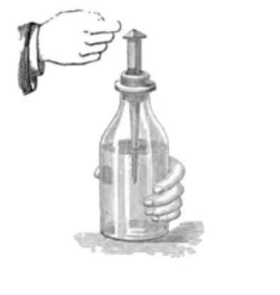

The “mental image” that took possession of his mind since that moment was that of the Leyden jar, the first accumulator of electrical energy, the first capacitor.
In Galvani’s mind, the force of the Leyden jar image was, however, not only “functional” and “mechanistic,” but also visual.

Slide 18
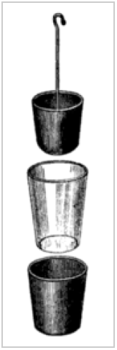

Slide 19
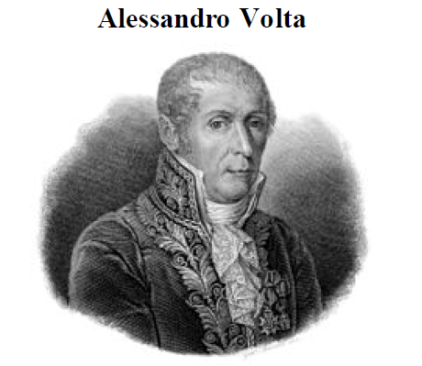
wrote "it contains one of the most beautiful and surprising discoveries and the germ of many others“

Slide 20
But, within two years, in 1793, Volta questioned Galvani's findings by proving that dissimilar metals in contact with an electrolyte (such as those present in body tissues) would generate an electric current.
noted that contractions could be obtained by connecting, through a bimetallic arc, two points of the same nerve without any contact with the muscle
Leyden jar could not be discharged by connecting two points of the same plate.

Slide 21
Frog leg preperation - “animal electrometer,” than as a source of internal electricity
an arc made by two different metals was more effective in inducing contractions than a monometallic arc.
Volta started considering the possibility that the electricity was external in origin and derived from the difference of the metals used for the connection

Slide 22
bimetallic arc on the tongue, a place where muscle tissue appeared to be almost directly exposed to external influence
No contraction was produced but a clear acid taste was instead perceived
lasted as long as the metals were maintained in contact with the tissues
dissimilar metals were themselves capable of producing and maintaining an artificial disequilibrium or, in other words, that they acted as “motors” of electricity (similar to electric machines) rather than simply as conductors.

Slide 23
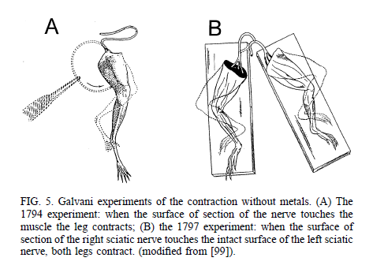
In the following year Galvani reaffirmed his concept when he found that a muscle contraction could be elicited by placing the free end of a nerve across a muscle without the intervention of metals.

Slide 24
However, Volta's blow was so powerful that the concept of animal electricity was not discussed meaningfully for four decades.

Slide 25
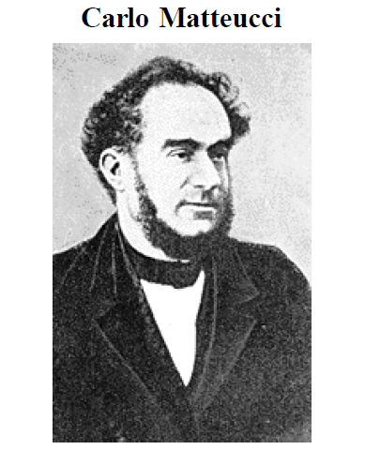
Intrigued by the works of Galvani and Volta, Carlo Matteucci in 1830 began a series of experiments which allowed him to prove that injured muscle tissues generated direct electrical currents using a sensitive galvanometer (current meter).

Slide 26
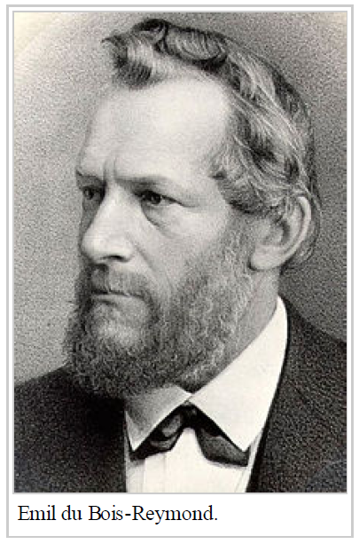
influenced by Matteuci’s observations
explained “the electrical phenomenas presented by living beings”
invented new techniques and improved existing methods for studying bioelectric phenomenas.
Notes:
influenced by Matteuci’s observations and through determined effort strived to explain “the electrical phenomenas presented by living beings” invented new techniques and improved existing methods for studying bioelectric phenomenas

Slide 27
He is credited with theorizing what we now call the nerve action potential and is considered to be the father of experimental electrophysiology

Slide 28
first report of the detection of voluntarily elicited electrical signals from human muscles
He placed blotting cloths on his subject’s hands and forearm and immersed each of them in separate vats of saline solution in electrical contact with electrodes.
The electrodes were connected to a galvanometer.
Upon flexing the subject’s arm - consistent and predictable deflections was observed.
He deduced that the magnitude of the readings was diminished by the impedance of skin.
After removing a portion of the subject’s skin and applying the electrodes he saw a large increase in signal magnitude during the wrist flexion.

Slide 29
In the early 1900s, Pratt F.H. demonstrated that the magnitude of energy related in a given muscle contraction was a result of individual muscle fibre recruitment rather than the magnitude of the neural impulse.

Slide 30
However, measurements from human musculature remained difficult until the metal surface electrode was employed by the German Piper in 1907.
The detection techniques were further simplified with the advent of the cathode ray tube, which was invented by Braun (1897) and was first used to amplify action potentials in conjunction with a string galvanometer by Forbes and Thacher (1920).

Slide 31
Two years later, Gasser and Erlanger (1922) used a cathode ray oscilloscope in place of the galvanometer, which up to this time was the sole apparatus able to "show" the signals from the muscles.

Slide 32
“Often we’d work all day and wind up at five o’clock at night with one good record. And that record was obtained not with a camera – the tube wasn’t bright enough to photograph – so we held up a big piece of film up against the end of the oscilloscope and we’d get a blurred line there that we could interpret approximately, defining the waves of the compound action current.”

Slide 33
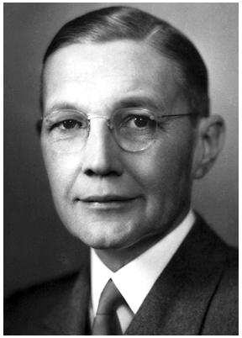
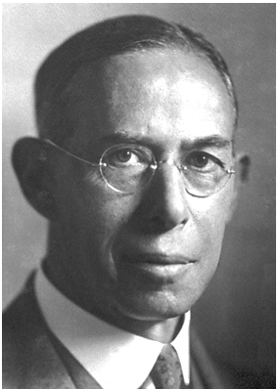
Herbert Spencer Gasser
Joseph Erlanger
This application, along with their wise interpretation of the action potentials which they were able to "see," earned Gasser and Erlanger a Nobel Prize in 1944.

Slide 34
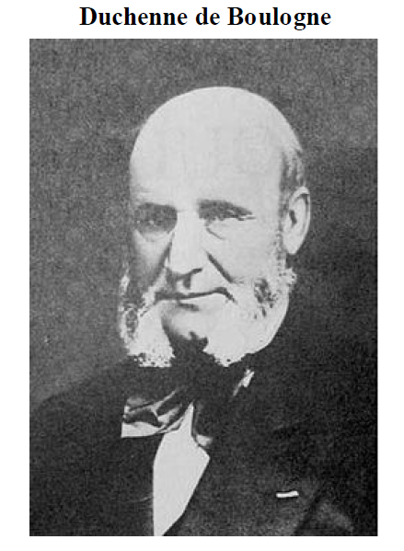
No one before or after has contributed so much to our understanding of muscular function
His immortal work was described under the title Physiologie des Mouvements

Slide 35
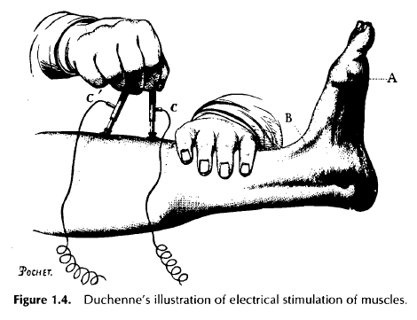
skillfully applied electrical stimulation to investigate systematically the dynamics and functions of intact skeletal muscles.

Slide 36
Englishman Baines, electrical engineer
appropriate technical considerations should be administered before obtaining or interpreting data related to electrophysiological phenomena.
first to formalize the analogy between the propagation of pulses in a nerve trunk and an electric cable.
This approach subsequently became known as the cable theory

Slide 37
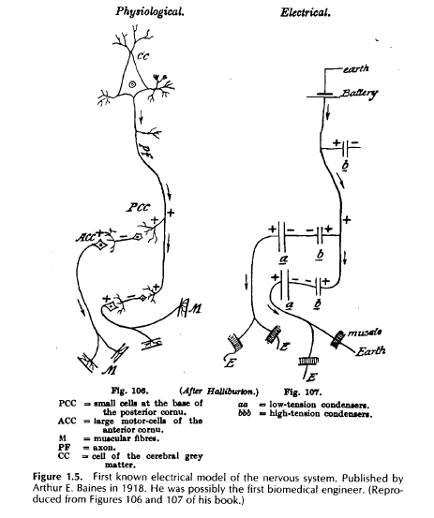
He initiated the concept of modeling parts of the nervous system with electrical circuits in attempting to explain their It may be said that he was the first biomedical engineer.

Slide 38
Adrian and Bronk (1929) introduced the needle electrode
This approach, for the first time, enabled us to observe the electrical activity associated with individual muscle fibers (or small groups ofmuscle fibers).
The use of the needle electrode was methodologically exploited by Buchthal and his colleagues during the 1950s and 1960s.

Slide 39
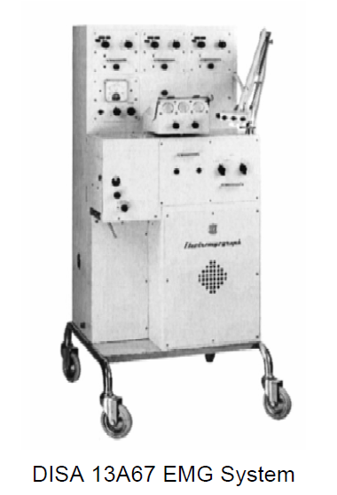
ANALOG EMG SYSTEMS: 1950–1973
1950
Denmark
Three channel EMG system
Each channel had amplifiers and filters to process the EMG signals to individual cathode ray tubes (CRT) used as the visual displays.
A channel selectable audio amplifier and loudspeaker was used for auditory presentation of the signals
paper film recorder was used for permanent storage of any acquired waveform.

Slide 40
Electro-stimulation was provided by a separate timing device attached to the system
There was no synchronization between the stimulation device and the free-running display.
If an electromyographer needed to evaluate a recording in detail he would take the exposed film out of the machine and into the darkroom to be developed and processed.

Slide 41
By the early 1960s, transistorized EMG systems.
synchronization of signals

Slide 42
DIGITAL EMG SYSTEMS: 1973–1982
These systems increased in size and complexity compared to previous generation.
EMG signals were digitized and were amenable to print out with all relevant user set information on a real-time printer.

Slide 43
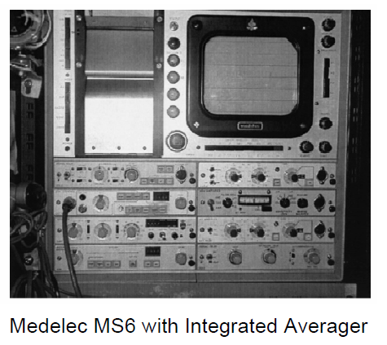
The MS6 was an analog EMG system introduced in 1969, but with the development of an averager in 1973, digital modules were offered for the analog system.

Slide 44
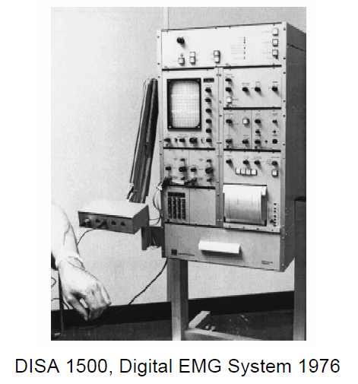
DIGITAL EMG SYSTEMS: 1973–1982
the DISA 1500 EMG system was considered to be the first completely digital EMG system

Slide 45
MICROPROCESSOR-CONTROLLED EMG SYSTEMS: 1982-1993
reduce production cost and increase clinician ease of use
Early microprocessors lacked the power to perform data acquisition and processing
These systems were typically menu driven with test settings that could be stored in memory.

Slide 46
MICROPROCESSOR-CONTROLLED EMG SYSTEMS: 1982-1993
Typical application of these microprocessor-controlled EMG systems included
  conduction of sensory nerve and motor tests,
  decrement analysis
  needle EMG exams
  various evoked potential modalities (“time locked” electrical signal in response to some stimulus).

Slide 47
However, the computing power of these early systems were considered too slow to perform advanced signal processing and analysis
To bypass these early computational limitations, many systems were digitally interfaced to an external computer.

Slide 48
PC-BASE EMG SYSTEMS: 1993–2001
PC perform all the processing related function required in EMG recording and analysis.
Benefits of a PC-based EMG system included
  powerful signal processing
  flexible graphical representation
  larger data storage capabilities
  shorter latencies.
“All EMG systems introduced after 1993 are PC-based” except for some.

Slide 49
HANDHELD & WIRELESS EMG SYSTEMS: 2001-PRESENT DAY
Universal Serial Bus 2.0 which provided faster data exchange rates and even a means of supplying power to the EMG handheld device to recharge the device.
Increased storage capacity of data recordings and computing power made it possible for small and powerful microprocessors to run entire training suites and store all user recorded stats to the handheld device.
The user can then upload their recordings to a PC at a later time, eliminating the need for a bulky workstation

Slide 50
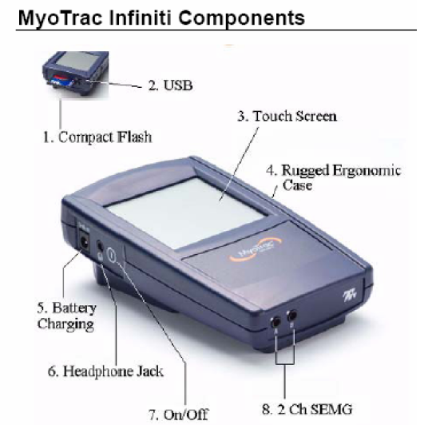
HANDHELD EMG SYSTEM
MYOTRAC INFINITI introduced in 2003
This unit is a dual channel, handheld portable EMG device with three distinct operating modalities:
  Surface Electromyography (SEMG)
  Neuromuscular Electro-stimulation (NMES)
  SEMG-triggered Stimulation (ETS).
This is uncommon compared to other EMG devices in that it reads SEMG and provides electro-stimulation

Slide 51
Wireless technologies such as Wi-Fi and Bluetooth have also been incorporated into today’s existing EMG equipment to provide the user with extended mobility from the PC on PC-based systems.
Acquired EMG signals can now be picked up on the body and sent wirelessly to a PC where it is recorded, processed and analyzed.

Slide 52
In 1960, a group of Russian engineers led by Kobrinsky revealed the design of a hand prosthesis controlled by myoelectric signals detected from the forearm muscles.
They are currently being tested by researchers at NASA who want to monitor EMG of astronauts.

Slide 53
Thus, we have seen that during the past two centuries a wide variety of individuals of diverse training have been fascinated by and have contributed to the understanding of the electrical phenomenon which is associated with a muscle contraction.

Slide 54
Thank you !!!

