Slide 1
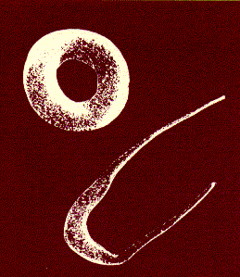
Sickle Cell Anemia
Thalassemia
Dr. Tejas Shah
Associate Professor
Dept of Biochemistry
SBKSMI&RC

Slide 2
Hemoglobin S (HbS)
Most common variant
Abnormality in primary sequence of amino acid in globin chains
Both α chains have amino acids sequences as HbA
Both β chains have hydrophilic glutamic acid replaced by hydrophobic valine at 6th position.

Slide 3
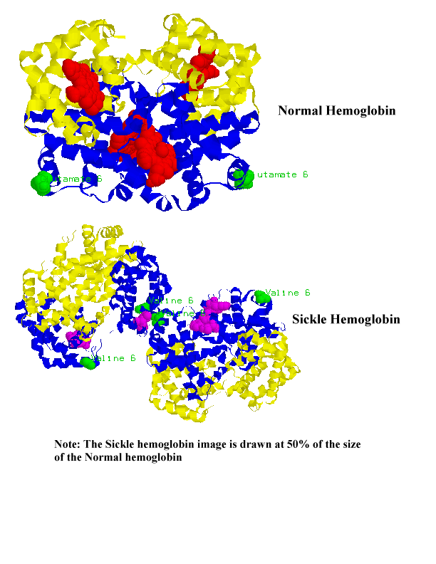

Slide 4
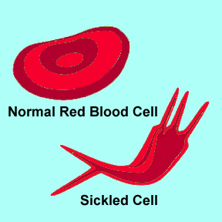
Polymerization of hemoglobin molecule inside RBCs.
Distortion of cell into sickle shape

Slide 5

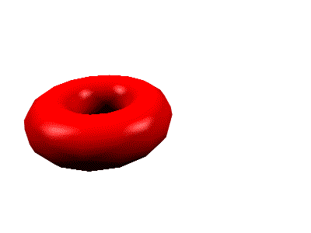
The change in cell structure arises from a change in the structure of hemoglobin.
A single change in an amino acid causes hemoglobin to aggregate.

Slide 6
Leads to localized stickiness on the surface of the molecule.
HbS can bind and transport O2. Sickling occurs under deoxygenated state.
The deoxygenated HbS has protrusion on one side and a cavity on other side, many molecules adhere and polymerise
HbA & HbF do not polymerise, no sickling

Slide 7
Deoxygenation of SS erythrocytes leads to intracellular hemoglobin polymerization, deformability and changes in cell morphology.
OXY-STATE
DEOXY-STATE

Slide 9
Due to non-polar valine a sticky patch develops on oxy and deoxy-HbS.
Complementary site – in deoxy-HbS
(masked in oxy state)
The complementary site of deoxy-HbS bind with sticky patch of other deoxy-HbS forming long fibrous precipitates

Slide 10
Solubility- deoxygenated HbS is only 2% soluble.
Due to alteration in distribution of negative and positive charges on protein surface.
  Sickled cells form small plugs in capillaries, occlusion of major blood vessels, infarction in organs.
  Lack of tissue oxygenation can cause excruciating pain, damage to body organs and even death.

Slide 11
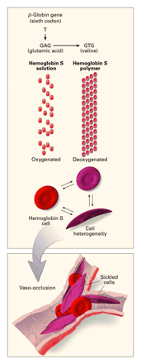
SUMMARY

Slide 12
SICKLE CELL DISEASE
Autosomal recessive genetic disease
Homozygous = 80-100% of HbS, 0-20% HbA
SS, SC, SD, SO varieties, S beta thalassemia
Death usually occurs in second decade.
In Asia, central & west Africa

Slide 13
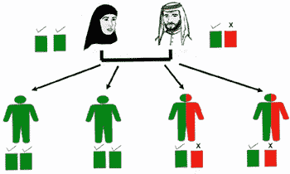
An example of inheritance: a carrier married to a normal person

Slide 14
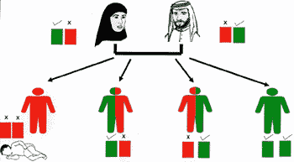
Inheritance :- marriage between two carriers

Slide 15
Sickle cell trait
Heterozygous – 50% of HbA in RBC is normal
Normal life span, but polymerization occurs at extreme deoxygenation or dehydration
Aggravated by- hypoxic conditions
high altitudes
chronic lung disorders

Slide 16
Clinical Syndromes
Anemia in Sickle Cell Disease
Chronic, usually well-compensated
Appropriate reticulocytosis
Mean Hgb ~8, Hct ~24%
Mean RBC lifespan ~ 17 days
Low folate
Iron Deficiency (20%)
Low Erythropoietin (in cases w/ renal disease)

Slide 17
Diagnosis
Prenatal Testing
At-Risk couples at 10 to 12 weeks gestation
Fetal DNA obtained via chorionic villus sampling or amniocentesis
PCR performed on fetal DNA (due to very small sample size)
If testing +, confirmatory testing is done on parents
Newborn Screening
Methods: Hemoglobin Electrophoresis, Thin Layer Isoelectric Focusing, HPLC
If testing +, confirmatory testing is done on parents

Slide 18
ELECTROPHORESIS
At alkaline pH, HbS band moves slower than HbA (due to lack of negative charge of glutamic acid ) towards positive charge
At acidic pH, HbS moves faster than HbA
Sickle cell trait – both bands of HbA &HbS
SICKLING TEST- Blood smear treated with reducing agent (sodium dithionite) shows sickled RBCs under the microscope.

Slide 19
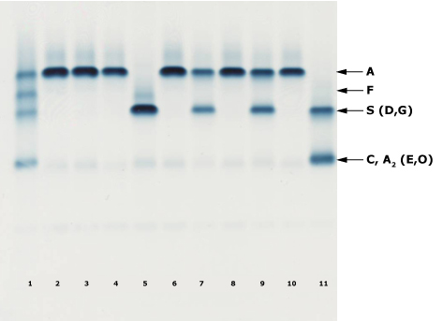
Hemoglobin Electrophoresis
Cellulose acetate, pH 8.4
Embury SH et al. Diagnosis of sickle cell syndromes. In: UpToDate, Rose, BD(Ed),
UpToDate, Waltham, MA, 2008.

Slide 21
THALASSEMIA
Thalassa- sea (around Mediterranean sea)
abnormal rate of synthesis in one of the globin chains
Abnormal gene function, autossomal recessive
α thalassemia- reduction in synthesis of alpha chain
β thalassemia- reduction in synthesis of beta chain

Slide 22
Genetics of Thalassemia
Alpha thalassemia usually caused by gene deletion
Beta thalassemia usually caused by mutation.
Microcytic, hypochromic anemia

Slide 23
Classical Syndromes of Beta Thalassemia
Silent carrier state – the mildest form of beta thalassemia.
Beta thalassemia minor - heterozygous disorder resulting in mild hypochromic, microcytic hemolytic anemia.
Beta thalassemia intermedia - Severity lies between the minor and major.
Beta thalassemia major - homozygous disorder resulting in severe transfusion-dependent hemolytic anemia.

Slide 24
Silent Carrier State
Heterogeneous beta mutations that produce only small decrease in production of beta chains.
Patients have nearly normal beta/alpha chain ratio and no hematologic abnormalities.
Have normal levels of HbA₂.

Slide 25
Beta Thalassemia Minor
Caused by heterogeneous mutations that affect beta globin synthesis.
Usually presents as mild, asymptomatic hemolytic anemia unless patient in under stress such as pregnancy, infection, or folic acid deficiency.
Have one normal beta gene and one mutated beta gene.

Slide 26
Hypochromic microcytic anemia
Slight aniso and poikilocytes, including target cells and elliptocytes; may see basophilic stippling.
Rarely see hepatomegaly or splenomegaly.
Hemoglobin level in 10-13 g/dL range with normal or slightly elevated RBC count.
Have high HbA₂ levels (3.5-8.0%) and normal to slightly elevated HbF levels.
Normally require no treatment.

Slide 27
Beta Thalassemia Intermedia
Patients able to maintain minimum hemoglobin (7 g/dL or greater) without transfusions.
Falls between thalassemia minor and thalassemia major.
Heterozygous mutation- mild decrease in beta chain production,
Homozygous - a more serious reduction in beta chain production.
See increase in both HbA₂ and HbF production.

Slide 28
Have varying symptoms of anemia, jaundice*, splenomegaly and hepatomegaly.
Anemia usually becomes worse with infections, pregnancy, or folic acid deficiencies.
Peripheral blood smear picture similar to thalassemia minor.
May become transfusion dependent as adults.
Tend to develop iron overloads as result of increased gastrointestinal absorption.
Usually survive into adulthood.

Slide 29
Beta Thalassemia Major
Severe microcytic, hypochromic anemia.
Detected early in childhood:
  Infants fail to thrive.
  Have pallor, variable degree of jaundice, abdominal enlargement, and hepatosplenomegaly.
Severe anemia causes marked bone changes due to expansion of marrow space for increased erythropoiesis.
See characteristic changes in skull, long bones, and hand bones.

Slide 30
Have protrusion upper teeth and Mongoloid facial features.
Physical growth and development delayed.
PS - hypochromic, microcytic erythrocytes, extreme poikilocytosis (target cells, teardrop cells, elliptocytes. See marked basophilic stippling and numerous NRBCs.
Hemoglobin level between 4 and 8 gm/dL.
Low retic count seen (2-8%).

Slide 31
Most of hemoglobin present is HbF with slight increase in HbA₂.
Regular transfusions, begin around one year of age and continue throughout life.
Danger in continuous transfusion therapy:
  Development of iron overload.
  Development of alloimmunization (developing antibodies to transfused RBCs).
  Risk of transfusion-transmitted diseases.

Slide 32
Comparison of Beta Thalassemias
GENOTYPE | HGB A | HGB A₂ | HGB F
NORMAL | Normal | Normal | Normal
SILENT CARRIER | Normal | Normal | Normal
MINOR | Dec | Normal to Inc | Normal to Inc
INTERMEDIA | Dec | Normal to Inc | Usually Inc
MAJOR | Dec | Usually Inc | Usually Inc

Slide 33
Other Thalassemias Caused by Defects in the Beta-Cluster Genes
Delta Beta Thalassemia- gene deletion that removes or inactivates only delta and beta genes so that only alpha and gamma chains produced.
Hemoglobin Lepore- gene crossovers between delta locus on one chromosome and beta locus on second chromosome.
Hereditary Persistence of Fetal Hemoglobin (HPFH)- continued synthesis of Hemoglobin F in adult life.

Slide 34
Beta Thalassemia with Hbg S
Inherit gene for Hb S from one parent and gene for Hb A with beta thalassemia from second parent.
Beta Thalassemia with Hgb C
Usually asymptomatic anemia
Beta Thalassemia with Hgb E
More severe disorder than homozygous E disease
Transfusion therapy required

Slide 35
Alpha Thalassemia
Absence of alpha chains will result in increase of gamma chains during fetal life and excess beta chains later in life;
Form molecules like Bart's Hemoglobin (γ₄) or Hemoglobin H (β₄), which are stable molecules but physiologically useless.
Large number of gene deletions in the alpha-globin gene

Slide 36
Are four clinical syndromes present in alpha thalassemia -
  Silent Carrier State
  Alpha Thalassemia Trait (Alpha Thalassemia Minor)
  Hemoglobin H Disease
  Bart's Hydrops Fetalis Syndrome

Slide 37
Silent Carrier State
Deletion of one alpha gene, leaving three functional alpha genes.
Alpha/Beta chain ratio nearly normal.
No hematologic abnormalities present.
Diagnose done by genetic mapping.
May see borderline low MCV (78-80fL).

Slide 38
Alpha Thalassemia Trait
(Alpha Thalassemia Minor)
Caused by two missing alpha genes. May be homozygous (-a/-a) or heterozygous (--/aa).
Mild microcytic, hypochromic anemia.
MCV between 70-75 fL.
May be confused with iron deficiency anemia.
Although some Bart's hemoglobin (γ₄) present at birth, no Bart's hemoglobin present in adults.

Slide 39
Hemoglobin H Disease
Second most severe form alpha thalassemia.
Usually caused by presence of only one gene producing alpha chains (--/-a).
Results in accumulation of excess unpaired gamma or beta chains.
Born with 10-40% Bart's hemoglobin (γ₄). Gradually replaced with Hemoglobin H (β₄). In adult, have about 30-50% Hb H.
γ₄ β₄

Slide 40
Normal life, but infections, pregnancy, exposure to oxidative drugs may trigger hemolytic crisis.
RBCs- microcytic, hypochromic with marked poikilocytosis, target cells.
HbH vulnerable to oxidation.
Gradually precipitate, form Heinz-like bodies of denatured hemoglobin.
Cells stained with brilliant cresyl blue show "golf ball" appearance.

Slide 41
Bart’s Hydrops Fetalis Syndrome
Most severe form. Incompatible with life. Have no functioning alpha chain genes (--/--).
Hydrops fetalis- edema and ascites caused by accumulation serous fluid in fetal tissues as result of severe anemia. Hepatosplenomegaly and cardiomegaly.
Hemoglobin Bart's (γ₄)has high oxygen affinity so cannot carry oxygen to tissues. Fetus dies in utero or shortly after birth.
Increased risk of toxemia and severe postpartum hemorrhage to mother.

Slide 42
Comparison of Alpha Thalassemias
Genotype | Hb A | Hb Bart | Hb H
Normal | 97-98% | 0 | 0
Silent Carrier | 96-98% | 0-2% | 0
Alpha Thalassemia Trait | 85-95% | 5-10% | 0
Hemoglobin H Disease | Dec | 25-40% | 2-40%
Hydrops Fetalis | 0 | 80% (with 20% Hgb Portland) | 0-20%

Slide 43
Malaria and hemoglobinopathies
Thalassemia and sickled celled RBCs provide protection against malaria by plasmodium falciparum
Due to reduced parasite multiplication in defective RBC
May be due to persistence of HbF which is resistant to digestion by malarial hemoglobinase

Slide 44
Lab investigations
CBC, Reticulocyte count,
Decreased osmotic fragility
Acid Elution Stain- HbF resistant to denaturation by acid
LFT- raised bilirubin in major cases
Electrophoresis- elevated Hb A₂
Globin Chain Testing - determines ratio of globin chains being produced.
DNA Analysis - Determine specific defect at molecular DNA level

Slide 45
Developing Treatments
Bone marrow transplantation
- Shown to provide a cure for severely affected children with sickle cell disease & thalassemia
Gene Therapy-
- Correcting the “defective gene” and inserting it into the bone marrow
- Turning off the defective gene and simultaneously reactivating another gene that turns on production of fetal hemoglobin.

Slide 46




Thank
you
Thank you

