Slide 1
EPILEPTOGENESIS
Faculty : Dr. Sanjay Prakash

Slide 2
Scheme of Presentation
Definition & concept of epileptogenesis
Mechanisms of Epileptogenesis
Role of ion channels, NTs/ receptors
Animal models of epileptogenesis
Kindling phenomenon
Mechanisms in human epileptogenesis
Epilepsy prevention
Recent advances

Slide 3
Definition
– gradual transformation of normal neuronal network into chronically hyperexcitable one resulting in recurrent, spontaneous seizures.
Epileptogenesis refers to a phenomenon in which the brain undergoes molecular and cellular alterations after a brain-damaging insult, which increase its excitability and eventually lead to the occurrence of recurrent spontaneous seizures.

Slide 4
Sequence of epileptogenesis
Brain damaging insult (eg stroke,TBI)
Hyperexcitability
Recurrent spontaneous seizures
Molecular & cellular alterations

Slide 5
Definition
The term epileptogenesis is most often associated with the development of symptomatic(acquired) epilepsy that presents with an identifiable structural lesion in the brain.
However epileptogenesis also seems to occurs in genetic epilepsies, in which it is regulated by developmental programming of gene expression leading to abnormal circuitry during maturation

Slide 6
Ictogenesis – initiation and propagation of a seizure in time & space – rapid & definitive electrical and chemical event occurring in sec to min
Seizure expression - which is concerned with processes that trigger & generate Szs, because Szs can arise in nonepileptic brain exposed to acute insults

Slide 7
Epileptogenesis ≈ Latent period
refers to a period of variable duration that
- begins after the occurrence of insult (e.g. TBI or stroke), or
- even during the insult (prolonged febrile Sz,or encephalitis)
- and ends at the time of the appearance of the first
spontaneous seizure.
In addition, most genetically determined epilepsy syndromes do not become clinically manifest until well after birth.
The latent period after a CNS insult offers a potential “window” for intervention to prevent epilepsy.

Slide 8
Does epileptogenesis extend beyond latency phase?
Recent data suggest that molecular and cellular changes triggered by an epileptogenic insult can continue to progress after the epilepsy diagnosis.
Sz modification by Rx can alter the underlying epileptogenic process
So epileptogenesis = latent phase + epilepsy phase
This approach is also helpful for antiepileptogenic strategies
Pitkanen A, Sutula TP. Is epilepsy a progressive disorder? Lancet Neurol 2002

Slide 9
Epileptogenesis : various causes
GENETIC
ACQUIRED
Channel mutations
Acute
Chronic
IGE
PME

Slide 10
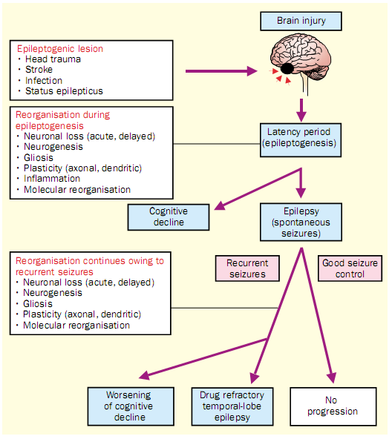





Slide 11
Changes in Epileptogenesis
↑ Excitation (LTP)
eg Glutamate
Neurodegenration
↓ Inhibiton
eg GABA
Gliosis
Alteration in voltage-gated ion channels
Acquired channelopathies
Changes in ion concentration
Changes in ECM
Glial cell dysfunction
Neurogenesis
Altered gene expression
Notes:
Development of ictogenesis depends upon Hyperexicitability of neurons

Slide 12
RR > 10: strong causal association with epilepsy
RR 4-10: probable association
Relative risk for unprovoked seizures after common brain injuries. The dotted line represents the general population risk for unprovoked seizures.

Slide 13
Prerequisites of Epileptogenesis
Hyperexcitability
In a mass of neurons
Ion channels
Receptors/NTs
Propagation
Normal pathways
Abnormal pathways
Hypersynchrony
Gap junctions
Ephaptic Trans
Non synaptic mech

Slide 14
Abnormal hyperexcitable state
Synaptic mechanisms
Non-synaptic mechanisms
Changes in ion concentrations
Excitatory
neurotransmission
Ionic channels and transporters
Electrotonic coupling
Inhibitory
neurotransmission
Electrical ﬁeld effects
(ephaptic transmission)
Other mechanisms
Notes:
Mechanism which leads to abnormal ……..

Slide 15
Excitatory potentials
Contribute to generation of paroxysmal depolarisation shifts in individual neurons
Provide mechanism for synchronisation of epileptiform discharges
Set off slow depolarisation and burst discharge in some neurons

Slide 16
Prerequisites of Epileptogenesis
Hyperexcitability
In a mass of neurons
Ion channels
Receptors/NTs
Propagation
Normal pathways
Abnormal pathways
Hypersynchrony
Gap junctions
Ephaptic Trans
Non synaptic mech

Slide 17
Changes in ion channels: Na channel
Essential for depolarization during action potential
Blocking fast channel inactivation leads to increased excitability - switches neocortical pyramidal neurons from regular spiking to burst firing
  Induces ‘paroxysmal depolarization shifts’
  Increasing synchrony
Role of Na channels in epilepsy suggested based on observed effect of AEDs on Na currents

Slide 18
paroxysmal depolarizing shift of a neuron in a seizure focus
The PDS consists of a large depolarization that triggers a burst of action potentials.
The depolarization is largely dependent on AMPA and NMDA channels activated
by the EAA glutamate and by VGCC.. After the depolarization, the cell is hyperpolarized
by activation of GABA receptors as well as voltage- and Ca-dependent K+ channels
A simplified version of the circuitry impinging on a cortical pyramidal neuron.
Recurrent axon branches activate inhibitory neurons and cause feedback inhibition.
Extrinsic excitatory inputs can also activate feed-forward inhibition.

Slide 19
K Channels
Important for membrane repolarization.
M current controls sub-threshold membrane excitability.
K Channel blockade produces epileptiform discharges in vitro.
Epileptiform discharges can be induced by increasing the extracellular K concentration, thus reducing the strength of the outward K currents as a result of the decreased IC/EC conc gradient.
  Shown to induce spikes in CA3 region that leads to Sz activity in CA1 area (K induced epileptogenesis)
  M current defect identified in benign neonatal familial convulsions
Notes:
M current, so-called because it is inhibited by the activation of muscarinic acetylcholine receptors, is particularly important in controlling neuronal excitability.

Slide 20
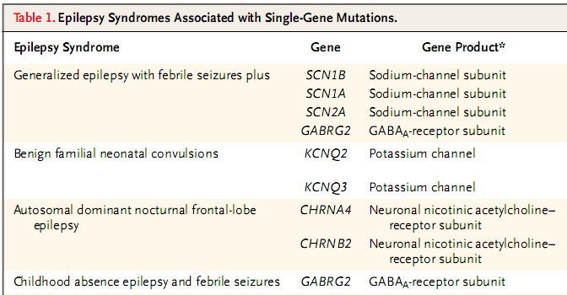
Few familial gen epilepsy syndromes assoc with ion channel mutations

Slide 21
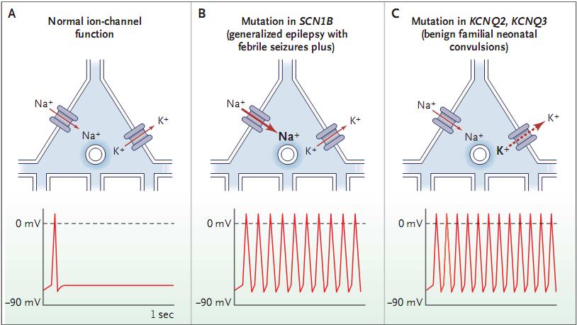
A- Sodium and potassium channels are responsible for the primary components of the action potential
B- Mutations in SCN1B - Allow increased passage of sodium current, which leads to greater depolarization during action potential and an increased tendency to fire repetitive bursts
C- Mutations in KCNQ2 and KCNQ3 - Decrease the potassium outflow underlying the longer-lasting “M current,” – loss of sustained repolarisation – repetitive firing

Slide 22
Ca Channels
Different types of channels (T, N, L, P, Q)
Ca currents contribute to the paroxysmal depolarization shift
May be responsible for long-term structural changes affecting excitability and synaptic efficacy
Participate in cytotoxicity
Activation of T-type channels is thought to underlie the abnormal thalamocortical rhythmicity associated with 3-Hz spike-and-wave in absence

Slide 23
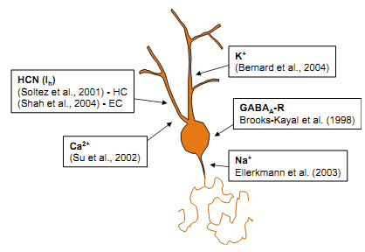
Acquired channelopathy
Brain injury can result in changes in both ligand-gated and receptor-gated ion channels that are associated with altered function when investigated using single-cell electrophysiology.
This phenomenon, called acquired channelopathy, has been described in the dendritic, somatic, and axonal channels
Whether the same neuron
can have multiple
channelopathies is not known.

Slide 24
Prerequisites of Epileptogenesis
Hyperexcitability
In a mass of neurons
Ion channels
Receptors/NTs
Propagation
Normal pathways
Abnormal pathways
Hypersynchrony
Gap junctions
Ephaptic Trans
Non synaptic mech

Slide 25
Neurotransmitters/ receptor changes
Major neurotransmitters in brain are
  Glutamate
  Gamma-amino-butyric acid (GABA)
  Acetylcholine (Ach)
  Adenosine
  Norepinephrine, dopamine, serotonin & histamine
Other molecules- neuropeptides & hormones, play modulatory roles that modify neurotransmission over longer periods

Slide 26
Role of Glutamate
Physiology
Pathology
Free radical formation
Excitotoxicity
Neuronal death
Major excitatory neurotransmitter
COOH
Fast & prolonged phase of excitatory neurotransmission
CH₂
CH₂
Development
Plasticity
CH
H₂N
COOH
Epileptogenesis
Glutamate
Notes:
Under excessive glutaminergic conditions ………And initiates the process of epileptogenesis

Slide 27
Glutamate receptors
Ionotropic & metabotropic
Ionotropic- AMPA, NMDA, Kainate
AMPA- fast excitatory transmission, by Na-K channel
- coexists with NMDA receptors in all synapses
- Mg block over NMDA rec released by opening of
AMPA channel- prolonged excitation
NMDA- Ca channel
Kainate- Kainic acid induced SE in exp models

Slide 28
Role of Glutamate
Excessive stimulation of NMDA ( eg. in SE) contributes to Ca++ mediated neuronal injury
  ↑ cell death
  ↑ neurogenesis & reactive synaptogenesis
  further ↑ excitability
Changes in NMDA R expression & function in human tissue from pt undergoing surgical resection
Notes:
Studies have shown…….

Slide 29
Involved in long term potentiation
Experimental animal studies have shown that
  NMDA, AMPA & kainate agonists induce Sz activity
  Their antagonists suppress Sz activity
Also studies of Cortical dysplasia have shown correlation between cytoarchitectural abnormalities and specific NMDA (NR1& NR2B) and AMPA (GluR2-3) receptor subunits
MTLE-HS: AMPA receptors are denser in both int & ext molecular layers of dentate gyrus
Moddel G. et al. The NMDA receptor NR2B subunit contributes to epileptogenesis in human cortical dysplasia. Brain Res 2005;1046(1–2):10–23
Notes:
Thus implicating role of glutamate and its receptors in epileptogenesis

Slide 30
Role of GABA
GABA receptors are divided into two subtypes GABA_{A} and GABA_{B}
The inflow of Cl ions and outflow of K ions prompted by binding of GABA to its receptors leads to membrane hyperpolarisation and IPSPs.
Most excitatory neurotransmission is meant to link relatively distant regions whereas the local circuitry interneuronal network belongs to the inhibitory GABA transmission
Notes:
Principle inhibitory neurotransmitter in cortical structures

Slide 31
GABA_{A} and Early Life
During early development, GABA acts as an excitatory neurotransmitter.
In immature neurons Cl⁻ is high, as K-Cl⁻ transporter is not fully expressed
Opening of GABA/ Cl channels : ↑ efflux Cl → depolarizes
immature neurons
↑ activation of VGCC → ↑ Ca⁺⁺ influx → excitation
GABA & NMDA receptor synergistic effect during the early/late postnatal period may provide a synaptic substrate for the neuronal hyperexcitability seen in early life or later onset epileptogenesis.

Slide 32
Role of Acetylcholine
ACh has variety of effects as neuromodulator
Causes slow depolarization by blocking a tonically - active K⁺ current → ↑ neuronal excitability
The channel is non-selective and permeable to +vely charged ions: Na, Ca, and K , which pass through the channel with roughly equal efficiency
↑ amplitude of LTP by enhancing currents through NMDA-R

Slide 33
Pilocarpine can cause severe Szs in animals – which may progress into SE → permanent neuronal loss & synaptic reorganisation
27 individuals from a large Australian family affected by ADNFLE were found to have a mutation in CHRNA4 coding for the 4 subunit of the nicotinic acetylcholine receptor
Phillips HA et al. Localization of a gene for autosomal dominant nocturnal frontal lobe epilepsy to chromosome 20q13.2. Nat Genet 1995
Notes:
Evidence for involvement of Ach in development of seizures comes from the fact

Slide 34
Role of Adenosine
Inhibitory effect on brain function
A1 receptor activation leads to reduction in excitatory transmission & in postsynaptic excitability
During Sz brain adenosine concentration rise markedly which may play role in termination of seizures & postictal depression of neural activity.
Notes:
Has mainly………. ……….It has been shown

Slide 35
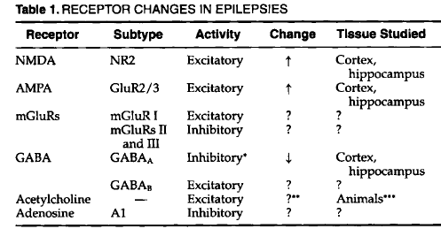


Slide 36
Prerequisites of Epileptogenesis
Hyperexcitability
In a mass of neurons
Ion channels
Receptors/NTs
Propagation
Normal pathways
Abnormal pathways
Hypersynchrony
Gap junctions
Ephaptic Trans
Non synaptic mech

Slide 37
Non synaptic factors: Changes in Extracellular space (ECS)
Reductions in ECS induce Sz like activity that is independent of chemical synaptic mechanisms
Rx with furosemide – which ↓ es ECS has shown to precipitate a variety of Szs

Slide 38
Glial Cells
Glial cells support homeostatic regulation of neuronal microenvironment
Strategically located near excitatory neurons.
Acts as a buffer for excess NTs, voltage spread and ATP
Role in synaptic neurotransmission
  Through expression of glial glutamate receptors
  Uptake of excitatory NT - GLT-1
Active K+ uptake normalises the K gradient
Notes:
Glial cells maintains neuronal excitability in various ways

Slide 39
  ↓ed glial connectivity thru gap junction
  Loss of buffering capacity or
  ↓ ed glutamate clearance
→ facilitate hypersynchrony
Failure of glial protective mechanism may signal ictal transformation & secondary generalisation of focal discharge

Slide 40
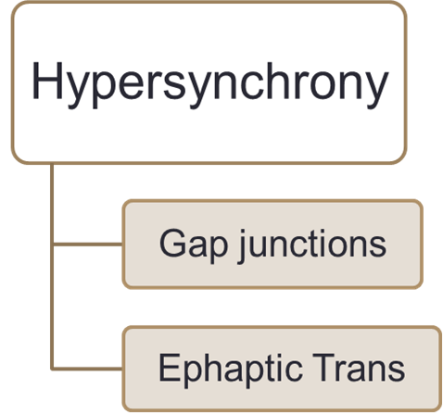
Role of electrical interactions in hypersynchrony
electrotonic coupling through gap junctions play imp role in neural integration & synchronization
More so in granule cells & pyramidal cells of hippocampus
Current flow through ECS - ephaptic transmission also synchronize hippocampal pyramidal cells
Notes:
facilitating increased synchronization of electrical activity……..

Slide 41
Our understanding of epileptogenesis
Comes largely from animal studies that have investigated status epilepticus induced epileptogenesis.
Animal studies classically mimic symptomatic epilepsies in humans.
Most common model is the chemically/electrically induced SE model
Caveats:
- heterogeneity of SE, TBI, stroke in humans
- only GTCS & limbic SE modeled in rodents
- Initial brain insult vs SE (in humans)
Notes:
In humans, SE is often associated with some underlying cause eg TBI, stroke. Thus, it is difficult to assess the contribution of the initial brain damaging insult and SE separately to the risk of epileptogenesis in humans.

Slide 42
Animal Models
Post SE
  Chemoconvulsant - Pilocarpine, Kainic acid, Bicuculline
  Stimulation – Kindling – amygdala, intrahippocampal
Post traumatic Epilepsy
  Lateral fluid percussion
Post Stroke epilepsy
  Cortical prothrombosis
  Cortical endothelin
Hypoxia-ischemia
  Carotid artery ligation + hypoxia
Notes:
Most of the currently available molecular and cellular data on the epileptogenic process originate from models in which epileptogenesis is initiated by status epilepticus in adult animals

Slide 43
Epilepsy Phenotype in TBI, Stroke, post-SE epilepsy Models
Notes:
In rats, the duration of the latency period shows clear etiology dependency; approximately 1–4 weeks after SE and several weeks to months after TBI or stroke.

Slide 44
Cellular alterations in diff epileptogenic models

Slide 45
Kindling & Sec epileptogenesis
Kindling is the process by which repeatedly induced seizures result in an increasing seizure duration until a moment when spontaneous Sz develop.
Gowers’ famous statement ‘seizures beget seizures’ a century ago initiated a controversy present till date.
Phenomena of secondary epileptogenesis, mirror focus & kindling suggest that in exp animals & possibly in humans with intractable epilepsy repeated seizures may promote additional seizures

Slide 46
The Kindling Phenomenon
Daily, subconvulsive stimulation of brain regions like hippocampus or amygdala result in
  Electrical afterdischarges
  Stimulation induced clinical Szs, and eventually
  In some instances, spontaneous Szs
This process involves long-lasting biochemical and/or structural changes in CNS
Notes:
phenomenon

Slide 47
Proposed Mechanisms of Kindling
Excessive  in [Ca2+]i mediated by NMDA R
Long lasting increase in EPSP, producing LTP
Paroxysmal depolarisation shifts
Progressive neuronal loss
Morphological reorganization of neurons & neural circuits

Slide 48
Primary epileptogenic zone - has macroscopic abnormality & can generate Szs independently
Secondary epileptogenic zone becomes epileptogenic d/t of influence of primary area which is separated from it by at least 1 synapse
Mirror focus - secondary epileptogenic zone is located in contralateral homotopic area with regard to primary zone

Slide 49
Recent studies have shown that many of cellular & functional changes noted with kindling are similar to those seen in humans with intractable TLE
Occurrence of kindling has not been directly demonstrated in human hippocampal circuitry and TLE due to the inability to serially study functional and cellular alterations.
The closest parallel in humans to repeated induced seizures is electroconvulsive therapy (ECT) used to treat severe depression. In this group of patients the incidence of epilepsy is extremely low

Slide 51
It is not clear if independent secondary epileptogenesis occurs in humans
If it does occur, early surgery would clearly be indicated, before development of an independent mirror focus
Overall, kindling currently is best regarded as a model of seizure-induced circuit plasticity

Slide 52
Epileptogenesis in humans
TBI, stroke, infection etc. results in epilepsy
Mechanisms may be different, certain features are common :
  Latent period – wks to yrs betw injury & epilepsy
  Anatomic changes with neuronal loss
  Involvement of synaptically connected but anatomically distant sites
  Its long duration or even permanence

Slide 53
Temporal Lobe Epilepsy: most studied of all partial epilepsies
In pts c TLE, hippocampus is hardened & sclerotic
Cellular alterations responsible for sclerosis are
  Neurodegeneration
  Neurogenesis
  Gliosis
  Axonal growth and mossy fiber sprouting
  Angiogenesis
  Changes in ECM
  Acquired chnnelopathies
Notes:
Of the partial epilepsies, temporal lobe epilepsy (TLE) is very common and has been extensively studied

Slide 54
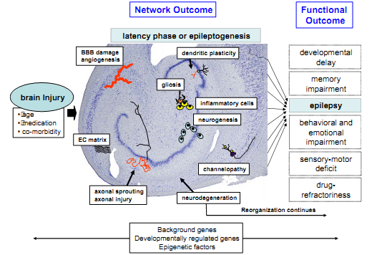
. During the entire epileptogenic process, these alterations are subject to
modulation by genetic background, developmentally regulated genetic programs,
or epigenetic factors.

Slide 55
Normal hippocampus:
Hippocampus consists of the CA1 through CA4 & dentate gyrus
Primary neurons
  Cornu Ammonis - Pyramidal cells
  Dentate gyrus - Granule cells
  Dentate gyrus acts as a gatekeeper of excitability
Hippocampal circuitry consists of a trisynaptic excitatory pathway – from entorhinal cortex to dentate granule cells, which project to CA3 pyramidal neurons via mossy fibers, & from there to CA1 region through Schaffer collaterals

Slide 56
Neurodegeneration
Occurs in hilus (mossy cells, somatostatin interneurons), CA1, CA3 pyramidal cells & – also in amygdala & many ET areas, like thalamus & cerebellum
MRI data - hippocampal & cortical atrophy in pts with newly diagnosed & chronic epilepsy
Currently, data on whether recurrent Sz contribute to neurodegeneration is controversial
Liu RS. et al. Progressive neocortical damage in epilepsy. Ann Neurol 2003;53:312–24.
Notes:
Best described changes during epileptogenesis

Slide 57
Animal models - even substantial protection of hippocampal neurons after SE does not prevent epileptogenesis
Neurodegeneration is not mandatory for epileptogenesis, at least in immature brain
However, alleviation of neurodegeneration reduced behavioral consequences after SE
Brandt C, et al. N-Methyl-D-aspartate receptor blockade after status epilepticus protects against limbic brain damage but not against epilepsy in the kainate model of temporal lobe epilepsy. Neuroscience 2003;118.
Notes:
But the Shown

Slide 58
Neurogenesis
Neural precursor cells have been isolated from surgical specimens obtained from pts c intractable TLE
Postnatal neurogenesis in the hippocampus can occur throughout life. ( Eriksson P S et al, Nat Med 1998)
New dentate granule cells become abn integrated in neuronal circuits.
Data also suggest that Szs induce neurogenesis in early dev period too- relevant for epileptogenesis
Blümcke I, et al. Increase of nestin-immunoreactive neural precursor cells in the dentate gyrus of pediatric patients with early-onset temporal lobe epilepsy. Hippocampus 2001;11:311–21.

Slide 59
Axonal growth and mossy fiber sprouting
Experimental models - many epileptogenic insults trigger mossy ﬁber sprouting
Also been described in hippocampus of surgical pts c epilepsy of various etiologies
Mathern GW,et al. Childhood generalized and mesial temporal epilepsies demonstrate different amounts and patterns of hippocampal neuron loss and mossy ﬁbre synaptic reorganization. Brain 1996;119(Pt. 3):965–87.
Notes:
It has been shown in

Slide 60
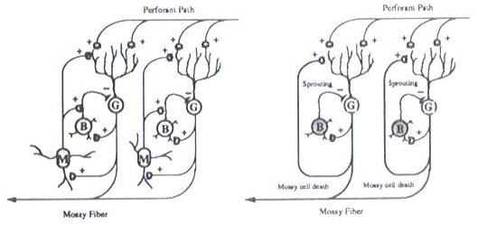
It causes synaptic reorganization of mossy fiber (axons of granule cells) so that they project & make excitatory contact c granule cell dendrites, resulting in recurrent excitatory circuit which eventually leads to seizures

Slide 61
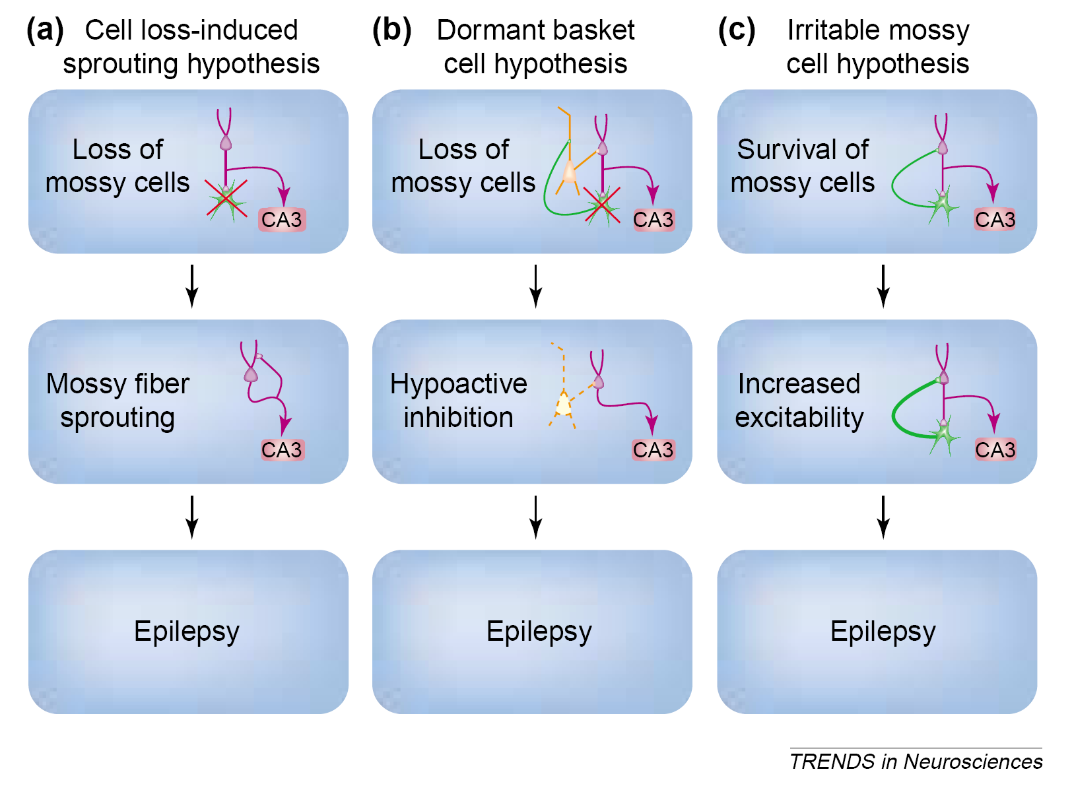

Slide 62
Angiogensis
Recent experimental evidence suggests that prolonged Sz or brief Szs, in animals & humans may be associated with opening of BBB & angiogenesis
Disruption of BBB can trigger epileptiform activity leading to a vicious cycle.
But so far, enhancement of angiogenesis has been used to increase post-TBI and poststroke motor recovery
There are no data on whether this would affect epileptogenesis
Van Vliet EA, et al. Blood–brain barrier leakage may lead to progression of temporal lobe epilepsy. Brain 2007

Slide 63
Absence seizures: prototype model of gen. epilepsy
Mechanism – involves alteration in circuitry b/w thalamus & cerebral cortex (thalamocortical oscillatory rhythm)
Thalamocortical rhythms form substrate of
  Neurobiology of sleep
  generation of sleep spindles
Generation of generalized spike and wave EEG pattern
Notes:
Underlying ……. And same rhythm may be involved in

Slide 64
3 neuronal populations - involved in this circuitry -
  Thalamic relay neurons or thalamocortical neurons ,
  Thalamic reticular neurons ,
  Cortical pyramidal neurons

Slide 65
Normal Thalamocortical Circuit
Thalamic relay neurons can activate cortical pyramidal neurons either in
  Tonic mode - wakefulness & REM sleep, or
  Burst mode - non-REM sleep
Burst mode firing- function of T-type calcium channels
Mode of thalamocortical activation is controlled largely by input from thalamic reticular neurons, which hyperpolarize relay neurons (by sending IPSPs), allowing them to fire in bursts
IPSP- GABA(A) mediated- 8 Hz network frequency
IPSP- GABA (B) mediated- 3 Hz frequency

Slide 66
B During wakefulness, the cortex is activated by the thalamus in a tonic mode, allowing for processing of external sensory inputs. This results in a desynchronized EEG.
During non-REM sleep, the cortex is activated in a burst mode, resulting in the EEG appearance of rhythmic sleep spindles.
During an absence seizure, the normal thalamocortical circuit becomes dysfunctional, allowing burst activation of the cortex to occur during wakefulness, which results in the EEG appearance of rhythmic spike-wave discharges and interrupts responsiveness to external stimuli.

Slide 67
Precise abnormality of circuit yet to be determined.
  T-type calcium channels may be primary culprits
  - Specific action of Ethosuximide is proof
  Altered GABA receptor function, esp GABA(B)
  - Baclofen, a GABA (B) agonist increase SWD on EEG
  - BZDs ( GABA (A) agonist) suppress absence Sz
  Combination of factors may be involved, including changes in modulatory input from brain stem

Slide 68
Traumatic brain injury
The risk for development of late seizures is directly related to the severity of the brain injury.
Penetrating head injury, hemorrhage, cortical injury, early seizures.
Mech:
- selective damage to vulnerable brain areas
(hippocampus),
- irritating effects of intracerebral hemorrhage,
- cortical damage
Patients with moderate to severe TBI are potential candidates for clinical trials with putative antiepileptogenic agents

Slide 69
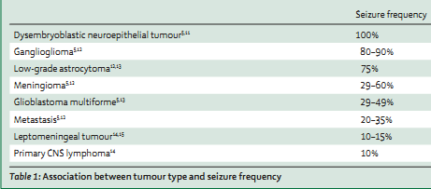
Epileptogenesis by brain tumors
Epileptogenic activity probably arises in the cortex adjacent to the tumour; lesions are usually electrically inert.
Slow growing tumors/ developmental tumors more epileptogenic

Slide 70
Epileptogenesis by brain tumors
Developmental tumours consist of well-differentiated cells that can release NTs with a role in epileptogenesis.
These slow growing might partly isolate brain regions through mechanic or vascular mechanisms, and such relative deafferentation of circumscribed cortical areas has intrinsic epileptogenic propensity
Rapidly progressive brain tumours (eg, metastasis, GBM) are thought to induce epilepsy through abrupt ways of tissue damage such as tissue necrosis or deposition of haemosiderin

Slide 71
Morphological changes in peritumoral tissue
Aberrant neuronal migration.
Changes in synaptic vesicles.
Enhanced intercellular communication through increased expression of gap-junction channels.
Persistent neurons in white matter.
Differences in angiogenesis
Genetic factors
Secondary epileptogenesis
Notes:
Therefore, early treatment of the primary epileptic lesion may be needed to prevent development of a secondary, potentially irreversible, focus

Slide 72
The role of gene expression
The expression of genes with widely variable functions may be altered in acute or chronic seizures
  Growth
  Angiogenesis
  Transcription factors
  Cell-signaling molecules
  Cytoskeletal elements
  Neurotransmitter receptor subunits and uptake sites
  Ion channels

Slide 73
Proposed antiepileptogenic/ Sz modifying agents
Prevention of Epilepsy
Rapamycin- mTOR inhibitor
2. Sz modification ( freq & severity)
BDNF, FGF-2 , EPO: neurotrophins
NSAIDs- Celecoxib, Parecoxib
Atipamezole: proconvulsant
Rimonobant in TBI model: cann 1 rec antagonist

Slide 74
Recent advances

Slide 75
Concept of Microseizures
The smallest functional units of the cortex are arrangements of cells called cortical columns.
Each column is a network of neurons measuring an average of 300 microns across, & is made up of only 1,000 to 7,500 neurons.
A standard intracranial electrode records from an area approximately 10 sq.mm and captures the activity of thousands of cortical columns and millions of neurons.

Slide 76

The Mayo Clinic experiment
Stead M et al, Epilepsia 2007; Worrell GA et al, Brain 2004
To discover if seizures originate in a single cortical column, Drs. Worrell and Stead found a totally new way to record human neuronal activity.
A unique, first-of-its-kind system capable of recording from over 300 microelectrodes at 32,500 Hz for days to weeks was used (world's largest data recording acquisition systems).
Neurosurgeons implanted microelectrode arrays along with standard clinical EEG electrodes during brain-mapping surgery.

Slide 77
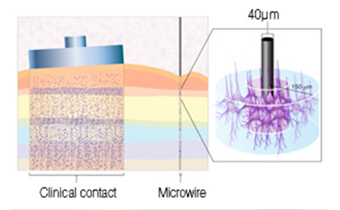
Microelectrode vs a routine IC electrode
Standard clinical EEG recording electrodes (left) cover about 4000 times the cortical surface area of a microelectrode (right) and averages the activity of hundreds of cortical columns. A microelectrode can record from a single cortical column,allowing us to see events such as microseizures

Slide 78
Synchronous activity was recorded coming from an area the size of a single cortical column.
Microseizures are sparsely distributed, more frequent in brain regions that generate seizures, and sporadically evolve into clinical seizures.
Rare microseizures are even observed in patients without regular seizures, but not on a scale that characterizes epilepsy.
These observations suggest that a full-blown, clinically detectable seizure develops when these microseizures begin to enlarge, coalesce, and eventually reach critical mass.

Slide 79
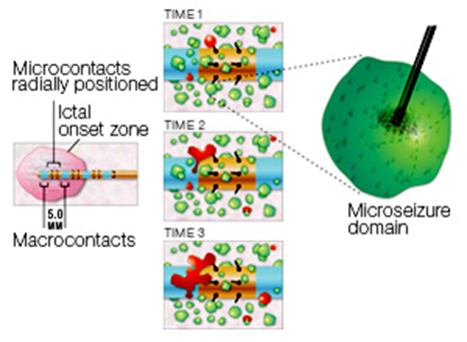
This figure illustrates the group's hypothesis:
seizure generating cortex is composed of discontinuous, pathological microdomains (cortical columns) that generate microseizures and high frequency oscillations.
These aberrations can recruit normal brain tissue and escalate into a clinical seizure.

Slide 80
How do microseizures transition to clinical seizures in patients with epilepsy?-The sick column hypothesis
The findings of Drs. Stead and Worrell support the hypothesis that in patients with epilepsy-
individual microdomains the size of cortical columns generate frequent hypersynchronous discharges, which recruit other columns of neurons.
This confirmation adds to the evidence that seizures may begin well before they produce observable symptoms and long before they are detected by standard EEG

Slide 81
New devices in the pipeline to detect/ interrupt seizures
Encouragement by the success of implants used to treat cardiac dysrhythmias.
Examples in use are the vagus nerve stimulator, and the anterior thalamic nucleus stimulator which is in clinical trials.
The next wave consists of responsive devices, or implants that extract data from an intracranial electroencephalogram (IEEG),

Slide 82
Responsive devices
The IEEG indicates that a seizure has started, typically before the appearance of clinical signs or symptoms.
The device then uses the data to trigger intervention in one of several forms: electrical stimulation, electric field or magnetic stimulation, local drug infusion, or focal cooling.
The intervention would be based on previously determined IEEG measures determined from the patient's seizure pattern.

Slide 83
Why do we need to know about epileptogenesis?
Epilepsy prevention has not been a major focus of research despite the fact that epilepsy is a major medical problem.
Epilepsy develops over time, so there is opportunity to intervene, and risk factors can often be identified.
Risk factors: head injury, ICH, brain tumors, SE, chronic neurodegenerative diseases, children with prolonged FS, dysplastic brains, and certain genetic forms of epilepsy.
However, at the present time, nothing can be done to reduce the risk of epilepsy in these individuals.

Slide 84
Why is it so ?
Insufficient basic scientific information about intervention strategies
Clinical trials mainly dealing with symptomatic therapy and very few with epilepsy prevention

Slide 85
For this reason, the recognition of a new syndrome has been proposed : the risk of epilepsy development (RED) syndrome.
The RED syndrome recognizes that after a variety of brain “injuries” (eg, trauma, SE, ischemia, CNS infection), a process has begun that leads to the development of epilepsy in a substantial fraction of individuals.

Slide 86
long-term goal
To “cure” epilepsy by preventing its development in at-risk individuals.
To accomplish this, it will be necessary
- to develop a consensus for the need for clinical trials
in antiepileptogenesis,
- to develop the clinical infrastructure for performing
such trials in a network of centers,
- to develop better clinical trial paradigms, and to
partner with those who perform basic research in
antiepileptogenesis.

Slide 87
Epilepsy would cease to be considered divine the day it is understood
- Hippocrates (460 BC - 377 BC)
THANK YOU

Slide 88
Topics not covered
Epileptogenesis in FCDs
Epileptogenesis in developing brain
Epigenetics of epileptogenesis

Slide 89
Referecnes
Principles of Neurosciences Eric J Kandel. 4th edition
Mechanisms of epileptogenesis – Neurology Clinics of North America Vol 19: May 2001
Mechanisms of disease: Epilepsy. Bernard S. Chang et al. N Engl J Med 2003;349:1257-66.
Recent advances in epileptogenesis Jayant N. Acharya. Current Science, Vol. 82, No. 6, 25 March 2002.

Slide 90
5. The relevance of secondary epileptogenesis to the treatment of epilepsy: Kindling & the mirror focus. Eli S. Golden. Epilepsia 1984 S156-168
6. Pathophysiology of epilepsy. S. Engelborghs. Acta neurol. belg., 2000, 100, 201-213
Molecular and cellular basis of epileptogenesis in symptomatic epilepsy. Asla Pitkänen. Epilepsy & Behavior 14 (2009) 16–25
Neurology Today: Dec 2006, Vol 6, Issue 23; p 13-14

Slide 91
Q
Pyramidal neurons spared in MTLE-HS
1. CA1
2. CA2
3. CA3
4. CA4

Slide 92
Q
ADNFLE is caused by mutation in :
Na channel
K channel
GABA receptor
Ach receptor

Slide 93
Q
One of the following was found to reduce epileptogenesis:
Erythropoeitin
Parecoxib
Tacrolimus
Rapamycin

Slide 96
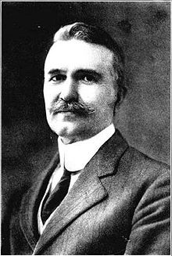
1904: The term "epileptologist" was first used to describe a person who specializes in epilepsy.
William Spratling, the neurologist who coined the word, is now regarded as North America's first epileptologist.
Notes:
Epilepsy was thought to be caused by abnormal or excessive sensory input to the cortex and was presumed
to be acquired through heredity or life-style or to develop through the experiencing of nonepileptic (symptomatic) seizures. He agreed with Gowers that seizures begat seizures. And, like many epileptologists today, he believed that
seizures destroyed the brain, progressively impairing memory and cognitive functioning

Slide 97
Mechanism of febrile seizures
Several genes have been implicated in the susceptibility to febrile seizures, those coding sodium channels, GABA-A receptors, and interleukins.
The fever-promoting, pyrogen, interleukin-1β contributes to fever generation and, conversely, fever leads to the synthesis of this cytokine in hippocampus.
In addition, interleukin-1β, has been shown to increase neuronal excitability, acting via both glutamate and GABA.
mice lacking the receptor for this cytokine required much higher temperatures to elicit hyperthermic seizures.

Slide 98
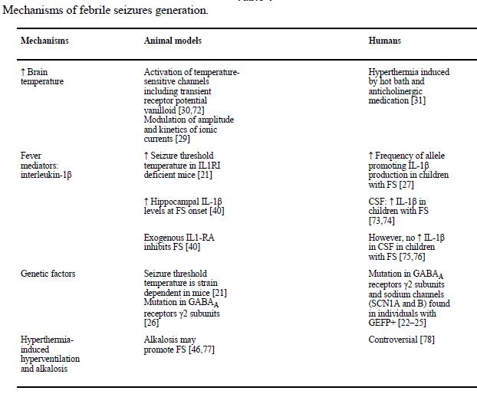

Slide 99
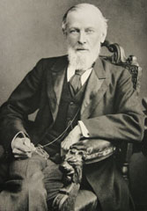
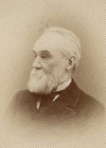
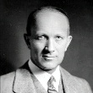
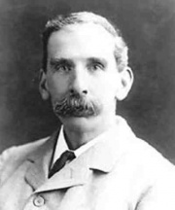
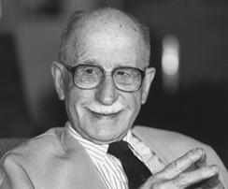
….brief history
1859-1906: Under the leadership of three English neurologists- John Hughlings Jackson, Russell Reynolds, and Sir William Richard Gowers--the modern medical era of epilepsy begins.
Pioneers of modern epilepsy surgery: Wilder Penfield, Victor Horsley & Herbert Jasper

