Slide 1
SBKS MEDICAL INSTITUTE & RESEARCH CENTER
Mrs. Hiral Panchal
Tutor & PhD Scholar
Department of Physiology

Slide 2
NERVE – MUSCLE PHYSIOLOGY

Slide 3
LIST OF UPCOMING LECTURES
Neuron- Structure & Functions
Myelin sheath and Neuroglial cells
Nerve fibers-Type & Function, Classification of Nerves
Nerve injury- Degeneration & Regeneration
Properties of NERVE-1
Properties of NERVE-2

Slide 4
LIST OF UPCOMING LECTURES
7. Muscle Physiology- Introduction & classification
8. Structure of Skeletal muscle and Sarcomere, Sarcotubular System
9. Molecular basis of muscle contraction
10. Properties of skeletal muscles and types of contraction
11. Neuromuscular junction and transmission

Slide 5
LIST OF UPCOMING LECTURES
12.Myasthenia gravis & Drugs acting on NM junction
13. Motor unit, EMG, Myopathies
14. Smooth muscle- structure and properties
15. Revision

Slide 6
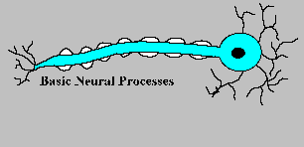
NERve

Slide 7
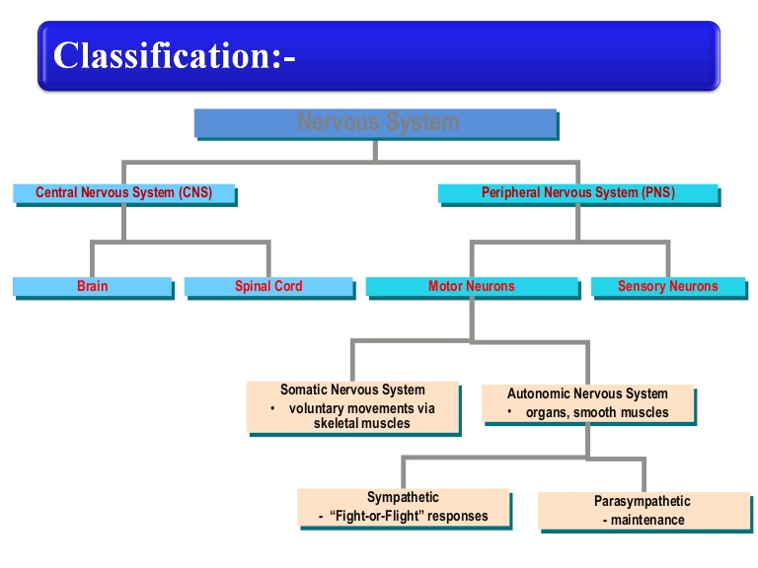

Slide 8
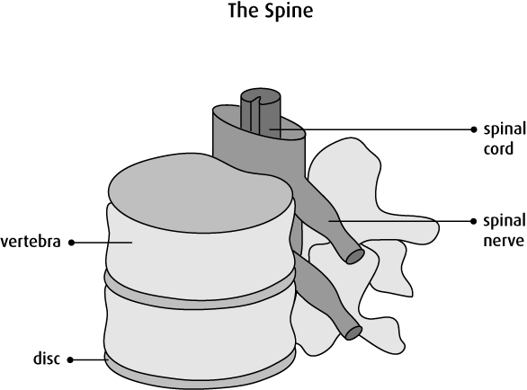

Slide 9
Nervous System
It is made up of nervous tissues.
Nervous tissue contains two main kinds of cells:
  Neurons - Structural and functional unit.
  Glial cells (or Neuroglia) – Supporting cells.

Slide 10
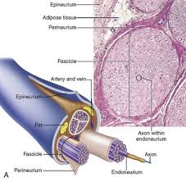
NEURON- Structural and functional unit of the nervous system.

Slide 11
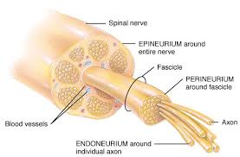

Slide 12
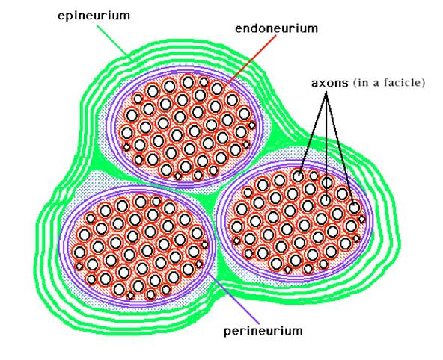

Slide 13
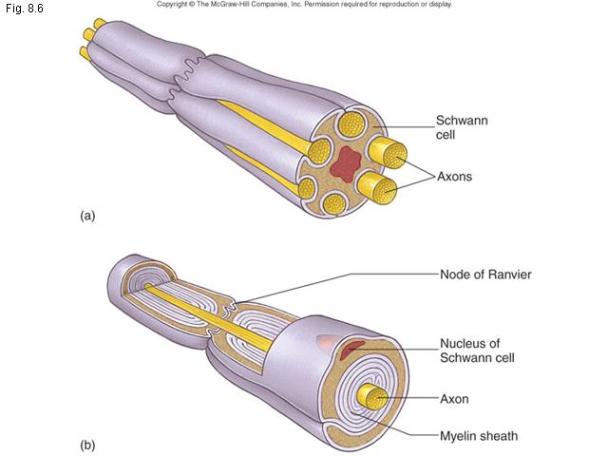

Slide 14
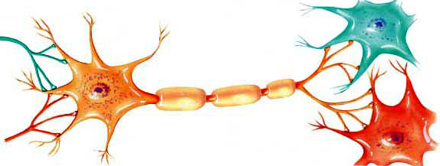
Structure of the Neuron
Dendrites
Cell Body
Myelin
Sheath
Axon of another
neuron
Axon
Dendrites of another neuron

Slide 15
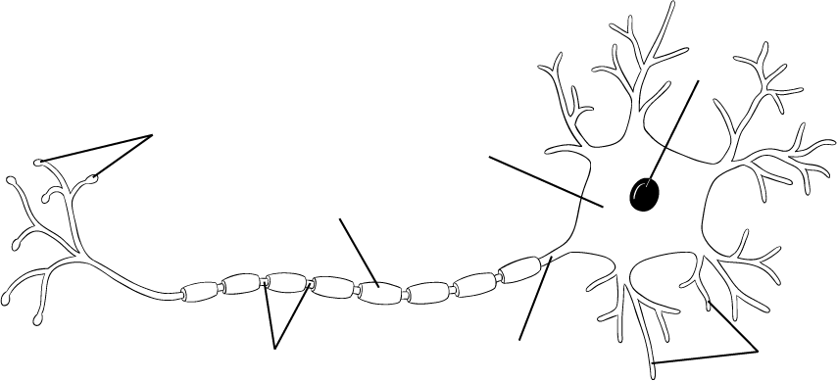
Structure of the Neuron
4. Myelin sheath: insulating membrane *increases speed of impulse*
1. Cell body: Contains the nucleus and other cell organelles
Nucleus
Axon terminals
1. Cell body
4. Myelin sheath
5. Axon terminals: synaptic Knobs
*store and release neurotransmiters
2. Dendrites
Nodes
3. Axon
2. Dendrites: Short, branched extensions of the cell body
*Function: receive stimuli*
3. Axon: long, thin extension of the cell body *Function: sends nerve impulses away from the cell body*
(Remember “A” for away!)

Slide 16
Nerve Cell Body
SOMA
PERIKARYON
Of various sizes and forms –
    Stellate,
    Round
    Pyramidal
    Fusiform

Slide 17
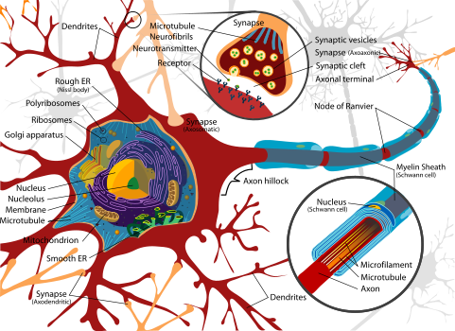

Slide 18
Nerve Cell Body
Its main composition are similar to a generalized cell.
  Nucleus,
  Cell membrane( neurilemma)
  cytoplasm
  Mitochondria, Ribosomes, ER, Golgi
After fixation with special stains it also reveals:
  Nissl’s granules/bodies
  neurofibrillae

Slide 19
Nerve Cell Body
Nissl Granules/Bodies
Modified rough endoplasmic reticulum
These are basophilic granules, composed of many thin, parallel arranged, membrane bound cavities(cisternae) which are covered by ribo-nucleoproteins(RNA with protein).

Slide 20
Certain poisons, cutting/ sectioning of axon causes Nissl’s granules to disintegrate and finally disappear – Chromatolysis.

Slide 21
Nerve cell body
Neurofibrillae
Modified cytoskeleton
Are fine threads(6-10 mm in diameter).
They traverse the cytoplasmic matrix forming a loose network.

Slide 22
Dendrites
5-7 fine processes extended out from the cell body.
Also contains Nissl’s granules, neurofibrillae, and mitochondria.
They are the receptive processes of neuron. Impulses can be transmitted from one dendrite to another in the CNS

Slide 23
Axon
The cell membrane – axolemma.
The cytoplasmic fluid in the center of axon – axoplasm.
Axon Cylinder or Nerve Fiber
Originates from a thickened area of the cell body, called AXON HILLOCK.
( contains no nissle granules).

Slide 24
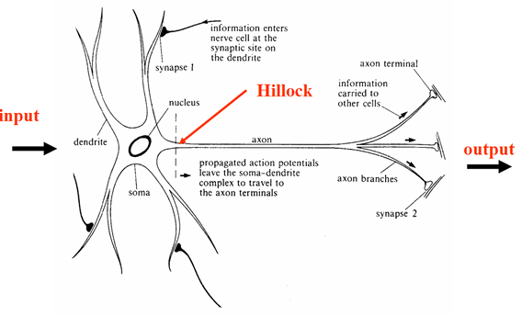

Slide 25
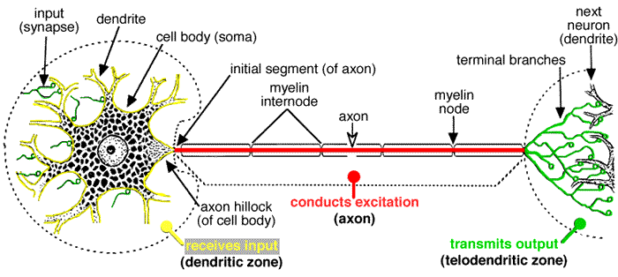

Slide 26
MYELINATION

Slide 27
Structure of the Neuron
Dendrites
Cell Body
Myelin
Sheath
Axon of another
neuron
Axon
Dendrites of another neuron

Slide 28
Myelin sheath
It is a protein-lipid complex (sphingomyelin) made up of many layers which envelopes(wraps) the axon,
except at its endings and at its periodic constrictions called NODES OF RANVIER.

Slide 29
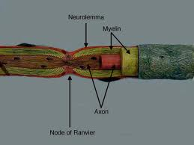

Slide 30
Myelinogenesis
Process of formation and deposition of myelin sheath around a nerve fiber is called myelinogenesis.
  In PNS
      Schwann cells
  In CNS
      Oligodendrocytes

Slide 31
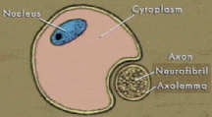
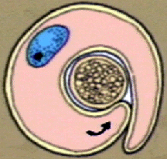
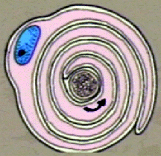
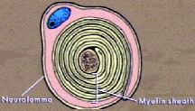
Myelinogenesis: PNS
The membrane of a Schwann cell first envelops the axon.
Then the Schwann cell rotates around the axon many times, laying down multiple layers of Schwann cell membrane containing the lipid substance sphingomyelin.

Slide 32
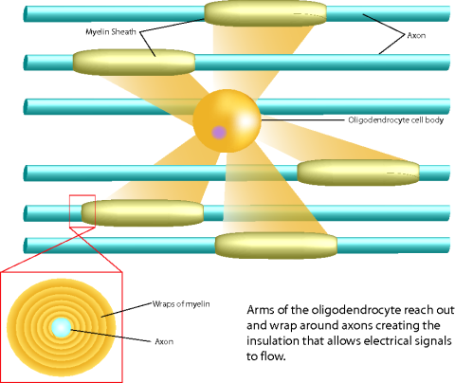
Myelinogenesis: CNS

Slide 33
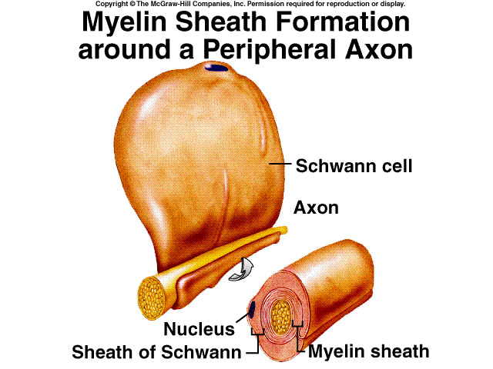
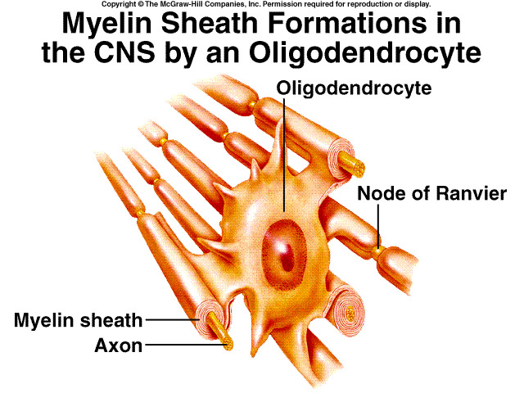
MYELINOGENESIS
Myelin sheath synthesis

Slide 34
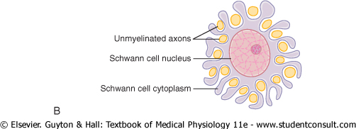
Myelinogenesis
Unmyelinated nerve fibers:
Partial wrapping of the membrane and cytoplasm of a Schwann cell.

Slide 35
Functions of myelin sheath
Due to high insulating property, it confines nerve impulse to individual fibers.
Facilitates faster conduction of nerve impulse from one node to another via saltatory conduction.

Slide 36
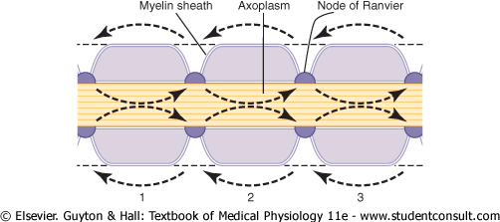
Node of Ranvier: Saltatory Conduction

Slide 37
Node of Ranvier: Saltatory Conduction
Flow of electrical current along a myelinated axon from node to node
  Importance
    Increases velocity of nerve transmission
    Conserves energy for axon
    Allow repolarization to occur with very little transfer of ions

Slide 38
Neurotrophines…….
Trophic support to the Neuron for growth and survival, protein in nature
Produced by gland the nerve innervates, muscles or astrocytes
Include: 1. Nerve Growth Factor(NGF): 6 subunits (2γ,2β,2α).
Promote the growth of sympathetic, sensory neuron and some of the cholinergic neuron in brain. Trk A
2. Brain derived neurotrophic factor(BDNF): peripheral
sensory neuron. Trk B
3. Neurotrophines 3 and 4/5- cutaneous mechano-receptors.
Trk C and B
Notes:
Trk A: Tropo-myosin Receptor Kinase A

Slide 39
NEUROGLIA
Neuronal Support Cells

Slide 40
NEUROGLIA
(Neuronal Support Cells)
  Neurons have a high metabolic rate and must be constantly supplied with oxygen and glucose or they will die.
Neuroglia (Glial cells) hold neurons in place, control their supply of chemicals, insulate them, and remove neurons that have died.

Slide 41
Neuroglia: Classification

Slide 42
Neuroglia: Classification
Microglia
Macroglia

Slide 43
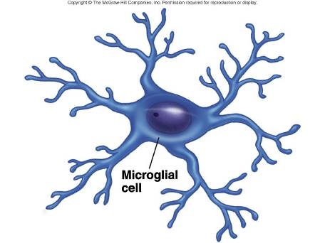
Neuroglia: Classification
Microglia- Specialized macrophage Scavanger cells that resemble tissue macrophages( PHAGOCYTOSIS)
Macroglia
  Oligodendrocytes
  Astrocytes
  Ependymal cells

Slide 44
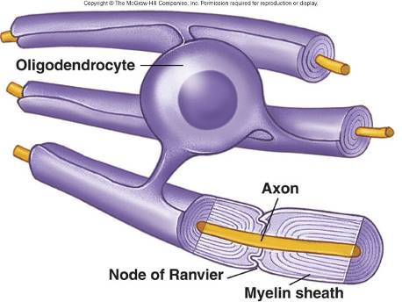
Neuroglia: Classification
Macroglia
  Oligodendrocytes
    Myelin formation
  ( Outside the central nervous system there are some other specialized support cells called Schwann cells )

Slide 45
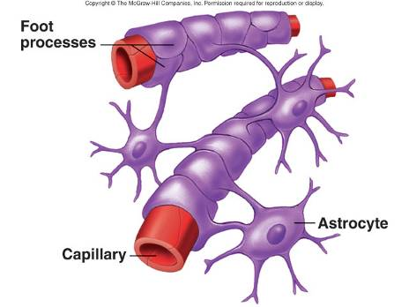
Neuroglia: Classification
  Astrocytes
    Fibrous
      Primarily in white matter
    Protoplasmic
      Gray matter
Astrocyte processes surround blood vessels and capillaries.
This is an important component of the blood-brain barrier.

Slide 46
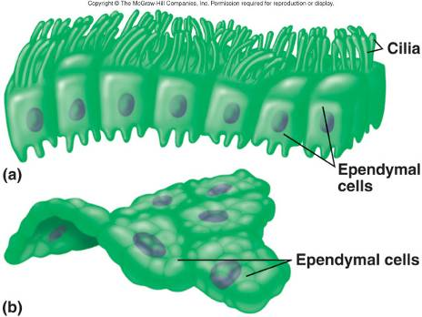
Neuroglia: Classification
  Ependymal cells
    Formation of choroid plexus, i.e. involved in formation of cerebro-spinal fluid.

Slide 47
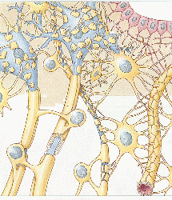
Supporting Cells: Neuroglia
Ependymal Cell
Microglia
Oligodendrocyte
Astrocyte

Slide 48
1. Material responsible for maintaining the integrity of the axon is
a. RNA b. DNA c. Neurotrophins d. lipids
2. Structural and functional unit of nervous system known as
a. Neuron b. sarcomere c. sarcolemma d. sarcoma
3. Gaps between two myelinations is known as
a. Nodes of Ranvier b. axon hillock c. dendrites d. tubules
Action potential in a nerve is starts from
a. axon hillock b. dendrites c. soma d. terminal buttons
5. The supporting cells of the nervous system is known as
a. glial cells b. sensory c. motor d. dead cells

Slide 49
1. Conduction in myelinated neuron is k/as
A. saltatory b. continoues c. segmental d. none
2. The supporting cells of the nervous system are k/as
a. Neoroglias b. sensory c.motor d. dead cells
3. Gaps b/w two myelinations is k/as
a. Nodes of ranvier b. axon hillock c. dendrites d. t tubules
4. Myelination in CNS is the function of
a. Astrocytes b. oligodendrocytes c. microglias
d none
5. BBB is formed by
a. Astrocytes b. oligodendrocytes c. microglias
d none

Slide 50
EBES
A sequence of cytoskeleton changes related to the formation of neurofibrillary tangles and neurophil threads
F. Braak, H. Braak, E. -M. Mandelkow. Acta Neuro- pathologica
Volume 87, Issue 6 , pp 554-567

Slide 51
A sequence of cytoskeleton changes related to the formation of neurofibrillary tangles and neuropil threads
REFERENCE | INETRVENTION | SUBJECT | RESULT | CONCLUSION
F. Braak, H. Braak, E. -M. Mandelkow. Acta Neuro- pathologica Volume 87, Issue 6 , pp 554-567 | For the purpose of correlation, the two methods are carried out one after the other on the same section. Layer pre-α in the transentorhinal/entorhinal region harbours nerve cells which are among the first nerve cells in the entire brain to show the development of neurofibrillary changes. | Frontal sections of the temporal lobe including the transentorhinal/entorhinal region, amygdala, and/or hippocampus from human adult brains are studied for cytoskeleton changes using immunostaining with the antibodies AT8 and Alz-50 and selective silver impregnation methods for neurofibrillary changes of the Alzheimer type. | Group 1 neurons present initial cytoskeleton changes in that the soma, dendrites, and axon are completely marked by granular AT8 immunoreactive material. These neurons appear quite normal and turn out to be devoid of argyrophilic material when observed in silverstained sections. CONTINUED….. | It is suggested that the altered tau protein shown by the antibody AT8 represents an early cytoskeleton change which eventually leads to the formation of argyrophilic neurofibrillary tangles and neuropil threads.

Slide 52
CONTINUED……
REF | INETRVENTION | SUB | RESULT | CON..
 | This presents the opportunity for study of both early events in the destruction of the cytoskeleton in individual neurons, and to relate changes which occur in the neuronal processes in the absence of alterations in their immediate surroundings to those happening in the soma. Immuno-reactions with the AT8 antibody in particular reveal a clear sequence of changes in the neuronal cytoskeleton. |  | Group 2 neurons show changes in the cellular processes. The terminal tuft of the apical dendrite is replaced by tortuous varicose fibres and coarse granules. The distal protions of the dendrites are curved and show appendages and thickened portions. Intensely homogeneously immunostained rod-like inclusions are encountered in these thickened portions and in the soma. A number of these rod-like inclusions are visible after silver staining, as well. Group 3 neurons display even more pronounced alterations of their distal-most dendritic portions. The intermediate dendritic parts lose Immunoreactivity, but the soma is homogeneously immunostained. Silver staining reveals in most of the distal dendritic parts neuropil threads, and in the soma a classic neurofibrillary tangle. Group 4 structures are marked by accumulations of coarse AT8-immunoreactive granules. Silver staining provides evidence that the fibrillary material has become an extraneuronal, “early” ghost tangle. Finally, group 5 structures present “late” ghost tangles in silver-stained sections but fail to demonstrate AT8 immunoreactivity.

Slide 53
EBES
EVIDENCE 1
Characterization of Ameboid Microglia Isolated from Developing Mammalian Brain
Dana Giulian and Timothy J. Baker The Journal of Neuroscience August 1986, 6(E): 2163-2178

Slide 54
Characterization of Ameboid Microglia Isolated from Developing Mammalian Brain
REFERENCE | INTERVENTION | SUBJECT | RESULT | CONCLUSION
Dana Giulian and Timothy J. Baker The Journal of Neuroscience August 1986, 6(E): 2163-2178 | Histochemical markers show that the microglial preparations are homogeneous (95 f 3%) and represent a 10% yield from starting cultures. | Ameboid microglia are isolated from the cerebral tissue of neonatal rat by selective cell adhesion to plastic. | Isolated ameboid microglia contain nonspecific esterase activity, the macrophage surface antigens MAC-l and MAC-3, and acetylated low-density lipoprotein receptors. Ameboid cells have functional properties similar to those of macrophages, including the ability to engulf 5 pm latex beads, to secrete Interleukin-1 (IGl) and to release superoxide anion. Unlike monocytes and adherent spleen cells, ameboid microglia do not show peroxidase activity by histochemical stain. Unlike resident peritoneal macrophages, ameboid microglia proliferate in vitro. Scanning electron microscopy shows that ameboid cells have short, spinous processes that can be distinguished from the ruffled surfaces of body macrophages. | suggest that ameboid microglia are a distinct class of mononuclear phagocytic cells.

Slide 55
EBES
EVIDENCE 2
Morphological consequences of myelination in the human retina
FitzGibbon T, Nestorovski Z
Experimental Eye Research. 1997; 65(6): 809-19

Slide 56
Morphological consequences of myelination in the human retina
REFERENCE | INTERVENTION | SUBJECT | RESULT | CONCLUSION
FitzGibbon T, Nestorovski Z Experimental Eye Research. 1997; 65(6): 809-19 | 3 retinae with intraretinal myelination and one normal retina were obtained post-mortem and prepared for electron microscopy. | Intraretinal myelination of ganglion cell axons occurs in about 1% of humans and when observed ophthalmoscopically, appears as a white or opaque patch within the fiber layer. Previous studies of myelinated retinal tissue have largely been conducted at the light microscopic level. | Within this population of myelinated axons were structures which were abnormal and there were obvious signs of axonal and myelin sheath degeneration within the myelinated patches. Outside thesemyelin patches the retina appeared normal without signs of degeneration indicating that post-mortem degeneration prior to fixation could not account for all of the degenerative changes observed. The lack of significant numbers of macrophages and lymphocytes indicated that there was no concomitant inflammatory process within the myelin patches. The myelination present within these eyes appeared to be due to the anomalous location of oligodendrocytes. | Both unmyelinated and myelinated axons had larger diameter than axons measured within normal areas of the retina or those within the optic nerve.

Slide 57
EBES
EVIDENCE 3
The Permeability of the Sodium Channel to Organic Cations in Myelinated Nerve
Hille B. The permeability of the sodium channel to organic cations in myelinated nerve. J Gen Physiol. 1971 Dec;58(6):599-619. PubMed

Slide 58
The Permeability of the Sodium Channel to Organic Cations in Myelinated Nerve
reference | problem | intervention | outcome | result
Hille B. The permeability of the sodium channel to organic cations in myelinated nerve. J Gen Physiol. 1971 Dec;58(6):599-619. PubMed | The relative permeability of sodium channels to 21 organic cations was studied in myelinated nerve fibers. | Ionic currents under voltage-clamp conditions were measured in sodium-free solutions containing the test cation. The measured reversal potential and the Goldman equation were used to calculate relative permeabilities. | The permeability sequence was: sodium ≈ hydroxylamine > hydrazine > ammonium ≈ formamidine ≈ guanidine ≈ hydroxyguanidine > aminoguanididine >> methylamine. The cations of the following compounds were not measurably permeant: N-methylhydroxylamine, methylhydrazine, methylamine, methylguanidine, acetamidine, dimethylamine, tetramethylammonium, tetraethylammonium, ethanolamine, choline, tris(hydroxymethyl)amino methane, imidazole, biguanide, and triaminoguanidine. Thus methyl and methylene groups render cations impermeant. | The results can be explained on geometrical grounds by assuming that the sodium channel is an oxygen-lined pore about 3 A by 5 A in cross-section. One pair of oxygens is assumed to be an ionized carboxylic acid. Methyl and amino groups are wider than the 3 A width of the channel. Nevertheless, cations containing amino groups can slide through the channel by making hydrogen bonds to the oxygens. However, methyl groups, being unable to form hydrogen bonds, are too wide to pass through.

