Slide 1
INTERSTITISL LUNG DISEASE
DR. Bhupendra Wala

Slide 2
INTRODUCTION
The interstitial lung diseases (ILDs) are a group of over 200 disease entities which affect the lung interstitium with variable degree of pulmonary fibrosis and share similar clinical, radiological and physiological manifestations.

Slide 3
PULMONARY INTERSTITIAL
The interstitium refers to the tissue of the alveolar wall between the capillary endothelium and the alveolar epithelium
This region includes a variety of cell types (fibroblasts, myofibroblasts, and macrophages) and matrix components (collagens, elastin, and proteoglycans).

Slide 4
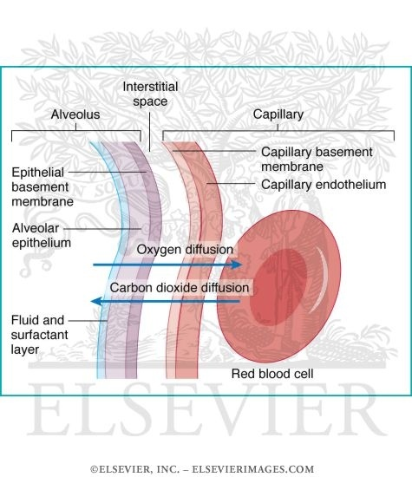
ANATOMY

Slide 5
DEFINITION
Interstitial lung diseases are a group of pulmonary disorders characterized by:
1. Radio logically diffused infiltrates.
2. Histologically by distortion of the gas exchanging units.
3. Physiologically by restriction of lung volumes and impaired oxygenation.

Slide 6
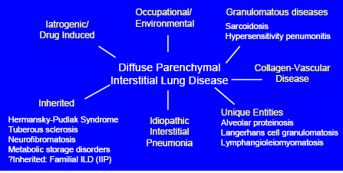

Slide 7
ETIOLOGY
ILD of known cause or association
Environmental (eg. bird,pet exposure)
Occupational (eg. asbestos, silica, berillium)
Drugs (eg. Amiodarone, methotrexate)
Radiation
connective tissue diseases
(eg. rheumatoid arthritis, scleroderma, SLE)
ILD of unknown cause
Idiopathic interstitial pneumonias (IIP)
Granulomatous ILD
sarcoidosis
hypersensitivity pneumonitis
Other forms of ILD
lymphangioleiomyomatosis
pulmonary Langerhans cell histiocytosis

Slide 8
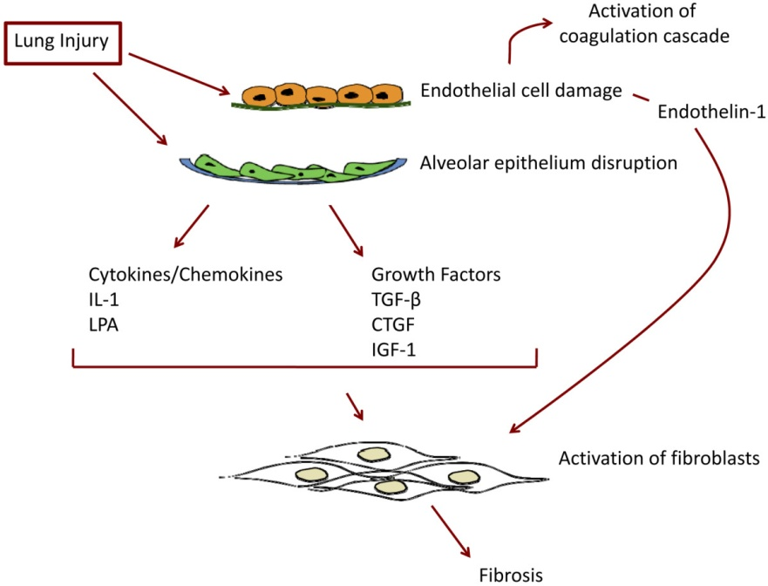
PATHOGENESIS

Slide 9
PATHOPHYSIOLOGY
Impaired gas exchange
Decreased lung capacity
Respiratory failure

Slide 10
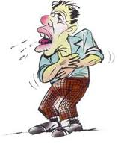
PULMONARY SYMPTOMS
Dyspnea
Cough
Wheezing
Chest pain
Hemoptysis
Fever

Slide 11
EXTRA PULMONARY SYMPTOMS
Arthritis – Sarcoidosis and collagen vascular diseases
Ocular – Sarcoidosis, collagen vascular diseases
Skin and muscle – Polymyosistis, SLE
Sicca syndrome – Sarcoidosis, Sjogrens and CVD
GERD – Scleroderma
Lower GI symptoms – Inflammatory bowel disease
Recurrent sinusitis – Wegners granulomatosis
Neurological symptoms – Sarcoidosis, Vasculitis
Epilepsy & mental retardation – Tuberous sclerosis
Diabetes inspidus – Sarcoidosis, PLCH

Slide 12
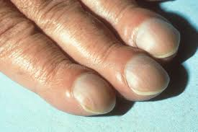
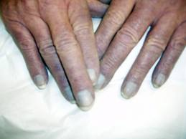
PULMONARY SIGNS
Crackles (dry, velcro , end inspiratory)
Inspiratory squeaks
Clubbing
Cor pulmonale
Cyanosis

Slide 13
EXTRA PULMONARY SIGNS
Skin abnormalities (Maculopapular skin rashes, Erythema nodosum,Subcutaneous nodules)
Arthratis
Uveitis, scleritis
lymphadenopathy,
Hepatosplenomegaly
Neurological deficit

Slide 14

DIAGNOSIS
Patient’s history and examination
Laboratory evaluation
Radiograph
Lung function test
Brochoalveolar lavage
Transbronchial biopsy
Open lung biopsy
Biopsy of extrathoracic tissues

Slide 15

HISTORY AND EXAMINATION
HISTORY
Age
Sex
Smoking
Exposure
Occupation
Drug
Family
PHYSICAL EXAMINATION

Slide 16
LABORATORY EVALUATION
Peripheral eosinophilia > 10%
- Chung-Strauss syndrome
Abnormal renal function:
- Pulmonary-renal syndromes
Precipitating antibodies to specific antigens: markers of exposure sensatization
ANCA/Anti-GBM
RF/ANA/Anti-DNA

Slide 17
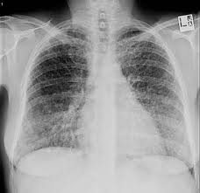
RADIOGRAPH
Reticonodular pattern
Reticular
Nodular
Mixed (alveolar filling + interstitial markings

Slide 18
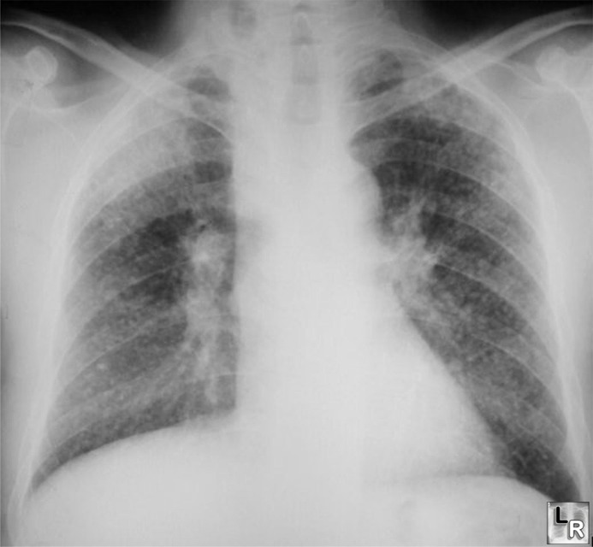
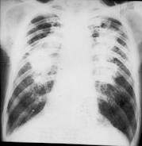
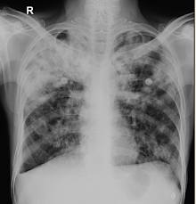
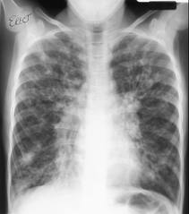

Slide 19
HRCT
High resolution computed tomography has a greater diagnostic accuracy than chest X-ray and is the imaging modality of choice in anyone with suspected ILD
ground glass attenuation
lung consolidation
reticular opacities
nodules
isolated lung cysts

Slide 20
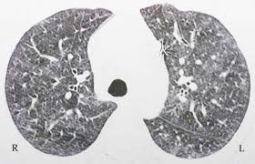
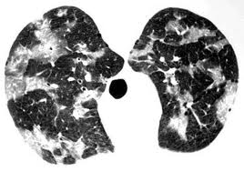
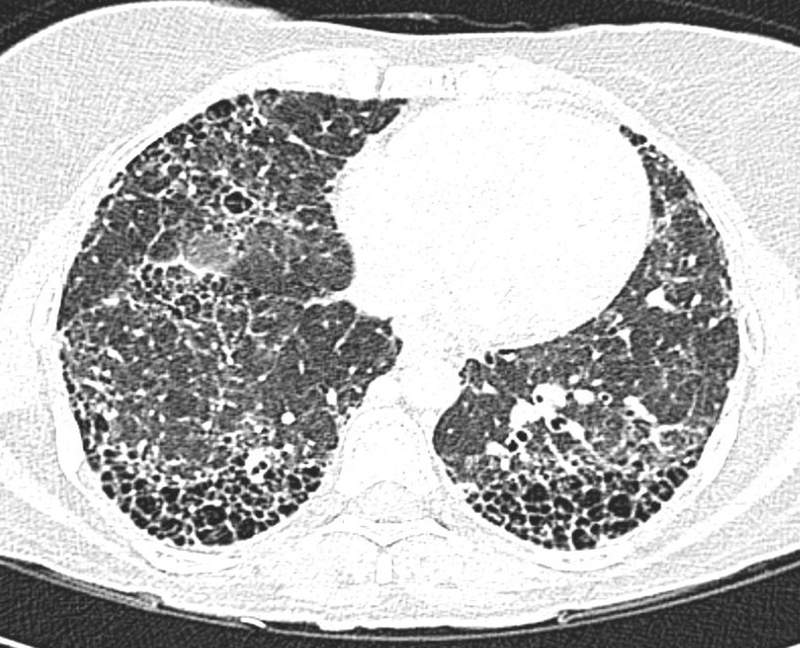
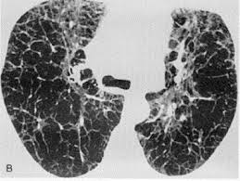

Slide 21
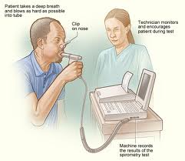
PULMONARY FUNCTION TEST
↓ Lung volumes (TLC, FRC,RV <80%)
↓ FEV1, FVC With Normal or ↑FEV1/FVC
Reduced diffusing capacity (DLCO)
Decreased oxygen tension

Slide 22
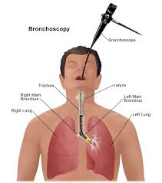
BRONCHOSCOPY
Endobronchial lesions:
- Sarcoidosis
- Wegener’s granulomatosis
Transbronchial bx:
- Sarcoidosis (75-80%)
- Lymphangitic carcinomatosis (80%)
Bronchoalveolar lavage
- Pulmonary alveolar proteinosis
- Good pasture’s syndrome

Slide 23
SURGICAL BIOPSY
Surgical lung biopsy is required to diagnose most types of ILD
Surgical lung biopsy is most commonly performed with minimally invasive techniques (video assisted thoracic surgery) but requires general anesthesia and mechanical ventilation during the procedure.

Slide 24
MANAGEMENT
Corticosteroid
Immunomodulatory
Azathioprine
Cyclophosphamide
antifibrotic agents
Pirfenidone
Interferon gamma
Bosentan

Slide 25
J Am Med. 2001 Mar;110(4):278-82
Steroids in idiopathic pulmonary fibrosis: a prospective assessment of adverse reactions, response to therapy, and survival
Flaherty KR, Toews GB, Lynch JP 3rd, Kazerooni EA, Gross BH, Strawderman RL, Hariharan K, Flint A, Martinez FJ. | Steroids in idiopathic pulmonary fibrosis: a prospective assessment of adverse reactions, response to therapy, and survival (Oxford Centre for Evidence-Based Medicine 2011 Levels of Evidence) Level 3 | prospectively studied 41 patients with previously untreated, biopsy-proven IPF. Patients were monitored monthly for steroid-related side effects, response to therapy at 3 months, and mortality. | Eleven (27%) patients were non responders, 11 (27%) were responders, and 19 (46%) remained stable. | Corticosteroid treatment for IPF is associated with substantial morbidity. Patients who remain stable or respond to corticosteroid therapy have better survival than those who fail to respond.

Slide 26
MANAGEMENT
Smoking cessation
oxygen therapy
gastro esophageal reflux disease
pulmonary hypertension
depression and anxiety
Pulmonary rehabilitation

Slide 27
THANK YOU

