Slide 1


Faculty : Dr. Kaushik Rana

Slide 2
Genetics in Clinical Neurology
In the modern practice of neurology, the use of genetics has become widespread.
The use of genetic information in the clinical evaluation of neurological disease has expanded dramatically over the past decade.

Slide 3
Genetic disorders Classification:
Single gene disorders
AD , AR, X-Linked Disorders.
2. Genetically complex disorders
Genetically heterogeneous
Interplay between multiple genes and environmental factors.

Slide 4
Genetic techniques
Single gene disorders
- Linkage analysis
- Exome sequencing
Genetically complex disorders
- Genome-wide association studies
- Candidate gene association studies

Slide 5
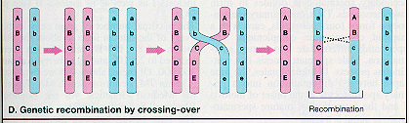
Linkage analysis

Slide 6
The logarithm of odds (lod) score is the most widely used and accepted measure of linkage.
LOD score is the ratio of the probability that the disease and marker loci are linked rather than unlinked.
Conclusive linkage requires a lod score of 3.3 in a single family.
Confirmation requires a lod score of 2 in further families.

Slide 7
Exome sequencing
Gene A
Gene B
Reference DNA
(exons+introns)
determine exome and design probes
probes

Slide 8
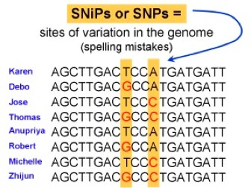

GWAS

Slide 9
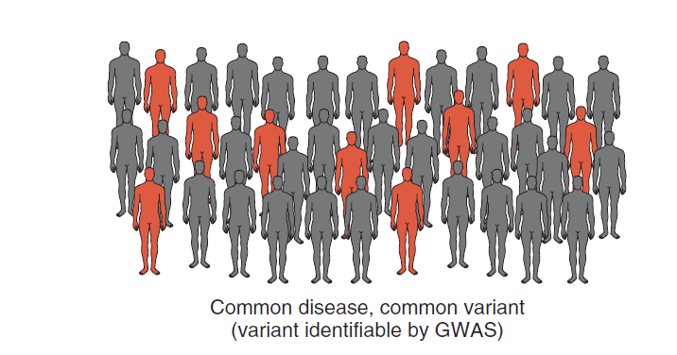

Slide 10
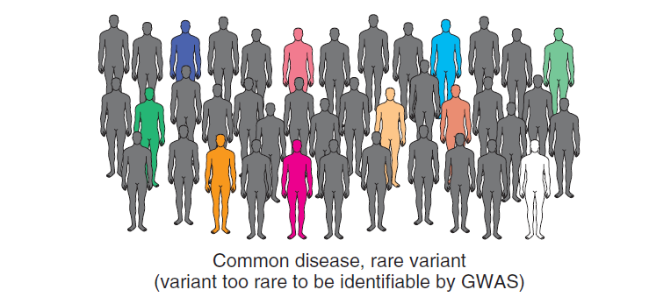

Slide 11
Essential Tremor may have
Monogenic inheritance
Genetically complex

Slide 12
What are problems of genetic studies of ET due to ?
Small sample sizes
Lack of biomarkers
High phenocopy rate
High locus heterogeneity in presumably monogenic ET.
Evidence for nonmendelian inheritance
Lack of stringent diagnostic criteria

Slide 13
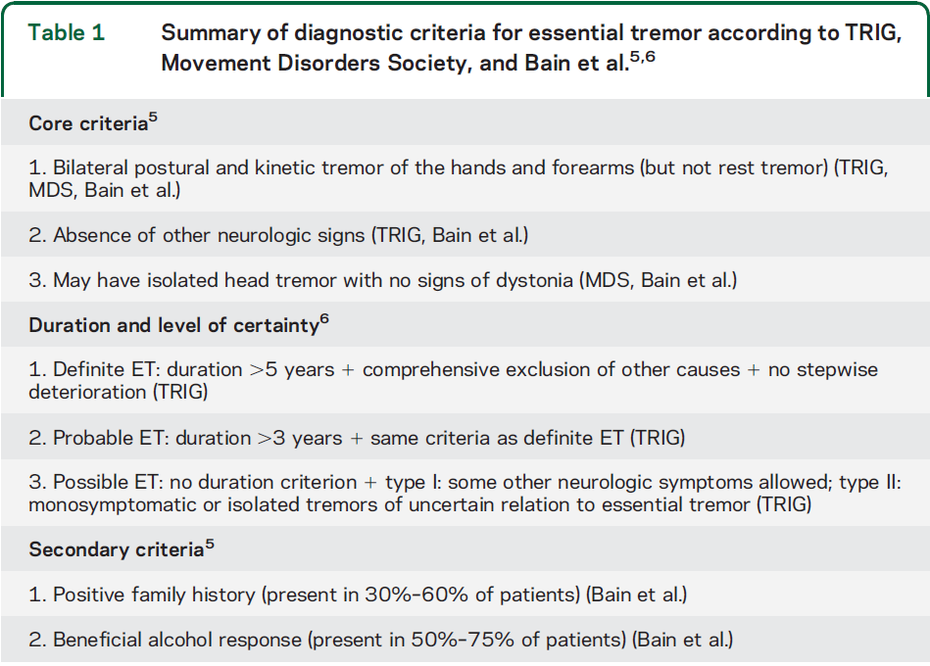

Slide 14
PubMed was searched with the key words.
About 70 studies were analysed.
Meta analyses was calculated when more than 3 studies assessed the same polymorphism.
Results of meta-analyses are expressed as odds ratio (OR ) and 95% confidence intervals (CIs) and shown as Forest plots.
This review aims to provide a review of the current knowledge concerning the genetics of ET.

Slide 15
ET divided genetically into :
Presumably monogenic ET
- Linkage analysis (ETM 1-3)
- Exome sequencing(FUS)
Genetically complex ET.
- Genome-wide association studies (LINGO1 and SLC1A2)
- Candidate gene association studies (Various genes)

Slide 16
ET divided genetically into :
Presumably monogenic ET
- Linkage analysis (ETM 1-3)
- Exome sequencing(FUS)
Genetically complex ET.
- Genome-wide association studies (LINGO1 and SLC1A2)
- Candidate gene association studies (Various genes)

Slide 17
Presumably monogenic ET, 3 loci has been mapped:
ETM 1 (3q13)
ETM 2 (2p24)
ETM 3 (6p23)

Slide 18
ETM 1
ETM1 was mapped to chromosome 3q13 in 16 small Icelandic families

Slide 19
Mapping of a familial essential tremor gene, FET1, to ch 3q13. Gulcher JR et al
Essential tremor (ET), the most common movement disorder in humans, appears to be inherited as an autosomal dominant trait in many families. The familial form is called familial essential tremor (FET), which seems similar to sporadic essential tremor. ET is a cause of substantial disability, particularly in the elderly. The prevalence of Parkinson's disease and dystonia may be increased in families with ET, but other movement disorders are seldom encountered in these families. Here we report the results of a genome-wide scan for FET genes in 16 Icelandic families with 75 affected individuals, in whom FET was apparently inherited as a dominant trait. The scan, which was performed with a 10-cM framework map, revealed one locus on chromosome 3q13 to which FET mapped with a genome-wide significance when the data were analysed either parametrically, assuming an autosomal dominant model (lod score = 3.71), or non-parametrically (NPL Z score = 4.70, p < 6.4 x 10(-6).
Nat Genet. 1997 Sep;17(1):84-7.

Slide 20
Maximum lod score across all families is 3.71.
Maximum lod score obtained in a single family is 1.42.
Eight independent follow-up studies in 37 families with 2–19 affected individuals per family were not able to confirm this locus.

Slide 21
Table e-1: Linkage studies with presumably monogenic ET
e-1.1 Locus ETM1 Chromosome 3q13
Study | Ref. | Country | Nr. of Fam. | Nr. of Pat. | Locus prov. | Locus excl. | Remarks
Gulcher et al. 1997 | 1 | ISL | 16 | 2 - 9 | no | no | max. LOD in one family = 1.29
Illarioshkin et al. 2000 | 2 | TJK | 5 | 6/4/2/4/3 | no | yes, only family 1
Kovach et al. 2001 | 3 | USA | 1 | 16 | no | yes
Abbruzzese et al. 2001 | 4 | ITA | 6 | NS | no | NS | "negative results for all recombination "
Ma et al. 2006 | 5 | USA | 4 | 19/14/13/19 | no | no | all LODs negative
Lorenz et al. 2008 | 6 | FRA/GER | 15 | 3-15 | no | yes, in 5 families | locus excluded
Aridon et al. 2008 | 7 | ITA | 1 | 9 | no | yes
Novelletto et al. 2011 | 8 | ITA | 4 | 6/8/8/6 | no | no
Pasini et al. 2012 | 9 | ITA | 1 | 5 | no | Yes

Slide 22
DRD 3
A French group demonstrated DRD3 Ser9Gly(rs6280) polymorphism located in the ETM1 locus in 23 out of 30 French families.
Also showed a weak association of the same polymorphism with ET in a sample of 276 sporadic US American patients with ET.

Slide 23
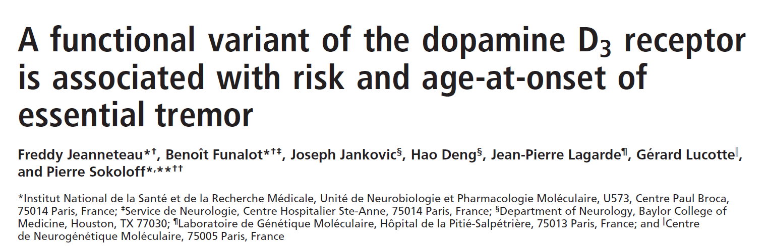
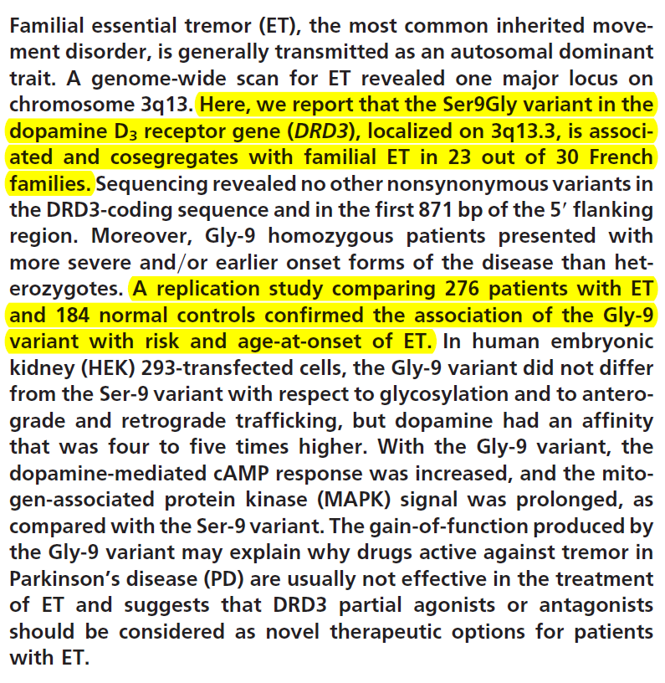
PNAS July 11, 2006 vol. 103 no. 28 10753–10758

Slide 24
6 Follow up replication studies were negative except for one
e-4.2.1.1 ETM1: Dopamine Receptor 3 (rs6280)
Study | Ref. | Poly. | Cou. | Ca. | Co. | CaMi | CaMa | CoMi | CoMa | p-val. | OR (95% CI) | Remarks
Jeanneteau et al. 2006 | 13 | rs6280 (Ser9Gly) | USA | 276 | 184 | 187 | 365 | 101 | 267 | 0.042 | 1.35 (1.00 - 1.83)
Tan et al. 2007 | 14 | rs6280 (Ser9Gly) | SNG | 163 | 192 | 106 | 220 | 127 | 257 | 0.936 | 0.98 (0.70 - 1.35)
Lorenz et al. 2008 | 6 | rs6280 (Ser9Gly) | FRA DEU DEN | 299 | 528 | 200 | 398 | 334 | 722 | 0.477 | 1.09 (0.87 - 1.35)
Vitale et al. 2008 | 40 | rs6280 (Ser9Gly) | ITA | 116 | 158 | 87 | 145 | 141 | 175 | 0.097 | 0.74(0.52-1.07)
Blair et al. 2008 | 15 | rs6280 (Ser9Gly) | USA | 237 | 272 | 179 | 295 | 215 | 329 | 0.606 | 0.93 (0.72 - 1.21)
Inashkina et al. 2008 | 41 | rs6280 (Ser9Gly) | LVA | 104 | 116 | 55 | 153 | 56 | 176 | 0.590 | 1.13 (0.72-1.78)
Garcia-Martin et al. 2009 | 42 | rs6280 (Ser9Gly) | ESP | 201 | 282 | 128 | 274 | 134 | 430 | 0.007 | 1.50 (1.12 - 2.02)

Slide 25
Out of 6 studies attempting replication between rs6280 and ET, only 1 yielded a significant p value, in metaanalysis all studies except the initial French study failed to reach significance (OR = 1.05, 95%
CI 0.95–1.16).

Slide 26
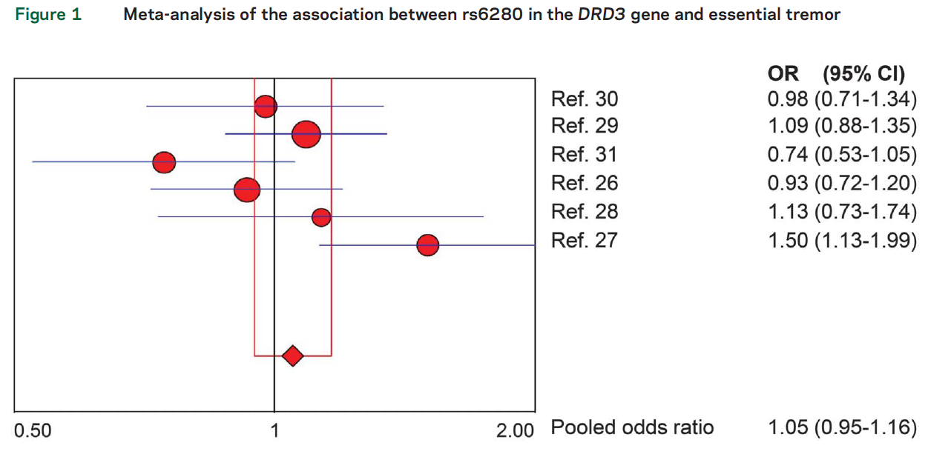

Slide 27
It is unlikely that ETM1 harbors a causative gene for monogenic ET or that the DRD3 polymorphism rs6280 is a major risk factor for ET.

Slide 28
ETM2
The ETM2 locus has been mapped to chromosome 2p24 in a very large Czech/American family with a conclusive maximum parametric lod score of 5.92

Slide 29
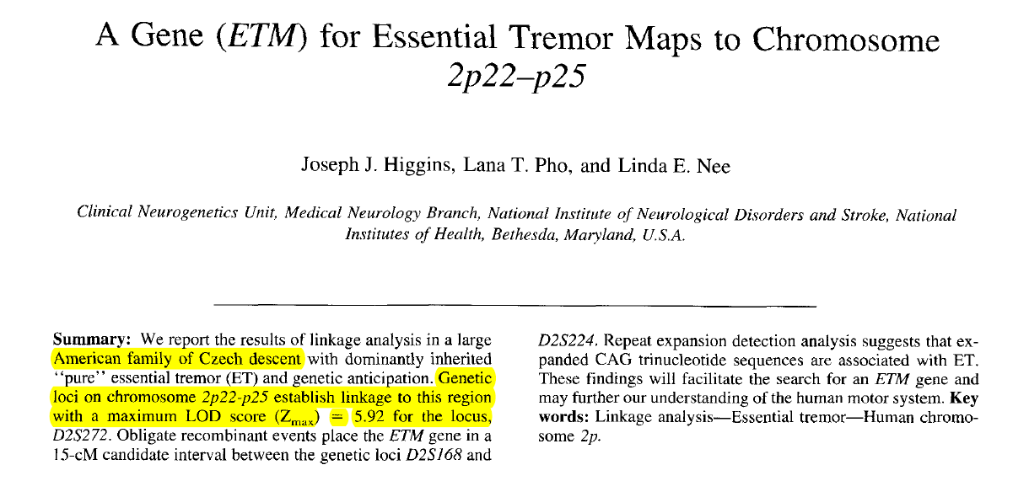
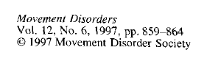

Slide 30
Eight follow-up analyses of 34 additional families did not confirm these results
e-1.2 Locus ETM2 Chromosome 2p24
Study | Ref. | Country | Nr. of Fam. | Nr. of Pat. | Locus prov. | Locus excl. | Remarks
Higgins et al. 1997 | 10 | USA | 18 | 4 | yes | NA | max. LOD = 5.92
Higgins et al. 1998 | 11 | USA | 14/7/4 | 3/3/2 | no | no | max. LOD = 1.34 in one family, one family reported previously (Higgins 1997) not included.
Kovach et al. 2001 | 3 | USA | 16 | 3 | no | no | max. LOD = 0.54
Abbruzzese et al. 2001 | 4 | ITA | NS | NS | no | NS | "negative results for all recombination values"
Ma et al. 2006 | 5 | USA | 19/14/13/19 | 2/2/3/3 | no | yes | max. LOD = -2.66
Lorenz et al. 2008 | 6 | FRA/GER | 3-15 | 1-3 | no | NS
Aridon et al. 2008 | 7 | ITA | 9 | 2 | no | (yes) | max. LOD D2S220 = -1.70
Novelletto et al. 2011 | 8 | ITA | 6/8/8/6 | 3/2/2/2 | no | yes
Pasini et al. 2012 | 9 | ITA | 5 | 3 | no | yes | max. LOD = -3.2

Slide 31
The group that mapped the locus (2p24), described a genetic variant (Ala265Gly) in the hematopoetic lineage cell specific protein binding protein 3 (HS1BP3) that segregated with ET.
Out of two studies, one found association between the HS1BP3 variant and ET and one did not.
e-4.2.1.2 ETM2: HS1BP3 Ala265Gly (not in dbSNP)
Study | Ref. | Poly. | Cou. | Ca. | Co. | CaMi | CaMa | CoMi | CoMa | p-val. | OR (95% CI) | Remarks
Deng et al. 2005 | 43 | Ala265Gly | USA | 222 | 132 | 20 | 424 | 12 | 252 | 1.000 | 0.99 (0.45-2.19) | familial ET
Higgins et al. 2006 | 44 | Ala265Gly | USA | 73 | 304 | 12 | 134 | 0 | 608 | 0.000 | NA (because allele not present in controls) | “singletons representing dominantly inherited ET”

Slide 32
The ETM2 locus is based on a very robust linkage result in one large family and could well harbor a gene for monogenic ET.
However, it is unlikely that the Ala265Gly variant in the HS1BP3 gene is causative.

Slide 33
ETM3
This locus has been mapped to chromosome 6p23 in one large American family with a nonconclusive maximum lod score of 2.93.

Slide 34
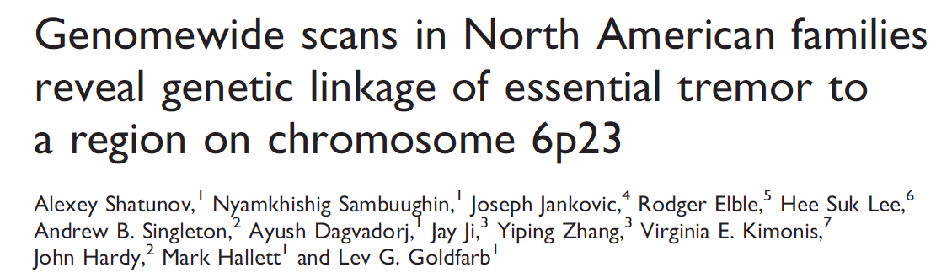
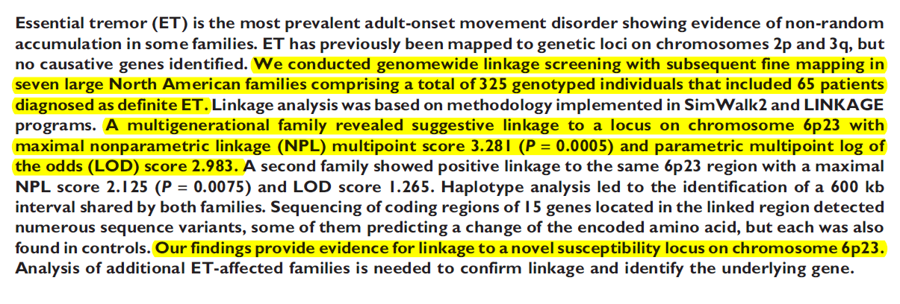


Slide 35
Follow-up studies examining 21 additional families with 3–15 affected individuals were not able to demonstrate linkage to this locus in any of the families.
e-1.3 Locus ETM3 Chromosome 6p23
Study | Ref. | Country | Nr. of Fam. | Nr. of Pat. | Locus p/c | Locus excl. | Remarks
Shatunov et al. 2008 | 12 | USA | 2 | 14/8 | no | no | max. parametric LOD = 2,93 but "affected only" analysis
Lorenz et al. 2008 | 6 | FRA/GER | 15 | 3-15 | no | NS
Aridon et al. 2008 | 7 | ITA | 1 | 9 | no | yes
Novelletto et al. 2011 | 8 | ITA | 4 | 6/8/8/6 | no | yes, in 2 families
Pasini et al. 2012 | 9 | ITA | 1 | 5 | no | no | Max. LOD = -0.145 for D6S422, D6S289 = -2.700, D6S1678 = -2.882
ETM3 locus is a candidate with low priority.

Slide 36
ET divided genetically into :
Presumably monogenic ET
- Linkage analysis (ETM 1-3)
- Exome sequencing(FUS)
Genetically complex ET.
- Genome-wide association studies (LINGO1 and SLC1A2)
- Candidate gene association studies (Various genes)

Slide 37
Exome sequencing
Mutations in the fused in sarcoma (FUS) gene.
Canadian group identified a stop mutation (c.868C . T> P.) in the fused in sarcoma (FUS) gene resulting in nonsense-mediated decay of the mRNA, which segregated with ET in a large Franco-Canadian family.

Slide 38
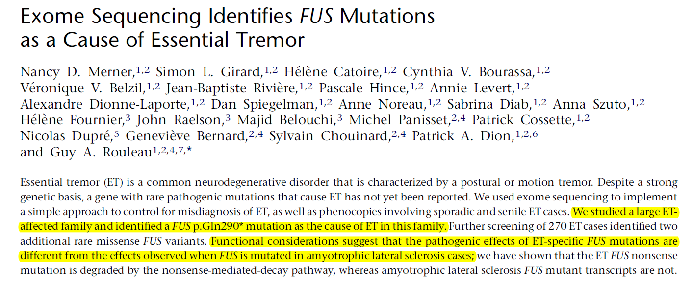

Slide 39
This study and 6 follow-up studies identified 4 further missense mutations in 1,164 patients.
Initial finding in the Canadian family is promising but needs confirmation in further large families

Slide 40
Genetically complex ET

Slide 41
ET divided genetically into :
Presumably monogenic ET
- Linkage analysis (ETM 1-3)
- Exome sequencing(FUS)
Genetically complex ET.
- Genome-wide association studies (LINGO1 and SLC1A2)
- Candidate gene association studies (Various genes)

Slide 42
GWAS are usually regarded as conclusive if they fulfill the following requirements:
2-stage design with a discovery stage and a replication stage.
(2) Achieving “genome-wide significance” in the discovery stage.
(3) Obtaining p values in the replication stage that remain significant after bonferroni correction.

Slide 43
Two GWAS for ET have been performed.
LINGO1. ( Leucine-rich repeat and Ig domain containing 1)
SLC1A2. (Solute carrier family)

Slide 44
Leucine-rich repeat and Ig domain containing 1(LINGO1)
The first GWAS by the Icelandic DeCode consortium showed association between ET and single nucleotide polymorphisms (SNPs) in LINGO1.

Slide 45
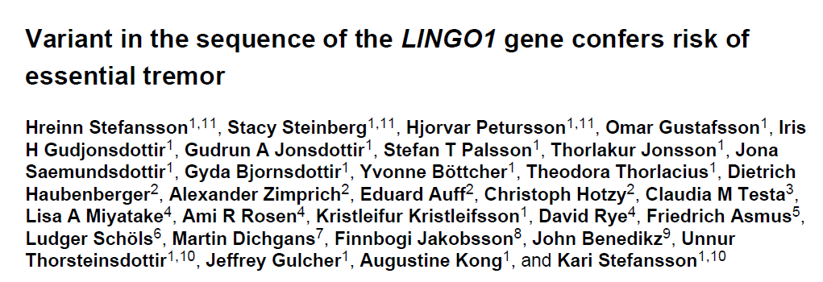
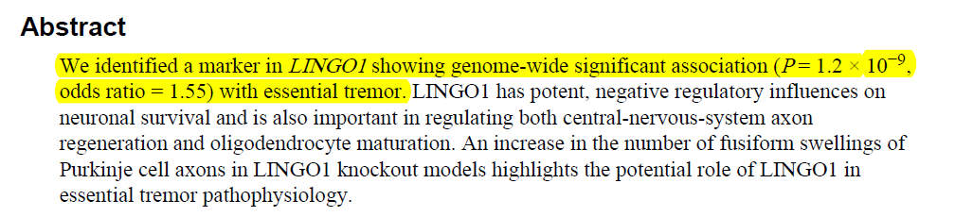
Nat Genet. 2009 March ; 41(3): 277–279

Slide 46

The SNP rs9652490 yielded a p value of in the Icelandic discovery cohort and failed to reach genome-wide significance.
In the replication sample, rs9652390 achieved a p value of 0.0010 and in the combined analysis of both stages genome-wide significance with a p value of
Ten replication studies have been published, all of them examining the lead SNP rs9652490, and 6 also the SNP rs11856808.

Slide 47
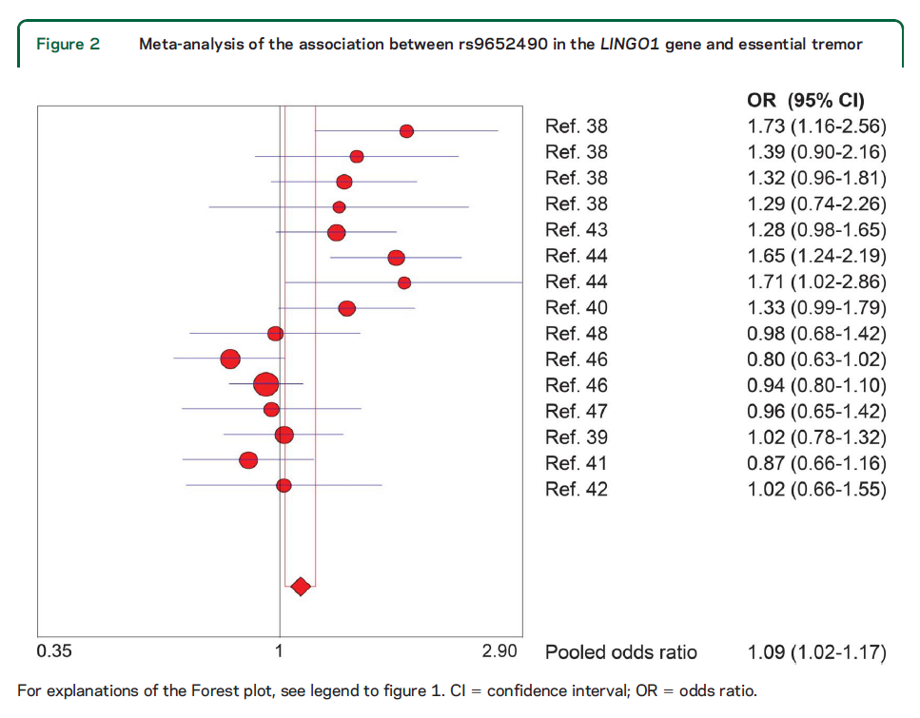

Slide 48
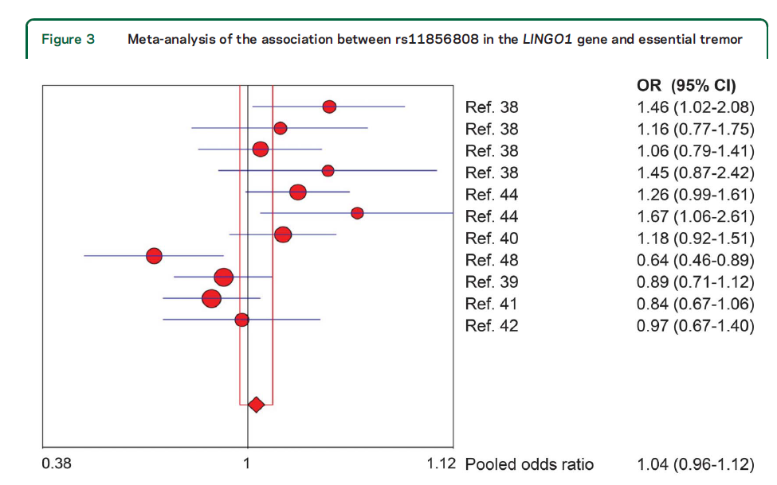

Slide 49
The SNP rs9652490 just achieves significance (OR 1.09, 95%CI 1.02–1.17) while rs11856808 does not (OR 1.04, 95% CI 0.96–1.12).
It appears possible that polymorphisms in the LINGO1 gene are a risk factor for ET.

Slide 50


SLC1A2 (solute carrier family 1)
Recently association between SNPs in the SLC1A2 gene and ET is reported .
The best SNP (rs3794087) failed to reach genome-wide significance in the discovery stage.
The analysis of the combined definite ET patients from both stages achieved genome-wide significance. (p = 3.44

Slide 51
To date, 3 replication studies have been published
e-4.1.2 Solute carrier family 1 member 2 (SLC1A2)
Study | Ref. | Poly. | Cou. | Ca. | Co. | CaMi | CaMa | CoMi | CoMa | p-val. | OR (95% CI) | Remarks
Thier et al. 2012 | 36 | rs3794087 | DEUAUT DEN | 410 | 919 | 235 | 585 | 395 | 1443 | 0.000 | 1.47 (1.21 - 1.78) | GWA discovery sample
Thier et al. 2012 | 36 | rs3794087 | DEUAUT DEN | 496 | 571 | 290 | 702 | 264 | 878 | 0.002 | 1.37 (1.13 - 1.68) | GWA replication sample
Tan et al. 2013 | 37 | rs3794087 | CHN | 357 | 1935 | 110 | 604 | 741 | 3129 | 0.018 | 0.77 (0.61 - 0.96) | Reported as association with the major allele
Yu et al. 2013 | 38 | rs3794087 | TWN | 273 | 269 | 123 | 423 | 94 | 444 | 0.040 | 1.37 (1.007-1.87)
Garcia-Martin et al. 2013 | 39 | rs3794087 | ESP | 202 | 308 | 87 | 317 | 154 | 462 | 0.228 | 0.82 (0.60-1.12)
The result of the meta-analysis is failed to achieve significance

Slide 52
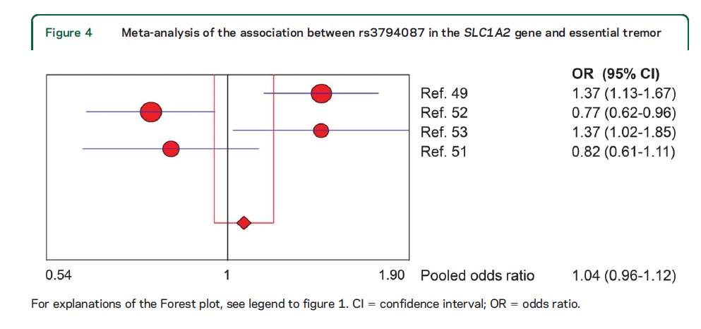

Slide 53
ET divided genetically into :
Presumably monogenic ET
- Linkage analysis (ETM 1-3)
- Exome sequencing(FUS)
Genetically complex ET.
- Genome-wide association studies (LINGO1 and SLC1A2)
- Candidate gene association studies (Various genes)

Slide 54
Candidate gene studies
As a whole, candidate gene mutation analysis and association studies have not been successful in the identification of genetic risk factors for complex disorders.

Slide 55
A number of genes were selected for analysis based on the unproven assumption of a pathogenetic overlap between ET and PD
SNCA
Parkin
LRRK2
MAPT
GBA
None of the candidate gene association studies showed a convincing positive result

Slide 56
Parkin
Study | Ref. | Poly. | Cou. | Ca. | Co. | CaMi | CaMa | CoMi | CoMa | p-val. | OR (95% CI) | Remarks
Pigullo et al. 2004 | 54 | NA | ITA | 110 | none | NA | NA | NA | NA | NA | NA | No putatively causal mutations in Parkin in ET patients.
Alpha-Synuclein (SNCA)
Study | Ref. | Poly. | Cou. | Ca. | Co. | CaMi | CaMa | CoMi | CoMa | p-val. | OR (95% CI) | Remarks
Tan et al. 2000 | 49 | NACP-Rep1 | USA | 46 | 100 | NA | NA | NA | NA | NA | NA | Association between NACP-Rep1 length and ET .
Pigullo et al. 2003 | 50 | NACP-Rep1 and 5 SNPs | ITA | 106 | 90 | NA | NA | NA | NA | NA | NA | NACP-Rep1 and five SNPs not associated with ET.
Ross et al. 2011 | 51 | 20SNPs | USA | 661 | 1316 | NA | NA | NA | NA | NA | NA | No association between 20 SNPs in the SNCA gene and ET

Slide 57
Leucine rich repeat kinase 2 (LRRK2)
Study | Ref. | Poly. | Cou. | Ca. | Co. | CaMi | CaMa | CoMi | CoMa | p-val. | OR (95% CI) | Remarks
Deng et al. 2006 | 55 | G2019S, I2012T, I2020T | USA | 272 | None | NA | NA | NA | NA | NA | NA | No mutations found.
Tan et al. 2008 | 56 | G2385R | SNG | 172 | 247 | NA | NA | NA | NA | NA | NA | Found in 4% of ET and 2,9% of control individuals: no association with ET.
Vitale et al. 2009 | 57 | DNA seq. of Exon 41 | ITA | 116 | None | NA | NA | NA | NA | NA | NA | Sequencing of LRRK2 exon 41. No novel or known mutations detected.
Clark et al. 2010 | 58 | See remarks | USA | 275 | 289 | NA | NA | NA | NA | NA | NA | No association with ET. G2019S, I2020T, R1441C, Y1699C, L1114L, I1122V + 19 additional SNPs
Glucocerebrosidase gene (GBA)
Study | Ref. | Poly. | Cou. | Ca. | Co. | CaMi | CaMa | CoMi | CoMa | p-val. | OR (95% CI) | Remarks
Sun et al. 2012 | 59 | rs35095275 (L444P) | CHN | 109 | none | NA | NA | NA | NA | NA | NA | No mutation L444P found in ET patients.
Clark et al. 2010 | 58 | DNA seq. of GBA | USA | 93 | 62 | NA | NA | NA | NA | NA | NA | No association of GBA mutations with ET (Ashkenazim)

Slide 58
Due to finding of anticipation in some families with ET, gene which is in other diseases often associated with repeat expansions :
FMR1
C9orf72
ATX2
MJD1
None of the candidate gene association studies showed a convincing positive result.

Slide 59
Fragile X mental retardation protein (FMR1)
Study | Ref. | Poly. | Cou. | Ca. | Co. | CaMi | CaMa | CoMi | CoMa | p-val. | OR (95% CI) | Remarks
Tan et al. 2004 | 60 | FMR1 rep. | SNG | 167 | 200 | NA | NA | NA | NA | NA | NA | FMR1 not expanded to premutation/mutation alleles in ET.
Deng et al. 2004 | 61 | FMR1 rep. | USA | 196 | none | NA | NA | NA | NA | NA | NA | FMR1 not expanded to premutation/mutation alleles in ET.
Garcia Arocena et al. 2004 | 62 | FMR1 rep. | USA | 81 | none | NA | NA | NA | NA | NA | NA | FMR1 not expanded to premutation/mutation alleles in ET.
C9 open reading frame 72 (C9orf72, causative gene for ALS, FTD)
Study | Ref. | Poly. | Cou. | Ca. | Co. | CaMi | CaMa | CoMi | CoMa | p-val. | OR (95% CI) | Remarks
Dejesus-Hernandez et al. 2012 | 63 | C9orf72 (GGGGCC) | USA | 106 | 1356 | NA | NA | NA | NA | NA | NA | (GGGGCC) C9orf72 rep. not altered in ET

Slide 60
"Ataxin 2 (ATX2); Machado-Joseph-disease 1 (MJD1, causative gene SCA3)"
Study | Ref. | Poly. | Cou. | Ca. | Co. | CaMi | CaMa | CoMi | CoMa | p-val. | OR (95% CI) | Remarks
Tan et al. 2007 | 64 | ATX2, MJD1 CAG | SNG | 177 | none | NA | NA | NA | NA | NA | NA | One ET patient with 59 CAG repeats in the MJD1 gene.
CAG expansion (general: repeat expansion detection = RED method)
Study | Ref. | Poly. | Cou. | Ca. | Co. | CaMi | CaMa | CoMi | CoMa | p-val. | OR (95% CI) | Remarks
Pigullo et al. 2001 | 65 | NA | ITA | 98 | none | NA | NA | NA | NA | NA | NA | """Repeat Expansion Detection"" (RED) detected no significantly expanded CAG in ET patients."

Slide 61
GABA receptors
Probably the functionally most interesting candidates are genes involved in GABAergic neurotransmission.
Multiple lines of evidence demonstrate involvement of the GABA system in ET.

Slide 62
GABA receptor a1 subunit knockout mice are a genetic model for ET
GABAergic deficit has been demonstrated in patients by PET
GABA receptor density is reduced in the dentate nucleus of patients with ET
Alcohol, which alleviates tremor in a large fraction of patients with ET, has a GABA-mimetic profile.

Slide 63
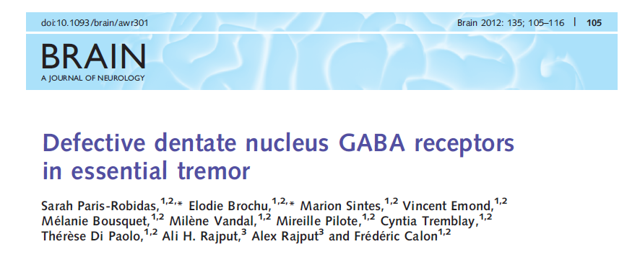
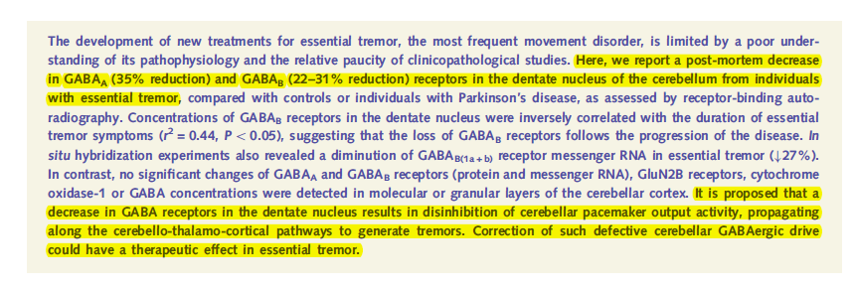

Slide 64
However 4 studies investigating a plethora of GABA-related genes were negative.

Slide 65
e-4.2.2 Gamma amino butyric acid (GABA) system
Study | Ref. | Poly. | Cou. | Ca. | Co. | CaMi | CaMa | CoMi | CoMa | p-val. | OR (95% CI) | Remarks
Deng et al. 2006 | 45 | Too many to report. | USA | 197 | 114 | NA | NA | NA | NA | NA | NA | Sequencing of GABRA1 gene. No mutations/polymorphisms associated with ET.
Garcia-Martin et al. 2011 | 46 | Too many to report. | ESP | 200 | 250 | NA | NA | NA | NA | NA | NA | Four missense SNPs in GABA-related genes. No association between SNPs and ET.
Garcia-Martin et al. 2011 | 47 | Too many to report. | ESP | 200 | 250 | NA | NA | NA | NA | NA | NA | Three missense SNPs in GABA-related genes. No association between SNPs and ET.
Thier et al. 2011 | 48 | Too many to report. | DEU | 503 | 818 | NA | NA | NA | NA | NA | NA | 240 tagging SNPs cov. GABA-related genes. 9 nominally significant in discovery sample but not replicated in verification sample.

Slide 66
Discussion

Slide 67
It was concluded that …
One of the loci for monogenic ET (ETM2) seems to be a promising
candidate region for future genetic studies.
Mutations in the FUS gene might be a rare cause of monogenic ET
2 risk genes (LINGO1, SLC1A2) that may or may not turn out to be
important in future studies.

Slide 68
Why many careful studies have not reproducibly uncovered more genes or genetic variants underlying ET ?
The most important weakness is that ET is clinically still poorly defined and that ET has to be diagnosed on clinical grounds alone.
The criteria are wide and partly controversial.
Therefore, a number of genetically distinct disorders might underlie the diagnosis.

Slide 69
THANK YOU

