Slide 1
Approach to febrile seizures
Faculty : Dr. Kaushik Rana

Slide 2
Definition
Types
Long term outcome
Febrile status
Treatment options

Slide 3
Definition
Fs seizures -age-related (6 months to 5 years) genetic susceptibility to epileptic fits, precipitated by fever without evidence of intracranial infection or other cause.
Children who have suffered a previous non febrile seizure are excluded.
Baram TZ, Shinnar S. Febrile seizures. San Diego, CA: Academic Press, 2002.
Shinnar S, Glauser TA. Febrile seizures. J Child Neurol 2002;17 Suppl 1:S44–52.
Notes:
sclerosis referred to the gross macroscopic features of a hard shrunken hippocampus, first
described by Bouchet and Cazauvielh in 1825,31

Slide 4
Onset is strictly between 6 months and 5 years of age (peak at 18–22 months).
Boys slightly (60%) predominate.
Prevalence - 3% of children, is higher in certain ethnic groups (e.g. 7% for Japanese).
The annual incidence rate is 460/100,000 children in the age group 0–4 years.
Notes:
By definition,

Slide 5
A rectal temperature level of at least 38°C more important than a rapid rise of fever. Berg AT. Are febrile seizures provoked by a rapid rise in temperature? Am J Dis Child 1993;147:1101–3.
The majority (78%) of febrile seizures occur within the first day of the onset of fever
The causes of fever
URTI (38%)
Otitis media (23%)
Pneumonia (15%)
Gastroenteritis (7%)
Roseola infantum (5%)
Non-infectious illness (12%).
Waruiru C, Appleton R. Febrile seizures: an update. Arch Dis Child 2004;89:751–6.20
Notes:
(others propose 38.5°C) probably reflecting their higher prevalence in children. , ; they may occur before the fever is noticed or late in the course of a febrile illness.

Slide 6
Types
Febrile seizures are categorised into simple and complex febrile seizures Baram TZ, Shinnar S. Febrile seizures. San Diego, CA: Academic Press, 2002.
Notes:
As a result of different prognostic implications

Slide 7
Simple febrile seizures
(70% of all)
Occur in neurologically healthy children aged between 6 months and 5 years
The seizures are brief (<15 min) and generalised
happen only once during a 24-hour period of a febrile illness.

Slide 8
Complex febrile seizures
Also known as ‘complicated’ or ‘atypical’
Prolonged (8%), lasting >15 min
Focal at onset (3.5–7%).
Repetitive (11–16%) in clusters of two or more within 24 hours
1/3 of all febrile seizures may have one, two or all three of these complicating factors. Verity CM, Golding J. Risk of epilepsy after febrile convulsions: a national cohort study [published erratum appears in BMJ 1992;304:147].
Post-ictal symptoms other than drowsiness are rare and should raise the suspicion of another diagnosis.
Notes:
or occur in children with perinatal psychomotor deficits

Slide 9
Semiology of febrile seizures
Seizures
(GTCSs) are by far the most common seizure type (80%).
Tonic (13%),
Atonic (3%)
Unilateral or focal onset tonic–clonic seizures (4%)
Notes:
Rarely there may be only staring accompanied by stiffness or floppiness, rhythmic jerking movements without prior stiffening, focal stiffness or jerking.
Febrile seizures with myoclonic jerks only (febrile myoclonic seizures) have a similar age of onset to other febrile seizures.
Onoe S, Nishigaki T. A clinical study of febrile myoclonus in children. Brain Dev 2004;26:321–25.

Slide 10
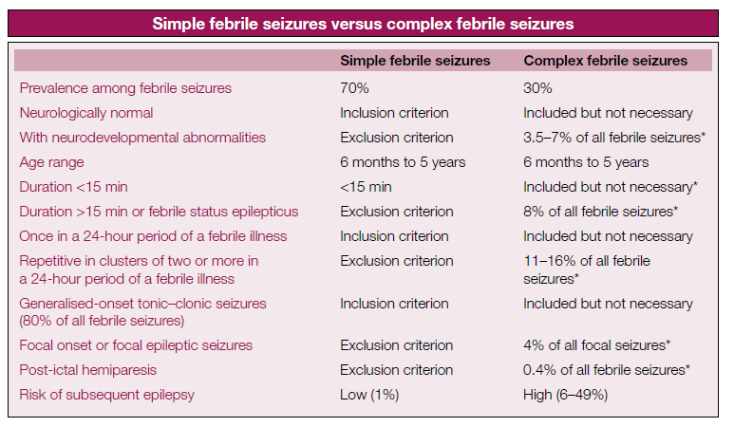

Slide 11
Risk factors of a first febrile seizure
The risk of a first febrile seizure is approximately 30% if a child has two or more of the following independent factors: Hauser WA, Leventhal JM. Predictors of recurrent febrile seizures: a metaanalytic review. J Pediatr 1990;116:329–37
First- or second-degree relative with febrile seizures
Delayed neonatal discharge of >28 days of age
Parental reports of slow development
Day-care attendance.
Higher temperature

Slide 12
Risk factors for recurrence
50% the children will have one (32%), two (15%) or more (3%) recurrent seizures after a first febrile seizure.
Recurrences are more likely
“Complex” first febrile seizures
F/H of Fs 1st degree Relatives
Persistent neurological abnormalities
Low temperature at the time of seizure
Short duration of fever before seizure
Younger age < 12- 18 months
The recurrence risk for those with none of the factors was 14%, with one factor 23%, with two 32%, with three 62%, and with all 76% Hauser WA, Leventhal JM. Predictors of recurrent febrile seizures: a metaanalytic review. J Pediatr 2001
Most recurrences are within 1 year.

Slide 13
Aetiology
Febrile seizures are often familial with a genetic predisposition .Hirose S, Mohney RP, Okada M, Kaneko S, Mitsudome A. The genetics of febrile seizures and related epilepsy syndromes. Brain Dev 2003
Children with siblings or parents who have a history of febrile sz are at a 4-5 fold higher risk than the general population.
Boys are more susceptible than girls.
Concordance rate is as high as 70% in monozygotic and 20% in dizygotic twins.
Notes:
The “afebrile-febrile seizure” scenario was also noted in a recent study of 39 children from Seattle, Washington.74

Slide 14
Aetiology
Evidence exists that febrile seizures have a strong genetic influence.
Polygenic in the majority
  Single febrile seizures
Single gene inheritance
  Families with recurrent febrile seizures
Autosomal dominant transmission in some families.
Digenic inheritance has been described (Baulac et al., 2001b).
  Affected individuals had two mutations
  unaffected had either one or no mutation.

Slide 15
Aetiology
Several mutations have been described, some in families with pure febrile seizures and others in families with both febrile seizures and epilepsy
No definitive gene or locus for common febrile seizures has yet been established.
In rare autosomal dominant kindreds of febrile seizures at least five different genetic loci were identified: 8q13-21,33 19p13.3 and 19q13.1,34,35 5q14-q15,36 6q22-q2437 and 21q22.38 Audenaert D, Van BC, De JP. Genes and loci involved in febrile seizures and related epilepsy syndromes. Hum Mutat 2006;27:391–401.
Notes:
, although this is probably polygenic. , which is characterised by heterogeneous phenotypes of focal and generalised epileptic seizures
suggesting locus heterogeneity.

Slide 16
Some genetic epilepsy syndromes are known to start with febrile seizures.
Dravet syndrome or severe myoclonic epilepsy of infancy
  due to a truncating mutation in the SCN1A sodium channel gene.
GEFS+
  autosomal dominant syndrome
  often due to a sodium channel mutation most often in the SCN1A or SCN1B gene (Escayg et al., 2001; Wallace et al., 2002).
  due to a mutation in the γ2 subunit of the γ-aminobutyric acid (GABA)-A receptor

Slide 17
Pathophysiology
Constitute a specific response to fever irrespective of cause.
Evidence - involvement of sodium channels, GABA A receptors
GABRG2 gene – has been recently shown to cause a temperature-dependent intracellular trafficking defect. Berkovic SF, Petrou S. Febrile seizures: traffic slows in the heat. Trends Mol Med 2006;12:343–4.
Kang JQ, Shen W, Macdonald RL. Why does fever trigger febrile seizures? GABAA receptor gamma2 subunit mutations associated with idiopathic generalized epilepsies have temperature-dependent trafficking deficiencies. J Neurosci 2006;26:2590–7.
Notes:
additional auxiliary proteins in the pathogenesis of FS+ and even in simple febrile seizures.

Slide 18
Pathophysiology
Circulating toxins and immune reaction products implicated
Relative lack of myelination in the immature brain and increased oxygen consumption during the febrile episode.
Immaturity of thermoregulatory mechanisms
Limited capacity to increase cellular energy metabolism at elevated temperatures
The central histaminergic neuronal system - involved in the inhibition of the seizures associated with febrile illnesses in childhood.
Children in whom the histamine levels in cerebrospinal fluid do not rise during febrile illnesses may be susceptible to febrile seizures. Kiviranta T, Tuomisto L, Airaksinen EM. Histamine in cerebrospinal fluid of children with febrile convulsions. Epilepsia 1995;36:276–80
Notes:
have been suggested as contributory factors.

Slide 19
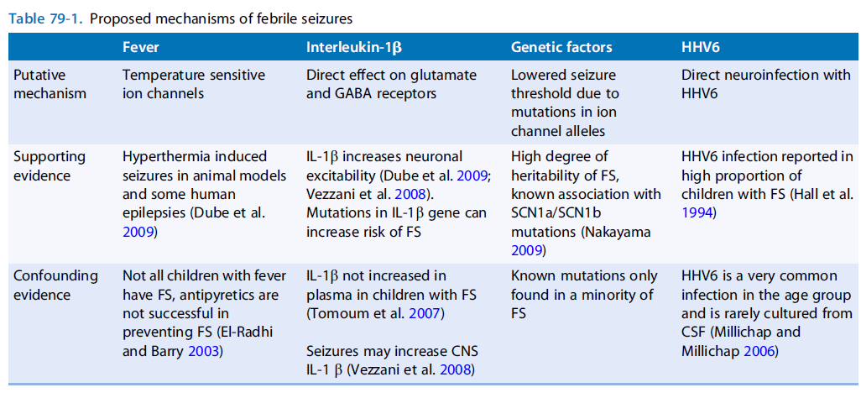

Slide 20
Long term outcome
Children FS - 6 fold excess (3%) of subsequent non-febrile seizures and epilepsy compared with controls. Nelson KB, Ellenberg JH. Predictors of epilepsy in children who have experienced febrile seizures. N Engl J Med 1976;295:1029–33.
Children with no risk factors have a 2.4% chance of developing non-febrile seizures by the age of 25 years compared with 1.4% for the general population
Notes:
Conversely,

Slide 21
Long term outcome
Non-febrile seizures--are of any type , generalised are more common than focal. Annegers JF, Hauser WA, Shirts SB, Kurland LT. Factors prognostic of unprovoked seizures after febrile convulsions. N Engl J Med1987;316:493–8.
Generalised non-febrile seizures - in children with frequent, brief, generalised febrile seizures and , positive family history of non-febrile seizures.

Slide 22
Long term outcome
Focal non-febrile seizures are likely in children with prolonged lateralised febrile seizures (20%)
Earlier onset and persisting neurological abnormalities.
The estimated risk of developing temporal lobe epilepsy (TLE) subsequent to prolonged febrile seizures is negligible, probably 1/75,000 children per year.
1/3rd of patients with hippocampal epilepsy have a previous history of prolonged febrile seizures Lewis DV. Losing neurons: selective vulnerability and mesial temporalsclerosis. Epilepsia 2005;46 Suppl 7:39–44.

Slide 23
Long term outcome
Febrile seizures precede the onset of various forms of epilepsies in 10–15% of children Camfield P, Camfield C, Gordon K, Dooley J. What types of epilepsy are preceded by febrile seizures? A population-based study of children.Dev Med Child Neurol 1994;36:887–92.
Myoclonic epilepsy in infancy, rolandic and Panayiotopoulos syndrome
Pre-existing developmental hippocampal abnormality - predispose individuals to having prolonged febrile seizures. Scott RC, King MD, Gadian DG, Neville BG, Connelly A. Prolonged febrile seizures are associated with hippocampal vasogenic edema and developmental changes. Epilepsia 2006;47:1493–8.

Slide 24
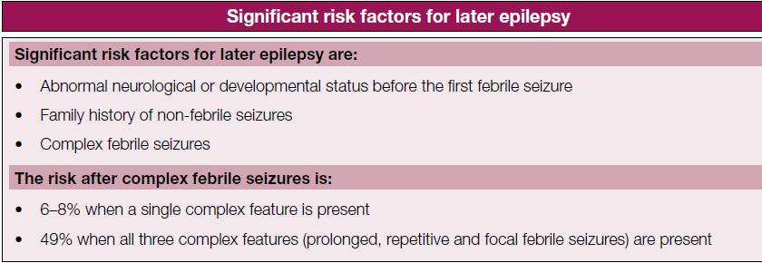

Slide 25

Epilepsy following febrile seizures
Simple febrile seizures
Generalized epilepsy
Complex febrile seizures
Partial epilepsies

Slide 26
Epilepsy following febrile seizures
Recent evidence in rats suggests that a prolonged febrile seizure may not be sufficient to cause later epilepsy by itself, but rather may permanently lower the seizure threshold, which in turn allows the expression of a second independent injury.

Slide 27
Intellectual and behavioural outcome
Children with Fs perform well - academic progress, intellect and behaviour.
Psychomotor development of children who were normal before the onset of febrile seizures remains normal. Ellenberg JH, Nelson KB. Febrile seizures and later intellectual performance. Arch Neurol 1978;35:17–21
If psychomotor deficits, learning difficulties and behavioural problems are found in children with Fs, these are not related to the seizures -overall developmental status of the child. Wallace SJ Febrile seizures. In: Wallace SJ, Farrell K, eds. Epilepsy in childen, pp 123–130. London: Arnold, 2004.

Slide 28
Febrile status epilepticus
Febrile status epilepticus of longer than 30 min is either one long-lasting seizure or a series of shorter seizures where the infant fails to regain consciousness inter-ictally.
Shinnar S, Hesdorffer DC, Nordli DR, Jr. et al. Phenomenology of prolonged febrile seizures: results of the FEBSTAT study. Neurology 2008;71:170–6.

Slide 29
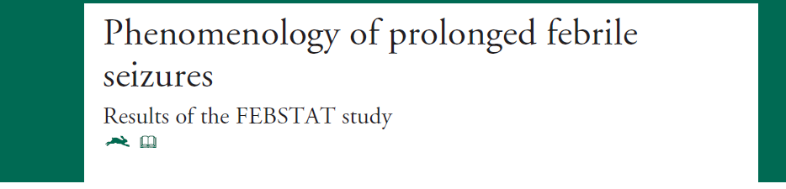

Notes:
For FEBSTAT, we adopted the older definition of SE as a seizure lasting 30 minutes rather that the newer proposals that redefine it as 5 minutes.26 This was done for several reasons. In terms of when to treat, 5 minutes is a good choice,13,26,27 but for studying consequences, which is the goal of this study, even 30 minutes may be too brief.1,6 This is especially true for FS, where a simple FS is defined as up to 10 or 15 minutes12,14 and animal data suggest that long-term effects only occur if seizures last 20 minutes.28-30

Slide 30
FEBSTAT study
ABSTRACT
Background: Febrile status epilepticus (FSE) has been associated with hippocampal injury and subsequent MTS and temporal lobe epilepsy. However, little is known about the semiology of FSE.
Methods: A prospective, multicenter study of the consequences of FSE included children, aged 1 month through 5 years, presenting with a febrile seizure lasting 30 minutes or more.
Procedures
Neurologic history and examination
MRI and EEG within 72 hours.
All information related to seizure semiology was reviewed by three epileptologists blinded to MRI and EEG results and to subsequent outcome.

Slide 31
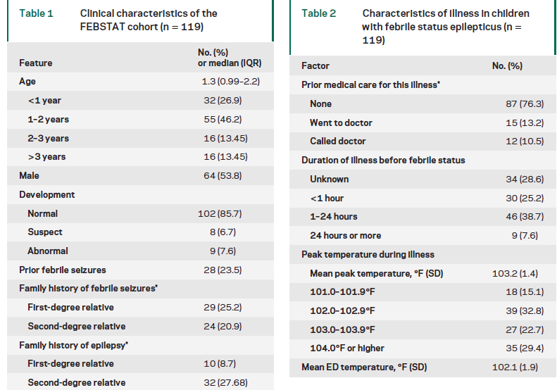

Slide 32
FEBSTAT study
Conclusions:
Febrile status epilepticus is usually focal and often not well recognized.
It occurs in very young children and is usually the first febrile seizure
Sz duration - that the longer a seizure continues, the less likely it is to spontaneously stop.

Slide 33
Epilepsy following febrile status epilepticus
Relative risk of unprovoked focal seizures following febrile status epilepticus is 0.065. Annegers JF et al. factors prognostic of unprovoked seizures after febrile convulsions.N Engl J Med. 1987; 316: 493-498
Retrospective studies demonstrate that adults with intractable TLE commonly have a history of prolonged or atypical FS.
Animal studies also indicate that prolonged febrile seizures may be associated with long term changes in hippocampal excitability.
Despite these observations, population based studies have failed to find a consistent causal link between FS and TLE.

Slide 34
Diagnostic procedures & DD
Correctly diagnose ‘febrile seizures’
To differentiate seizures with fever’
Occurring in the context of pre-existing epilepsy.
A high index of suspicion for acute bacterial meningitis in the child with febrile convulsive status epilepticus
Febrile seizures do not require any investigations if the diagnosis is certain.
Notes:
The main concern is to , such as acute symptomatic febrile seizures and , The classical symptoms and signs of acute bacterial meningitis may be absent in febrile convulsive status epilepticus, such as in meningo encephalitis, and metabolic or neurodegenerative diseases. Febrile seizures’ should be clearly distinguished from ‘seizures with fever’, which are acute symptomatic febrile seizures caused by pyogenic or viral meningitis, herpes simplex encephalitis, other acute encephalitides, cerebral palsy with inter current infection and metabolic or neurodegenerative disease with a seizure precipitated by fever. whether a first febrile seizure is a genuine febrile seizure or FS+ or the first manifestation of another genetically determined epileptic syndrome

Slide 35
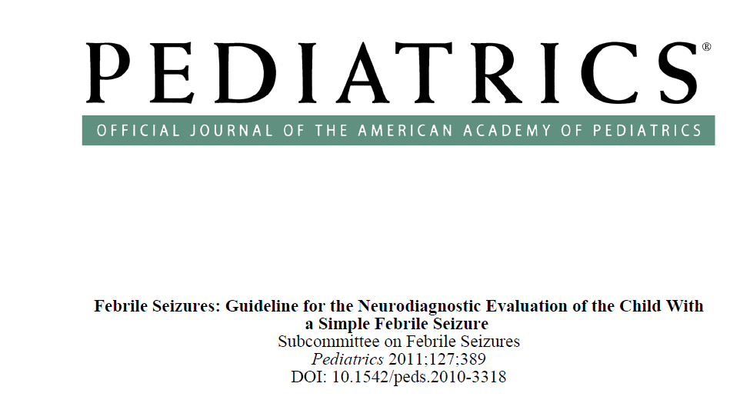

Slide 36
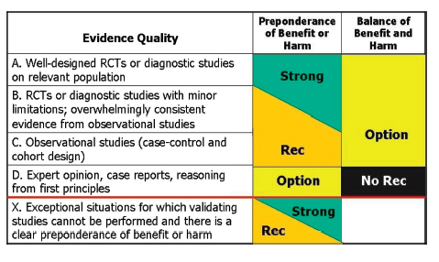
Notes:
Integrating evidence quality appraisal with an assessment of the anticipated balance between benefits
and harms if a policy is carried out leads to designation of a policy as a strong recommendation,
recommendation, option, or no recommendation. RCT indicates randomized controlled trial; Rec,
recommendation.

Slide 37
Diagnostic procedures (LP)
A lumbar puncture should be performed in any child who presents with a seizure and a fever and has meningeal signs and symptoms in any child whose history or examination suggests the presence of meningitis or intracranial infection.
Evidence level: B (evidence from observational studies)
Parents may not wish to have their child undergo a lumbar puncture, health care providers should explain that if meningitis is not diagnosed and treated, it could be fatal.
Policy level: Strong recommendation

Slide 38
Diagnostic procedures (LP)
In any infant between 6 and 12 months of age who presents with a seizure and fever, a lumbar puncture is an option when the child is considered deficient in type b (Hib) or Streptococcus pneumoniae immunizations because of an increased risk of bacterial meningitis.
Evidence level: D (expert opinion, case reports).
Policy level: Option.

Slide 39
Diagnostic procedures (LP)
A lumbar puncture is an option in the child who presents with a seizure and fever and is pretreated with antibiotics, because antibiotic treatment can mask the signs and symptoms of meningitis.
Evidence level: D (reasoning from clinical experience, case series)
Policy level: Option.

Slide 40
Diagnostic procedures (EEG)
An electroencephalogram (EEG) should not be performed in the evaluation of a neurologically healthy child with a simple febrile seizure
Evidence level: B (overwhelming evidence from observational studies).
Policy level: Strong recommendation
Single study in favour paroxysmal EEG was associated with a higher rate of afebrile seizures Kuturec M, Emoto SE, Sofijanov N, et al. Febrile seizures: is the EEG a useful predictor of recurrences? Clin Pediatr (Phila). 1997; 36(1):31–36
Notes:
The one special feature of the EEG and febrile seizures is hypnagogic spike-wave. This discharge consists of
short bursts of irregular high-voltage δ-waves with a few buried spikes as the child drifts off to sleep. It has a
peak expression at about 3 to 4 years of age—long after the peak age of febrile seizures—and apparently may be
seen in the majority of children with febrile seizures. 2,56,63 An EEG also does not have any predictive value for either the risk of recurrence of febrile seizures or the development of epilepsy

Slide 41
Diagnostic procedures (CBC, SE)
The following tests should not be performed routinely for the sole purpose of identifying the cause of a simple febrile seizure: measurement of serum electrolytes, calcium, phosphorus, magnesium, or blood glucose or complete blood cell count.
Evidence level: B evidence from observational studies
Policy level: Strong recommendation
Notes:
When fever is present, the decision regarding the need for laboratory testing should be directed toward identifying the source of the fever rather than as part of the routine evaluation of the seizure itself.

Slide 42
Diagnostic procedures (Neuro imaging)
Should not be performed in the routine evaluation of the child with a simple febrile seizure.
Evidence level: B - evidence from observational studies
MRI is associated with risks from required sedation and high cost.
Policy level: Strong recommendation.
Notes:
Extrapolation of data from the literature on the use of CT in neurologically healthy children who have generalized epilepsy has shown that clinically important intracranial structural abnormalities in this patient population are uncommon.

Slide 43
Meningitis considered and ruled out on clinical grounds with a lumbar puncture, particularly in children under 2 years of age with or without meningism
Features of being unwell for a few days
vomiting, drowsiness, petechiae, decreased feeding
complex febrile seizures and, febrile status epilepticus. Sadleir LG, Scheffer IE. Febrile seizures. BMJ 2007;334:307–11.

Slide 44
Management
Control of the seizures is paramount.
Long-lasting febrile convulsive seizures (>10 min) or status (>30 min) is a genuine paediatric emergency
Appropriate and vigorous treatment, similar to non-febrile convulsive status epilepticus
The child’s airway should be kept clear, oxygenation maintained, and intravenous or rectal benzodiazepines – to stop the seizure
Notes:
Early, usually parental, treatment is more effective than late emergency treatment. The parents of children with recurrent seizures should be advised to place the child on his or her side or stomach on a protected surface and administer a preparation of rectal benzodiazepine.

Slide 45
Admission
The decision to admit a patient with febrile seizure is mostly related to the source of the fever.
Children with a simple febrile seizure can be discharged from the ED after explanation and reassurance of the caregivers.
Indications for admission
1. Undifferentiated infection
2. Treatment of infections requiring hospitalization
3. Significant caregiver anxiety and concerns of coping with a recurrent seizure at home.

Slide 46
Management
Diazepam
intravenously at a dose of 0.2 –0.3 mg/ kg, or in rectal preparations at a dose of 0.5 mg/ kg
Disadvantage - short duration of action.
Lorazepam
intravenously (0.1 mg/kg) has a longer duration of action than diazepam
Notes:
, is often preferred in medical facilities, Rectal absorption of liquid diazepam is very rapid; it reaches the brain within minutes and has an almost intravenous efficacy. which is less likely to cause respiratory depression and probably

Slide 47
Management
Midazolam
Buccal (0.4–0.5 mg/kg) or intranasal (0.2 mg/kg) - superior efficacy to diazepam and is becoming the drug of choice for terminating prolonged seizures in the home Scott RC. Buccal midazolam as rescue therapy for acute seizures. Lancet Neurol 2005;4:592–3. ,Walker DM, Teach SJ. Update on the acute management of status epilepticus in children. Curr Opin Pediatr 2006;18:239–44.

Slide 48
ANTIPYRETICS in fsz
Treatment of the fever and, mainly, the underlying illness is important.
Antipyretic treatment during febrile illnesses does not reduce the recurrence rate
Recommended - to make the child more comfortable and avoid dehydration.
Paracetamol is more widely used than ibuprofen
Aspirin is avoided - development of Reye syndrome.

Slide 49
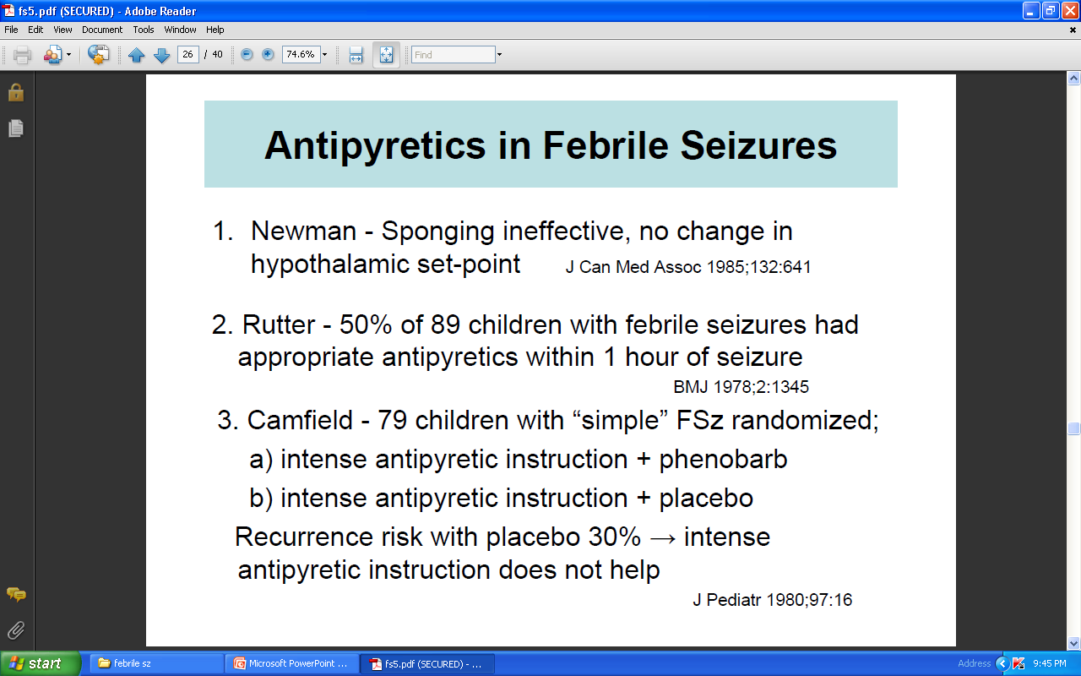
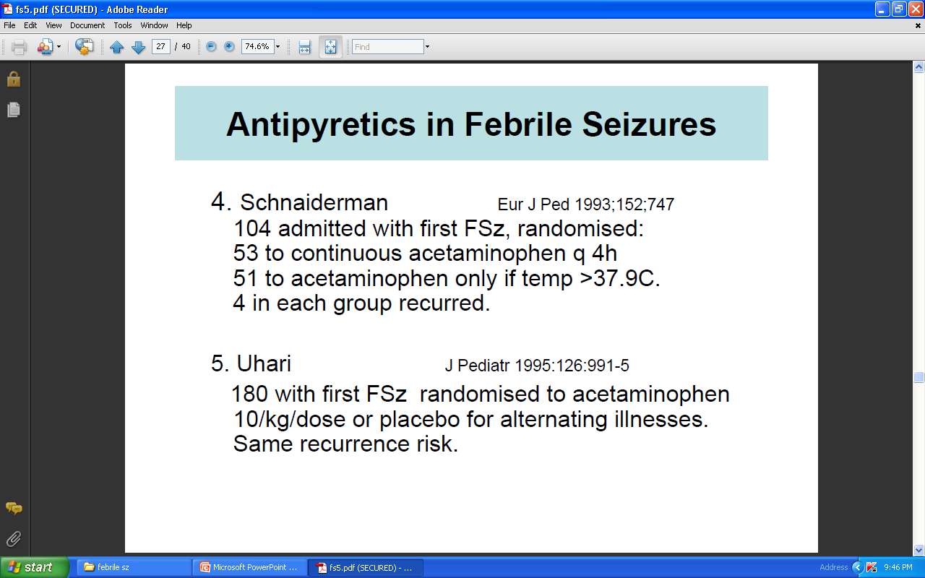
ANTIPYRETICS in fsz

Slide 50
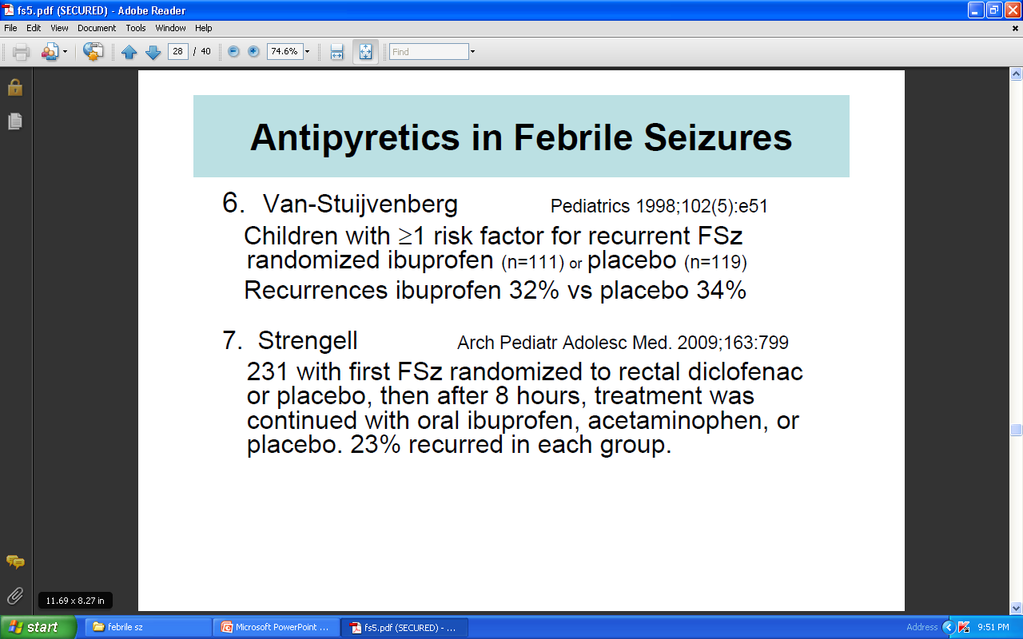

Slide 51
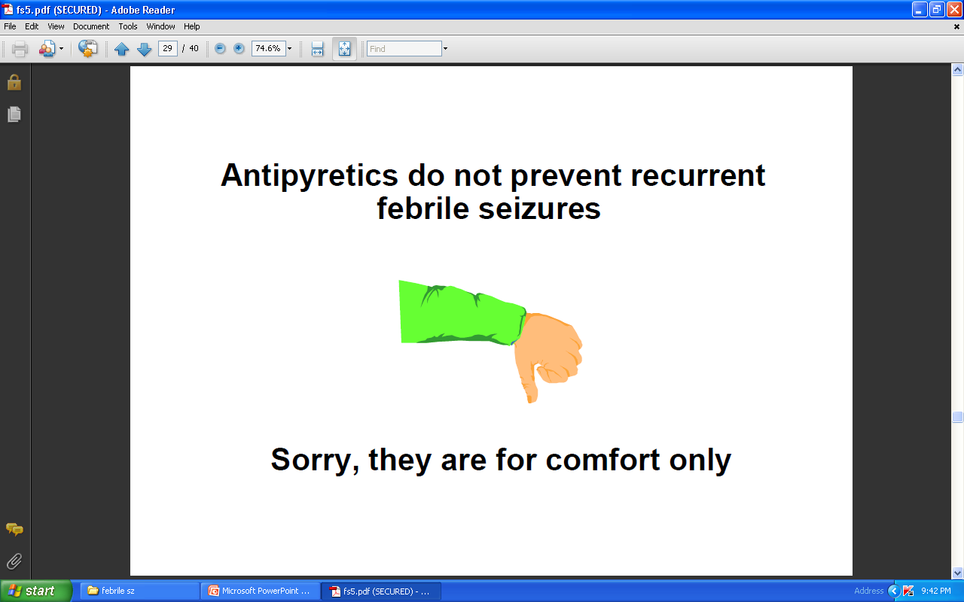

Slide 52
Prophylactic management
The best treatment for children with a first febrile seizure is education and reassurance for the parents. Camfield PR, Camfield CS. Management and treatment of febrile seizures. Curr Probl Pediatr 1997;27:6–14.
Simple febrile seizures do not need prophylactic treatment.
Prophylactic treatment - continuous or intermittent
Require not only a knowledge of the evidence but also an understanding of individual aspects of the patient, of his or her family, and of the social structure of which the child is a part.
.
Notes:
The risks are small and the potential side effects of drugs appear to outweigh the benefits, at the time of a febrile illness.

Slide 53
Prophylactic management
Prophylactic treatment indicated
if a child has one or, mainly, a combination of the following features
Complex febrile seizures
Neurological abnormalities
Age <1 year
Frequent recurrences.
Notes:
Neither of these may be needed for most children with febrile seizures, who almost invariably do well.

Slide 54
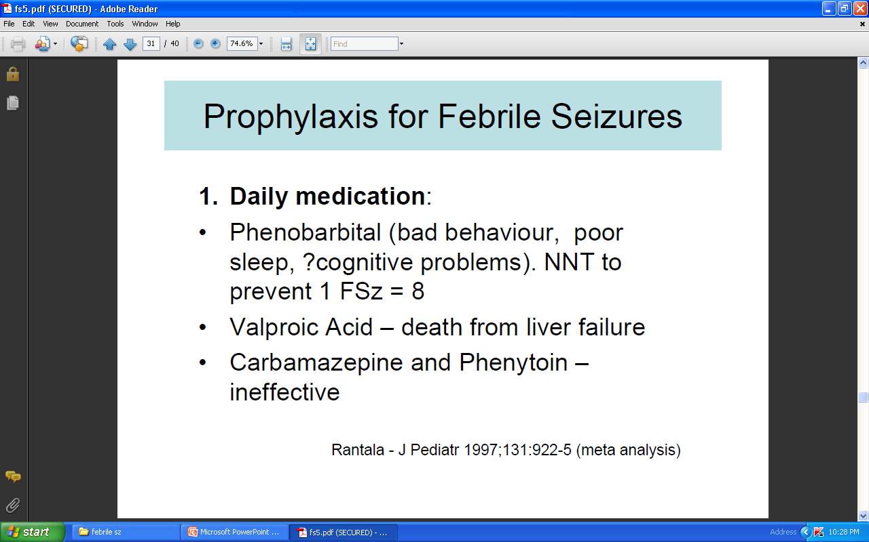
Continuous treatment

Slide 55
Continuous treatment
Only in cases in which onset of fever was so rapid as to prevent the mother or caregiver from noticing it
High temperature was only detected after the seizure.
Failure of intermittent prophylaxis
The initial febrile seizure progressed to status epilepticus.
Notes:
mainly, phenobarbital (which at a blood level of 15 μg/ml can effectively reduce the risk of recurrences) and, less often, valproate (fatal hepatitis in this age group or pancreatitis make valproate probably unacceptable). Carbamazepine and phenytoin are ineffective in the prevention of febrile seizures.

Slide 56
Intermittent treatment
At the time of a febrile illness, mainly with rectal or oral diazepam
There is a small reduction in the recurrence risk with a dose of diazepam 0.3 mg/kg,
1/3 rd of children - significant side effects of somnolence or ataxia.

Slide 57
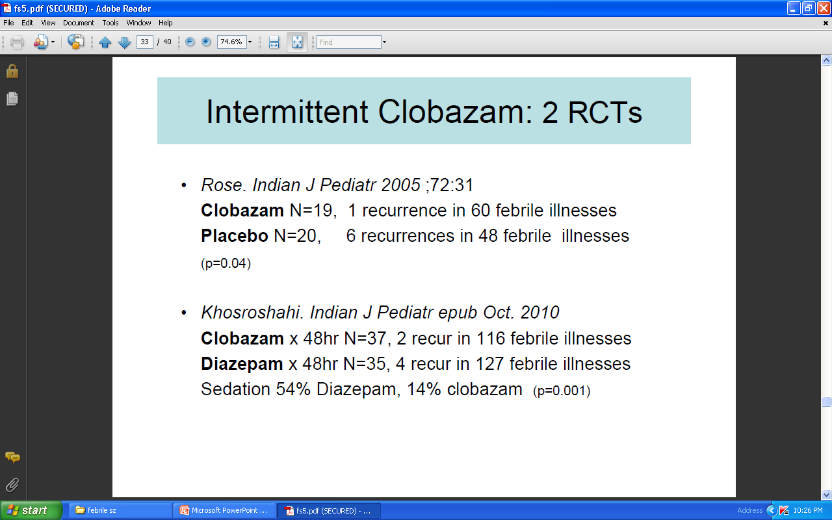

Slide 58

Parental Reaction and Response to Febrile
Seizures in Children
Disrupt the quality of life and the parents experience anxiety and fear whenever a child develops a fever.
"vulnerable child syndrome",
Caregiver - medical attention for their child more frequently
Found in previous parent-perceived child vulnerability studies involving general pediatrics and premature infants
Notes:
The full term to describe this perception is referred to as the, which includes a compilation of behaviors that are thought to develop as a result of this excessive parental anxiety. These parents may also perceive that somehow the child is now “vulnerable” or unusually susceptible to medical or developmental problems

Slide 59
Supportive family management
47% of parents - thought their child was dying during the initial febrile seizure. van Stuijvenberg M,etal. Parents’ fear regarding fever and febrile seizures. Acta Paediatr 1999;88:618–22.
Parents who have watched their child during a fit need specific information in order to avoid long-term reactions. Valeta T. Impact of newly identified epileptic seizures in patients and family.
includes
Education about febrile seizures
Providing specific instructions
Notes:
. Patient and Family Education
An integral part of the management of a first febrile seizure is helping the family to cope with a frightening experience. Parents may believe that their child is dying during a first febrile seizure. The challenge is to help the family deal with the emotional trauma and to understand the excellent prognosis of febrile seizures. It is important that the family understand that there is no increased risk of intellectual delay or school difficulties and that febrile seizures less than 30 minutes do not result in brain damage.
Provide the family with information on the risk of recurrence during the same illness or in the future and how to deal with subsequent seizures. Inform the families about the low risk of developing epilepsy and the lack of benefit of using antiepileptic drug treatment in altering that risk. Discuss this information with the family when the child is seen at the time of the febrile seizure. Provide information to family (Parent Education and Resources) before leaving the ED. about anti pyretic and anti-epileptic prophylaxis and emergency procedures for possible subsequent seizures.

Slide 60
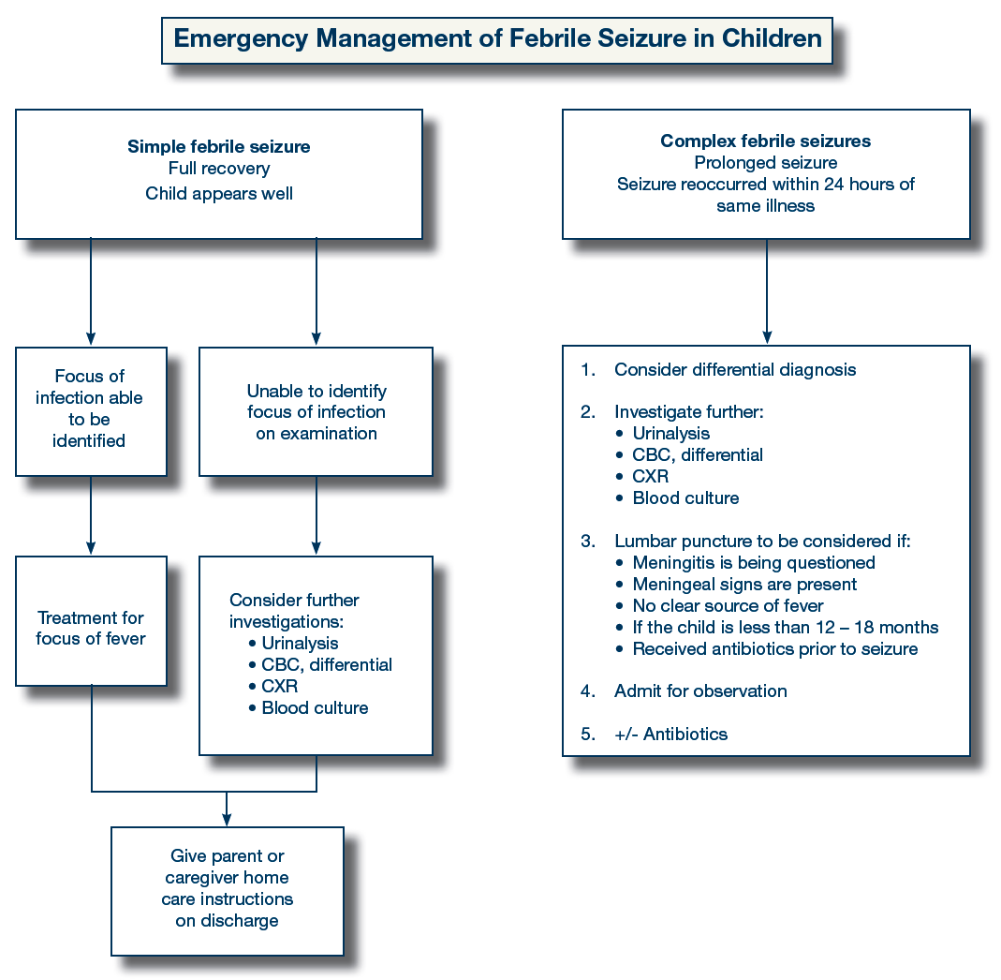
approach

Slide 61
To conclude
Febrile seizures are essentially benign
Outgrow by 6 years of age
Resolve without appreciable risk of sequelae
Most important determinant of neurological status after a febrile seizures is the child’s neurological status before any seizure occurred.

