Slide 1
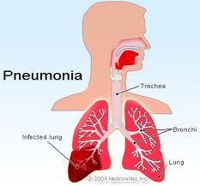
Dr.Arti Shah
Respiratory Medicine

Slide 2
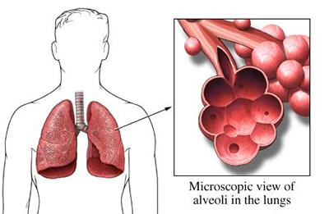
Definition
An acute infection of the pulmonary parenchyma that is associated with at least some symptoms of acute infection, accompanied by an acute infiltrate on CXR or auscultatory findings consistent with pneumonia
Pneumonia is an acute infection
of the parenchyma of the lung
caused by bacteria, fungi ,virus,
parasite etc.

Slide 3
Epidemiology
The morbidity and mortality of pneumonia are high especially in old people.

Slide 4
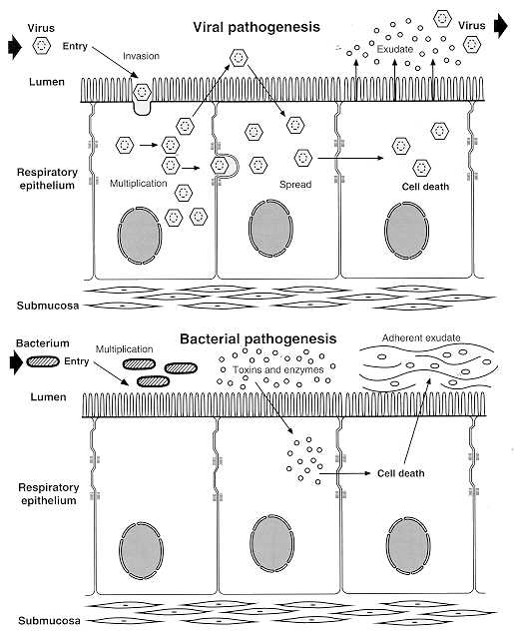
Etiology
There are two factors involved in the formation of pneumonia
----pathogens
----host defenses.

Slide 5
CAP – Pathogenesis
Inhalation
Aspiration
Hematogenous

Slide 6
Colonisation
Air
Non pulmonary infection
Contagious infection
Aspiration
Inhalation
Blood stream
Direct/ Extension
Lung Defences
Pneumonia

Slide 7
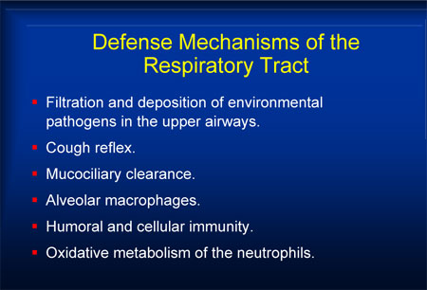

Slide 8

pathogenesis
Pneumococci usually reach the lungs by inhalation or aspiration. They lodge in the bronchioles, proliferation and initiate an inflammatory process.

Slide 9
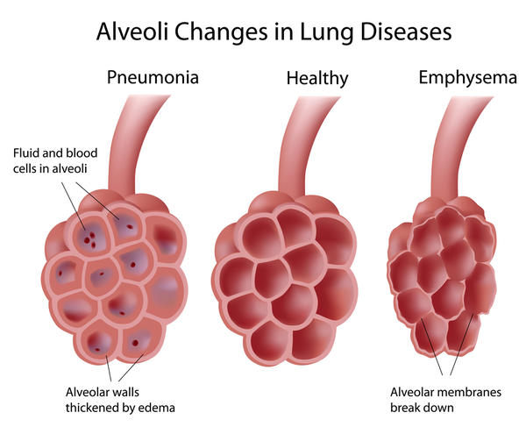
Pathology
Congestion(from 12 h to 3 days),
Red hepatization (1­3 days),
Grey hepatization (2­6 days),
Resolution stage of completion
Notes:
Which is third pathological stages of pneumonia?
1. Congestion
2. Grey hepatization
3. Red hepatization
4. Resolution

Slide 10
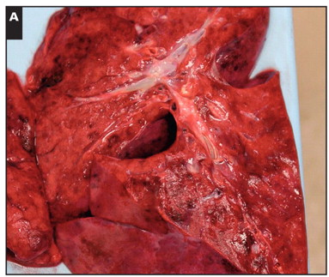
Congestion
Heavy, boggy and red lung
Vascular engorgement
Intra alveolar fluid
  Few neutrophils
  Numerous bacteria

Slide 11
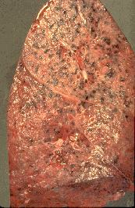
Red hepatization
Distinctly red, firm and airless with a liver like consistency
Massive confluent exudation with
  Red cells
  Neutrophils
  Fibrin filling the alveolar spaces

Slide 12
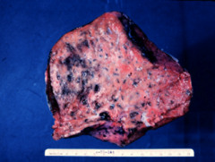
Grey hepatization
Greyish brown, dry surface
Progressive disintegration of red cells
Persistence of a fibrinosuppurative exudate

Slide 13
◆ All of the four main stages of the inflammatory
reaction described above may be present at the
same time
◆ In most cases, recovery is complete with
restoration of normal pulmonary anatomy

Slide 14
classification
Anatomist
Microbiologist
Empiricist
Behaviorist

Slide 15
Anatomist
Pneumonia
Lobar
Segmental
Sub segmental
Bronchopneumonia

Slide 16
Microbiologist
Pneumonia
Bacterial
Non bacterial

Slide 17
Bacterial More common
Pneumococcal pneumonia
Strep. pneumoniae
Atypical pneumonia
Legionella spp.
Mycoplasma pneumoniae
Chlamydia spp.
Coxiella burnetii(Q fever)
Staphylococcal pneumonia
Staph. aureus
Gram Neg.
Klebsiella spp.
Pseudomonas aeruginosa
E. colli
Enterobacter spp.
Serratia spp.
H. influenzae pneumonia
Moraxella catarrhalis
Anaerobic
Bacteroides spp.
Fusobacterium spp.
Peptococcus spp.
Peptostreptoccus spp
Mycobacterial
M. tuberculosis

Slide 18
Non bacterial pneumonia
Viral Pneumonia
  Influenza
  Measles
  Adenoviruses
  Varicella
  Cytomegalovirus
  RSV
  Parainfluenza virus
  Corona virus
  Coxsackie virus
  Rhinovirus
  EBV
  HSV

Slide 19
Bacteria like and rickettsia like pneumonia
Fungal and Actinomycotic pneumonia
Parasitic pneumonia
Chemical pneumonia
Physical pneumonia(radiation)

Slide 20
CAP – The Two Types of Presentations
Atypical
Classical
Gradual & insidious onset
Low grade fever
Dry cough, No blood tinge
Good GC – Walking CAP
Low mortality 1-2%; except in cases of Legionellosis
Mycoplasma, Chlamydiae, Legionella, Ricketessiae, Viruses are causative
Sudden onset of CAP
High fever, shaking chills
Pleuritic chest pain, SOB
Productive cough
Rusty sputum, blood tinge
Poor general condition
High mortality up to 20% in patients with bacteremia
S.pneumoniae causative

Slide 21
Ⅰ.Classification by pathogen
Pathogen classification is the most useful
to treat the patients by choosing effective
antimicrobial agents

Slide 22
Bacterial /Fungal /Viral pneumonia
(1) Aerobic Gram-positive bacteria,such
as streptococcus pneumoniae, staphy-
lococcus aureus, Group A hemolytic
streptococci
(2) Aerobic Gram-negative bacteria, such
as klebsiella pneumoniae, Hemophilus
influenzae, Escherichia coli
(3) Anaerobic bacteria

Slide 23
Atypical pneumonia
Including Legionnaies pneumonia ,
Mycoplasmal pneumonia ,chlamydia pneumonia.

Slide 24
Fungal pneumonia
Fungal pneumonia is commonly caused by candida and aspergilosis.
pneumocystis jiroveci

Slide 25
Viral pneumonia
Viral pneumonia may be caused by adenoviruses, respiratory syncytial
virus, influenza, cytomegalovirus,
herpes simplex

Slide 26
Ⅱ. Classification by anatomy
1. Lobar: Involvement of an entire lobe
2. Lobular: Involvement of parts of the lobe only, segmental or of alveoli contiguous to bronchi (bronchopneumonia).
3. Interstitial

Slide 27

Lobar pneumonia

Slide 28

Lobular pneumonia

Slide 29

Interstitial pneumonia

Slide 30
Classification by acquired environment
Community acquired pneumonia，CAP
Hospital acquired pneumonia，HAP ，NP
Immuno compromised host pneumonia,(ICAP)

Slide 31
Community Acquired Pneumonia
CAP refers to pneumonia acquired outside of hospitals or extended-care facilities .

Slide 32
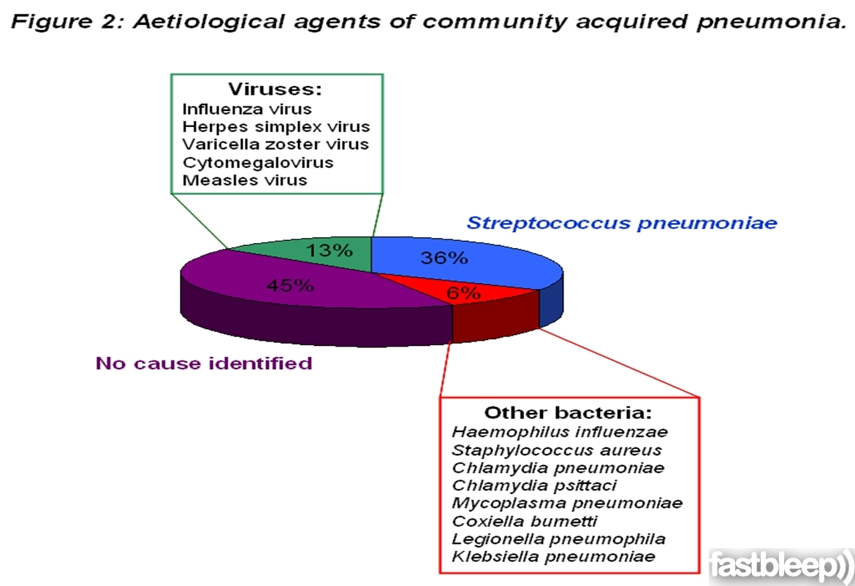

Slide 33
Hospital Acquired Pneumonia
HAP refers to pneumonia acquired in the hospital setting.
Enteric Gram-negative organisms,
Pseudomonas aeruginosa
Staphylococcus aureus
(Including MRSA)
Klebsiella pneumoniae
Serratia marcescens
Acinetobacter

Slide 34
Differential Diagnosis
Pulmonary tuberculosis
Lung cancer
Acute lung abscess
Pulmonary embolism
Noninfectious pulmonary infiltration
Bronchogenic carcinoma
Pulmonary infarction

Slide 35
Diagnosis
Give a definite diagnosis of pneumonia
To evaluate the degree of the pneumonia
To definite the pathogen of the pneumonia
History and physical examination(5W)
X-ray examination
Pathogen identification

Slide 36
signs
Consolidation signs
Moist rales
Respiratory rate or heart rate

Slide 37
Laboratory examinations

Slide 38
Laboratory examinations
• The peripheral white blood cell (WBC) count
• Before using antibiotic, the culture of blood and
of expectorated purulent sputum between 24-48
hours can be used to identify pneumococci
• Colony counts of bacteria from bronchoalveolar
lavage washings obtained during endoscopy are
seldom available early in the course of illness
• Use of the PCR may amplify pneumococcal
DNA and improve potential for detection

Slide 39
X-ray examination
• Chest radiographs
• PA and lateral chest radiographs

Slide 40
X-ray examination
• Usually lobar or segmental consolidation
suggests a bacterial cause for pneumonia
• If blunting of the costophrenic angle is noted, pleural effusion may be exist.

Slide 41
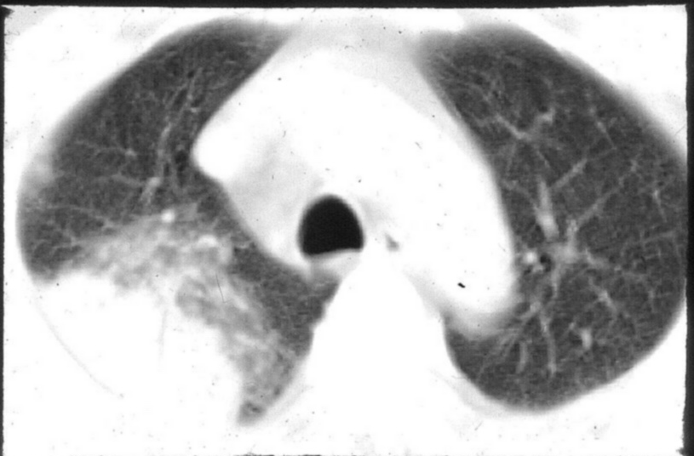
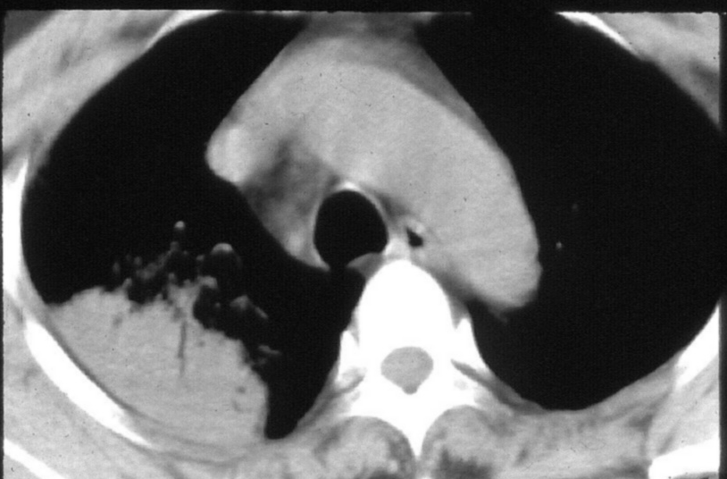
The features of CT
Air-bronchogram sign

Slide 42
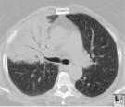
CT

Slide 43
Special Clues on Chest X-ray
Lobar pneumonia – Strep. Pneumonia
Diffuse interstitial infiltrates – Pneumocystis
RUL infiltrate – Tuberculosis
Diffuse interstitial infiltrates – Tuberculosis in HIV

Slide 44
Complications
Lung abscess or Empyema
Pleural effusion
Pleuritis
Pneumothorax
Extrapulmonary infections
Sepsis
ARDS
ARF
Bacteremia
Meningitis,
Arthritis,
Pericarditis,
Endocarditis,
Peritonitis,
Otitis Media

Slide 45
CAP – Evaluation of a Patient
Hx. PE, CXR
No Infiltrate
Alternate Dx.
Infiltrate or Clinical evidence of CAP
Evaluate need for Admission
Medical Ward
Out Patient
ICU Adm.
PORT & CURB 65

Slide 46
Treatments
Antibiotics
Support therapy
Therapy of complications

Slide 47
Traditional Treatment Paradigm
Conservative start with ‘workhorse’ antibiotics
Reserve more potent drugs for non-responders

Slide 48
New Treatment Paradigm
Hit hard and early with appropriate antibiotic(s)
Short Rx. Duration; De-escalate where possible

Slide 49
Antibiotics of choice for CAP
Macrolide -M
Azithromycin
Clarithromycin
Fluroquinolone-FQ
Levofloxacin
Moxifloxacin
Betalactum - B
Ceftriaoxone
Erythromycin
Gatifloxacin
Trovafloxacin
Cefotaxime
B Inhibitor - BI
Doxycycline
Sulbactam
Tazobactam
Piperacillin
Telithromycin

Slide 50
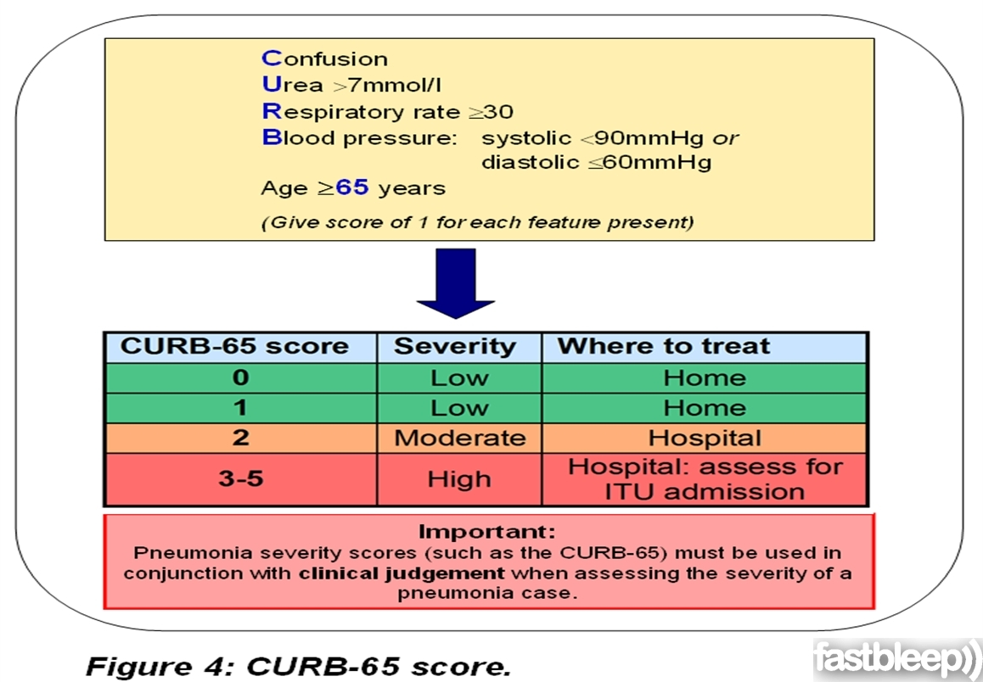

Slide 51
Treatment of HCAP, HAP, VAP
Antipseudomonal cephalosporin (Cefepime, Ceftazidime) + Vancomycin
Anti-pseudomonal Carbapenem (Imipenem, Meropenem) + Vancomycin
Beta-Lactamase/Beta-Lactamase Inhibitor (Pip-Tazo – Zosyn) + Pseudomonal Fluoroquinolone (Cipro) + Vancomycin
Aminoglycoside (Gentamycin, Amikacin) + Vancomycin

Slide 52
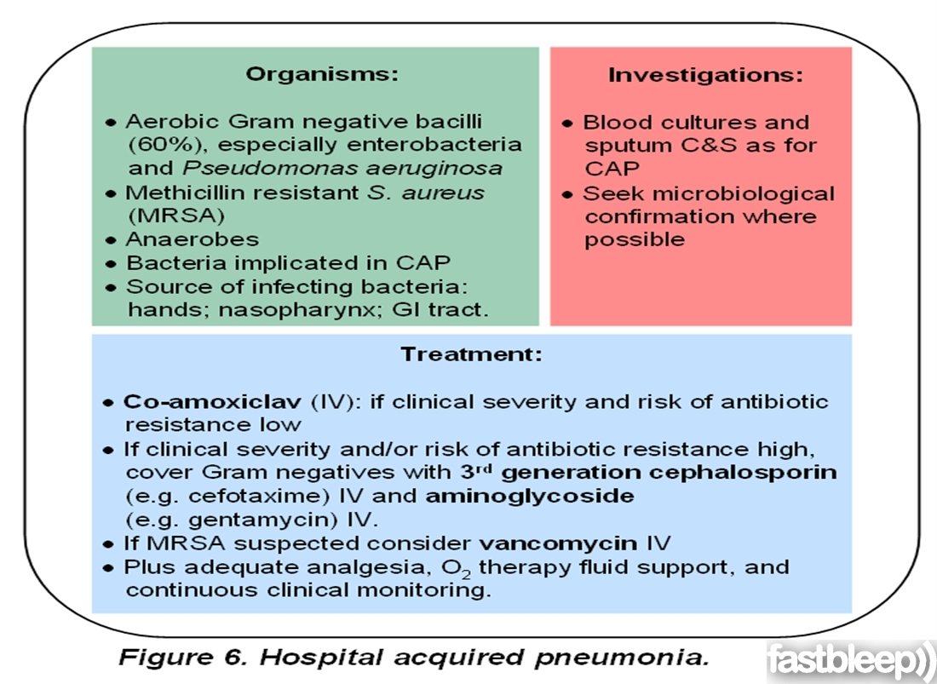

Slide 53
Supportive measure
Supportive measure are generally used in
the initial management of acute pneumo-
coccal pneumonia, such measures include
• Bed rest
• Monitoring vital signs and urine output
• Administering an occasional analgesic to
relieve pleuritic pain
• Replacing fluids, if the patient is dehydrated
• Correcting electrolytes
• Oxygen therapy

Slide 54
Prognosis
Prognosis is much better
Any of the following factors makes the prognosis
less favorable and convalescence more prolonged
elderly:
• involvement of 2 or more lobes
• underlying chronic diseases (heart lung
kidney) normal temperature and WBC
count <5000
• immunodeficiency with severe complication

Slide 55

Prevention
The most important preventive tool available
is using a poly valent pneumococcal vaccine
in those with chronic lung diseases, chronic
liver diseases, splenectomy, diabetes mellitus
and aged

Slide 56
Questions
1.What is the differences between CAP and HAP?
2.What is the standard of sever pneumonia?
3.what are the principals of antibiotic therapy of various of pneumonias?

