Slide 1
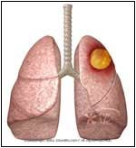
Dr. Arti Shah
(Respiratory medicine)
LUNG ABSCESS

Slide 2
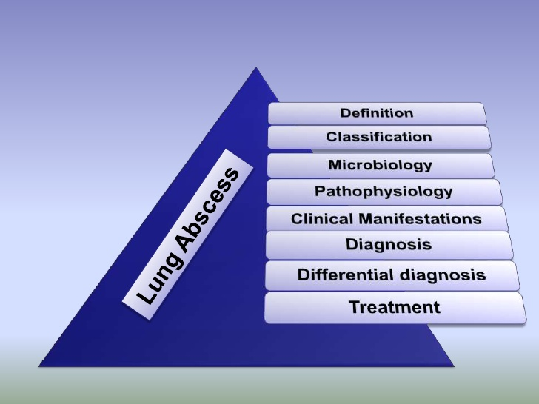

Slide 3
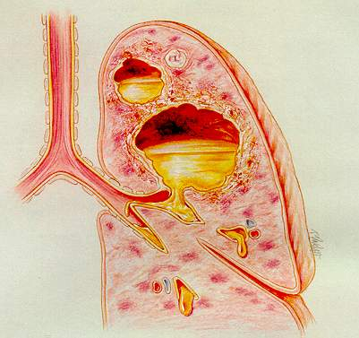
Definition
A lung abscess is a localized area of destruction of lung parenchyma in which infection by pyogenic organisms results in tissue necrosis and suppuration
may be single or multiple
Radiographically an air – fluid levels.
When multiple and small (<2 cm in diameter) sometimes referred to as necrotizing or suppurative pneumonia.

Slide 4
Lung Abscess - Classification
Primary
Secondary

Slide 5
Mechanisms of infection
Aspiration
Necrotizing pneumonia
Haematogenous spread from a distal site
Pre-existing lung disease
Infected pulmonary infarct
Trauma
Immunodeficiency

Slide 6

Predesposing Factors
Aspiration of oropharyngeal flora
Dental/periodontal sepsis
Paranasal sinus infection
Depressed conscious level
Alcohol/sedative drug abuse
Anaesthesia
Epilepsy
Head injury
Cerebrovascular accident
Diabetic coma
Impaired laryngeal closure
Cuffed endotracheal tube
Tracheotomy tube
Recurrent laryngeal nerve palsy
Disturbances of swallowing
Oesophageal stricture (benign or malignant)
Oesophageal motility disorders, e.g. systemic sclerosis
Neuromuscular disease,
Achalasia
Delayed gastric emptying/gastro-oesophageal reflux/vomiting

Slide 7
Necrotizing pneumonia
Staphylococcus aureus
Streptococcus milleri/intermedius
Klebsiella pneumoniae
Pseudomonas aeruginosa
Haematogenous spread
Urinary tract infection
Abdominal /Pelvic sepsis
Infective endocarditis (right-sided)
Intravenous drug abuse
Infected intravenous cannulae
Septic thrombophlebitis
Pre-existing lung disease
Bronchiectasis
Cystic fibrosis
Bronchial obstruction
Tumour
Foreign body
Infected pulmonary infarct
Trauma
Immunodeficiency
Primary or acquired

Slide 8
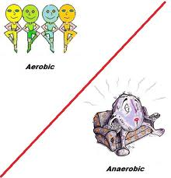
Microbiological characteristics
Anaerobic organisms:
Bacteroides ( Bacteroides fragilis.)
B. melaninogenicus
genera, Prevotella and Porphyromonas.
Peptostreptococcus and anaerobic or microaerophilic streptococci.
Fusobacterium species, F. nucleatum and F. necrophorum.

Slide 9

Aerobic organisms
Strep. Intermedius group
Strep. intermedius,
Strep. Constellatus
Strep. Anginosus
Staph. Aureus-
influenza infectn.
St. pyogens and very rarely st. pneumoniae

Slide 10
PATHOLOGY

Slide 11
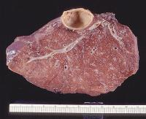
Areas of consolidation
Untreated/incomplete treatment
Treated
Zones of necrosis (microabscess)
Resolution
A predilection for infection in dependent segments is seen, particularly the posterior segments of the upper lobes and the superior segments of the lower lobes.
coalesce
Abscess

Slide 12
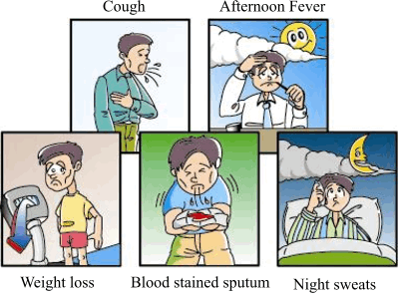

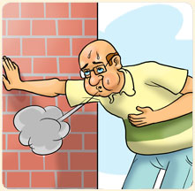
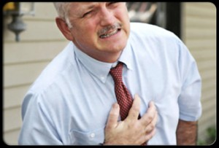
Clinical features
Symptoms
Cough with purulent sputum
Fever (sometimes with chills and rigors),
Dyspnoea
Chest pain.
Haemoptysis
associated disease

Slide 13
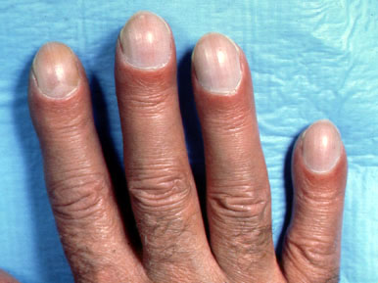

Signs
Digital clubbing
diminished breath sounds
Dullness to percussion
consolidation and a pleural friction rub.
The ‘amphoric’ or ‘cavernous’ breath sounds
There may be signs of an associated pleural effusion, empyema or pyopneumothorax.

Slide 14
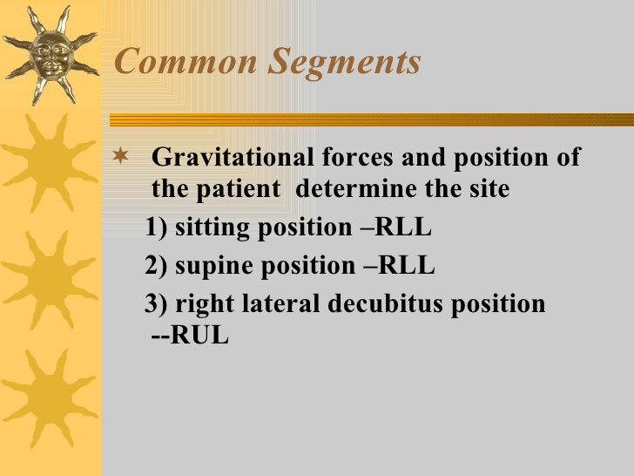
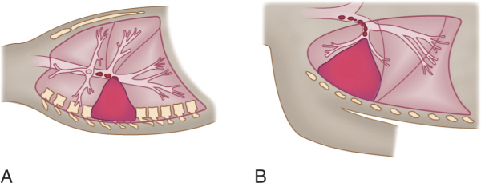

Slide 15
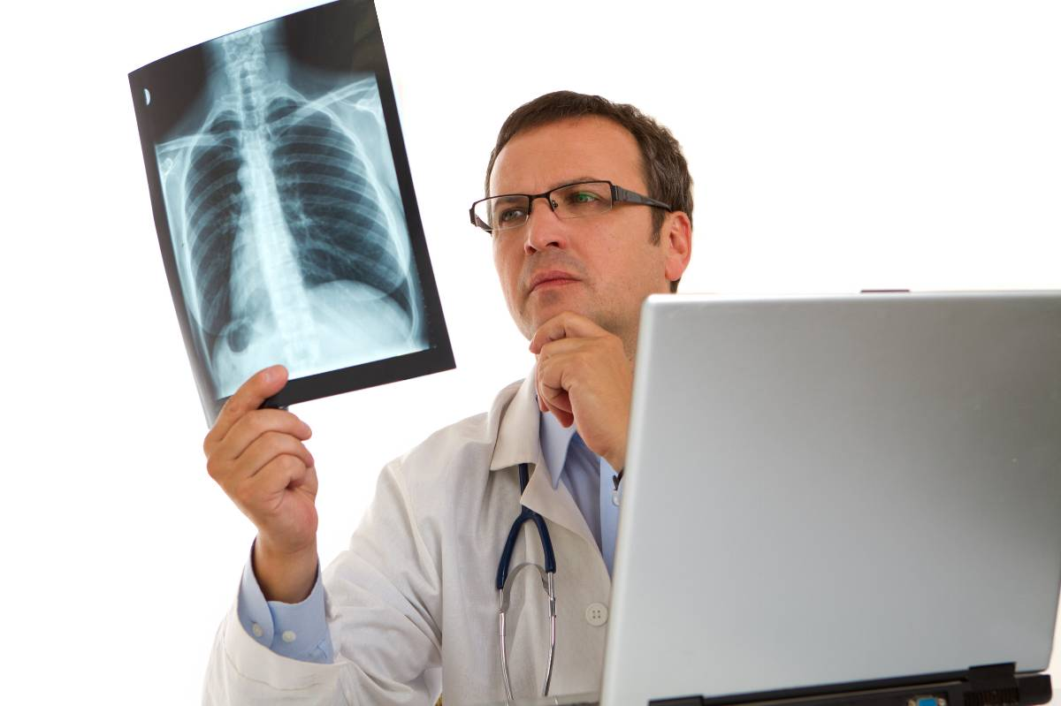
Diagnosis

Slide 16
Investigations
CBC neutrophil leucocytosis,
The ESR - raised.
Sputum- gram stain, Z-N stain/CS, Gas liquid chromatography.
Blood for CS
Radiography
Other imaging techniques
CT chest and USG

Slide 17
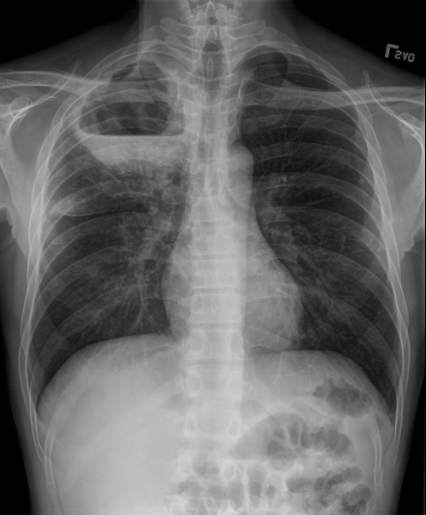

Slide 18
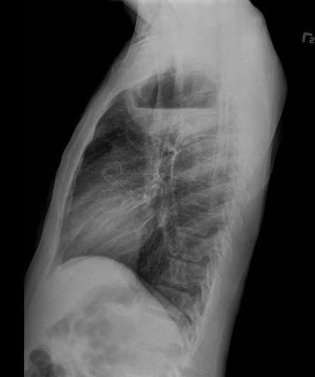

Slide 19
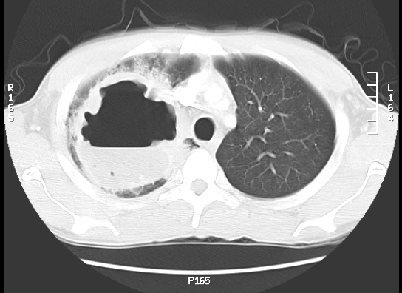

Slide 20
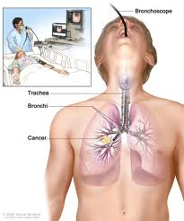
Percutaneous transtracheal aspiration,
Percutaneous needle aspiration
Bronchoscopic sampling using a brush
Bronchoscopy as a diagnostic procedure if cavitaing ca or obstructive lesions suspected.

Slide 21
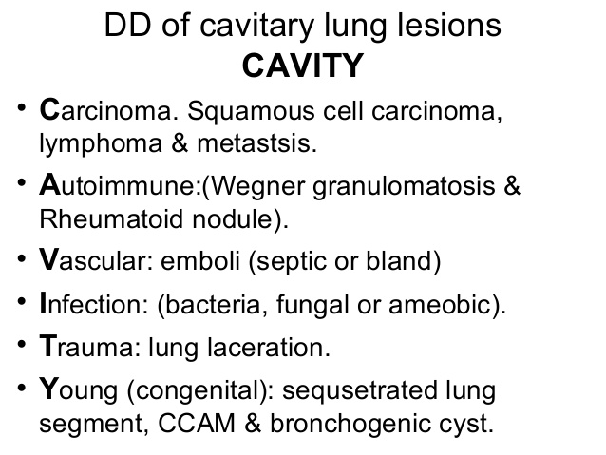


Slide 22
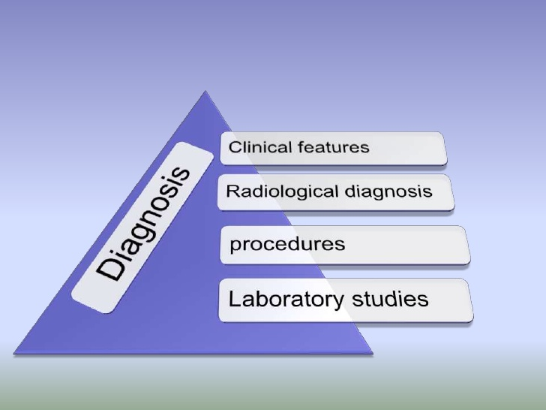

Slide 23

Treatment

Slide 24

Antibiotics
Penicillins(B lactamase/inhibitors)
Clindamycin
Metronidazole
SUPPORTIVE TREATMENT
CHEST PHYSIOTHERAPY

Slide 25
Dosage
Metronidazole 500mg intravenously every 8 h by infusion.
The dose of clindamycin is 600 mg intravenously every 6–8 h, switching to oral therapy at a dose of 300mg every 6–8 h.S
Modifications - culture and sensitivity results.
As infection comes under control reduce the dose of penicillin, switching to an oral .

Slide 26
Other antibiotics
amoxicillin and clavulanic acid (co-amoxiclav)
piperacillin and azlocillin
Ticarcillin
ticarcillin–clavulanate
piperacillin–tazobactam.
Imipenem
cephalosporins, (cefoxitin or cefamycin)
Chloramphenicol
The macrolides (e.g. erythromycin, clarithromycin and azithromycin)
Tetracyclines best avoided
Quinolones relatively ineffective against anaerobes.
the aminoglycosides, may be considered as part of a combination regimen to cover Gram negative aerobic bacilli.

Slide 27
Percutaneous Drainage of Pyogenic Lung
Abscess
.
Scand J Infect Dis 34: 673–679, 2002
.
SIRAJ O. WALI, ABEER SHUGAERIet al. | Oxford Centre for Evidence-Based Medicine 2011 Levels of Evidence Level 1 Evidence | Study to review the medical literature on PTTD from the last 25 y, focusing on its ef. cacy, indications, technique, complications and mortality. percutaneous transthoracic tube drainage | PTTD is a safe and effective method for treating lung abscess and is probably the surgical treatment of choice in a medically complicated patient with a poorly draining lung abscess

Slide 28
Duration of treatment
Debated
Some advocate 4-6 weeks
Most treat until radiographic abnormalities resolve , generally requiring months of treatment

Slide 29
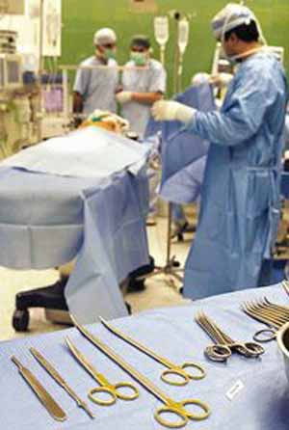
Surgical intervention
Surgery rarely required
Indications: failure of medical management, suspected neoplasm, or hemorrhage.
Predictors of poor response to antibiotic therapy alone: abscesses associated-
with an obstructed bronchus, large abscess (>6 cm in diameter), relatively resistant organisms, such as P. aeruginosa.
The usual procedure in such cases is a lobectomy or pneumonectomy

Slide 30
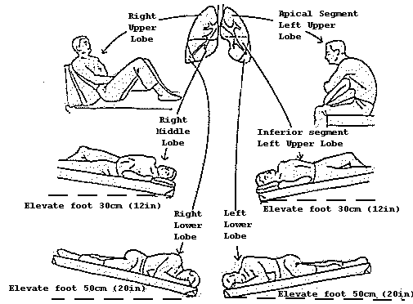
Physiotherapy
Bronchoscopy
Surgery
intercostal catheter or tube drainage
Open drainage via pneumonostomy
thoracotomy and lung resection (usually lobectomy)

Slide 31
delayed response to treatment
Consider:
Erroneous microbial diagnosis
Obstruction with a foreign body or neoplasm
Large cavity size (>6 cm) which may require unusually prolonged therapy or empyema which necessitates drainage
Non-infectious causes - pulmonary infarcts

Slide 32

complications
Empyema
Bronchopleural –fistula
Pneumothorax , pyoneumothorax
Metastatic cerebral abscess
Sepsis
Fibrosis,bronchiectasis,amyloidosis

Slide 33
Prognosis
The prognosis for lung abscess following antibiotic treatment is generally favorable. Over 90% of lung abscesses are cured with medical management alone, unless caused by bronchial obstruction secondary to carcinoma.

Slide 34


Slide 35
MCQ
1) The commonest cause of lung abscess?
Tuberculoma
Congenital
Hematogenous
Aspirated oropharyngeal secretion
2) All are complications of lung abscess except?
Dry pleurisy
Empyema
Pneumothorax
Pleural effusion

Slide 36
3) Least likely treatment modalities of lung abscess among the following is?
Chemotherapy
Postural drainage and percussion therapy
Bronchoscopic aspiration
Surgery
4) Mycobacterium responsible for causing lung abscess are all except?
M.tuberculosis
M.kansasii
M.aviumintracellulare
M.leprae
5) Commonest site of lung abscess?
Post segment of right upper lobe
Lingual
Post segment of left lower lobe
Post segment of right lower lobe
1)d (2)d (3)d (4)d (5)d

