Slide 1
EPIDURAL ANESTHESIA
Dr. Sara Mary Thomas
Associate Professor,
Dept. of Anaesthesia,
S.B.K.S.M.I.R.C.,Piparia

Slide 2
EPIDURAL ANESTHESIA
One advantage of an epidural is that the muscle blockade can range from none to complete and can be regulated and changed by:
Choice of drug
Concentration of LA
Dosage
Level of injection

Slide 3
ADVANTAGES
Epidural techniques allow for the placement of a continuous catheter which is especially useful for:
Cases of unpredictable duration
Prolonged postoperative analgesia
Chronic pain control
Obstetric analgesia & anaesthesia

Slide 4
PHYSIOLOGY
Local anaesthetics or other solutions injected into the epidural space (steroids, narcotics) spread anatomically
Horizontal spread is to the region of the dural
cuffs with diffusion into the CSF and leakage
through the intervertebral foramen into para-
vertebral space
Longitudinal spread is preferentially cephalad in direction

Slide 5
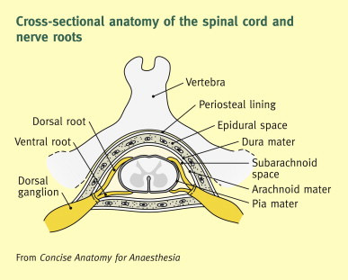
PHYSIOLOGY
Possible sites of anesthetic action include:
Paravertebral nerve roots
Intradural spinal roots
Dorsal & ventral spinal roots
Dorsal root ganglia
The spinal cord
The brain itself (by diffusion)

Slide 6
PHYSIOLOGY
Initial blockade is PROBABLY a result of anaesthetic blockade at the spinal roots within the dural sleeves
The dural cuffs or sleeves have a proliferation of arachnoid villi and granulations that effectively reduce the thickness of the dura mater, facilitating rapid diffusion of the LA from the epidural space, through the dura and into the CSF surrounding the nerve roots
Then the local anaesthetic diffuses into the nerve root itself, producing anaesthesia to that particular dermatome

Slide 7
PHYSIOLOGY
Because epidural anesthesia is DIFFUSION dependent, relatively LARGE volumes of LA are needed to achieve a block that spans several dermatomes
The block ONLY goes as high or low as you regulate it (by volume)
It is a DIFFERENTIAL block

Slide 8
SPREAD OF ANESTHESIA
Anaesthetist must be familiar with the variables that affect spread and duration of epidural anaesthesia.
The variables are more numerous than those of spinal anaesthesia and baricity plays a very small factor
whereas in a spinal, baricity is a KEY factor in spread and distribution of the block

Slide 9
SPREAD OF ANESTHESIA
The factors that affect the level of the epidural block are:
Injection site
Dose
Volume
Concentration
Position
Age
Height and weight (?)
Pregnancy (?)
Speed of injection

Slide 10
INJECTION SITE
Unlike spinal anaesthesia, produces a segmental block that spreads both caudally and cranially
Injection site is arguably the most important determinant of the spread of an epidural block
The injection site should be in the middle of the range of dermatomes that needs to be anesthetized and closest to the main nerve roots involved

Slide 11
INJECTION SITE
Caudal epidural blocks are largely restricted to sacral and LOW lumbar dermatomes
Thoracic levels can be reached by the caudal approach
Only if large volumes (30cc) are given, and then the block is patchy at best because of the distance that the drug has to travel

Slide 12
INJECTION SITE
Lumbar local anaesthetic injections of 10cc tend to spread caudal to include all the sacral dermatomes
Lumbar injections of 20cc volumes produce much better quality sacral blocks and can also extend cranially to include the mid thoracic levels

Slide 13
INJECTION SITE
Thoracic injections tend to produce a symmetric segmental band of anesthesia with minimal lumbar spread
It is generally not feasible to produce surgical anesthesia in the low lumbar or sacral nerve distributions when using thoracic injection sites
Thoracic injection sites are ideally suited for procedures of the chest and upper abdomen or for relief of post-op thoracotomy pain with a catheter being placed for continuous infusions

Slide 14
DOSE, VOLUME & CONCENTRATION
Within the range typically used for surgical anaesthesia, drug CONCENTRATION is relatively unimportant in determining block spread
DOSE & VOLUME, however, are important variables in determining both spread and quality of the epidural block obtained

Slide 15
DOSE, VOLUME & CONCENTRATION
If drug CONCENTRATION is held constant, increasing the volume of LA (and thereby increasing the DOSE) results in significantly greater average spread
DOSE = volume x concentration (i.e. 15cc x 2.5mg/cc = 37.5mg; 20cc x 2.5mg/cc = 50mg)
The CONCENTRATION of the LA generally affects the DENSITY of the block, NOT the spread

Slide 16
DOSE, VOLUME & CONCENTRATION
So a small volume of a more concentrated LA will produce a very limited BUT very strong block
But take the same DOSE and double the volume, the spread will increase BUT the strength of the block may not be as intense

Slide 17
DOSE, VOLUME & CONCENTRATION
NOTE: the increase in block level IS NOT in direct proportion to the volume increase.
Doubling the volume WILL NOT double the block spread. It is a non-linear relationship and doubling the volume will only increase the level about 1/3-1/2 the original number of segments
The same relationship exists with DOSE;
doubling the dose will usually only increase the level of block the same 1/3-1/2 of the original number of segments blocked

Slide 18
DOSE, VOLUME & CONCENTRATION
Recommended amounts of LA differ as to which level is being injected:
Cervical/thoracic doses are 0.7 to 1cc per segment with an initial volume of 10cc
Lumbar level doses are 1.25 –1.5cc per segment with an initial volume of 15-20cc
This is due to the narrowing of the spinal canal as it progresses cranially

Slide 19
CONCENTRATION AND DIFFERENTIAL BLOCK
Using a lower concentration drug can sometimes give a differential block
The lower concentration means the dose is lower and there is less LA to penetrate the nerve roots so the block acts more peripherally on the nerves, differentially blocking sensory and pain fibers over larger muscle fibers in the center of the nerves

Slide 20
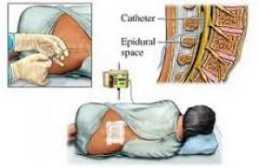
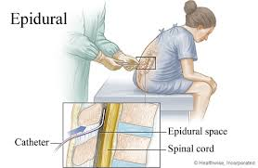
POSITION
Lateral position may be preferred position to optimize spread
Sitting position has anatomical advantages
Studies have shown small to NO differences in spread of block when comparing the two position

Slide 21
AGE
Most (but NOT all) studies that have examined the effect of age on epidural blocks have demonstrated a greater spread in older patients
This is thought to be related to a less compliant epidural space and dura mater
Even so, the clinical effect is usually atmost an increase of, no more than three or four dermatomes

Slide 22
HEIGHT AND WEIGHT
The correlation between patient height or weight and spread of epidural block is very weak at best and seems to have no clinical significance
The only instance where it may have an effect is in EXTREMELY TALL people (greater than 6’6”) or in EXTREMELY SHORT(less than 4’10”) or in MORBIDLY obese patients

Slide 23
PREGNANCY
Studies examining the effect of pregnancy on spread of epidural blocks are conflicting
Some have shown a greater spread at TERM and early in pregnancy
Other studies have shown no significant differences in level of spread between pregnant and non-pregnant patients

Slide 24
SPEED OF INJECTION
Rapid injection may increase the level of spread or decrease the time it takes for the block to set
Drugs should, in fact, be injected SLOWLY to avoid rapid increases in CSF pressure, headache and increased intracranial pressures
Also, incremental bolus vs. Slow, steady injection has shown NO difference in level of spread in multiple studies

Slide 25
SPEED OF INJECTION
All solutions should be injected in increments of 3-5cc every 3 minutes and titrated to the desired anaesthetic level
If a catheter has been placed and injecting through the catheter, then the catheter needs to be aspirated prior to every injection to show no CSF is present

Slide 26
SPEED OF INJECTION
This gradual administration of medication slows the rate of onset of the anaesthetic level and controls the development of the sympathetic blockade
The spinal is ALL or none, whereas the epidural can be brought up gradually, slowing whatever hypotensive response

Slide 27
ONSET OF BLOCKADE
The onset of an epidural block can usually be detected within 5 minutes in the dermatomes immediately surrounding the injection site
The time to PEAK effect differs somewhat among different LA’s
Shorter acting drugs usually reach their maximum spread in 15-20 minutes
Longer acting LA’s usually reach their maximum spread in 20-25 minutes
Increasing the DOSE of LA SPEEDS the onset of both motor and sensory block

Slide 28
DURATION OF BLOCK
The DURATION of the epidural block depends on:
The LA itself
Dose given
Patient age
Use of adrenergic agonists

Slide 29
LOCAL ANESTHETICS & DURATION
Choice of LA is the most important factor in determining DURATION of the block
Chlorprocaine is shortest
Lidocaine & Mepivicaine are intermediate
Bupivicaine and Ropivicaine long lasting epidural blocks

Slide 30
DOSE AND AGE
DOSE: increasing the DOSE of a LA results in increased duration AND density of the block
AGE: there are conflicting studies, but the majority seem to show a longer duration of action in the elderly population. The exact reason is unknown and more studies need to be performed

Slide 31
ADRENERGIC AGENTS AND
DURATION
Epinephrine in a concentration of 5 micrograms/cc (1:200,000) is the most common adrenergic agent added to epidural LA’s
It has been shown to prolong the blocks of lidocaine and Mepivicaine by as much as 80%
Epinephrine has been shown NOT to significantly prolong the duration of anaesthesia when added to concentrated solutions of Bupivicaine and Ropivicaine used for surgical anaesthesia

Slide 32
ADRENERGIC AGENTS AND
DURATION
However, when added to more dilute concentrations of Bupivacaine, as used for OB analgesia, it has been shown to increase the duration AND quality of the block
The mechanism proposed, is that through vasoconstriction, it slows the systemic absorption and elimination of the LA
Why it does not work with higher concentrations of Bupivacaine and Ropivacaine is not clearly understood

Slide 33
TECHNIQUE
Preoperative preparation
Review of anesthetic preoperative evaluation and recent lab values. Surgical and anesthesia consents are checked
Iv access established; generous with fluid if permissible
Low-dose anxiolytic
Monitors: ECG, Pulse oximeter
Epidural set
Emergency equipment
Personnel: provider positioning
Communications

Slide 34
PREPARATION
Place patient in optimal position
Prepare skin over a wide area with povidone iodine
Fenestrated sterile drape
Find the interspace along the midline

Slide 35
TECHNIQUE
In cervical , thoracic , lumbar , caudal
Position
Sitting -cervico thoracic
easy to identify midline
Avoid rotation of spine
Good flexion
lateral -lumbar , for placing catheter

Slide 36
TECHNIQUE
Local anaesthetic is injected at the planned insertion site and a skin wheal is raised with an injection of 1-2 cc of local with the 26g skin needle
Local needles can be changed and place the 22g needle on the local syringe, and in the centre of the skin wheal, go deeper along the planned injection tract, injecting slowly as they penetrate deeper into the subcutaneous tissue

Slide 37
TECHNIQUE
The epidural is most often performed with a 16,17 or 18 gauge needle with a BLUNTED tip designed to facilitate passage of a catheter into the epidural space at the beginning or end of the procedure
The blunted tip is also designed specially to AVOID puncture of the dura and if it comes in contact with the dura, the lack of a sharp point will hopefully just inwardly push the dura without puncturing it

Slide 38
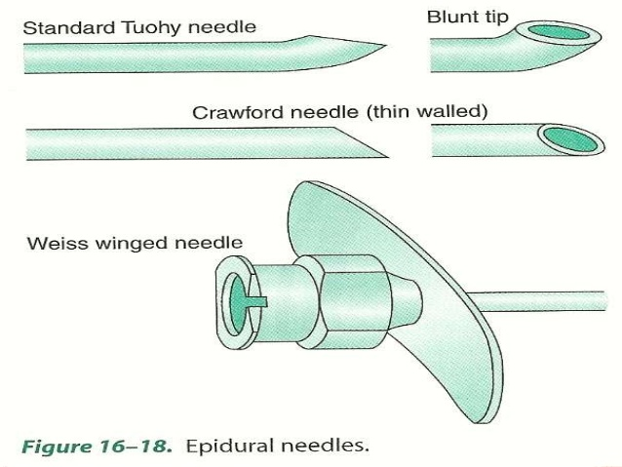

Slide 39
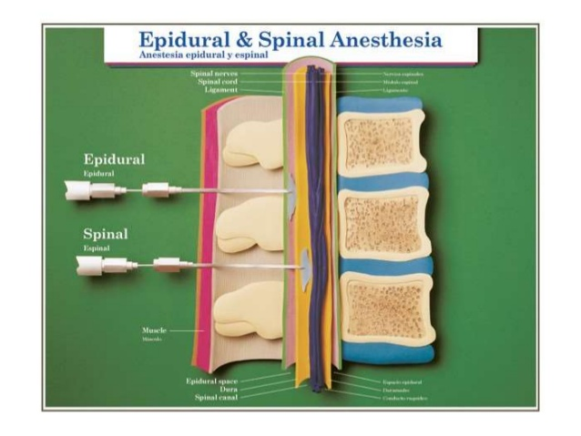

Slide 40
TECHNIQUE
The epidural needle is place bevel up and introduced into the skin
It is passed slowly through the supraspinous ligament and seated in the interspinous ligament before the stylet is removed
It can tell that the needle is seated in the interspinous ligament by letting go of the needle; it should still be supported in the same position, not drop down

Slide 41
TECHNIQUE
Site and angle of the needle entry
Lumbar –
exactly centre and directed perpendicular
T7 –T12 –
upper border of lower spine
Advanced 1–2cms angulated to 70º
T2 – T6 -angulated to 40º
Cervical- C7 –T1-perpendicular

Slide 42
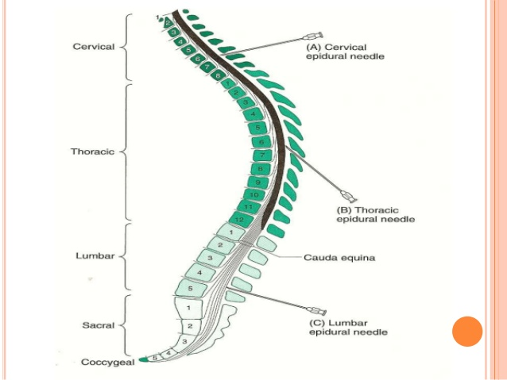

Slide 43
INSERTION
Stylet is removed and a well lubricated glass syringe with air or saline is attached
Needle and syringe is advanced slowly with the left hand , while the thumb of right hand keeps constant pressure over the plunger of the syringe

Slide 44
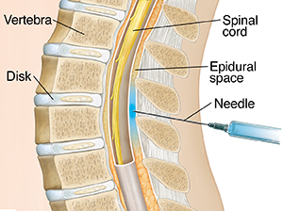

Slide 45
When the needle bevel passes through ligamentum flavum and enters the epidural space , sudden loss of resistance to injection occurs
Confirmation –
Sudden disappearance of resistance
Sudden ease of injection of air
Hanging drop sign
Capillary tube method of odom (movement of air bubble in a capillary tube attached to hub)

Slide 46
TECHNIQUE
The syringe/needle combo should only be moved 0.5-1cm at a time and then tested for resistance or LOR
The syringe/needle combo is advanced by applying pressure to the NEEDLE and not the syringe
As the needle passes through the ligamentum flavum, resistance increases and you may feel a distinct “pop” as you pass through it
•
Once it pass through the LF, will experience an
immediate LOR and then the tip of the needle
will be in the epidural space

Slide 47
CATHETER
Made of polyurethane or polyamide
Polyamide -stiffer , threading easier
Chance of dural or venous puncture
TYPES:-
Closed tip
Multiple side hole
Spring wire reinforced Polymer coated

Slide 48
Threading difficult –
advance and try again
If c/o pain, remove and reintroduce by changing angle of needle or rotated on either side n try again
LA prior to insertion -may open up false spaces
Faulty catheter insertion

Slide 49
LEVELS OF AREA TO BE BLOCKED
Dermatomes that will have to be anaesthetised for a particular surgery are decided
The catheter tip to be placed in the center of the dermatomes to be blocked
Site of needle entry should be 1 or 2 vertebral spines away from intented site of catheter placement
Catheter length of 3 -5 cms inside the space
Determines the spread of the anaesthetic agent

Slide 50
> 5 cms
kinking and knotting
Entry into intervertebral foramen
<3 cms
chance of accidental exit
Threaded cephalic or caudal direction
Firmly fixed with plaster to skin
May be left insitu for…..
Polyurethane catheters – less tissue reaction

Slide 51
EPIDURAL TEST DOSE
To identify epidural needles or catheters that have entered an epidural vein or the subarachnoid space.
The most common test dose is 3 mL of local anesthetic containing 5 µmg/mL of epinephrine (1:200,000).
The dose of local anesthetic should be sufficient that subarachnoid injection will result in clear evidence of spinal anesthesia.

Slide 52
EPIDURAL TEST DOSE
Intravenous injection of this dose of epinephrine typically produces an average 30 beats per minute heart rate increase between 20 and 40 seconds after injection
In beta-blocked patients, a systolic blood pressure increase of
=20 mm Hg may be a more
reliable indicator of IV injection

Slide 53
TECHNIQUE
If gotten a dural puncture by accident, the test dose should produce numbness and/or
weakness or a “pins and needles” sensation in the lower extremities
This can take up to three minutes to occur, so need to wait at least three minutes before continuing injection of LA

Slide 54
TECHNIQUE
Techniques and opinions differ as to whether to pass a catheter and inject total dose via the catheter or inject total dose through the needle and then insert the catheter
With catheter can slowly raise level of anesthesia having better control and less incidence of sympathetic block

Slide 55
TECHNIQUE
The problem with the catheter first is that it is possible
for the catheter NOT to go correctly into the epidural
space. It may kink or coil up and then will be
performing a useless epidural which will end up not
working or be patchy or one sided

Slide 56
TECHNIQUE
With needle the injection of the LA opens up and distends the epidural space and makes it easier to pass the catheter into the correct location
Also, if the catheter fails,will have a complete block for a period of time and that may be all the time need to complete the surgery or procedure

Slide 57
TECHNIQUE
As you pass the catheter, you may initially feel resistance at the tip of the needle
A slightly stronger push may be needed and then you will feel the resistance drop and the catheter will thread smoothly
It should be inserted between 3-5cm and no more (3-5 little black lines)

Slide 58
TECHNIQUE
The most commonly performed epidural is a lumbar epidural, followed by a caudal, then thoracic and finally cervical
Today most high thoracic and cervical epidurals are performed under flouroscopic guidance by pain specialists as it takes a greater level of skill to successfully perform those procedures

Slide 59
TECHNIQUE
The lumbar region is by far the easiest due to:
The angle of the spinous processes
The larger spaces BETWEEN adjacent spinous processes
Easily identifiable location by using easy to find landmarks (iliac crests)
Width of epidural space is greatest at this level as well so if you are a little off the mark, you still stand a good chance of finding it

Slide 60
CAUTION
NEVER pull the catheter back through the needle once it has been inserted
It is possible to catch the catheter on the needle tip and shear or cut the tip off
Then it becomes a permanent new addition to the epidural space and will be there for the rest of the patient’s life!!!!

Slide 61
CONTRAINDICATIONS
ABSOLUTE
Infection
Patient refusal
Coagulopathy or other bleeding diathesis
Severe hypovolemia
Increased intracranial tension
Severe aortic stenosis
Severe mitral stenosis

Slide 62
CONTRAINDICATIONS
RELATIVE
Sepsis
Preexisting neurological deficits
Demyelinating lesions
Stenotic valvular heart lesions
Severe spinal deformities
Prior back surgery at the site
Inability to communicate

Slide 63
CONCLUSION
Spinal and epidural anaesthesia each have advantages and disadvantages that may make one or the other technique better suited to a particular patient or procedure
Studies comparing both techniques have consistently found that spinal anaesthesia takes less time to perform, produces more rapid onset of both sensory and motor block and is associated with less pain during surgery

Slide 64
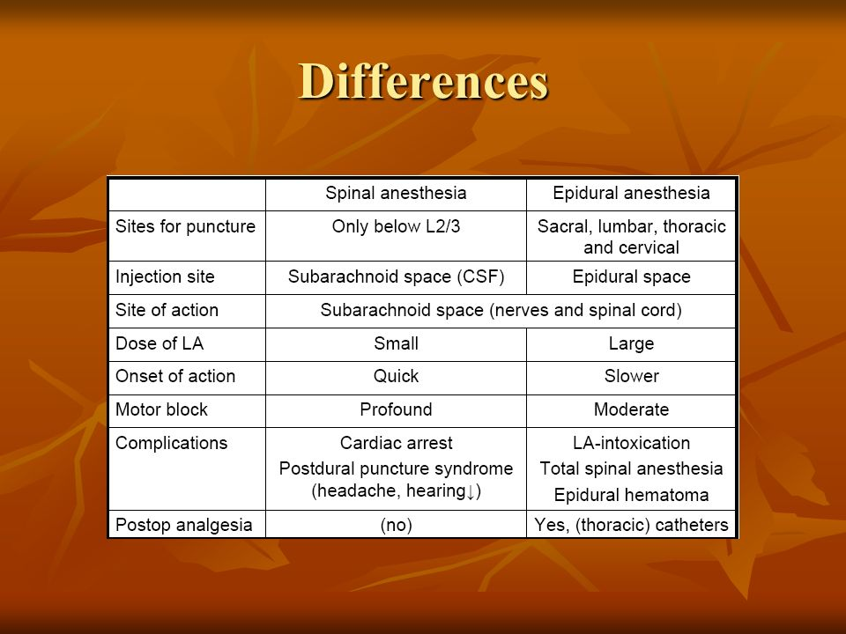

Slide 65
CONCLUSION
Despite these important advantages, epidural anaesthesia offers advantages
lower risk of PDPH
less hypotension
the ability to prolong or extend the block using an indwelling catheter
postoperative analgesia

Slide 66
CONCLUSION
Despite the advantages and disadvantages of BOTH techniques and even done with very experienced hands, BOTH blocks can have systemic, toxic reactions and complications
Be vigilant, be cautious, and be prepared to handle all the emergencies and complications that can occur with BOTH
Again, always be prepared to convert to GA at a moment’s notice

Slide 67


