Slide 1
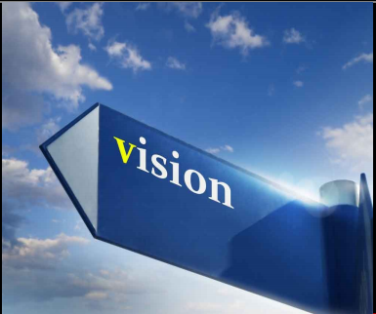
PHOTOCHEMISTRY OF VISION

Slide 2
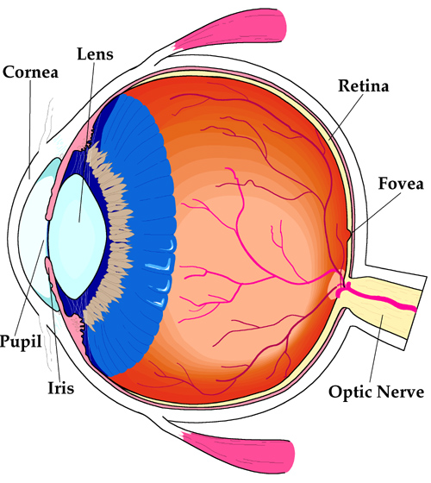
Retina
Thin, semitransparent,
multilayered sheet of neural tissue
lines the inner aspect of the posterior two thirds of the globe
terminates anteriorly at the ora serrata

Slide 3
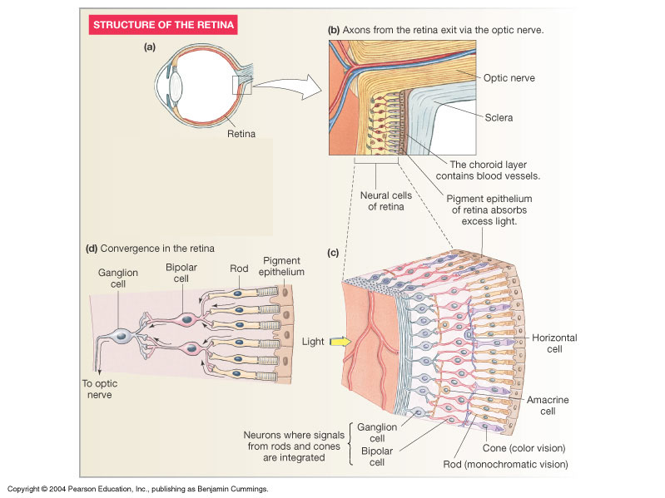
Photoreception and Local Integration
Figure 10-35: ANATOMY SUMMARY: The Retina

Slide 4
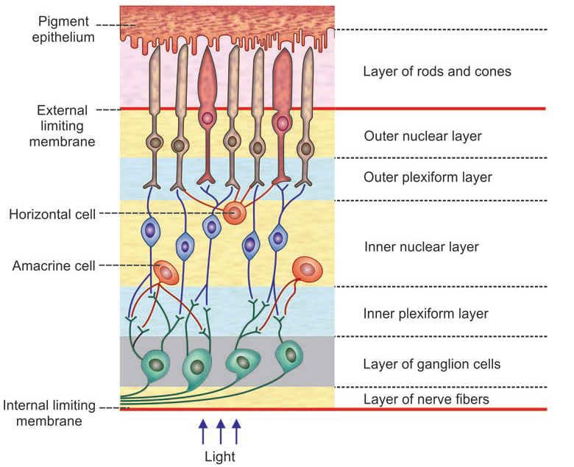
Layers of retina from outside in:

Slide 5
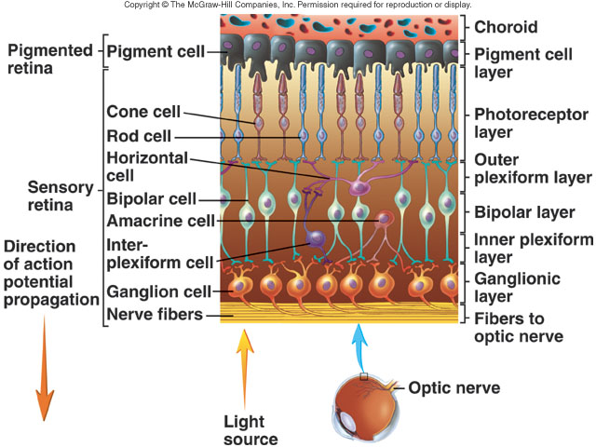
The Retina
Provides black backdrop for increasing visual acuity
Sensory retina and pigmented retina

Slide 6
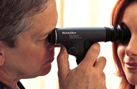
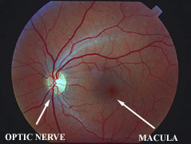
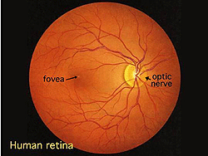
Normal Ophthalmoscopic View of Eye

Slide 7
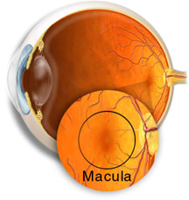
Macula
Located in the center of the retina, temporal to the optic nerve, small and highly sensitive part of the retina
The macula allows us to appreciate detail and perform tasks that require central vision such reading
It has pigment (xantophyll) a pale yellow pigmentation that is visible through an ophthalmoscope

Slide 8
The fovea
central portion of macula
area-1 square millimeter
The central fovea
0.3 millimeter
Presence of only cones
have a special structure long and slender bodies, in contradistinction to the much fatter cones located more peripherally in the retina
In constricted pupil the image on the retina is formed on the macula and cones.

Slide 9
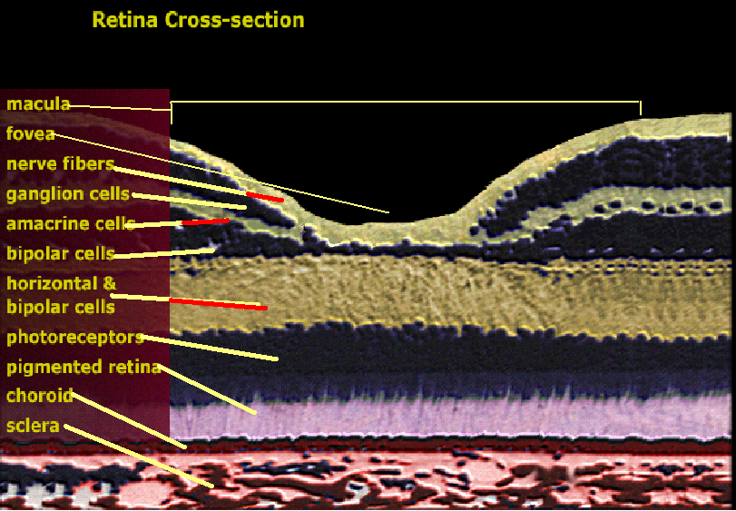
The foveal region….
the blood vessels, ganglion cells, inner nuclear layer of cells, and plexiform layers are all displaced to one side rather than resting directly on top of the cones
This allows light to pass unimpeded to the cones

Slide 10
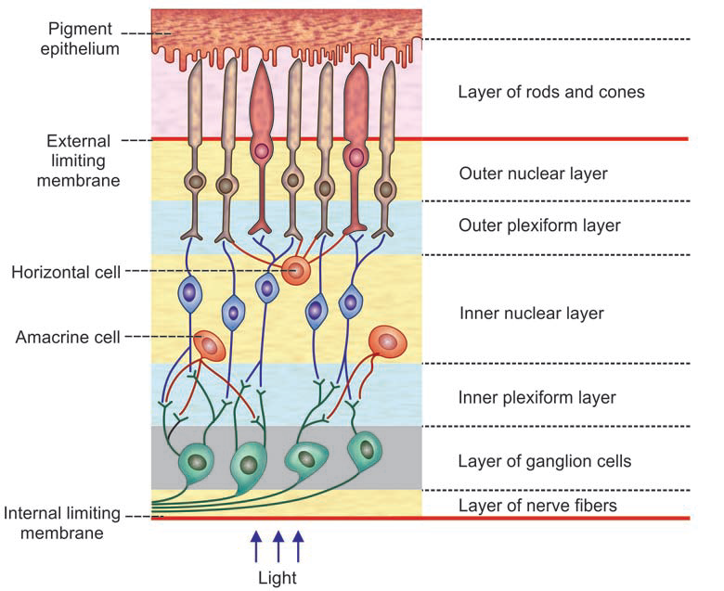
Retinal Pigment Epithelium:
Sheet of melanin-containing epithelial cells lying between the choroid and the neural portion
Epithelial cells works as a barrier between the vascular system of the choroid and the retina.

Slide 11
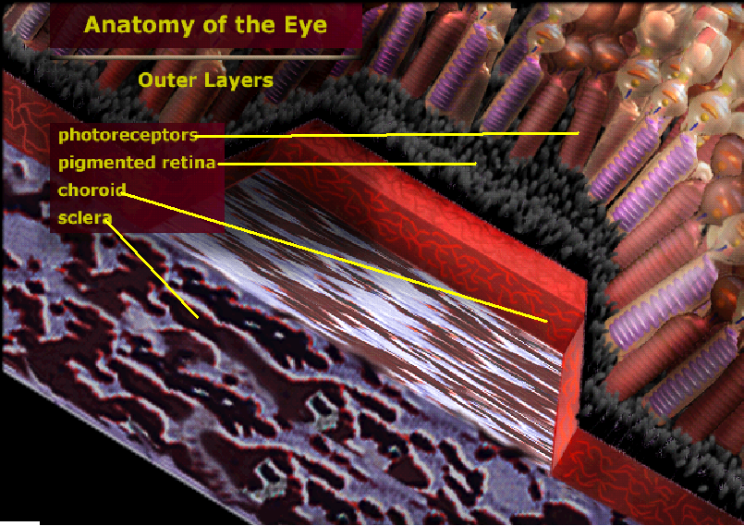
Retinal Pigment Epithelium:
1. The black pigment melanin in the pigment layer prevents light reflection throughout the globe of the eyeball
2. Stores large quantities of vitamin A
Vitamin A :- Exchanged back & forth through the cell membranes of the outer segments of the rods & cones

Slide 12
Importance of this layer….
Absent in albinos :
hereditarily lacking in melanin pigment in all parts of their bodies
an albino enters a bright room
light that impinges on the retina reflected in all directions inside the eyeball by the unpigmented surfaces of the retina and by the underlying sclera,
a single discrete spot of light that would normally excite only a few rods or cones is reflected everywhere and excites many receptors.
The visual acuity of albinos, even with the best optical correction, is seldom better than 20/100 to 20/200 rather than the normal 20/20 values

Slide 13


Photoreceptor layer
Comprised of ROD and CONS .
detecting the intensity & the frequency of the incoming light → nerve impulses to the brain
120 million rods : detect the intensity of light
6 million cones : detect the frequency of light
Cones
Rods

Slide 14
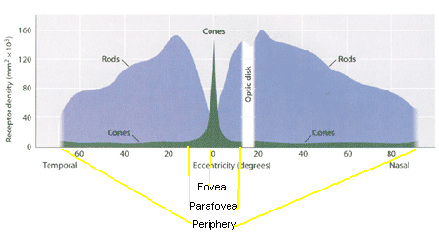

Slide 15
CONES :- responsible for color vision (bright light vision-photopic)
RODS :- for black and white vision and vision in the dark (scotopic vision)
in periphery only rods present so to utilize all the rods, there must be pupillary dilation

Slide 16
Rods | Cones
For dim light vision | For day light and colour vision
120 million in number; 4 µ in size | 6 million in number; 6 µ in size (1.5 µ at fovea)
More in peripheral retina, absent at optic disc and macula | More in central retina, absent at optic disc Macula having only cones (well packed long and slender cones)
50-100 rods converge on single ganglionic cell (summation is more) | 2 cones converge on 1 ganglionic cell while at macula, 1 cone converges on 1 ganglionic cell
Rod pigment: Rhodopsin made up of scotopsin (protein) + 11-cis retinal which responds to dim light | Cone pigment: Photopsin (protein + vitamin A) responds to bright and coloured light
RMP: -30 to -40 mv (by Na⁺ pump and Na⁺ dark current) | -same-

Slide 17
Rods | Cones
Mechanism of action: light hyperpolarizes them and electrotonic potential is generated (-30 to -90 mv) | -same-
Secretes Glutamate at bipolar cell | -same-
Terminate on Lateral geniculate body layer I & II (magnocellular layer) → occipital cortex layer 4C | Terminate on LGB layer III, IV, V & VI (parvocellular layer) → occipital cortex layer 4C
Very sensitive but slow | 100 times less sensitive than rods but 4 times rapid
Only one type exists | 3 types (blue, green & red)
Peak spectral sensitivity at 505 nm (scotopic vision) | Peak spectral sensitivity at 560 nm (photopic vision) Blue cone – 440 nm Green cone – 535 nm Red cone – 565 nm

Slide 18
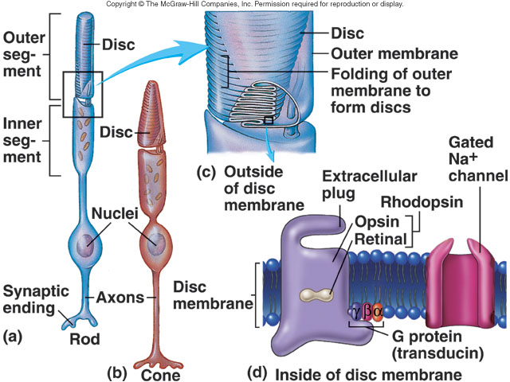
Sensory Receptor Cells

Slide 19
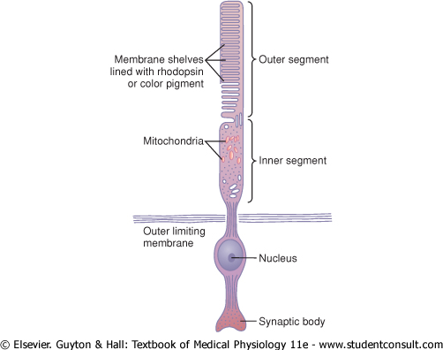
Major functional segments of either a rod or a cone:-
The Outer Segment
The Inner Segment
The Nucleus
The Synaptic Body

Slide 20
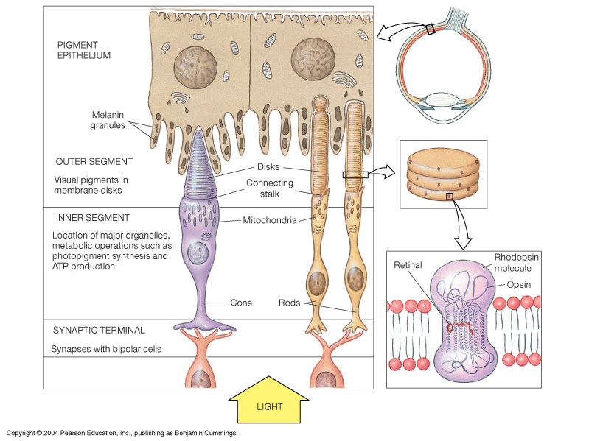
Outer segment
Rods:-
narrower and longer than the cones
Photochemicals present in this….constantly renewed by formation of new discs at the inner segment and phagocyosis of old disc form the outer tip by cells of pigment epithelium.
the rods → rhodopsin

Slide 21
Outer segment
Cons:-
conical in shape
it s renewal is more diffused process and appears to occur at multiple sites in the outer segment.
the cones → 3 "color" photochemicals → color pigments

Slide 22
The inner segment
contains cytoplasm with cytoplasmic organelles
the mitochondria providing energy for function of the photoreceptors
The synaptic body
this portion connects with subsequent neuronal cells, the horizontal and bipolar cells, that represent the next stages in the vision chain (also called flat zone-rod end bulb and cone plate)

Slide 24
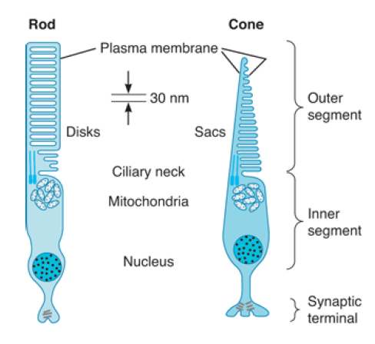
Photochemistry of vision

Slide 25
Photoreceptors
The photosensitive compounds in photoreceptors is made up of a photopigment.
In Rods it is called Rhodopsin: opsin (scoptopsin) and retinene1 (retinal = the aldehyde of Vit A)
In Cones it is called Iodopsin having same protein as opsin (photopsin) and retinene1.
Three types of cones: Red, green, blue….
Some animal species : retenene2

Slide 26
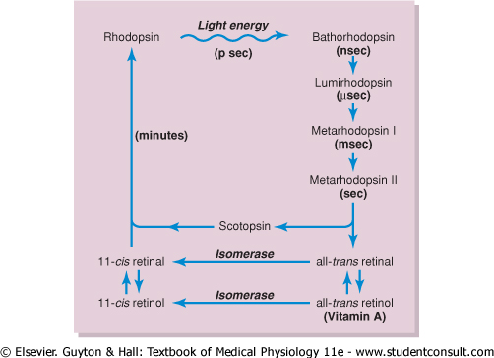
Rhodopsin
Light energy is absorbed by rhodopsin also k/a VISUAL PURPLE
Scotopsin + the carotenoid pigment 11-cis retinal ("retinene")
Only cis form can bind with scotopsin to synthesize rhodopsin.

Slide 27
Light induced changes
Rhodopsin bleaching.
Rhodopsin regeneration.
Visual cycle.

Slide 28
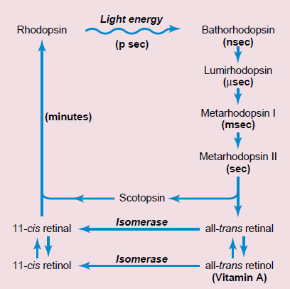

Slide 29
Rhodopsin bleaching:-
  Rhodopsin= Opsin + 11-cis retinal
  Light converts the 11-cis retinal into all trans retinal.
  This light induced isomerization occurs through formation of many intermediates, which exists for a transient period.
  The all trans retinal can no longer remain in combination with the opsin & thus there occurs separation of all trans retinal & opsin.
  This process of separation is called Photodecomposition & rhodopsin is said to be bleached by the action of the light.

Slide 30
Rhodopsin regeneration:-
  It is done by enzyme retinal isomerase which converts the all trans retinal into 11-cis retinal.
  11-cis retinal will combine with opsin to form rhodopsin.

Slide 31
Visual cycle:-
  The rate at which the photochemicals are bleached should be equal to the rate of regeneration.
  This equilibrium between the photodecomposition & regeneration of visual pigments is referred to as visual cycle.

Slide 33
Phototransduction:-
  Phototransduction refers to conversion of light energy into nerve impulse.
  It includes following steps:-
    Activation of rhodopsin
    Activation of transducin (G protein)
    Conversion of cGMP to GMP.
    Production of receptor potential.

Slide 34
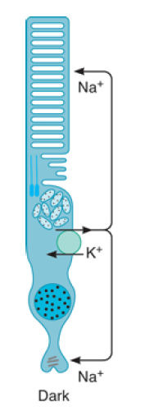
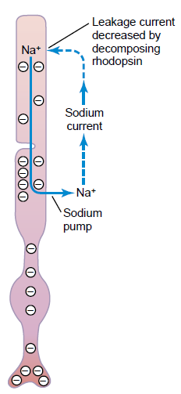

Slide 35
  Activation of rhodopsin:-
    Due to exposure of light rhodopsin will be converted into its active form metarhodopsin II.
  Activation of transducin:-
    Activated rhodopsin acts as an enzyme to activate many molecules of transducin (G-protein).
  3. Conversion of cGMP to GMP:-
    Activated G- protein will activate the enzyme phosphodiesterase, which will convert the cGMP into GMP.
    It will lead to decrease concentration of cGMP within photoreceptors.

Slide 36
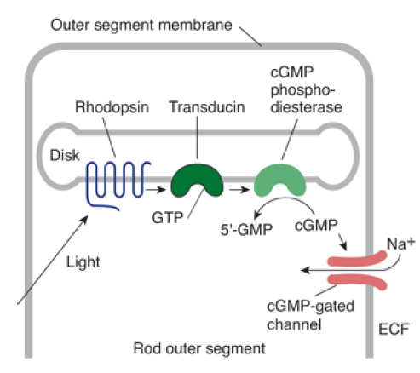
Metarhodopsin II
↓
Activates membrane protein Transducin (G-protein)
↓
Activates cGMP phosphodiesterase
↓
Hydrolyzes c-GMP to 5’-GMP
↓
Closure of Na+ channels in outer segment
↓
Hyperpolarization

Slide 37
Production of receptor potential:-
  In dark the sodium channels present in the cell membrane of the outer segment of the photoreceptor are kept open by cGMP.
  This causes sodium influx, which keeps the receptor cell in a constant state of depolarization.
  The intracellular sodium concentration is kept at a steady state level by sodium pump located in the inner segment.

Slide 38
When light strikes the photoreceptors, the amount of cyclic GMP will be reduced, so some of the sodium channels will be closed, it leads to hyperpolarization of the receptor cells.
This hyperpolarization will produce electric signals which will be transmitted by optic nerve to visual cortex.

Slide 40
Role of Vitamin A for Formation of Rhodopsin
second chemical route
all-trans retinal
↓
all-trans retinol (form of vitamin A)
↓
isomerase
↓
11-cis retinol
↓
the 11-cis retinol
↓
11-cis retinal
↓
scotopsin
↓
rhodopsin

Slide 41
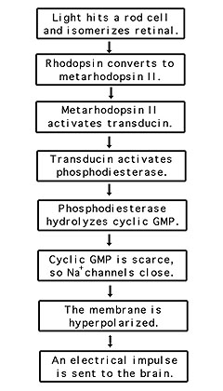
Rhodopsin kinase present in the rod, inactivates the metarhodopsin II
the entire cascade reverses back to the normal state with open sodium channels

Slide 42
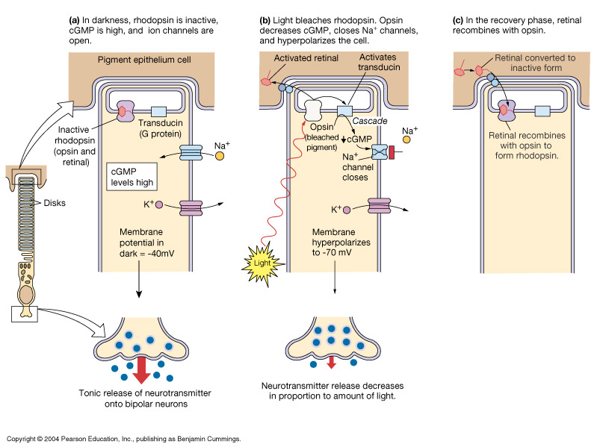
Figure 10-40: Phototransduction in rods

Slide 43
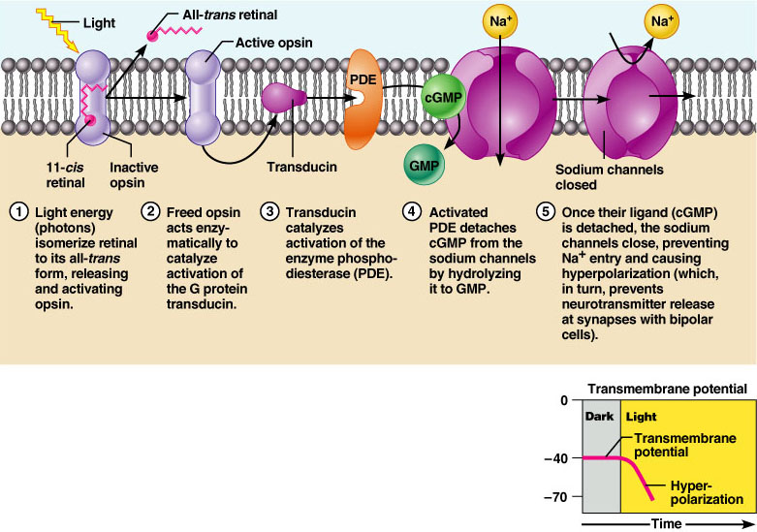
Figure 15.22

Slide 44
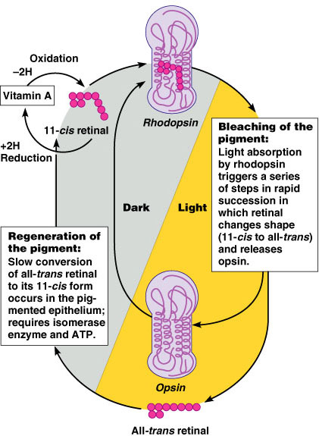
Excitation of Rods
Figure 15.21

Slide 45
Duration of the Receptor Potential, and Logarithmic Relation of the Receptor Potential to Light Intensity
When a sudden pulse of light strikes the retina, the transient hyperpolarization that occurs in the rods-that is, the receptor potential that occurs-reaches a peak in about 0.3 second and lasts for more than a second.
In cones, the change occurs four times as fast as in the rods. A visual image impinged on the rods of the retina for only one millionth of a second can sometimes cause the sensation of seeing the image for longer than a second.
Another characteristic of the receptor potential is that it is approximately proportional to the logarithm of the light intensity. This is exceedingly important, because it allows the eye to discriminate light intensities through a range many thousand times as great as would be possible otherwise.

Slide 46
Visual adaptation
The human eye in its ordinary use throughout the day is capable of functioning normally over an exceedingly wide range of illumination by a highly complex phenomenon termed as he “visual adaption”
Clear vision is possible in both light and dark conditions only if retinal sensitivity changes accordingly.
In human eye, it is achieved automatically and very effectively and retinal sensitivity is changed according to illumination.
Dark adaption - adjustment in dim illumination
Light adaption – adjustment in bright light

Slide 47
Adaptation
Adaptation to bright light (going from dark to light) involves:
  Dramatic decreases in retinal sensitivity – rod function is lost
  Switching from the rod to the cone system – visual acuity is gained
Adaptation to dark is the reverse
  Cones stop functioning in low light
  Rhodopsin accumulates in the dark and retinal sensitivity is restored

Slide 48
Dark adaption
Dark adaptation refers to how the eye recovers its sensitivity in the dark after exposure to bright lights.
The rods are much more sensitive to low illumination than cones
Therefore rods are more used in dim light (scotopic vision) & cones are more used in bright light (photopic vision)

Slide 49
Mechanisms of dark adaptation:-
  Photochemical adaptation:-
    It’s the major mechanism having 2 parts: cone adaptation & rod adaptation mainly because of increased photochemical pigment.
    Cone adaptation occurs first within minutes but it’s less effective (increased retinal sensitivity to 10-100 times).
    Rod adaptation starts late (after 10 minutes or so) but increases retinal sensitivity thousands times (~25,000 times) in about 40 minutes.

Slide 50
Rate of dark adaptation depends upon degree of previous exposure to light.
If eye is exposed to light for long time, photosensitive chemicals in the receptors not only splits into retinal & opsin but vitamin A is formed from retinal.
So vitamin A content of the eye is high.
When eye is exposed to darkness, vitamin A is first converted to retinal & than to photosensitive chemical.
Interconversion of vitamin A to retinal is a slower process as compared to interconversion of retinal to photosensitive chemical.
Therefore dark adaptation takes a longer time when previous exposure of eye to light is for a long time.

Slide 51
Dilatation of pupil- works within fraction of seconds – 30 folds increase in retinal sensitivity
Neural mechanism- works within fraction of seconds – few folds increase in retinal and brain sensitivity
Shifting vision from cones to rods- 100 or more rods converge on single ganglion cell – summation increases retinal sensitivity.

Slide 52
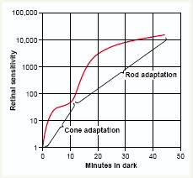
Dark adaptation curve

Slide 53
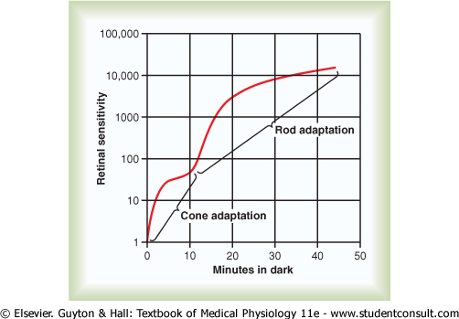
dark adaptation curve
inflection in the curve
The early portion of the curve : by 4x rapidly adapting cones → cease adapting after only a few minutes
do not achieve anywhere near the same degree of sensitivity change in darkness as the rods

Slide 54
dark adaptation curve
slowly adapting rods continue to adapt for many minutes and even hours
sensitivity increasing
still more increase in sensitivity of the rods is caused by neuronal signal convergence of 100 or more rods onto a single ganglion cell in the retina; these rods summate to increase their sensitivity

Slide 55
All chemical events of vision, including adaptation, occurs about four times as rapid in cones
Cones ceases adapting after only a few minutes
While slowly adapting rods continue to adapt for many minutes and even hours
Severe deficiency of Vitamin A elevates the threshold for dark adaptation curve due to depletion of photosensitive pigment

Slide 56
Course of dark adaptation
Duration in the darkness | sensitivity of the retina
0 second | very low
within 1 minute | ↑ed 10-fold*
20 minutes | ↑ed 6000-fold
40 minutes | ↑ed 25,000-fold
* the retina can respond to light of one tenth the previously required intensity
* Moderate dark adaptation occurs in 40 min, whereas complete in 18 hrs.

Slide 57
Light adaptation
The process by means of which retina adapts itself to bright light is called light adaptation
Unlike dark adaptation, light adaptation is very quick & occurs over a period of 5 minutes
  It is disappearance of dark adaptation.

Slide 58
Light adaptation:-
  Mechanisms of light adaptation-
    Photochemical adaptation
      Due to rods and cones adaptation (mainly because of breakdown of photochemical pigment into Retinal and opsin and then all the way into vitamin A)
      It’s very quick and almost complete within 5 minutes
    Constriction of pupil
    Neuronal adaptation: Signals transmitted by the neurons first increases. Most of the signals decreases rapidly at different stages of transmission in neural circuit
    Shifting vision from rods to cones- Only 8-10 cones converge on single ganglion cell – less summation

Slide 59
Light Adaptation | Dark Adaptation
When the person exposed to light, there is decreased sensitivity of retina to light, is called….. If a person has been in bright light for hours, large portions of the photochemicals in both the rods and the cones will have been reduced to retinal and opsins Retinal of both the rods and the cones → Vitamin A ↓ Concentrations of the photosensitive chemicals remaining in the rods and cones reduced Sensitivity of the eye to light reduced | Def: when the person remains in darkness for long time there is increased sensitivity of retina to light which is dark adaptation. If a person remains in darkness for a long time, the retinal and opsins in the rods and cones converted back into the light-sensitive pigments. Vitamin A → retinal →more light-sensitive pigment

Slide 60
Why light adaptation quicker than dark adaptation?

Slide 61
Factors affecting dark adaptation:-
depends on degree of previous exposure to light
if the eye is exposed to light for longer time….
photosensitive chemicals in the receptors, split into opsin, retinal → Vit A
When exposed to dark…..
Vit A → retinal → photosensitive chemicals
Interconversion of retinal - Vit A → slower process

Slide 62
light adaptation slower reaction (interconversion between retinal and Vit A) doesn’t play any role and thus it occurs quickly

Slide 63
Night Blindness (Nyctalopia)
severe vitamin A deficiency
the amounts of retinal and rhodopsin severely depressed
vitamin A-deficient diet for months (liver) → night blindness
Night blindness develops reversed in less than 1 hour by iv vitamin A

Slide 64
CCES
Active form of Rhodopsin
Bathrhodopsin
Lumirhodopsin
Metarhodopsin I
Metarhodopsin II

Slide 65
2. Receptor potential generated in photoreceptors are
______type.
Depolarizing
Hyperpolarizing
Spike potential
Action potential

Slide 66
3. Visual Purple is made up of
Scotopsin + All trans retinal
Scotopsin + All cis retinal
Scotopsin + All trans retinol
Scotopsin + All cis retinol

Slide 67
4. Resting membrane potential of photoreceptors are
-40 mV
-50 mV
-70 mV
-80 mV

Slide 68
5. Storage site of Vitamin A in eye is all except
Pigment layer of Retina
Cytoplasm of rods
Cytoplasm of cons
Cell membrane of rods

