Slide 1
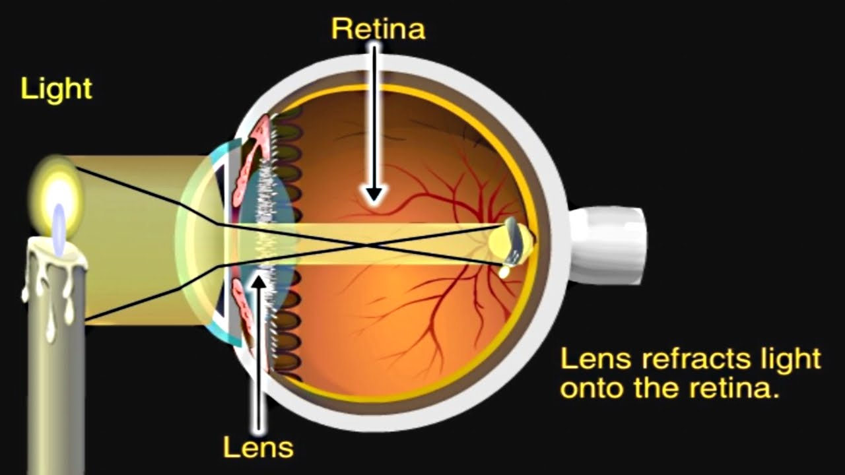
REFRACTIVE ERRORS

Slide 2
Accommodation
Definition:-
  The ability of the eye to focus an object at varying distance is called accommodation
Mechanism for near vision:-
  Parasympathetic (3rd cranial nerve) stimulation
  Contraction of ciliary muscle.
  Loosening of suspensory ligament.
  Increased in the curvature of anterior surface of lens.
  Constriction of pupil- by sphincter pupillae by parasympathetic fibers in 3rd cranial nerve.
  Convergence of visual axis- by medial rectus supplied by 3rd cranial nerve.

Slide 3
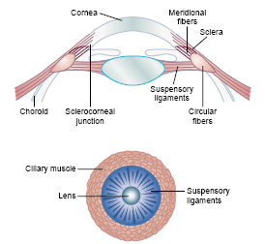

Slide 4
Far point:-
  It is farthest distance from the eye at which an object is seen clearly (infinity) but for practical purposes, it is considered 6 meter (20feet).
Near point:-
-- Nearest distance from eye at which object can be seen
clearly. It is 25cm (10 inches)

Slide 5
Presbyopia
An eyesight of old age
Not an error of refraction but condition of physiological insufficiency of accommodation
Leading to failure of near vision
Pathophysiology:-
(1) Decrease in elasticity of crystalline lens due to age related sclerosis
(2) Age related decrease in power of ciliary muscles
Symptoms:- difficulty in near vision, asthenopic symptoms due to fatigue of ciliary muscles
Treatment:-convex glasses for near vision or bifocal lens for both near and far vision

Slide 6
Ametropia:-
  (a condition of refractive error) parallel rays of light coming from infinity are focused either in front or behind the retina when accommodation being at rest.
  It includes myopia, hypermetropia & astigmatism.
Pathological:-
  Myopia (near sightedness)
  Hypermetropia / hyperopia (far sightedness)
  Astigmatism
  Presbiopia

Slide 7
Common defects (Refractive errors)
Hypermetropia (hyperopia/long sightedness):-
Is the refractive state of eye wherein parallel rays of light coming from infinity are focused behind the retina with accommodation being at rest

Slide 8
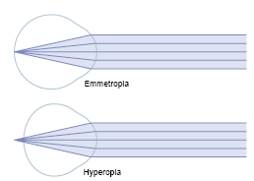

Slide 9
Causes of hyperopia
(1) Axial hypermetropia:- most common form
There is axial shortening of eyeball
(2) Curvatural hyperopia:- the curvature of lens ,cornea or both are falter than normal
(3) Index hyperopia :- due to change in in refractive index of lens in old age
(4) Positional hyperopia:- due to posteriorly placed lens
(5) Absence of crystalline lens:- either congenitally or acquired leads to aphakia

Slide 10
Characteristic features
Far sightedness
Near point of vision moves further away & problem in near vision
Asthenic symptoms:- mild headache, eyeache, feeling of tiredness, discomfort in reading
Accommodative convergent squint may develop in children

Slide 11
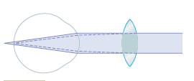
Optical correction:- with convex(plus) lens

Slide 12
Myopia (short sightedness)
Parallel rays of light coming from infinity are focused in front of retina
Causes:-
Axial:- increase in anterior-posterior diameter of lens
Curvatural:- increased curvature of crystalline lens
Positional:- produced by anterior placement of lens
Index:- increase in refractive index of lens
Due to excessive accommodation- in spasm of accommodation

Slide 13

Characteristic features:-
Short sightedness- far point is a finite point in front of eye, so cannot see distant object
Accommodation in uncorrected myopia is developed well normally, since they need not accommodate to see the near objects

Slide 14
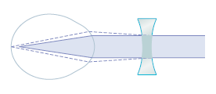
Optical correction:- with concave (minus) lens

Slide 15
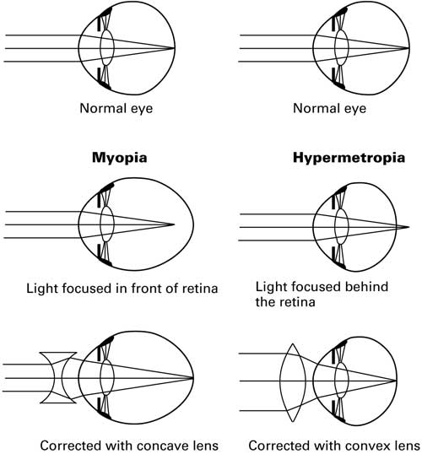

Slide 16
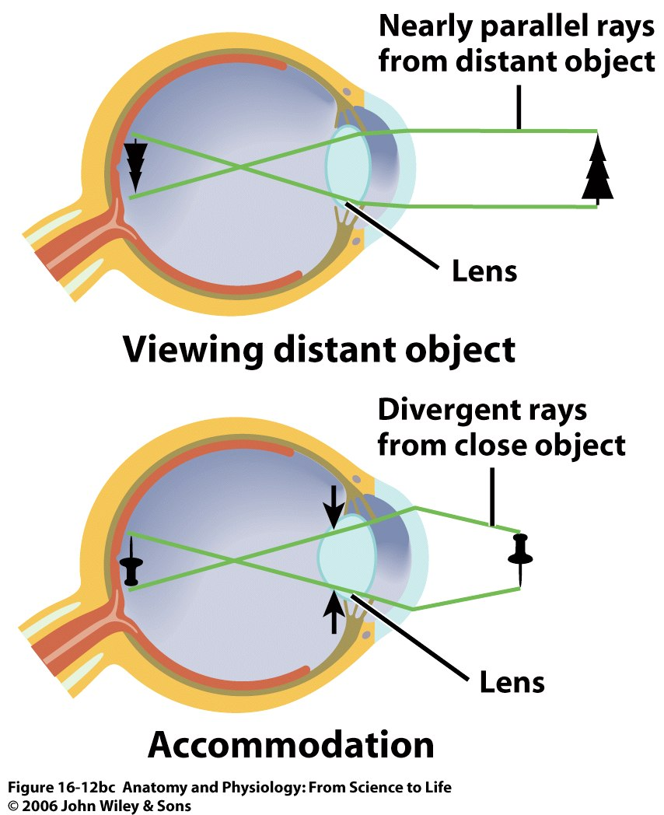
Figure 16.12bc

Slide 17
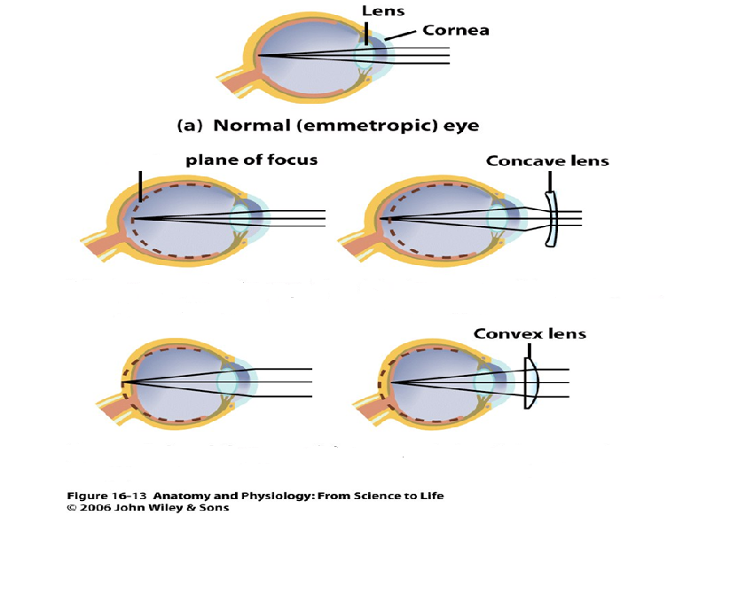

Slide 18
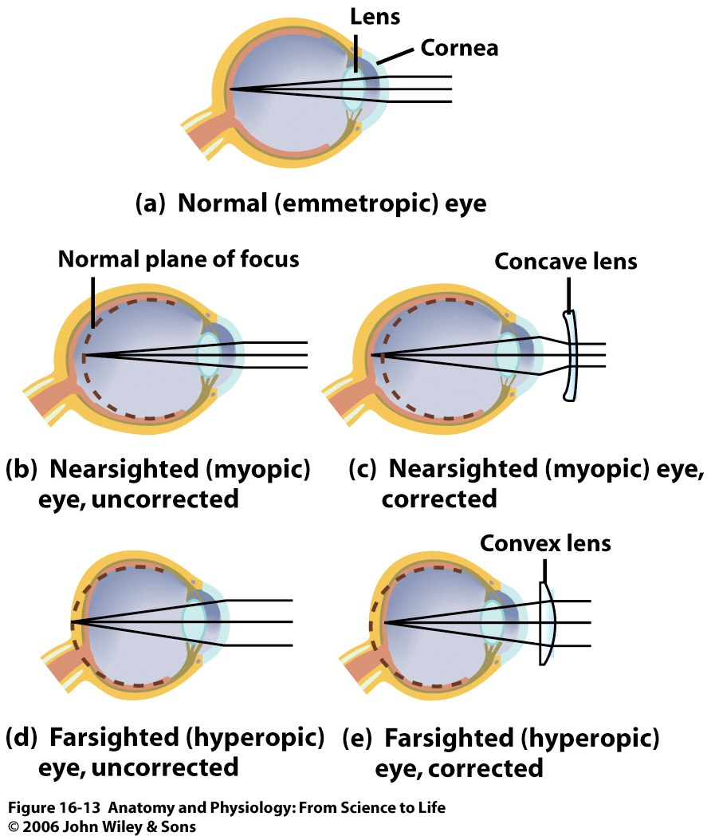
Figure 16.13

Slide 20
Figure 16.13

Slide 21
Myopia | Hypermetropia
Also known as near sightedness | Also known as far sightedness
Definition: It is the condition in which parallel rays of light coming from infinity focus in front of the retina instead of on the retina, with accommodation being at rest. | Definition: It is the condition in which parallel rays of light coming from infinity focus behind the retina instead of on the retina, with accommodation being at rest.
Causes: -Increased AP diameter of eye -Increased refractive power of the lens or cornea | Causes: -Decreased AP diameter of eye -Decreased refractive power of the lens or cornea

Slide 22
Myopia | Hypermetropia
Pathophysiology: Far point – Near Near point – Nearer | Pathophysiology: Far point – Normal (with accommodation) Near point – Far
Accommodation: used lately, while focusing on object very close to eye. | Accommodation: used even at rest
Clinical features: Near vision – Normal Far vision – Decreased | Clinical features: Near vision – Decreased Far vision – Normal (with accommodation)
Diagnosis: Clinically Snellen’s chart | Diagnosis: Clinically Jaeger’s chart
Correction / treatment: Spherical concave lens Contact lenses LASIC surgery | Correction / treatment: Spherical convex lens

Slide 23
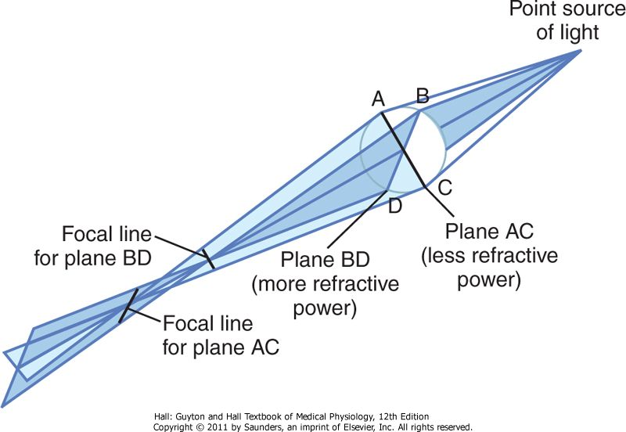
Astigmatism
  Definition:-
    It is an ammetropic condition due to difference in curvature of lens or cornea in one or more meridians so that image in that meridian is blurred.

Slide 24
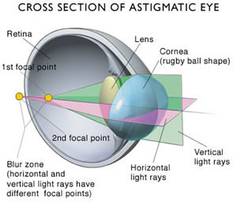

Slide 25
Causes
Refraction varies in different meridian
The rays of light entering the eye cannot converge to a point focus but form focal lines
Most often result from too great curvature of the cornea in one plane of eye
Accommodative power of eye can never compensate for astigmatism

Slide 26
Optical correction:-
  Correction / treatment:-
    Astigmatism can be corrected with cylindrical lens (concave or convex) in the defected meridian.
Find a spherical lens by trial& error that corrects the focus in one of the two planes of astigmatic lens
Then an additional cylindrical lens is used to correct the remaining error in the remaining plane

Slide 27
Visual acuity
Visual acuity: It is the degree to which the details and contours of objects are perceived. and
Minimum separable distance:- it is the shortest distance by which two lines can be separated and still be perceived as two lines.
Tested separately for distant and near vision

Slide 28
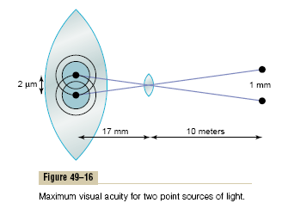
Visual acuity

Slide 29
Clinical Method for Stating Visual Acuity
The chart for testing eyes usually consists of letters of different sizes placed 20 feet away from the person being tested.
If the person can see well the letters of a size that he or she should be able to see at 6 met, the person is said to have 6/6 vision—that is, normal vision.
If the person can see only letters that he or she should be able to see at 60 feet, the person is said to have 6/60 vision.
In other words, the clinical method for expressing visual acuity is to use a mathematical fraction that expresses the ratio of two distances, which is also the ratio of one’s visual acuity to that of a person with normal visual acuity.

Slide 30
Snellen’s test
Two distant points can be visible as separate only when they subtend an angle of 1 min at the nodal point of eye known as Visual angle, form the basis of snellen’s test
Consists of series of black letters on a white board
Arranged in lines, each progressively diminishing in size
The lines comprising letters have such a breadth that they subtend an angle of 1 min at the nodal point
Represented as ratio of one’s visual acuity to that of a person with normal visual acuity (6/60, 6/24..)

Slide 31
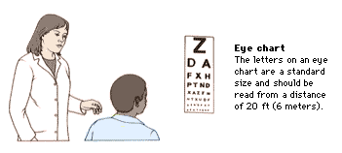

Slide 32
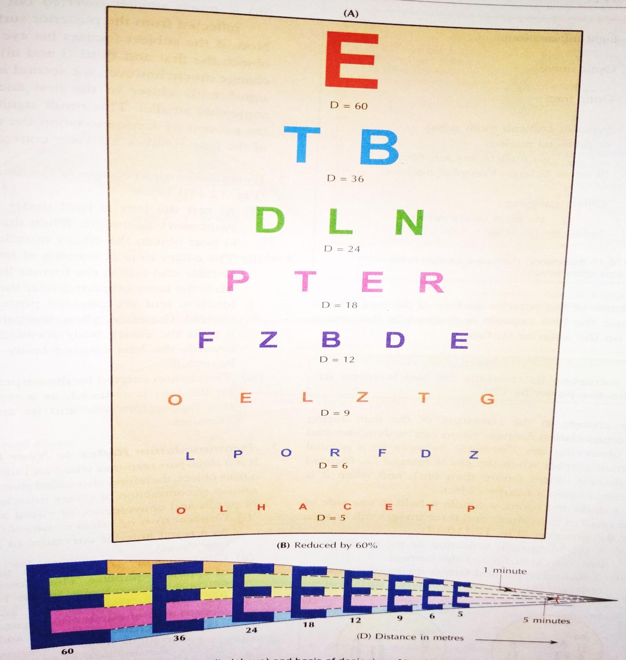

Slide 33
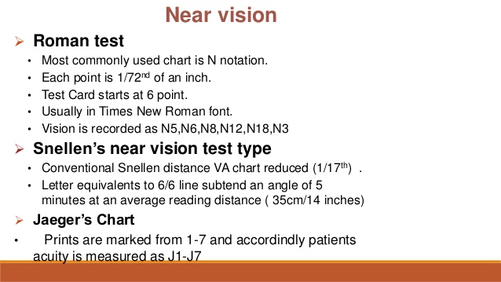

Slide 34
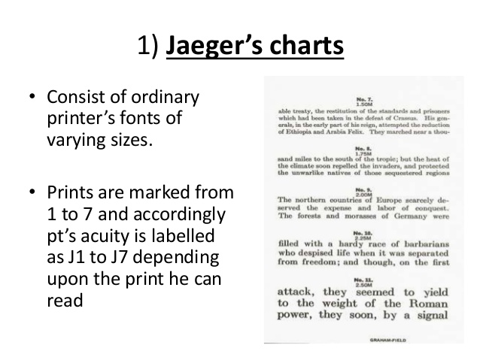

Slide 35
Figure 16.13

Slide 36
Treatments
Refractive Errors correction
With prescription glasses,
Contact lenses or
Refractive surgery, such as LASIK (laser-assisted in situ keratomileusis), or PRK (Photorefractive keratectomy).
Other treatments include;
Clear Lensectomy and Intra-ocular lens (IOL) Implantation
Implantable Contact Lens (ICL)

Slide 37
CCES
Peripheral retina is responsible for mainly _______ vision?
Daylight
Bright light
Color
Black and white

Slide 38
2. During accommodation, constriction of pupil decreases all except…
Spherical and chromatic aberration
Intensity of light entering to eye
Depth of focus
Size of pupil

Slide 39
3. For normal eye of a 20 year old individual, Far point is situated at ……
10 cm
25 cm
5 metre
Infinity

Slide 40
4. False about Blind spot
Also called Optic Disc
Lies 3 mm medial to posterior pole of eyeball
Vision is not possible over this area
With anterior pole of eyeball forms the optical axis

Slide 41
5. Action potential generating cells of Retina
Rods and Cones
Bipolar cells
Amacrine cells
Ganglionic cells

