Slide 1
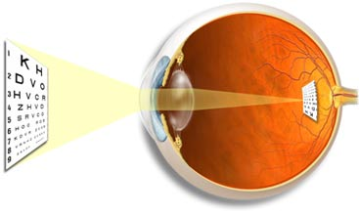
THE IMAGE FORMING MECHANISM
Dr. Jayna Devalia
(M.B.B.S., M.D. Physiology)
Tutor
Department of Physiology
Smt. B. K. Shah Medical Institute & Research Centre
Sumandeep Vidyapeeth

Slide 2
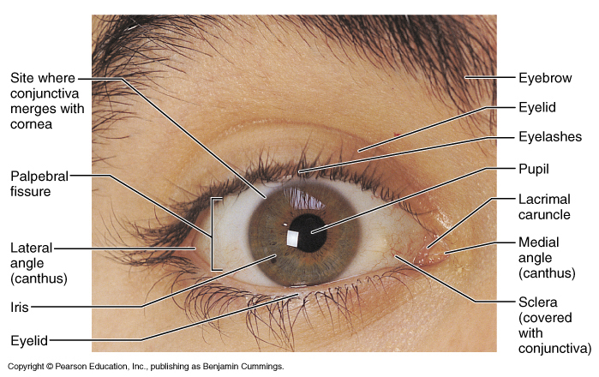
M&M, fig. 16.4

Slide 3
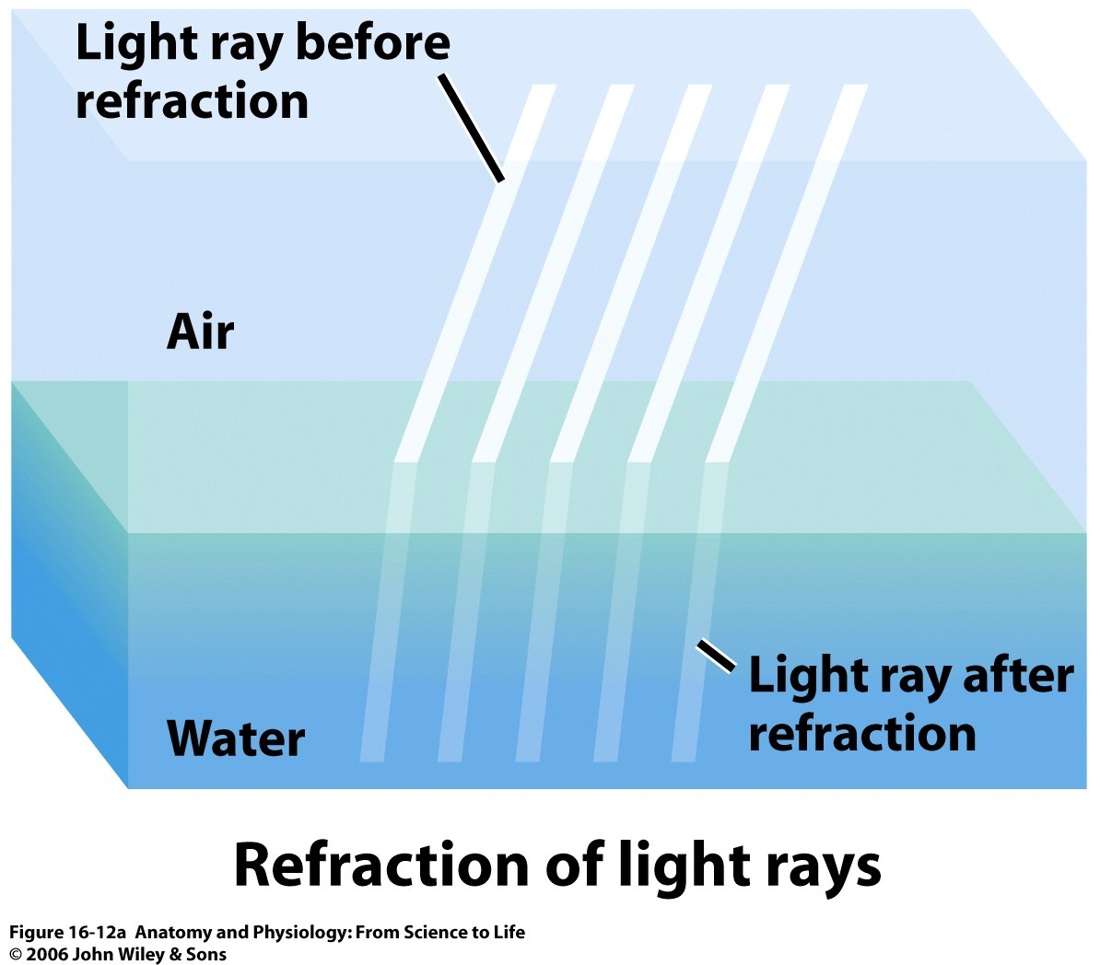
Refraction
Bending of light rays at an angulated surface is known as “refraction”
Degree of refraction increase if
The ratio of refractive indices of two transparent media more
The degree of angulation b/w the interface and the entering wave front

Slide 4
Refraction of light
Refractive index:-
of a transparent media is the ratio of
the velocity of light in air
the velocity of light in substance
Refractive index of air - 1
When light rays strike an interface that is perpendicular to the beam-no refraction
If light rays pass through angulated interface the rays bend if the refractive index of the two media are different

Slide 5
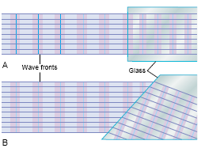

Slide 6
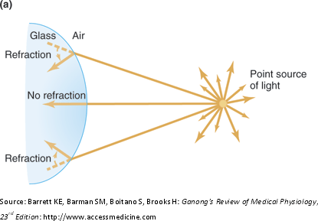

Slide 7
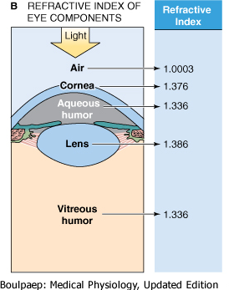
The structures forming refractive media of the eye from anterior to posterior are:-
  Tear film
  Cornea
  Aqueous humour
  Crystalline lens
  Vitreous humour

Slide 8
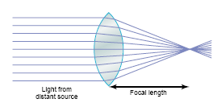
Convex lens
Convex lens focuses light rays
The outer rays bend more and more toward the center, called convergence
Half the bending occurs when the rays enter the lens and half as they exit from opposite side

Slide 9
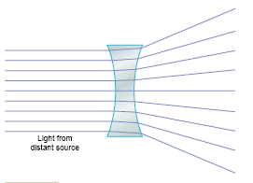
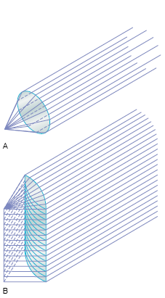
Concave lens:- diverges light rays
Cylindrical lens:- bends light rays in only one plane
Bends light rays from the two sides of lens but not from the top or bottom
Thus parallel rays are bent to a focal line

Slide 10
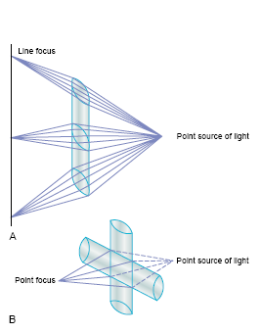
Combination of 2 cylindrical lens at right angles equals a spherical lens
The vertical cylindrical lens converges light rays pass through the two sides of lens
The horizontal lens converges the top & bottom rays
All rays come to single focus point

Slide 11
Measurement of refractive power
The more a lens bends light rays, the greater is its “refractive power.”This refractive power is measured in terms of diopters.
The refractive power in diopters of a convex lens is equal to 1 divided by its focal length in metres.
Total: +59 D
Cornea: +43 D
Crystalline lens: +16 D

Slide 12
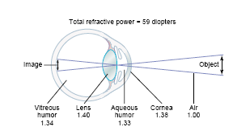

Slide 13
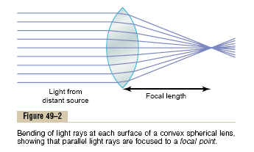
Focal length
The distance beyond a convex lens at which parallel rays converge to a common focal point is called the focal length of lens
Diverging light rays- more focal length
Parallel light rays- less focal length

Slide 14
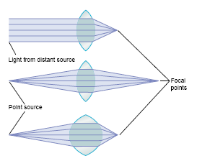

Slide 15
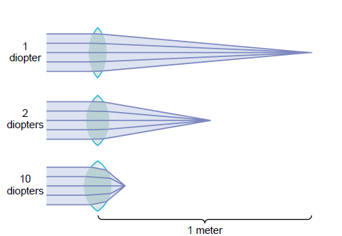

Slide 16
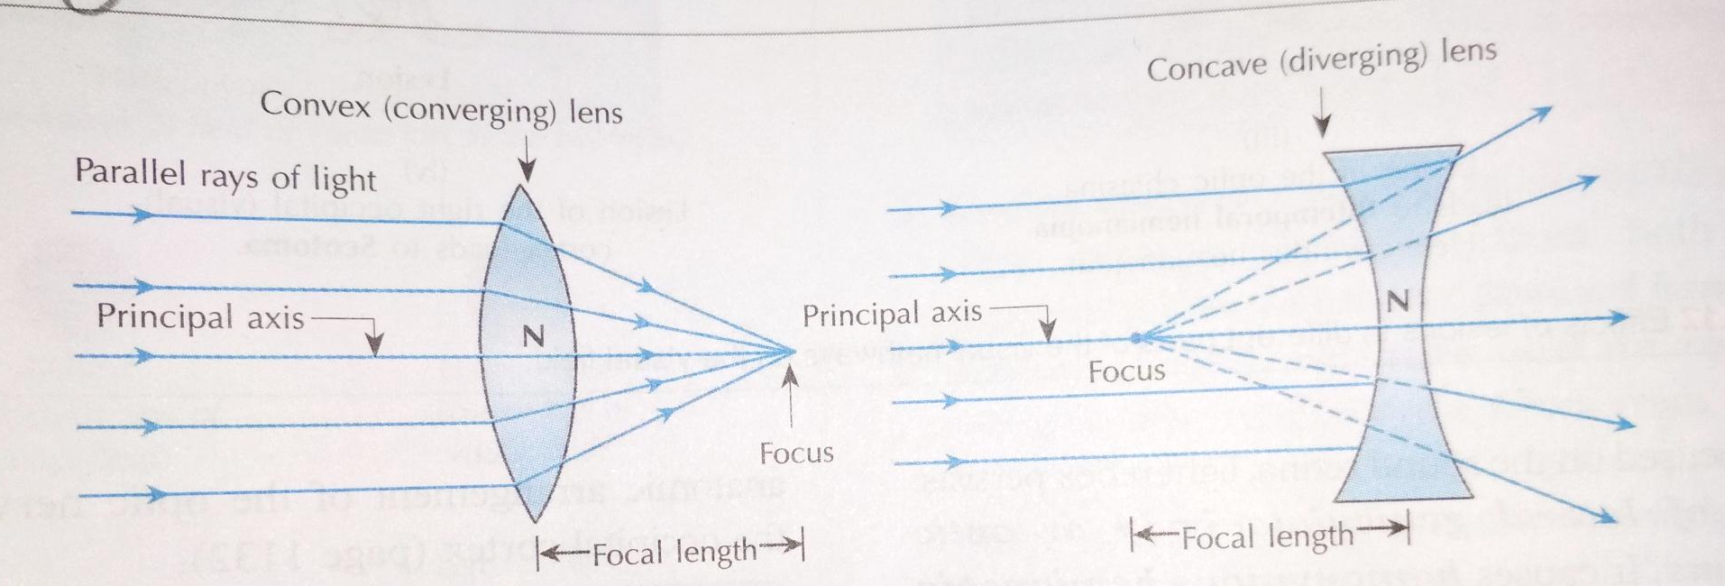
Convex lens has positive focal length, so the power of convex lens is written as + sign
Concave lens has negative focal length, so the power of concave lens is negative; written as –sign

Slide 17
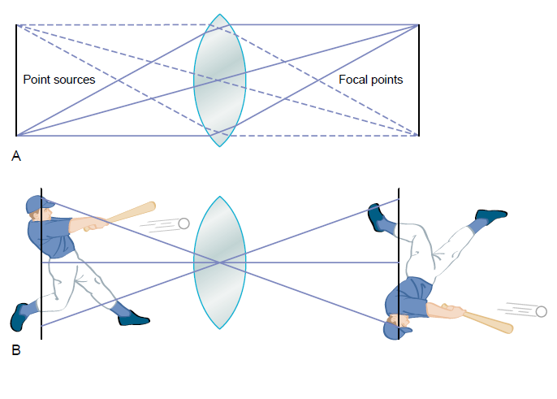
Formation of image by a convex lens
Each point source of light on the object comes to a separate point focus on the opposite side of lens in line with the lens center
Image is upside down with respect to original object & the two lateral sides of image are reversed

Slide 18
Formation of an Image by a
Convex Lens

Slide 19
Optics of the eye
Visual axis:- line joining the fixation point, nodal point and the fovea
Optical axis:- line passing through the center of cornea, nodal point and meets the retina on macula at nasal side of fovea
  It is an imaginary line joining anterior and posterior pole of eye.
(Both axes cross each other at the center of crystalline lens where no refraction takes place

Slide 20
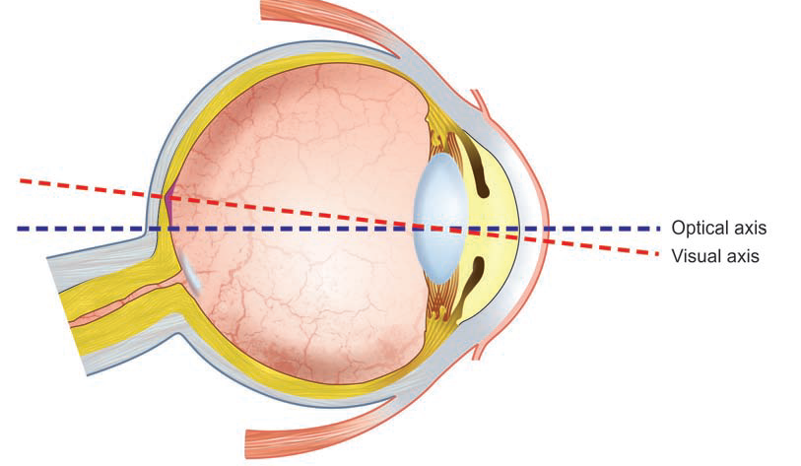
Optic axis Vs Visual axis

Slide 21
Optics of the eye
Cardinal points of the eye:-
  Two principle foci
  Two principle points
  Two nodal point
All are situated on principle axis.
Gauss described the optics of eye by using these six cardinal points, this model is known as schematic eye.

Slide 22
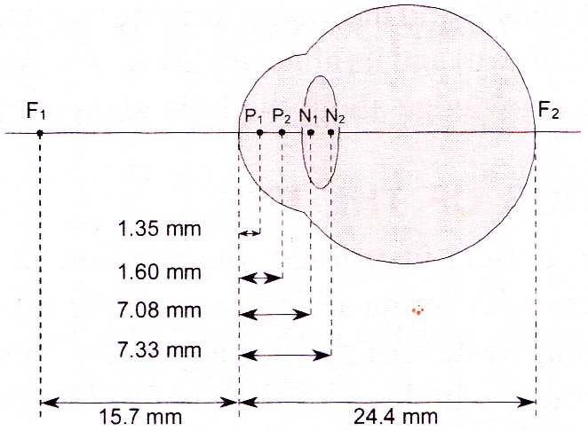

Slide 23
The reduced eye:-
  The optics of eye is very complex with schematic eye, so listing has simplified the data by choosing single principle point & single nodal point lying midway between two principle points & two nodal points, this is called listing’s reduced eye.
  The simplified data of this eye are:-
    Power is +59 diopter
    Principle point lies 1.5mm behind the cornea.
    Nodal point lies 7.2 mm behind the cornea.
    Anterior focal point is 15.7 mm in front of the cornea.
    posterior focal point is 24.4 mm behind the cornea.
    Anterior focal length is 17.2mm & posterior focal length is 22.9 mm.

Slide 24
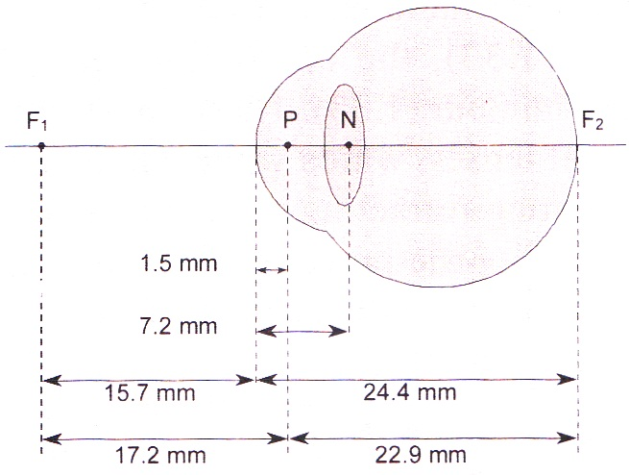

Slide 25
Refractive power of lens of the reduced eye
Posterior focal point is 24.4 mm behind the cornea.
Nodal point lies 7.2 mm behind the cornea.
So, the Focal length is 24.4-7.2 = 17.2 mm
RP in Diopters = 1
Focal length in meters
= 1000/17.2
= 58 D
Normal human eye has almost identical refractive power of 59 D; S, it also behaves as reduced eye.

Slide 26
Accommodation
Definition:-
  The ability of the eye to focus an object at varying distance is called accommodation
Mechanism for near vision:-
  Parasympathetic (3rd cranial nerve) stimulation
  Contraction of ciliary muscle.
  Loosening of suspensory ligament.
  Increased in the curvature of anterior surface of lens.
  Constriction of pupil- by sphincter pupillae by parasympathetic fibers in 3rd cranial nerve.
  Convergence of visual axis- by medial rectus supplied by 3rd cranial nerve.

Slide 27
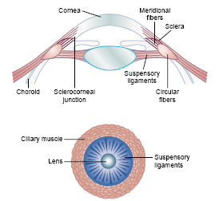

Slide 28
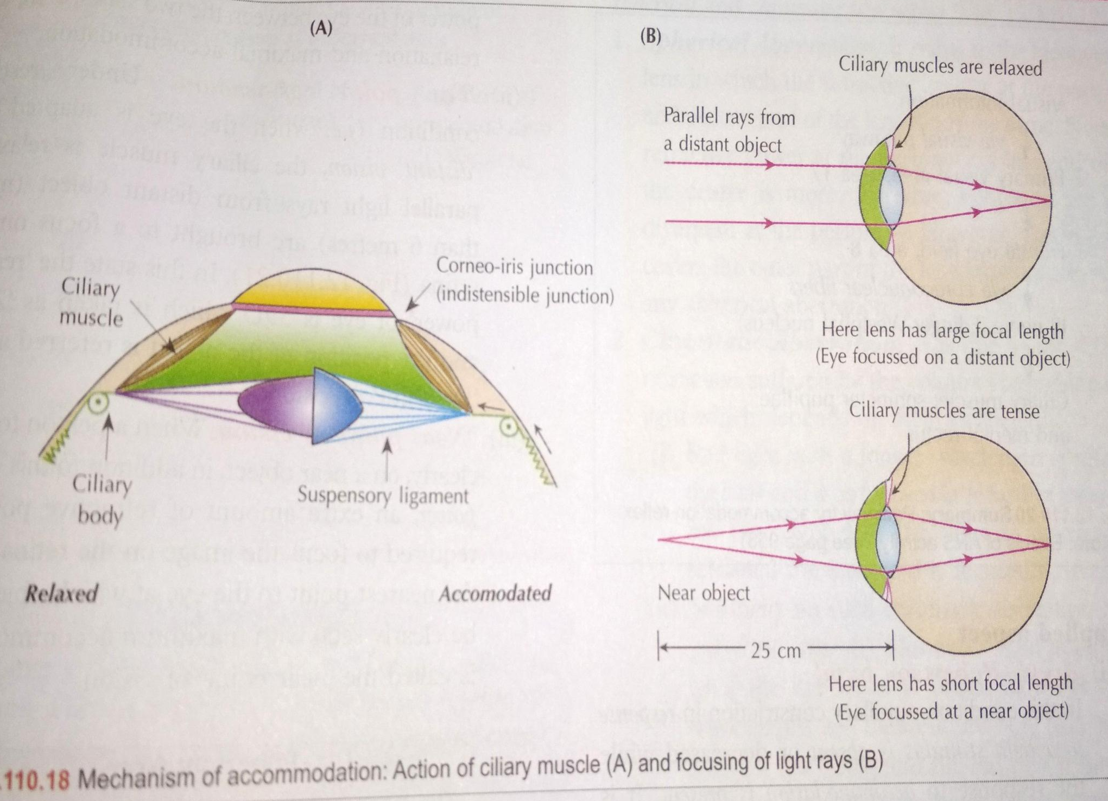

Slide 29
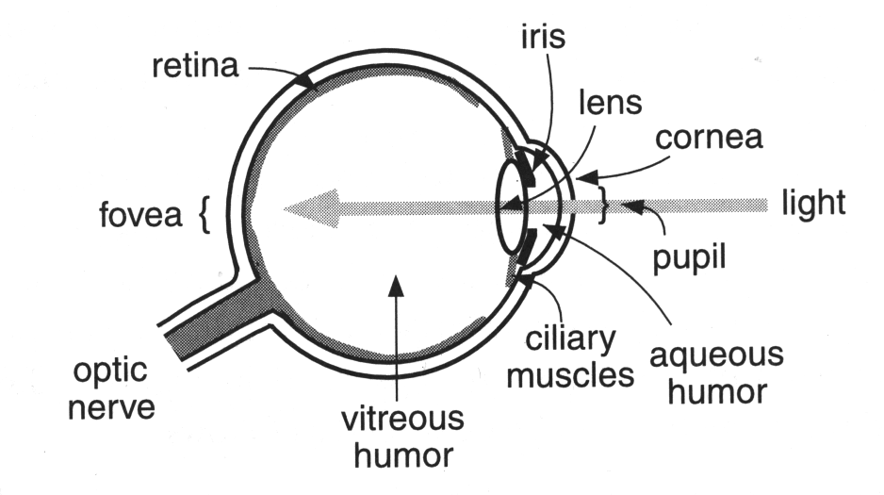

Slide 30
Far point:-
  It is farthest distance from the eye at which an object is seen clearly (infinity) but for practical purposes, it is considered 6 meter (20feet).
Near point:-
- Nearest distance from eye at which object can be seen clearly. It
is 25cm (10 inches)
Amplitude of accommodation:-
  Difference between the dioptric power needed to focus at near point & needed to focus at higher point.
Range of accommodation:-
  It is distance between ‘far point’ and ‘near point’.

Slide 31
Errors of refraction
Physiological:-
  Spherical aberration-
    Parallel light rays passing through the peripheral portions of the eye lens do not exactly focus at the same point where rays passing through central portion of the lens focused.
    This defect is physiological and is called spherical aberration.
    It is minimized especially when pupil constricts because of the iris covering the peripheral portions of the lens.
    So brings more paraxial rays to focus closer to the lens

Slide 32
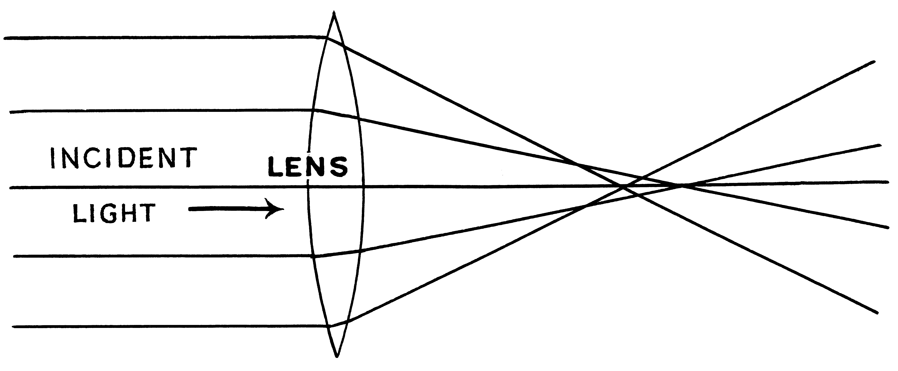

Slide 33
Chromatic aberration:-
  Refractive power of the lens of the eye is different for different colours.
  Therefore the light rays of different colours get focused at different distances behind the lens.
  This error is also physiological and is called chromatic aberration.
  In human eye blue & green rays are focused slightly in front of red rays

Slide 34
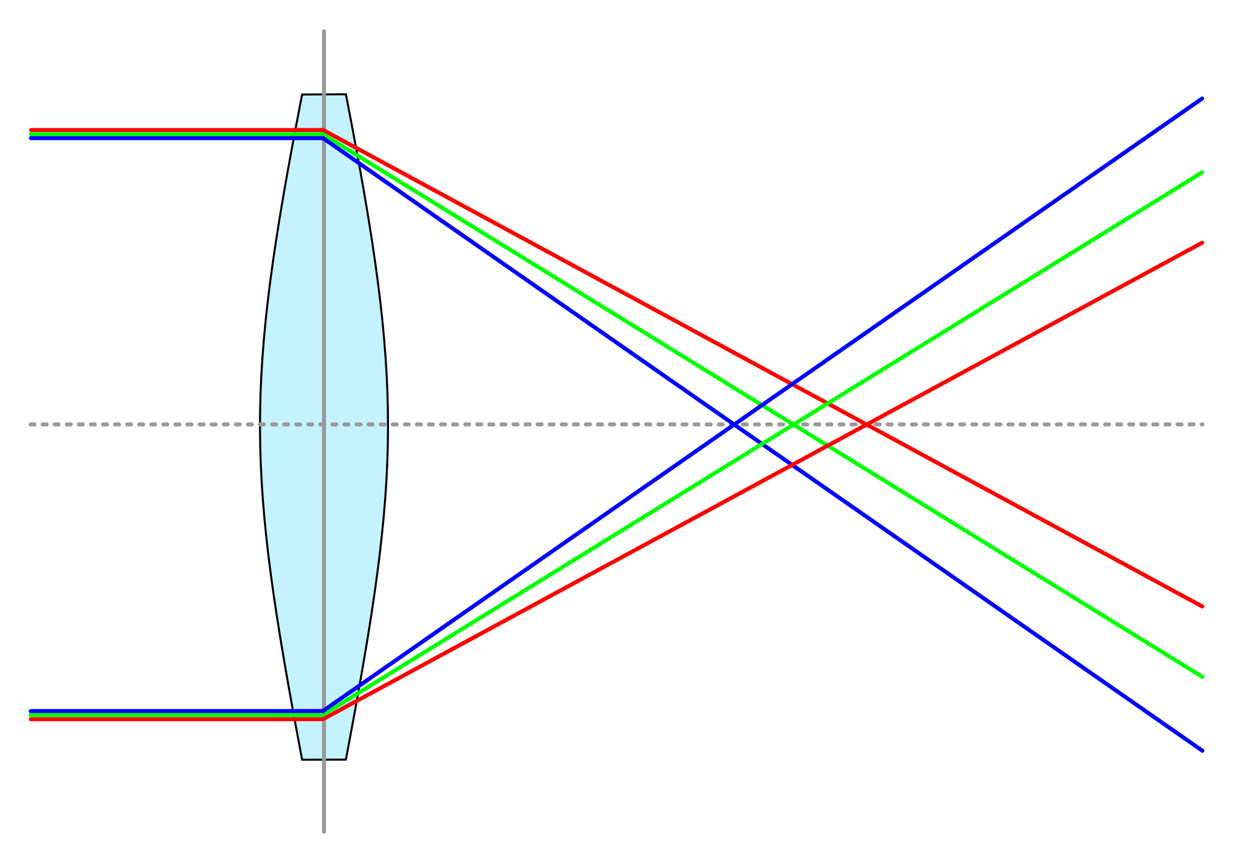

Slide 35
Diffraction:-
  Bending of the light rays as they pass over the sharp borders of the pupil is known as diffraction.
  It interferes with image formation when pupil size is small.
  The ideal size of pupil is 2.5 mm.
Emmetropia:-
  (optically normal eye) parallel rays of light coming from infinity are focused at retina when accommodation being at rest.

Slide 36
Ametropia:-
  (a condition of refractive error) parallel rays of light coming from infinity are focused either in front or behind the retina when accommodation being at rest.
  It includes myopia, hypermetropia & astigmatism.
Pathological:-
  Myopia (near sightedness)
  Hypermetropia / hyperopia (far sightedness)
  Astigmatism
  Presbiopia

Slide 37
Common defects (Refractive errors)
Hypermetropia(hyperopia/long sightedness):-
Is the refractive state of eye wherein parallel rays of light coming from infinity are focused behind the retina with accommodation being at rest

Slide 38
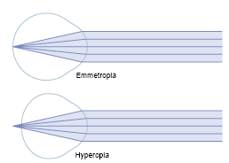

Slide 39
Causes of hyperopia
(1) Axial hypermetropia:- most common form
There is axial shortening of eyeball
(2) Curvatural hyperopia:- the curvature of lens ,cornea or both are falter than normal
(3) Index hyperopia :- due to change in in refractive index of lens in old age
(4) Positional hyperopia:- due to posteriorly placed lens
(5) Absence of crystalline lens:- either congenitally or acquired leads to aphakia

Slide 40
Characteristic features
Far sightedness
Near point of vision moves further away & problem in near vision
Asthenic symptoms:- mild headache, eyeache, feeling of tiredness, discomfort in reading
Accommodative convergent squint may develop in children

Slide 41
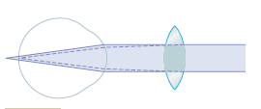
Optical correction:- with convex(plus) lens

Slide 42
Myopia (short sightedness)
Parallel rays of light coming from infinity are focused in front of retina
Causes:-
Axial:- increase in anterior-posterior diameter of lens
Curvatural:- increased curvature of crystalline lens
Positional:- produced by anterior placement of lens
Index:- increase in refractive index of lens
Due to excessive accommodation- in spasm of accommodation

Slide 43

Characteristic features:-
Short sightedness- far point is a finite point in front of eye, so cannot see distant object
Accommodation in uncorrected myopia is developed well normally, since they need not accommodate to see the near objects

Slide 44
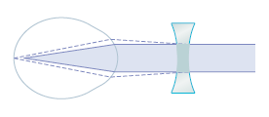
Optical correction:- with concave (minus) lens

Slide 45
Myopia | Hypermetropia
Also known as near sightedness | Also known as far sightedness
Definition: It is the condition in which parallel rays of light coming from infinity focus in front of the retina instead of on the retina, with accommodation being at rest. | Definition: It is the condition in which parallel rays of light coming from infinity focus behind the retina instead of on the retina, with accommodation being at rest.
Causes: -Increased AP diameter of eye -Increased refractive power of the lens or cornea | Causes: -Decreased AP diameter of eye -Decreased refractive power of the lens or cornea

Slide 46
Myopia | Hypermetropia
Pathophysiology: Far point – Near Near point – Nearer | Pathophysiology: Far point – Normal (with accommodation) Near point – Far
Accommodation: used lately, while focusing on object very close to eye. | Accommodation: used even at rest
Clinical features: Near vision – Normal Far vision – Decreased | Clinical features: Near vision – Decreased Far vision – Normal (with accommodation)
Diagnosis: Clinically Snellen’s chart | Diagnosis: Clinically Jaeger’s chart
Correction / treatment: Spherical concave lens Contact lenses LASIC surgery | Correction / treatment: Spherical convex lens

Slide 47
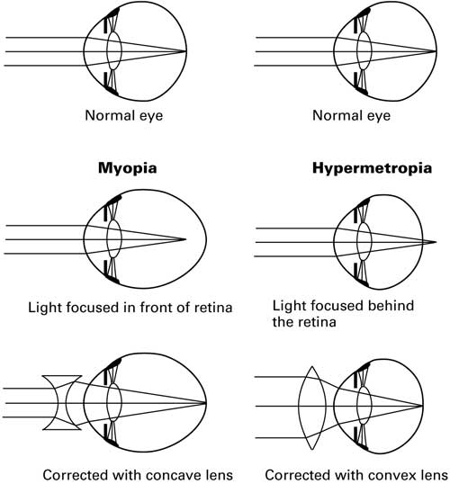

Slide 48
Astigmatism:-
  Definition:-
    It is an ammetropic condition due to difference in curvature of lens or cornea in one or more meridians so that image in that meridian is blurred.

Slide 49
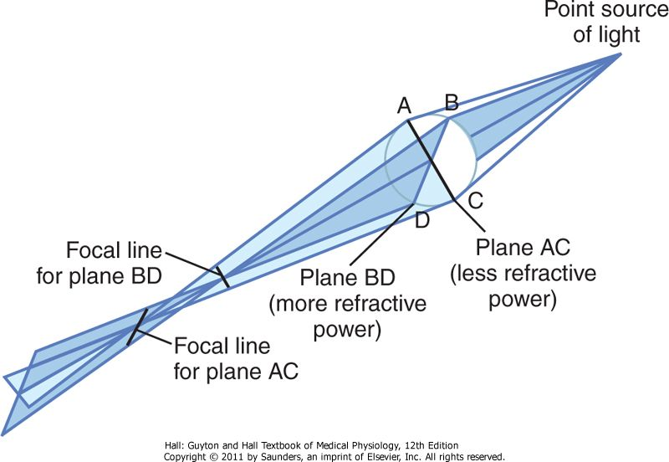
Astigmatism

Slide 50
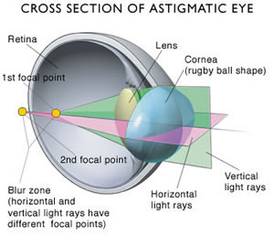

Slide 51
Causes
Refraction varies in different meridia
The rays of light entering the eye cannot converge to a point focus but form focal lines
Most often result from too great curvature of the cornea in one plane of eye
Accommodative power of eye can never compensate for astigmatism

Slide 52
Optical correction:-
  Correction / treatment:-
    Astigmatism can be corrected with cylindrical lens (concave or convex) in the defected meridian.
Find a spherical lens by trial& error that corrects the focus in one of the two planes of astigmatic lens
Then an additional cylindrical lens is used to correct the remaining error in the remaining plane

Slide 53
Contact lenses
Glass or plastic contact lenses used that fit against the anterior surface of cornea
Especially important for abnormally shaped cornea, caratoconus - odd shaped, bulging cornea
Advantages:-
The lens turns with eye and gives broader field of clear vision
Has little effect on the size of object the person sees through lens

Slide 54
Presbyopia
An eyesight of old age
Not an error of refraction but condition of physiological insufficiency of accommodation
Leading to failure of near vision
Pathophysiology:-
(1) Decrease in elasticity & plasticity of crystalline lens due to age related sclerosis
(2) Age related decrease in power of ciliary muscles
Symptoms:- difficulty in near vision, asthenopic symptoms due to fatigue of ciliary muscles
Treatment:-convex glasses for near vision

Slide 55
Visual acuity
Defined as the resolving power of the eye, that is, to what extent the eye can perceive the details and counters of an object
Minimum separable distance:- smallest gap by which two lines can be separated and can be seen as two separate lines
It is the function of cones, highest in fovea
Average diameter of cone in fovea is about 1.5 micrometers
A person can distinguish two separate point if centre of light spot lies as much as 2 micrometer apart on retina
The normal visual acuity of human eye for discriminating b/w point source of light is about 25 second of arc
Tested separately for distant and near vision

Slide 56
Snellen’s test
Two distant points can be visible as separate only when they subtend an angle of 1 min at the nodal point of eye known as Visual angle, form the basis of snellen’s test
Consists of series of black letters on a white board
Arranged in lines, each progressively diminishing in size
The lines comprising letters have such a breadth that they subtend an angle of 1 min at the nodal point
Represented as ratio of one’s visual acuity to that of a person with normal visual acuity

Slide 57
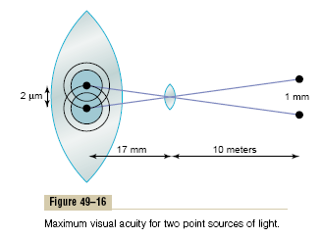
Visual acuity

Slide 58
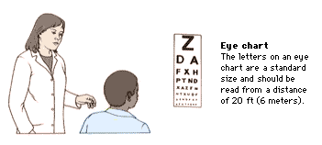

Slide 59
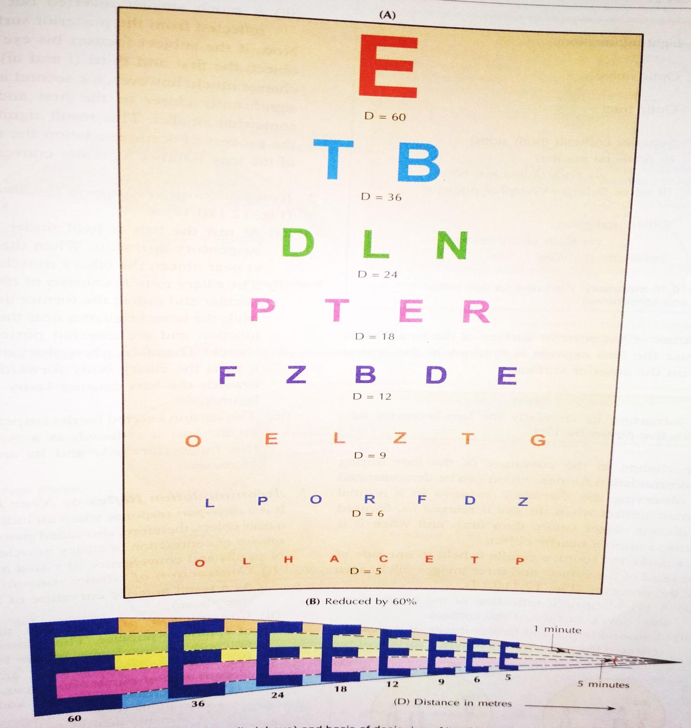

Slide 60
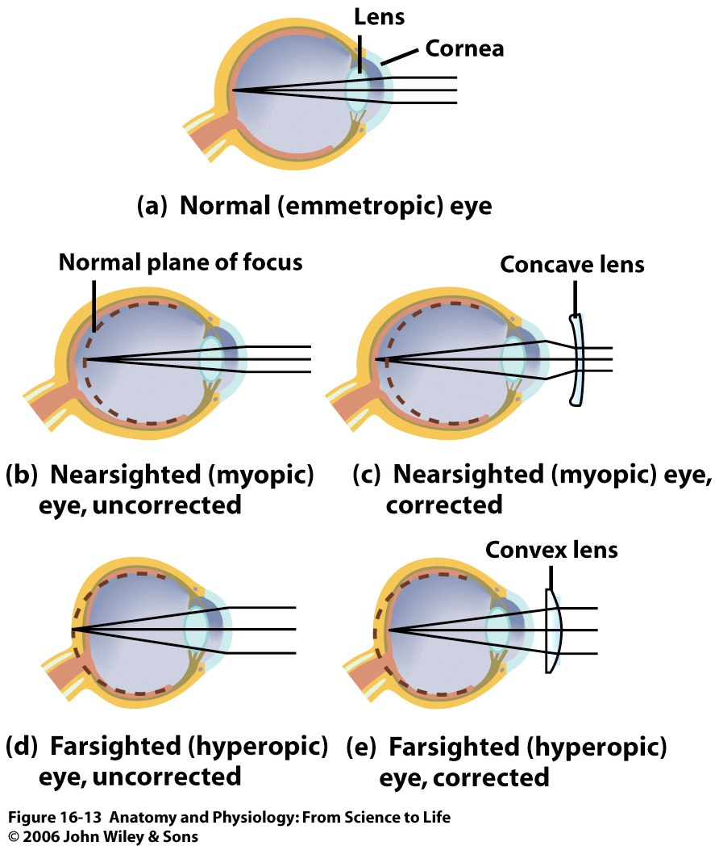
Figure 16.13

Slide 61
Treatments
Refractive Errors correction
With prescription glasses,
Contact lenses or
Refractive surgery, such as LASIK (laser-assisted in situ keratomileusis), or PRK (Photorefractive keratectomy).
Other treatments include;
Clear Lensectomy and Intra-ocular lens (IOL) Implantation
Implantable Contact Lens (ICL)

Slide 62
CCES
Center point of lens is known as
  Nodal point
  Focal Point
  Principle focus
  Visual point

Slide 63
2. Changes occurring during Accommodation
except
  Contraction of ciliary muscle.
  Contraction of suspensory ligament.
  Constriction of pupil
  Convergence of visual axis- by medial rectus supplied by 3rd cranial nerve

Slide 64
3. Long sightedness is a condition in which
following features occur except:
  Parallel light rays focused behind retina
  Parallel light rays focused in front of retina
  Near point of vision moves away from eyeball
  Corrected by convex lenses

Slide 65
4. Near sightedness is corrected by
  Concave lens
  Convex lens
  Cylindrical lens
  Bifocal lens

Slide 66
5. Visual angle is the angle subtended by an
object at the
  Fovea
  Cornea
  Nodal point
  Retina

Slide 67
THANK YOU

