Slide 1
General sensation
Composed of sensory receptors throughout the body.
  General senses
    Touch, pressure, pain, heat, cold, stretch, vibration.
  Special senses
    Vision, hearing, equilibrium, olfaction, taste.
Relative to the source of the stimuli.
  Exteroceptors
  Interoceptors
  Propioceptors (sketetal muscle). Conscious.
General structure (histology, activity 1)
  Modified dendrites.
    Free nerve endings
    Merkel discs in epidermis
    Hair follicle receptors
    Meissner corpuscles: light touch
    Ruffini corpuscles: deep pressure and stretching.
    Pacinian corpuscles: pressure recptor.
    Muscle spindles
    Golgi tendon organs
Receptor physiology
  Act as signal transducers. Direct relationship between importance and number of clustering of the receptors; punctuate distribution.

Slide 2
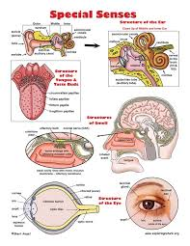
Four Senses
Vision (Sight)
Hearing
Smell
Taste

Slide 3
Special Senses
1. All confined to head
2. All special senses reach the central nervous system
through cranial nerves
3. Consist of highly specialized cells which serve as
receptors
4. These specialized receptor cells housed in sensory
organs which are also specialized for a particular
function.

Slide 4
Special Senses
Specialized
Receptor Cells
Specialized
Organ.....
TASTE:
SMELL:
VISION:
HEARING:
EQUILIBRIUM:
Gustatory Cells Taste Buds
Olfactory Cells Olfactory
Epithelium
Rods & Cones Eye (Retina)
Hair Cells Cochlea
Hair Cells Vestibular
Apparatus

Slide 5
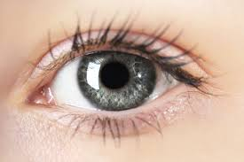
Physiology of Vision
Dr. Jayna Devalia
(M.B.B.S., M.D. Physiology)
Tutor
Department of Physiology
SBKSMI& RC , SVDU

Slide 6
FUNCTIONAL ANATOMY OF THE EYEBALL
MORPHOLOGY
Eyeball is approximately globe shaped, slightly flattened from above downwards.
Length of eyeball ~24 mm.
Eyeball is made up of two segments, anterior (1/6) and posterior (5/6).

Slide 7
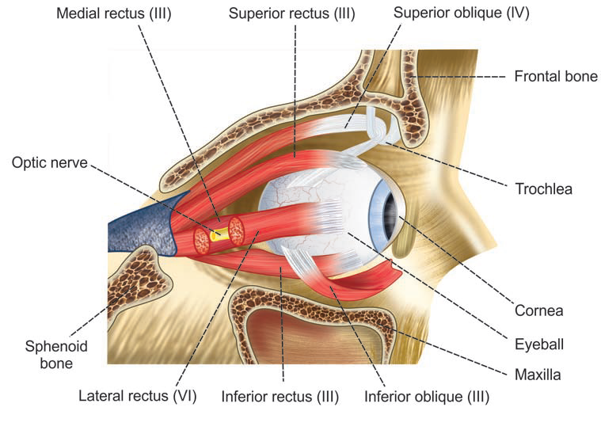
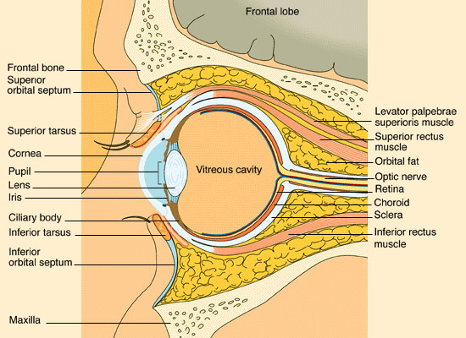
FUNCTIONAL ANATOMY OF THE EYEBALL
Orbital cavity
The eyeball is situated in a bony cavity known as orbital cavity or eye socket.
ocular muscles- eyeball movements.
Areolar/fatty tissue – protective cushion to the eyeball.

Slide 8
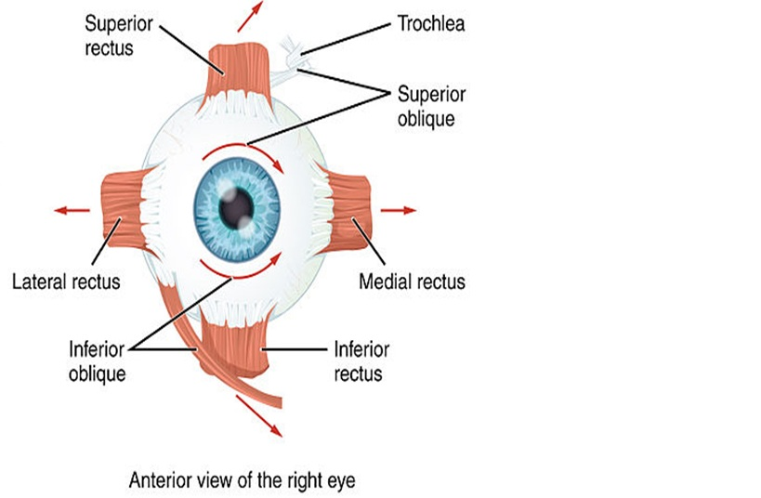
Extra-ocular Muscles
Rectus Muscles
superior rectus
inferior rectus
medial rectus
lateral rectus
Oblique Muscles
Superior oblique
Inferior oblique

Slide 9
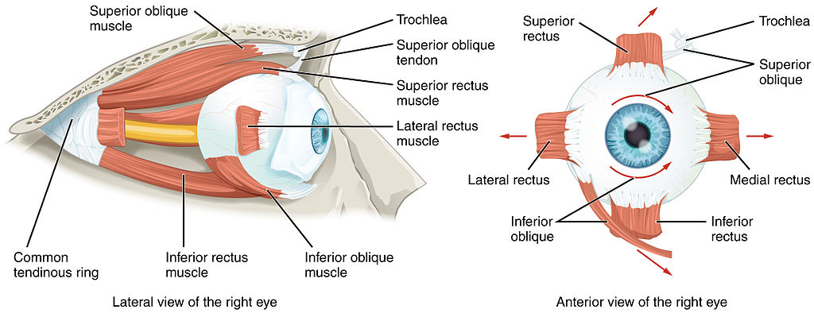

Slide 10
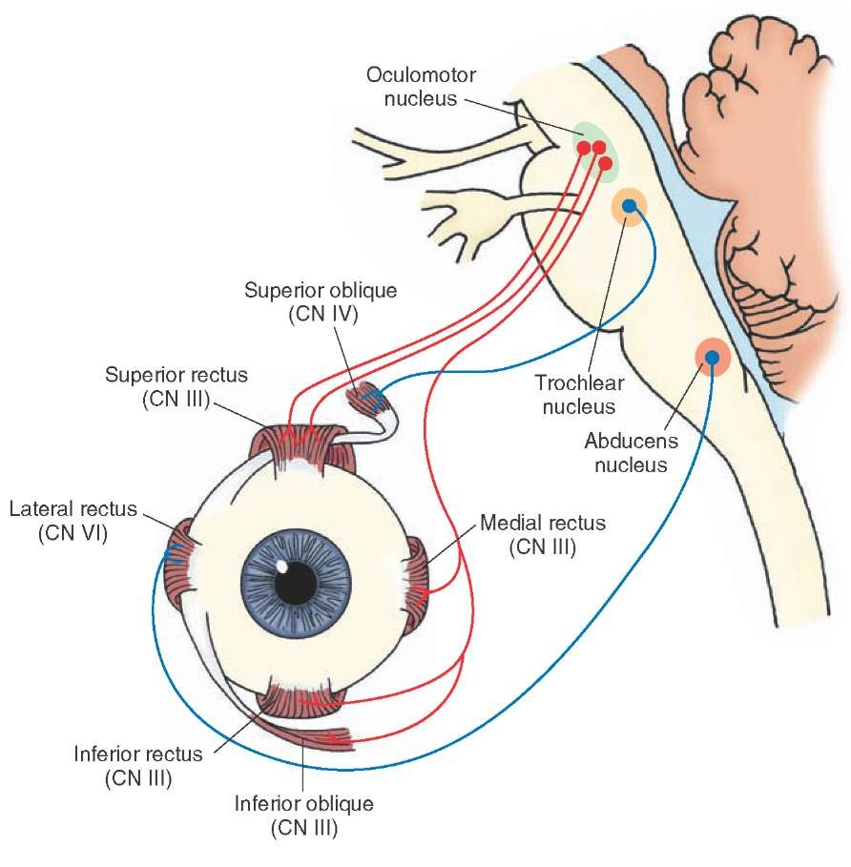
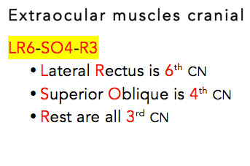

Slide 11
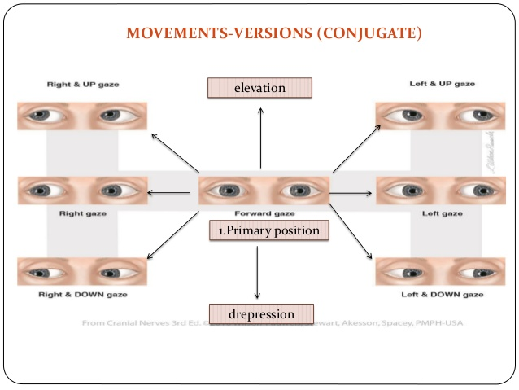

Slide 12
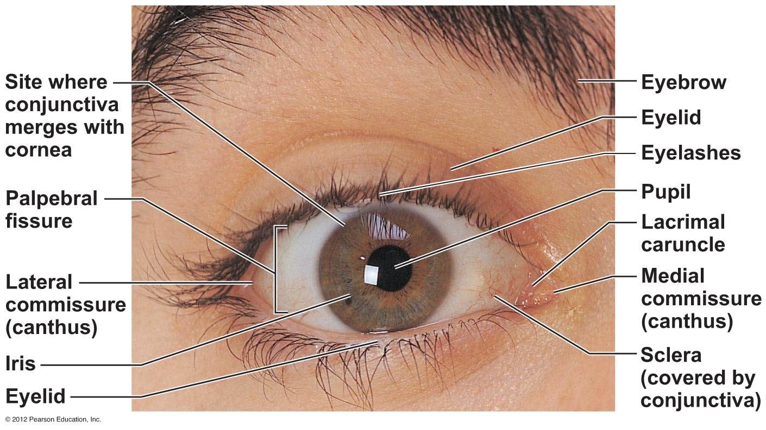
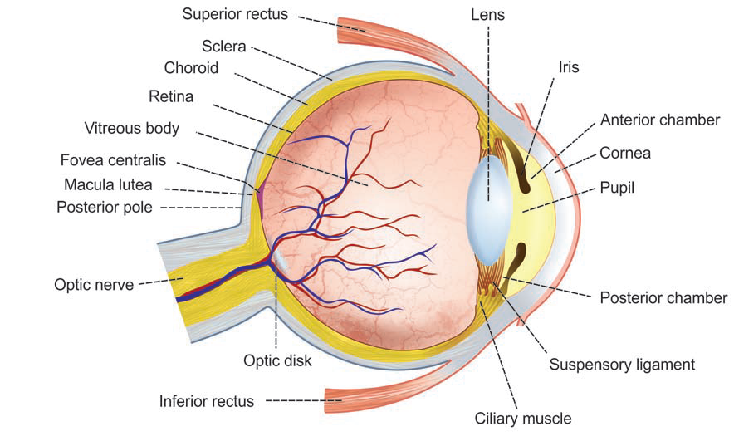
Appendages of the Eye

Slide 13
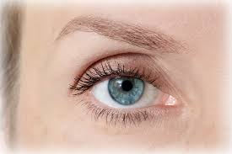
FUNCTIONAL ANATOMY OF THE EYEBALL
Eyelids
Opening between the 2 eyelids is called palpebral fissure.
width - 25 mm.
length-12 to 15 mm
(opened) Margins of eyelids have sensitive hairs, cilia.
upper eyelid-100 to 150 hairs
lower eyelid -50 to 75 hairs

Slide 14
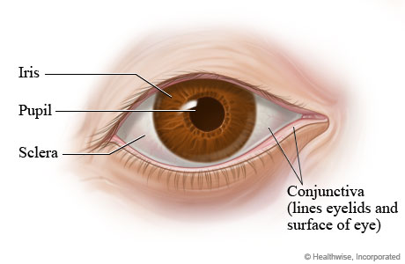
FUNCTIONAL ANATOMY OF THE EYEBALL
Conjunctiva
It is a thin mucus membrane, which covers the exposed part of eye.
2 parts-
bulbar(the eyeball)
palpebral (the eyelid).

Slide 15
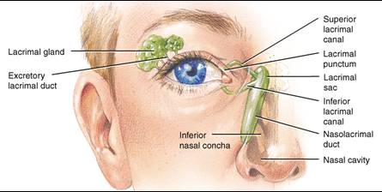
FUNCTIONAL ANATOMY OF THE EYEBALL
Lacrimal apparatus
Lacrimal gland
situated in upper and outer border of wall of the orbital cavity.
lacrimal ducts
lacrimal sac
nasolacrimal duct.

Slide 16

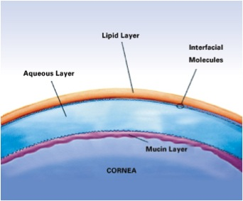
FUNCTIONAL ANATOMY OF THE EYEBALL
Tear
Tear is a hypertonic, serous fluid.
Due to its continuous washing and lubrication, the conjunctiva is kept moist.
Tear also contains lysozyme (immune function).

Slide 18
EYEBALL

Slide 19
COATS OF THE EYEBALL
3 layers:
Outer layer OR Tunica externa/fibrosa:
CORNEA AND SCLERA
B. Middle layer OR Tunica media/vasculosa:
CHOROID, CILIARY BODY AND IRIS
C. Inner layer OR Tunica intima/nerviosa :
RETINA.

Slide 20
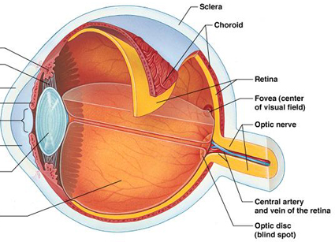

Slide 21
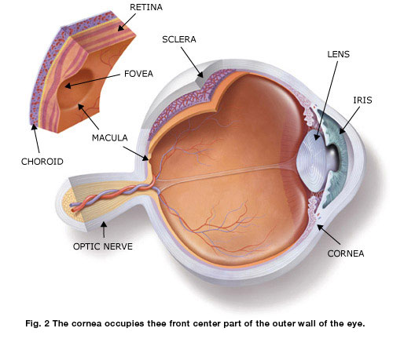
WALL OF THE EYEBALL outer layer- sclera
Sclera is the tough, white fibrous structure, covers posterior 5/6th of the eyeball.
Anteriorly, it is continuous with cornea.
Posterior-most part of sclera is pierced by the optic N., in the form of thin perforations called lamina cribrosa

Slide 22
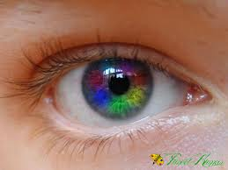
WALL OF THE EYEBALL outer layer- cornea
Cornea is the transparent anterior portion of the outer layer of eyeball, covers the iris and pupil, forms the anterior 1/6th of eyeball.
Diameter of cornea is 12 mm horizontally and 11 mm vertically.

Slide 23
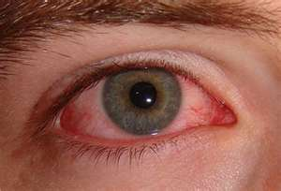
WALL OF THE EYEBALL outer layer- cornea
It is very sensitive to pain, touch, pressure and cold, because of rich supply of free nerve endings.
Cornea is not vascularized, it derives its nourishment mainly from aqueous humor.

Slide 24
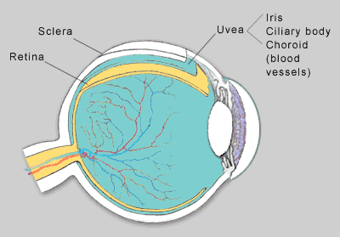
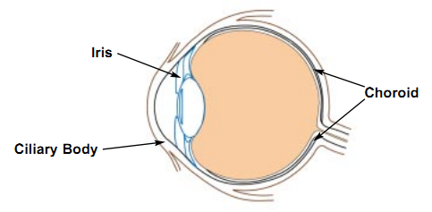
WALL OF THE EYEBALL
Middle layer
Middle layer surrounds the eyeball completely, except for a small opening in front known as pupil.
This layer comprises of 3 structures:
1. Choroid
2. Ciliary body
3. Iris.

Slide 25
Middle layer
Choroid:-
  It’s a vascular structure, stores and provides vitamin A to rods and cones.
  It also provides blood supply to outer layer of rods and cones

Slide 26
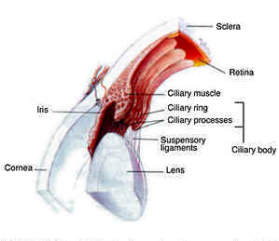
WALL OF THE EYEBALL
Middle layer- ciliary body
Is situated between choroid and iris.
Ciliary body is made up of two sets of ciliary muscles, namely outer longitudinal and inner circular muscles, both innervated by the parasympathetic III C. N.

Slide 27
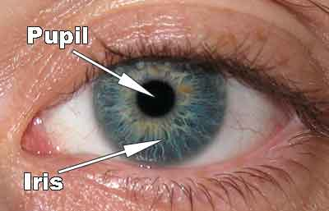
WALL OF THE EYEBALL
Middle layer- Iris
Iris is a thin circular diaphragm with a circular opening in the center called pupil.
Iris is formed by muscles:
i. Constrictor pupillae pupillary constrictor m.
ii. Dilator pupillae or pupillary dilator muscle.

Slide 28
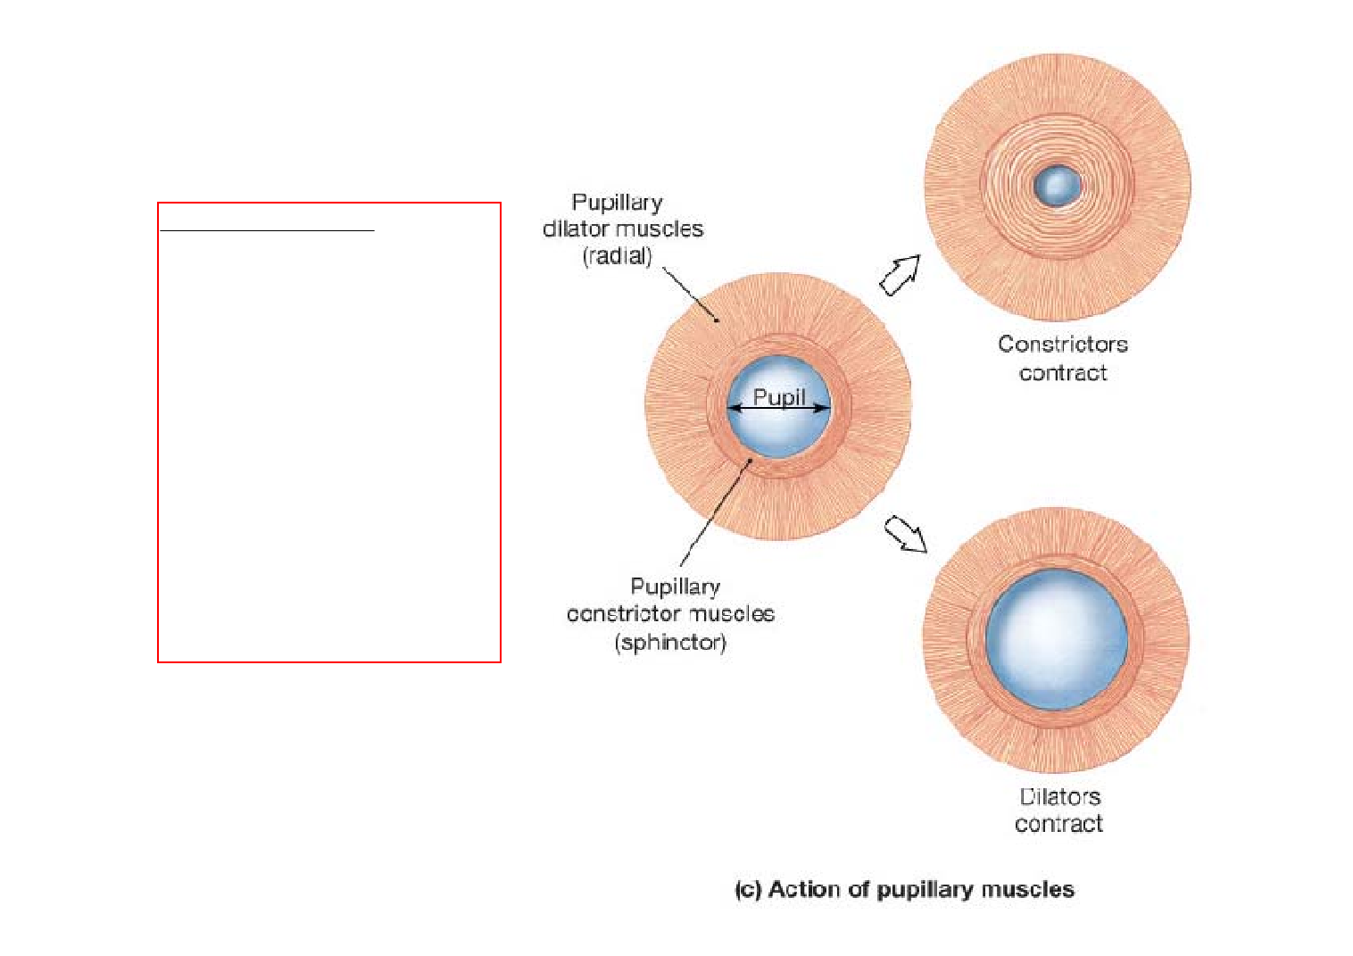
Iris regulate the amount of light entering.

Slide 29
WALL OF THE EYEBALL
Inner layer- Retina
light-sensitive membrane.
extends from the margin of optic disk to just behind ciliary body.
retina is made up of 10 layers.

Slide 30
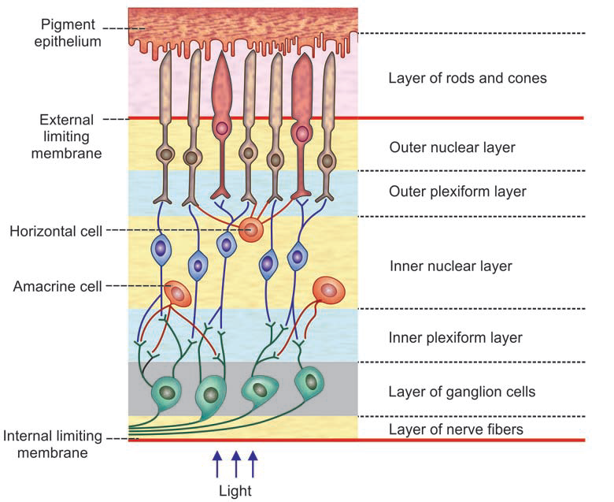
WALL OF THE EYEBALL
Inner layer- Retina
Layers of retina from outside in:
1. Layer of pigment epithelium
2. Layer of rods and cones
3. External limiting membrane
4. Outer nuclear layer
5. Outer plexiform layer
6. Inner nuclear layer
7. Inner plexiform layer
8. Ganglion cell layer
9. Layer of nerve fibers
10. Internal limiting membrane.

Slide 31
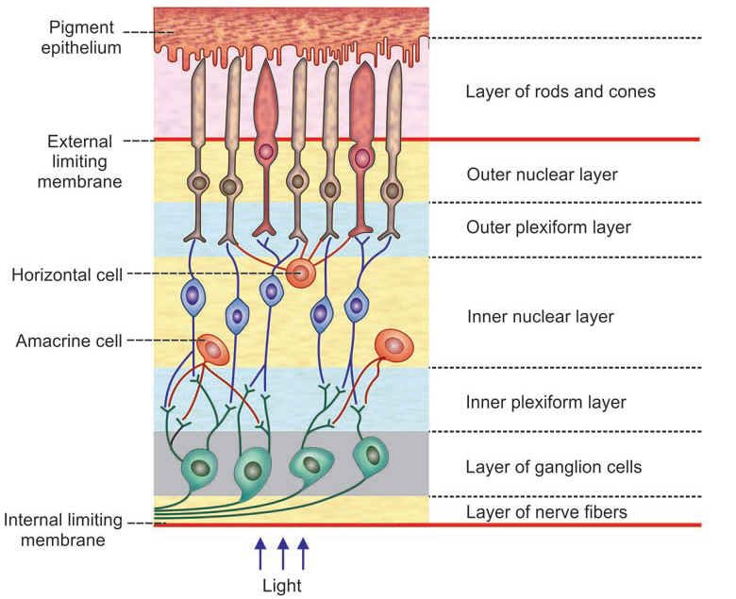

Slide 32
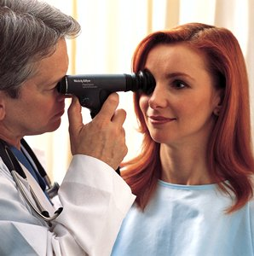
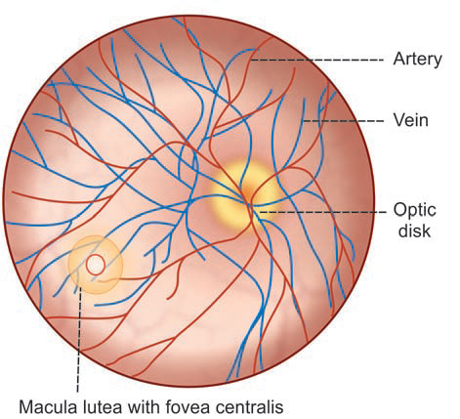
FUNDUS OCULI
Inner layer- Retina
Fundus oculi is the posterior part of interior eyeball
(ophthalmoscope)
Fundus has 2 important structures:
1. Optic disc
2. Macula lutea with fovea centralis.

Slide 33
FUNDUS OCULI
BLIND SPOT
yellow spot

Slide 34
FUNDUS OCULI
WALL OF THE EYEBALL
Inner layer- Retina
OPTIC DISK –
BLIND SPOT
Optic disk is a pale disk, situated near the center of the posterior wall of eyeball.
contains all the layers of retina, except rods and cones.
MACULA LUTEA-yellow spot
It is a small yellowish area, situated a little lateral to the optic disk.
Macula lutea has fovea centralis in its center, the region of most acute vision because it contains only cones.

Slide 35
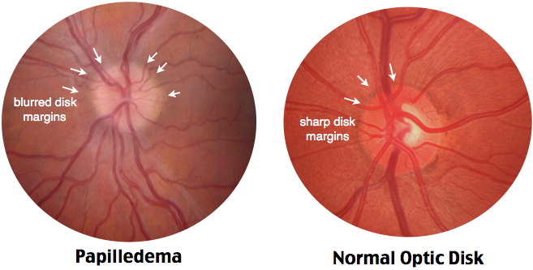

Slide 36
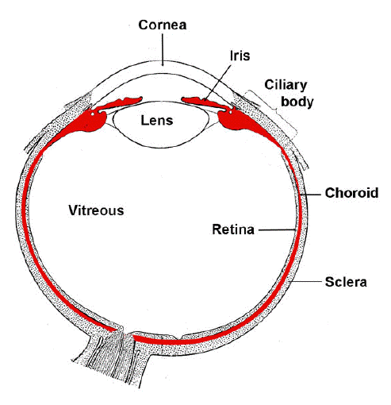
Crystalline Lens
Circular, transparent, biconvex body enclosed within a capsule
Lies behind pupil
Held in position by suspensory ligaments (or zonules).
Helps in image formation on retina by changing curvature of anterior surface.

Slide 37
Intraocular fluid

Slide 38
INTRAOCULAR FLUID
Intraocular fluid (fluid in eyeball) is responsible for the maintenance of shape, intra-ocular pressure as well as nourishment of the eyeball.
It is of two types:
1. Vitreous humor
2. Aqueous humor.

Slide 39
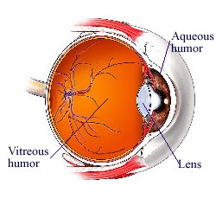
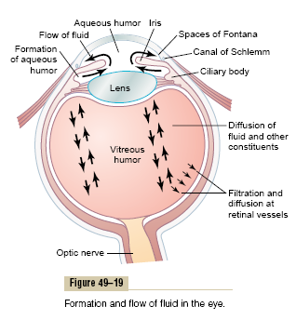
INTRAOCULAR FLUID

Slide 40
VITREOUS HUMOR
It is a viscous fluid present behind lens, in the space between lens and retina. It is also known as vitreous body.
It is formed by a fine fibrillar network of proteoglycan molecules mainly albumin and hyaluronic acid.

Slide 41
AQUEOUS HUMOR
It is a thin, watery fluid filled in the space between lens and cornea. This space is divided into anterior and posterior chambers by iris. Both the chambers communicate with each other through pupil.
  Formation:-
    It is formed by blood vessels of the ciliary processes.
    It has the same composition as that of blood plasma.
    It is continuously secreted with a rate of 2-3 microlitre/hour.

Slide 42
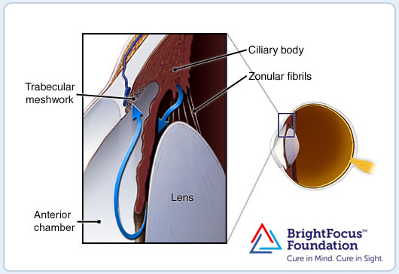
AQUEOUS FLOW

Slide 43
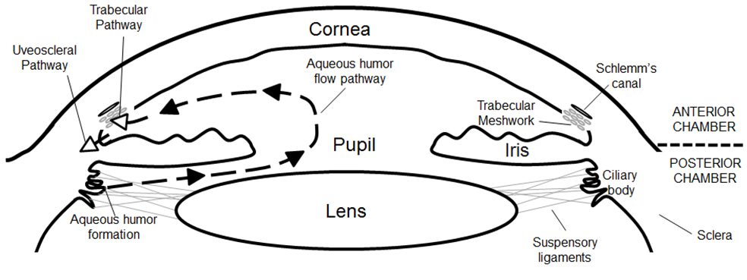

Slide 44
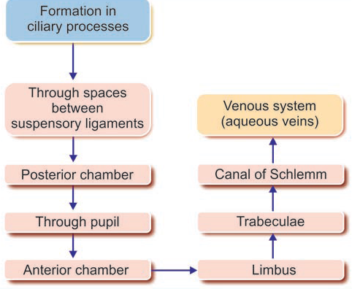
AQUEOUS FLOW
DRAINAGE

Slide 45
Functions:-
  Supply nutrients (especially glucose) as well as oxygen to the lens and cornea and collect waste products and CO₂ from these structures. (Both are avascular structures).
  It maintains IOP (normal intra-ocular pressure) at 10-20 mm of Hg and shape of the eye. Intraocular pressure is the measure of fluid pressure in eye, exerted by aqueous humor IOP can be measured by tonometry.
  Its refractory index is 1.33, which help in formation of image.

Slide 46
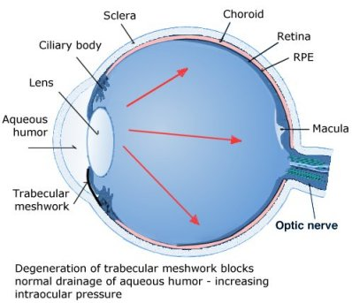
INTRAOCULAR PRESSURE

Slide 47
Clinical –
  Glaucoma:-
      Intraocular pressure is increased.
    Causes
      Advancing age, ocular infections, diabetes, high myopia, surgery, congenital etc.
      It is commonest cause of blindness after the age of 50 years.
      Above 65 years of age, 30% people suffer from glaucoma worldwide.
      Direct mechanical pressure or ischemia of optic nerve results blindness.

Slide 48
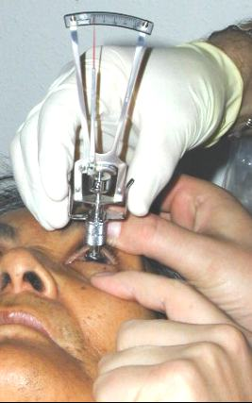
INTRAOCULAR PRESSURE
TONOMETRY

Slide 49
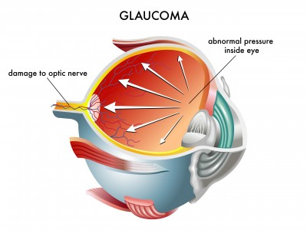

Slide 50
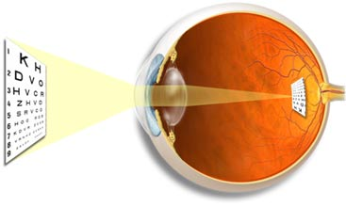
THE IMAGE FORMING MECHANISM

Slide 51
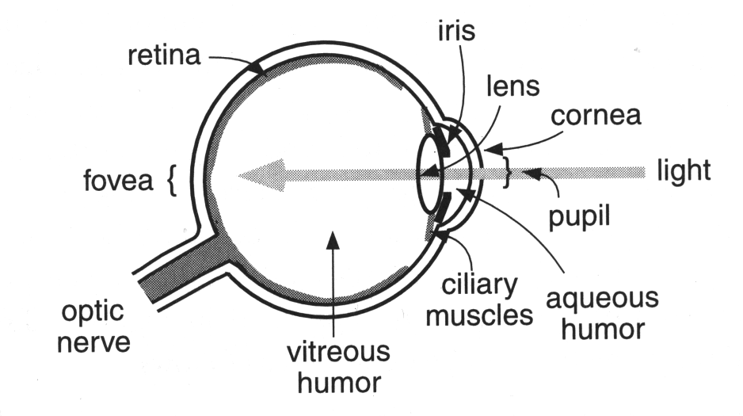

Slide 52
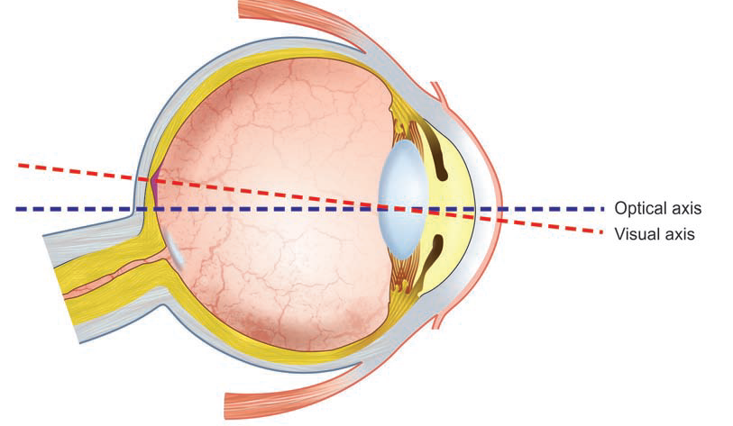
Optic axis Vs Visual axis

Slide 53
Optics of the eye
Visual axis:- line joining the fixation point, nodal point and the fovea
Optical axis:- line passing through the center of cornea, nodal point and meets the retina on macula at nasal side of fovea
  It is an imaginary line joining anterior and posterior pole of eye.
(Both axes cross each other at the center of crystalline lens where no refraction takes place

Slide 54
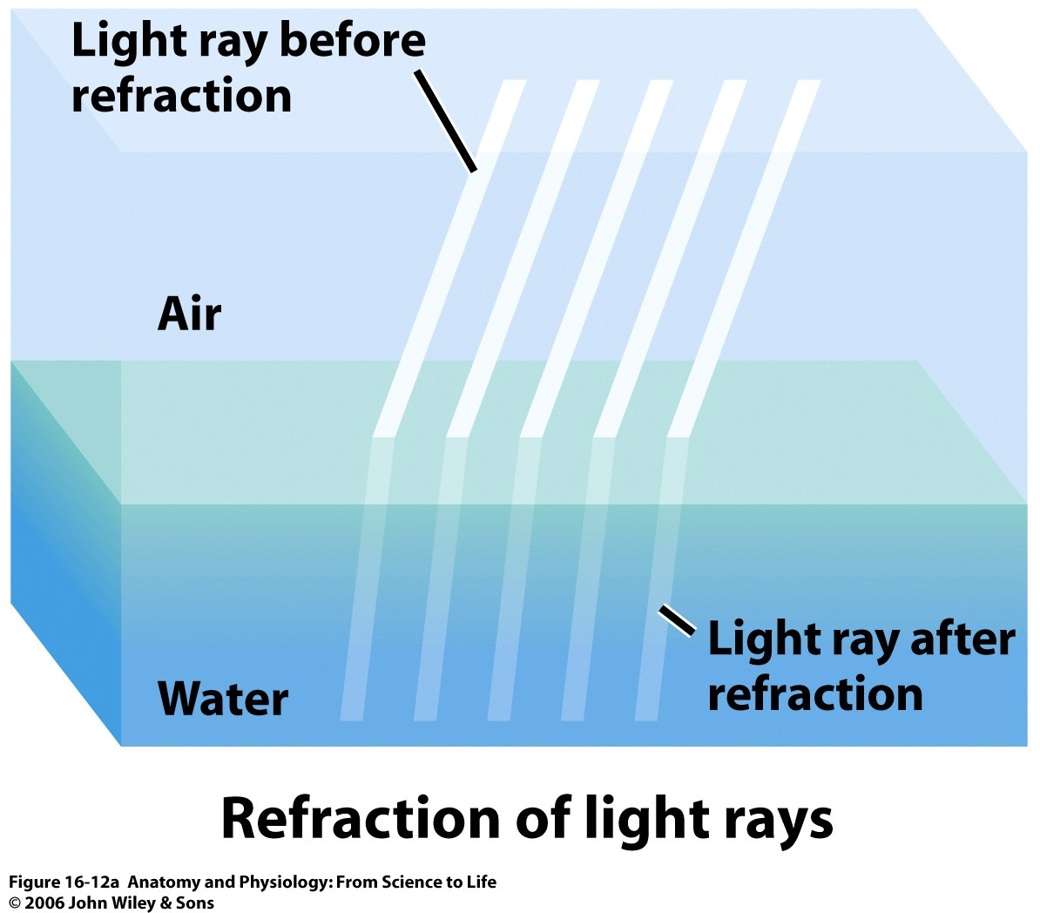
Refraction
Bending of light rays at an angulated surface is known as “refraction”
Degree of refraction increase if
The ratio of refractive indices of two transparent media more
The degree of angulation b/w the interface and the entering wave front

Slide 55
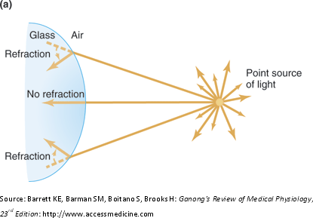

Slide 56
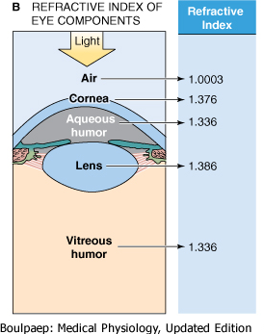
The structures forming refractive media of the eye from anterior to posterior are:-
  Tear film
  Cornea
  Aqueous humour
  Crystalline lens
  Vitreous humour

Slide 57
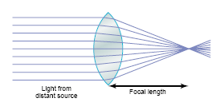
Convex lens
Convex lens focuses light rays
The outer rays bend more and more toward the center, called convergence
Half the bending occurs when the rays enter the lens and half as they exit from opposite side

Slide 58
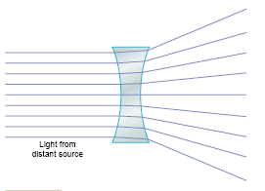
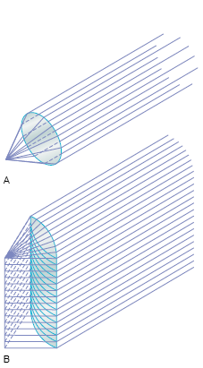
Concave lens:- diverges light rays
Cylindrical lens:- bends light rays in only one plane
Bends light rays from the two sides of lens but not from the top or bottom
Thus parallel rays are bent to a focal line

Slide 59
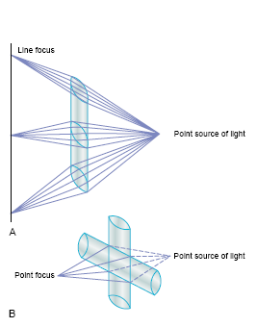
Combination of 2 cylindrical lens at right angles equals a spherical lens
The vertical cylindrical lens converges light rays pass through the two sides of lens
The horizontal lens converges the top & bottom rays
All rays come to single focus point

Slide 60
Measurement of refractive power
The more a lens bends light rays, the greater is its “refractive power.”This refractive power is measured in terms of diopters.
The refractive power in diopters of a convex lens is equal to 1 divided by its focal length in metres.
Total: +59 D
Cornea: +43 D
Crystalline lens: +16 D

Slide 61
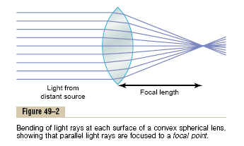
Focal length
The distance beyond a convex lens at which parallel rays converge to a common focal point is called the focal length of lens
Diverging light rays- more focal length
Parallel light rays- less focal length

Slide 62
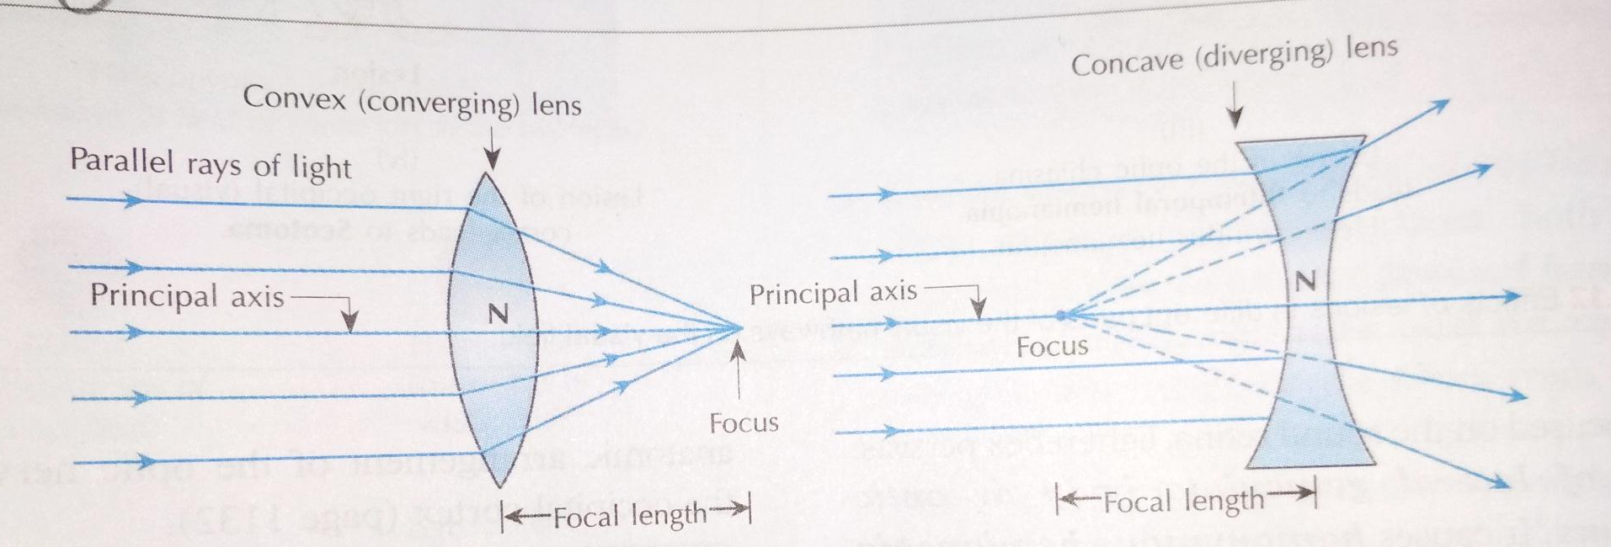
Convex lens has positive focal length, so the power of convex lens is written as + sign
Concave lens has negative focal length, so the power of concave lens is negative; written as –sign

Slide 63
Accommodation
Definition:-
  The ability of the eye to focus an object at varying distance is called accommodation
Mechanism for near vision:-
  Parasympathetic (3rd cranial nerve) stimulation
  Contraction of ciliary muscle.
  Loosening of suspensory ligament.
  Increased in the curvature of anterior surface of lens.
  Constriction of pupil- by sphincter pupillae by parasympathetic fibers in 3rd cranial nerve.
  Convergence of visual axis- by medial rectus supplied by 3rd cranial nerve.

Slide 64


Slide 65


Slide 66
Far point:-
  It is farthest distance from the eye at which an object is seen clearly (infinity) but for practical purposes, it is considered 6 meter (20feet).
Near point:-
- Nearest distance from eye at which object can be seen clearly. It
is 25cm (10 inches)
Amplitude of accommodation:-
  Difference between the dioptric power needed to focus at near point & needed to focus at higher point.
Range of accommodation:-
  It is distance between ‘far point’ and ‘near point’.

Slide 67
CCES

Slide 68
Q1. Which of the following is not the constituent of middle layer of eyeball
Sclera
Choroid
Iris
Cilliary body

Slide 69
Q.2. Which statement is false about aqueous humor?
They are secreted from cilliary process
They are absorbed through trabecular meshwork
Main constituent of aqueous humor is albumin and hyaluronic acid.
Blocking of the drainage of aqueous humor can lead to damage of optic nerve.

Slide 70
Q.3. which statement about cornea is true-
Cornea has no blood supply.
Cornea has no nerve supply
Cornea gets its nutrition from surrounding blood vessels
Cornea can never be transplanted.

Slide 71
Q.4. which statement is true?
Iris controls the amount of light entering in eye.
Choroid is made up of nervous tissue
Main constituent of aqueous humor is albumin and hyaluronic acid.
Intraocular pressure is measured by ophthalmoscope.

Slide 72
Q.5. which of the following statement about tear is false-
Tear is a hypertonic.
Tear is mostly mucus in characteristic.
Tear keeps eyeball surface moist.
Tear contains lysozyme.

