Slide 1
Reabsorption and Secretion

Slide 2
Reabsorption and Secretion in renal tubules
Secretion :- addition of substance to the filtrate
Reabsorption:- removal of substance from filtrate
Filtered load:- amount of solute transported across the glomerular membranes per unit time.
Filtered load = GFR × PLASMA CONC.OF SOLUTE
= ml/min × mg/ml
= mg/min

Slide 3
The excretion rate:- It is the amount of a substance that appears in the urine per unit time.
Excretion rate= urine flow rate (V) × urine concentration of the substance (Ux)
Excretion rate=V (Ux)
= ml/min × mg/ml
= mg/min

Slide 4
Renal tubular transport maximum (Tm)
for most substance that are actively reabsorbed or secreted ,there is a limit to the rate at which the solute can be transported which is referredto as a TRANSPORT MAXIMUM .
It is due to saturation of specific transport system.

Slide 5
The highest attainable rate of reabsorption is called the maximum tubular reabsorptive capacity (Tr or Tm)
Substances that are reabsorbed by an active carrier mediated process and that have Tm inculde:-
Glucose -375 mg/min
Phosphate ion- 0.1mg/min
Amino-acids- 1.5 mg/min
Sulphate- 0.06 mg/min
Plasma protien- 30 mg/min

Slide 6
The highest attainable rate of secretion is called the maximum tubular secretory capacity (Ts or Tm)
Substances that are secreted by the kidneys and have a Tm include:
Creatinine -16 mg/min
PAH -80 mg/min
Certain diuretics
Substance which are passively transported do not exhibit Tmax
Ex.
Sodium (for reabsorption)
Potassium (for secretion)
Urea

Slide 7
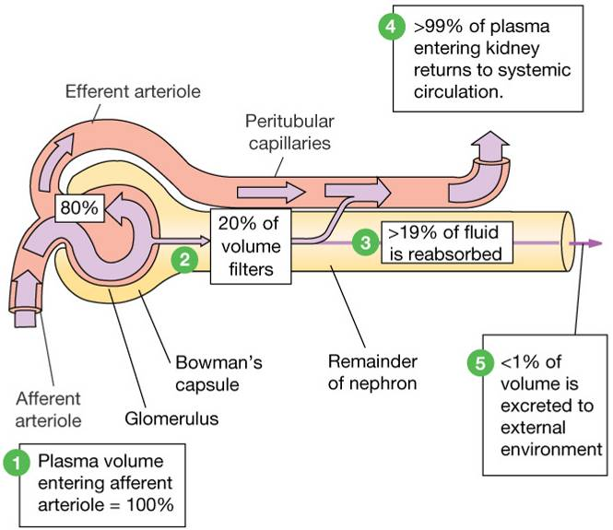
GFR ≈ 125 ml/min (180L/day)
(about 1% is excreted)

Slide 8
Filtration, reabsoption, and excretion rates of substances by the kidneys
Filtered Reabsorbed Excreted Reabsorbed
(meq/24h) (meq/24h) (meq/24h) (%)
Glucose (g/day) 180 180 0 100
Bicarbonate (meq/day) 4,320 4,318 2 > 99.9
Sodium (meq/day) 25,560 25,410 150 99.4
Chloride (meq/day) 19,440 19,260 180 99.1
Water (l/day) 169 167.5 1.5 99.1
Urea (g/day) 48 24 24 50
Creatinine (g/day) 1.8 0 1.8 0

Slide 9
Two pathways of the absorption:
Transcellular
Pathway
Paracellular
transport
Plasma
Lumen
Cells

Slide 10
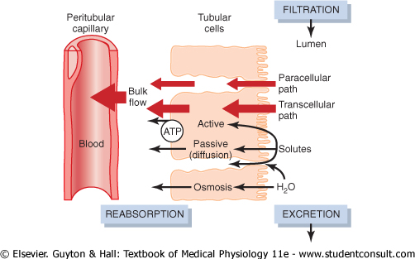

Slide 11
Mechanism of Transport
1. Primary Active Transport
2. Secondary Active Transport
3. Pinocytosis
4. Passive Transport

Slide 12
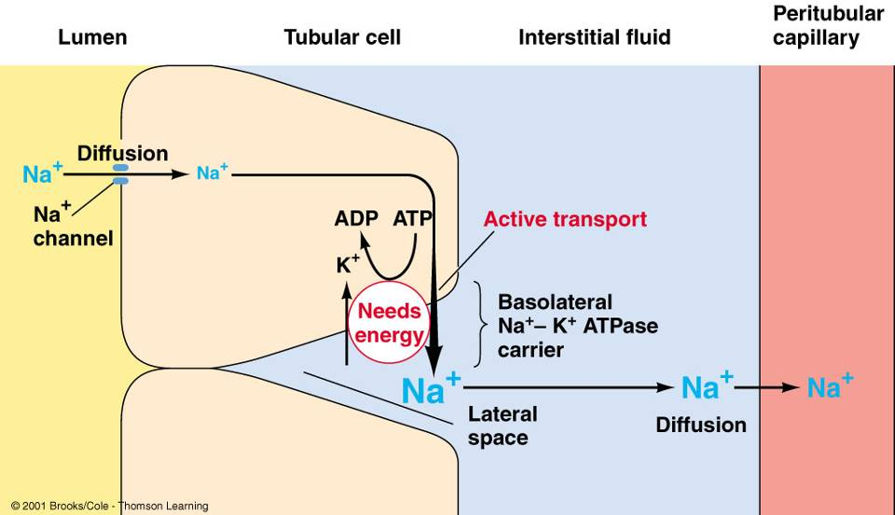
Primary Active Transport

Slide 13
Secondary active transport
Interstitial
Fluid
Tubular
lumen
Interstitial
Fluid
Tubular
lumen
Tubular Cell
Tubular Cell
co-transport counter-transport
(symport) (antiport)
out in
out in
Na⁺
Na⁺
glucose
H⁺
Co-transporters will move one moiety, e.g. glucose, in the same direction as the Na⁺.
Counter-transporters will move one moiety, e.g. H⁺, in the opposite direction to the Na⁺.

Slide 14
Pinocytosis:
Some parts of the tubule, especially the proximal tubule, reabsorb large molecules such as proteins by pinocytosis.

Slide 15
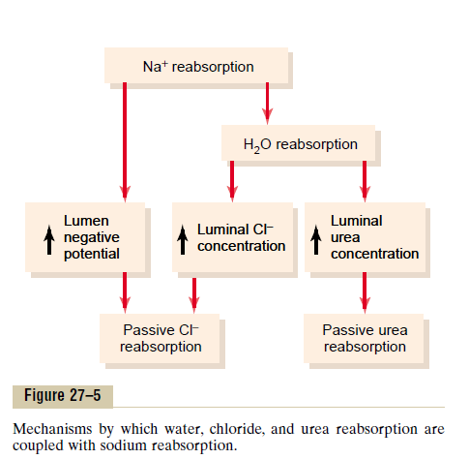
Passive transport

Slide 16
Proximal Tubule
Epithelial cells are highly metabolic and have larger no. of mitochondria.
Extensive brush border
Reabsorb about 65% of the filtered sodium, chloride, bicarbonate, and potassium and essentially all the filtered glucose and amino acids.
Secrete organic acids, bases, drugs, toxins and hydrogen ions into the tubular lumen

Slide 17
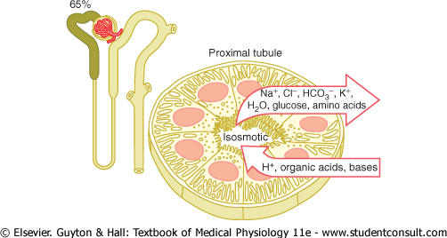

Slide 18
Sodium, water and chloride reabsorption in proximal tubule
The Na+K+-ATPase: major force for reabsorption of Na+, chloride and water
In the first half of the proximal tubule, sodium is reabsorbed by co-transport along with glucose, amino acids, and other solutes.
In the second half of the proximal tubule, sodium reabsorbed mainly with chloride ions.
the higher chloride concentration favors the diffusion of this ion from the tubule lumen through the intercellular junctions into the renal interstitial fluid.

Slide 19
Obligatory Water Reabsorption: 85% of the filtered water is always reabsorbed irrespective of the body water balance, occurs by osmosis is called Obligatory (must occur)Water Reabsorption.
Facultative Water Reabsorption: the remaining 15-18% of water may or may not be absorbed depending upon the body water balance it is called Facultative Water Reabsorption

Slide 20
Obligatory Urine Volume
It is the minimum amount of urine which is to be formed in a day to remove the metabolic waste product.
Normal Value – 500 ml/day
Oligouria- Urine volume less than 500 ml/day.
Oligouria is a sign of Renal Failure.

Slide 21
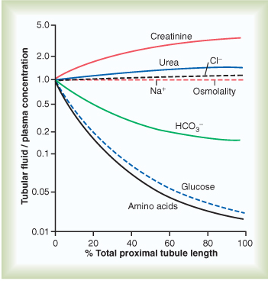

Slide 22
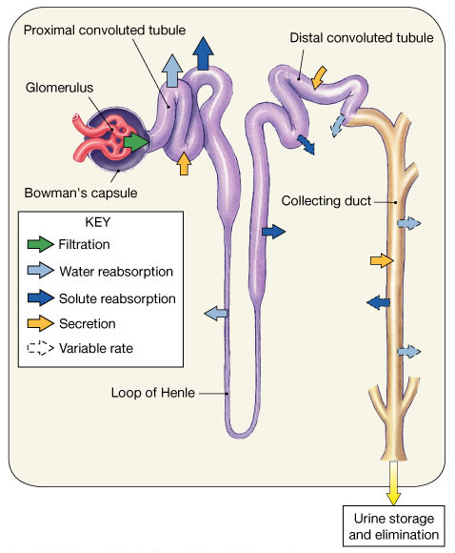
Loop of Henle
The loop of Henle consists of three functionally distinct segments:
the thin descending segment,
the thin ascending segment,
and the thick ascending segment.

Slide 23
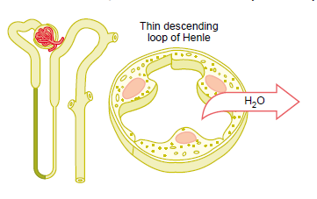
Thin descending limb
Thin epithelial membrane
No brush borders
Few mitochondria
Minimal metabolic activity
Highly permeable to water.
About 20% of filtered water is reabsorbed.

Slide 24
Ascending Limb of the Loop of Henle
  a part of the counter current multiplier
  impermeable to water and actively transports (reabsorbs) salt (NaCl) to the interstitial fluid of the pyramids in the medulla. “Saves salt and passes the water.”
  the passing filtrate becomes dilute and the interstitium becomes hyperosmotic

Slide 25
Thick ascending limb
Thick epithelial cells
High metabolic activity
About 25% of filtered load of sodium, chloride and potassium is reabsorbed.
Also paracellular reabsorption of Mg++, Ca++, Na+, K+
Na+ H+ counter transport
Impermeable to water

Slide 26
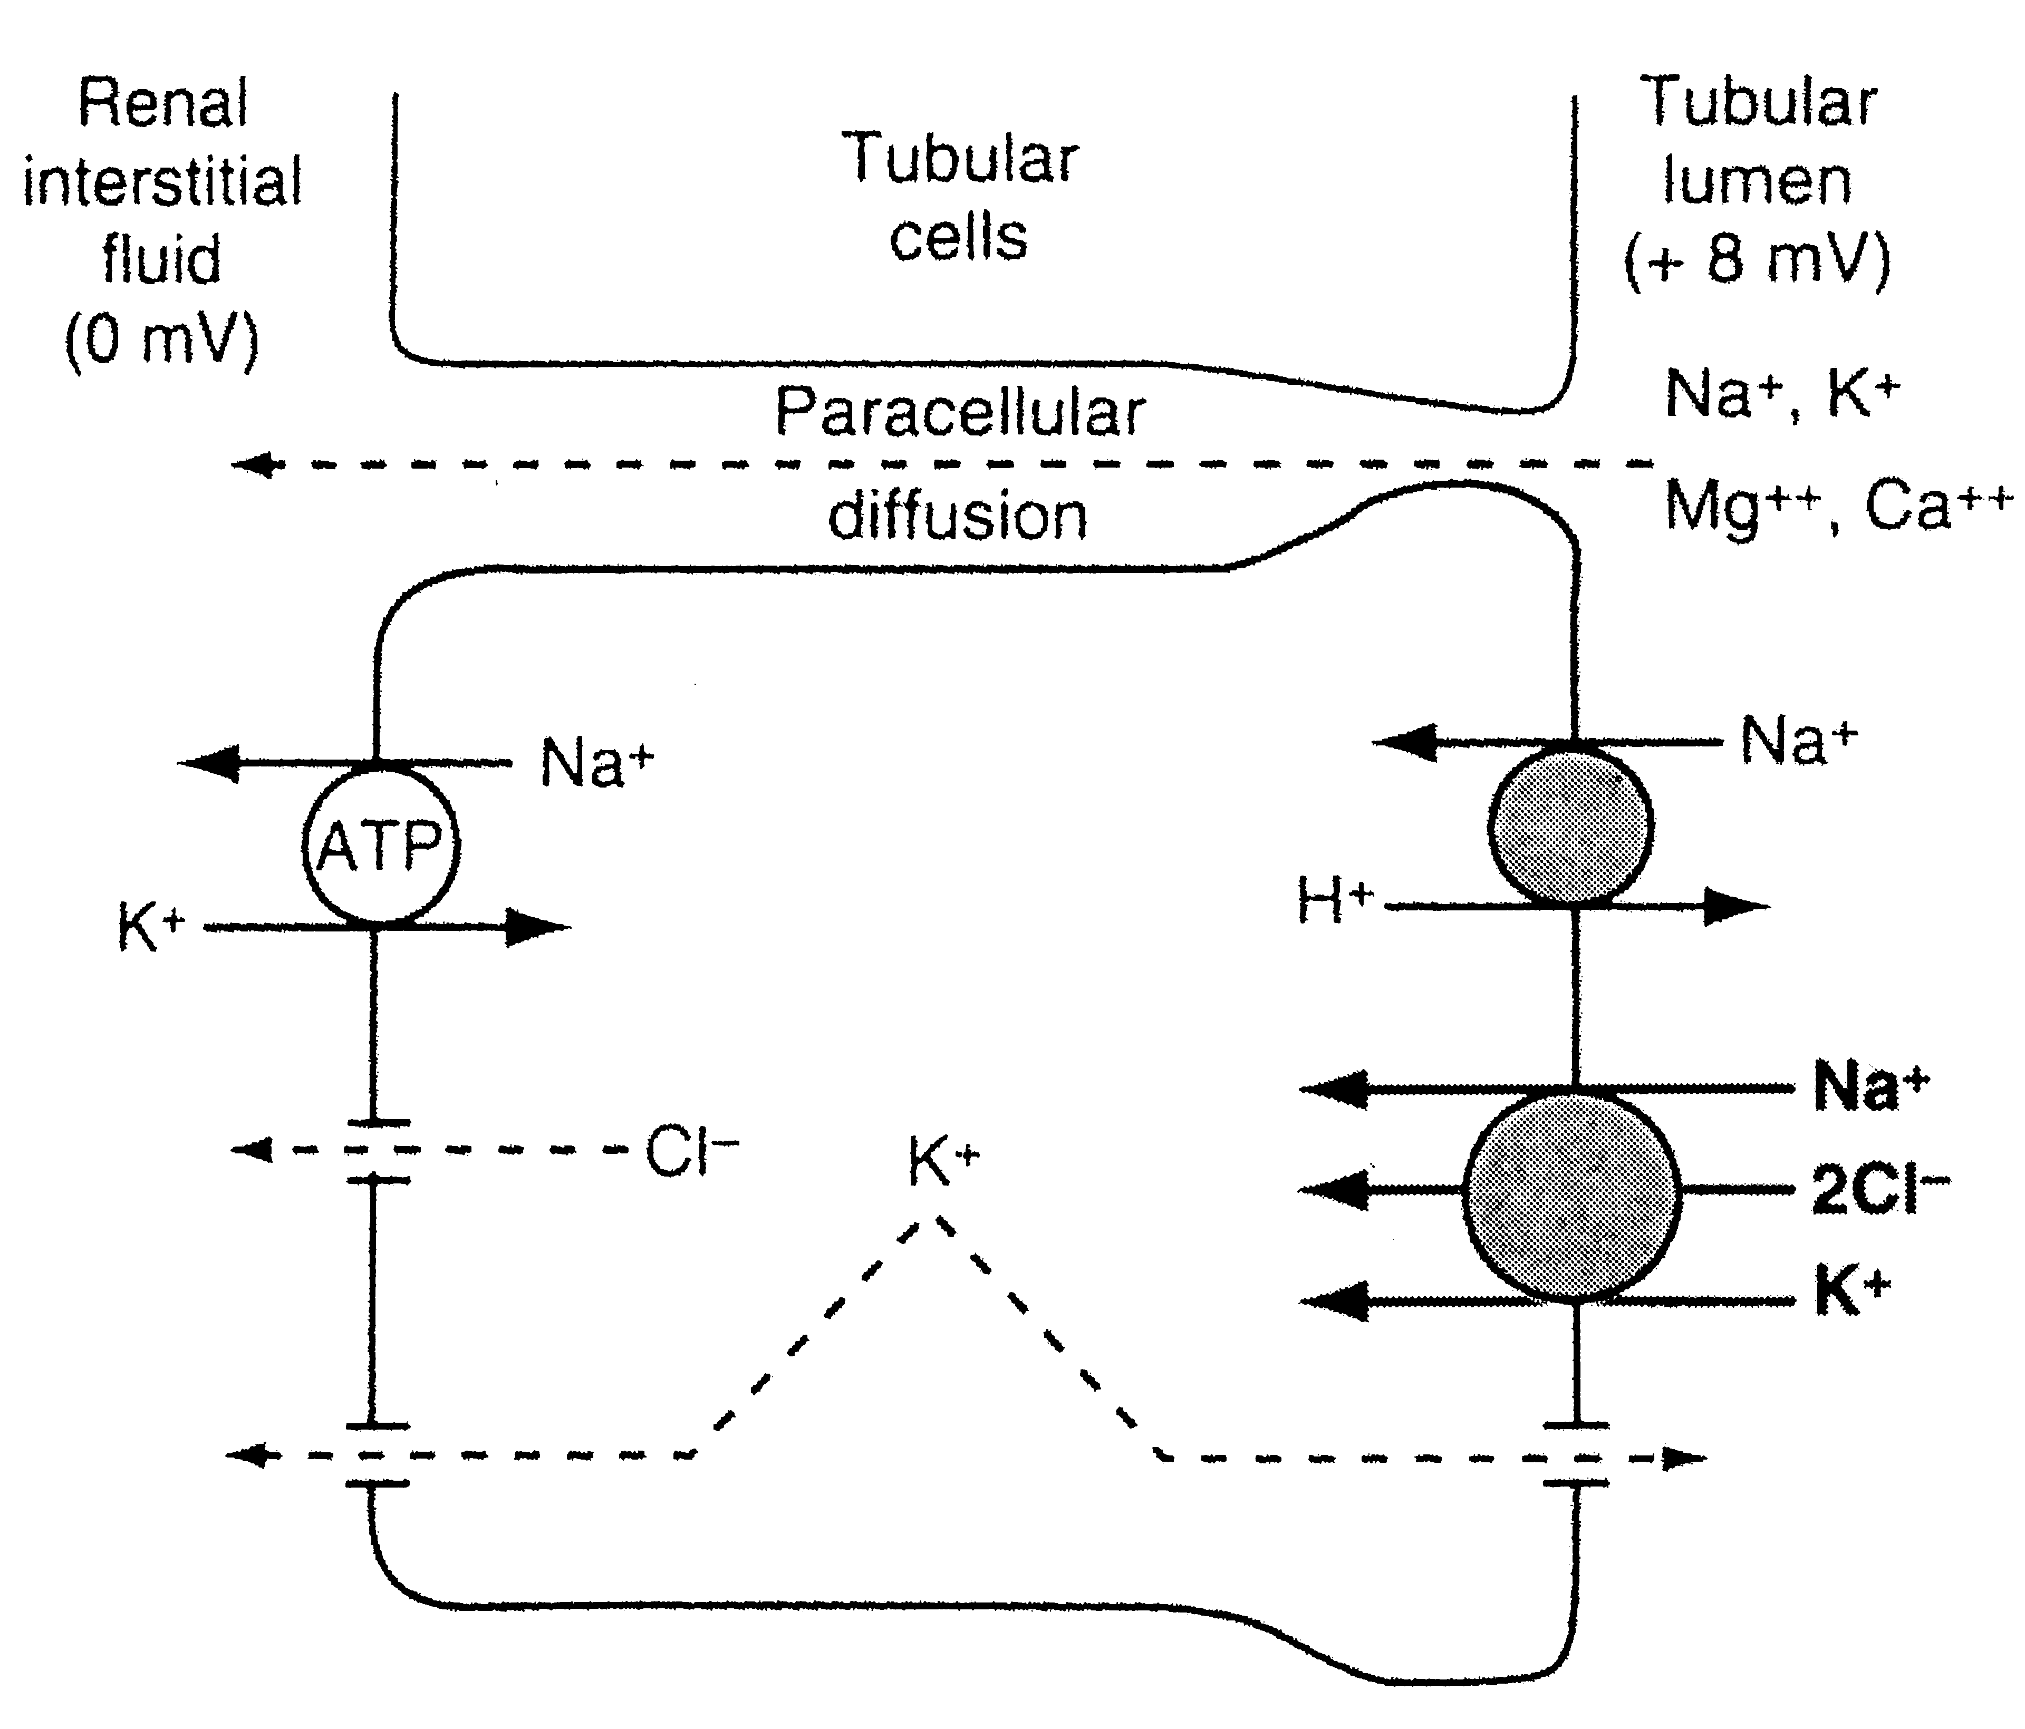

Slide 27
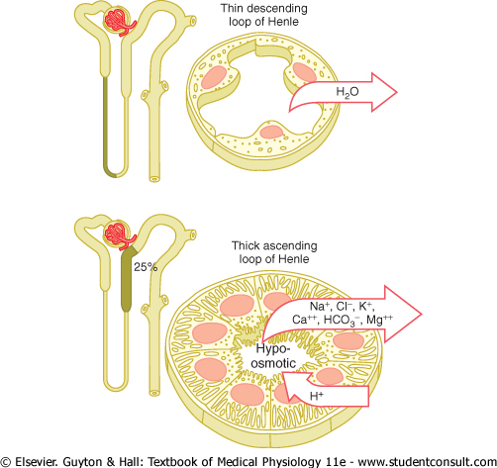

Slide 28
Early Distal Tubule
The very first portion of early distal tubule contain juxtaglomerular complex.
The next segment of tubule has same characterstics of thick ascending limb so it is impermeable to water. So called diluting segment
Approximately 5% of filtered load of Na,Cl reabsorbed.

Slide 29
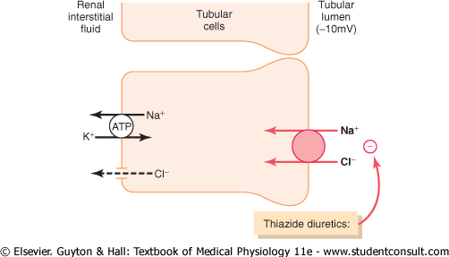

Slide 30
Late distal tubule & cortical collecting duct
Both the segment having similar characteristics functionally and anatomically.
Contain principal and intercalated cells.
Impermeable to urea
Reabsorption of water is highly depend on presence or absence of ADH.

Slide 31
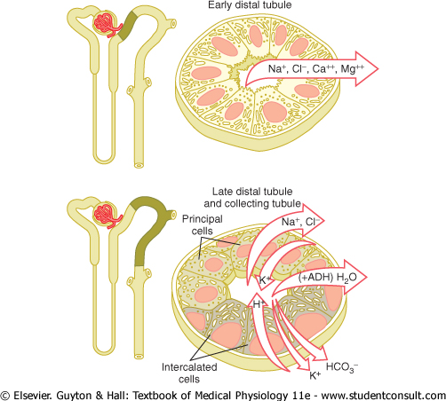

Slide 32
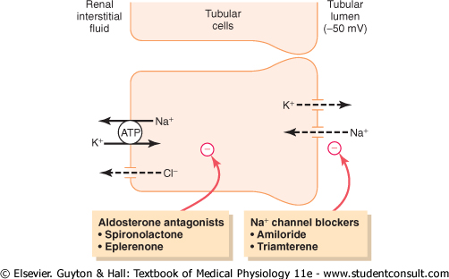

Slide 33
Principal cells
- Reabsorb sodium and water
- Secrete potassium
- Controlled by aldosterone
Intercalated cells
- Reabsorb potassium
- Secrete hydrogen by active H+ ATPase mechanism (different from proximal tubule) capable of secreting hydrogen ions against a large conc. Gradient 1000 to 1

Slide 34
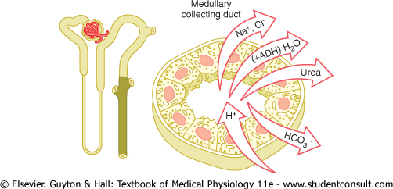
Medullary collecting duct
=>It’s a final site of processing of urine,so play important role in excretion of urine containing water & solute.
=>Less then 10% filtrate of Na & Cl reabsorbed through this segment.
=>Absorption of water is controlled by ADH.
=>This part is highly permeable to urea ,so it increase osmolality of medullary interstitium that helpful in formation of concentrated urine.
=>secretion of H ion helpful in regulation of acid base balance.

Slide 35
Threshold substances
High-threshold substances:
- Do not appear in urine under normal conditions.
- Appears in urine only if their concentration in plasma is abnormally high or in renal diseases when reabsorption is affected.
e.g. Glucose, amino acids

Slide 36
Non-threshold substances:
-either little or not at all reabsorbed
-- excreted in urine irrespective of their plasma level.
e.g. creatinine, Urea, uric acid,

Slide 37
Threshold substances
High-threshold substances:
- Do not appear in urine under normal conditions.
- Appears in urine only if their concentration in plasma is abnormally high or in renal diseases when reabsorption is affected.
e.g. Glucose, amino acids

Slide 38
Low-threshold substances:
- Appear in urine even under normal conditions
- Reabsorption occurs but to a little extent.
e.g. Urea, uric acid
Non-threshold substances:
- Not at all reabsorbed and excreted in urine irrespective of their plasma level.
e.g. creatinine

Slide 39
2. Glucose Reabsorption
Glucose is reabsorbed along with Na⁺ in the early portion of the proximal tubule.
Glucose is typical of substances removed from the urine by secondary active transport.
Essentially all of the glucose is reabsorbed

Slide 40
The renal threshold for glucose is the plasma level at which the glucose first appears in the urine,
And is about 180-200mg%

Slide 41
Transport maximum(Tm)
Tm refers to the plasma conc..at which carriers are fully saturated.
beyond plasma glucose conc. of 375 mg/dL (TmG) the reabsorption rate does not increase, i.e. becomes constant and is independent of PG.
Therefore, as the TmG is reached, the urinary excretion rate increases linearly with increase in plasma glucose concentration

Slide 42
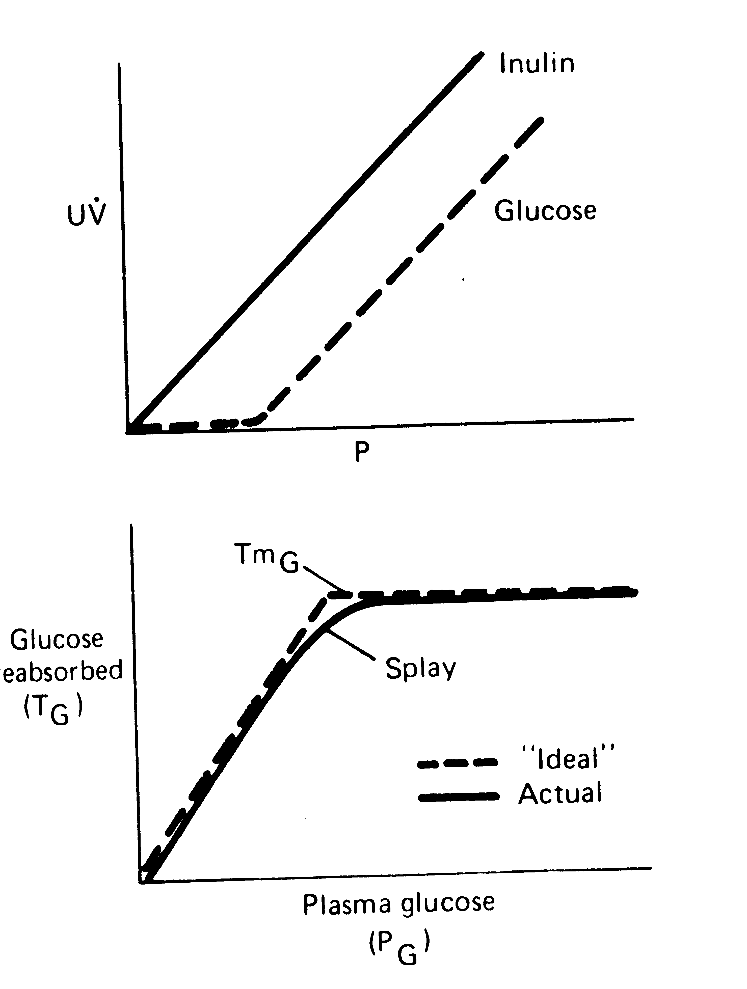
Top: Relationship between the plasma level (P) and excretion (UV) of glucose and inulin
Bottom: Relationship between the plasma glucose level (P_{G}) and amount of glucose reabsorbed (T_{G}).

Slide 43
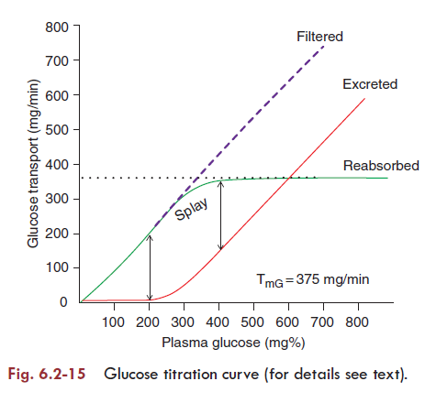

Slide 44
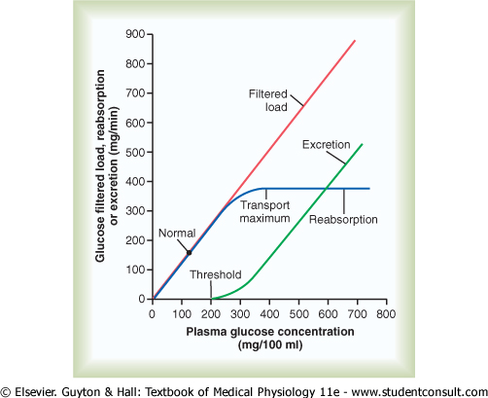

Slide 45
Splay refers to the region of the glucose curve between threshold and TmG, i.e. between PG 180 and 375mg/dL.
It represents the excretion of glucose in urine before the TmG is fully achieved.

Slide 46
Causes of splay are:
Difference in
- glomerular size,
- proximal tubular length and
- number of carrier proteins for glucose reabsorption.
Variability in TmG of the nephron.
eg. there is variability in the number of glucose carrier, the transport rate of the carriers and the binding affinity of the Na+ glucose carriers.

Slide 47
Top: Relationship between the plasma level (P) and excretion (UV) of glucose and inulin
Bottom: Relationship between the plasma glucose level (P_{G}) and amount of glucose reabsorbed (T_{G}).

Slide 48
Regulation of tubular reabsorption
Glomerulotubular balance
Starling’s forces
Effect of arterial blood pressure
Hormones
Nervous regulation

Slide 49
Glomerulotubular balance
Intrinsic ability of tubules to increase their reabsorption rate in response to increased tubular load.
The % of GFR reabsorbed in the proximal tubule remains relatively constant at about 65%
Helps to prevent overloading of distal tubular segments when GFR increases.

Slide 50
Glomerulotubular balance acts as a second line of defense to buffer the effect of spontaneous changes in GFR on urine output.
(The first line of defense discussed above includes the renal auto regulatory mechanism, especially tubuloglomerular feedback, that help to prevent changes)

Slide 51
Glomerulotubular balance: Mechanism
GFR increase -- The peritubular capillary colloid osmotic pressure increase and the hydrostatic pressure decrease – The reabsorption of water in proximal tubule increase

Slide 52
Starling’s forces
P_{c} = Peritubular capillary hydrostatic pressure
P_{if} = Renal interstitial hydrostatic pressure
πc = Peritubular capillary colloidal osmotic
pressure
πif = Renal interstitial colloidal osmotic pressure
Net reabsorptive force = Pif – Pc + πc – πif
Reabsorption = Kf * Net reabsorptive force

Slide 53
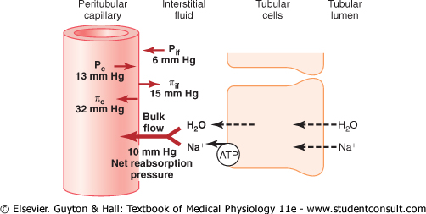

Slide 54
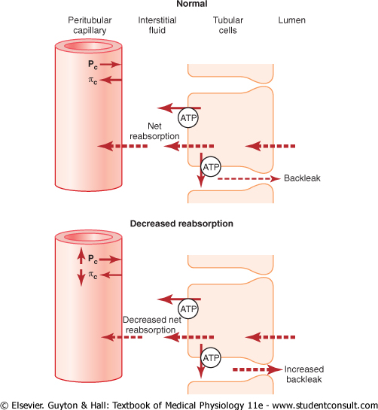

Slide 55
Effect of arterial blood pressure
Pressure natriuresis, pressure diuresis.
Autoregulation (75-160mmHg)
Actions of increase in arterial blood pressure
- Increase in GFR
- Decreases reabsorption of sodium and water
- Reduced angiotensin II formation.

Slide 56
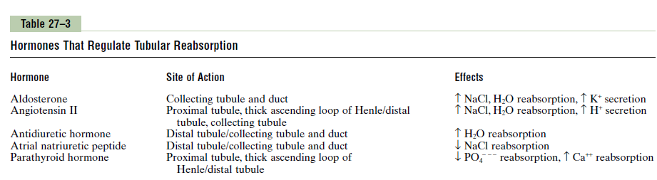
Hormones

Slide 57
Nervous regulation
Sympathetic system activation increases sodium reabsorption by:
Activation of sympathetic nervous system constricts renal arterioles , decreases GFR, decreases sodium and water excretion
Increases sodium reabsorption in proximal tubule, loop of Henle and perhaps in distal parts
Activates renin angiotensin system which adds to overall effect.

Slide 58
MCQs
1) Substance poorly reabsorbed in nephron:
a) Creatinine
b) Urea
c) Uric acid
d) All of the above

Slide 59
2) which substance is actively transported but has not been shown to have Tm?
a) Albumin
b) Hemoglobin
c) Sodium ions
d) Glucose

Slide 60
3.Na -2Cl-K+ cotransporter is active in
A)PCT
B)descending limb of LOH
C)thin ascending limb of LOH
D) thick ascending limb of LOH

Slide 61
4) which part of nephron is essential for maintaining plasma potassium homeostasis?
a) PCT
b) Loop of Henle
c) DCT and CT
d) All of the above

Slide 62
5) Aldosterone:
a) Produced in JGA
b) Increase sodium reabsorption by nephron
c) Increase potassium reabsorption by nephron
d) Tends to increase H+concentration in blood

