Slide 1
Renal Blood Flow

Slide 2
Renal Blood Flow
Importance
Supplies- oxygen, nutrients, hormones
Delivers –metabolites, waste products to kidney for excretions
Controls- concentration and dilution of urine
Determines GFR
Influences solute and water reabsorption from kidney

Slide 3
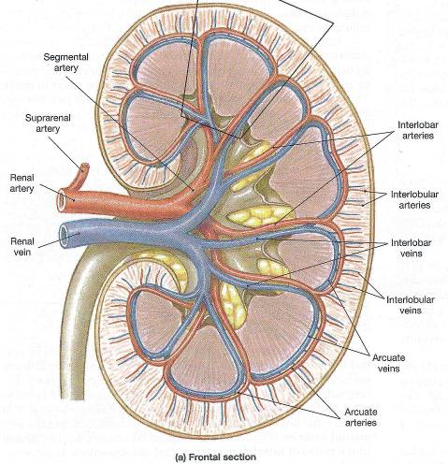
Blood Supply of the Kidney
Renal artery
Interlobar arteries
Arcuate arteries
Interlobular arteries
Afferent arterioles
Glomerular capillaries
Efferent arterioles

Slide 4
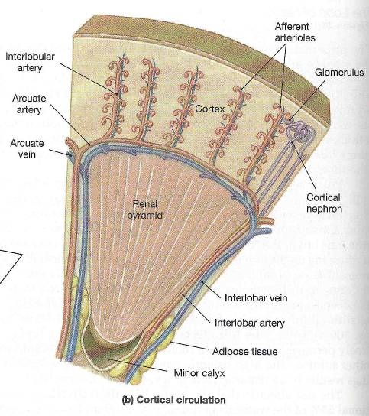
Efferent arterioles
Peritubular capillary plexus and vasa recta
Stellate vein
Interlobular vein
Arcuate vein
Interlobar vein
Renal vein

Slide 5
Characteristics Of RBF
Rate: 1200 ml/min (400 ml/100 g tissue/min)
Total RBF is approx. 20% of resting CO
Higher RBF related to its excretory function rather than its metabolic requirement.

Slide 6
  Thus,
  RBF = Renal arterial pressure − renal venous pressure
  Renal vascular resistance
Renal oxygen consumption - 6ml/100gm tissue/min

Slide 7
Measurement of RBF
1. With the help of electromagnetic flow meter
2. Para-amino hippuric acid (PAH) clearance method.
3. Renal blood flow can also be measured indirectly from
              the filtration fractions

Slide 8
Regulation of RBF
Auto regulation
Hormonal regulation
Nervous Regulation

Slide 9
Substance that is used for RBF measurement should have following properties
Substance used should be measurable in arterial and venous blood
Should not be metabolized
Should not be stored
Should not be produced by kidney
By itself, should not affect the blood flow
Should not be toxic
  Ex. Para-aminohippuric acid (PAH)

Slide 10
MECHANISM OF
URINE FORMATION

Slide 11
Three processes in the urine formation :
Glomerular filtration,
Tubular reabsorption and
Tubular secretion.
Urinary Excretion =
Filtration - Reabsorption + Secretion

Slide 12
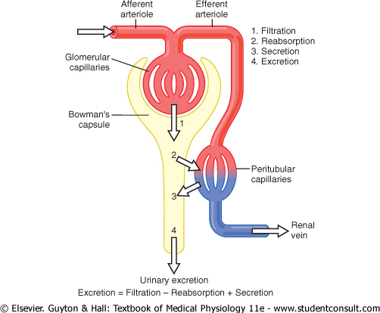
Steps:

Slide 13
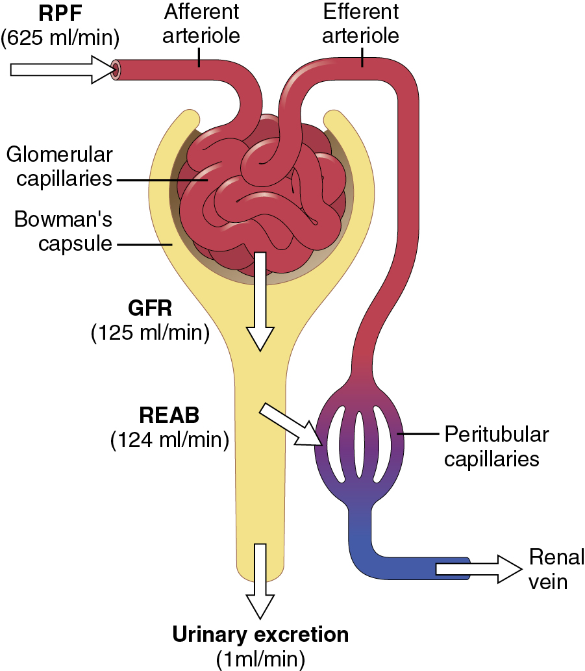
Urine formation

Slide 14
GLOMERULAR FILTRATION
Process of ultra filtration of plasma from the glomerular capillaries into the Bowman’s capsule.
Involves a review of:
- Composition of glomerular filtrate,
- Dynamics of glomerular filtration,
- Glomerular filtration rate,
- Filtration fraction,
- Factors affecting glomerular filtration and
- Measurement of glomerular filtration

Slide 15
COMPOSITION OF GLOMERULAR FILTRATE
like that of the plasma except for
absence of proteins (colloids) and cells.

Slide 16
Factors that determining the glomerular filterability
Molecular weight
Charges of the molecule

Slide 17
Filterablility of plasma constituents vs. water
Constituent | Mol. Wt. | Filteration ratio
Urea | 60 | 1.00
Glucose | 180 | 1.00
Inulin | 5,500 | 1.00
Myoglobin | 17,000 | 0.75
Hemoglobin | 64,000 | 0.03
Serum albumin | 69,000 | 0.005

Slide 18
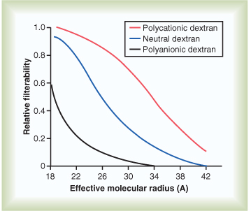

Slide 19
Determinants of GFR
Net filtration pressure
Glomerular capillary filtration coefficient(Kf)
GFR = Kf * Net filtration pressure

Slide 20
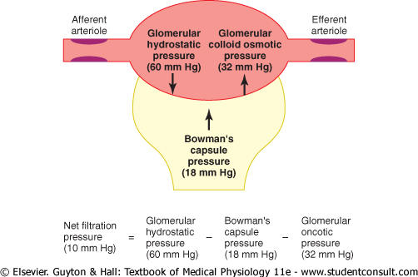
Net filtration pressure = PG – PB – πG + πB
PG = Glomerular capillary hydrostatic pressure
PB = Bowmen’s capsule hydrostatic pressure
πG = Glomerular capillary colloidal osmotic pressure
πB = Bowmen’s capsule colloidal osmotic pressure

Slide 21
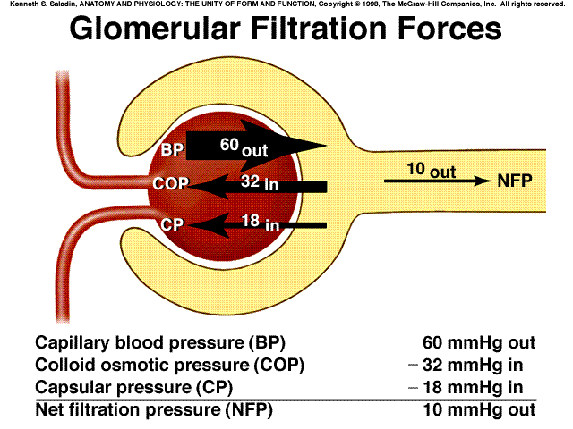

Slide 22
Kf
Product of the permeability and filtering surface area of glomerular capillaries.
Kf = GFR/ Net filtration pressure
= 125ml/min / 10 mm Hg
= 12.5 ml/min/mmHg

Slide 23
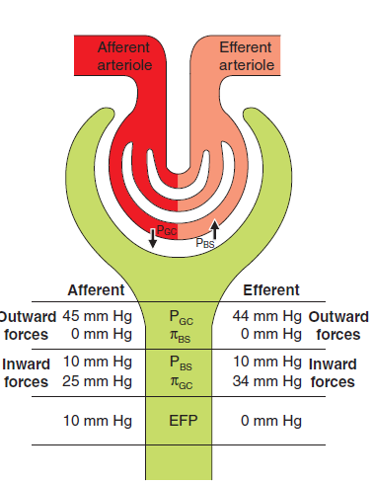
DYNAMICS OF GLOMERULAR FILTRATION
GFR = Kf *[(PGC − PBS) − (πGS − πBS)]
GFR = 12.5 (45 – 10) − (25 0)
    =12.5 *10
= 125 ml/min
.

Slide 24
NORMAL GLOMERULAR FILTRATION RATE
GFR = 125 ml/min
( 90–140 ml/min)
In 24 hr, 180 L/day
99% or more is reabsorbed and only 1% or less is excreted as urine

Slide 25
Effective filtration pressure is the net outward force and
is calculated as the difference between the outwardly (i.e.PGC and πBS) and inwardly (PBS and πGC) directed forces
Thus under normal circumstances,
GFR = 12.5 (45 – 10) − (25 – 0) = 125 mL/min

Slide 26
Filtration fraction
Fraction of plasma filtered as glomerular filtrate
FF=GFR/RPF
FF=125/625
FF=0.2 means 20% of RPF filtered as GFR

Slide 27
FACTORS AFFECTING GFR
1. Filtration coefficient (Kf): product of permeability and filtration area of the glomerular capillary membrane
2. Hydrostatic pressure in Bowman’s space fluid (PBS)
3. Glomerular capillary hydrostatic pressure (PGC)
4. Glomerular capillary oncotic pressure (πGC)
5. Sympathetic stimulation
6. State of glomerular membrane

Slide 28
MEASUREMENT OF GFR
Renal clearance of Inulin, urea and Creatinine.
Renal clearance is volume of plasma that is completely cleared of substance by kidney per unit time and is calculated by:
C (ml/min) = UV/P
Where,
C = Renal clearance of the substance,(ml/min)
U = Urine concentration of substance,(mg/ml)
V = Rate of urine flow and(ml/min)
P = Plasma concentration of the substance(mg/ml)

Slide 29
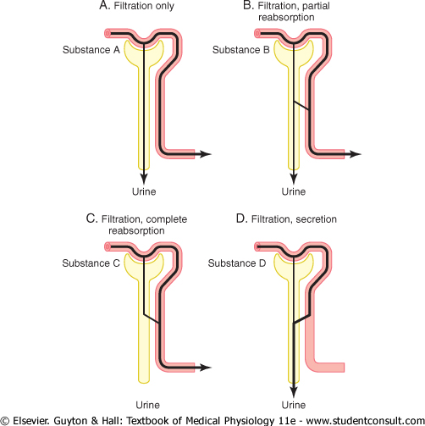

Slide 30
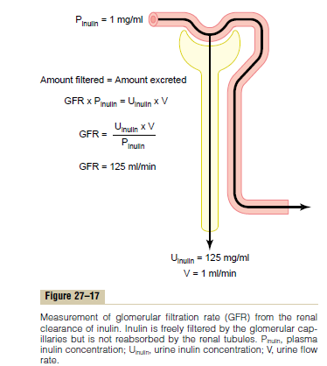
Inulin,creatinine used to measure GFR.
CRITERIA OF THE SUNSTANCE USED
Freely filtered, neither reabsorbed nor secreted
Non metabolized in the body, non toxic
Should not stored,altered or systhesized by kidney
Concentration should be easily measured

Slide 31
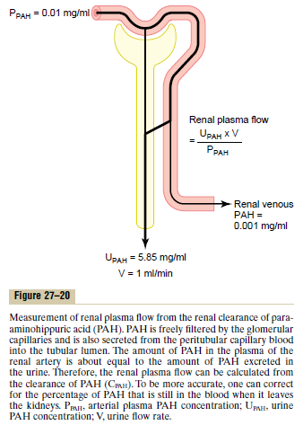
RENAL PLASMA FLOW
To measure RPF, PAH is used.
After infusion in the body 90% of it extracted by kidney.
So clearance of it can be used to measure RPF.
C = U*V/P
By this we can get ERPF
RPF=ERPF/EXTRACTION OF PAH
RPF=625/0.9
RPF=694ml/min

Slide 32
If hematocrit value is 45% then
RBF = RPF×1/1- hematocrit
= 694× 1/1-0.45
= 1260 ml/min

Slide 33
REGULATION OF GFR and RBF
1) Auto regulatory mechanism
- Myogenic theory
- Tubuloglomerular feedback
2) Hormonal mechanism
3) Neural mechanism

Slide 34
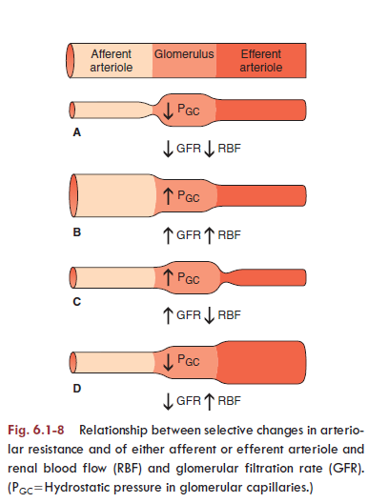

Slide 35
Auto regulation
Blood Flow to kidney is maintained at a relatively constant level despite the change in systemic pressure range b/w 80 to 180 mmHg
This is called auto regulation of RBF
Two types:
- Myogenic Mechanism
- Tubuloglomerular feedback mechanism

Slide 36
Myogenic mechanism
Increased pressure in blood vessel
Stretching of vessel wall
Opening of cation channels
Resulting in depolarization
Voltage dependent opening of Ca⁺² channel –calcium influx
Increased intracellular calcium
Vasoconstriction

Slide 37
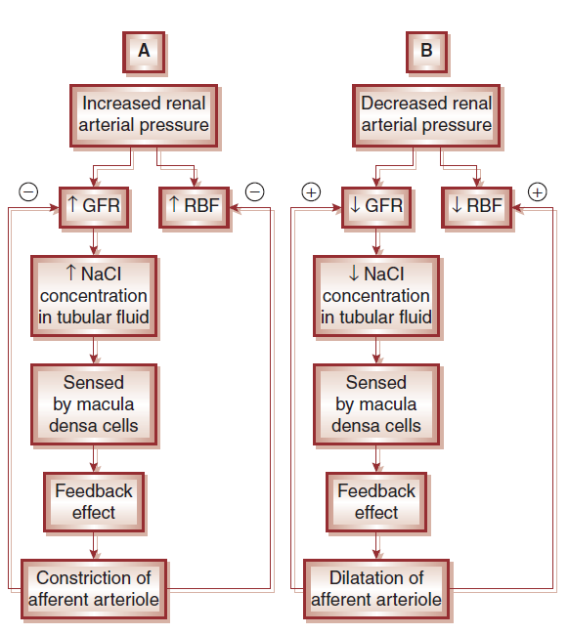
Tubuloglomerular feedback mechanism

Slide 38
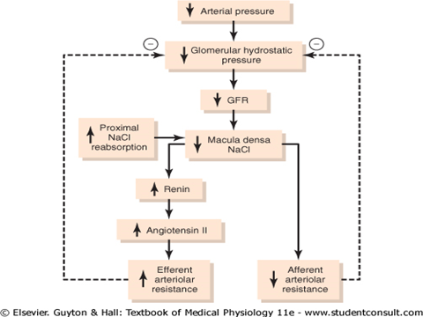
Tubuloglomerular feedback mechanism

Slide 39
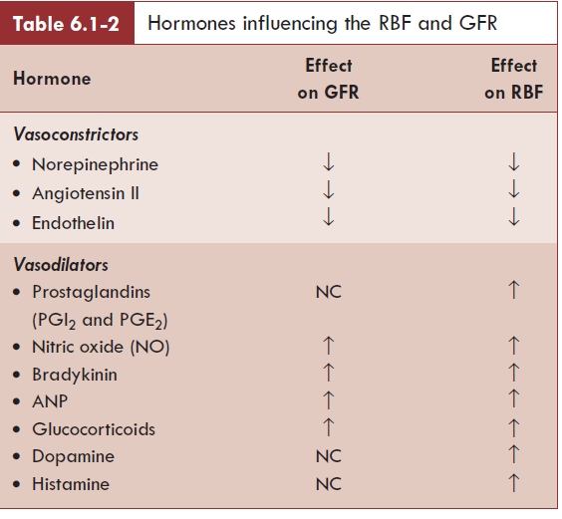
Hormonal regulation

Slide 40
Neural factors
Stimulation of renal sympathetic fibers causes vasoconstriction---------decreases RBF
Sympathetic stimulation----renin release----activation of Renin Angiotensin System----angiotensin-II ------vasoconstriction
Local PGs (PG E2 and I2)---VASODILATION

Slide 41
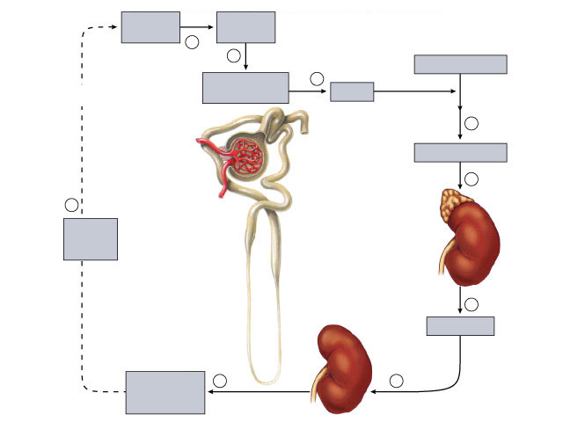
Fig. 49.22(TE Art)
Copyright © The McGraw-Hill Companies, Inc. Permission required for reproduction or display.
Low blood
pressure
Low blood
flow
1
2
Angiotensinogen
Negative
feedback
Juxtaglomerular
apparatus
3
Distal
convoluted
tubule
Renin
4
Afferent
arteriole
Angiotensin II
Proximal
convoluted
tubule
Glomerulus
5
9
Efferent
arteriole
Adrenal
cortex
Increased
blood
volume
Bowman's
capsule
Loop
of Henle
6
Aldosterone
Kidney
Increased NaCl
and H₂O
reabsorption
8
7

Slide 42
MCQ-1
1. Glomerular filtration per day
A) 40-50 lit
B) 90-100 lit
C) 140-150 lit
D) 170-180 lit

Slide 43
2. Capillary pressure in renal glomeruli is:
A) lower than pressure in efferent arteriole
B) increases when afferent arterioles constricts
C) higher than most other capillaries in the body
D) fall by approx 10% when BP decreases by 10% from normal level

Slide 44
3. Most potent endogenous vasopressor is
A) Aldosterone
B) Nor epinephrine
C) Angiotensin II
D) Cortisol

Slide 45
4.what % of glomerular filtrate is normally reabsorbed?
A)1%
B)10%
C)80%
D)99%

Slide 46
5. Net filtration pressure in kidney is……..mmHg
A)5
B)10
C)15
D)20

Slide 47
Thank you

