Slide 1
MONITORING IN ANAESTHESIA
DR. DINESH CHAUHAN
Prof. & Head,
Dept. Of Anaesthesia,
S.B.K.S.M.I.R.C.,Piparia

Slide 2
CLINICAL MONITORING
Auscultate pt
See nail bed of pt
See baseline pulse volume
Hear heart sounds
See eye signs
Look for pallor

Slide 3
TYPES OF MONITORING
CVS Monitoring
Non CVS Monitoring
Pulse oximetry
Capnography
Temperature
ABG analysis
Precordial & Oesophageal stethoscope
Urinary output
monitoring blood loss
Anaesthetic gas analysis
Lung Volumes
O2 analysers
CNS-monitoring depth of anaesthesia

Slide 4
CVS Monitoring
NON INVASIVE MONITORING
1) NIBP
2) ECG
SEMI INVASIVE MONITORING
1)TEE
INVASIVE MONITORING
1)IBP
2)CVP
3)PULMONARY ARTERY CATHETERIZATION

Slide 5
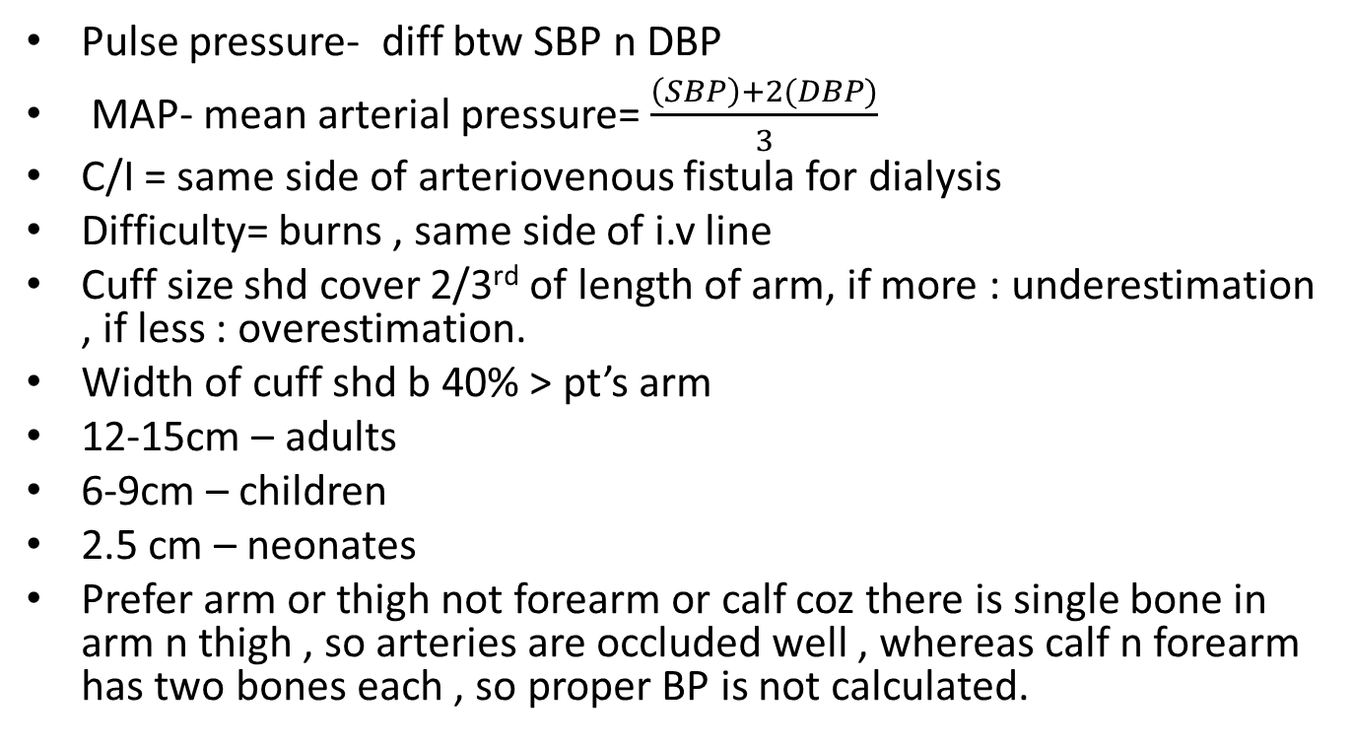
NIBP
Pulse pressure- diff btw SBP n DBP
MAP- mean arterial pressure= $\frac{\left(SBP\right)+2(DBP)}{3}$
C/I = same side of arteriovenous fistula for dialysis
Difficulty= burns , same side of i.v line
Cuff size shd cover 2/3rd of length of arm, if more : underestimation , if less : overestimation.
Width of cuff shd b 40% >pt’s arm
12-15cm – adults
6-9cm – children
2.5 cm – neonates
Prefer arm or thigh not forearm or calf coz there is single bone in arm n thigh , so arteries are occluded well , whereas calf n forearm has two bones each , so proper BP is not calculated.

Slide 6
NIBP
Techniques
Palpatory- only SBP.
Ausculatory-korotkoff sounds r produced.
Oscillometory-arterial pulsations cause oscillations n are max @ MAP.
Doppler probe- subsituted for anesthesiologist fingers.
Probe transmits ultrasonic signal which is refleted by underlying tissue.
Moving RBC causes change in frequency shift.

Slide 7
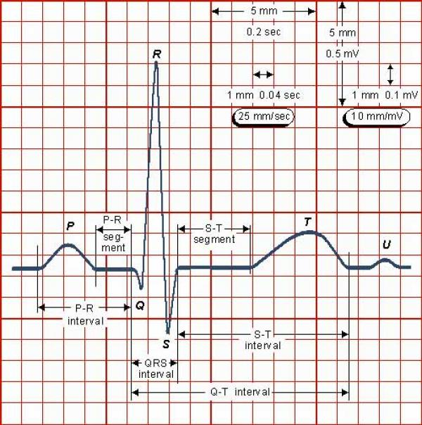
ECG
Its mandatory , no C/I, HR= 300/large boxes & 1500/small boxes
For arrythmias – see in lead II
For ischaemias – V5

Slide 8
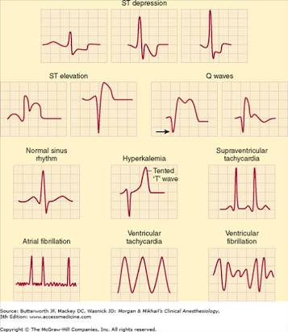

Slide 9
IBP- INVASIVE BLOOD PRESSURE
For beat to beat BP monitoring or end organ disease.
Sites: 1) radial A-
m/c, superficial, with collateral flow (ulnar A)
Allens test-method for assessing safety of radial A cannulation= pt exsanguinates hand by fist, while operator occludes Radial & Ulnar A by fingertip pressure, then release ulnar pressure n still occluding Radial pressure- flushing of thumb <5 sec (N), 5-10 sec (borderline), >11sec (C/I)
2) doraslis pedis – m/c after radial , distorted waveform
3)ulnar A – deeper, more difficult, more torturous,
compromise blood flow to hand if radial already punctured
4)brachial A- large, easy to identify , good waves, but kinks
5)Femoral A – easy acess, prone to atheroma n infections
6)Axillary A – n damage

Slide 10
IBP
Complications
- arterial injury, spasm, distal ischaemia
- thrombosis n embolization (... continous heparin flush)
- sepsis
- tissue necrosis
- fistula/ aneurysm

Slide 11
CVP
R- IJV- best access n safe, valveless n in direct communication with right atrium, L IJV causes pleural effusion n chylothorax.
Subclavian-most difficult, high complications - pneumothorax
Femoral-worst for long term use – line related sepsis, easy
Indication : - open heart surgeries
- fluid m/n in shock
- major sx
- along with aspiration of air embolism, venous access, parentral nutrition
N CVP=
3 cannulation techniques- we use seldinger’s- slide catheter over guidewire

Slide 12
CVP
Catheter tip shd not b in heart chambers.
Shd b @ junction of SVC n Right atrium (confirmed by arrhythmic changes in ECG, so withdraw a little)
Complications- line infection
- bloodstream infection
- air/ thromboembolism
- pneumothorax/chylothorax/hemothorax/hydrothorax
- arrhythmias
- cardiac perforations, cardiac tamponade
- trauma to brachial plexus, carotid A, phrenic N
CVP ↑- fluid overload (same reason) - IPPV with PEEP
- CHF - pleural effusion
- pul embolism (d/t ↑ Pul A press - ↑backflow- ↑RV press) - haemothorax
- cardiac tamponade (same reason) - coughing n straining
CVP ↓ - hypovolemia n shock , GA , SA(↓ venous return)

Slide 13
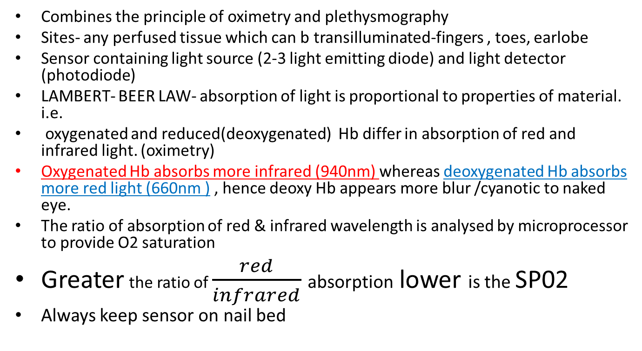
PULSE OXIMETRY
Combines the principle of oximetry and plethysmography
Sites- any perfused tissue which can b transilluminated-fingers , toes, earlobe
Sensor containing light source (2-3 light emitting diode) and light detector (photodiode)
LAMBERT- BEER LAW- absorption of light is proportional to properties of material. i.e.
oxygenated and reduced(deoxygenated) Hb differ in absorption of red and infrared light. (oximetry)
Oxygenated Hb absorbs more infrared (940nm) whereas deoxygenated Hb absorbs more red light (660nm ) , hence deoxyHb appears more blur /cyanotic to naked eye.
The ratio of absorption of red & infrared wavelength is analysed by microprocessor to provide O2 saturation
Greater the ratio of $\frac{red}{infrared}$absorption lower is the SP02
Always keep sensor on nail bed

Slide 14
PULSE OXIMETRY
Clinically-
1)carbonmonoxide poisoning – it shows fixed saturation of SP02=95% irrespective of real amount.
2)methemoglobinemia –there is same absorption coefficient @ both red and infrared wavelength.
SP02 fixed @ 85%
So gives falsely low saturation if its actually > 85%
& falsely high SP02 if actually SP02<85%.
3)excessive light
4) motion
5) methylene blue dye
6) low perfusion (low cardiac output, anaemia , hypothermia)
7) malpositioned sensor (v common)
8) nail polish (that’s why if Pt has 4 gm Hb ,
9) shivering never cyanosis)
10) @ SP02 – 90% , PaO2- <65mmHg (ODC)
11) clinically detectable cyanosis : SPO2 < 80% = 5 gm of desaturated Hb.

Slide 15
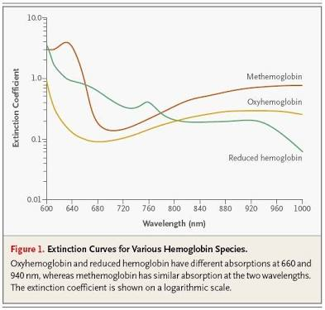

Slide 16
CAPNOGRAPHY
It represents the graph for continous measurement of EtCO2.
i.e.- End tidal carbon diaoxide
Normal- 32-42mmhg
Principle: Infrared light (940 nm wavelength)
are absorbed by CO2 – based on Lambert Beer Law.
Pressure gradient Btw PaCO2 & Etco2 =2-5mmhg
that reflects alveolar dead space.
More imp than pulse oximetry , coz if sudden detachemnt, extubation or esophageal intubation or shivering, hypothermia , pulse ox will not show proper saturation but EtCO2 will )

Slide 17
CAPNOGRAPHY
EtCO2 = Decreased
Pulmonary embolism
--- air
---fat
---thrombus
No Change in EtCO2
Bronchospasm
EtCO2 = 0/ Flat line
Esophageal intubation
Accidental extubation
Complete obstruction
Disconnection
Ventilator failure
Cardiac arrest
EtCO2 = Increased
malignant hyperthermia(increase BMR so more work more CO2)
Exhausted sodaime
Thyrotoxicosis (same reason)
Fever(same reason)
Neuroleptic syndrome

Slide 18
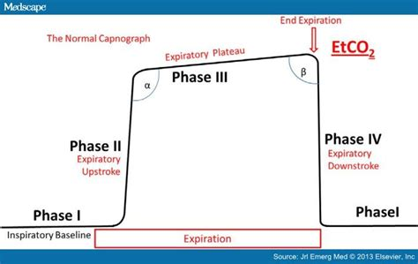

Slide 19
TEMPERATURE
Essential for every pt but most imp for cardiac surgeries, neonates and small children, large evaporative loss like burns, long hours OT.
most accurate is core temp
Core temp > rectal > surface temp
Core temp- measured by thermistor or thermocouple
Sites for core temp-
1) lower end of esophagus- best site
2) pulmonary artery- most accurate
3) nasopharynx
4) Tympanic membrane – most accurately
measures brain temp(ECA)
5) Bladder
6) Rectum
7) Skin
neonates/children have more heat loss d/t large body surface n less heat generation also no compensation by shivering mech , so temp monitoring vvimp, also they maintain temp by brown fat.

Slide 20
TEMPERATURE
HYPOTHERMIA
Temp < 35°C
Reasons- anaesthetic drugs are vasodilators(heat loss)
- AC Ots
-cold i.v. fluids
- Evaporation
Heat loss in GA can b max- 30kcal/hr.
Mild = 28°C - 35°C
Moderate = 21°C - 27°C
Severe or Profound = < 20°C
Systemic Effects-
1) CVS- Bradycardia , hypotension , ventricular arrythmia
2) Cerebral - ↓ cerebral metabolc rate
3) RS – ODC shifts to left , ↓ minute volume, resp arrest < 23°C
4) Blood – ↑blood viscosity, ↑ platelet count, impaired coagulation
5) Kidney - ↓ GFR , no urianry output @ 20°C
6) Endocrine - ↓ ADR n Noradr , hyperglycemia(↓insulin synthesis)
7) Others – vasoconstriction, impaired resistance to infection, delayed dry metabolism

Slide 21
TEMPERATURE
HYPOTHERMIA t/t
warm i.v fluids(don’t overheat, otherwise hypethermia, tachycardia)
↓ room temp – ideal OT temp- adults : 21°C
-children : 28°C
cover the patients
Warm air by special instruments: blowers , heaters
(don’t keep in direct contact, keep some thing in interspace , best is sheet/clothes, otherwise burns blisters)

Slide 22
ABG Analysis
Radial artery (preffered)/ femoral artery
2ml/5 ml syringes, heprinized
Glass syringes preffered over plastic bcoz CO2 diffuses through plastic
Remove all air, 0.2 ml of blood
Normal values
pH-: 7.35-7.45
pCO2-: 35-45mmHg
HCO3-: 24-26meq/L
Base deficit-: (-3) – (+3)
pO2-: 96-98mmHg
SpO2-: 96-98%
(if venous blood pO2-40mmHg, Spo2- 75%)

Slide 23
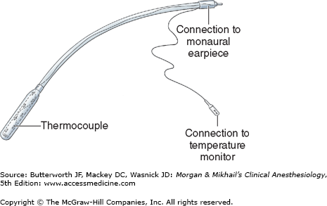
PRECORDIAL & ESOPHAGEAL STETHOSCOPES
Primitive method to ensure-
1) B/L lung ventilation
2) quality of breath sounds
3) regularity of heart rate
PRECORDIAL – aka Wenger chestpiece, must in children OT
bell shaped metal piece placed on suprasternal notch by double side adhesive disk.
ESOPHAGEAL – soft plastic catheter with balloon distally, quality of heart n breath sounds are better.
But causes mucosal irriation n bleeding and can b used in intubated pts only.
C/I – esophageal varices n strictures

Slide 24
URINARY OUTPUT
PREOP Urinary bladder catheterization
Indication:- CHF, renal failure,
advanced Hepatic diseases
shock
cardiac surgeries
renal vascular surgeries
major abdominal surgeries
craniotomy
lengthy surgeries
Post op catheterization- difficulty in voiding in recovery after GA or RA
C/I – sepsis or high risk of infection
Techniques : - transurehtrally and suprapubic
Complications :- Trauma & UTI , rapid decompression can cause of hypotension
Clinical uses- renal, CVS, n fluid volume status
kidney perfusion n function
oligouria ( output < 0.5 ml/kg/hr)

Slide 25
CNS – monitoring depth of anaesthesia
Signs n symptoms of light anaesthesia
1)tachycardia
2)HTN
3)lacrimation
4)Perspiration
5)movt. Response to painful stimuli
6)Tachypnea, breath holding, coughing, laryngospasm n bronchospasm
7)Eye movts
8)Preserved Reflexes

Slide 26
CNS monitoring
EEG- Electroencephalogram
1)monitor depth n cerebral ischaemia
2)all inhalational n i.vi ansethetics – produce biphasic pattern –
low dose = excitation =β= high frequency n low amplitude= LIGHT
high dose = depression =θ & δ=high amplitude n low frequency=DEEP
3) Cerebral ischaemia, hypothermia, opiods= depression
4) N2O n ketamine = Excitation
EVOKED Responses
1) meaure integrity of neuronal tissue n monitor depth.
2)Neurological injury, iscahemia, inahalational agents n barbiturates decrease the amplitude n increae the latency ( response time ) of evoked responses.
3) Types – SSEP- somatosensory evoked potential
- AEP – Auditory Evoked Potential
- VEP – Visual Evoked Potential

Slide 27
MONITORING BLOOD LOSS
3 methods
Gravimetric method- weighing blood soaked swabs n sponges
Volumetric method- estimating blood loss in suction
Colorimetric method- most accurate

