Slide 1
Excretory System
Dr.Dipika Baria

Slide 2
What is Excretion ?
Removal of waste products
Various organs –
  -Lungs
  -Kidneys
  -GIT
  -Skin
Notes:
Concept of excretory system:

Slide 3
Why is Excretion Important ?
-Excretion of metabolic products & foreign substances
-Regulation of body fluid osmolality,
-water -electrolyte balance

Slide 4
Functions of Kidney
1. Excretion of metabolic waste products and foreign chemicals
2. Regulation of water and electrolyte balances
- Regulation of body fluid osmolality and electrolyte concentrations
3. Regulation of arterial pressure
4. Regulation of acid-base balance
5.Secretion, metabolism, and excretion of hormones
- Erythropoietin,
- Renin
- Activation of vitamin D
6. Gluconeogenesis

Slide 5
Literally, the word excretion means elimination of any matter from the body of an organism
However except CO2 remaining substances in bulk (ammonia, urea, uric acid, creatinine, various pigments and inorganic salts), are excreted by kidneys.
Thus in strict sense kidneys are excretory organs.
Also called urinary system

Slide 6
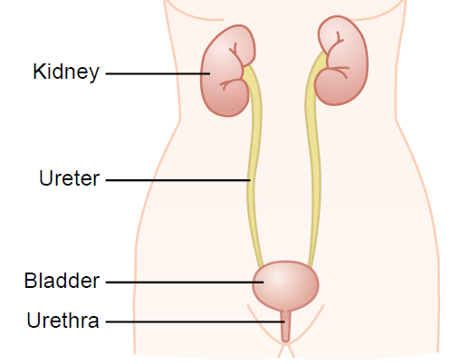
Components of Urinary system
Notes:
The urinary system consists of two kidneys, two ureters, one urinary bladder, and one urethra. After the kidneys filter blood plasma, they return most of the water and solutes to the bloodstream. The remaining water and solutes constitute urine, which passes through the ureters and is stored in the urinary bladder until it is excreted from the body through the urethra.

Slide 7
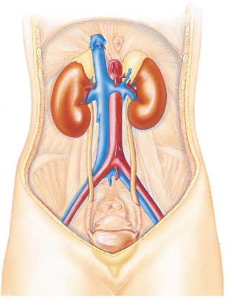
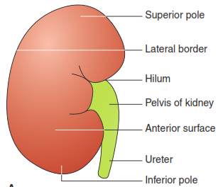
Gross Anatomy of Kidney
Renal artery
Renal Vein
Kidney
Ureter
Urinary Bladder

Slide 8
Functional Anatomy of Kidney
Gross Anatomy:
Bean shaped
Retroperitoneal organ
150 gm weight
Covered by thick capsule Renal Capsule
Medial border-concave
Centre of concavity – Renal hilus-ureter

Slide 9
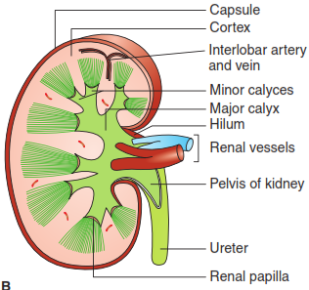
Internal Structure of Kidney
Outer cortex:
Granular appearance
Inner medulla:
Striated appearance
8-12 conical masses
Renal pyramids – terminated into PAPILLA
Minor calyx
Major calyx
Renal pelvis
Ureter

Slide 10
Medulla. It is made up of triangular areas of renal tissue that are called the renal pyramids. Pyramids are 4–14 in number and separated from each other by cortical columns of Bertin. Each pyramid has a base directed towards the cortex and an apex (or renal papilla) which is directed towards the renal pelvis and fits into the minor calyx. Pyramids show striations that pass radially towards the apex. These striations are due to a straight portion of the nephron and extend some distance upwards into the cortex where they are called medullary rays.

Slide 11
Microscopic Structure Of Kidney
Nephrons, blood vessels, lymphatics and nerves.
Nephron is a structural and functional unit of the kidney.
1.2 million nephrons/kidney.
Hollow tubes composed of single cell layer.
Each nephron is capable of forming urine.
Notes:
Microscopically, the cortex and medulla of the kidney are composed of

Slide 12
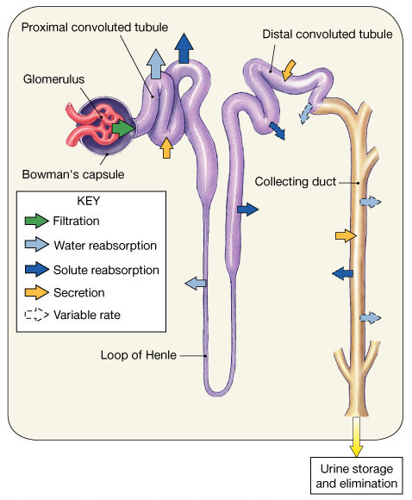
Ultra structure of the Nephron
Two major parts:
- Renal corpuscle
  – the head of the nephron
- Renal tubule
  the tubular passageway of the nephron

Slide 13
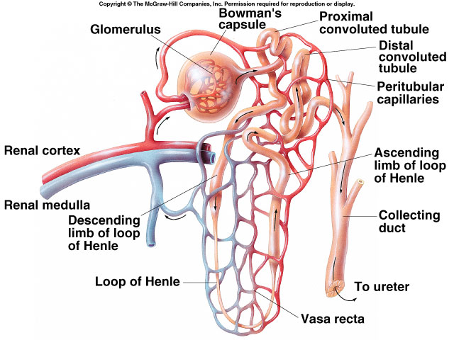

Slide 14
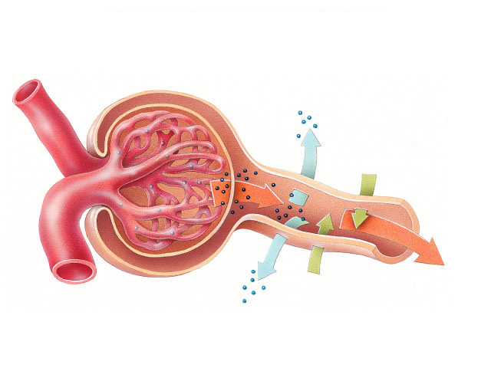
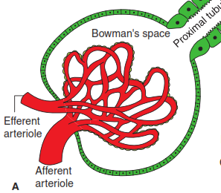
Renal corpuscle (Malpighian corpuscle )
Rounded structure comprising
glomerulus surrounded by a glomerular capsule.
Bowman's
capsule
Glomerulus
Filtration

Slide 15
Glomerulus
Glomerulus refers to a rounded tuft of anastomosing capillaries.
located in the initial dilated and cup like portion of tubule, called BOWMAN’S CAPSULE

Slide 16
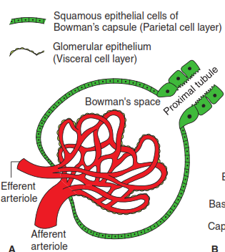
Glomerular capsule has
- Visceral layer(inner)
- Parietal layer(outer)
- BOWMAN’S SPACE
Notes:
BOWMAN’CAPSULE:
Capsule has
Visceral layer-remain close to glomerulus
Podocytes form the visceral layer
Parietal layer-outer portion of capsule
Parietal epithelial cells form parietal layer
BOWMAN’S SPACE: space b/w visceral and parietal layer
This GM consists of
Capillary endothelial cells
Basement membrane
Foot process of podocytes
Through this filtration barrier blood passes through and filtered to form the tubular fluid

Slide 17
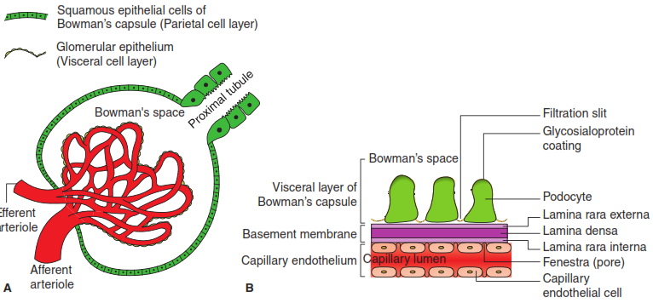
Glomerular Filtration Membrane
- Capillary endothelial cells
- Basement membrane
Foot process of podocytes
Blood passes through and filtered to form the tubular fluid

Slide 18
1.Capillary endothelial cells:
Fenestrated type
Contains pores with large diameter 50 to 100nm
This allows free passage of large molecules through them
This allows water and small solutes like sodium, urea, glucose etc.
Endothelial cells – negatively charged(anionic glycoprotein)
Proteins in plasma are also anionic, it is absent in urine normally.

Slide 19
2.Basement membrane
Made up of:
Meshwork of collagen and proteoglycan fibrillae
It is barrier for the proteins
No pores, however its permeability corresponds to pore size of 8 nm

Slide 20
3.Foot Processes of Podocytes
Basically podocytes are epithelial cells
Foot processes interdigitate to cover the basement membrane
Interdigitating processes are separated by SLIT PORES OR FILTRATION SLITS (width 20 nm)

Slide 21
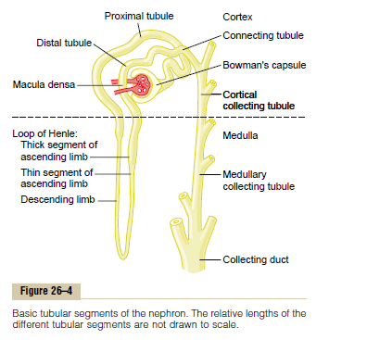
Renal Tubules
PCT
Loop of Henle
DCT
Collecting duct system
Total length: 45-65 mm

Slide 22
Functions of Nephron Structures
Glomerulus
  The site for blood filtration
  operates as a nonspecific filter; in that, it will remove both useful and non-useful material
  the product of the glomerulus is called filtrate

Slide 23
Bowman’s Capsule
  A sac that encloses glomerulus and transfers filtrate from the glomerulus to the Proximal Convoluted Tubule (PCT)

Slide 24
Proximal Convoluted Tubule (PCT)
  A thick, constantly actively segment of the nephron that reabsorbs most of the useful substances of the filtrate: sodium (65%), water (65%), bicarbonate (90%), chloride (50%), glucose (nearly 100%!), etc.
  The primary site for secretion (elimination) of drugs, waste and hydrogen ions

Slide 25
Decending Limb of the Loop of Henle
  A part of the counter current multiplier
  freely permeable to water and relatively impermeable to solutes (salt particles)
  receives filtrate from the PCT, allows water to be absorbed and sends “salty”filtrate on the the next segment. “Saves water and passes the salt”

Slide 26
Ascending Limb of the Loop of Henle
  a part of the counter current multiplier
  impermeable to water and actively transports (reabsorbs) salt (NaCl) to the interstitial fluid of the pyramids in the medulla. “Saves salt and passes the water.”
  the passing filtrate becomes dilute and the interstitium becomes hyperosmotic

Slide 27
Distal Convoluted Tubule (DCT)
  receives dilute fluid from the ascending limb of the Loop of Henle
  Variably active portion of the nephron
  When aldosterone hormone is present, sodium is reabsorbed and potassium is secreted. Water and chloride follow the sodium.

Slide 28
Collecting Duct
  receives fluid from the DCT
  variably active portion of the Nephron
  when antidiuretic hormone (ADH) is present, this duct will become porous to water.
  The last segment to save water for the body

Slide 29
Peritubular Capillaries
  transport reabsorbed materials from the PCT and DCT into kidney veins and eventually back into the general circulation
  help complete the conservation process (reabsorption) that takes place in the kidney

Slide 30
Types of Nephrons
Physiologically nephrons are
(1) Cortical nephrons
(2) Juxtamedullary nephrons
Kidney can’t regenerate new nephrons.

Slide 31
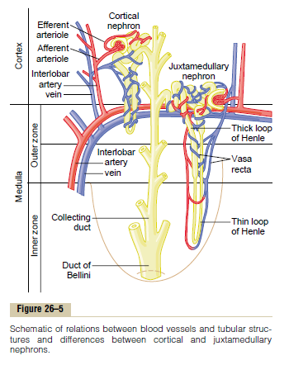

Slide 32
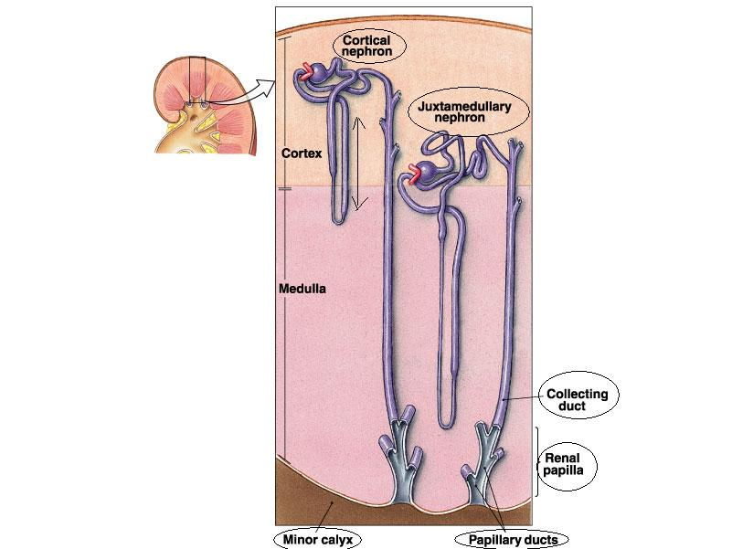

Slide 33
FEATURE | CORTICAL NEPHRON | JUXTA-MEDULLARY N
Location of glomerulus | Upper region of cortex | Near junction of cortex and medulla
% (total nephron) | 85% | 15%
Size of glomeruli | Small | Larger
Size of LOH | Small | Large
Ascending limb of LOH comprises | Thick segment | Thin segment
Efferent arterioles | Large diameter, break-up peri-tubular capillries | Small diameter and continue as vasa recta
Rate of filtration | Slow | High
Major function | Excretion of waste products in urine | Concentration of urine by the CCS
Notes:
Size of LOH
Small, extend up to outer layer of medulla
Large, extend deep into the medulla

Slide 34
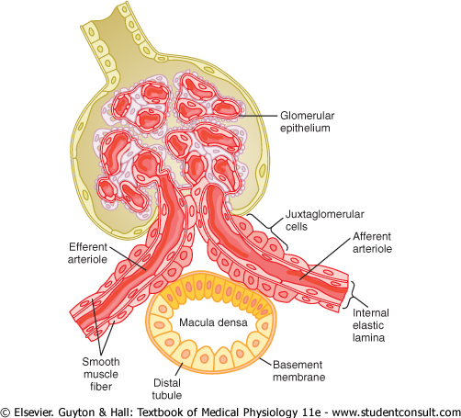
Juxtaglomerular Apparatus
Collection of specialised cells near to the glomerulus.
Major component of renin–angiotensin -aldosterone system.
Comprises three types of cells:
Juxtaglomerular cells
Macula densa cells and
Mesangial cells (or lacis cells).

Slide 36
Juxtaglomerular cells
JG cells are specialised (modified vascular smooth muscle) cells located in the media of the afferent arteriole in the region of JG apparatus.
They synthesize, store and release an enzyme called Renin.
They act as baroreceptors (tension receptors) and respond to changes in the pressure gradient between the afferent arterioles and the interstitium .
These cells are stimuated by hypovolemia

Slide 37
Macula densa cells
Location: short segment of the thick ascending limb of loop of Henle which passes between the afferent and efferent arterioles.
They act as chemoreceptors and are stimulated by decreased NaCl concentration and thereby causing increased renin release.

Slide 38
Mesangial cells
Also known as lacis cells are the interstitial cells of the JG apparatus.
They are in contact with both the macula densa cells and JG cells
It relay the signals from macula densa to the granular cells.
NaCl – in the region of macula densa stimulates the JG cells to secrete renin.

Slide 39
Renin- Angiotensin System (RAS)
RAS- Involved in the control of BV and BP
RENIN-
Angiotensinogen Angiotensin –I
ANGIOTENSINOGEN-
Glycoprotein synthesized in liver
Angiotensinogen –physiologically inactive
Acts as precursor for the formation of angiotensin -I
Renin

Slide 40
Angiotensin-I Angiotensin –II
majority are in the capillaries of lungs
Angiotensin-II -most active angiotensin
ACE

Slide 41
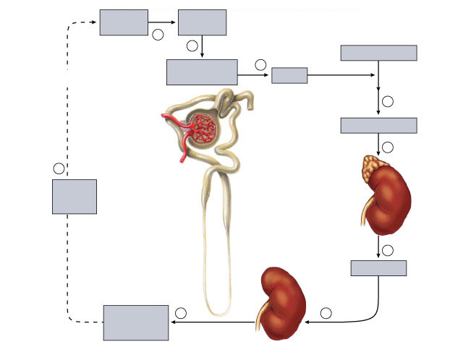
Fig. 49.22(TE Art)
Copyright © The McGraw-Hill Companies, Inc. Permission required for reproduction or display.
Low blood
pressure
Low blood
flow
1
2
Angiotensinogen
Negative
feedback
Juxtaglomerular
apparatus
3
Distal
convoluted
tubule
Renin
4
Afferent
arteriole
Angiotensin II
Proximal
convoluted
tubule
Glomerulus
5
9
Efferent
arteriole
Adrenal
cortex
Increased
blood
volume
Bowman's
capsule
Loop
of Henle
6
Aldosterone
Kidney
Increased NaCl
and H₂O
reabsorption
8
7

Slide 42
Physiological actions of Angiotensins
Angiotensin II is more active
PERIPHERAL ACTIONS:
Most potent vasoconstrictor
Stimulate Aldosterone –
Release of Norepinephrine

Slide 43
CENTRAL ACTIONS:
Acts on brain centers to decrease the sensitivity of the baroreflex
Stimulates thirst centres
Increases the secretion of ADH from post.pitu.
Increases the secretion of ACTH from ant.pitu.
Acts as neurotransmitters

Slide 44
Angiotensin II receptors
AT 1 RECEPTORS:-
Present in arteries and adrenal cortex
Two subtypes of AT1 receptors-
AT1-A:- present in Blood vessels and Brain
AT1-B:- present in adrenal cortex and ant.pitu.
AT 2 RECEPTORS:-
Present in brain of adults and neonates

Slide 45
MCQs
1) How many nephron are present in each kidney?
A) 1million
B) 6 million
c) 4 million
D) 5 million

Slide 46
2). Which is activated by kidney?
A) Vit A
B) Vit B
C) Vit C
D) Vit D

Slide 47
3) Which hormone is produced by Kidney ?
A) Erythropoietin
B) Parathyroid
C) Thyroid
D) Cortisol

Slide 48
4) Renin is secreted by
A) Mesangial cells
B) Juxtaglomerular cells
C) Vasa recta
D) Peritubular endothelial cell

Slide 49
5. Normal urine output per day :
A) 750 to 2000 ml
B) 3000 to 3500 ml
C) 2500 to 3000 ml
D) 3500 to 4000 ml

Slide 50
5. Macula densa cell are located at………
A) DCT
B) PCT
C) Collecting duct
D) Thick ascending limb of loop of Henle

Slide 51
Thank you….
….Have a nice day

