Slide 1
NEWER CPR GUIDELINES
Dr.Dinesh Chauhan,
Prof. & Head,
Dept. of Anaesthesia,
S.B.K.S.M.I.R.C.,Piparia

Slide 2
How CPR works??
Effective Cardio Pulmonary Resuscitation provides normal blood flow.
Rescue breaths contain 17% oxygen (out of 21%)
CPR consists of 3 main components
Chest compressions
Airway
Breathing

Slide 3
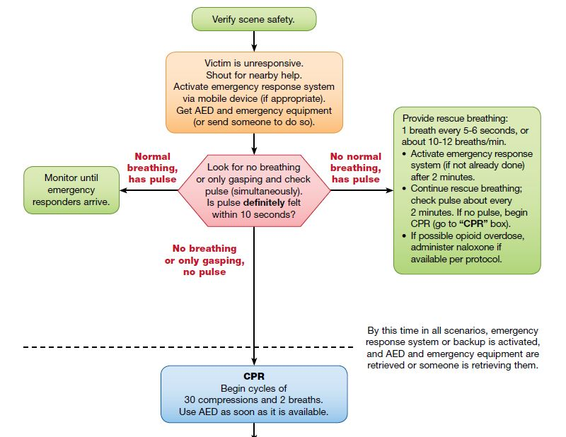
BLS Healthcare Provider Adult Cardiac Arrest Alogrithm (2015 update)
1
2
3b
3
3a

Slide 4
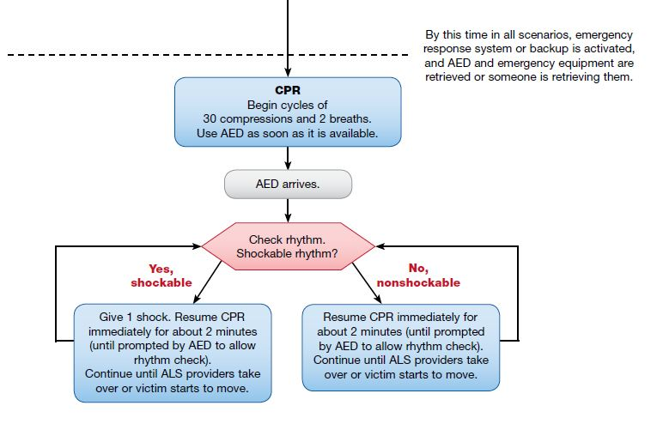
BLS Healthcare Provider Adult Cardiac Arrest Alogrithm (2015 update)
4

Slide 5
1- rescuer BLS sequence

Slide 6
Boxes 1 & 2-scene safety,responsiveness & Get help
Verify that the scene is safe for you and the victim. Don’t become a victim yourself.
Check for responsiveness. If not,shout for help.
Activate the emergency response system/call local emergency number/mobilize code team/notify advanced life support.
If alone, get AED/defibrillator/emergency equipment. Ifsomeone else is available, send that person to get it.

Slide 7
Box 3 – Assess Breathing and Pulse
BREATHING
Assess breathing at the same time checking pulse, not taking more than 10 seconds.
If victim is breathing, monitor until additional help arrives.
If victim is not breathing or only gasping, not normal & is a sign of cardiac arrest.

Slide 8
Box 3 – Assess Breathing and Pulse
PULSE
Palpate a carotid pulse.
If pulse not felt definitely within 10 seconds, begin high-quality CPR, starting with chest compressions.

Slide 9
IF
THEN
Victim is breathing normally & pulse is present.
Victim not breathing, but a pulse present.
Victim not breathing/only gasping & no pulse
Monitor the victim.
Provide rescue breathing.
Confirm activation of emergency response system.
Continue rescue breathing & check pulse about every 2 minutes. Perform high-quality CPR if pulse not felt.
In opioid use, consider naloxone & follow local protocols.
Begin high-quality CPR

Slide 10
Box 4 – Begin High-Quality CPR
If victim is not breathing normally/only gasping & has no pulse immediately start high quality CPR with chest compressions.
Remove or move the clothing of victim’s chest to locate the appropriate placement of hand for compression. This also allows placement of AED pads.

Slide 11
*Adult chest compressions*
Importance
Each time chest compression stopped,blood flow to heart & brain decreases significantly.
High quality chest compressions
Compression-to-ventilation ratio -- 30 compressions to 2 breaths.
Compress at a rate of 100 to 120/min.
Compress chest atleast 5cm.
Allow chest to recoil completely after each compression.
Minimize interruptions.

Slide 12
Other factors
Don’t move the victim while CPR is in progress unless the environment is dangerous.
To make compressions effective, place the victim on a firm surface which allows compression of the chest & heart to create blood flow.(if on soft surface, the force used will simply push the body into the soft surface)

Slide 13
Chest Compression Technique
Position at victim’s side.
Victim should lie faceup on a firm, flat surface.
Put the heel of 1 hand in centre of the victim’s chest on the lower half of the sternum. Put the heel of other handon top of first hand. Straighten arms and position shoulders directly over hands.
Give chest compressions at rate of 100 to 120/min.
Press down atleast 5cm with each compressions & make sure to allow chest recoil completely. Incomplete chest recoil reduces filling of heart between compression & reduces blood flow created by chest compression. Minimize interruptions.

Slide 14
Box 5, 6, 7, 8 – Attempt Defibrillation with AED & Resume High-Quality CPR
Use AED as soon as available & follow the prompts.
Immediately resume high-quality CPR.

Slide 15
*Adult Breaths*
OPENING THE AIRWAY
For breaths to be effective, the victim’s airway must be open by either
Head tilt-Chin lift or
Jaw thrust
In head/neck injury, use jaw thrust maneuver to reduce neck and spine movement.

Slide 16
Head tilt-Chin lift
Jaw thrust
Place 1 hand on victim’s forehead & push with palm to tilt the head back.
Place fingers of other hand under bony part of lower jaw.
Lift the jaw to bring the chin forward.
Place 1 hand on each side of victim’s head & rest elbows on surface on which victim is lying.
Place fingers under the angles of victim’s lower jaw & lift with both hands, diplacing the jaw forward.
If lips close, push the lower lip with your thumb to open.

Slide 17
Interrupt chest compressions to give 2 breaths.
Deliver each breath over 1 second.
Note visible chest rise with each breath.
Resume chest compressions in less than 10 seconds.

Slide 18
2- rescuer BLS sequence

Slide 19
Rescuer 1 (at the victim’s side)
COMPRESSIONS
Rescuer 2 (at the victim’s head)
BREATHS
Make sure victimis face up on firm, flat, surface
Perform chest compression
Rate 100-120 /min.
Compress chest atleast 5 cms
Minimise interruptions .
Compression to ventilation ratio 30:2. Count compression out loud.
Maintain open airway by Head tilt – chin lift or jaw thrust.
Give breaths, watch for chest rise, avoid excessive ventilation.
Encourage first rescure to perform compressions that are deep, fast, allow complete chest recoil between compressions.
Switch compressions about every 5 cycles or every 2 mins, taking less than 5 seconds to switch.

Slide 20
THANK YOU

