Slide 1
A RARE CASE OF MESENTERIC VENOUS OCCLUSION.
- Dr. Rajesh Rathore

Slide 2
Abstract.
Mesenteric venous thrombosis is an uncommon but potentially lethal cause of bowel ischemia. Several imaging methods are available for diagnosis, each of which has advantages and disadvantages.
Doppler ultrasonography allows direct evaluation of the mesenteric and portal veins, provides semiquantitative flow information, and allows Doppler waveform analysis of the visceral vessels; however, it is operator dependent and is often limited by overlying bowel gas.
Conventional contrast material–enhanced computed tomography (CT) allows sensitive detection of venous thrombosis within the central large vessels of the portomesenteric circulation and any associated secondary findings; however, it is limited by respiratory misregistration, motion artifact, and substantially decreased longitudinal spatial resolution.

Slide 3
Patient history.
64 year old woman came with complains of abdominal pain with vomiting since 8 days. No history of constipation, diarrhoea or abdominal distension.
Past history of splenectomy.
Patient was then referred to our department for ultrasonography followed by computed tomography.

Slide 4
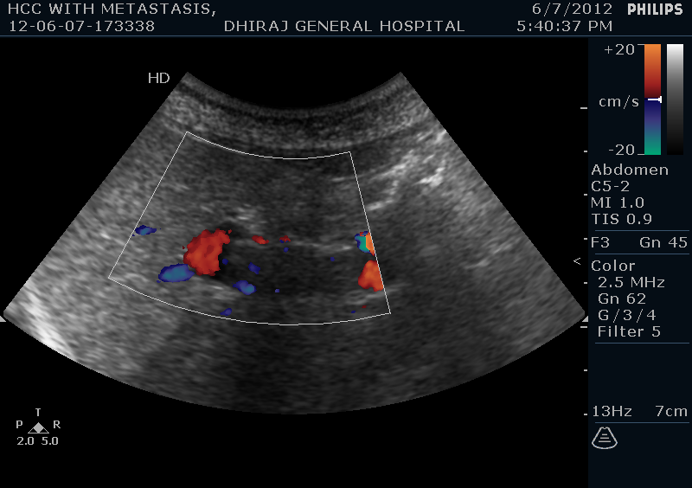
USG Images
Echogenic thrombus with no blood flow on doppler in the portal vein .

Slide 5
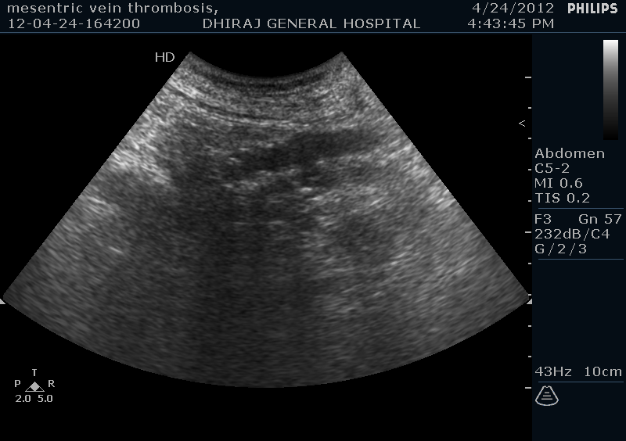
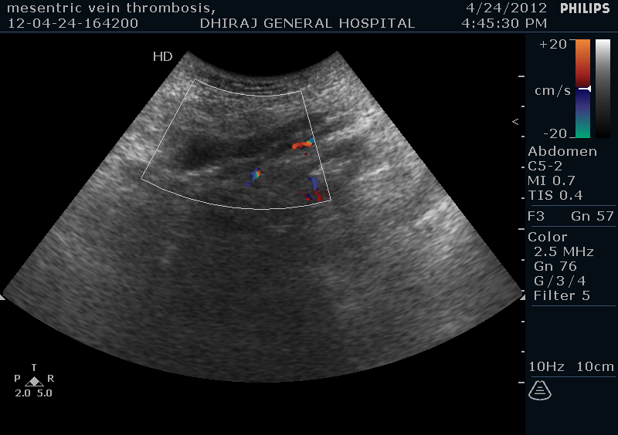
Calcification seen in the mesenteric vein.
Echogenic thrombus with no blood flow on doppler in the mesenteric vein.

Slide 6
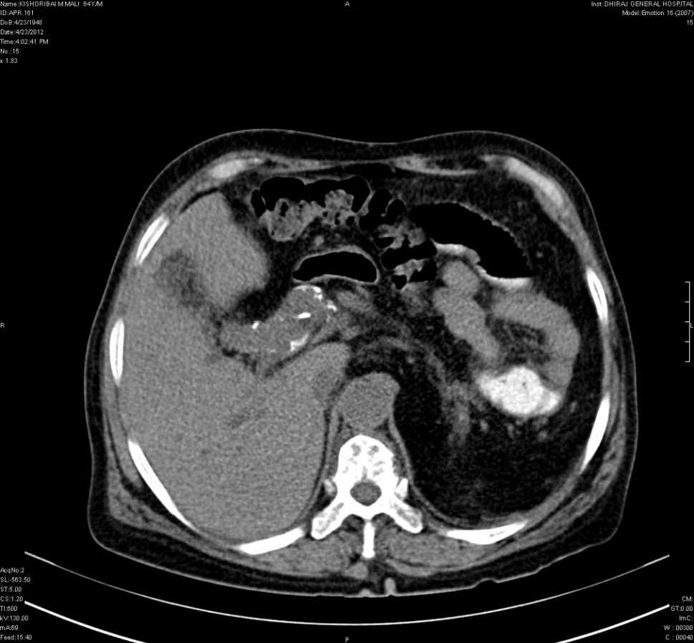
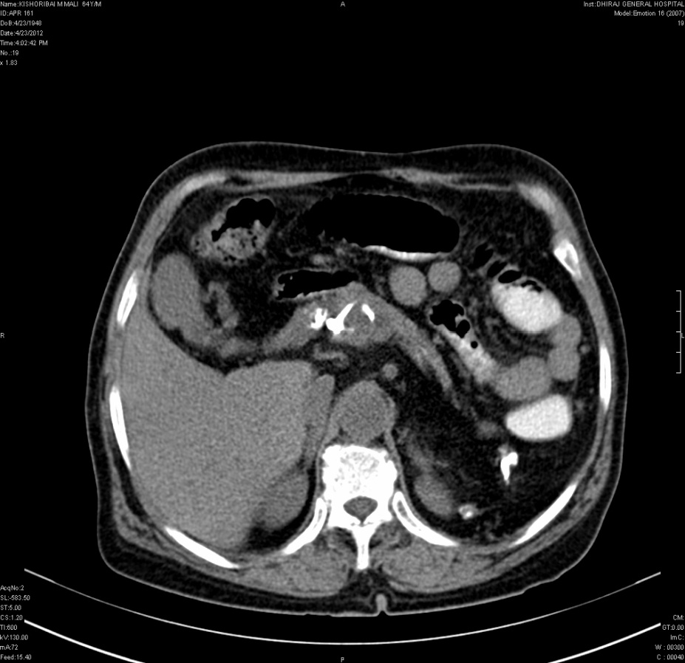
CT Images
Portal radicals appear dilated.
There is calcification in main portal vein and superior mesenteric vein

Slide 7
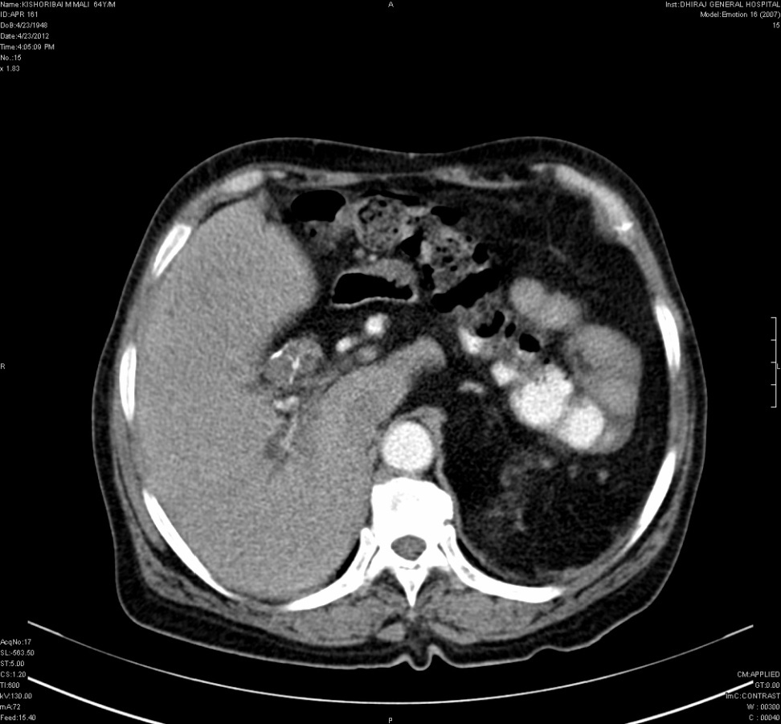
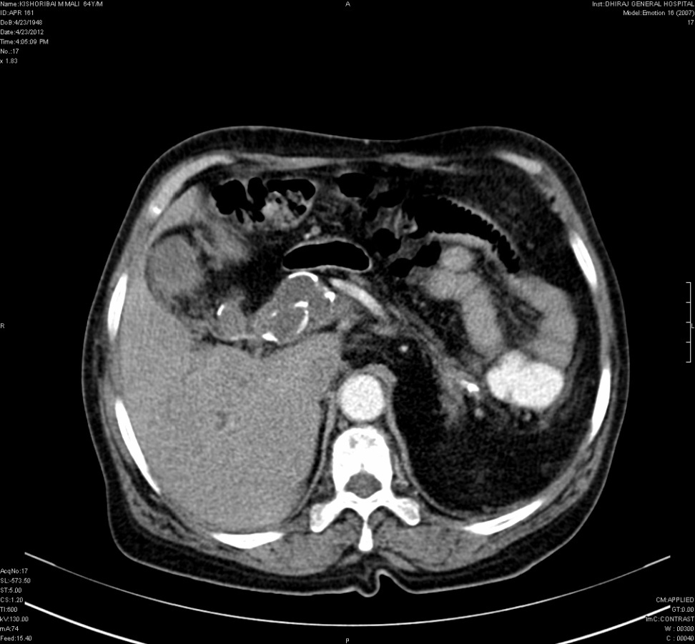
CT…..
Portal radicals appear dilated with thrombus formation.
There is calcification with non enhancing filling defect within lumen with rim enhancement
s/o thrombus formation (TRAM TRACK) in main portal vein and
superior mesenteric vein

Slide 8
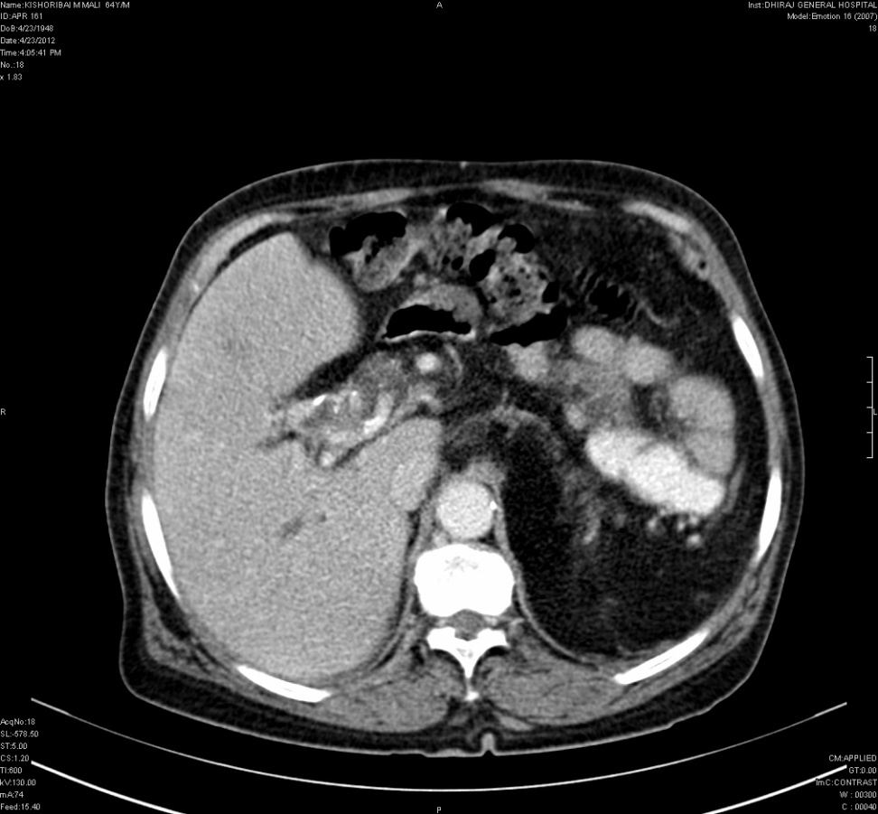
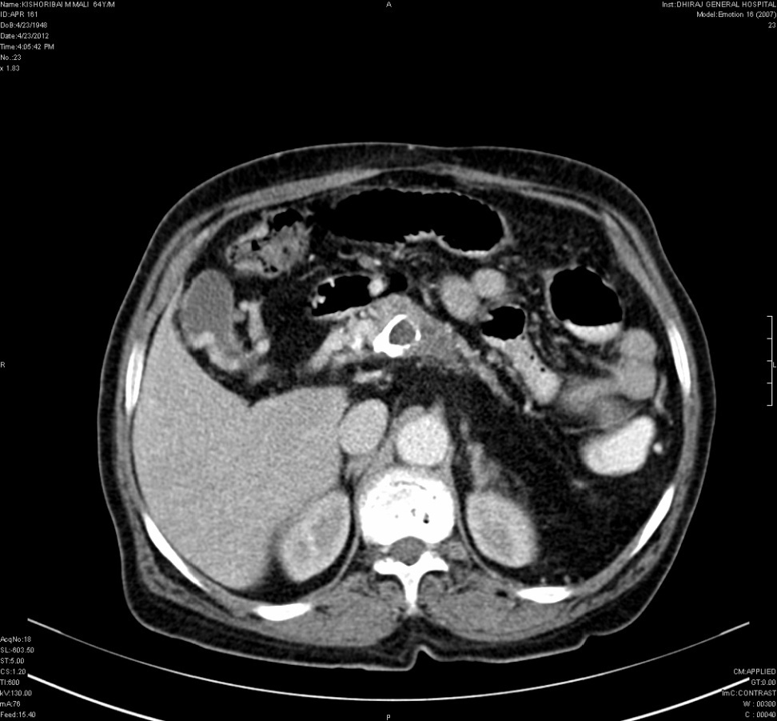
CT…..
Formation of multiple venous collaterals when the portal system is obstructed.
Cavernoma (serpigenous) formation with collaterals around the gall bladder

Slide 9
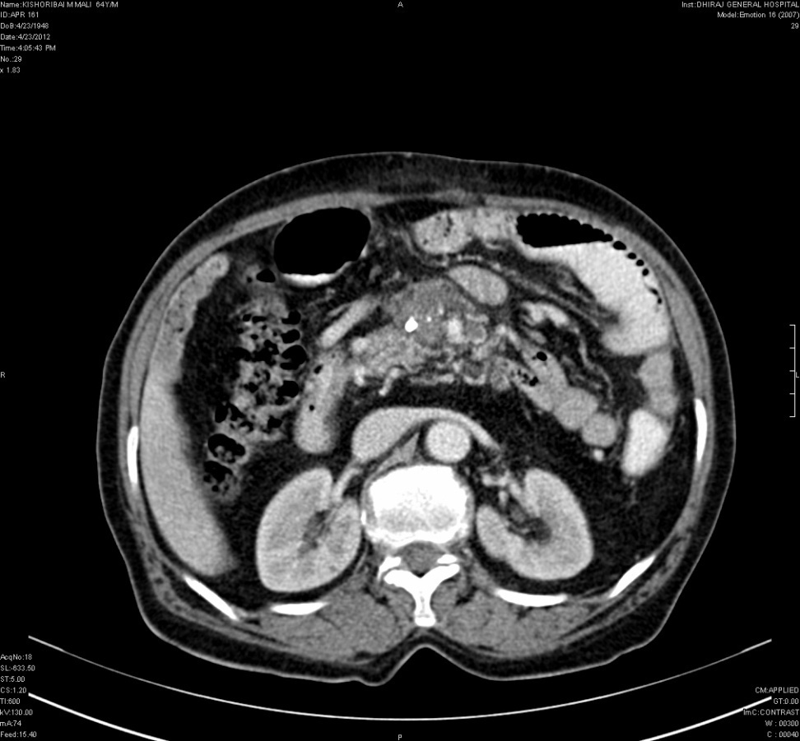
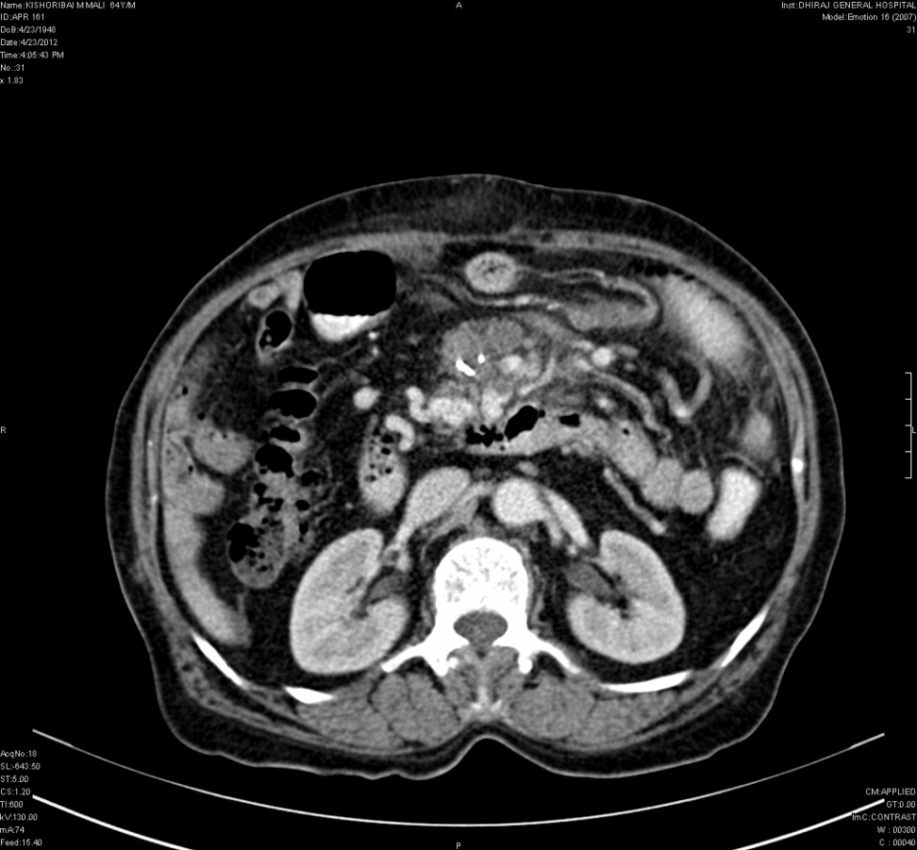
CT…...
Multiple gastric and left renal collaterals seen

Slide 10
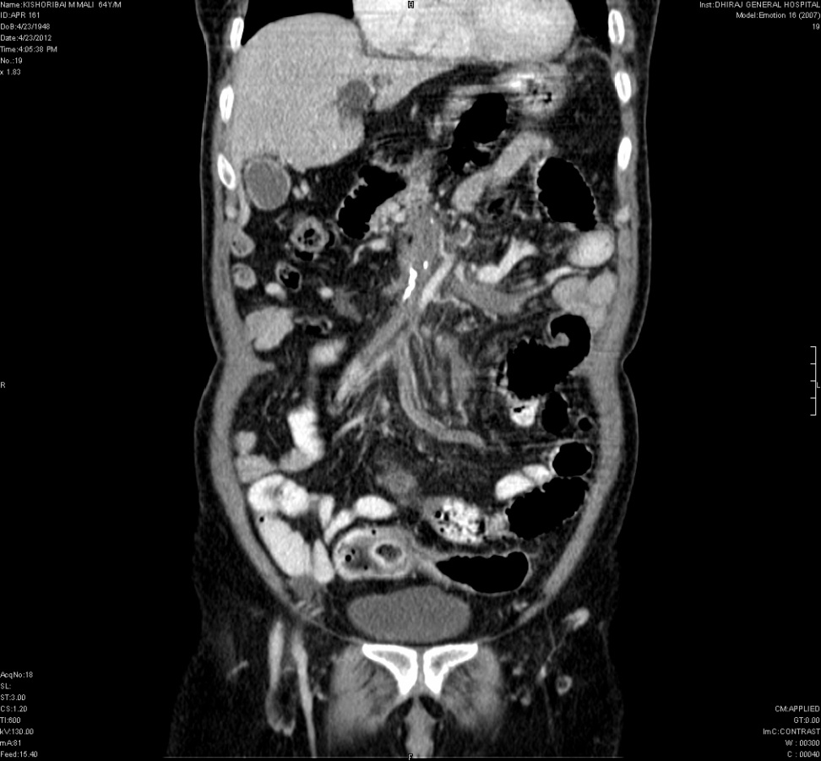
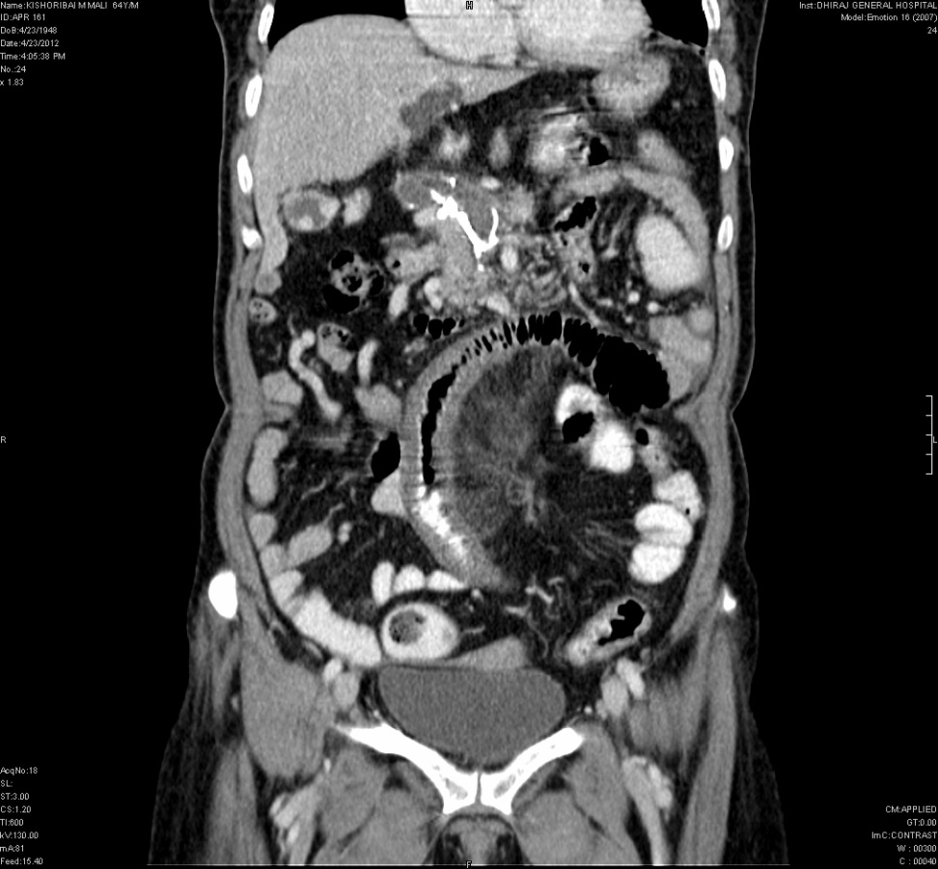
CT…..
Portal and superior mesenteric vein thrombus with calcification.

Slide 11
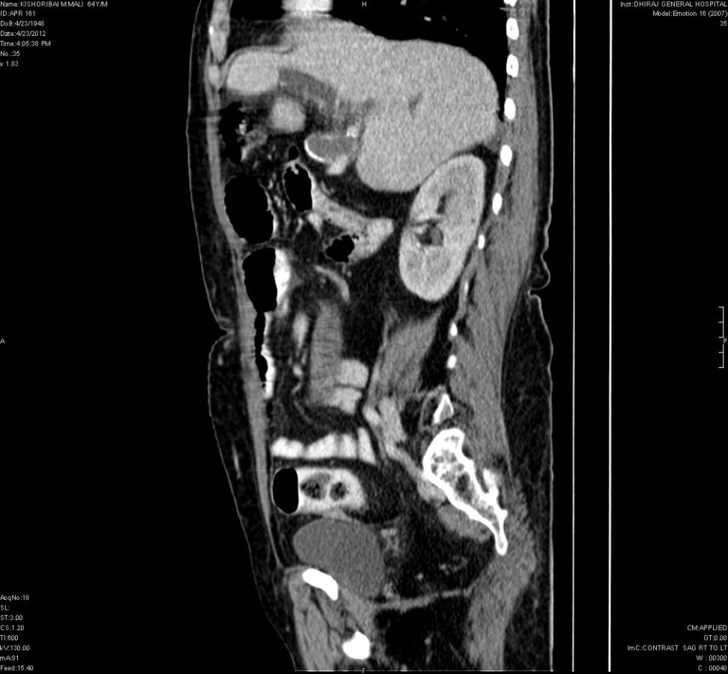
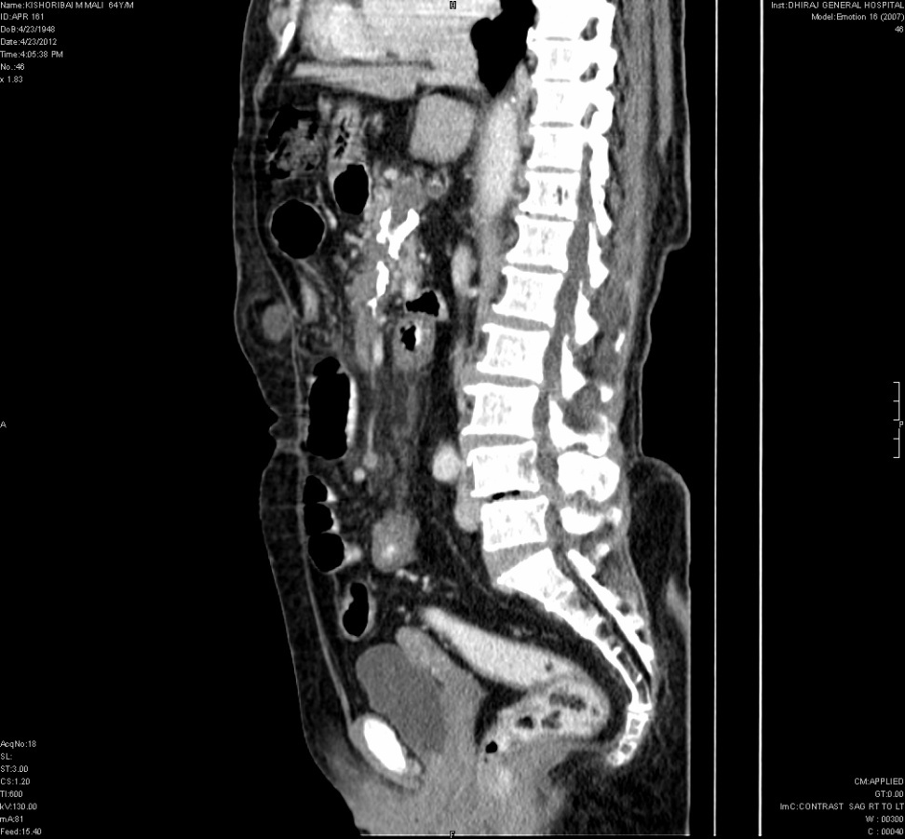
CT….
Portal and superior mesenteric vein thrombus with calcification

Slide 12
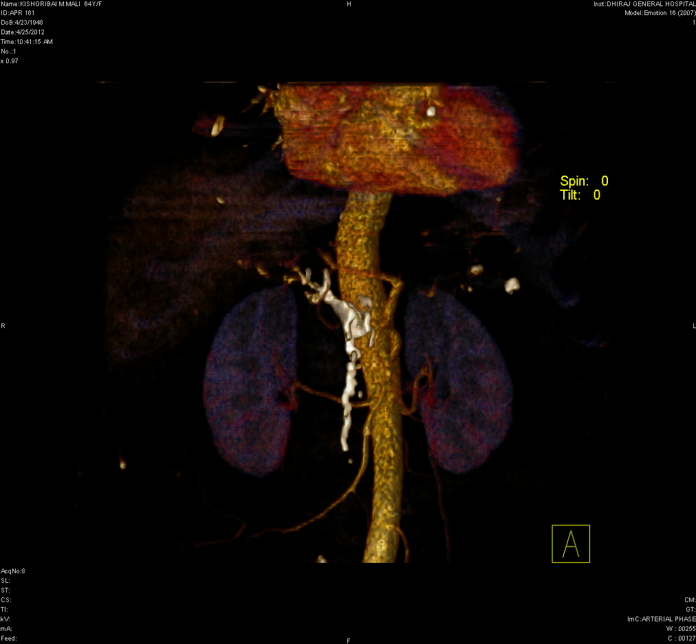
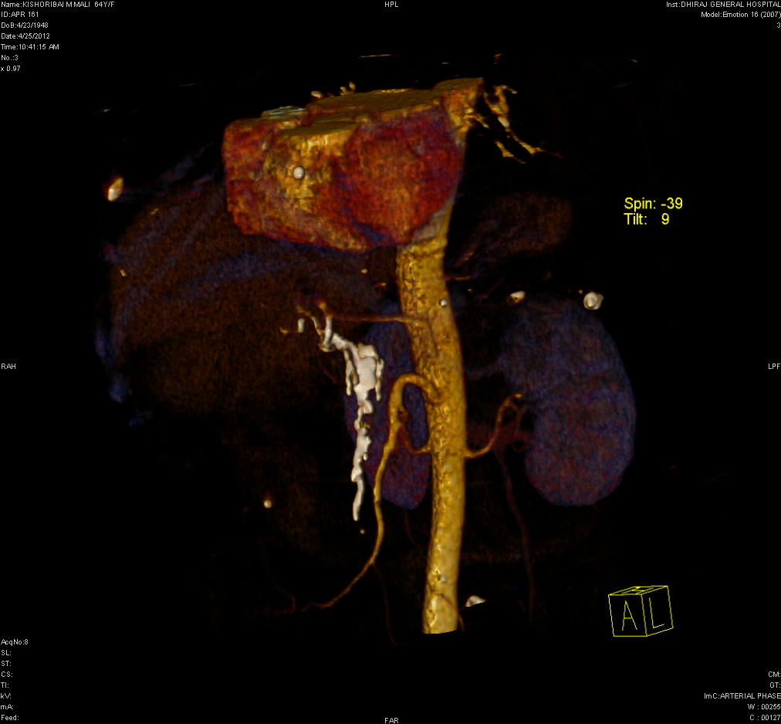
CT….
Portal and superior mesenteric vein thrombus with calcification.

Slide 13
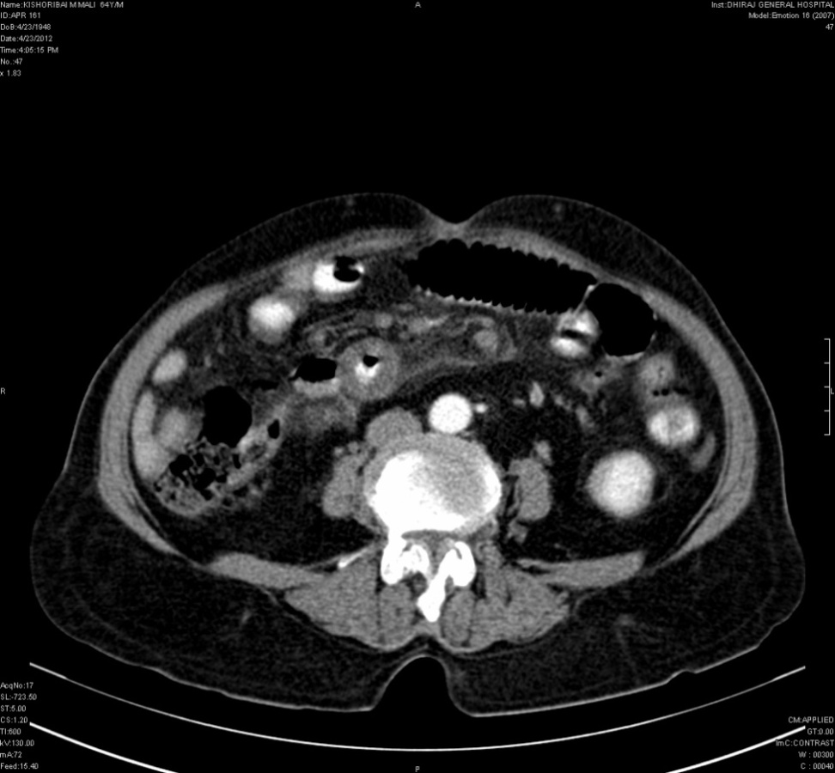
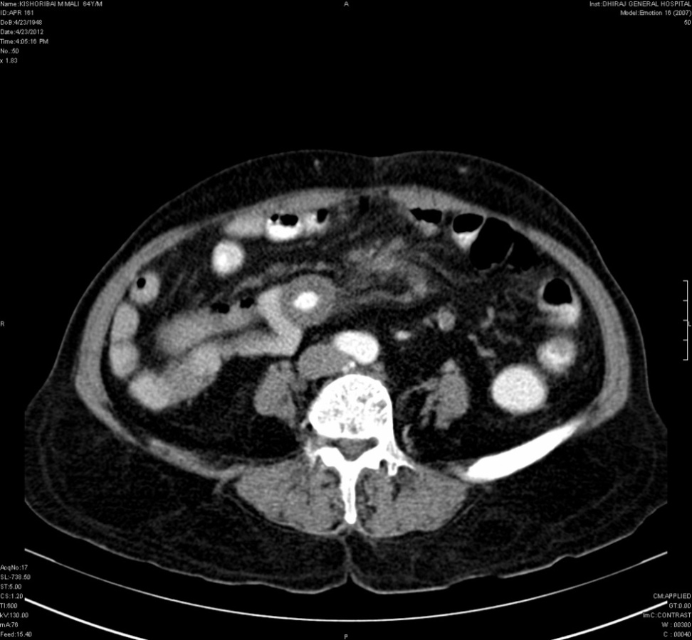
CT…..
Marked bowel wall thickening giving characteristic “TARGET SIGN” with severe mesenteric haziness or oedema.

Slide 14
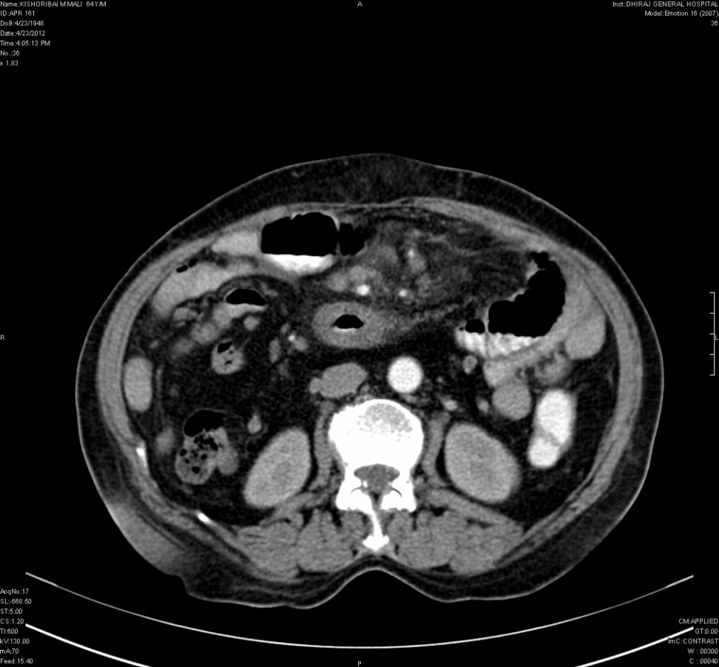
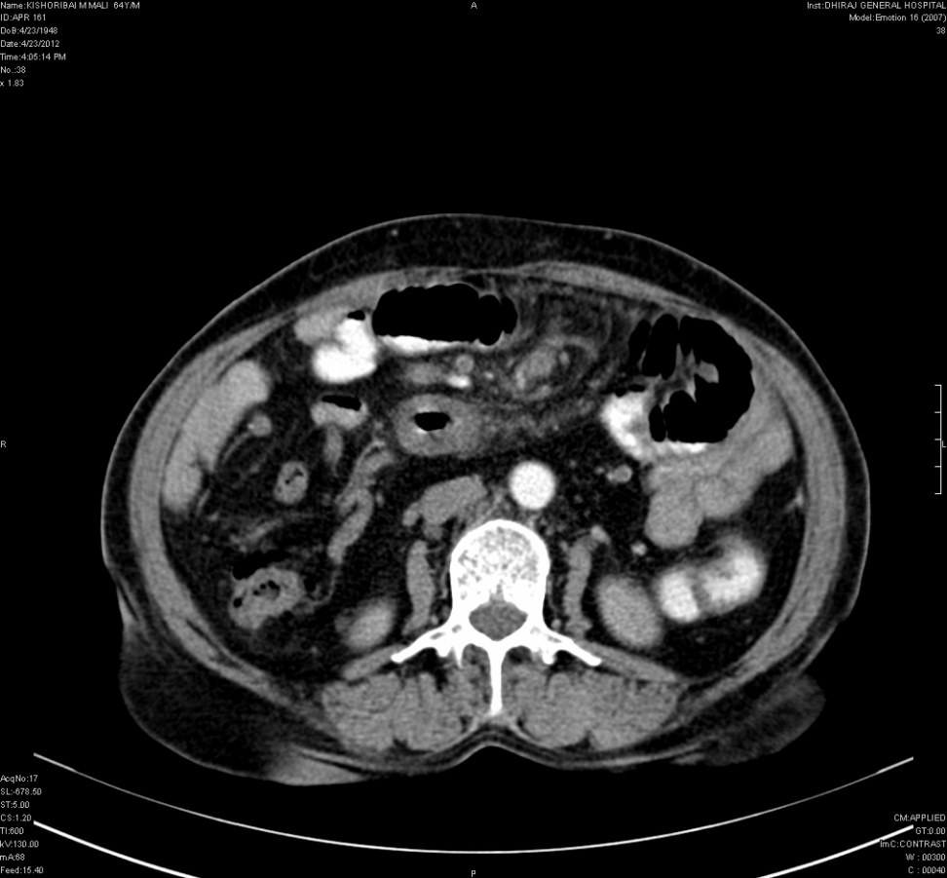
CT…..
Engorgement of mesenteric vein with fat stranding and considerable degree of collateral vasculature.

Slide 15
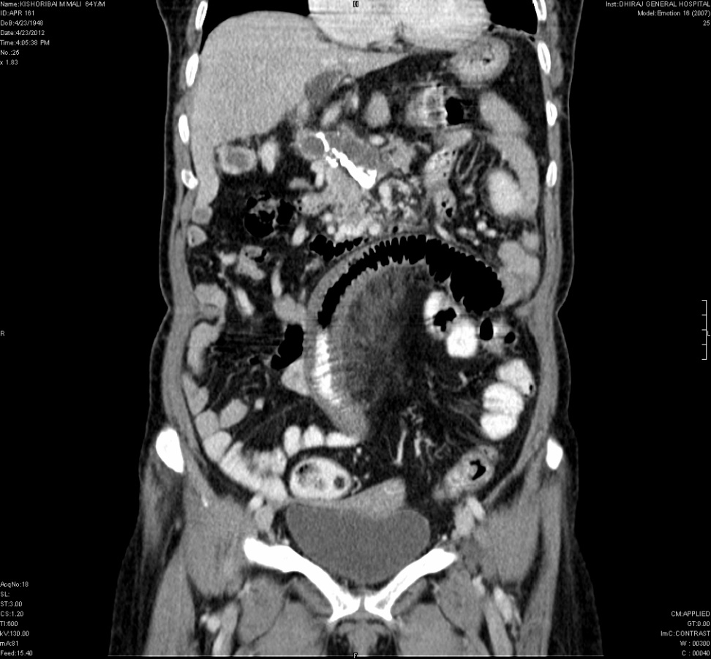
CT…..
Portal and superior mesenteric vein thrombosis with calcification causing mesenteric ischemia hence producing dilated bowel loop with fat stranding and mesenteric vein engorgement.

Slide 16
MESENTERIC ISCHEMIA
Mesenteric ischemia encompasses a broad spectrum of diseases but has traditionally been classified according to the various causes of acute arterial occlusive disease, nonobstructive mesenteric arterial insufficiency, mesenteric venous occlusion, and chronic mesenteric ischemia

Slide 17
MESENTERIC VENOUS OCCLUSION- CAUSES.
Mesenteric venous thrombosis can be classified on the basis of its cause as primary or secondary. Spontaneous, idiopathic thrombosis of the splanchnic veins not associated with any predisposing conditions has been termed primary mesenteric venous thrombosis.
Patients with known medical conditions or factors associated with portal or mesenteric venous thrombosis, such as pancreatitis, hypercoagulability states, cirrhosis, or surgery, are said to have secondary mesenteric venous thrombosis.

Slide 18
Venous Occlusion
Thrombosis of the mesenteric vein can be primary or secondary to portal hypertension or infection or can be associated with various hypercoagulopathy states.
Mesenteric venous obstruction does not typically lead to severe bowel ischemia; however, thrombosis of the mesenteric vein, particularly at a distal level, may cause bowel infarction and accounts for 5–10% of acute bowel ischemia.
Impairment of venous drainage causes elevation of the hydrostatic pressure, which leads to extravascular leakage of plasma, RBCs, or both into the bowel wall, mesentery, and peritoneal cavity. The bowel loops are typically prominently dilated . Impairment of venous drainage may also compromise the arterial blood flow and cause bowel ischemia and infarction.

Slide 19
USG
Can provide semiquantitative information about portomesenteric blood flow.
Venous flow anomalies or thrombus, a thickened bowel wall, free intraperitoneal fluid, and biliary disease can also be demonstrated.
Limitations of this modality are its operator-dependent nature, sensitivity of the equipment to slow flow, inability to identify a suitable acoustic window, variable visualization of the entire portomesenteric vasculature due to overlying bowel gas, and potential failure to depict deep varices involving the retroperitoneal and mesenteric vessels.

Slide 20
CT Findings
On contrast-enhanced CT, thrombus in the mesenteric and portal veins is usually visible, and mesenteric venous obstruction can be confirmed by CT in more than 90% of cases.
Engorgement of the mesenteric veins is also observed. Fat stranding in the mesentery and ascites are common findings.
The bowel wall is prominently thickened with absent or diminished enhancement, hyperenhancement, or a halo or target pattern of contrast enhancement.
Absent or diminished contrast enhancement of the bowel wall usually indicates transmural infarction, particularly when it is associated with pneumatosis and portomesenteric venous gas.

Slide 21
Clinical Features and Typical CT Findings of Mesenteric Ischemia in Venous occlusion.
Characteristic | Venous Occlusion
Incidence | 5–10% of PMI
Presentation | Subacute
Risk factors | Portal hypertension, venous hypercoagulopathy, right-sided heart failure
Bowel wall | Thickening
Attenuation of bowel wall on unenhanced CT | Low with edema; high with hemorrhage
Enhancement of bowel wall on contrast-enhanced CT | Diminished, absent, target appearance, or increased
Bowel dilatation | Moderate to prominent
Mesenteric vessels | Defect or defects in veins, venous engorgement
Mesentery | Hazy with ascites

Slide 22
PATIENT SUMMARY
AUTOSPLENECTOMY
PORTAL VEIN THROMBOSIS
PORTAL HYPERTENSION
VENOUS MESENTERIC ISCHEMIA

Slide 23
CONCLUSION.
An accurate and early diagnosis is essential for the appropriate and successful treatment of patients with acute mesenteric ischemia to improve their prognoses.
With the advances in CT technology, CT has realized a high diagnostic performance and become an essential diagnostic tool in this clinical setting. For a correct diagnosis, a technically appropriate CT examination and proper interpretation of images are mandatory. Because acute mesenteric ischemia can be caused by various conditions, the CT findings vary widely, depending on the cause and underlying pathophysiology and the presence of associated complications.
Recognition of the characteristic CT appearances and variations of each cause may help in the accurate interpretation of CT in the diagnosis of mesenteric ischemia

Slide 24
THANK YOU.

