Slide 1
Spontaneous intracranial haemorrhage : A rare presentation of Arachnoid cyst
- Dr. Chandra Raychaudhari

Slide 2
Clinical Presentation
A 14-year-old boy presented with acute onset headache and three episodes of vomiting followed by brief loss of consciousness.
There was no history of trauma or head injury. No other co-morbid conditions.
Patient was advised plain and contrast CT scan and MRI.

Slide 3
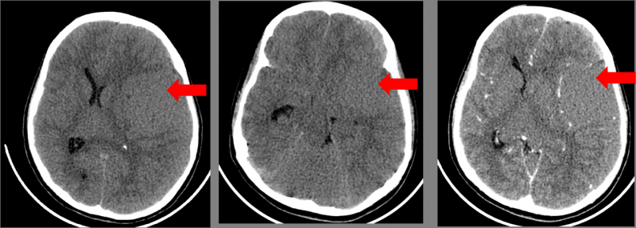
CT
Plain and contrast CT axial images show a non-enhancing mildly hyperdense lesion in the left sylvian fissure with a hyperdense crescentic subdural haematoma in the left frontal region.

Slide 4
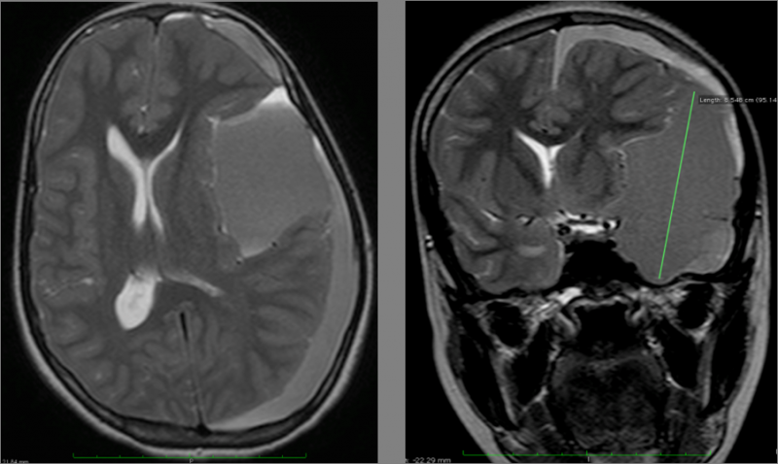
MRI
Axial and coronal T2W MR images show a thin-walled cystic lesion with hypointense contents in the left sylvian fissure, with hyperintense left convexity subdural collection.

Slide 5
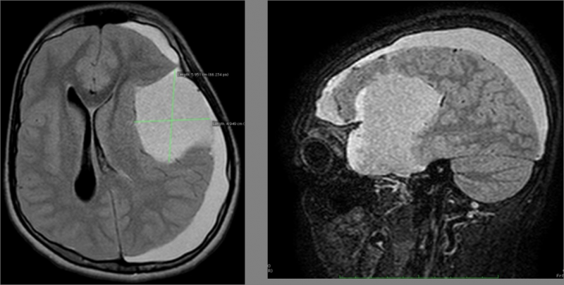
MRI
Axial and Coronal FLAIR images show the hyperintense cystic lesion in the left sylvian fissure with fluid-fluid level and left convexity subdural collection.

Slide 6
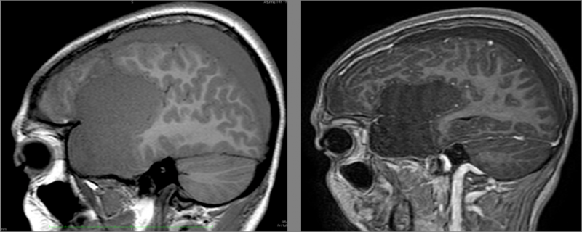
MRI
Plain and contrast sagittal T1W MR images show the sylvian fissure arachnoid cyst with left convexity fluid collection.

Slide 7
Diffrential Diagnosis
Epidermoid cyst
Porencephalic cyst
Chronic subdural haemorrhage
Subdural hygroma

Slide 8
Conclusion
Arachnoid cysts demonstrate non-enhancing, well circumscribed, non-calcified, and extra-axial cystic mass lesions on CT or MR.
Arachnoid cysts constitute 1 % of intracranial space occupying lesions, and their detection has increased with the use of CT and MRI.

Slide 9
THANK YOU

