Slide 1
Testicular Microlithiasis
- Dr. Tushar Vaishnav

Slide 2
Clinical History
Patient consulted the out-patient department of urology with increasing pain in his right testis. His clinical history was non relevant. There was also no history of abnormal testicular descent. On physical examination the right testis was slightly larger than the left. Ultrasound examination of both testicles was performed.

Slide 3
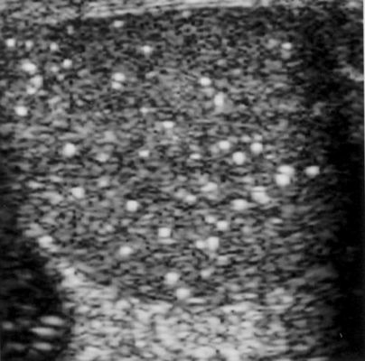
Imaging Findings
Ultrasonography of the left testis shows multiple small, bright echogenic foci scattered through-out the whole testicular parenchyma, «snow storm» sign, characteristic of testicular microlithiasis.

Slide 4
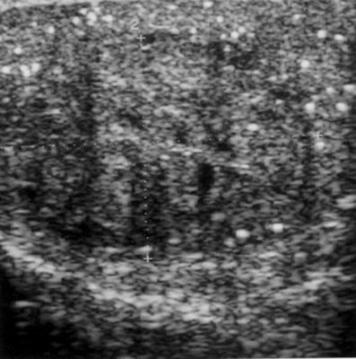
Ultrasonography of the right testis demonstrates an oval, isoechogenic and slightly inhomogeneous intratesticular space-occupying lesion. The lesion is surrounded by an incomplete hypoechoic rim.

Slide 5
Discussion
Multiple calcifications or testicular microlithiasis (TM) is an uncommon, asymptomatic, non-progressive abnormality which is usually discovered incidentally during an ultrasound examination of the testis. The sonographic image of TM is characteristic. It appears as a diffuse speckled pattern with multiple small, echogenic foci scattered throughout the testis, measuring 2mm orless in diameter. A space-occupying lesion in such testis can be easily detected. Testicular microlithiasis is usually bilateral, but it may be asymmetric.

Slide 6
THANK YOU

