Slide 1
Thoracic aortic aneurysm: case report
- Dr. ParthivBrahmbhatt

Slide 2
A 64-year-old British white lady presented with sudden onset sharp central chest pain of one hour duration with non-specific electrocardiographic findings and negative Troponin I test. She underwent Computed Tomography Aortography (CTA) and was sent for surgical management.

Slide 3
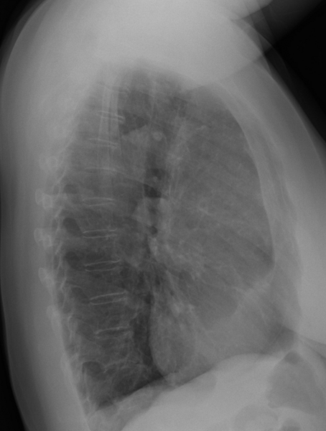
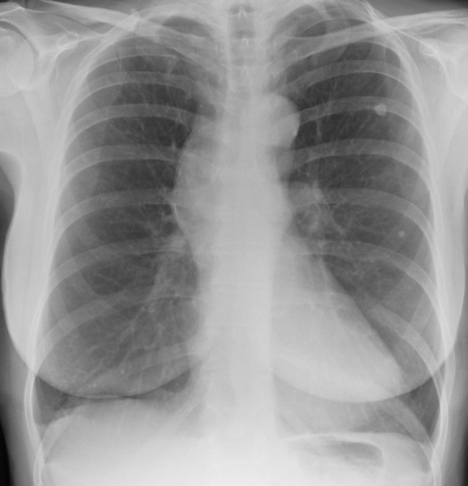
P.A VIEW AND LATERAL VIEW

Slide 4
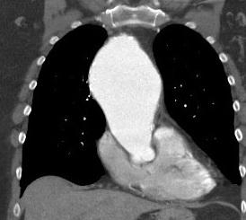
CT Aortography scout film showed widening of the mediastinum with curvilinear peripheral calcification, marginally increased in comparison with 3 years old X-ray chest. Non-contrast enhanced CT (NECT) images confirmed atherosclerotic dilatation of ascending aorta. Calcification was circumferential with no evidence of haematoma or thrombus formation. Axial contrast enhanced CT (CECT) images revealed dilated ascending aorta filling almost all of the mediastinum with some evidence of compression over the surrounding structures. Computer assisted sagittal and coronal reformatted images depicted dilatation of ascending aorta. The whole of the ascending aorta was aneurysmal in fusiform shape, widest in the middle of its length. It was well contained with no evidence of ulceration, leakage, rupture or dissection.

Slide 5
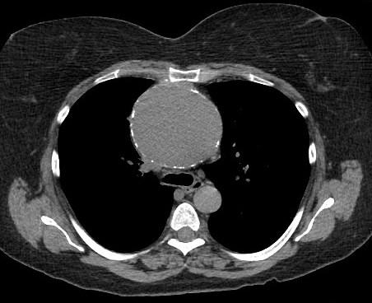
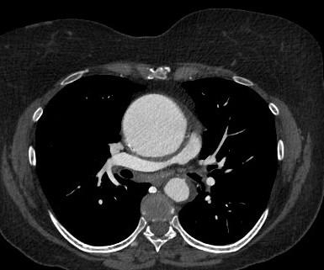
AXIAL SECTION
PLAIN CT SCAN THORAX
CECT THORAX

Slide 6
DISSCUSSION
Thoracic aortic aneurysm (TAA) is less prevalent (25%) as compared to its abdominal counter-part, however, it can be much more devastating because of enhanced chances of rupture and dissection . An aneurysm is the irreversible blood filled dilatation of a vessel 50% of its normal size. The shape of the aneurysm can either be saccular - localised outpouching of aortic wall or fusiform - symmetrical, uniform dilatation affecting the entire circumference. Degenerative changes in elastic media of aortic wall are the most common aetiological factor. It includes cystic medial degeneration causing fragmentation of elastic fibres and smooth muscle loss.

Slide 7
Diffrential diagnosis
Mediastinal mass
Aortic dissection

Slide 8
THANK YOU

