Slide 1
RARE PRESENTATION OF
THYMIC CYST
- Dr. Jayesh Shah

Slide 2
Case Report
A 60 year old female patient came to Dhiraj General Hospital with complaints of left sided chest pain since 1 month and dry cough since 1 month.No past h/o Hypertension,Diabetes Mellitus or Tuberculosis.Her Cardiac investigations were within normal limits.The patient came to our department for a chest X ray PA view.

Slide 3
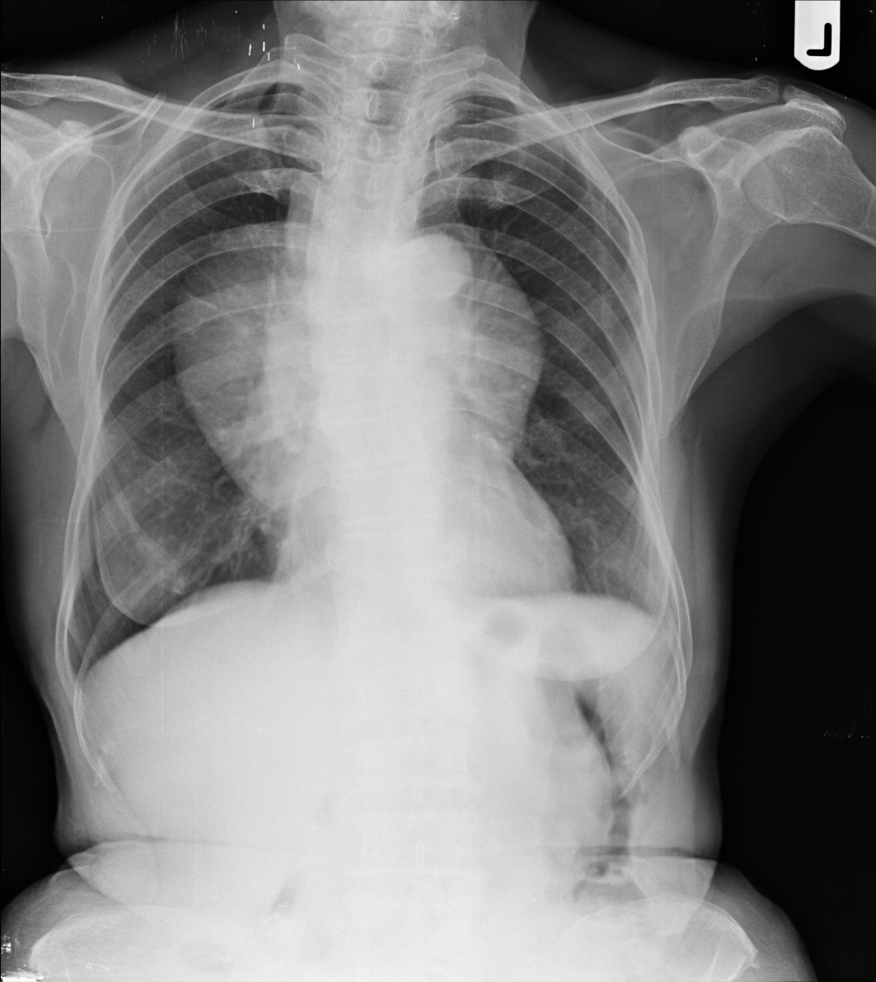
X-RAY(PA VIEW)
There is well defined soft tissue opacity with sharp margins ,extending above the aortic arch to the above of the diaphragm.
No evidence of calcification seen within the soft tissue opacity.
Aortic shadow appears to be normal.
No evidence of erosion of the rib is seen.

Slide 4
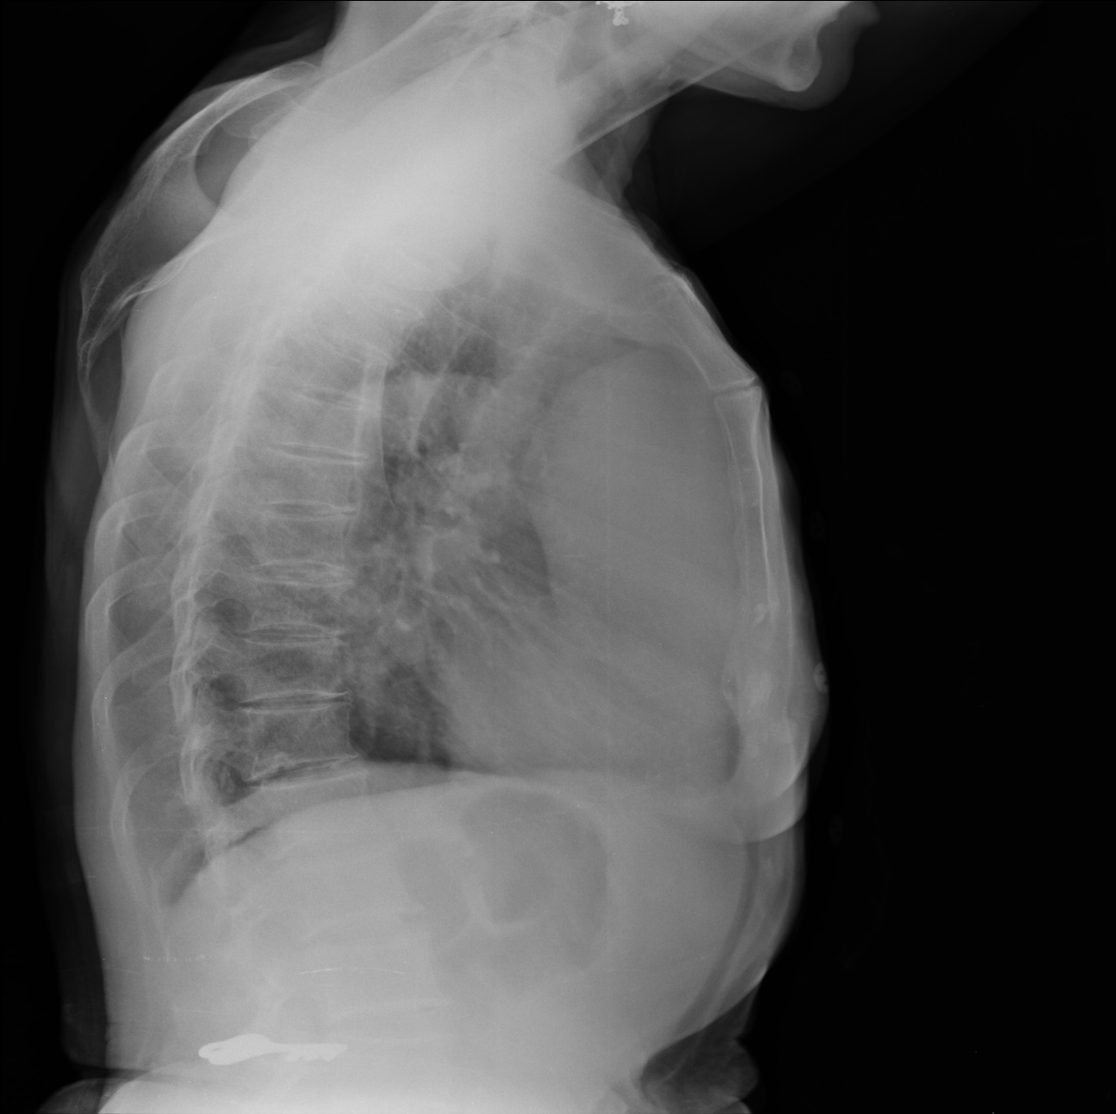
X-RAY(LATERAL VIEW)
There is well defined soft tissue opacity seen in the anterior mediastinum behind the manubrium and sternum.
No erosion of stenum is noted.
Above findings are suggestive of anterior mediastinal mass in the region of thymus and appears to be thymic mass.

Slide 5
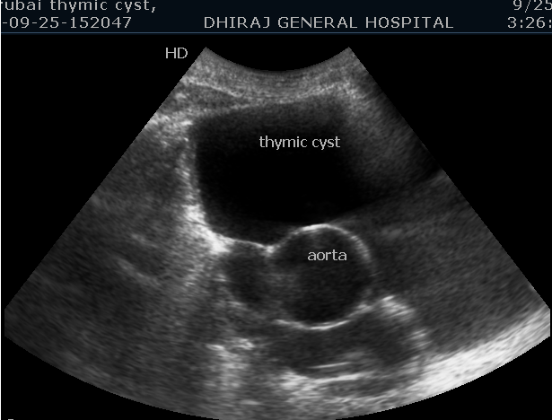
USG
USG showed well defined anoechoic lesion in the anterior mediastinum anterior to aorta, this appears to be cystic in nature.
No calcificatiomn is seen in the margins.
No evidence of soft tissue component within the cystic lesion noted.

Slide 6
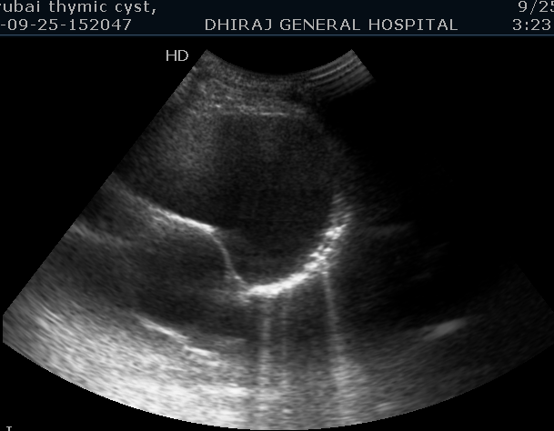
USG
USG showed well defined anoechoic lesion in the anterior mediastinum anterior to aorta, this appears to be cystic in nature.
No calcificatiomn is seen in the margins.
No evidence of soft tissue component within the cystic lesion noted.

Slide 7
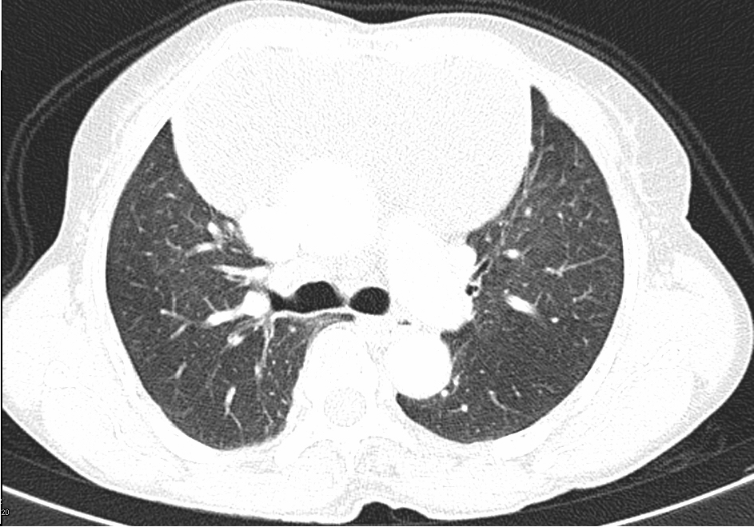
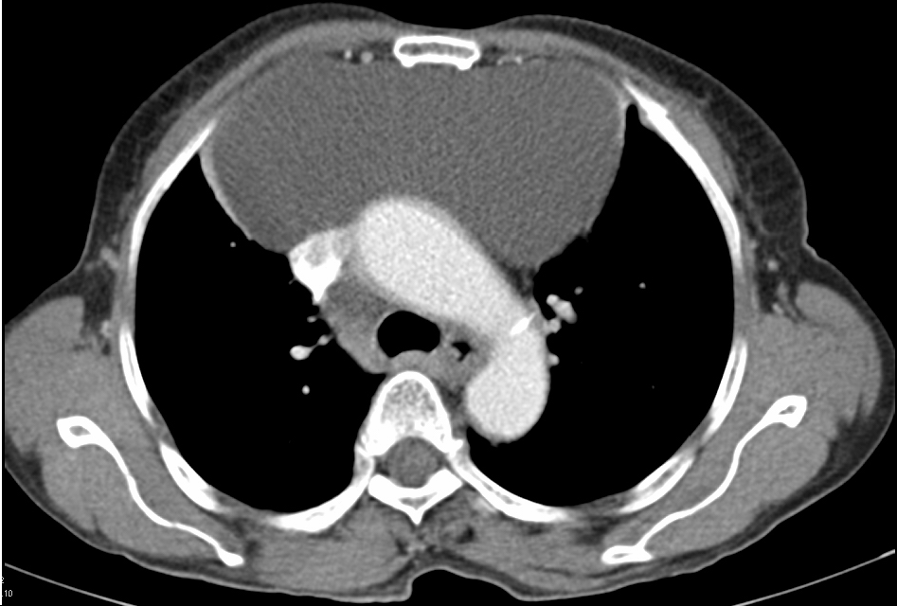
CT SCAN
            BOTH OF THE ABOVE FIGURE SHOWS:
A very well defined cystic lobulated lesion having size 13x6.8 cm in axial plane , is seen in the anterior mediastinum anterior to the arch of aorta without calcification, having density of fluid.
No enhancement of contrast seen.
This is suggestive of thymic cyst.

Slide 8
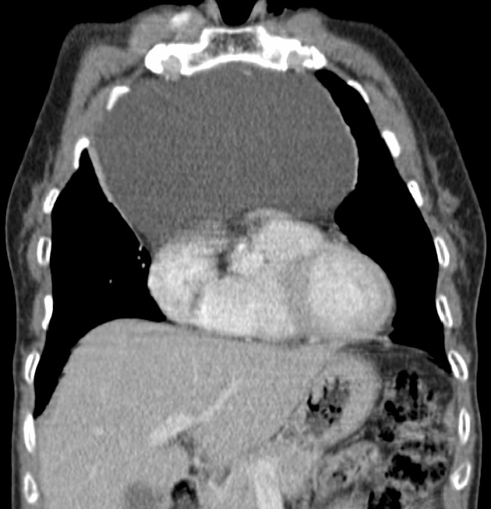
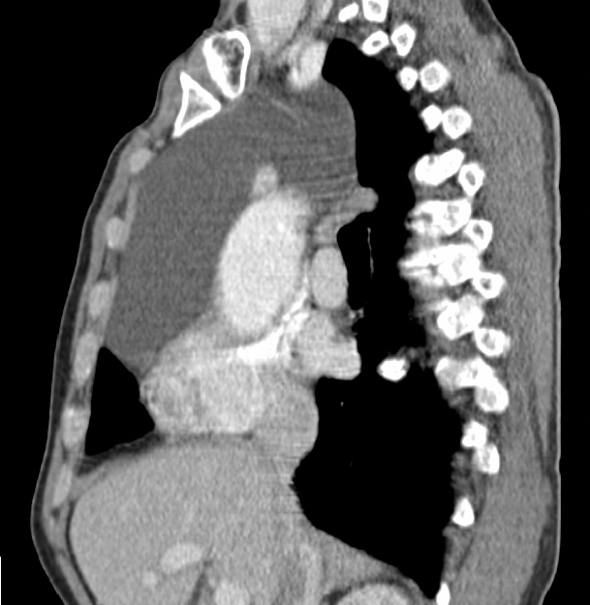
BOTH OF THE ABOVE FIGURE SHOWS:
There is widening of anterior mediastinum noted.
A very well defined cystic lobulated lesion having size 13.6x8 cm in sagittal plane, is seen in the anterior mediastinum anterior to the arch of aorta without calcification, having density of fluid.
No enhancement of contrast seen.
This is suggestive of thymic cyst

Slide 9
SURGICAL NOTE
Thoracotomy with cyst excision was done on this patient and post operative period was uneventful.
HISTOPATHOLOGY
The histopathology report was suggestive of simple thymic cyst.

Slide 10
DISCUSSION
Thymic cysts are uncommon mediastinal lesions that account for only 1% to 2% of all tumors in the anterior mediastinum. It can be either congenital or acquired.
Thymic cysts are usually diagnosed accidentally during radiological evaluation of the chest for unrelated conditions. Symptoms appear late when the mass compresses on adjoining tissues.

Slide 11
CONCLUSION
A detailed study of this patient,with chest X-ray PA View and lateral view, and USG examination suggest possibility of Thymic cyst.
CT SCAN confirmed the diagnosis of thymic cyst.

Slide 12
THANK YOU

