Slide 1
Traumatic subcapsular hematoma of the spleen
- Dr. Mayur Khandhedia

Slide 2
Clinical History
Abdominal pain and anemia after trauma

Slide 3
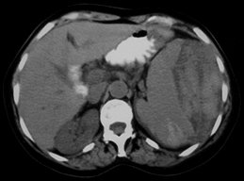
Imaging Findings
Non contrast CT image: low density hematoma with high density areas. The spleen is displaced medially.

Slide 4
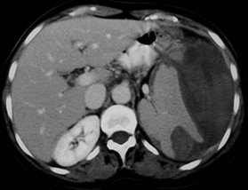
Post contrast CT image: a large defect in the inferior spleen portion is shown secondary to a blunt trauma.

Slide 5
Discussion
The spleen is the intraabdominal organ mostly injuried in case of blunt abdominal trauma and the
recognition of the fundamental role of the spleen in the immune response has led to greater efforts
to preserve the spleen after injury. Currently two criteria guide the decision to abstain from surgery:
hemodynamic stability and absence of another intraabdominal lesions requiring laparotomy. The
decision of a conservative management implies a very rigorous clinical monitoring and diagnostic
imaging represents a very helpfull tool to establish diagnosis and prognosis. Although ultrasound
can be used as an initial effective screening method for blunt abdominal trauma, CT is actually
considered the modality of choice for detecting intra-abdominal lesions for stable patients.

Slide 6
THANK YOU

