Slide 1
The Newborn Examination
Dr.Manish Rasania
Professor
Department of Paediatrics
SBKS MIRC

Slide 2
Learning Objectives
Classification of newborn
Understand Apgar score
Assess growth measurements
Assess vital signs
Estimate the gestational age
Assess the different body systems
▪
Recognize normal findings in the newborn examination
Recognize common newborn problems

Slide 3
Classification of newborn
Classification by Gestational Age Preterm <37 wks
Full term Postterm
37-4
>42 Wks
▪
Classification By Birth Weight Low Birth Weight < 2500 g
Very Low birth weight < 1500 g Extreme low birth weight < 1000 g

Slide 4
Classification
Classification By Weight Percentiles
AGA
SGA
LGA
10th-90th percentile for GA
< 10th percentile for GA
>90th percentile for GA

Slide 5
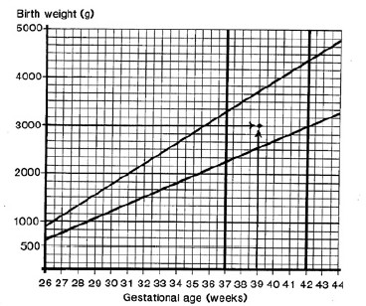
Weight for Gestational Age Chart
.Acta Paediatr Scand Suppl 1985; 31: 180

Slide 6
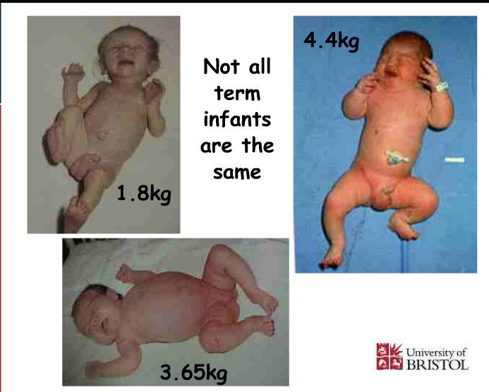

Slide 7
Small for Gestational Age
•
Symmetric
HC, length, weight all <10 percentile
33% of SGA infants
Cause: Infection, chromosomal abnormalities, inborn errors of metabolism, smoking, drugs
Asymmetric
Weight <10 percentile, HC and length normal
55% of SGA infants
Cause: Uteroplacental insufficiency, Chronic hypertension or disease, Preeclampsia, Hemoglobinopathies, altitude, Placental infarcts or chronic abruption
Combined
Symmetric or asymmetric
12% of SGA infants
Cause: Smoking, drugs, Placental infarcts or chronic abruption, velamentous insertion, circumvallate placenta, multiple gestation
•
•

Slide 8
Large for Gestational Age
Etiologies
  Infants of diabetic mothers
  Beckwith-Wiedemann Syndrome
    characterized by macroglossia, visceromegaly, macrosomia, umbilical hernia or omphalocele, and neonatal hypoglycemia
  Hydrops fetalis
  Large mother

Slide 9
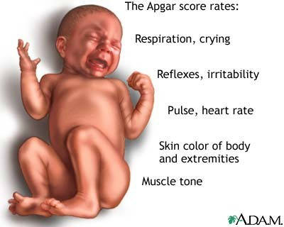
APGAR Score
Score Heart Rate
Respiratory effort
0
Absent Absent, irregular
1
<100bpm Slow, crying
2
>100bpm Good
Muscle tone
Limp
Some flexion of extremities
Grimace
Active motion
Reflex irritability (nose suction)
Color
No response
Cough or sneeze
Blue, pale
Acrocyanosis
Completely pink

Slide 10
Apgar Score
Assess the physical condition of newborns after delivery at
1,5 m and every 5 m.until its value is > 7
▪A value > 7 indicate the baby’s condition is good to
excellent
▪A value less than 4 necessitate continued resuscitation
▪Apgar score is a good predictor of survival but using it to predict long-term outcome is inappropriate

Slide 11
Examination of newborn
complete physical exam.should be done within 24 h. after birth
Include the following:
Vital signs
Physical exam
Neurological exam
Estimation of gestational age

Slide 12










Temperature
  Heart rate
Respiratory rate
  Blood pressure
Capillary refill time

Slide 13
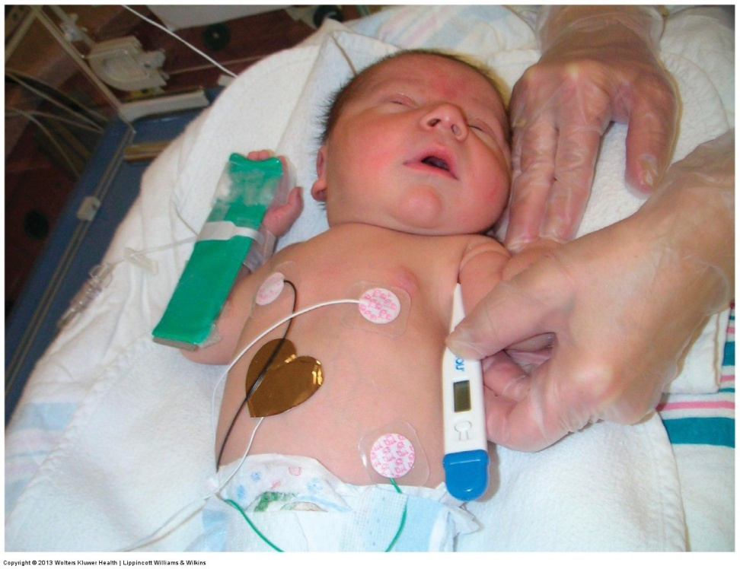
1.Temperature
Temperature should be taken axillary
The normal temperature for infant is 36.5- 37-5⁰C.
Axillary temp.is 0.5-1 0c lower than rectal

Slide 14
Heart rate
It should be obtained by auscultation and counted for a full minute
Normal heart rate is 120-160 beat /m.
If the infant is tachycardic (heart rate >170 BPM), make sure the infant is not crying or moving vigorously

Slide 15
3. Respiratory rate
Normal respiratory rate is 40 –60/minute
Respiratory rate should be obtained by observation for one full minute
Newborns have periodic rather than regular breathing

Slide 16
4. Blood pressure
It is not measured routinely
Normal blood pressure varies with gestational and postnatal ages

Slide 17
5. Capillary refill time
Normally < 3 seconds over the trunk
May be as long as 4 seconds on extremities
Delayed capillary refill time indicates poor perfusion

Slide 18













Slide 19
Physical examination
1st examination in delivery room or as soon as possible after delivery
▪2nd and more detailed examination after 24 h of life
Discharge examination with 24 h of discharge from hospital

Slide 20
1- Measurements
There are three components measurements in neonates
➢Weight
➢Length
➢Head circumference
for growth
All should be plotted on standardized growth curves for the infant’s gestational age

Slide 21
34
33
32
31
30
0
-
23
22
0
3.60
3.50
3.40
3.30
3.20
3 .10
3.00
2.90
2.80
2 . 70
2.60
2.50
2.40
2.30
2.20
2. 10
2.00
1.90
1.80
1.70
1.60
 |  | 1
 |  | I
INT11MJtEAINf wt lGtffU MGTH: MTIO HII w GRAMSA³. cu m 111m RS IKJl1t SU(ts
 |  |  |  |  |  |  |  |  |  | - |  |  |  |  |  |  |  | 90% 75%
 |  |  |  |  | .,
 |  | , |  | ., |  |  |  |  |  |  |  | ..... |  |  |  | .
 |  | . | ,, |  | . |  |  |  | ,. | -· |  |  | •• .... |  | • |  | 50%
 |  |  |  |  |  |  |  |  |  |  |  |  |  |  |  |  |  | 25% 10%
 |  |  |  | -, |  | • | - | ,- |  | - ., |  | .⁻..,
 |  |  |  |  |  |  | ,....
 |  | . | -··
 |  |  |  | - | J |  |  |  |  |  |  |  |  |  |  |  |  | .i
 |  |  |  | .
 |  |  |  |  |  |  |  |  |  |  |  |  |  |  |  |  |  | i
•
GM.
---
4000
WEIGHT
gm
.,
....
90% 3800
-·50%
75% 3600
.,
L..,
3400
3200
i,,
,
...
/
,
25% 3000
,
I
••
-
,
/
10o/o ²⁸⁰⁰
GM
2400
2200
2000
1800
1600
1400
1200
1000
800
600
400
0
,
,
.,,
,
2600
,
'
/
.
,,.
,
,
I
,
J
,
,
/
" .-
., ,
,
... ,,; ,
,; ,,.
I
.-,.
,,,,
,,,...
...
•
.,.
•
•
....
-"'
I-"
•
I
...
..^{P}.^{O}.$
PR E -TE RM
TE RM
T- T ERM
OMB V 29:J0 323334.36V36. 410q
WEEK OF GESTATION
1s1Exam (X)
2nd Exam (0)
LA RGE FOR GESTATIONAL AGE (Ll)A)
APPROPRIATE FOR GESTATIONAL AGE (AGA)
SMALL FOR GESTATIONAL AGE (IGA.)" ' | . -;.
Age at E xam | hrs | hrs
Si gnatu fe o f E xam in er | M . O . | M . O .
Ad•oted from Lut>ch..,c,o LO. Hwi-.m,;n C, •nd 8oyd E: P.cliatr, 19&6; 37:403; 8•tt.aglia FC, and lubchenco l O: J Pediatr. 1917: 71:15$,

Slide 22
1- Weight
Weight of F.T infants at birth is 2.6– 3.8kg.
Babies less than 2.5 kg are considered low birth weight.
Babies loose 5 – 10% of their birth weight in the first few days after birth and regain their birth weight by 7 – 10 days.
Weight gain varies between 15-20 gm/day.

Slide 23
2. Length
Crown to heel length should be obtained on admission and weekly
Acceptable newborn length ranges from 48-52 cm at birth

Slide 24
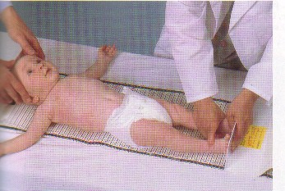
2. Length

Slide 25
3. Head Circumference
Head circumference should be measured on admission and weekly
Using the measuring paper tape around the most prominent part of the occipital bone and the frontal bone
Acceptable head circumference at birth in term newborn is 33-38 cm

Slide 26
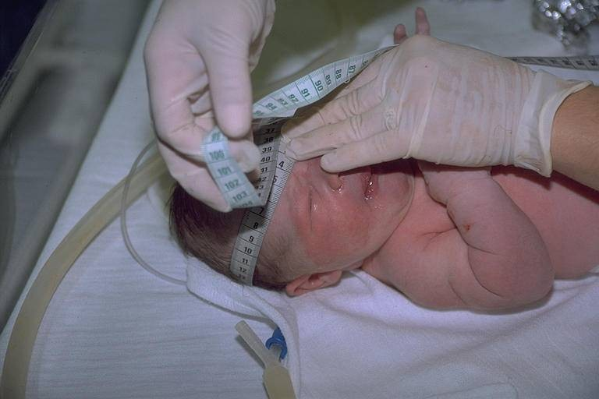
3. Head Circumference

Slide 27
GENERAL EXAMIINATION

Slide 28
1-Colour
Pallor: associated with low hemoglobin or shock
Cyanosis: associated with hypoxemia
Plethora: associated with polycythemia
Jaundice: elevated bilirubin

Slide 29
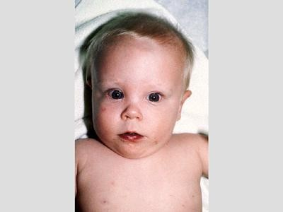
Cyanosis

Slide 30
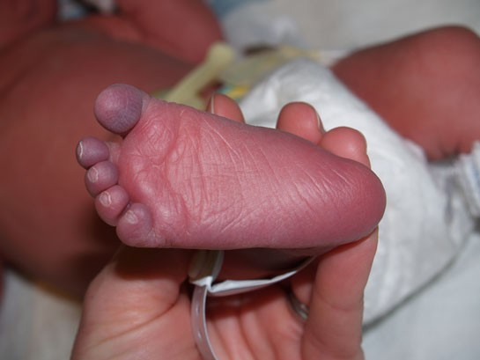
Acrocyanosis

Slide 31
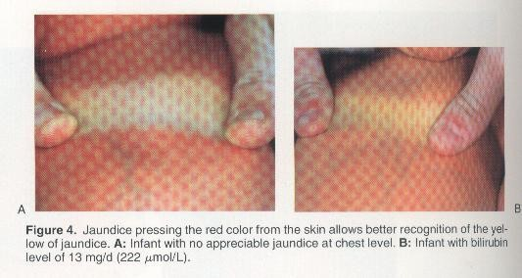
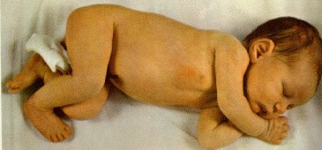
Jaundice

Slide 32
2-skin
Purpura,echymosis
Mottling
Vernix caseosa
Edema
Mongolian spots
Collodion infant

Slide 33
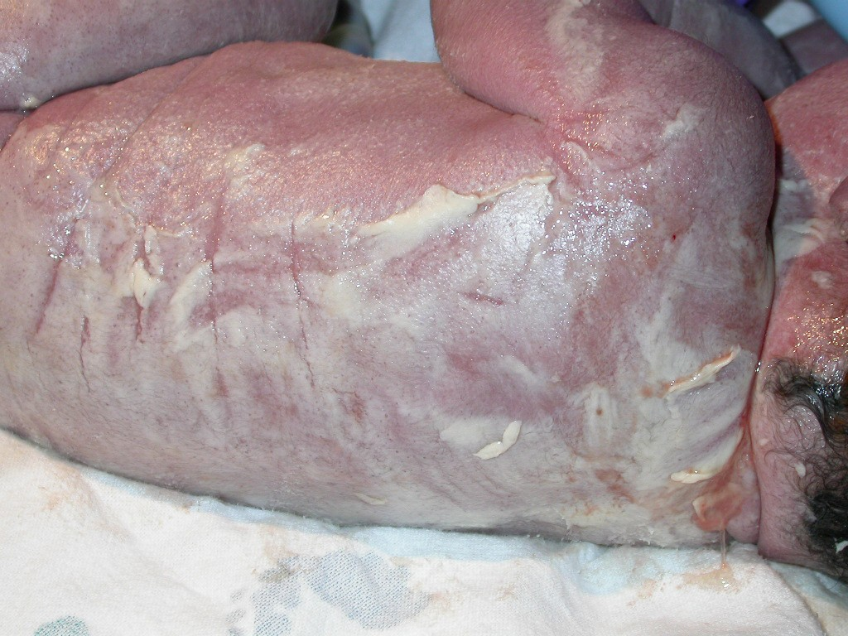
Vernix Caseosa
A lubricant found on the skin or skin fold
Disappears as the fetus ages
Almost absent in post- term

Slide 34
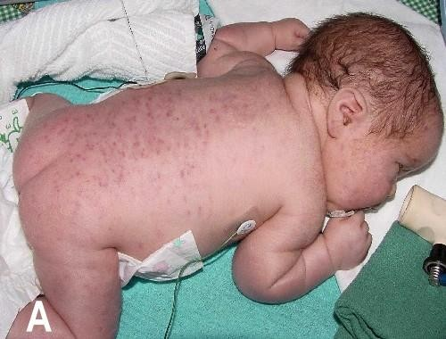
Purpura

Slide 35
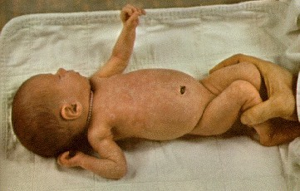
Mottling

Slide 36
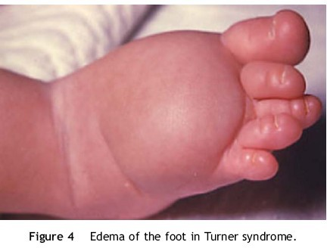
Edema

Slide 37
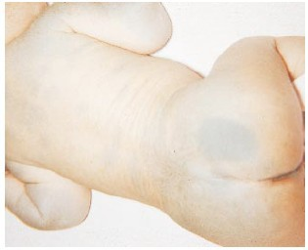
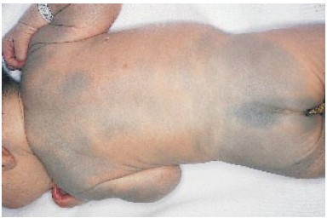
Mongolian spots
Dark blue bruise-like macular spots usually over sacrum
In 90% of blacks and Asians
Disappear by 4 yrs

Slide 38
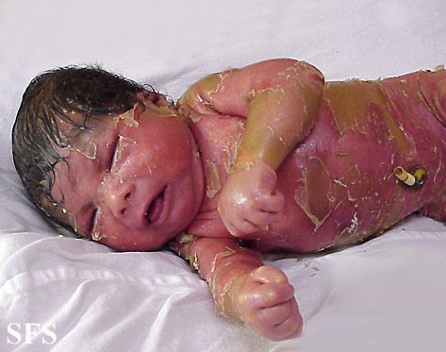
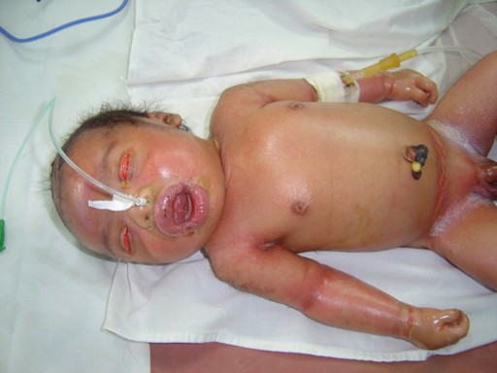
Collodion Baby

Slide 39
3- rashes
Milia
Erythema toxicum
Bullous impetigo
Diaper rash
nevi

Slide 40
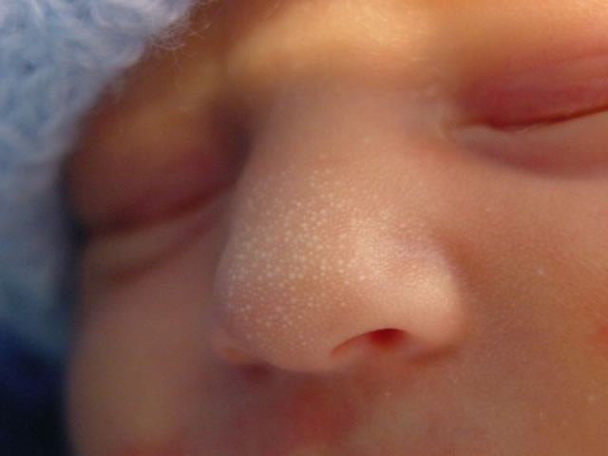
Milia
White papules < 1 mm in diameter scattered across the forehead, nose, cheeks
▪
Sebaceous retention
cysts disappear within wks

Slide 41
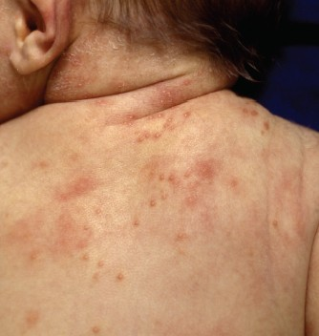
Erythema toxicum
White vesicles with
a red
base
Contain esinophils
48 h after birth
Transient
Benign

Slide 42
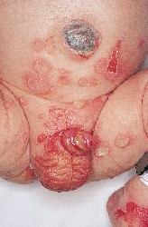
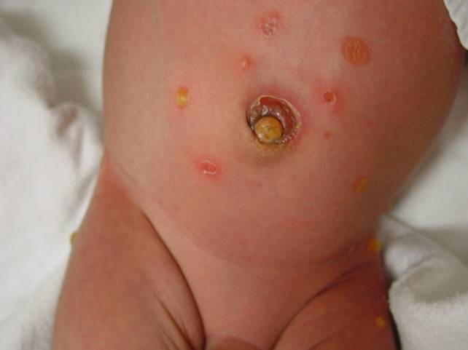
Bullous impetigo: Pemphigus neonatorum

Slide 43
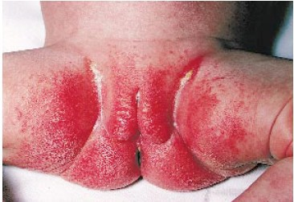
Candida diaper dermatitis

Slide 44
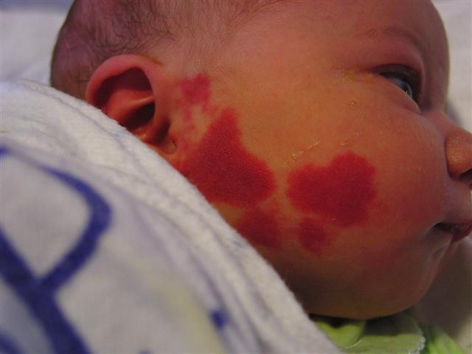
Port Wine stain
”Nevus flammeus“
Flat, deep red, do not blanch with
pressure
May be
associated with retinal and
intracranial
hematomas

Slide 45
4- Head and Neck
Skull
–
–
–
–
–
Macrocephaly and microcephaly Caput succedaneum cephalhematoma,
subgaleal hemorrhage Fontanelle

Slide 46
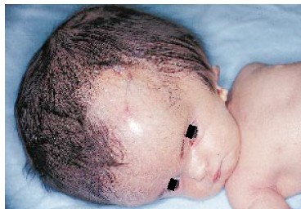
Hydrocephalus

Slide 47
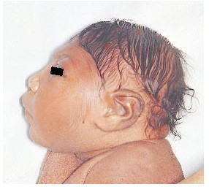
Microcephaly

Slide 48
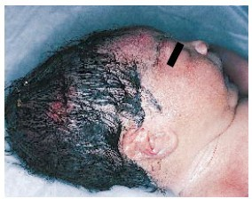
Caput Succedaneum
Edema of scalp skin, crosses suture lines

Slide 49
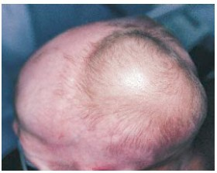
Cephalhematoma
Subperiosteal
Not cross suture lines

Slide 50
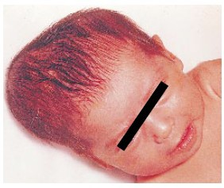
Cephalhematoma
Complications:
Underlying linear skull fracture
Jaundice
Calcification
Infection
Intracranial Hge

Slide 51
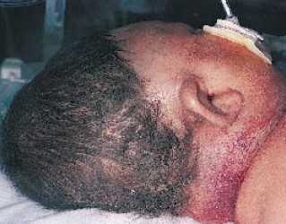
Subgaleal hemorrhage
▪Under the aponeurosis of the scalp
▪Cross suture lines

Slide 52
Anterior and posterior fontanelle
•
Large anterior fontanelle is seen in
hypothyroidism,osteogenesisimperfecta,hydrocephalus
•
Small ant.fontanelle in microcephaly and craniostenosis
•
Bulging ant. fontanelle in menigitis and hydrocephalus Intracranial hemorrhage
•
Depressed ant.fontanelle in dehydration
•
Large post.fontanelle :suspicious of hypothyroidism

Slide 53
Eyes
▪Pupils: equality, reactivity to light.
Squint
Cornea
Conjunctiva
Iris

Slide 54
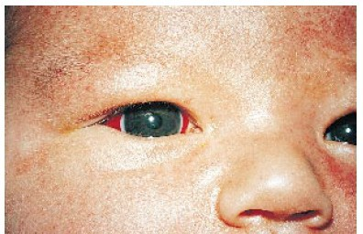
Subconjunctival hemmorrhage
Benign condition Resolve by 2-4 wks

Slide 55
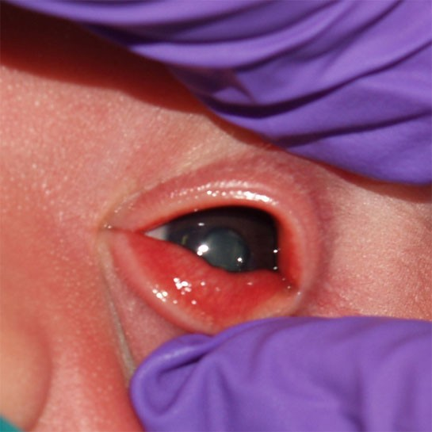
Congenital cataract: rubella

Slide 56
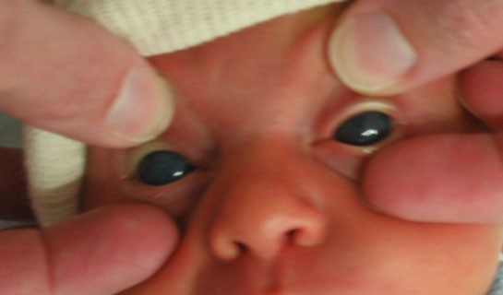
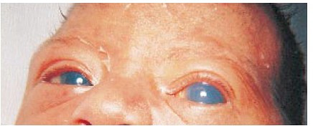
Glaucoma

Slide 57
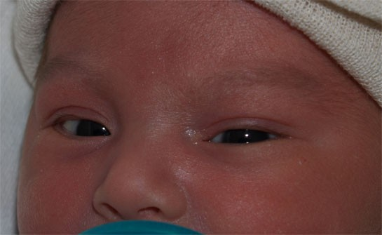
Dysconjugate Eye Movements

Slide 58
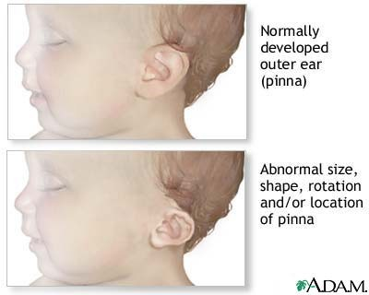
Ear Examination
Assess for asymmetry or irregular shape
Note presence of auricular or pre-auricular pits, fleshy appendages, lipomas, or skin tags.
Low set ears
  Below lateral canthus of eye
  Associated with genitourinary anomalies, because these areas develop at similar times.
Malformed ears
  Can be associated with Downs or Turners Syndromes

Slide 59
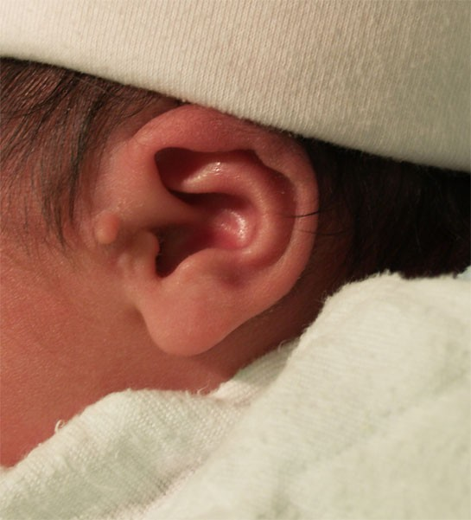
Ear Tag

Slide 60
Nose
▪Patency of each nostril: exclude choanal atresia
▪Flaring of nostrils

Slide 61
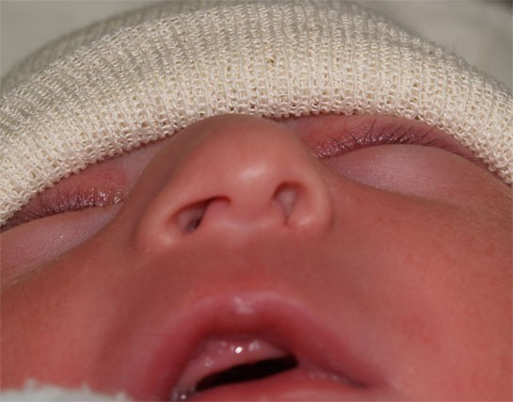
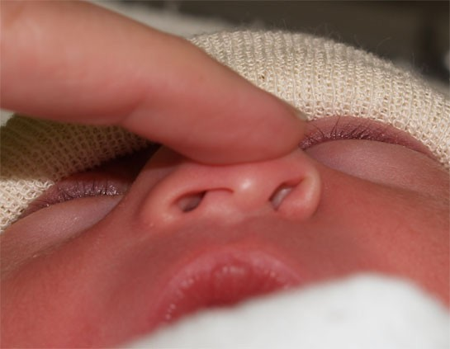
Dislocated Nasal Septum

Slide 62
Mouth
▪Cleft lip and palate
▪Tongue tie
▪Natal teeth
▪Tongue size

Slide 63
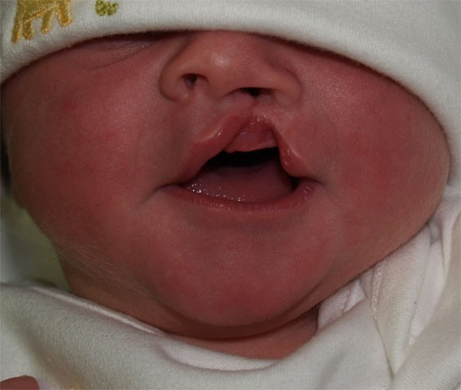
Cleft Lip

Slide 64
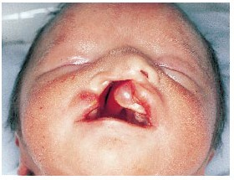
Unilateral Cleft Lip and cleft palate

Slide 65
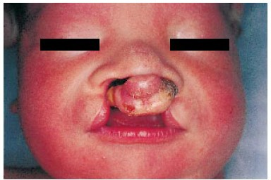
Bilateral Cleft Lip and cleft palate

Slide 66
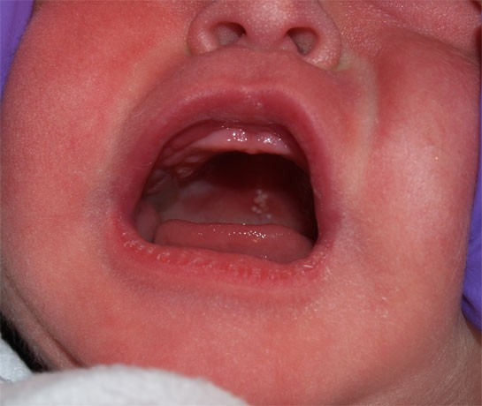
Epstein Pearls & cheeks
•
small white cysts which contain keratin
frequently found on either side of the median raphe of the palate.
Resolves in 1-2 months
•
•

Slide 67
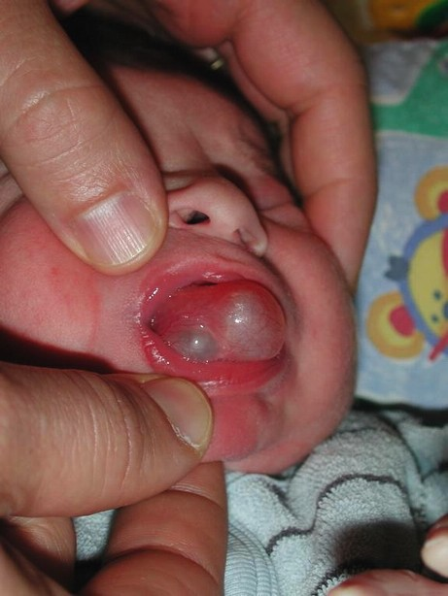
Mouth
Ranulas
– small bluish-white swellings of variable size on the floor of the mouth representing benign mucous gland retention cysts

Slide 68
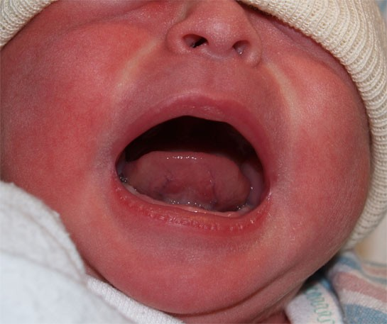
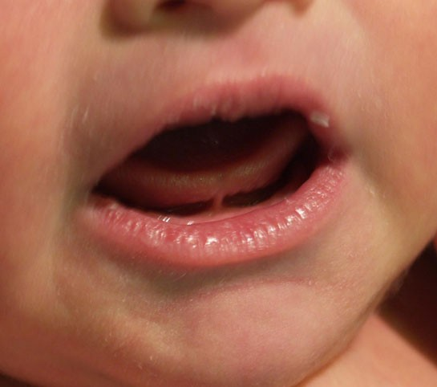
Ankyloglossia
Normal Tongue

Slide 69
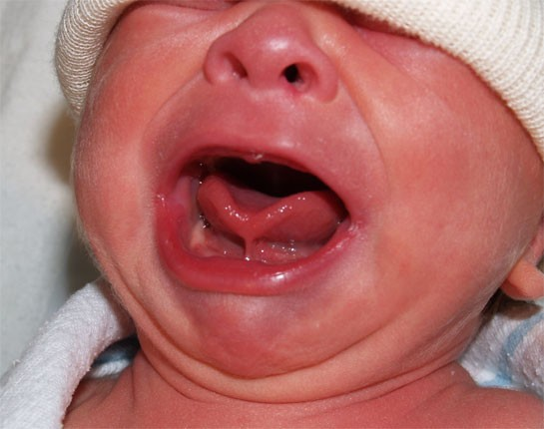
Ankyloglossia

Slide 70
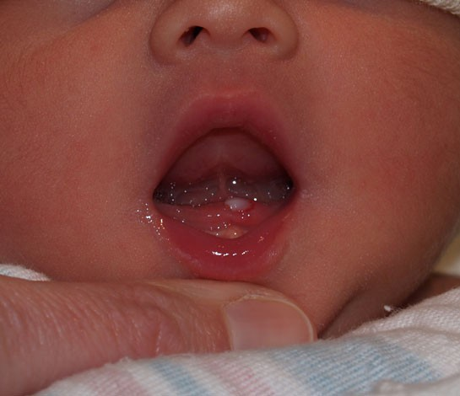
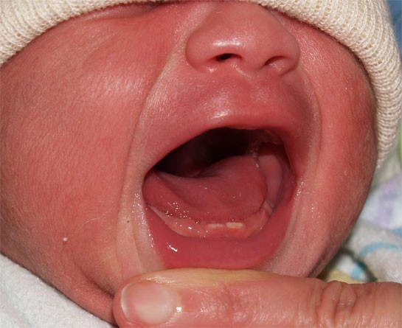
Natal Tooth

Slide 71
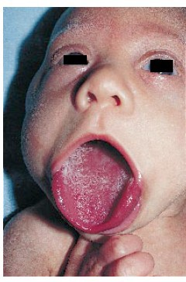
Macroglossia

Slide 72

Oral thrush

Slide 73
Neck
▪Cysts:
Thyroglossal cyst Cystic hygroma
▪Masses: Sternomastoid tumor
Thyroid
▪Webbing

Slide 74

Sternomastoid tumor
▪Hematoma in the middle third of the sternomastoid muscle
▪Torticolis, Limitation of lateral rotation of the neck

Slide 75

Webbed Neck

Slide 76
Muskloskletal
Fractures
Dislocations
Polydactyly
Syndactyly
Deformities

Slide 77

Erb’s Palsy

Slide 78


Polydactyly

Slide 79

Syndactyly
Simple – involves soft tissue attachment only
Complex – involves fusion of bone or nail
Partial - web extends from base partially
Complete - web from base to tip of finger
Radiographs needed to determine degree of fusion.
Should refer to orthopedics.

Slide 80



Talipes Equinovarius (Clubfoot)

Slide 81
Spine and hips
Inspect back for meningeocele
Examine for dislocation hip:
expected if there is assymetry of skin folds of the thigh and shortening of the affected leg

Slide 82


Meningiomyelocele

Slide 83

Meningiomyelocele & meningeocele

Slide 84

DDH

Slide 85
Chest/Lung Examination
Inspection
  Supernumerary breast or nipple is common (10%)
  Breast enlargement secondary to maternal hormones
  Unilateral absence or hypoplasia of pectoralis major
    Poland's Syndrome (Poland's Sequence)
  Widely spaced nipples
    Turner's Syndrome
    Noonan Syndrome

Slide 86
Chest/Lung Examination
Inspection
  Chest Deformity
    Pectus Carinatum
      Much less common than Pectus Excavatum
      More common in males by ratio of 4:1
      Narrow thorax with increased anteroposterior diameter
    Pectus Excavatum
      Gender predominance: Boys (3:1 ratio)
      Mild: Oval pit near infrasternal notch
      Severe: Sinking of entire lower sternum

Slide 87
Chest/Lungs
Observe
  Respiratory pattern
    Brief periods apnea are normal in transition, called “periodic breathing”
  Chest movement
    Symmetry
    Retractions and Tracheal tugging
Ascultation
  Audible stridor, grunting
  Wheeze, rales.

Slide 88

Slight substernal retraction evident during inspiration

Slide 89
Heart and vascular system
▪Tachypnea,tachycardia
Increased pericordial activity
Cyanosis: hyperoxia test
Auscultation of heart sounds, murmurs or Irregular heart rhythm
Perfusion: Capillary refill time
▪Palpate femoral pulsation: absent in coarctation of the aorta
▪Bounding pulses often indicated PDA

Slide 90
Abdomen
Organomegaly: liver may be palpable 1-2 cm below the costal margin .spleen is at the costal margin
Masses
▪Distension , scaphoid abdomen
▪Umbilical stump: bleeding , meconium straining, granuloma, discharge, inflammation
Omphalocele and Gastroschisis

Slide 91

Abdomen
Cylindrical in Shape

Slide 92

Normal Umbilical Cord
Bluish white at birth with 2 arteries & one vein.

Slide 93

Meconium Stained Umbilical Cord

Slide 94



Omphalocele
Defect covered by amnion, with cord attachment to apex of defect.
Herniation through defect: any abdominal organs

Slide 95

Abdominal distension

Slide 96
Genitalia and rectum
Male genitalia
In full term,scrotum is well developped,with deep rugae. Both testes are in the scrotum
In preterm,scrotum is small with few rugae.testes are absent or high in the scrotum
abnormalities: undescended testis hydrocele,
inguinal hernia hypospadius
•
•
•
•

Slide 97

Bilateral hydrocele

Slide 98


Bilateral Inguinal hernias

Slide 99

Hypospadius
Meatus opens on the ventral
surface of the penis

Slide 100
Female genitalia
•
In full term,labia majora completely cover labia minora
•
In preterm,labia majora is widely separated and labia minora protruded
•
A discharge from the vagina or withdrawal bleeding may be observed in the first few days
•
Infant with ambiguous genitalia should not undergoe gender assignment until endocrinal evaluation is performed

Slide 101

Withdrawal bleeding

Slide 102

➢Umbigious Genitalia

Slide 103

Imperforate Anus
The anus is inspected for its location and patency
.
An imperforate anus is not always immediately apparent.
Thus, patency often is checked by careful insertion of a rectal thermometer to measure the baby's first temperature

Slide 104
Meconium should pass in the first 48h after birth
Delayed passage of meconium may indicate imperforate anus or intestinal obstruction
Urine should pass in the first 24h of life

Slide 105















Slide 106
Muscle tone
▪Connvulsions
▪Neonatal reflexes Moro Grasp Tonic Neck
Stepping and Placing Rooting &Suckling

Slide 107


Posture
•
Term infants normal posture is hips abducted and partially flexed, with knees flexed.
Arms are abducted and flexed at the elbow.
Fists are often clenched, with the fingers covering the thumb
•
Tone
To test, support the infant with one hand under the chest. Neck extensors should be able to hold head in line for 3 seconds
There should be no more than 10% head lag when moving from supine to sitting positions.

Slide 108

Hypotonia

Slide 109


Slide 110
Neonatal reflexes
Also known as developmental, primary,or primitive reflexes.
They consist of autonomic behaviors that do not require higher level brain functioning
They can provide information about integrity of
C.N.S. Their absence indicate C.N.S depression
They are often protective and disappear as higher level motor functions emerge.

Slide 111
Moro Reflex
Onset: 28-32 weeks GA
Disappearance:4- 6 months
It is the most important reflex in neonatal period

Slide 112

Moro reflex
Stimulus : when baby in supine position elevate his head by your hand then allow head to drop suddenly
:Response
Extension of the back
Extension and abduction of the UL
Flexion and adduction of the UL with open fingers
Crying

Slide 113

Significance of Moro
Bilateral absence:
CNS depression by narcotics or anesthesia
Brain anoxia and kernicterus
Very Premature baby
Asymmetric response:
Erbs palsy , fracture clavicle or humerus
Persistence beyond 6th month:
CNS damage

Slide 114


Slide 115
Suckling Reflex
When a finger or nipple is placed in the mouth, the normal infant will start to suck vigorously
Appears at 32 w & disappears by 3 – 4 m

Slide 116

Suckling Reflex

Slide 117
Rooting Reflex
Well-established: 32-34 weeks GA
Disappears: 3-4 months
Elicited by the examiner stroking the upper lip or corner of the infant’s mouth
The infant’s head turns toward the stimulus and opens its mouth

Slide 118

Rooting Reflex

Slide 119
Palmar grasp
Well-established: 36 weeks GA
Disappears: 4 months
Elicited by the examiner placing her finger on the palmar surface of the infant’s hand and the infant’s hand grasps the finger
Attempts to remove the finger result in the infant tightening the grasp

Slide 120


Grasp reflex
Technique: put the examiner finger in the baby palm with slight rubbing .
Response: the infant grasp the finger firmly
Significance:
Absent depression
Persist damage
CNS
CNS

Slide 121
Stepping Reflex
Onset: 35-36 weeks GA
Disappearance: 6 weeks
Elicited by touching the top of the infant’s foot to the edge of a table while the infant is held upright.
▪
The infant makes movements that resemble stepping

Slide 122

➢Stepping :
Hold baby in
upright position then lower him till his sole touch table → stepping movement start.

Slide 123

➢Placing :
When dorsum of the baby foot touches the under surface of the table
→ flexion then extension to place or put his foot on the table

Slide 124

Placing Reflex

Slide 125
Tonic neck (Fencing posture)
Evident at 4 weeks PGA
Disappearance: 7 months
Elicited by rotating the infant’s head from midline to one side
The infant should respond by extending the arm on the side to which the head is turned and flexing the opposite arm
Appearance at birth or persistence beyond 9m indicate cerebral palsy

Slide 126

Tonic neck (Fencing posture)

Slide 127


























Slide 128
Gestational Age Assessment
▪Obstetricians
LMP
Ultrasound
▪New Ballard score

Slide 129
Gestational Age Assessment
New Ballard Score
Performed within 12-24 hours
Neuromuscular maturity (6)
Physical maturity (6)
Ballard JL, et al. J Pediatrics; 1991: 119 (3)

Slide 130
Ballard Score
•
External Characteristics
Edema
Skin texture, color, and opacity
Lanugo
Plantar creases
Nipples and breasts
Ear form and firmness
Genitals
Neuromuscular Score
  Posture
  Square Window
  Arm recoil
  Popliteal angle
  Scarf sign
  Heel to ear

Slide 131

New Ballard Score
Ballard JL, et al. J Pediatrics; 1991: 119 (3)

Slide 132


