Slide 1




COMMON NEONATAL PROBLEMS
Dr. Hemal Dave
Assistant Professor
Department of Paediatrics
SBKS MIRC

Slide 2



Skin

Slide 3


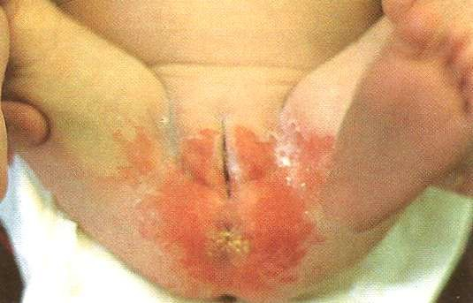
Diaper Rash
⌘ ‘Nappy rash’, ‘ammoniacal dermatitis’
⌘ Irritant dermatitis
⌘ Exposure to urine & stools

Slide 4
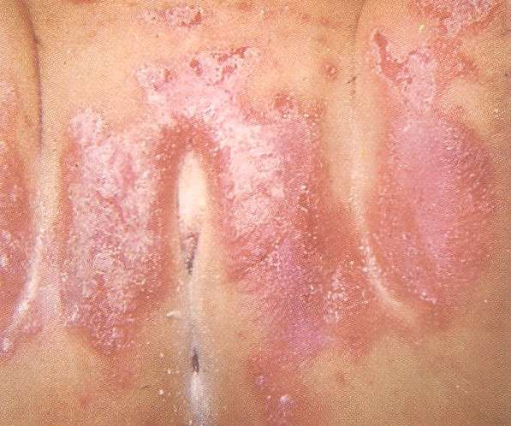
Diaper Rash
⌘ Skin creases spared
⌘ Exclude superimposed Candidal infection

Slide 5
Diaper Rash
Rx
⍓Frequent diaper changes
⍓Exposure of region to allow drying
⍓ Zinc oxide creams; even prophylactically

Slide 6


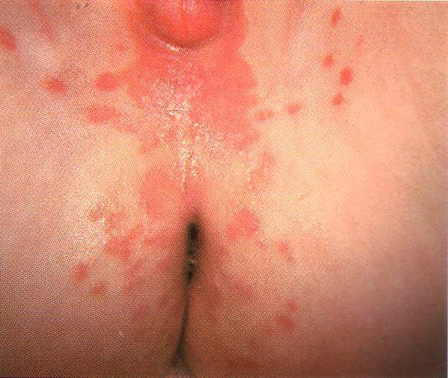
Candida albicans Rash
⌘ Moist, warm areas
⌘ Frequently intertriginous areas
⍓Neck folds, axillae diaper area
⌘ Confluent, erythematous
plaques with sharply
demarcated edges

Slide 7
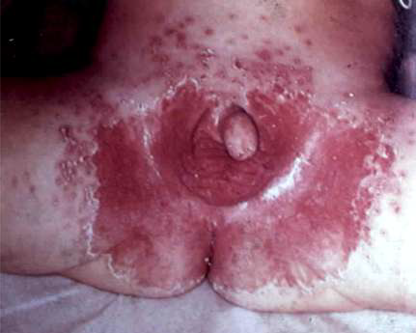
Candida albicans Rash
⌘ Satellite lesions (pustules on contiguous areas of skin)
⌘ Skin folds involved
Rx
⍓Miconazole cream, powder

Slide 8


Staphylococcus aureus
⌘ Staphylococcal pustulosis
⌘ Bullous Impetigo
⌘ Staphylococcal Scalded Skin Syndrome

Slide 9


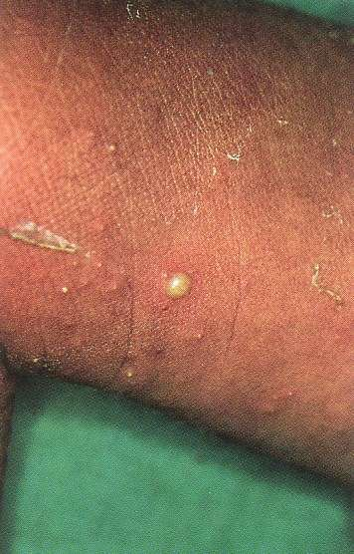
Staphylococcal Pustulosis
⌘ Usually at 3-5dys old
⌘ Discrete pustules with erythematous base

Slide 10


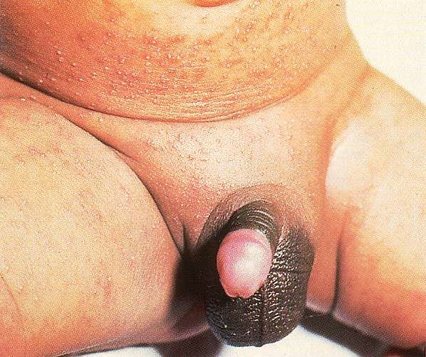
Staphylococcal Pustulosis
⌘ Diaper area, periumbilical, neck, lateral aspect of chest
Rx
⍓ Systemic
Cloxacillin

Slide 11


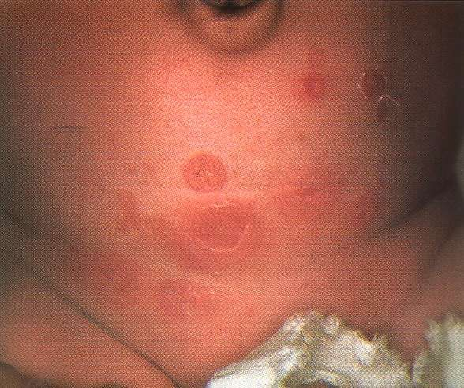
Bullous Impetigo
⌘ Flaccid blisters, rupture quickly, become superficial round/oval erosions
Rx
⍓ Systemic Cloxacillin, Cephalosporin

Slide 12


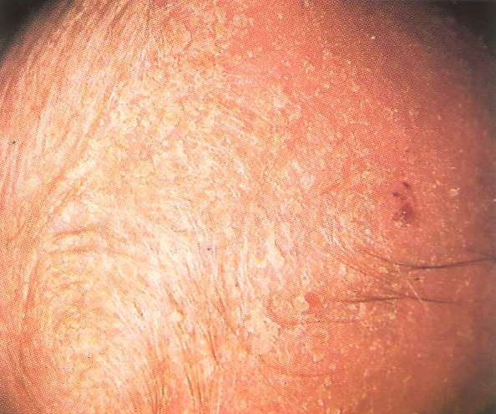
Seborrhoeic Dermatitis
⌘ Onset within 1st 2mths
⌘ Greasy yellow scales on an erythematous base, minimal pruritus

Slide 13
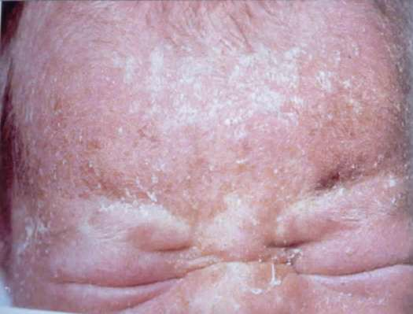
Seborrhoeic Dermatitis
⌘ Face, eyebrows, scalp (cradle cap)

Slide 14
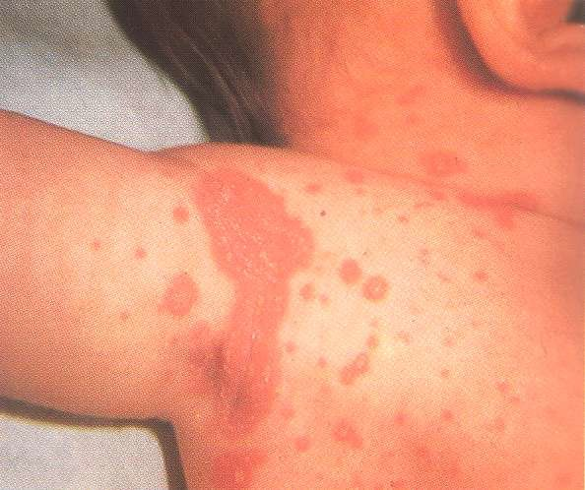
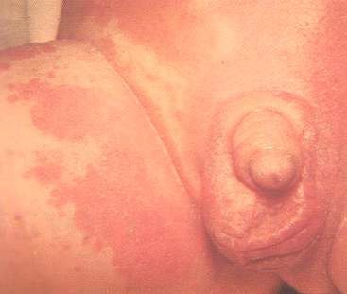
Seborrhoeic Dermatitis
⌘ Diaper area, flexural areas (posterior auricular sulcus, neck, axillae, inguinal folds)

Slide 15
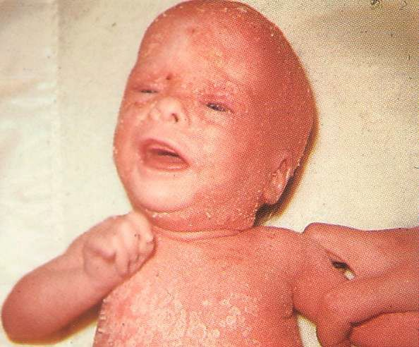
Seborrhoeic Dermatitis
⌘ Localised or generalised
⌘ If severe, fissures may develop & become
secondarily infected
⌘ Cause
⍓ Pityrosporum ovale
(yeast)

Slide 16
Seborrhoeic Dermatitis
⌘ Spontaneously improves by end of 1st yr
Rx
⍓Cradle cap shampoo
⍓ Olive oil on scalp to soften crusts (for 1hr before washing off)
⍓ 1% Hydrocortisone cream sparingly

Slide 17


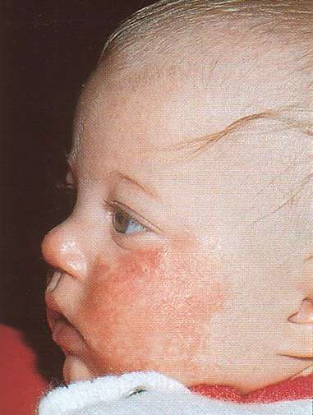
Atopic Dermatitis
⌘ Atopic dermatitis & seborrhoeic dermatitis share clinical features

Slide 18
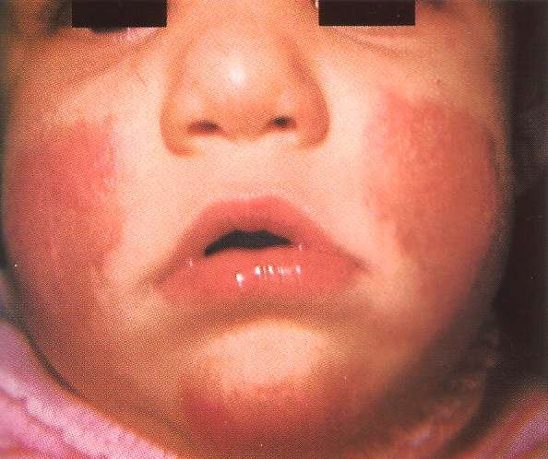
Atopic Dermatitis
⌘ Difficult to distinguish during neonatal
period

Slide 19
Atopic Dermatitis
Differentiating features
⌘ Pruritic (cardinal feature)
⍓ Irritable, scratching & rubbing against nearby objects
⌘ Diaper area spared
⌘ Recurrence after clearing
⌘ Dry, white scaling
⌘ Strong family history of atopy

Slide 20


Atopic Dermatitis
Rx
⍓Emollients liberally particularly immediately after bath
⍓ 0.5% or 1% Hydrocortisone cream sparingly
⍓Treat superimposed infections

Slide 21


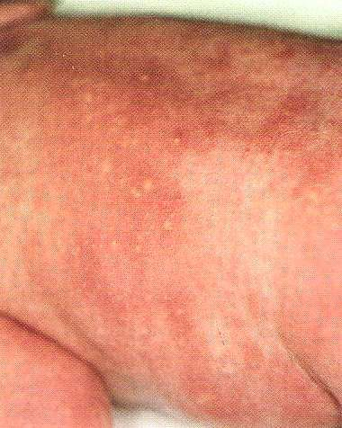
Erythema Toxicum
⌘ 50-70% of term babies; rare in preterm
⌘ Basic lesion is a small (1-3mm) papule, evolves into pustule with a prominent halo of erythema

Slide 22
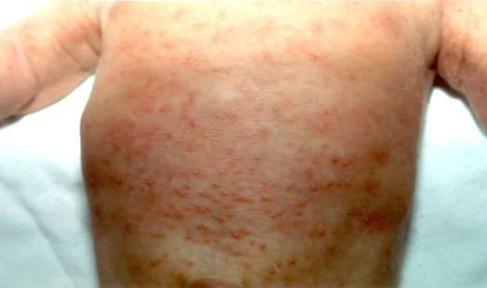
Erythema Toxicum
⌘ Few to numerous, small areas of red skin with yellow-white centre
⌘ Usually on trunk, frequently on extremities
& face
⌘ Palms & soles almost always spared

Slide 23
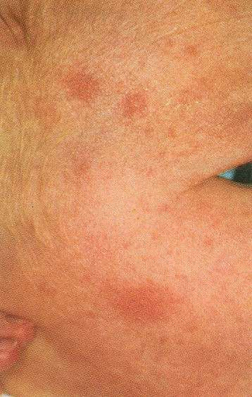
Erythema Toxicum
⌘ Most noticeable at 48hrs; may appear as late as 7-10dys
⌘ Smear: Eosinophils
⌘ Benign, resolves spontaneously

Slide 24


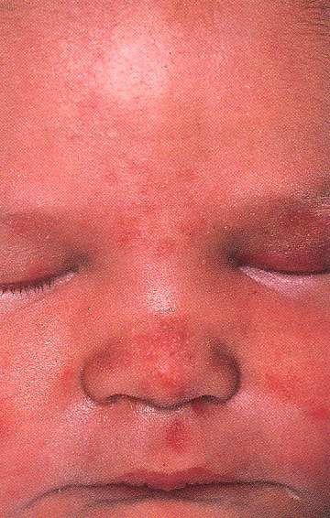
Salmon Patch
⌘ Naevus simplex or macular haemangioma
⌘ 30-40% infants
⌘ Distended dermal capillaries
⌘ Flat, pink macular lesion

Slide 25


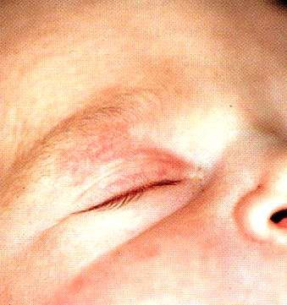
Salmon Patch
⍓Forehead
⍓Upper eyelid
⍓Nasolabial area
Most resolve by 1 yr
⌘ Crying makes fading
lesion more prominent

Slide 26
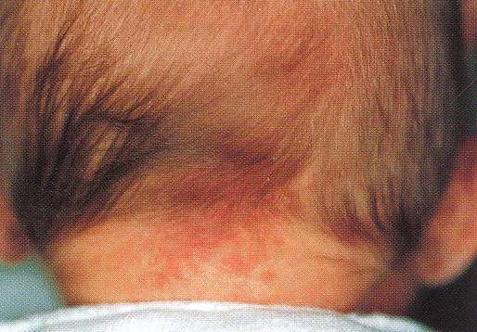
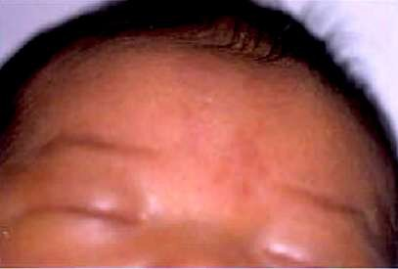
Salmon Patch
⍓Glabella (‘angel’s kiss’)
⍓Nape of neck (‘stork bite’)
Most resolve by 1 yr
Usually persists

Slide 27


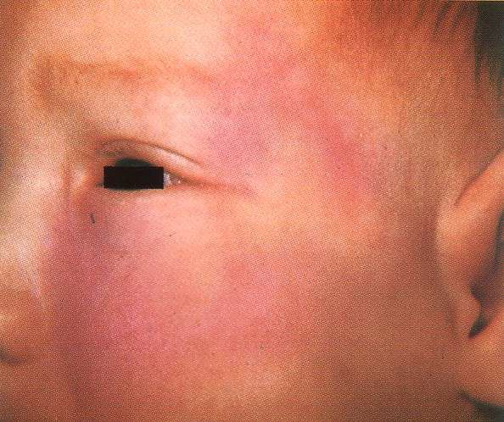
Port-wine Stain
⌘ Nevus flammeus
⌘ 0.3% neonates, seen at birth
⌘ Most commonly on face
⍓ Also trunk, back,
limbs
⌘ Often unilateral

Slide 28
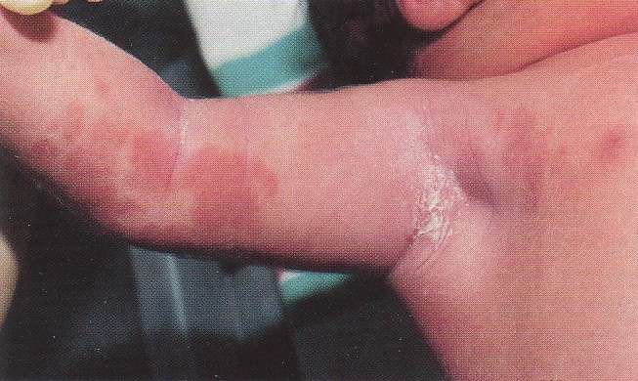
Port-wine Stain
⌘ At birth, pink & macular
⌘ With time, darken to reddish purple (especially face), papulonodular surface (on limbs greater tendency to fade)

Slide 29
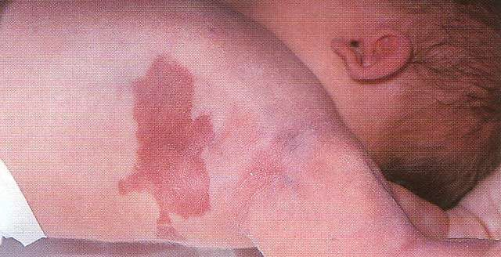
Port-wine Stain
⌘ Vascular malformation of dilated capillary-like vessels
⌘ Do not involute
⌘ Majority are isolated

Slide 30
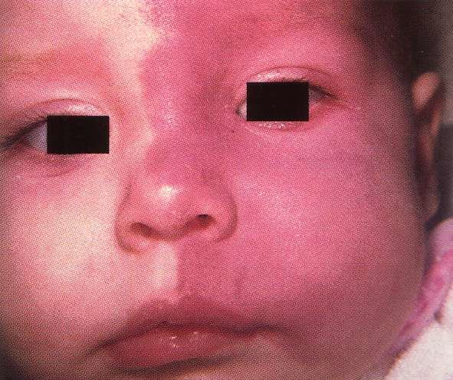
Port-wine Stain
⌘ Exclude Sturge-Weber syndrome, Klipple-Trenaunay syndrome
Rx
⍓Pulse-laser therapy

Slide 31


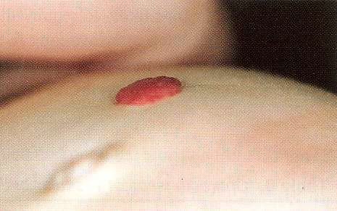
Strawberry Haemangioma
⌘ Bright red, raised, well circumscribed

Slide 32
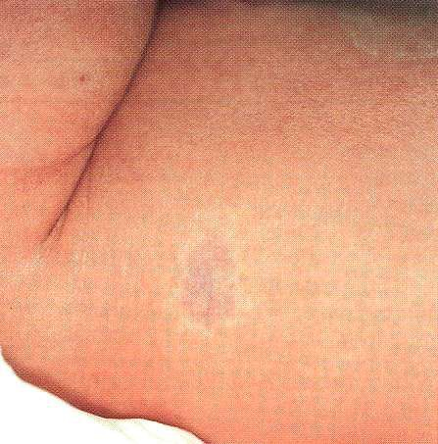
Strawberry Haemangioma
⌘ At birth, may be absent or pale macule with irregular margins

Slide 33
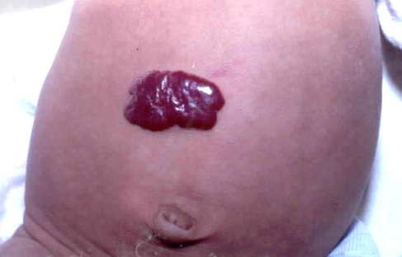
Strawberry Haemangioma
⌘ Grow rapidly during 1st 6mths; continue to grow till 1yr
⌘ More common in head, neck & trunk; in premature
infants

Slide 34
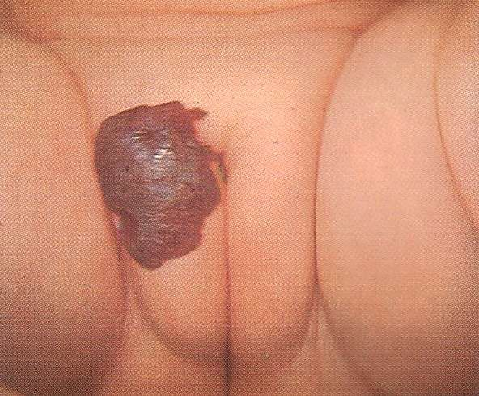
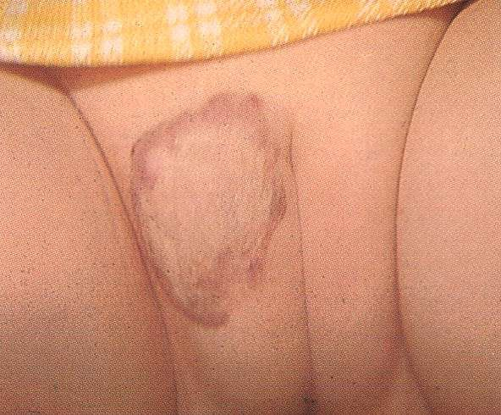
Strawberry Haemangioma
⌘ Majority involute with by age 4-5yrs (50% by 5 yrs)

Slide 35
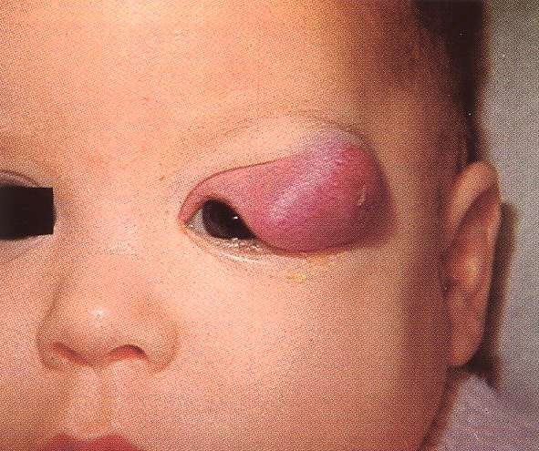
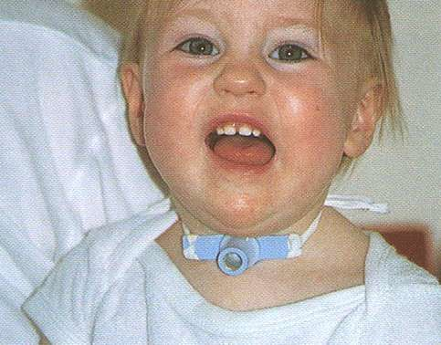
Strawberry Haemangioma
⌘ Complications
⍓ Obstruction: Eye, ear, airway

Slide 36
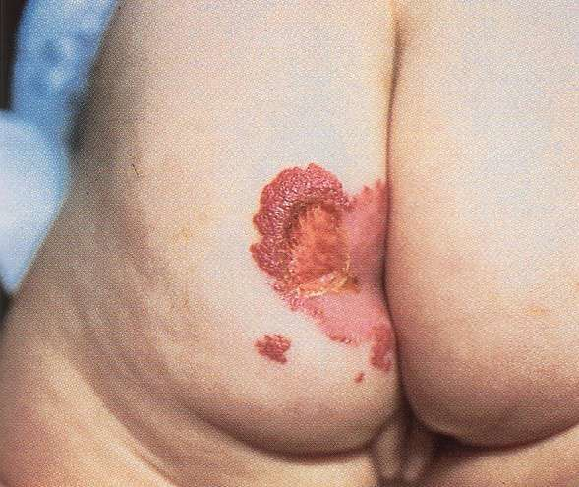
Strawberry Haemangioma
⌘ Complications
⍓Ulceration

Slide 37
Strawberry Haemangioma
⌘ Complications
⍓ Bleeding
⍓ Associated visceral involvement
⌧Liver, GIT, lungs, CNS

Slide 38


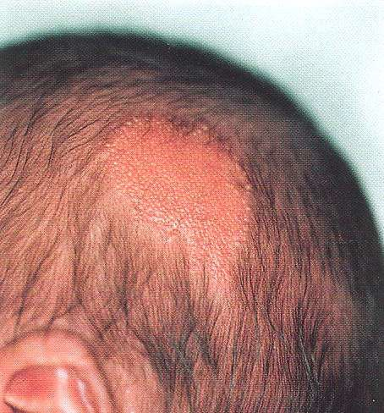
Naevus Sebaceum
⌘ Single yellowish slightly raised hairless plaque
⌘ Scalp or face

Slide 39
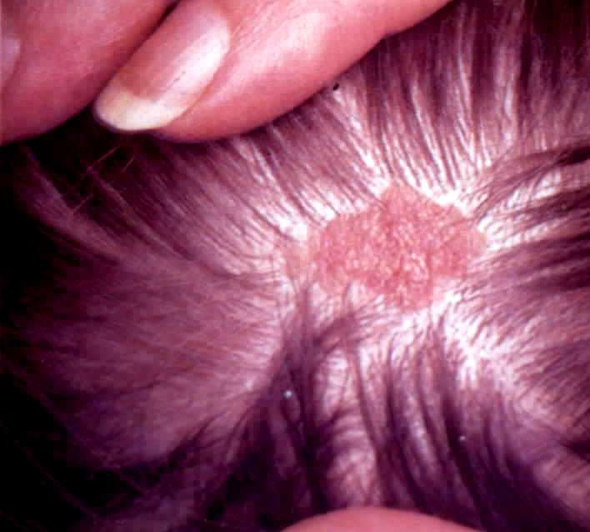
Naevus Sebaceum
⌘ Excessive sebaceous glands & malformed
hair follicles

Slide 40
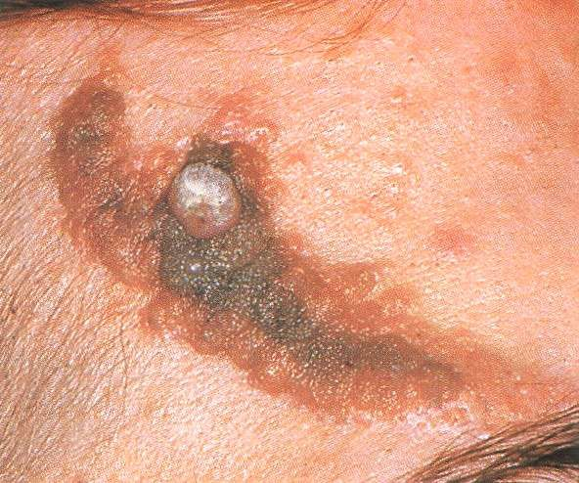
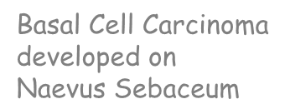

Naevus Sebaceum
⌘ Risk of benign or malignant tumours in 15% (rarely before puberty)
Rx
⍓Excision
before puberty
Basal Cell Carcinoma developed on Naevus Sebaceum

Slide 41


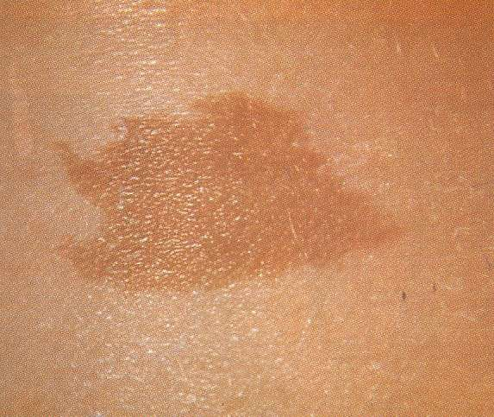
Café au lait Spots
⌘ Light brown, round or oval, macules
⌘ Smooth edges
⌘ Vary in size

Slide 42
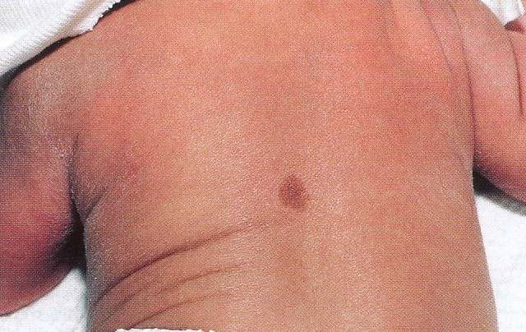
Café au lait Spots
⌘ Do not resolve with time
⌘ Histology: Increased melanin within basal keratinocytes, without melanocyte
proliferation
⌘ Few small spots of little significance

Slide 43

Café au lait Spots
Disorders with Café au lait Spots
⌘ Neurofibromatosis
⌘ McCune-Albright syndrome
⌘ Russell-Silver syndrome
⌘ Multiple lentigenes
⌘ Ataxia telangiectasia
⌘ Fanconi anaemia
⌘ Tuberous sclerosis
⌘ Bloom syndrome
⌘ Epidermal naevus
syndrome
⌘ Gaucher disease
⌘ Chēdiak-Higashi syndrome

Slide 44
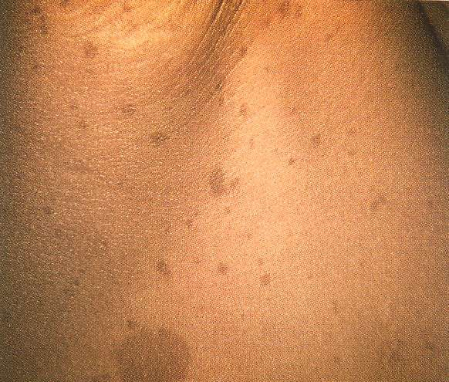
Café au lait Spots - Neurofibromatosis

Slide 45


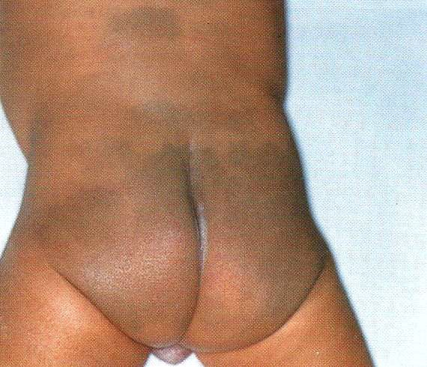
Mongolian Spots
⌘ 90% blacks, 80% asians, 10% whites
⌘ Brown, grey, blue macules
⌘ Commonly lumbosacral area; occasionally upper back, limbs, face
⌘ Vary in size & number

Slide 46
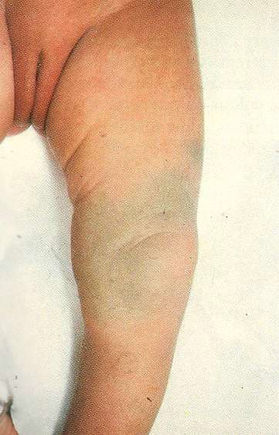
Mongolian Spots
⌘ Infiltration of melanocytes deep in dermis
⌘ Often fade within 1st few yrs due to decreasing transparency of skin rather than true disappearance

Slide 47


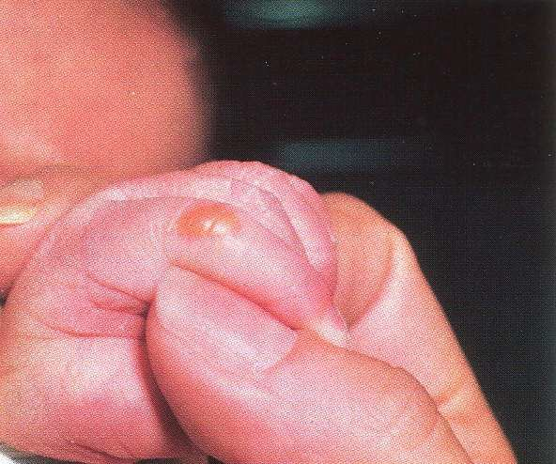
Sucking Blisters
⌘ Clear blister
⌘ Lip, finger, hand, wrist
⌘ Friction of repeated sucking

Slide 48
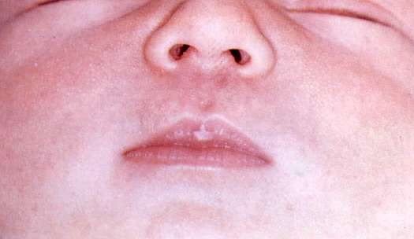


Sucking Blisters
⌘ Some may be healed & appear like calluses
⌘ Resolves spontaneously
Sucking Pad

Slide 49


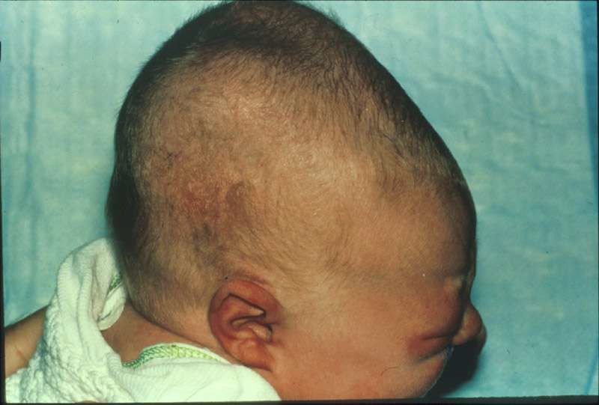
Cephalhaematoma

Slide 50


Cephalhaematoma
⌘ from prolonged stage II of labour
⌘ instrumental delivery, especially ventouse
⌘ the misshapen head can cause some parental alarm
⌘ subperiostial swelling
⌘ boundaries is limited by bony margin, doesn't cross midline

Slide 51
Cephalhaematoma
Treatment
⍓ Reassurance
⍓ will resolve with time 4-8 weeks.
complications
⍓ Anaemia from the quantity of bleed into the haematoma
⍓ Jaundice from haemolysis within it.
⍓ Calcification

Slide 52



Eye

Slide 53


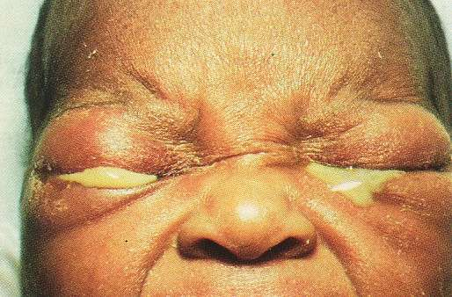
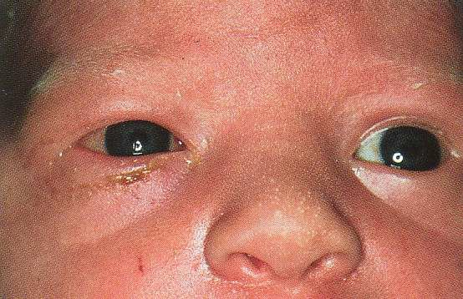
Eye Sepsis
⌘ Eye swab Gram stain & culture
⌘ Gutt Chloramphenical 1 drop 6H
⌘ Chlamydia if associated cough
⌘ Gonococcal

Slide 54


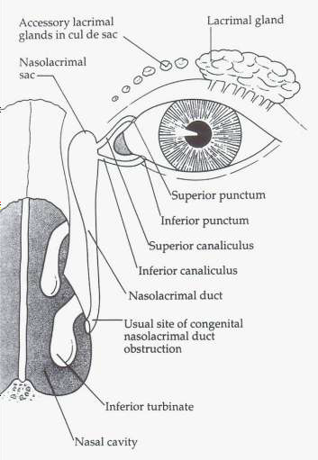
Blocked Nasolacrimal Duct
⌘ Tearing, sticky eye
⌘ Nasolacrimal duct massage

Slide 55


Squints
⌘ Intermittent strabismus may be normal in 1st 3-4mths
⌘ Any misalignment after 4mths considered abnormal
⌘ Divergent squint always abnormal
⌘ Pseudosquint if wide, flat nasal bridge

Slide 56

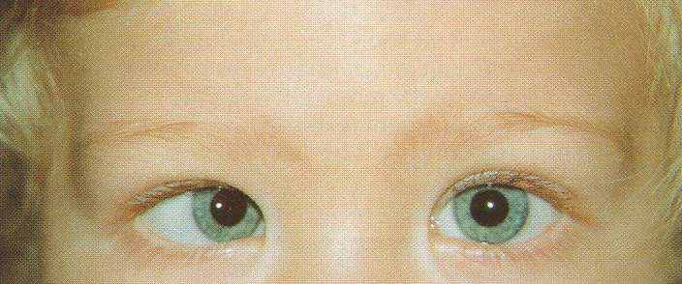
Squints
⌘ Hirschberg corneal reflex test

Slide 57



Ear

Slide 58


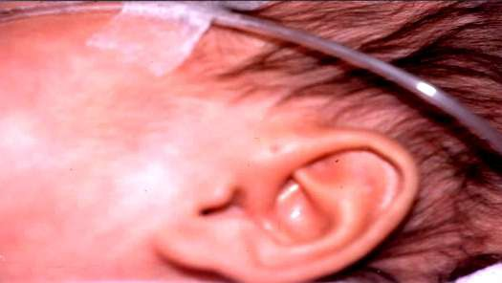
Preauricular Sinus
⌘ Common
⌘ Remnant of 1st branchial cleft
⌘ From anterior end of upper helix of pinna, runs downwards &
forwards, towards the cheek, for
5-10mm

Slide 59
Preauricular Sinus
⌘ Associated with renal hypoplasia, hearing impairment
(Branchio-oto-renal [BOR] syndrome)
Rx
⍓ Surgery only if discharging, infection, preauricular abscess

Slide 60



Preauricular Skin Tag
⌘ Isolated
⍓Cosmetic
⍓ Removal

Slide 61
Preauricular Skin Tag
⌘ Associated with other malformations
⍓Cleft lip/palate
⍓ Syndromes: Goldenhar, Treacher-Collins, Nager, etc.

Slide 62



Neck

Slide 63



Torticollis
⌘ Not obvious at birth
⌘ Diagnosed at 1-2mths
⌘ Face turns away from affected side

Slide 64

Torticollis
⌘ Sternomastoid tumour palpable at 3-4wks

Slide 65

Torticollis
⌘ Facial asymmetry, plagiocephaly & amblyopia if left untreated

Slide 66


Torticollis
⌘ Exclude visual impairment as underlying cause
Rx
⍓Physiotherapy for passive stretching
⍓ Sternomastoid release if deformity persists after 1yr

Slide 67



Oral Cavity

Slide 68



Ranula
⌘ Cystic swelling from floor of mouth
⌘ Under the tongue

Slide 69

Ranula
⌘ A mucous cyst related to sublingual salivary gland
⌘ Most disappear spontaneously
⌘ Surgery may be required

Slide 70



Oral Thrush
⌘ White curd-like plaques on orobuccal mucosa, extends to pharynx if severe
⌘ Adherent, difficult to scrape off

Slide 71

Oral Thrush
⌘ May affect feeding
Rx
⍓Miconazole oral gel
⍓ Syrup Nystatin 100 000U qds

Slide 72



Natal Teeth
⌘ Erupted teeth at birth
⌘ Usually lower incisors
(c.f. Neonatal teeth: Erupt during 1st mth)

Slide 73

Natal Teeth
⌘ Predeciduous teeth (1/4000 births)
⍓Usually loose
⍓ Roots absent or poorly formed
⍓ Removed to avoid aspiration
⌘ True deciduous teeth (1/2000 births)
⍓True teeth that erupt early
⍓ Should not be extracted

Slide 74


Facial Nerve Palsy
⌘ Birth trauma
⌘ Lower motor neuron lesion
⌘ Varying severity
⌘ Difficulty with sucking, drooling of feed on affected side
⌘ Most resolve spontaneously within weeks

Slide 75




Facial Nerve Palsy

Slide 76



Umbilical Cord

Slide 77



Umbilical Cord
⌘ Routine care: Clean with alcohol to base of cord (where it attaches to skin), exposure to air to help dry cord

Slide 78

Umbilical Cord
⌘ Usually separates within 1wk after birth (mean 7-14dys)
⌘ Delayed separation (> 14dys)
⍓Neutrophil function/chemotactic defects
⍓ Bacterial infection

Slide 79



Umbilical Sepsis
⌘ Periumbilical erythema & induration
⌘ Purulent discharge

Slide 80
Umbilical Sepsis
⌘ Risk of haematogenous spread, extension to liver, portal vein phlebitis & later portal hypertension
Rx
⍓Prompt parenteral antibacterial therapy

Slide 81



Umbilical Granuloma
⌘ Common
⌘ Granulation tissue at base
⌘ Soft, granular, dull red or pink
⌘ Seropurulent
secretion

Slide 82
Umbilical Granuloma
⌘ Differentiate from gastric/intestinal mucosa
Rx
⍓Cauterisation with silver nitrate
⍓ Repeat at intervals of several dys until base is dry

Slide 83



Umbilical Polyp
⌘ Rare
⌘ Remnant of vitelline duct or urachus
⌘ Firm & bright red (intestinal or urinary tract mucosa)

Slide 84

Umbilical Polyp
⌘ Mucoid secretion, faecal material or urine
Rx
⍓ Surgical excision of entire VI or urachal remnant

Slide 85



Umbilical Hernia
⌘ Imperfect closure or weakness of umbilical ring
⌘ Soft, skin-coloured swelling that protrudes during crying, coughing or straining
⌘ Easily reduced

Slide 86


Umbilical Hernia
⌘ Most disappear spontaneously by 1-2yrs
⌘ 80% close spontaneously by 3-4yrs
⌘ Risk of incarceration exceedingly low
⌘ Surgery rarely indicated
⍓Persists at 3-4yrs
⍓ Becomes strangulated

Slide 87



Spine

Slide 88



Spinal Dysraphism
⌘ Lumbosacral region
⍓ Skin dimple/sinus tract
⍓ Hairy patch
⍓Pigmented naevus
⍓ Haemangioma
⍓Lipoma
⌘ Ultrasound spine

Slide 89




Hormonal Withdrawal

Slide 90



Hormonal Withdrawal
⌘ Vaginal discharge (thick, mucous)

Slide 91

Hormonal Withdrawal
⌘ Gynaecomastia

Slide 92

Hormonal Withdrawal
⌘ Milk production (‘witch’s milk’)

Slide 93
Hormonal Withdrawal
⌘ Bleeding PV (pseudomenses)
⌘ Reassure parents

Slide 94



Groin

Slide 95



Hydrocele
⌘ Common in newborn
⌘ Transilluminant, painless, palpate above swelling
⌘ Resolve spontaneously in mths
Rx
⍓ Surgery if persists after 1-2yrs

Slide 96



Inguinal Hernia
⌘ Scrotal/groin mass which fluctuates in size
⌘ Obvious during crying & straining
⌘ Reducible
Rx
⍓ Bilateral herniorraphy
⍓ Risk of strangulation

Slide 97



Undescended Testis
⌘ May be incompletely descended or ectopic
Rx
⍓ Orchidopexy before 1yr
⍓Testicular cancer

Slide 98



Phimosis
⌘ Physiological in infancy
⌘ 90% under 3yrs have phimosis
⌘ Slowly resolves in childhood

Slide 99



Hypospadias
⌘ Urethra opens on ventral aspect of penis

Slide 100

Hypospadias
⌘ Usually associated with chordee (ventral shortening) causing ventral bend in shaft
⌘ Absolute contraindication to circumcision

Slide 101



Feet

Slide 102


Congenital Talipes Equinovarus
⌘ Postural
⍓ Inutero positioning
⍓Passive stretching
⌘ Structural
⍓Not easily correctable
⍓ Orthopaedic surgeon for serial casting

Slide 103


Congenital Talipes Equinovarus

Slide 104

Congenital Talipes Calcaneovalgus

Slide 105



Jaundice

Slide 106


Neonatal Jaundice
Common Causes
⌘ Physiologic
⌘ Haemolytic
⍓ ABO/Rh incompatibility
⍓G6PD deficiency
⌘ Breastmilk jaundice
⌘ Breastfeeding jaundice

Slide 107


Physiologic Jaundice
⌘ Appears around D2-3
⌘ Peaks around D4-5
⌘ Falls after D5-7

Slide 108
Neonatal Jaundice
Management
⌘ Adequate fluid intake
⌘ Phototherapy
⍓Criteria dependent on birthweight, postnatal age & presence of haemolysis

Slide 109
Neonatal Jaundice
Sunning
⌘ Not recommended
⌘ Not effective
⌘ Risk of dehydration & sunburn

Slide 110

Prolonged Neonatal Jaundice
Jaundice beyond
⌘ 14dys in term baby
⌘ 21dys in preterm baby

Slide 111
Prolonged Neonatal Jaundice
Some Causes
⌘ Breastmilk jaundice
⌘ Hypothyroidism
⌘ Urinary tract infection
⌘ Biliary atresia
⌘ Neonatal hepatitis

Slide 112
Prolonged Neonatal Jaundice
Investigations
⌘ Liver function test
⍓Total & direct bilirubin
⌘ Urine FEME & culture
⌘ Thyroid function test

Slide 113


Breastfeeding Jaundice
⌘ ‘Breast-nonfeeding’ or ‘starvation jaundice’
⌘ Early onset, exaggeration of early jaundice with higher SB in 1st 5dys
⌘ Due to inadequate frequency of breastfeeding & insufficient caloric intake which enhances bilirubin absorption

Slide 114


Breastmilk Jaundice
⌘ Late onset
⌘ Prolongation of physiologic jaundice, SB continues to rise from D5
⌘ Levels stay elevated, then fall slowly, returning to normal by 4-12wks
⌘ In 3rd wk, ~ ¹/₃ full term exclusively breastfed babies will be clinically jaundiced

Slide 115
Breastmilk Jaundice
⌘ Baby is well with good weight gain
⌘ LFT is normal
⌘ If breastfeeding is stopped, SB will fall rapidly in 48hrs
⌘ If resumed, SB may rise a little, if at all, but will not reach previous high level

Slide 116



Pyrexia

Slide 117



Neonatal Pyrexia
Definition
⌘ Temperature
Management
37.5ºC
⌘ Admit for monitoring of temperature
⌘ Investigations
⍓FBC, Blood, Urine, CSF cultures, CXR
⌘ IV antibiotics after cultures taken

Slide 118




Common Parental Concerns

Slide 119


Feeding
Q.Can I feed water to my baby?
⌘ Breastfeeding preferred
⌘ Infant formula
⌘ Only milk till 4-6mths old
⌘ No water or other food/drinks
⌘ Wean from 4-6mths

Slide 120

Feeding
Q.Should I Wake baby up for a feed?
⌘ During the 1st mth
⍓ Should be fed at least every 3-4hrs
⍓ If baby sleeps longer than 4-5hrs & starts missing feeds, wake baby up to feed

Slide 121

Burping
⌘ Q.My baby takes very long to burp or doesn't burp easily?
⌘ Babies do not always need to burp after feeding
⌘ Unnecessary to persist if baby doesn’t burp after a 20 minutes
⌘ Breastfed babies swallow less air

Slide 122


Weight Gain
Q. Is my baby’s weight gain is adequate?
⌘ Full term baby lose 6-10% BW (water)
⌘ Regain BW by 7-10dys
⌘ By 1mth, gain ~ 1kg
⌘ Subsequently,
⍓ 20g/dy till 5mth
⍓ 15g/dy from 5-12mth
⌘ Double BW by 4-5mth, triple BW by 1yr

Slide 123



Bowel Movements
Q.Why my baby is passing green stool?
⌘ Meconium
⍓ 1st 48hrs
⍓ Sticky, thick dark-green or black
⍓ Odourless
⍓Mucus, epithelial debris & bile

Slide 124


Bowel Movements
⌘ Transitional Stools
⍓With onset of feeding, stools gradually change colour & consistency
⍓ Softer, greenish

Slide 125

Bowel Movements
⌘ Breastfed
⍓ Bright yellow, loose, seed-like particles

Slide 126
Bowel Movements
⌘ Formula fed
⍓Tan or yellow
⍓Firmer than breastfed stools

Slide 127
Bowel Movements
⌘ First few weeks, stool 2-6 times/dy; breastfed more frequently than formula fed
⌘ Change in bowel movements with time
⌘ Stools become more solid
⍓ Intestines hold more & absorb greater amount nutrients from milk
⌘ Gastrocolic reflex diminishes & no longer BO after each feed

Slide 128
Bowel Movements
⌘ Infrequent stools not a sign of constipation as long as stools soft (no firmer than peanut butter), baby otherwise well, gaining weight & feeding normally
⌘ Frequency varies from baby to baby

Slide 129
Bowel Movements
Breastfed
⌘ After 6wks, some have only 1 BO/wk
Formula fed
⌘ Some stool once in 2-3dys

Slide 130
Bowel Movements
⌘ Babies less than 6mths commonly grunt, groan, push, strain, draw up legs & become flushed in face during bowel movements
⌘ This is not constipation

Slide 131


Constipation
Constipated stools
⌘ Hard, dry
Consider
⌘ Hypothyroidism
⌘ Hirshsprung disease

Slide 132



Crying
⌘ Normal to be tense, angry & red- faced when crying
⌘ Normal to drawing up legs & flex arms, tense
abdomen

Slide 133


Crying
Causes
⌘ Hunger
⌘ Soiled diaper
⌘ Too hot or cold
⌘ Tired or overstimulated
⌘ Reaction to mum’s mood
⌘ Unwell

Slide 134


Colic
⌘ Unexplained bouts of crying
⌘ Suddenly cry inconsolably, often screaming, face flushed, abdomen distended & tense, legs drawn up & momentarily extended, hands clenched, pass flatus
⌘ Usually last 1-2hrs, late afternoon or evening

Slide 135
Colic
⌘ Usually begins from 2-4wks & stops by 3mths
⌘ Cause: Uncertain
⌘ Reassure parents if baby otherwise well & fine in between crying

Slide 136
Colic
Rx
⍓Exclude medical cause
⍓ Identify possible allergenic food in infant’s or nursing mum’s diet
⍓ Hold & soothe baby, prone across lap & rub back, swaddle
⍓ Improve feeding techniques
⌧Burping, avoid under & overfeeding
⌧Colic drops
⌧“I Love u’ Massage

Slide 137


Nasal Stuffiness
⌘ Relatively narrow nasal passages
⌘ No need to clean out nostrils with cotton bud
⌘ Especially noticeable at night, when it is quiet
⌘ Reassure parents if
⍓ It is not affecting feeding
⍓ Baby is otherwise well

Slide 138


Phlegm
⌘ Exclude upper/lower respiratory tract infection
⌘ Pooling of saliva & secretions in oropharynx

Slide 139


Cough
⌘ Occasional cough may be associated with choking/feeding
⌘ Exclude bronchiolitis

Slide 140


Nasal Stuffiness, Phlegm & Cough
If otherwise well,
⌘ Reassure parents
⌘ Medication unnecessary
⌘ Avoid sedating cough mixtures in 1st 6mths, especially in exprem

Slide 141


