Slide 1
DENGUE IN CHILDREN
DR. PRASHANT MODI
ASSOCIATE PROFESSOR
DEPARTMENT OF PAEDIATRICS
SBKS MIRC

Slide 2
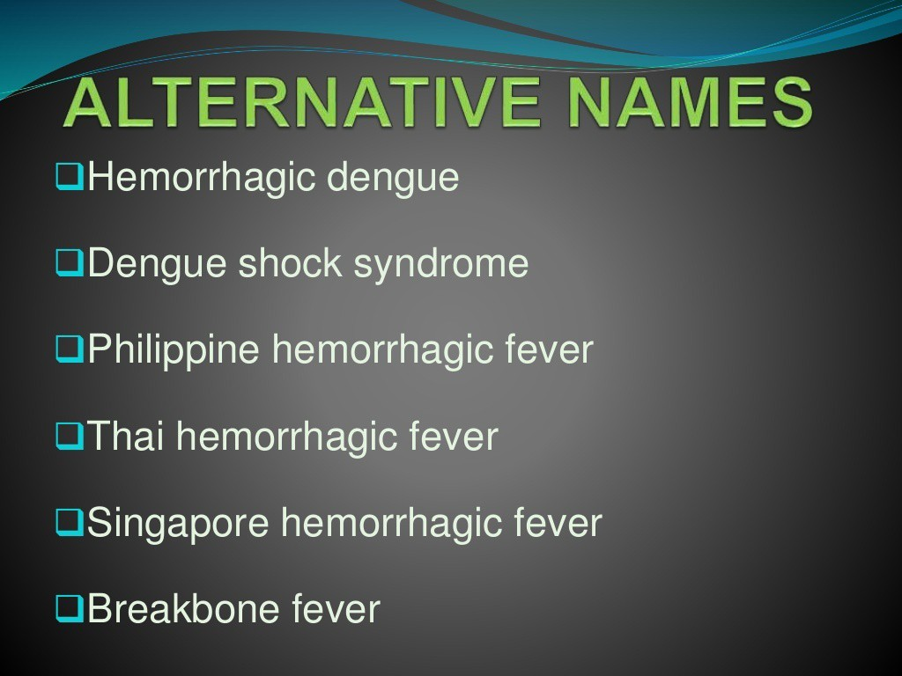

Slide 3

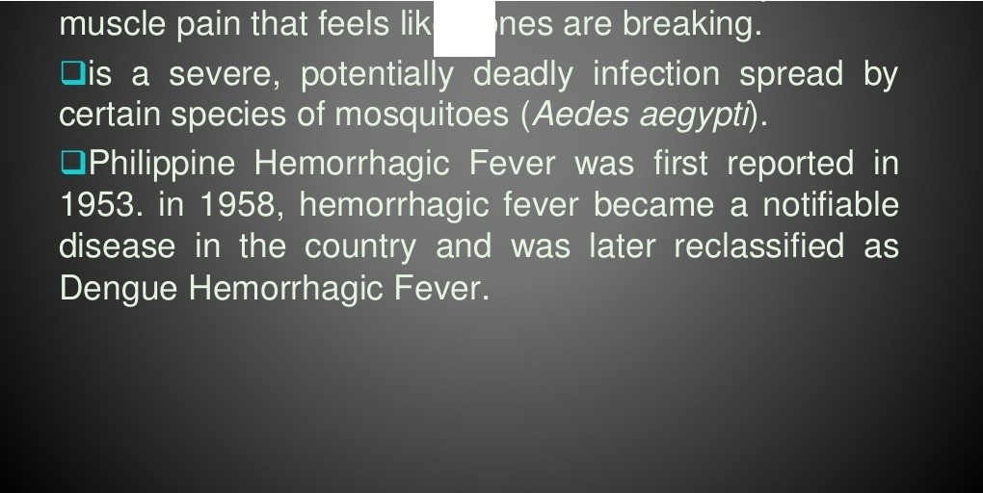
.....

Slide 4


Slide 5
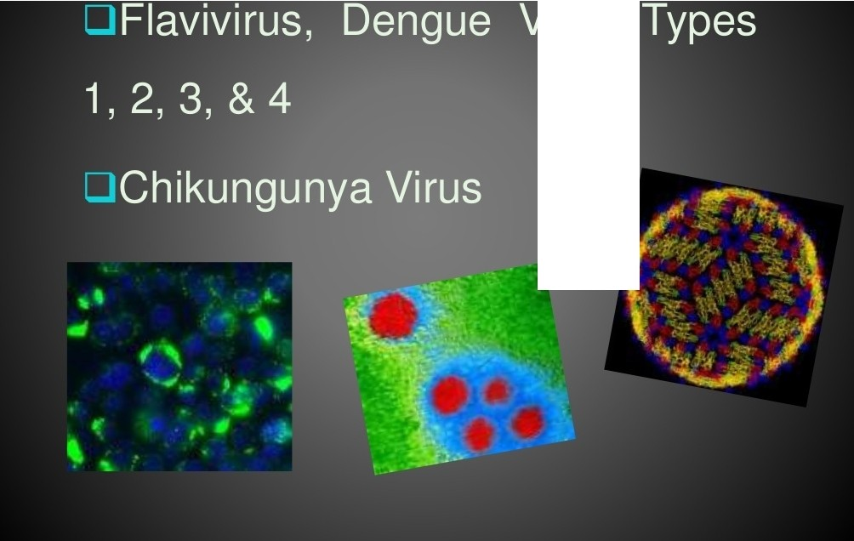
Virus

Slide 6


Slide 7
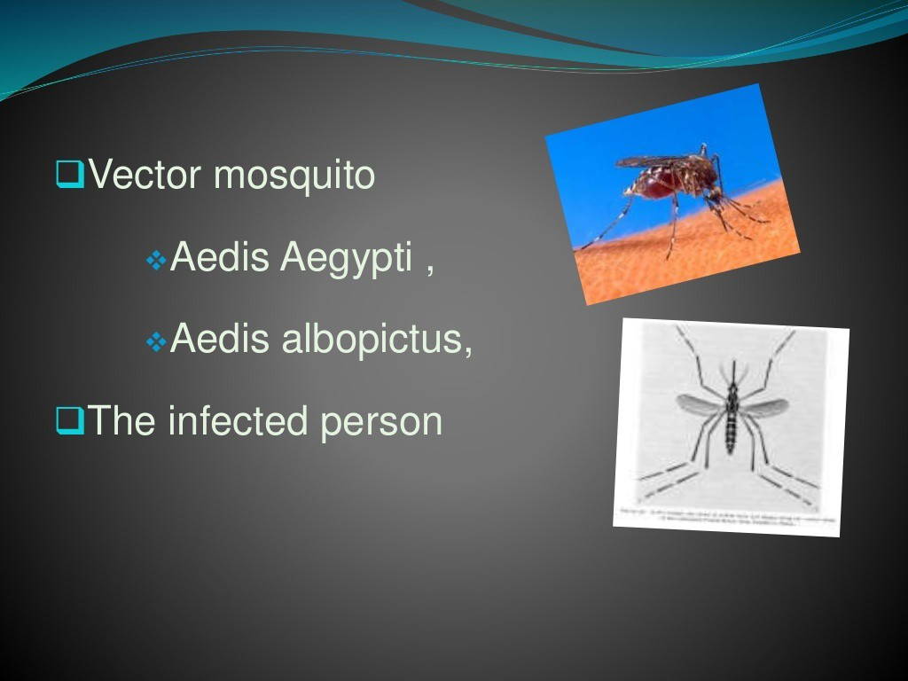

Slide 8
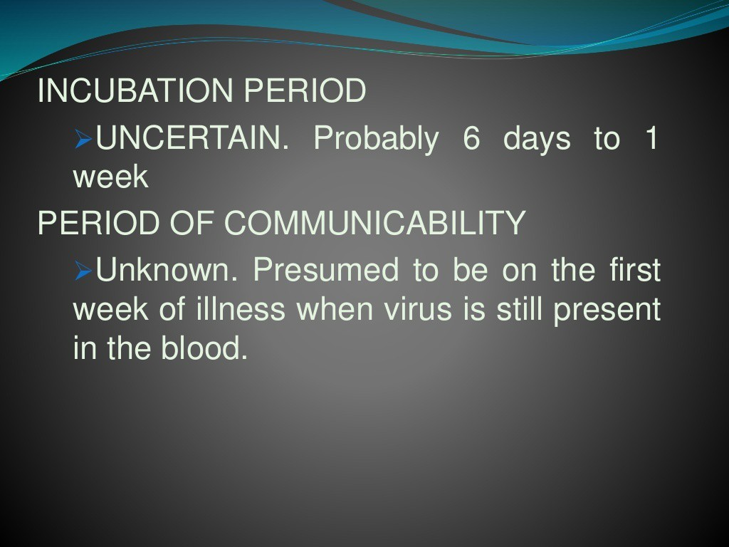

Slide 9

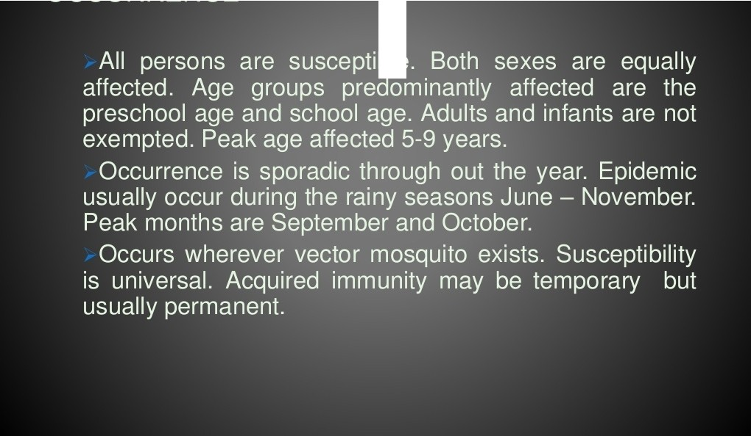
••

Slide 10

Pathophysiology
Two main pathophysiological changes in dengue
increase in vascular permeability
pasma from vascular compartment hemoconcentration , low pulse pressure, shock
loss of
Disorder in hemostasis
vascular changes,
thrombocytopenia , coagulopathy

Slide 11
PATHOPHYSIOLOGY
Predisposing
-Geographlcat area - tropical Islands In theP acific (Ph ili p p ine s) andA.sia
P reepl l taUng
-Environmental conditions (open spaces
w11h water pots. and plants)
-lmmunocompron,lse
-Mosquito carrying csengue virus
-SOk:lier
-sw eaty skin
l
IB i t e o f a vlrus carrying aedes mosquit o
.1
I
I
Rednt!SS & kc;hlness
in the •.e.a
I | Mosq uito | inject | fl uid | t o vid | im' | s skin
I I
Vhv s entersb lood stream
l
lnfe-cst cell andg enerat e ceHula,, esponse
.I.
ln1t tate..s i.m m u n e respons.e.(st 1n1 u l a t es
r el e a s e of cyt o k i n es )
_,_
Cytoklnesd estr-ovs cell membrane and cell wall
(viral anug ens found In monocyte.s)
l
Dengue.inf ecti on
an-or-exia
I h ep a t o m eg;;,ly I
th romb o cyt op en ia
h e,n o r-r h a-gjc
manif llM'l.-at i o n s
/
I n cr e a se d v a scu l a r-
permeab. ifity
I
I
!
PosiUve
t o u rn i qu et te:n
G)
( A )
( C) ( 0
)

Slide 12






.a_- I
.- - -
- - - -
- Ll
_...__ _ ._ ._
t
_ _ _... ,_
I
-
I
•
r
S tl'l.._,.• of
PirCMlwc:T d
I
-- T.,_
'""-"-•-Cc!'l!'IPCi.k.•M"ld''°''
t
°""NV
•" ..,
1
Ur
-...,.;c-
= 1----
I
......._..._.... ........
I
- •-=-ti
M 4Jd I .,. -cell:&:
" t
6<fPl)h,<- ,.,.
,,. ,..
<,plbrw: o,
ri g
....-..-c T
'--- - -
---- _.i
-
-­
.- ca•1J.C'l• d M ­•
­
..--
« rud , •
., , -c:.a.::­
y e...,.
.,,t.c,...,,.,,.....-.d
r:;ir"I 1Q"t>Of'\ In
tt:,-d.ocJ,t
.wtac,opft•.a••
t.-JJI ill •..IIOt"II -n
<
l
•
N r o,n,..lft
I I D
lc C-
1
l
l
--...-...
••-..oQ-• o........,_,...,
......-.'°'"
.IS .,,,b .._,....
h&l<YDC>CIIJiK
,nf
-pr ,ct::,.1'111D:)
S ■t ets -- • • • • r,r,;
dw,,t:IIC'.!Clicl
.. lf'N y.k. l JI. 2.ll......
II..·lll 'I. 10. IL I '.I.IL ...
TGF c=c• C-M<:9 t
.._-
CCUVEGF:HO
-.
,,. - ... o11
Jl...c.._:-.--..:,. - ·...I..
.. ._._ flf'Md laW-..
I

Slide 13


Slide 14
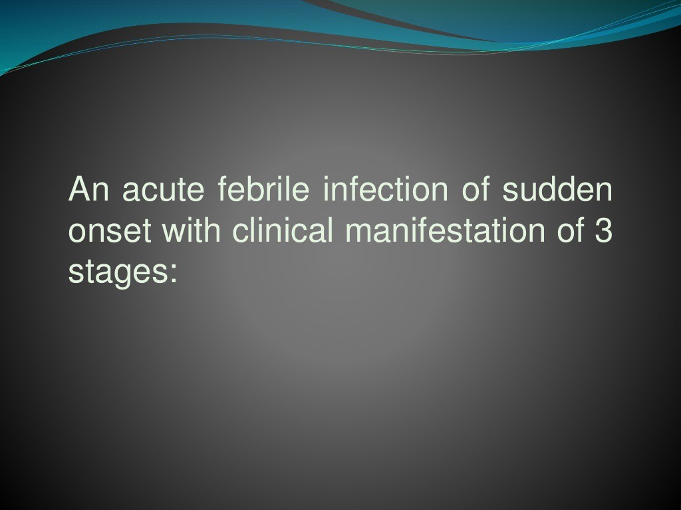

Slide 15

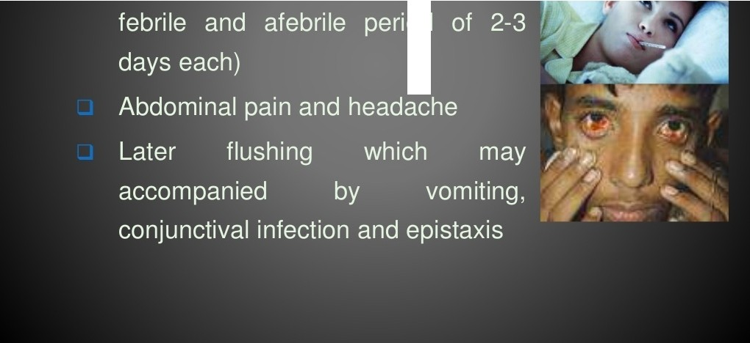
••

Slide 16
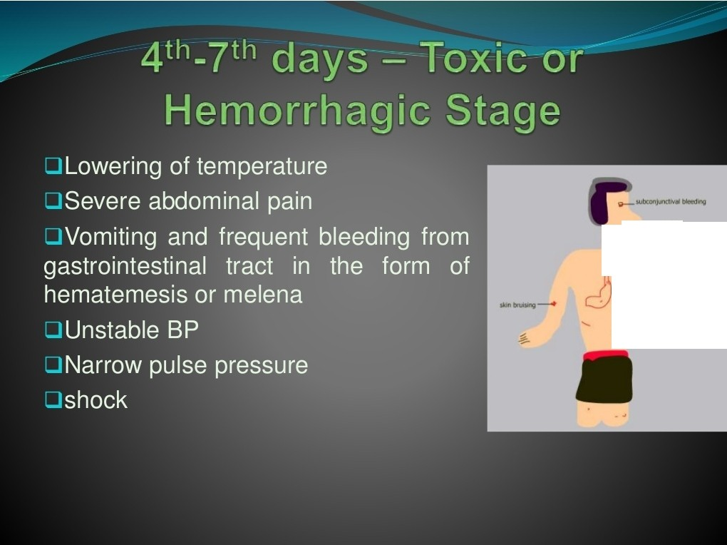

i.......
Ii
'atH,. "OM\ ffl,f
bOCfltbt.lnetlfacl
'

Slide 17
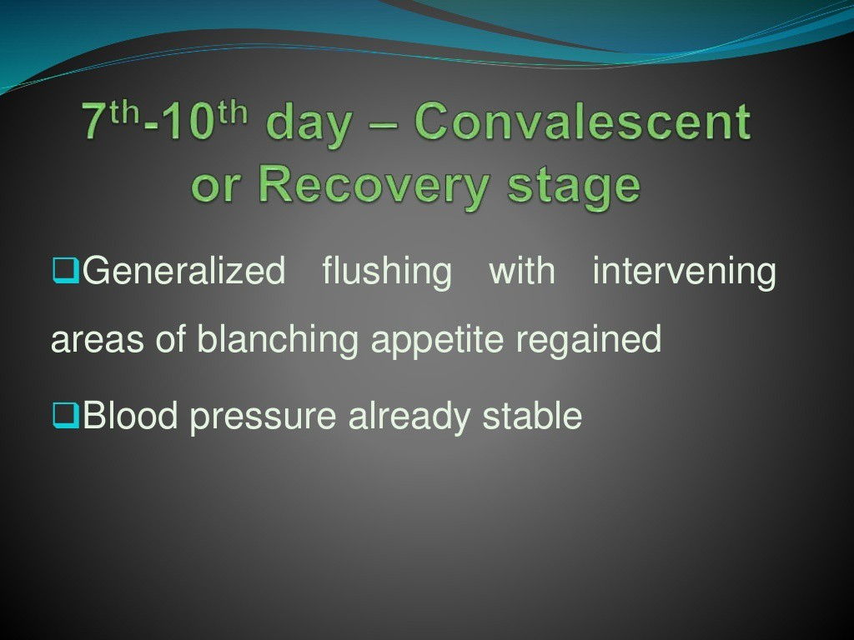

Slide 18





Days of illness
1 2
-j
I
I I
4 5
'6
7 8 9 10
I I I I
40°c
Temperature
I shock
I
I reabsorption
I
I fluid overload
dehydration
1
bleeding
1
1 organ
Potential clinical i•ssues
1 impairment 1
I I
I
-'
I
I
'
platelets
Laboratory changes
' \
hematocrit
- - -
I I I I
viraemia
,,, ...
lgG/lgM
Serology and virology
/ '
I
/ '
'
I
I I
/
'
/
Phases of i11ness
Febrile
Critical
Recovery

Slide 19


Slide 20
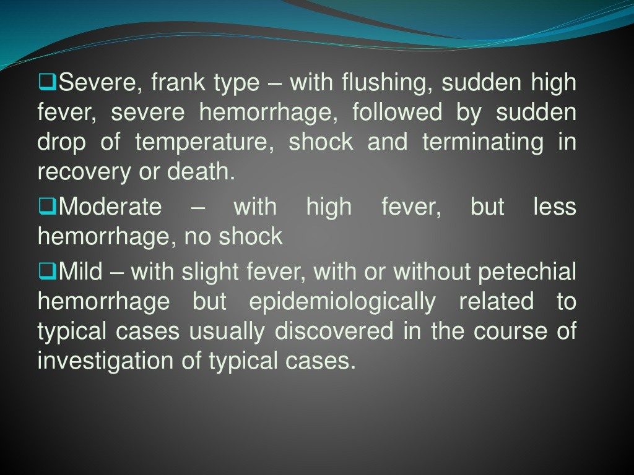

Slide 21
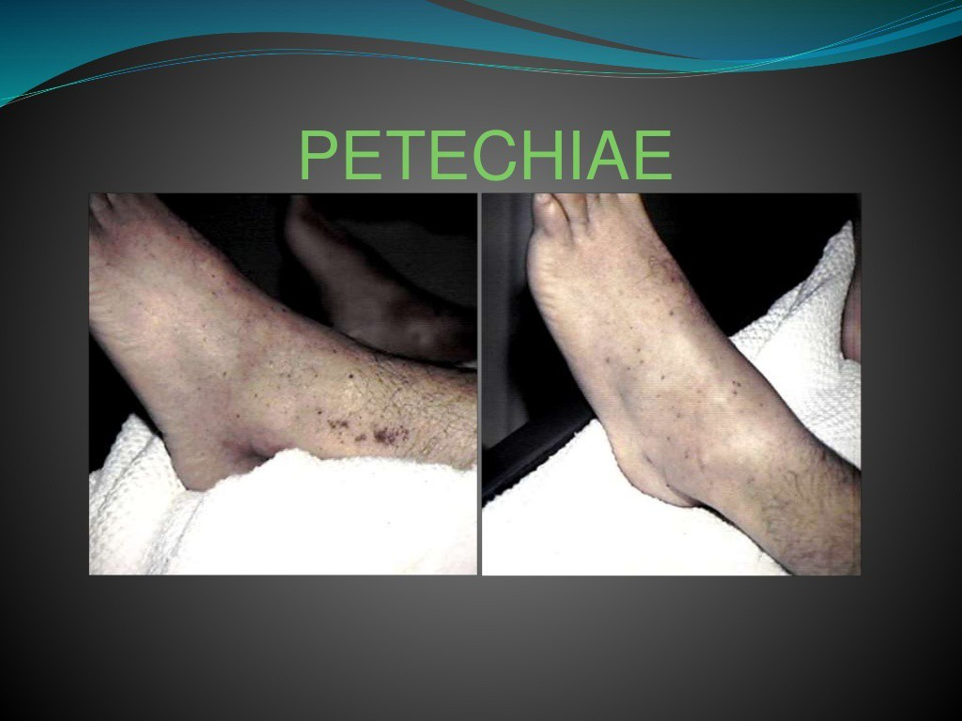

Slide 22
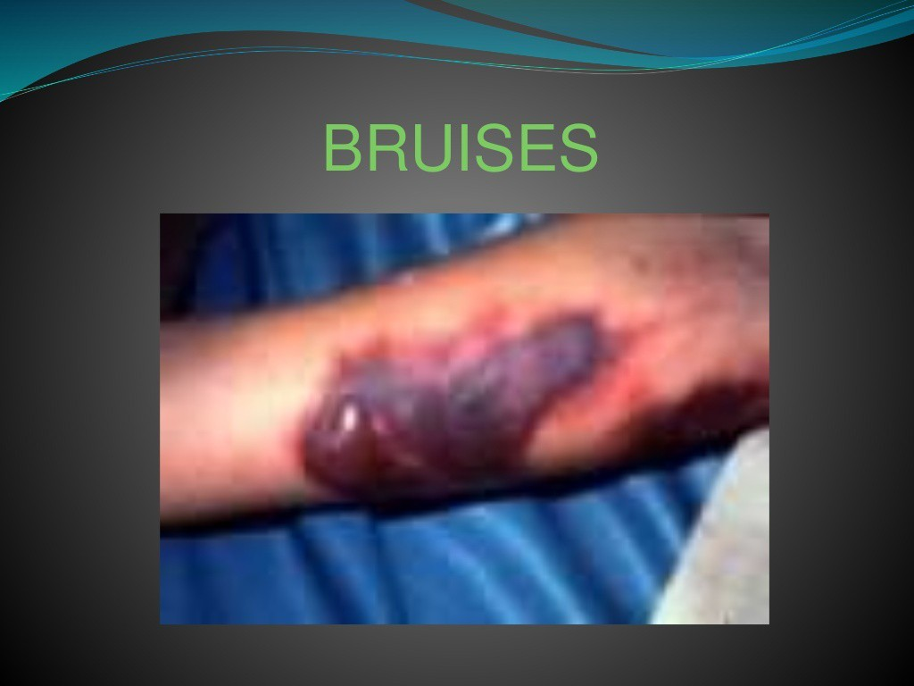

Slide 23
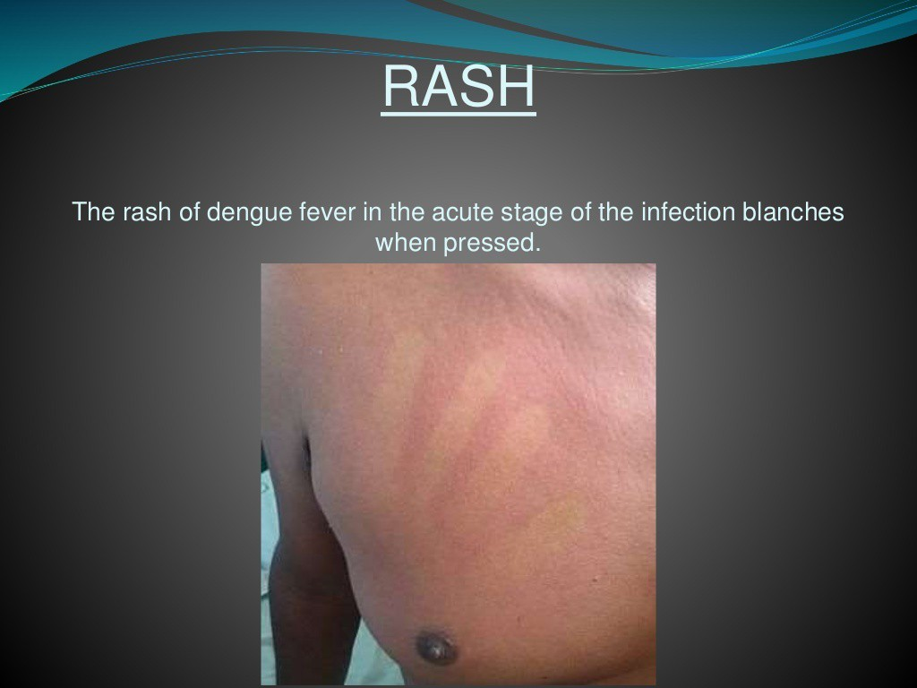

Slide 24


Slide 25
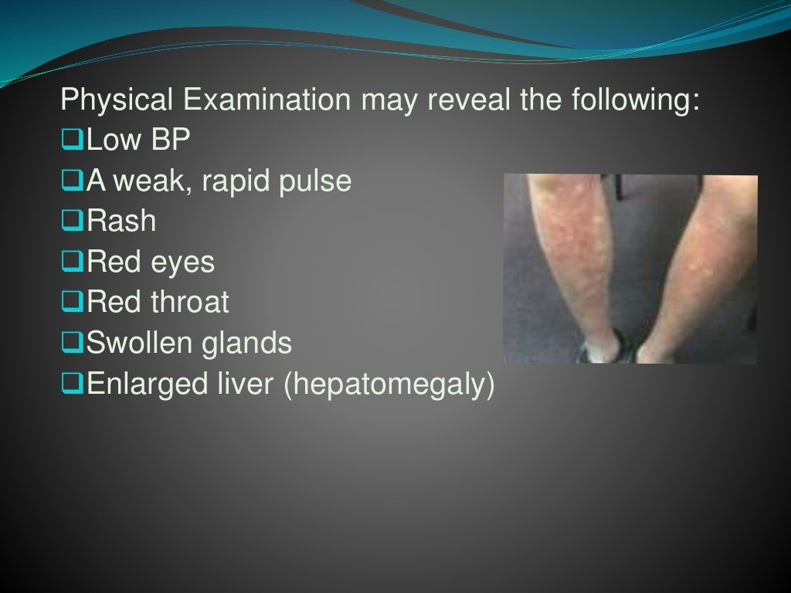

Slide 26
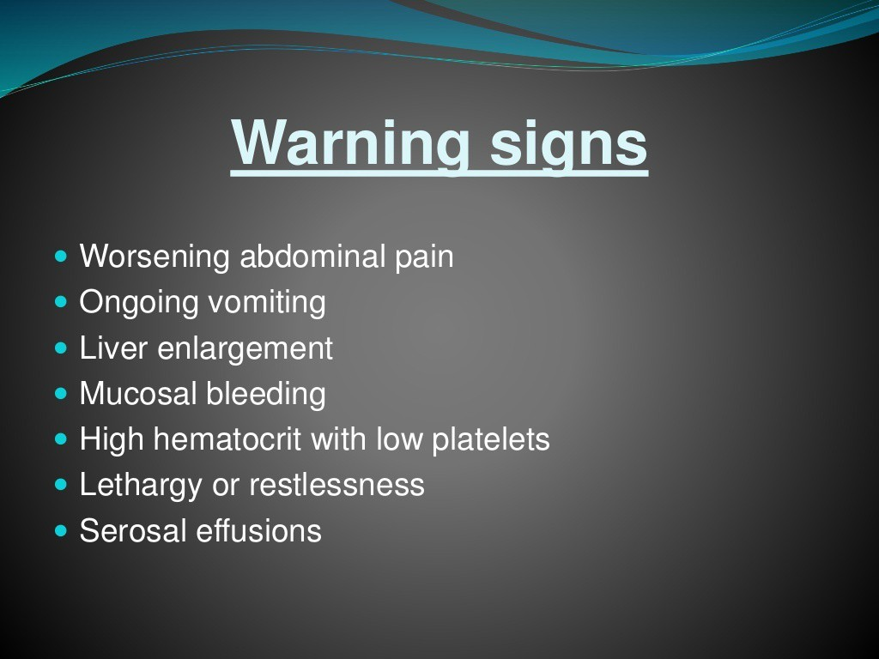

Slide 27
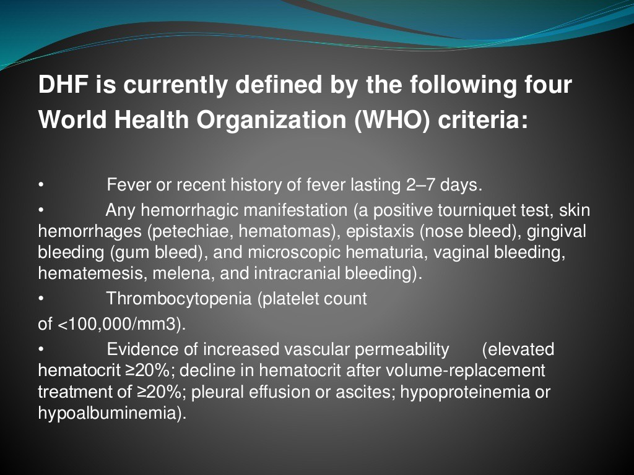

Slide 28
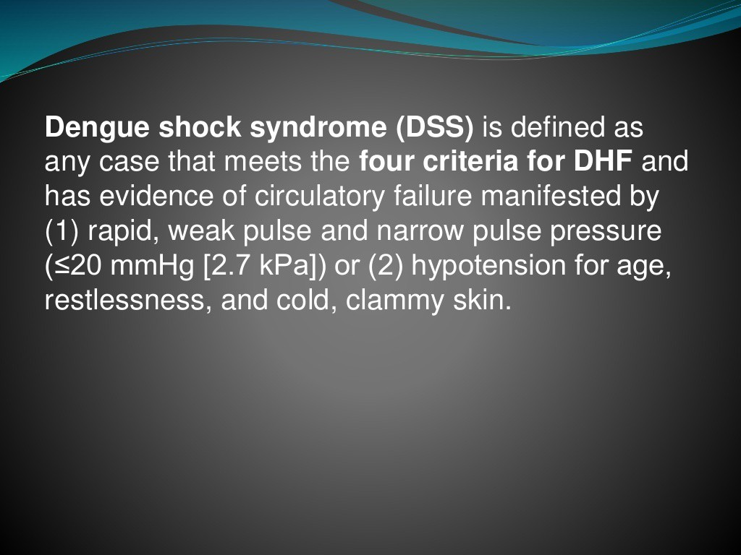

Slide 29
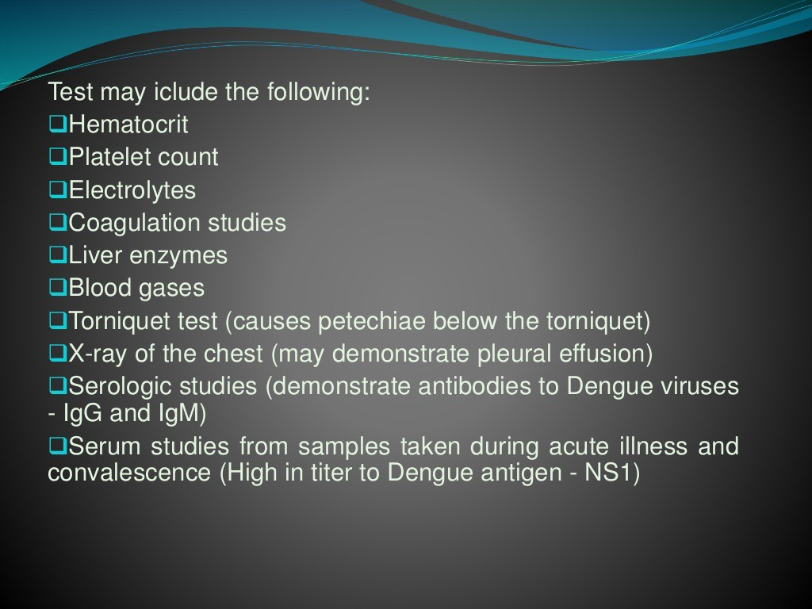

Slide 30


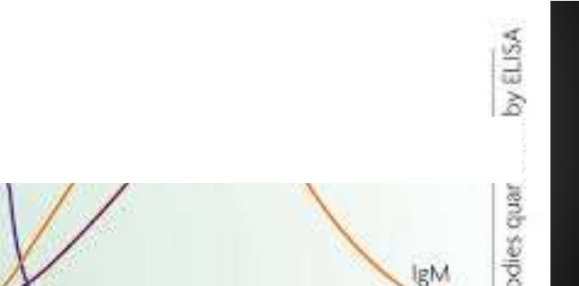



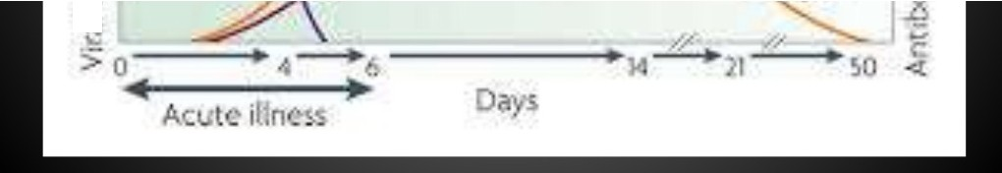
_..
a...
lSi
•
lg•:-:
', )
:
•
-
•...
l
-
\ ¹1ra c r'r 1
-₋
,.
Y.

Slide 31
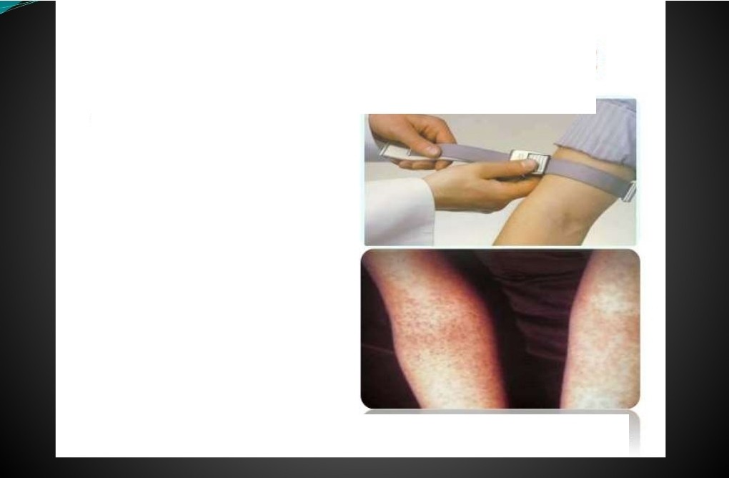
How to do a Tourniquet test
The tourniquet test is performed by inflating a blood pressure cuff to a point mid-way between the systolic and diastolic pressures for five minutes. A test is considered positive when 10 or more petechiae per 2.5 cm2 (1 inch) are observed. In DHF, the test usually gives a definite positive result (i.e. >20 petechiae). The test may be negative or mildly positive during the phase of profound shock.
o,.1v
oMD
2&

Slide 32


Slide 33
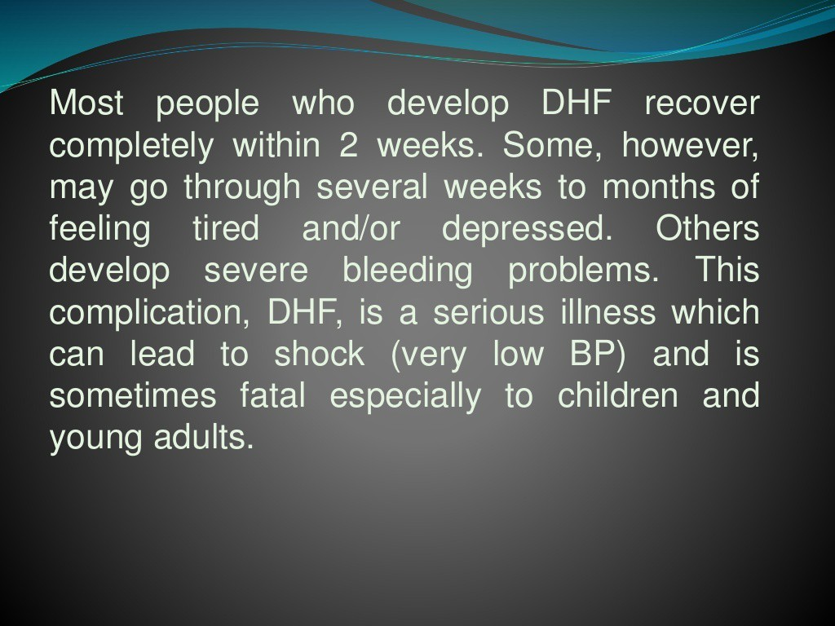

Slide 34
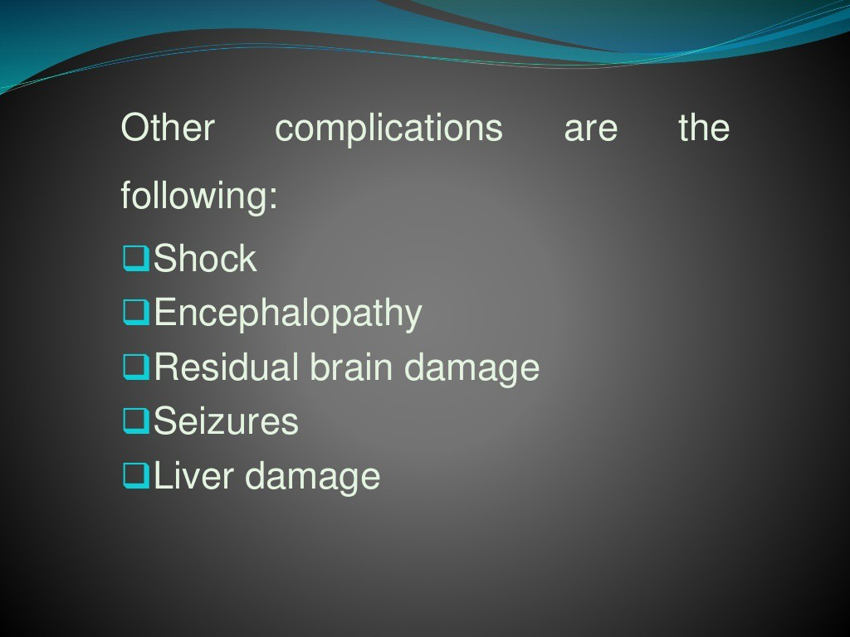

Slide 35


Slide 36
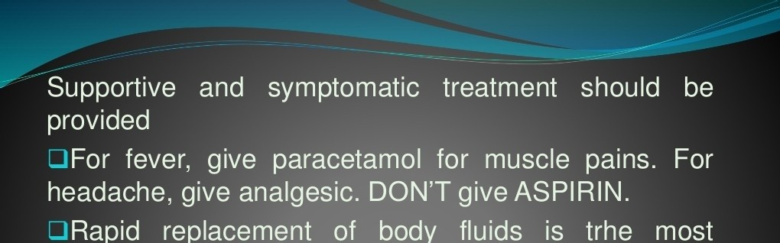
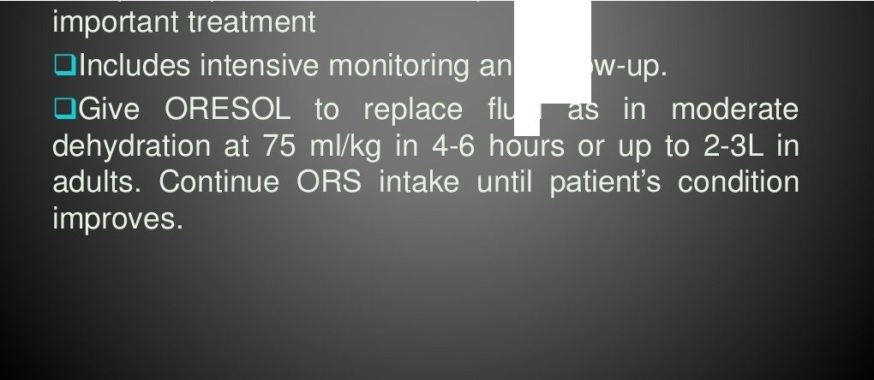
• • •
•

Slide 37

DHF Grades I rind II
H l>ffnOrrhogic (bleeding) 'te!n dencies,
Thrtw•-.1 IOJ'C'"'la.
H -. n .01.0Crll wkau. P>o11S4> ..,. .. ..... un:> • u
I
lni tb te IV ThempyS n, lfkghl r
Crystalloid olu t io n fo r 1· 2 h ro
I
i
Nol t
J.
R u CILIOO IV 3 rl ) lil< Ql' ll
l l) C QQS(lo I V l O n11.11<g,n
6 -lrnr..
Ollc;;ld d urati o n
C OIIOl<l Cl r o t lo n 2 nn .
I
Fu nhor
I
N o •m p r,o.V01n o nt
I
In•P"'""""•-- ••
Uns.ub lQ Vl ui l s1gn..
l,
i
D co , , n r""lu .:l rv
.-,n...- 2 4 .,,.,
r.tectuce IV to
(l "' tllc:c,/11
C,Y5t4 IIOICIWltn
n11lh er l t"<ll Cl.lon
ro 3 m1JJ<gm .
a tsc c- n u n u o <1r to r
H oe m a tocr it:
Ri M>'S
H.ooem .nl Q<:ril
f e lsl
IV C cl lold (DeJ<t ron
B l oo d 1T.-in51u, to n
I O ollikl)/nr
•
24 -48 r,
(40 J I Orn l/k ()l ll r
durouon 1 IT.
d u rotlon 1 t1r.
+
I V 1n cr 3 py o,yc ry; ,:3 110 10 :s
"' o ty
recJu Ge t t1e noi.v rro,n 1 0 tQ IS, G to
3 1 n &Jkg hl - , O IS C Of"ll lll 110 e rr u 1· 2 4--49 l"'"f !i.
l m pr OVPnlQfll: H e rrv,1ocr11 r H Jj Ul$9 r :t @ lll'ldbloodp rE'5)un , ,l l'lb t!Elr. Lr ln Oll tf;)Ul r' l!l:A
No l rnp,ovoMGn t: 3 0 1n a to cr lt or pu 11'0 ra t o rls.05. putl-0 p<'O<Su ro 1./lUs bo l o- v 2 0 n1m H g L2. 7'tcPa) u r tn o o u l!XJl f all s
u miio11 v1t.111 Sl lJf l'i : Unne, ou cpu 1 r,m-s.. •om or sno c K

Slide 38


Slide 39
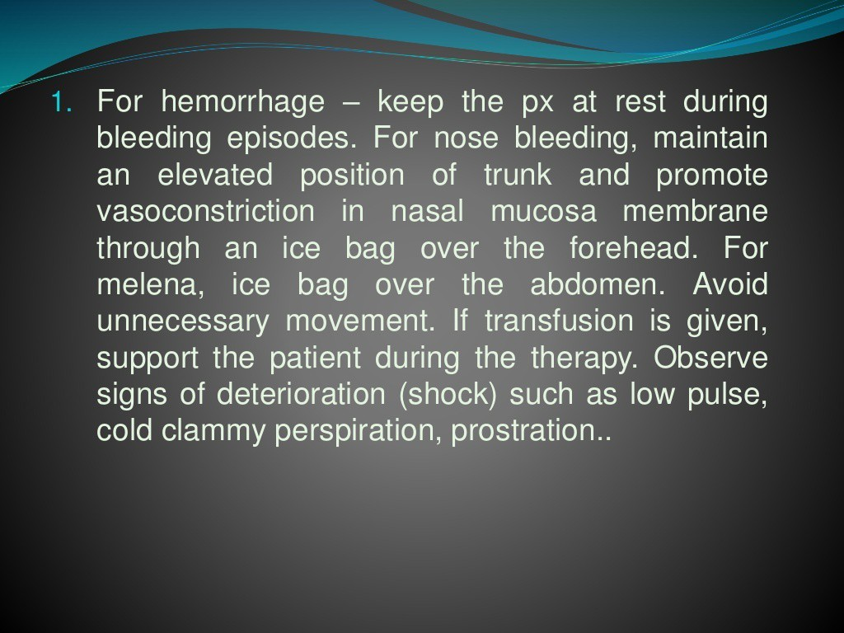

Slide 40

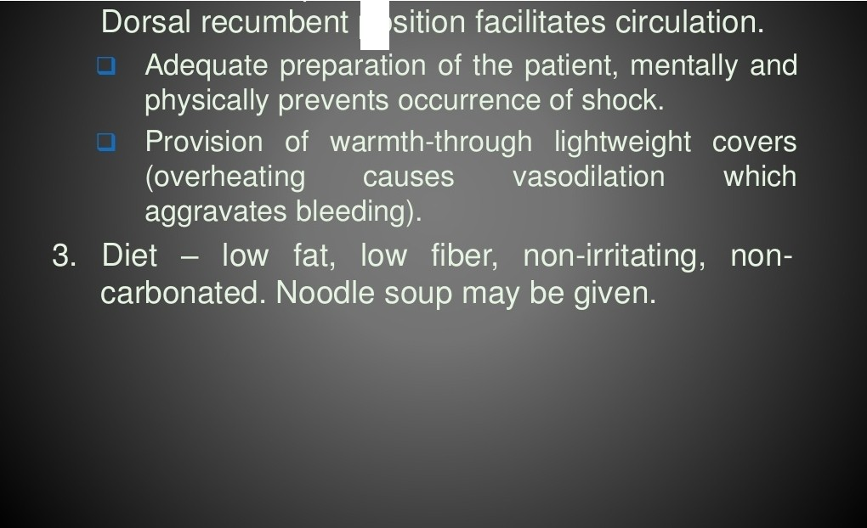
••

Slide 41


