Slide 1
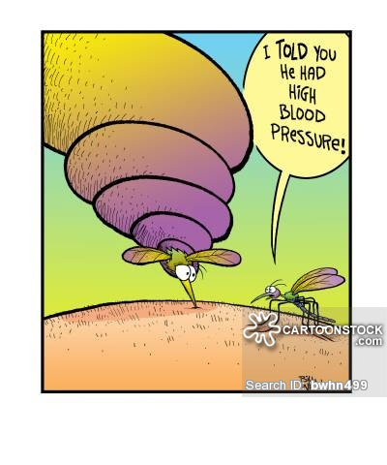
HYPERTENSION
IN CHILDREN
Dr. Sunil Pathak
Assistant professor
SBKS MIRC

Slide 2
FLOW OF DISCUSSION
Significance of childhood hypertension
BP Measurement
Definition of Hypertension
Etio-pathogenesis
Clinical Manifestations
Evaluation
Prevention
Management Guidelines

Slide 3
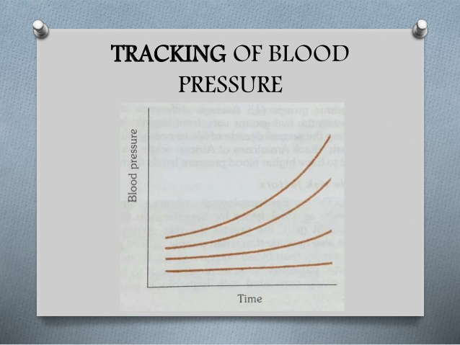
WHY IS IT SIGNIFICANT TO DIAGNOSE?
Primary hypertension during childhood often tracks into adulthood
Children with BP >90th percentile → 2.4-fold greater risk of having hypertension as adults.

Slide 4
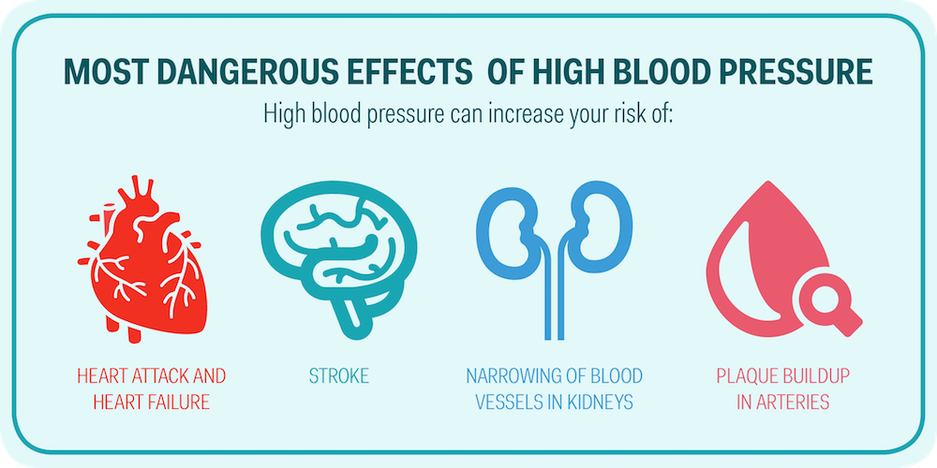
FUTURE RISKS
In adults with hypertension, a 5 mm Hg increase in diastolic blood pressure increased the risk of coronary artery disease by 20% and the risk of stroke by 35%. Furthermore, hypertension is implicated in the etiology of nearly 50% of adults with end-stage renal disease.

Slide 6
PREVALANCE
In infants and young children, systemic hypertension is uncommon, with a prevalence of <1%, but when present, it is often indicative of an underlying disease process (secondary hypertension). Severe and symptomatic hypertension in children is usually caused by secondary hypertension.
The prevalence of primary essential hypertension, mostly in older school-age children and adolescents, has increased in parallel with the obesity epidemic.

Slide 7
WHEN TO DO BP MEASUREMENT?
The NEW guideline recommends annual BP measurement for children ≥3 years and has identified subgroups for more frequent checks:
obese,
on medications known to increase blood pressure,
renal disease,
history of coarctation, or
Diabetes.

Slide 8
WHEN TO DO BP MEASUREMENT?
Children <3 years warrant regular measurements if they have any of the following:
congenital heart disease,
recurrent urinary tract infection,
urological malformation,
solid organ transplant,
bone marrow transplant,
malignancy,
neurofibromatosis,
tuberous sclerosis,
sickle cell disease.

Slide 9
WHEN TO DO BP MEASUREMENT?
Small for gestational age new-borns,
premature(<32weeks), or
very low birth weight babies and
those with umbilical arterial catheterization also require regular checks.

Slide 10
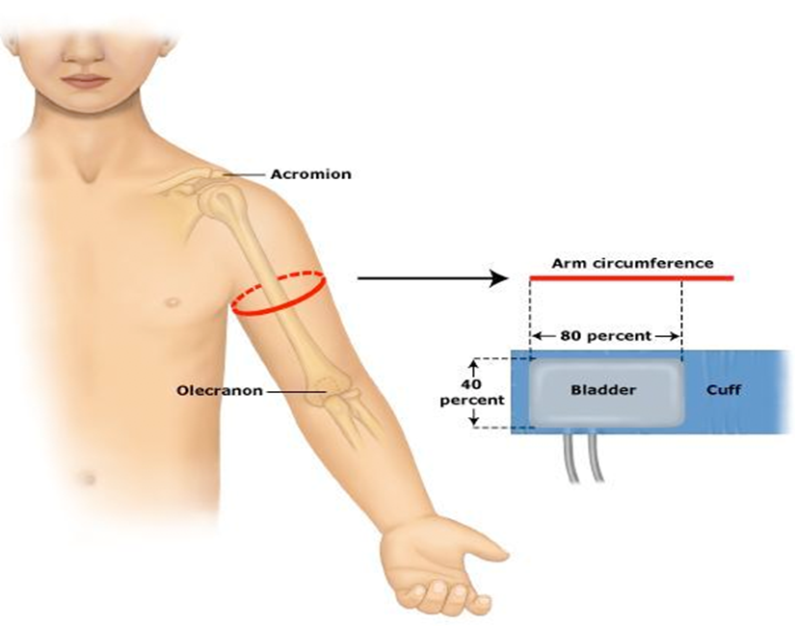
METHOD OF MEASUREMENT
The preferred method is by auscultation and a BP cuff appropriate for the size of the child’s arm should be used.
An appropriate sized cuff has an inflatable bladder that is at least 40% of the arm circumference at a point midway along the upper arm. The inflatable bladder should cover at least two thirds of the upper arm length and 80-100% of its circumference.
A cuff that is too short or narrow artificially increases BP readings.

Slide 11
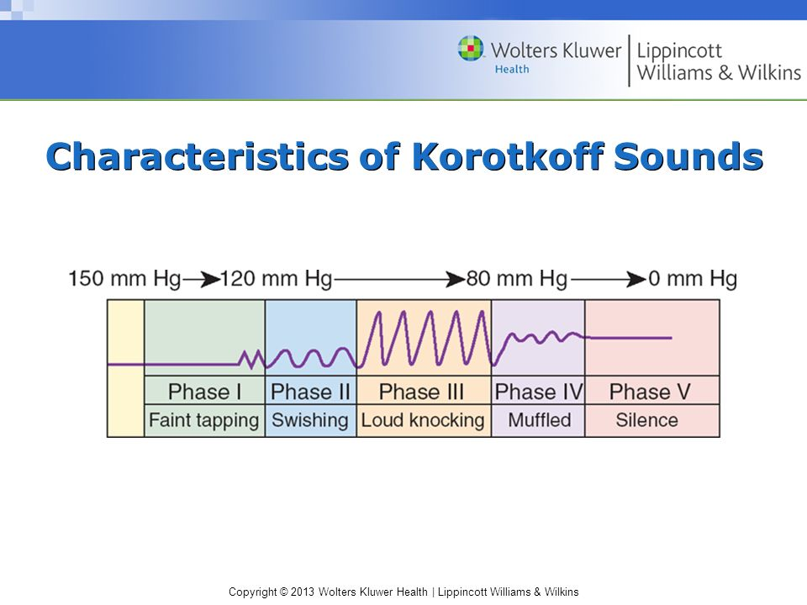
METHOD OF MEASUREMENT
Child should be seated for 3-5 minutes with uncrossed legs in a quiet room. BP should be measured in right arm at the heart level.
Systolic pressure --1st Korotkoff sound.
Diastolic pressure --5th Korotkoff sound.

Slide 12
In case of an initial ‘elevated BP’, two additional readings should be taken in the same visit and its average taken as final record.
In office setting, hypertension should only be diagnosed based on readings on three different occasions.

Slide 13
ABPM(Ambulatory blood pressure monitoring)
Child wears a device that records BP every 20-30 min, throughout the day which allows calculation of the mean daytime BP, sleep BP, and mean BP over 24 hr.
The physician can also determine the proportion of BP measurements that are in the hypertensive range (BP load) and whether there is an appropriate decrease in BP during sleep (nocturnal dip).
BP load – is the % of BP readings exceeding the 95th percentile of normal which is a better measure of the hemodynamic stress.
Mean BP -Average of 24 hrs. record of BP
Sleep decline- Normal nocturnal dipping is 10% of the awake BP. It is lost in hypertensive organ injury/ end stage renal disease / insulin dependent DM.

Slide 14
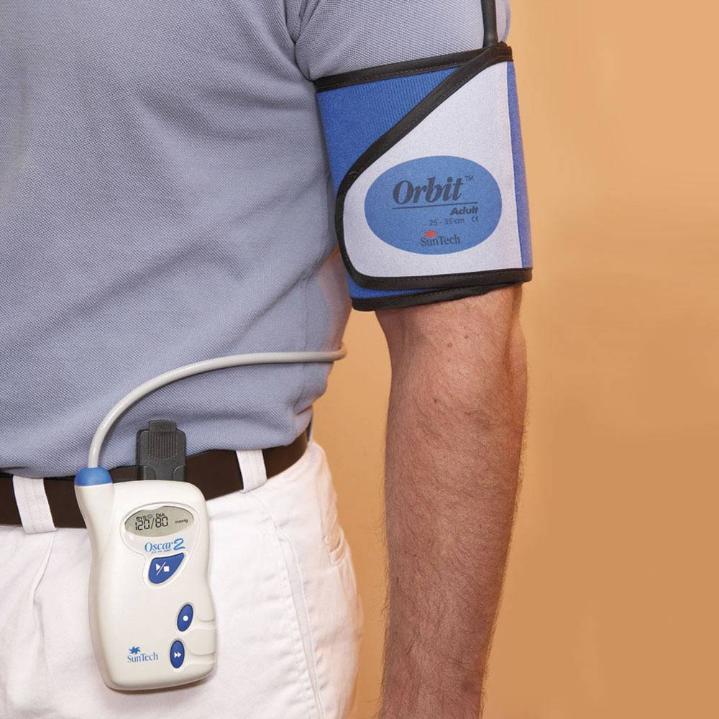
ABPM
Regular use of ABPM was advocated for children with chronic kidney disease (CKD), secondary hypertension, type 1 or 2 diabetes mellitus (DM), obstructive sleep apnea syndrome (OSAS), a history of prematurity, and in children who have undergone solid-organ transplant or coarctation repair.

Slide 15
ABPM
Office blood pressure readings have multiple drawbacks, including chances of missing:
White coat hypertension: Office BP ≥95th percentile but ambulatory BP < 95th percentile with less than 25% BP load
Masked hypertension : office BPs are < 95th percentile but ambulatory BP ≥95th percentile with more than 25% BP load.

Slide 16
ABPM
ABPM should be performed in children more than 5 years of age for confirmation of hypertension if the BP is in the “elevated” category for at least 1 year or with stage 1 hypertension across three clinic visits.

Slide 17
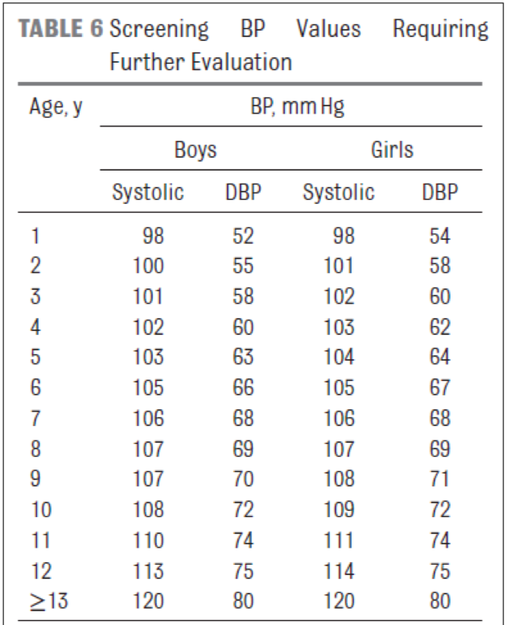

Slide 18
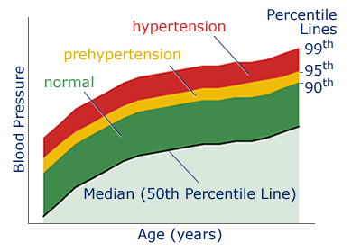
DEFINITION OF HYPERTENSION
The Fourth Report on the Diagnosis, Evaluation, and Treatment of High Blood Pressure in Children and Adolescents, defined hypertension as average systolic blood pressure (SBP) and/or diastolic BP that is ≥95th percentile for age, sex, and height on ≥3 occasions.
Prehypertension = ≥90th percentile but <95th percentile.

Slide 19
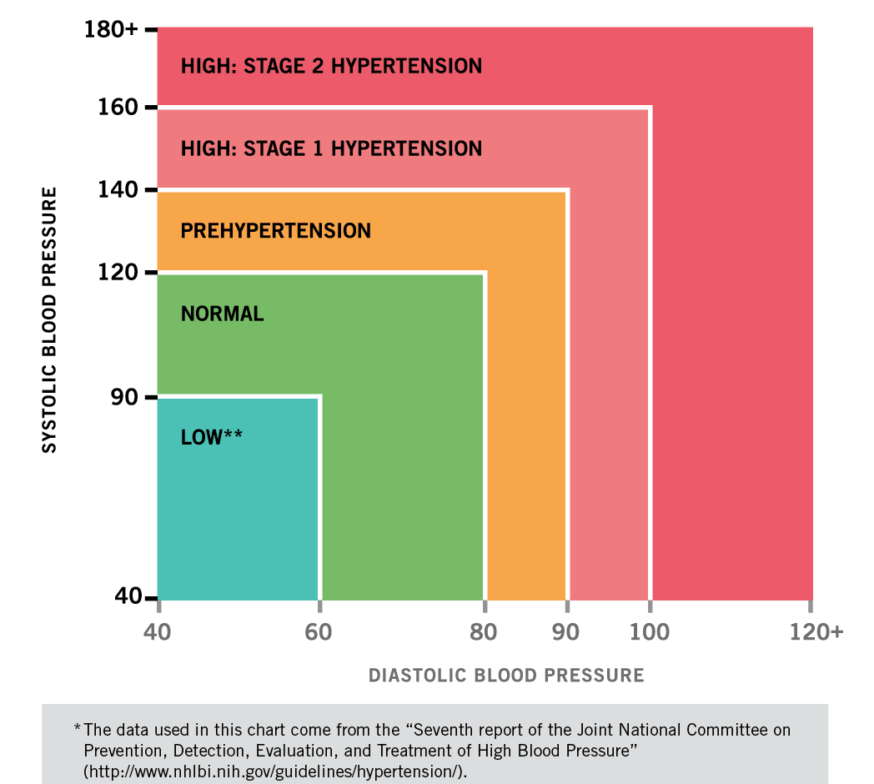
DEFINITION OF HYPERTENSION
In adolescents beginning at age 12 yr, prehypertension is defined as BP between 120/80 mm Hg and the 95th percentile.
Stage 1 Hypertension= 95th to 99th percentile
Stage 2 Hypertension = >99th percentile
A child with BP levels ≥95th percentile in a medical setting but normal BP outside of the office has white coat hypertension.

Slide 20
NEW GUIDELINE
Major change in recent guideline is the updated blood pressure percentiles for both boys and girls. They have also excluded overweight and obese children which constituted 20% of population, used for obtaining the previous data.
BP charts now have height in centimetre rather than in percentile
For new-borns, it has recommended tables compiled by Dionne, et al. and for infants, the normative BP values published by the Task Force in 1987

Slide 21
NEW GUIDELINE
Pre- hypertension has been relabelled as elevated blood pressure and stage 1 and 2 hypertension has been redefined.
For adolescents ≥13 years, instead of percentile-based definitions, hypertension is now defined as per adult thresholds.

Slide 22
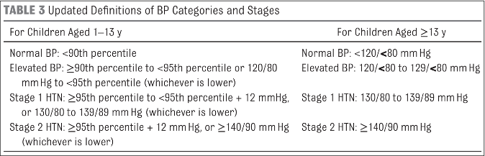
2017 AAP Guidelines for Childhood Hypertension
Flynn JT, Kaelber DC, Baker-Smith CM, et al., and AAP Subcommittee on Screening and Management of High Blood Pressure in Children. Clinical practice guideline for screening and management of high blood pressure in children and adolescents. Pediatrics. 2017;140(3):e20171904

Slide 23
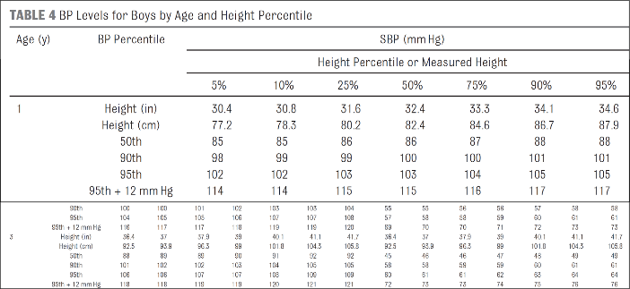
Flynn JT, Kaelber DC, Baker-Smith CM, et al., and AAP Subcommittee on Screening and Management of High Blood Pressure in Children. Clinical practice guideline for screening and management of high blood pressure in children and adolescents. Pediatrics. 2017;140(3):e20171904

Slide 24
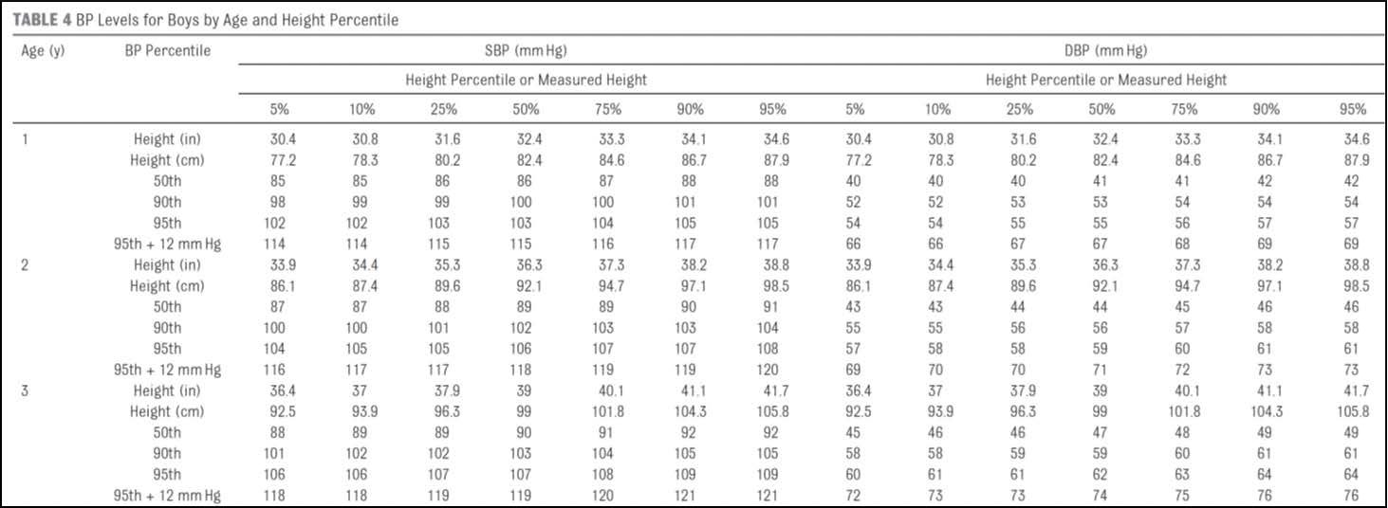
New Blood Pressure Tables
Flynn JT, Kaelber DC, Baker-Smith CM, et al., and AAP Subcommittee on Screening and Management of High Blood Pressure in Children. Clinical practice guideline for screening and management of high blood pressure in children and adolescents. Pediatrics. 2017;140(3):e20171904

Slide 25
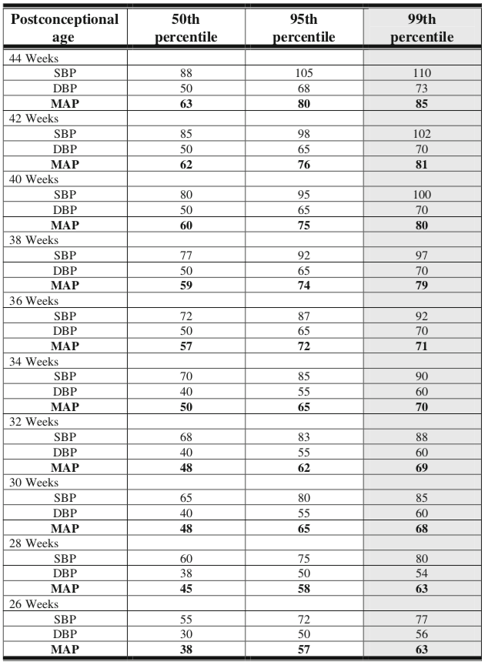
BP CENTILES
FOR NEWBORN

Slide 26
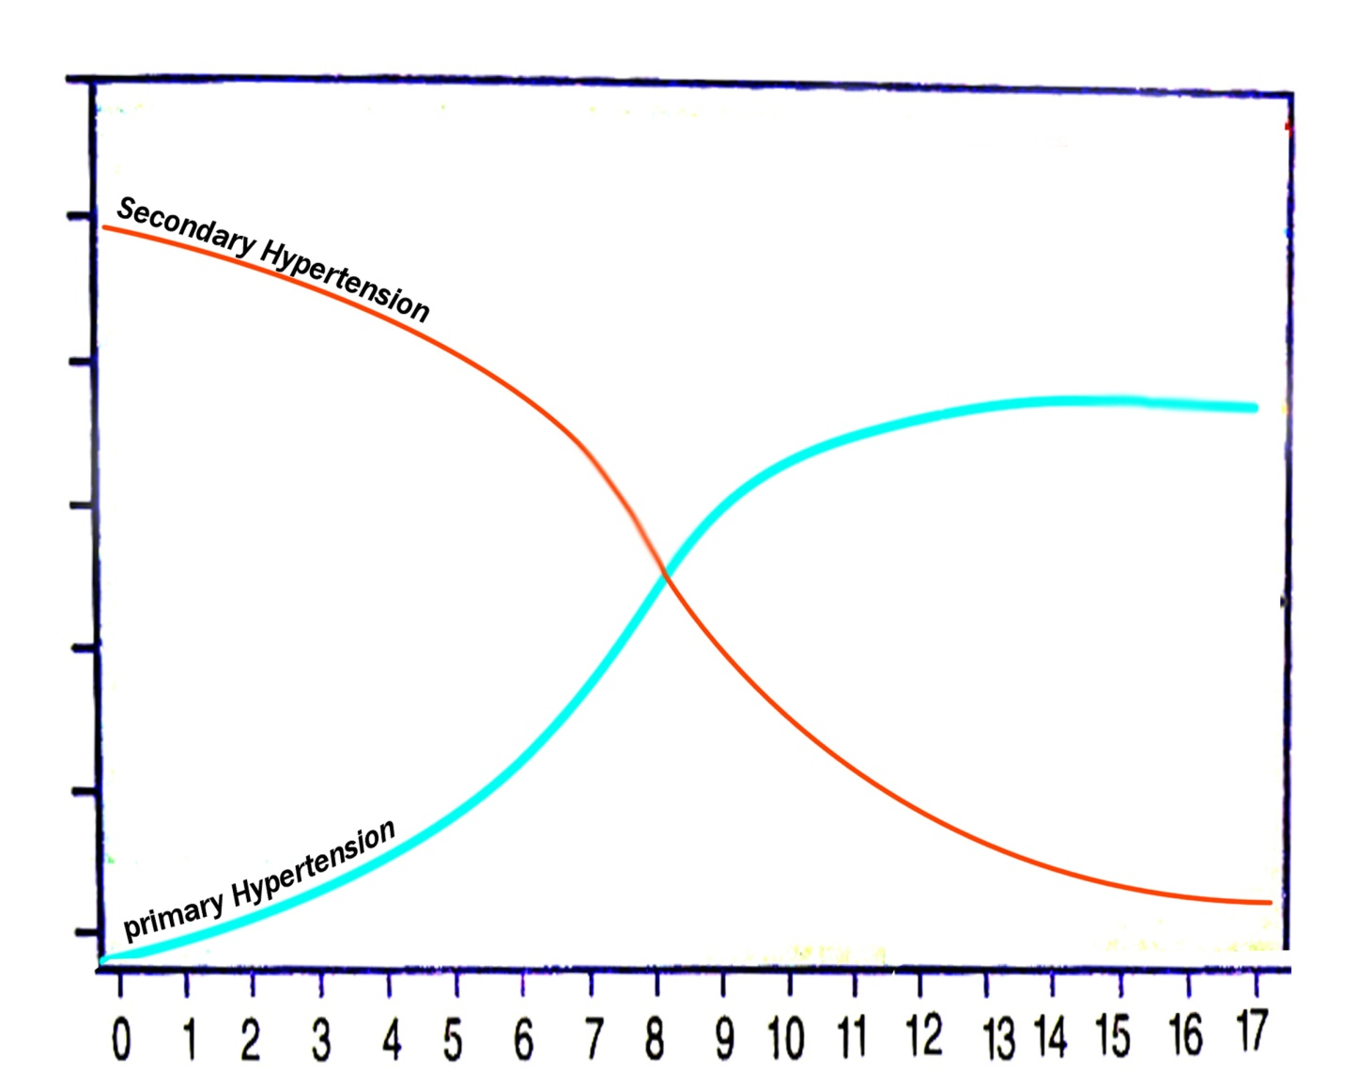
ETIOLOGY
When hypertension is the result of another disease process, it is referred to as secondary hypertension. When no identifiable cause can be found, it is referred to as primary (essential) hypertension.
Many factors, including heredity, diet, stress, and obesity play a role in the development of primary hypertension.
I
N
C
I
D
E
N
C
E
→AGE

Slide 27
ACCORDING TO AGE
Premature infant: a/w umbilical artery catheterization and renal artery thrombosis
Early childhood: renal disease, coarctation of aorta, endocrine disorders, or medications.
Older school-age children and adolescents: primary hypertension becomes increasingly common.

Slide 28
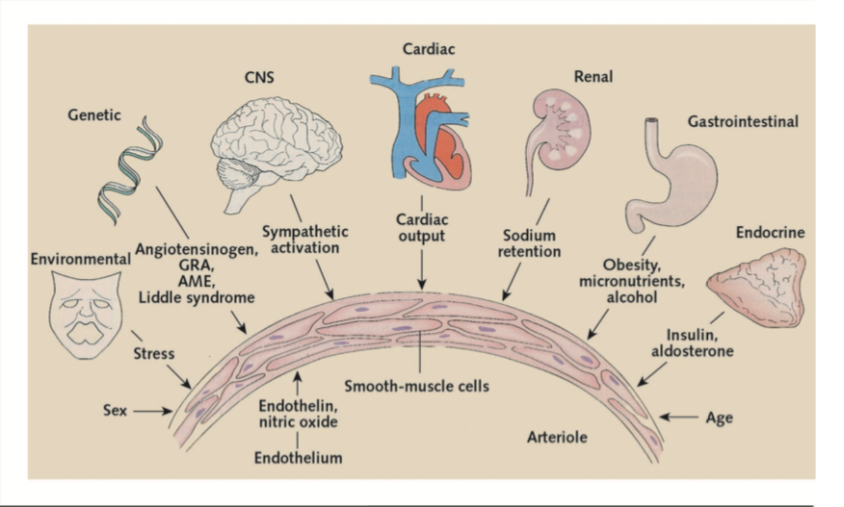
ETIOPATHOGENESIS

Slide 29
CHRONIC HTN: RENAL CAUSES
Chronic pyelonephritis
Chronic glomerulonephritis
Hydronephrosis
Congenital dysplastic kidney
Multicystic kidney
Solitary renal cyst
Vesicoureteral reflux nephropathy
Segmental hypoplasia (Ask-Upmark kidney)
Ureteral obstruction
Renal tumours
Renal trauma
Systemic lupus erythematosus (other connective tissue diseases)

Slide 30
CHRONIC HTN: VASCULAR CAUSES
Coarctation of thoracic or abdominal aorta
Renal artery lesions (stenosis, fibromuscular dysplasia, thrombosis, aneurysm)
Umbilical artery catheterization with thrombus formation
Neurofibromatosis (intrinsic or extrinsic narrowing for vascular lumen)
Renal vein thrombosis
Vasculitis
Arteriovenous shunt
Moyamoya disease
Takayasu arteritis

Slide 31
CHRONIC HTN: ENDOCRINE CAUSES
Hyperthyroidism
Hyperparathyroidism
Congenital adrenal hyperplasia (11β-hydroxylase and 17-hydroxylase defect)
Cushing syndrome
Primary aldosteronism
Glucocorticoid remedial aldosteronism (familial aldosteronism type 1)
Glucocorticoid resistance (Chrousos syndrome)
Pseudohypoaldosteronism type 2 (Gordon syndrome)
Pheochromocytoma
Other neural crest tumors (neuroblastoma, ganglioneuroblastoma, ganglioneuroma)
Liddle syndrome
Geller syndrome

Slide 32
CHRONIC HTN: CNS CAUSES
Intracranial mass
Haemorrhage
Residual following brain injury
Quadriplegia

Slide 33
CAUSES OF TRANSIENT HYPERTENSION
RENAL | DRUGS AND POISONS | CNS AND ANS | MISCELLANEOUS
Acute post infectious glomerulonephritis Anaphylactoid (Henoch-Schönlein) purpura with nephritis Hemolytic-uremic syndrome Acute tubular necrosis Hypervolemia Pyelonephritis Renal trauma Leukemic infiltration of the kidney | Cocaine Oral contraceptives Sympathomimetic agents Amphetamines Corticosteroids and adrenocorticotropic hormone Lead, mercury, cadmium, thallium Antihypertensive withdrawal (clonidine, methyldopa, propranolol) Vitamin D intoxication | Increased intracranial pressure Guillain-Barré syndrome Posterior fossa lesions Poliomyelitis Encephalitis Spinal cord injury (autonomic storm) | Preeclampsia Fractures of long bones Hypercalcemia Extracorporeal membrane oxygenation Chronic upper airway obstruction

Slide 34
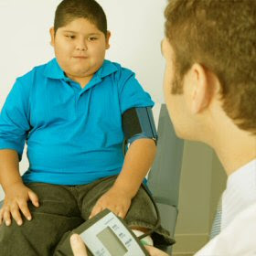
CLINICAL MANIFESTATIONS
Usually asymptomatic
The BP elevation is usually mild and is detected during a routine examination
The child may be obese.
Unless the pressure has been sustained or is rising rapidly, hypertension does not usually produce symptoms.
Clinical manifestations may instead reflect the underlying disease process, such as growth failure in children with chronic kidney disease.

Slide 35
CLINICAL MANIFESTATIONS
With substantial hypertension, headache, dizziness, epistaxis, anorexia, visual changes, and seizures may occur.
Cardiac failure, pulmonary oedema, and renal dysfunction may occur in the face of marked hypertension.
Bell palsy may be seen in asymptomatic or symptomatic patients.

Slide 36
 | PHYSICAL FINDINGS | POTENTIAL RELEVANCE
G E N E R A L | Pale mucous membranes, oedema, growth retardation | Chronic renal disease
 | Elfin facies, poor growth, retardation | Williams syndrome
 | Webbing of neck, low hairline, widespread nipples, wide carrying angle | Turner syndrome
 | Moon face, buffalo hump, hirsutism, truncal obesity, striae, acne. | Cushing syndrome
H A B I T U S | Thinness | Pheochromocytoma, renal disease, hyperthyroidism
 | Virilization | Congenital adrenal hyperplasia
 | Rickets | Chronic renal disease

Slide 37
 | PHYSICAL FINDINGS | POTENTIAL RELEVANCE
S K I N | Café-au-lait spots, neurofibromas | Neurofibromatosis, pheochromocytoma
 | Tubers, “ash-leaf” spots | Tuberous sclerosis
 | Rashes | Systemic lupus erythematosus, vasculitis (Henoch-Schönlein purpura), impetigo with acute nephritis
 | Pallor, ﬂushing, sweating | Pheochromocytoma
 | Needle tracks | Illicit drug use
 | Bruises, striae | Cushing syndrome
 | Acanthosis nigricans | Type 2 diabetes, insulin resistance
PUL MO NARY | Pulmonary edema | Congestive heart failure, acute nephritis
 | Picture of bronchopulmonary dysplasia | Bronchopulmonary dysplasia-associated hypertension

Slide 38
 | PHYSICAL FINDINGS | POTENTIAL RELEVANCE
E Y E | Extraocular muscle palsy | Nonspecific, chronic, severe
 | Fundal | Nonspecific, chronic, severe
 | Proptosis | Hyperthyroidism
C V S | Absent or diminished femoral pulses, low leg pressure relative to arm pressure | Aortic coarctation
 | Heart size, rate, rhythm; murmurs; respiratory difficulty, hepatomegaly | Aortic coarctation, congestive heart failure
 | Bruits over great vessels | Arteritis or arteriopathy
 | Rub | Pericardial effusion secondary to chronic renal disease

Slide 39
HYPERTENSIVE ENCEPHALOPATHY
Also called generalized or posterior reversible encephalopathy syndrome
Suggested by the presence of
headache,
vomiting,
temperature elevation,
visual disturbances,
ataxia,
depressed level of consciousness,
CT abnormalities, and
Seizures

Slide 40
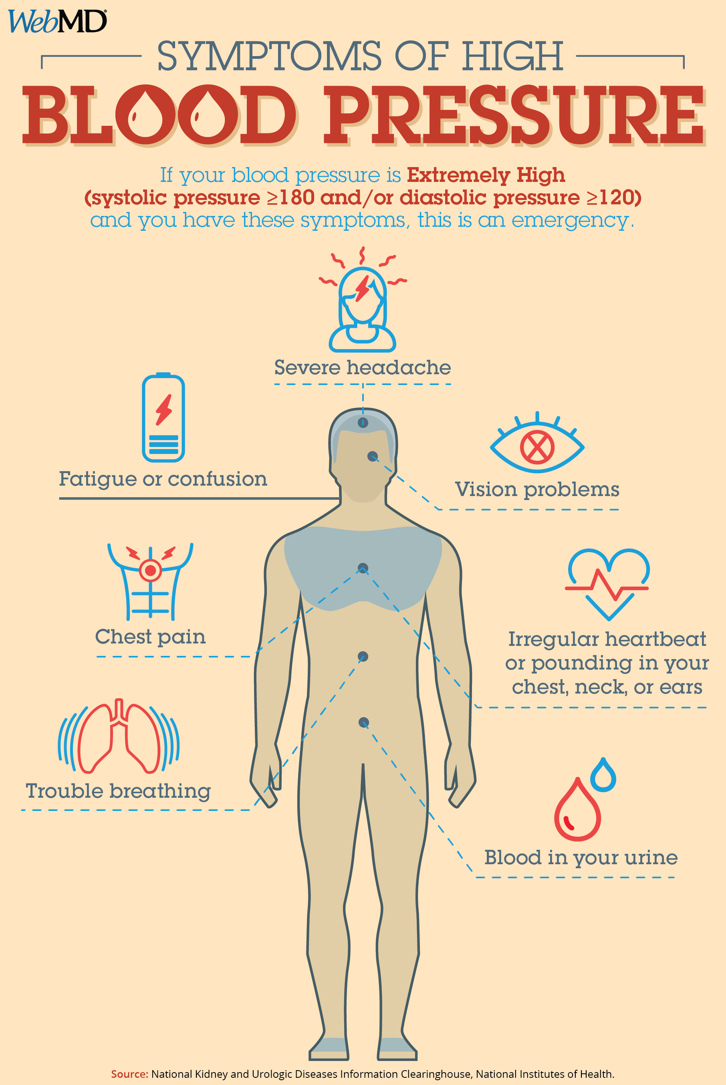
HYPERTENSIVE CRISIS
May manifest with:
decreased vision (retinal haemorrhages of hypertensive retinopathy)
papilledema,
encephalopathy (headache, seizures, depressed level of consciousness),
heart failure, or
accelerated deterioration of renal function.

Slide 41
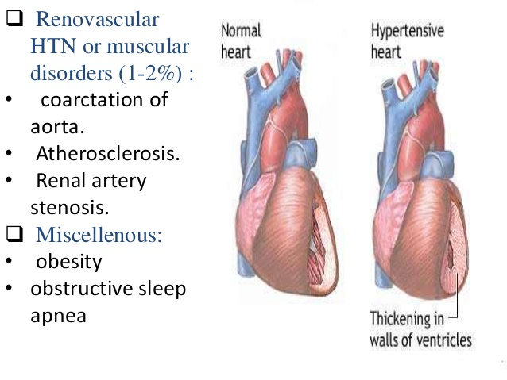
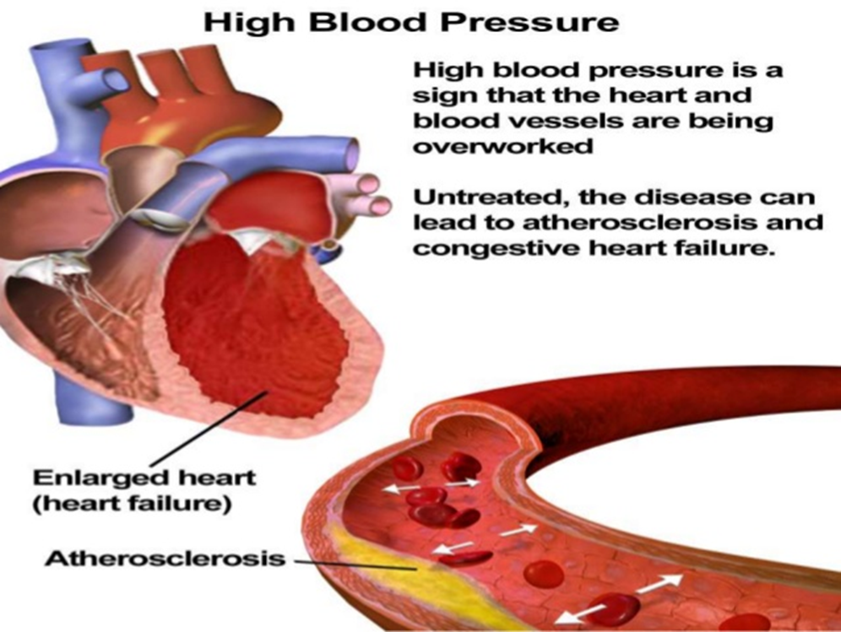
TARGET END ORGAN DAMAGE
40% of hypertensive children have LV hypertrophy
They have increased carotid intima–media thickness, a marker of early atherosclerosis.

Slide 42
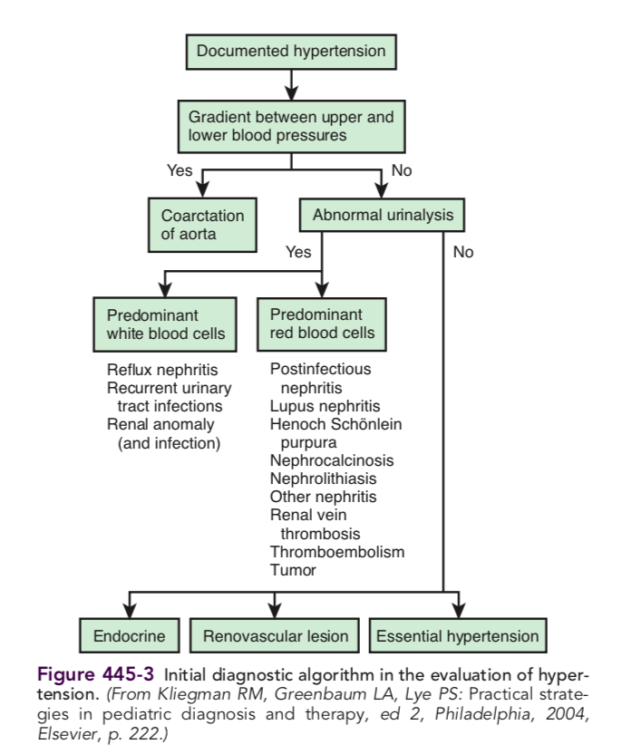
EVALUATION

Slide 43
STUDY OR PROCEDURE | PURPOSE | TARGET POPULATION
EVALUATION FOR IDENTIFIABLE CAUSES
History, including sleep history, family history, risk factors, diet, and habits such as smoking and drinking alcohol; physical examination | History and physical examination help focus subsequent evaluation | All children with persistent BP ≥95th percentile
Blood urea nitrogen, creatinine, electrolytes, urinalysis, and urine culture | R/O renal disease and chronic pyelonephritis, mineralocorticoid excess states | All children with persistent BP ≥95th percentile
Complete blood count | R/O anemia, consistent with chronic renal disease | All children with persistent BP ≥95th percentile
Renal ultrasound | R/O renal scar, congenital anomaly, or disparate renal size | All children with persistent BP ≥95th percentile

Slide 44
STUDY OR PROCEDURE | PURPOSE | TARGET POPULATION
EVALUATION FOR CO-MORBIDITY
Fasting lipid panel, fasting glucose | Identify hyperlipidemia, identify metabolic abnormalities | Overweight patients with BP at 90th-94th percentile; all patients with BP ≥95th percentile; family history of hypertension or cardiovascular disease; child with chronic renal disease
Drug screen | Identify substances that might cause hypertension | History suggestive of possible contribution by substances or drugs.
Polysomnography | Identify sleep disorder in association with hypertension | History of loud, frequent snoring

Slide 45
STUDY OR PROCEDURE | PURPOSE | TARGET POPULATION
EVALUATION FOR TARGET ORGAN DAMAGE
Echocardiogram | Identify left ventricular hypertrophy and other indications of cardiac involvement | Patients with comorbid risk factors and BP 90th-94th percentile; all patients with BP ≥95th percentile
Retinal exam | Identify retinal vascular changes | Patients with comorbid risk factors and BP 90th-94th percentile; all patients with BP ≥95th percentile

Slide 46
STUDY OR PROCEDURE | PURPOSE | TARGET POPULATION
ADDITIONAL EVALUATION AS INDICATED
Ambulatory blood pressure monitoring | Identify white coat hypertension, abnormal diurnal BP pattern, BP load | Patients in whom white coat hypertension is suspected, and when other information on BP pattern is needed
Plasma renin determination | Identify low renin, suggesting mineralocorticoid-related disease | Young children with stage 1 hypertension and any child or adolescent with stage 2 hypertension. Positive family history of severe hypertension
Renovascular imaging Isotopic scintigraphy (renal scan). Magnetic resonance angiography Duplex Doppler ﬂow studies. 3-Dimensional CT Arteriography: digital subtraction arteriography or classic | Identify renovascular disease | Young children with stage 1 hypertension and any child or adolescent with stage 2 hypertension

Slide 47
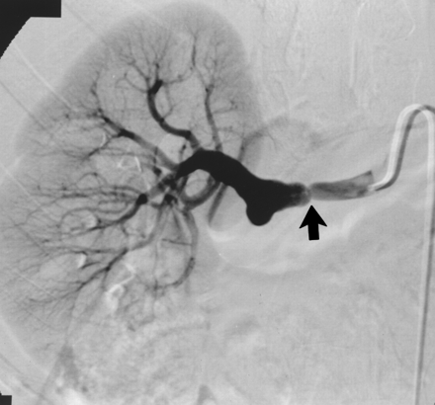
RENAL ANGIOGRAPHY

Slide 48
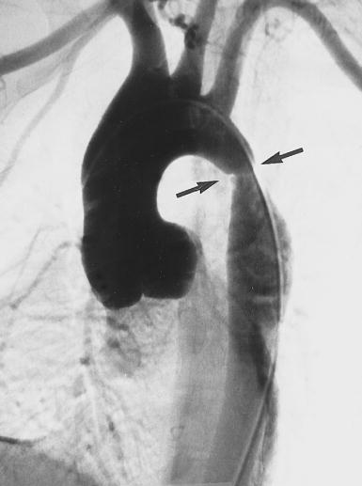
AORTOGRAM SHOWING COA

Slide 49
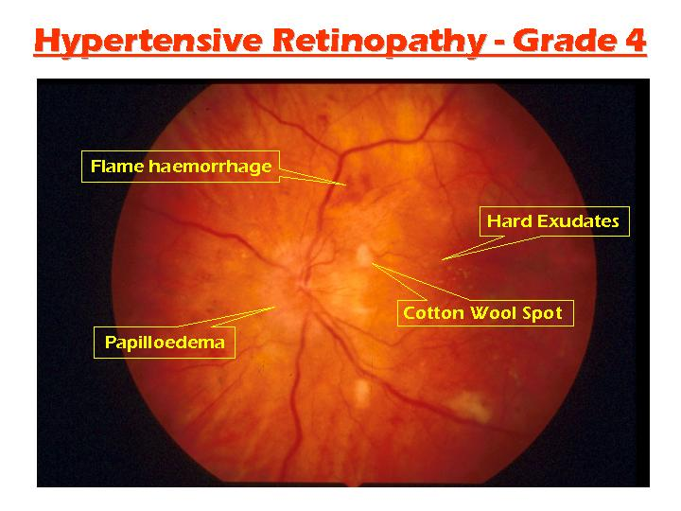

Slide 50
PREVENTION
Population approaches to prevention of primary hypertension include
a reduction in obesity,
reduced sodium intake, and
an increase in physical activity through school and community-based programs.

Slide 51


Slide 52


Slide 53


REGULAR ISOTONIC EXERCISES

Slide 54
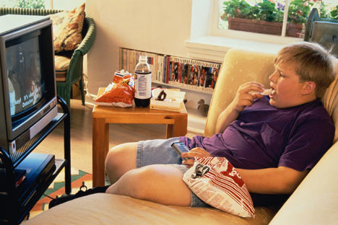
AVOID SEDENTARY LIFESTYLE

Slide 55
YOGA/MEDITATION

Slide 56
AVOID DRINKS, SMOKING, DRUGS BY PARENTAL COUNSELLING

Slide 57
MANAGEMENT
GUIDELINES

Slide 58
GOAL
The target blood pressure has been revised to <90th percentile in light of recent reports of target organ damage even in children with blood pressure between 90th and 95th percentile, as well as evidence of improving left ventricular mass index with this lower threshold.
For those with CKD BP targets were revised to <50th percentile.

Slide 59
Elevated BP (Previously called pre- hypertension)
Children aged 1-12 y (percentile based) :
≥ 90th percentile to <95th percentile or
120/80 mm Hg to <95th percentile (whichever is lower)
Adolescents ≥13 y (mm Hg based) :
120/<80 to 129/<80 mm Hg

Slide 60
Elevated BP
Step1: Lifestyle modification; repeat BP after 6 mo.
Step 2: If still elevated, check UL/LL BP. If these are normal – lifestyle modification continued and BP re-checked again after 6 mo.
Step3: If BP still elevated, ABPM should be ordered (if available), and consider diagnostic evaluation. If BP normalizes at any point, return to annual BP screening at well-child care visits.

Slide 61
Stage 1 Hypertension
Children aged 1-12 y (percentile based) :
≥ 95th percentile to <95th percentile + 12 mm Hg or
130/80 to 139/89 mm Hg (whichever is lower).
Adolescents ≥13 y (mm Hg based) :
130/80 to 139/89 mm Hg

Slide 62
Stage 1 Hypertension
Step1:If asymptomatic, provide lifestyle counselling and recheck the BP in 1 to 2 wk by auscultation.
Step 2: If the BP reading is still at the stage 1 level, UL/LL BP should be checked and if normal, nutrition and/or weight management initiated and BP rechecked in 3 months.
Step3: If BP continues to be at the stage1 HTN level after 3 visits, ABPM should be ordered (if available), diagnostic evaluation should be conducted, and treatment should be initiated. Subspecialty referral should be considered. If symptomatic, early initiation / referral should be considered.

Slide 63
Stage 2 Hypertension
Children aged 1-12 y (percentile based) :
≥ 95th percentile + 12mmHg, or
≥ 140/90 mm Hg (whichever is lower)
Adolescents ≥13 y (mm Hg based) :
≥ 140/90 mm Hg

Slide 64
Stage 2 Hypertension
Step 1: If asymptomatic: UL /LL BP should be checked, lifestyle recommendations given, and the BP rechecked within 1 week (Alternatively, the patient could be referred to subspecialty care within 1 week).
Step2: If the BP reading is still at the stage 2 HTN level when repeated, then diagnostic evaluation, including ABPM, should be conducted and treatment should be initiated, or the patient should be referred to subspecialty care within 1 week. If symptomatic, or the BP is >30mm Hg above the 95th percentile (or >180/ 120 mm Hg in an adolescent), refer to an immediate source of care, such as an emergency department.

Slide 65
Non-pharmacological interventions
Dietary intervention (DASH diet including more of fruits, vegetables, low fat milk products and low salt content) and increased physical activity has been strongly supported.
Importance of weight loss has been stressed and motivational interview for weight reduction were mentioned along with encouraging patient and family educations.

Slide 66
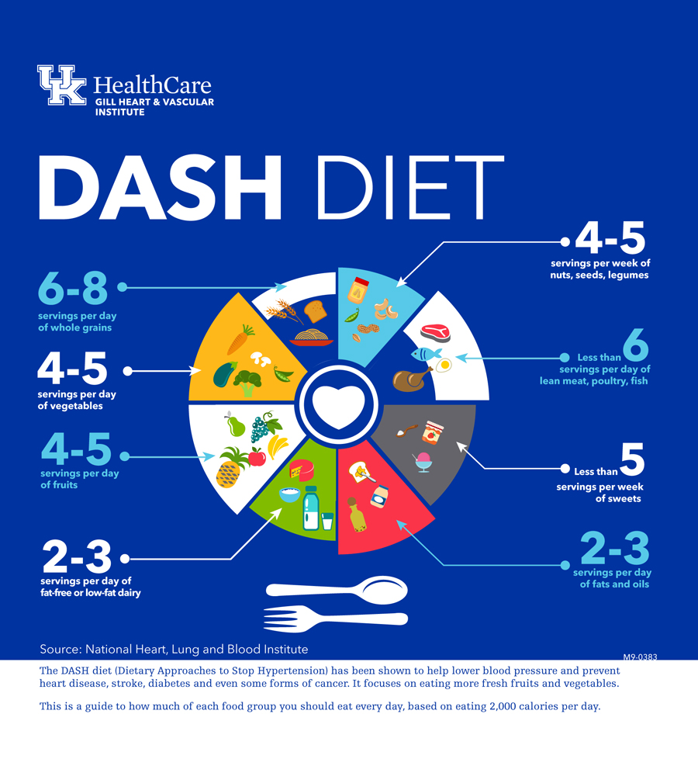

Slide 67
Indications for starting pharmacological interventions:
Anti-hypertensive medications were suggested for those:
who remain hypertensive despite a trial of lifestyle modifications or
who have symptomatic hypertension,
stage 2 hypertension without a clearly modifiable factor (e.g., obesity), or
any stage of hypertension associated with CKD or diabetes mellitus (DM).

Slide 68
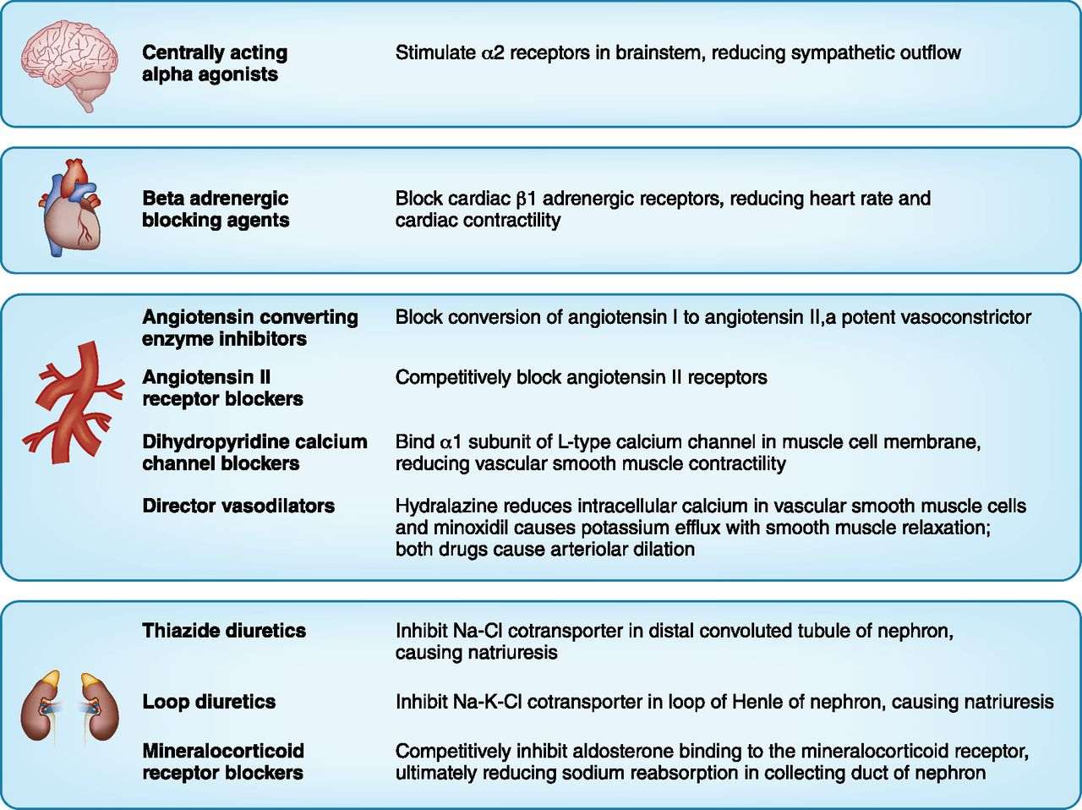

Slide 69
Anti hypertensive agents
ANGIOTENSIN CONVERTING ENZYME INHIBITORS | Doses | Side effects; comments
Enalapril | 0.1-0.6 mg/kg/day qd or BID(max 5 mg/day) | Side effects- Cough, angioedema , hyperkalemia, avoid in B/L renal artery stenosis. C/I in pregnancy; risk of renal tubular agenesis, defective skeletal development , death in utero
Lisinopril | 0.05-0.6 mg/kg/day QD
Fosinopril | 0.1-0.6 mg/kg/day QD
Captopril | 0.3-0.5 mg/kg/dose BID or TID

Slide 70
Angiotensin receptor blockers | Doses | s/e
Losartan | 0.75-1.4 mg/kg QD | S/E- Hyperkalemia ;watch for rise in creatinine
Irbesartan | 75-150 mg/ kg QD
Valsartan | 1.3-2.7 mg/kg/day QD
Aldosterone receptor antagonist
Eplerenone | 25-100 mg/day QD or BID | Hyperkalemia
Spironolactone | 1 mg/ kg/ day qd or bid

Slide 71
Beta blockers | Doses
Atenolol | 0.5-2 mg/kg/day QD | Bradycardia , syncope, lethargy, irritability, depression. C/I in DM , asthma, CHF, Raynaud phenomenon, atrio ventricular septal defects.
Propranolol | 1-4 mg/kg/ day BID-QID
Metoprolol | 1-6 mg/ kg BID
Alpha blockers |  | Phentolamine and Phenoxybenzamine used mostly in pheochromocytoma.
Prazosin | 50-100 µg/kg/day BID-TID
Phentolamine | 15mg/kg in 50ml dextrose @1-10 ml/hr iv
Phenoxybenzamine | 0.2-0.5 mg/kg BID-TID
Alpha and beta blockers
Carvedilol | 0.1-0.5 mg/kg/dose BID | Pallor , bradycardia; Avoid in asthma and heart failure
Labetalol | 2-10 mg/kg/day BID

Slide 72
CCB | Doses
Amlodipine | 0.06-0.3 mg/kg/day QD | Edema, headache, flushing, tachycardia
Felodipine | 2.5mg/kg QD
Vasodilators
Hydralazine | 0.25-7.5mg/kg/day TID-QID | Tachycardia,headache, salt and water retention , hirsuitism with minoxidil
Minoxidil | 0.1-1 mg/kg/dayBID-TID
Diuretics
Furosemide | 0.5-6 mg/kg/day QD or BID | Electrolyte abnormalities and dehydartion
Hydrochlorthiaide | 1-3 mg/kg QD- BID
Amiloride | 5-20 mg/kg QD

Slide 73
Suggested choice of anti hypertensive drugs based on underlying etiology
Condition | Medication
Reno vascular hypertension | ACEI,ARB , diuretics ; ACEI/ARB contraindicated in b/l renal artery stenosis
Chronic kidney disease with proteinuria, DM with micro albuminuria, obesity related hypertension | ACEI, ARB
Coarctation of aorta, migraine | Beta- blockers
Hypertension related to fluid overload eg acute post infectious glomerulonephritis | Diuretics ,CCB, ; avoid potassium sparing diuretics and ACEI and ARB in oliguria or severe acute kidney injury

Slide 74
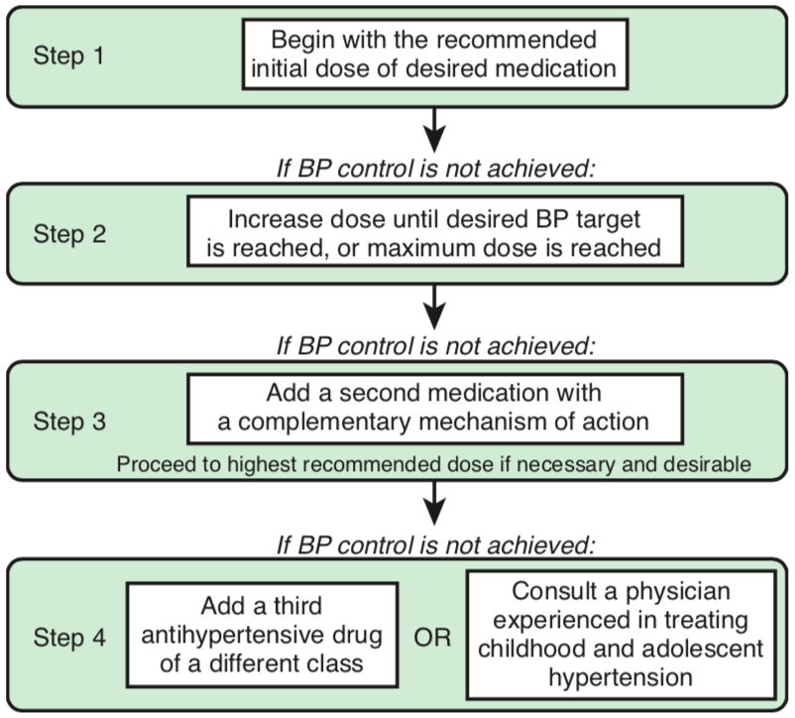

Slide 75
Monitoring while on anti-hypertensive agents:
For children on only life style changes, a longer follow-up (3- 6 months) was suggested.
If on anti-hypertensive, more frequent review (every 4-6 weeks) was suggested for dose adjustments and/or addition of more anti-hypertensive medications till target BP is achieved.
Use of 24-hour ABPM was also supported for monitoring treatment efficacy.

Slide 76
Treatment of resistant hypertension
Persistent hypertension despite treatment with 3 or more anti- hypertensive agents of different classes
initial re- confirmation by appropriate size cuff and by ABPM,
dietary sodium restriction,
elimination of substances known to elevate blood pressure,
identification of previously undiagnosed secondary causes of hypertension,
optimization of current therapy and addition of additional agents as needed
Use of existing pediatric lipid guidelines was suggested for any dyslipidemia.

Slide 77
HYPERTENSIVE EMERGENCY
In presence of life threatening complications like encephalopathy or heart failure, a controlled drop of BP by 25% within first 8 hour was advised, preferably by use of intravenous agents.
Because too rapid a reduction in BP may interfere with adequate organ perfusion, a stepwise reduction in pressure should be planned.
In general, the pressure should be reduced by 10% in the 1st hr, and 15% more in the next 3-12 hr, but not to normal during the acute phase of treatment.

Slide 78
Medications used in hypertensive emergencies
Drugs | Dose | Side effects
Sodium nitroprusside | 0.5-8 µg/kg/min iv infusion | Nausea, arrhythmia, muscle twitching, headache
Labetalol | 0.2 -1 mg/kg/dose iv. 0.5-3 mg/kg /hr iv infusion | Bradycardia, avoid in asthma , C/I heart failure
Esmolol | Load 500-600 µg/kg/ min f/b 50-250 µg/ kg / min | Blurred vision, confusion, diziness, increased sweating ; avoid in suspected pheochromocytoma
Nifedipine | 0.25-0.5 mg /kg /oral or sublingual | Flushing, headache, unpredictable hypotension
Hydralazine | 0.1-0.5 mg /kg/ dose IV slow, can be repeated in 4 hours | Tachycardia, palpitation, flushing , fluid retention.

Slide 79
HYPERTENSION AND SPORTS
The guideline states that children with stage 2 hypertension be restricted from static sports until their BP is in the normal range.
Children with evidence of target organ damage needs proper specialist assessment prior taking a call on their participation in competitive sports.

Slide 80
THANK YOU!!

