Slide 1
HEPATITIS C
Dr. Sheetal Chhaya
Associate Professor
Dept. of Clinical Nutrition

Slide 2
What is Hepatitis?
“Hepatitis” means inflammation of the liver
Can be caused by:
  Genetic diseases
  Medications (including over-the-counter)
  Alcohol
  Hepatitis viruses (A,B,C,D,E)
Notes:
Many things can cause hepatitis.
With hepatitis C you need to be careful not to do anything that will irritate your liver
With hepatitis the liver enzymes are usually elevated and the liver can become enlarged

Slide 3
INTRODUCTION
130–150 million people globally have chronic hepatitis C infection.
Hepatitis C is a very common disease. The progression from infection with the virus to fibrosis, cirrhosis, and cancer takes decades to develop, and many cases are undiagnosed.
Antiviral medicines can cure approximately 90% of persons with hepatitis C infection, thereby reducing the risk of death from liver cancer and cirrhosis, but access to diagnosis and treatment is low.
There are six major hepatitis C genotypes - genotypes 1 through 6 - and there are more than 100 subspecies. The most common genotype worldwide is type 1.
There is currently no vaccine for hepatitis C.

Slide 4
Hepatitis C
HCV causes an inflammatory reaction that is localized within the liver, allowing the virus to gradually infect and destroy liver tissue, such that liver damage progresses slowly.
Used to be known as “non-A, non-B” hepatitis
Spread through blood-to- blood contact.
C
Notes:
Important to stress the fact that HCV does not always have symptoms. Can feel healthy for 10-20 or more years before developing symptoms. Patient can be asymptomatic but have hepatitis C.
Symptoms are often very mild, but liver damage can occur without symptoms
No vaccine is available for hepatitis C, but researchers are working hard. The virus mutates quickly making it difficult to make a vaccine.

Slide 5
How Do People Become Infected With Hepatitis C?
High Risk:
If one comes into contact with the blood of an infected person.
Injecting drugs. eg-anabolic steroids
Blood donation
Blood transfusion and treatment
Sharing toothbrush and razors
Sexual transmission
Tattooing and body piercing
Mother to child
Needlestick injury
Notes:
The largest two predictors are IV drug use and use of blood products.
Just one contaminated needle, regardless of it that person was sure the needle was new, can infect someone with hepatitis C.
It only takes one drop of blood to become infected.
The blood supply is thoroughly tested for hepatitis C and recent blood products are no longer a risk factor. Less than 1 chance per million units transfused.
1. CDC, Viral Hepatitis C, Frequently Asked Questions, http://www.cdc.gov/ncidod/diseases/hepatitis/c/faq.htm#7a

Slide 6
What Are the Symptoms?
Many people with Hepatitis have no symptoms. But one could notice these:
Jaundice (a condition that causes yellow eyes and skin, as well as dark urine)
Stomach pain
Loss of appetite
Nausea
Fatigue
High body temperature

Slide 7
How is Hepatitis C Diagnosed?
Blood testing
  Hepatitis C antibody test
  Hepatitis C PCR test to find virus in blood
Liver function tests
Notes:
The first test is the antibody test. It tells if the patient has ever been exposed to HCV.
The PCR test is done after the Antibody test and determines if the HCV is present in the blood stream.
Liver function tests, such as AST (SGOT) and ALT (SGPT) detect inflammation of the liver. When your liver is working well, the levels of these are low. When your liver is not working as well as it should, they can get much higher. However, liver function tests do not give a good idea of what’s really going on in the liver.
9. Department of Veteran Affairs, The Liver Brochure Series, What Is Your Liver, http://www.va.gov/hepatitisC
Can you have a normal liver enzyme (e.g., ALT) level and still have chronic hepatitis C?
Yes, it is common for persons with chronic hepatitis C to have a liver enzyme level that goes up and down, with periodic returns to normal or near normal. Some persons have a liver enzyme level that is normal for over a year but they still have chronic liver disease. If the liver enzyme level is normal, persons should have their enzyme level re-checked several times over a 6 to 12 month period. If the liver enzyme level remains normal, your doctor may check it less frequently, such as once a year.
1. CDC, Viral Hepatitis C, Frequently Asked Questions, http://www.cdc.gov/ncidod/diseases/hepatitis/c/faq.htm#7a

Slide 8
Hepatitis C prevelance
About 3 million Americans infected
About 150 million infected worldwide
Many do not experience symptoms
Notes:
4 times more common than HIV
Fewer people are transmitting HCV now compared to 20-30 years ago.
About 30,000 more become infected each year

Slide 9
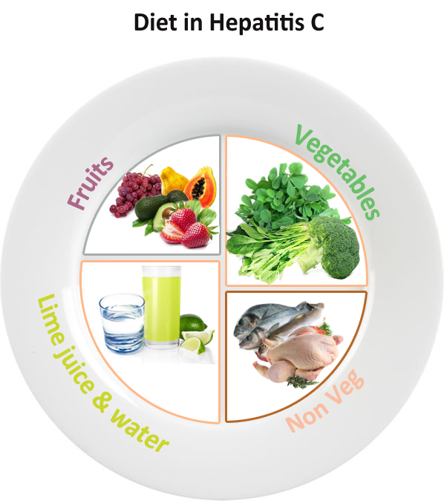
Treatment
Medical nutrition therapy
eating a healthy and balanced diet
exercising regularly
cutting out alcohol or limiting your intake
stopping smoking
Eat whole-grain cereals, breads, and grains
Eat lots of fruits and vegetables
Get adequate protein
Go easy on fatty, salty, and sugary foods
Drink enough fluid
maintain a healthy weight
Eat fewer iron rich foods
keeping personal items, such as toothbrushes or razors, for your own use
not sharing any needles or syringes with others

Slide 10
Hepatitis C medications
pegylated interferon – a medication that encourages the immune system to attack the virus
ribavirin – an antiviral medication that stops the virus reproducing

Slide 11
Case study
38-year-old man had been diagnosed as having common variable immunodeficiency at the age of 24 years.
Medical history
He was treated initially with intramuscular gamma globulin injections and then changed to intravenous immunoglobulin (IVIG) at 3-weekly intervals
He experienced adverse reactions to each infusion due to his high levels of antibodies to trace amounts of IgA in the IVIG preparation.
Eventually, he was transferred to a preparation with an extremely low IgA content that was well tolerated and he was maintained in excellent health for several years.

Slide 12
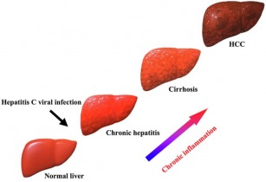
Early in 1994, abnormal liver function tests were noted on routine monitoring in this case. At the same time, cases of suspected hepatitis C infection were reported after use of the same IVIG product in Sweden and Spain. It was confirmed that all these patients, including this case, had received the same batch of IVIG

Slide 13
.Examination
He was shown to be positive for hepatitis C virus (HCV) RNA by the polymerase chain reaction (PCR) .
Duration- he suffered from hepatitis C-induced liver disease over a 10-month period, with five episodes of severe symptomatic acute hepatitis flares.
Result of clinical tests- His liver transaminase levels rose to peaks of 1100iu/l (NR 2-50) with marked clinical and biochemical cholestasis.
He was treated with thrice-weekly, subcutaneous injections of IFN-alpha for 6 months. However, he remained persistently PCR positive for HCV and his liver function tests continued to fluctuate. He was then given combination therapy with IFN-alpha and ribavirin for a further 4 months but his severe symptoms persisted, he lost 24kg in weight and his liver biopsies showed progression from mild hepatitis shortly after diagnosis to severe chronic active hepatitis and near cirrhosis in under 2 years

Slide 14
Medical treatment
Had to undergo liver transplantation.
He was accepted by the transplant centre and received an orthotopic cadaveric liver 2 months later.
He had a remarkably uneventful operation and a smooth postoperative recovery.
Medication- Minimal immunosuppression was given to reduce the risks of viral replication and he was restarted on IFN-alpha and ribavirin.
Post surgery- He experienced many side-effects from his therapy but improved slowly. Post-transplant liver biopsies showed mild hepatitis but 3 years following transplantation, he is well clinically, has put on 11kg in weight and has returned to work.

Slide 15
Medical nutrition therapy
He was given five servings of fruits and vegetables each day.
No grapefruit and grapefruit juice, pomegranates, or Seville oranges due to their effect on a group of immunosuppressant medications.
fiber diet
whole grain foods
low-fat or fat-free dairy products, which is important to maintain optimal calcium and phosphorus levels
Diet low in salt,cholesterol,fat and sugar.

Slide 16
References
http://www.immunologyclinic.com/case.asp?chap=14&case=6
http://www.mayoclinic.org/
Krause
Hepatitis c patient education

