Slide 1
INFECTIVE ENDOCARDITIS
GUIDE:
Dr. PUTUN PATEL
Senior resident
Department Of Pediatrics

Slide 2
Infective endocarditis includes acute and subacute bacterial endocarditis, as well as nonbacterial endocarditis caused by viruses, fungi, and other microbiologic agents.
It is a significant cause of morbidity and mortality in children and adolescents despite advances in the management and prophylaxis of the disease with antimicrobial agents.
The disease represents a complex interplay between a pathogen and host factors such as endothelial disruption and immune function that is still not completely understood.

Slide 3
The nature of the infecting organism has changed over time; diagnosis may be difficult during early stages and is thus often delayed until a more serious infection has set in.
Infective endocarditis (IE) accounts for 0.5 to 1 of every 1000 hospital admissions, excluding postoperative endocarditis.
The frequency of IE among children seems to have increased in recent years.
This is due to survivors of surgical repair of complex congenital heart disease , survivors of neonatal intensive care units, who are at an increased risk for IE.

Slide 4
PATHOGENESIS –
Two factors are important in the pathogenesis of IE:
a damaged area of endothelium
bacteremia, (even transient.)
Almost all patients who develop IE have a history of congenital or acquired heart disease. Drug addicts may develop endocarditis in the absence of known cardiac anomalies.
All congenital heart defects, with the exception of secundum-type atrial septal defect, predispose to endocarditis.

Slide 5
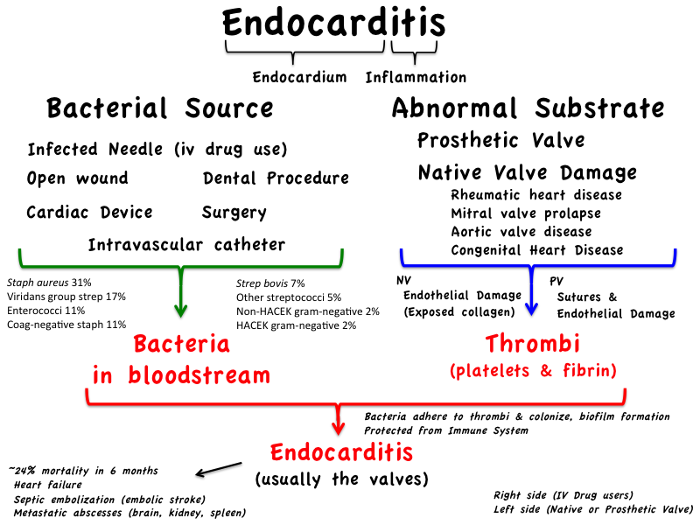

Slide 6


Slide 7
CONGENITAL CONDITIONS | ACQUIRED CONDITIONS
TETRALOGY OF FALLOT | RHEUMATIC VALVULAR DISEASE-PARTICULARLY MITRAL INSUFFICIENCY,
VENTRICULAR SEPTAL DEFECT (VSD), | PROSTHETIC HEART VALVE
AORTIC VALVE DISEASE, | PROSTHETIC MATERIAL IN THE HEART
TRANSPOSITION OF THE GREAT ARTERIES, | MVP WITH MITRAL REGURGITATION
SYSTEMIC-TO-PULMONARY ARTERY (PA) SHUNT. | HYPERTROPHIC OBSTRUCTIVE CARDIOMYOPATHY
 | DENTAL PROCEDURES,
 | ANY LOCALIZED INFECTION (E.G., ABSCESS, OSTEOMYELITIS, PYELONEPHRITIS)

Slide 8
Pathology
Vegetation in infective endocarditis Is usually found in the low pressure side of the defect or on the opposite surface of the defect where endothelial damage is established by the jet effect of the damage e.g.
IN PATENT DUCTUS ARTERIOSUS
- found in pulmonary artery
IN MITRAL REGURGITATION
–in atrial surface of the mitral valve
IN AORTIC REGURGITATION
-on the ventricular surface of the aortic valve
IN AORTIC STENOSIS
– at the site of a jet lesion in aorta

Slide 9
MICROBIOLOGY
STREPTOCOCCUS VIRIDANS, STAPHYLOCOCCUS AUREUS -
-responsible for over 60% of the cases.
HACEK- (Haemophilus, Actinobacillus, Cardiobacterium, Eikenella, and Kingella)
common in neonates and immunocompromised children,
accounting for 17% to 30% of cases.
A-HEMOLYTIC STREPTOCOCCI (S. VIRIDANS) –
dental procedures or in those with carious teeth or periodontal
disease.
ENTEROCOCCI - after genitourinary or gastrointestinal surgery or instrumentation.

Slide 10
STAPHYLOCOCCI –
Postoperative Endocarditis
S. AUREUS, PSEUDOMONAS AERUGINOSA OR SERRATIA MARCESCENS –
Intravenous drug abusers
FUNGAL –
Candida and aspergillus species
sick neonates
patients who are receiving long-term antibiotic or steroid therapy,
after open-heart surgery.
Fungal endocarditis is often associated with very large friable vegetations; emboli from these vegetations frequently produce serious complications.

Slide 11
indwelling vascular catheters, prosthetic material, and prosthetic valve
-S. aureus or coagulase-negative staphylococci.
Culture-negative endocarditis.
A diagnosis of culture-negative endocarditis is made when a patient has -
clinical and/or echocardiographic evidence of endocarditis but persistently
negative blood cultures.
The most common cause of culture-negative endocarditis is current or recent antibiotic therapy or infection with a fastidious organism that grows poorly in vitro.
Fungal endocarditis and IE caused by other rare organisms are rare causes of culture-negative endocarditis.
At times, the diagnosis can be made only by removal of vegetation (during surgery).

Slide 12
CLINICAL MANIFESTATIONS
HISTORY-
Underlying heart defect.
History of toothache (from dental or gingival disease)
A history of a recent dental procedure or tonsillectomy is occasionally present,
Endocarditis is rare in infancy; at this age, it usually follows open-heart surgery.
The onset is usually insidious
with prolonged low-grade fever fatigue weakness,
loss of appetite pallor, arthralgia
myalgias, weight loss diaphoresis.

Slide 13
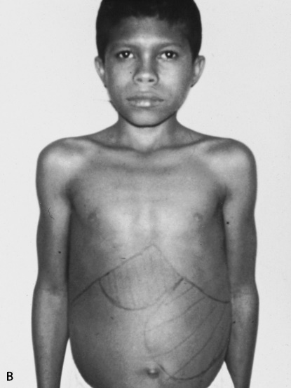
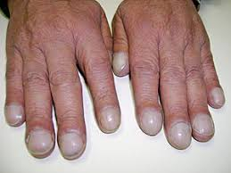
PHYSICAL EXAMINATION
Clubbing of fingers in the absence of cyanosis develops rarely in more chronic cases
Skin manifestations (50%) (either secondary to micro embolization or as an immunologic phenomenon) may be present in the following forms:
CLUBBING
SPLEENOMEGALY

Slide 14
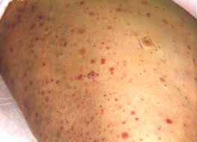
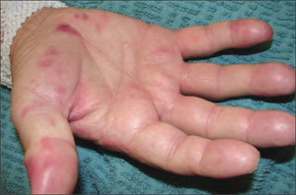
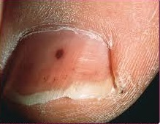
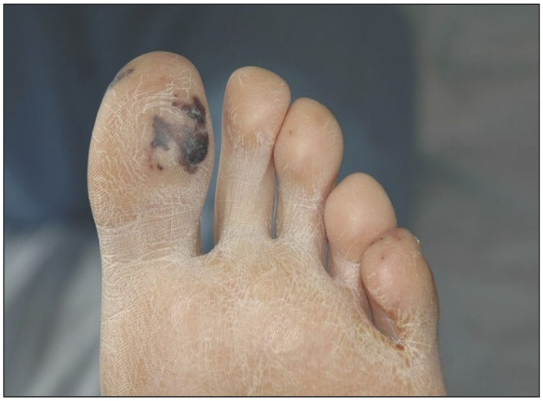
SKIN MANIFESTATION
Either seconadary
microembolisation
immunological phenomenon
Petechiae
JANEWAY LEISON AND OSLERS NODE
JANEWAY LEISON
SPLINTER HAEMORRHAGE

Slide 15
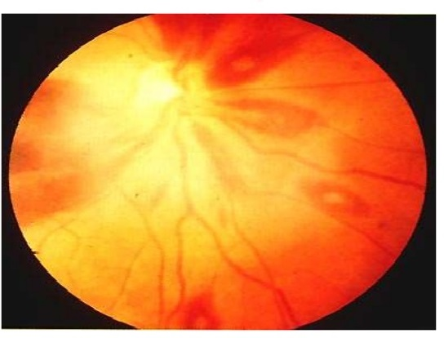
Embolic or immunologic phenomena in other organs are present in 50% of cases:
Pulmonary emboli may occur in patients with VSD, PDA, or a systemic-to-PA shunt.
Seizures and hemiparesis are the result of embolization to the central nervous system (20%) and are more common with left-sided defects such as aortic and mitral valve disease or with cyanotic heart disease.
Hematuria and renal failure may occur.
Roth spots (oval retinal haemorrhages with pale centers located near the optic disc )
ROTH SPOTS

Slide 16
Heart murmur is universal (100%).
The appearance of a new heart murmur and an increase in the intensity of an existing murmur are important.
However, many innocent heart murmurs are also of new onset.
The clinical manifestations in a neonate with IE are nonspecific (respiratory distress, tachycardia) and may be indistinguishable from septicaemia or congestive heart failure (CHF) from other causes.

Slide 17
Laboratory Studies
1. Positive blood cultures – In more than 90% of patients in the absence of previous antimicrobial
therapy.
A complete blood cell count shows
Anemia, with hemoglobin levels lower than 12 g/100 mL (present in 80% of patients),
leukocytosis with a shift to the left.
Patients with polycythemia preceding the onset of IE may have normal hemoglobin.
3. ESR- increased unless there is polycythemia.
4. Microscopic hematuria is found in 30% of patients.

Slide 18
(PROCEDURE OF SAMPLING IN INFECTIVE ENDOCARDITIS- BLOOD CULTURE)
a. Usually, three blood culture samples are drawn by separate venipunctures over 24 hours, unless the patient is very ill. In 90% of cases, the causative agent is recovered from the first two cultures.
b. If there is no growth by the second day of incubation, two more may be obtained. There is no value in obtaining more than five blood cultures over 2 days unless the patient received prior antibiotic therapy.
c. It is not necessary to obtain the cultures at any particular phase of the fever cycle.
d. An adequate volume of blood must be obtained; 1 to 3 mL in infants and young children and 5 to 7 mL in older children are optimal.
e. Aerobic incubation alone suffices because it is rare for IE to be due to anaerobic bacteria.

Slide 19
Echocardiography.
Two-dimensional echo is the main modality for detecting endocardial infection. It detects
the site of infection,
extent of valvular damage,
and cardiac function
Baseline evaluation of ventricular function and
cardiac chamber dimension.
Colour Doppler is a sensitive modality for detection of valvular regurgitation.

Slide 20
Certain echo findings are included as major criteria in the modified Duke criteria.
They include:
a. Oscillating intracardiac mass on valve or supporting structures, in the path of regurgitation jets, or on implanted material
b. Abscesses
c. New partial dehiscence of prosthetic valve
d. New valvular regurgitation

Slide 21
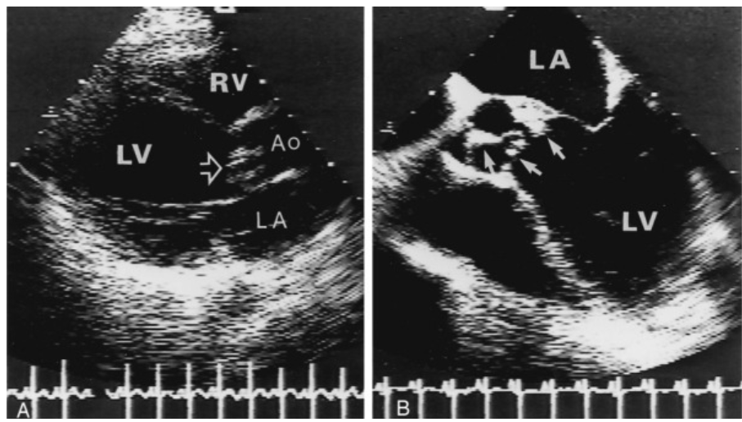
Echoes of aortic valve vegetation.
A - Parasternal long-axis view of a young adult patient with a bicuspid aortic
valve demonstrating vegetation on the aortic valve (arrow).
B- Five-chamber transverse plane of a transesophageal echo of the same patient that demonstrates vegetations and aortic valve anatomy more clearly than the ordinary two-dimensional echo. Ao, aorta; LA, left atrium; RV, right ventricle.

Slide 22
TRANSESOPHAGEAL ECHO (TEE)
In obese or very muscular adolescents,
in post-cardiac surgery patients,
or in the presence of compromised respiratory function or pulmonary
hyperinflation.
TEE MAY BE SUPERIOR TO TTE IN
Identifying vegetations on prosthetic valves,
Detecting complications of left ventricular (LV) outflow tract endocarditis
Detecting aortic root abscess and involvement of the sinus of Valsalva.

Slide 23
Both TTE and TEE may produce false-negative results if vegetations are small or have already embolized, and they may miss initial perivalvular abscess.
Repeated examinations are indicated if suspicion exists without diagnosis of IE or there is a worri-some clinical course during early treatment of IE.
FALSE-POSITIVE diagnosis is also possible. -
An echogenic mass may represent a sterile thrombus,
sterile prosthetic material,
normal anatomic variation;
an abnormal uninfected valve (previous scarring, severe myxomatous changes)
improper gain of the echo machine.
Echoevidence of vegetation may persist for months or years after bacteriologic cure.

Slide 24
Certain echo features suggest a high-risk case or a need for surgery:
a. Large vegetations (greatest risk when the vegetation is >10 mm)
b. Severe valvular regurgitation
c. Abscess cavities
d. Pseudoaneurysm
e. Valvular perforation or dehiscence
f. Decompensated heart failure

Slide 25
Definition of infective endocarditis according to the modified duke criteria
DEFINITE INFECTIVE ENDOCARDITIS
A. Pathologic criteria
B. Clinical criteria
1. Microorganisms demonstrated by culture or histologic examination of a vegetation, a
vegetation that has embolized, or an intracardiac abscess specimen; or
2. Pathologic lesions; vegetation or intracardiac abscess confirmed by histologic
examination showing active endocarditis
1. Two major criteria
2. One major criterion and three minor criteria; or
3. Five minor criteria

Slide 26
Possible infective endocarditis
Rejected
One major and one minor criteria
Three minor criteria
Firm alternative diagnosis explaining evidence of infective endocarditis or
Resolution of infective endocarditis syndrome with antibiotic therapy for <4 days or
No pathological evidence of infective endocarditis at surgery or autopsy with antibiotic therapy <4 days or
Does not meet criteria for possible infective endocarditis as above

Slide 27
MAJOR CRITERIA
A. Blood culture positive for IE
Typical microorganisms consistent with IE from two separate blood cultures:
Viridans streptococci
Streptococcus bovis
HACEK group,
Staphylococcus aureus, or
Community-acquired enterococci in the absence of a
primary focus.

Slide 28
Microorganisms consistent with IE from persistently positive blood cultures defined as
follows: at least two positive cultures of blood samples drawn >12 hours apart;
all of three or a majority of four separate cultures of blood (with first and last samples drawn at least 1 hour apart)
Single positive blood culture for Coxiella burnetii or anti-phase 1 IgG antibody titer >1:800

Slide 29
B. Evidence of endocardial involvement
Echocardiogram positive for
Oscillating intracardiac mass on valve or supporting structures, in the path of regurgitant jets,
or
on implanted material in the absence of an alternative anatomic explanation.
Abscess.
New partial dehiscence of prosthetic valve.
New valvular regurgitation (worsening or changing or pre-existing murmur not sufficient)

Slide 30
MINOR CRITERIA
1. Predisposition, predisposing heart condition, or injection drug users.
2. Fever, temperature >38°C
3. Vascular phenomena: major arterial emboli, septic pulmonary infarcts, mycotic
aneurysm, intracranial hemorrhage, conjunctival hemorrhages, and Janeway's lesions
4. Immunologic phenomena: glomerulonephritis, Osler's nodes, Roth's spots, and
rheumatoid factor
5. Microbiologic evidence: positive blood culture but does not meet a major criterion as
noted above[*] or serologic evidence of active infection with organism consistent
with IE

Slide 31
MANAGEMENT
Treatment of infective endocarditis consists of
Medical Management
Surgical Management.
Empirical therapy before the identifiable agent is recovered may be initiated with
Vancomycin -(30 mg/kg per 24 hr IV in 2 equally divided doses) x 4 wks
+
Gentamicin- (3 mg/kg per 24 hr IV/IM in 1 dose) x 2 wks
In patients without a prosthetic valve and when there is a high risk of S. aureus, enterococcus, or viridans streptococci (the 3 most common organisms).
A total of 4-6 wk of treatment is usually recommended. Depending on the clinical and laboratory responses, antibiotic therapy may require modification and, in some instances, more prolonged treatment is required

Slide 32
The final selection of antibiotics depends on the organism isolated and the results of an antibiotic sensitivity test.
A. Streptococcal endocarditis-
1). In general, native cardiac valve IE caused by a highly sensitive S. viridans can be
successfully treated with intravenous (IV) penicillin (or ceftriaxone daily) for 4 weeks.
Alternatively, penicillin, ampicillin or ceftriaxone combined with gentamicin for 2 weeks
may be used.
B. Staphylococcal endocarditis-
1). The drug of choice for native valve IE caused by methicillin-susceptible staphylococci is
one of the semisynthetic -lactamase-resistant penicillins (nafcillin, oxacillin, and
methicillin) for a minimum of 6 weeks (with or without gentamicin for the first 3 to 5
days).
2). Patients with methicillin-resistant native valve IE are treated with vancomycin for
6 weeks (with or without gentamicin for the first 3 to 5 days).

Slide 33
Enterococcus infection-
caused native valve endocarditis usually requires a combination of IV penicillin or ampicillin with
gentamicin for 4 to 6 weeks.
If patients are allergic to penicillin, vancomycin combined with gentamicin for 6 weeks is required.
HACEK infection-
organisms have begun to become resistant to ampicillin. Ceftriaxone or another third-generation
cephalosporin alone or ampicillin plus gentamicin for 4 weeks is recommended.
IE caused by other gram-negative bacteria (such as Escherichia coli, Pseudomonas aeruginosa, or Serratia marcescens) is treated with piperacillin or ceftazidime together with gentamicin for a minimum of 6 weeks.

Slide 34
Amphotericin B is the most effective agent for most fungal infections.
For culture-negative endocarditis, treatment is directed against staphylococci, streptococci, and the HACEK organisms using ceftriaxone and gentamicin.
Patients with prosthetic valve endocarditis should be treated for 6 weeks based on the organism isolated and the results of the sensitivity test.
Operative intervention may be necessary before the antibiotic therapy is completed if the clinical situation warrants (such as progressive CHF, significant malfunction of prosthetic valves, persistently positive blood cultures after 2 weeks of therapy).
Bacteriologic relapse after an appropriate course of therapy also calls for operative intervention.

Slide 35
If the infection occurs on a valve and induces or increases symptoms and signs of heart failure, appropriate therapy should be instituted, including diuretics, afterload reducing agents, and in some cases, digitalis.
Surgical intervention for infective endocarditis is indicated for severe aortic, mitral or prosthetic valve involvement with intractable heart failure.
Severe heart failure may be associated with acute valve regurgitation, obstruction, or fistula formation.
Rarely, amycotic aneurysm, rupture of an aortic sinus, intraseptal abscess causing complete heart block, or dehiscence of an intracardiac patch requires an emergency operation.

Slide 36
Other surgical indications include –
Continued bacteremia or persistent fever after 2 wks of appropriate antibiotic therapy.
Worsening heart failure due to valvular regurgitation
Embolic event :systemic pulmonary coronary cerebral
Myocardial or periannular abscess
Pathogens who are difficult to cure with medical therapy alone like psuedomonaa aeruginosa ,Brucella and fungal endocarditis.
Leaflet perforation or sinus of valsalva anuerysm
Mobile vegetation more than 10 mm in the settings of severe valve regurgitation or stenosis

Slide 37
Prosthetic valve dysfunction like valve dehiscence.
Postoperatively a full course of antimicrobial therapy starting from the time of surgery is warranted.
Late surgery is indicated in some patients after the infection is controlled eg. In patient with small VSD with a previous episode of infective endocarditis.

Slide 38


Slide 39
PROGNOSIS -
The overall recovery rate is 80% to 85%;
S. viridans it is 90%
Staphylococcus organisms about 50%
Fungal endocarditis is associated with a very poor outcome.

Slide 40
COMPLICATION OF INFECTIVE ENDOCARDITIS
Congestive cardiac failure
Pericarditis
Cardiac valvular in sufficiency
Embolic events (cerebral, pulmonary, renal, coronary)
Persistent bacteremia or fungemia
Periannular extension of abscess,sinus of Valsalva aneurysm
intracardiac fistula

Slide 41
Prosthetic device dysfunction including valvular dehiscence
Arrhythmia or development of new heart heart block
Aortic root or myocardial abscesses
Mycotic aneurysm
Glomerulonephritis/acute renal failure
Metastatic abscess,mesenteric or splenic abscess or infarct

Slide 42
PROPHYLAXIS
More important than the diagnosis and treatment of IE is its prevention. Maintenance of good oral hygiene is more important than antibiotic prophylaxis.
Prophylaxis for patients is recommended for “all dental procedures that involve manipulation of
gingival tissue or the periapical region of teeth or perforation of the oral mucosa.
PROPHYLAXIS RECOMMENDED-
High-Risk Category
Prosthetic cardiac valve, including bio-prosthesis and homograft valves
Previous bacterial endocarditis

Slide 43
Complex cyanotic congenital heart defect (e.g., single ventricle, transposition of the great arteries, tetralogy of Fallot )
Surgically constructed systemic-to-pulmonary artery shunt.
Dental extraction.
Periodontal procedures including surgery, scaling and root planing, probing.
Dental implant placement and reimplantation of avulsed teeth
Endodontic (root canal) instrumentation or surgery only beyond the apex
Intraligamentary local anesthetic injections

Slide 44
Moderate-Risk Category
Most other congenital heart defects (e.g., patent ductus arteriosus, ventricular
septal defect, atrial septal defect, coarctation of the aorta)
Acquired valvular dysfunction (e.g., rheumatic heart disease, collagen vascular
disease)
Hypertrophic cardiomyopathy
Mitral valve prolapse with mitral regurgitation and/or thickened mitral valve leaflets.

Slide 45
PROCEDURE FOR WHICH ENDOCARDITIS PROPHYLAXIS IS RECOMMENDED.
DENTAL PROCEDURES.
All dental procedures that include manipulation of gingival tissues of the periapical region of the teeth or or perforation the oral mucosa.
RESPIRATORY TRACT PROCEDURES
Prophylaxis is recommended for procedure that involve incision oe biopsy of respiratory mucosa such as tonsillectomy of adenoidectomy
Prophylaxis is not recommended for bronchoscopy (unless it involves incision of mucosa such as for abscess or empyema)

Slide 46
GI OR GU PROCEDURES -
No prophylaxis is used for diagnostic esophagogastroduedenoscopy or
colonoscopy.
Prophylaxis is reasonable in patients with infected gi or gu tract (with amoxicillin or ampicillin to cover against enterococci
SKIN, SKN STRUCTURE OR MUSCULOSKELETAL TISSUE-
Prophylaxis is recommended for surgical procedures that involves infected skin, skin structure or musculoskeletal tissue (with antibiotis against staphylococcus or b-haemolytic streptococcus )
Vancomyin or clindamycin is administered if unable to tolerate b lactam or if infection is caused by methicillin resistant staphylococcus

Slide 47
The antibiotic prophylaxis is given orally 1 hour before a procedure. It should not be started several days before the procedure. Parenteral antibiotics are given within 30 minutes of starting a procedure
Standard general prophylaxis
Amoxicillin - 50 mg/kg orally 1 hr before procedure.
Unable to take oral medications
Ampicillin Children- 50 mg/kg IM or IV within 30 min before procedure.
Allergic to penicillin
Clindamycin: children, 20 mg/kg; orally 1 hr before procedure.
Cephalexin or cefadroxil: children, 50 mg/kg orally 1 hr before procedure

Slide 48
Allergic to penicillin and unable to take oral medications
Clindamycin or cefazolin -Clindamycin: children, 20 mg/kg IV.
-Cefazolin: children, 25 mg/kg IV
Vigorous treatment of sepsis and local infections and careful asepsis during heart surgery and catheterization reduce the incidence of infective endocarditis.

Slide 49
THANK YOU

