Slide 1
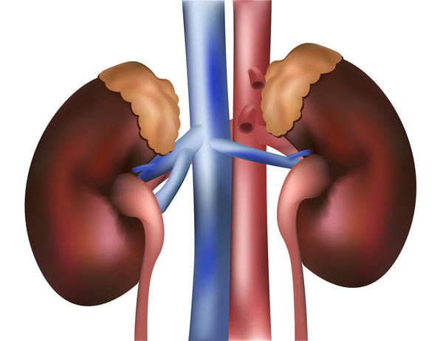
Nephrotic Syndrome
DR PRASAD MULEY
PROFESSOR
SBKS MIRC

Slide 2

Incidence ( paediatric ) ?
90- 100 cases /10,00,000 children.( India)
Occurs at all ages but is most prevalent in children between the ages 2-6 years( for MCNS).
More common in boys.

Slide 3

Etiology
Idiopathic or Primary
Genetic
Secondary

Slide 4
PRIMARY/IDIOPATHIC
Minimal change disease( most common in children)-- > 80 %.
Focal segmental glomerulosclerosis.
Membranous nephropathy
Membranoproliferative glomerulonephritis

Slide 5
SECONDRY NS
Infections- HIV, Hep B &C, malaria, syphilis, endocarditis.
Drugs- Captopril, gold, penicillamine, lithium, NSAIDs.
Malignancy- lymphoma, leukemia, solid tumors
Immunological disorders- SLE, HSP, serum sickness,

Slide 6
HEREDITARY CAUSES
Finnish type congenital Nephrotic syndrome- AR, NPHS1, protein affected is nephrin.
FSGS- AR, NPHS2, protein affected is podocin.
Denys Drash syndrome- AD, WT1 gene.
Diffuse mesangial sclerosis- mutation in laminin beta 2 chain.

Slide 7
Pathophysiology

Slide 8
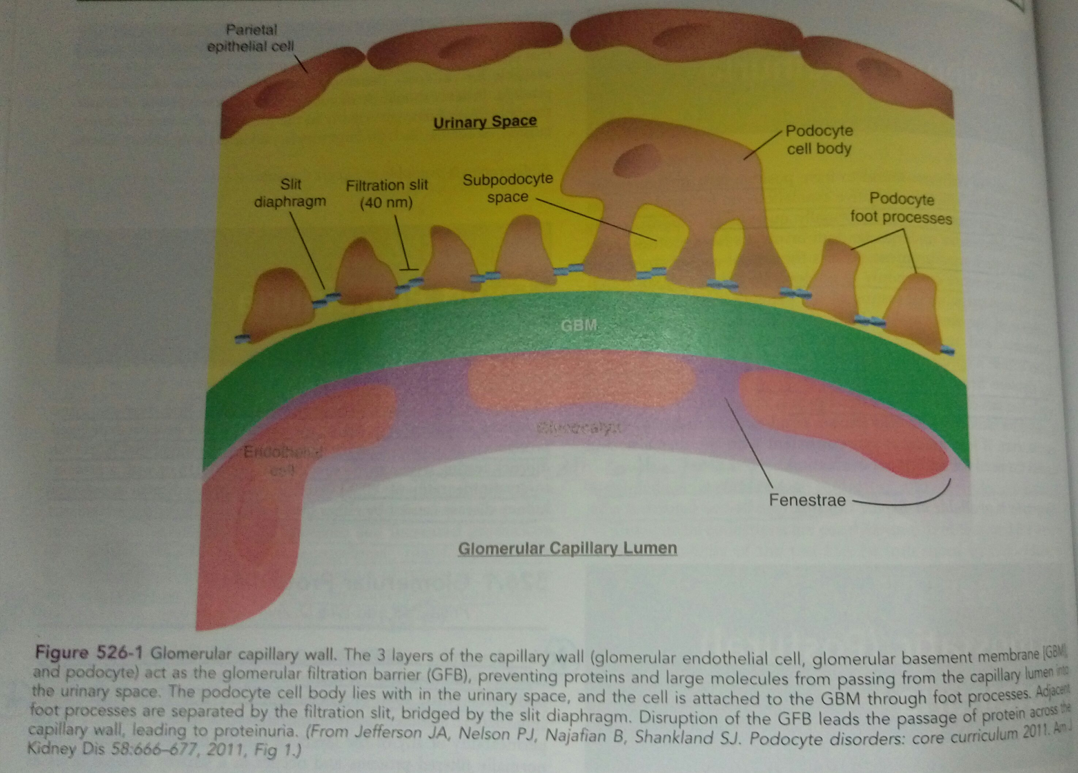

Slide 9
Complex disturbances in
immune system
Genetic Mutations /
Mutations in proteins
Extensive effacement of podocyte foot processes
Increased permeability of the glomerular capillary wall
Massive proteinuria
Hypoalbuminemia
Edema

Slide 10
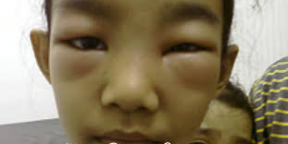
Clinical features

Slide 11
1. EDEMA – most common presenting feature
Under fill hypothesis
Overfill hypothesis
insidious onset
starts as periorbital puffiness then gradually progresses to involve extremities and in severe cases may cause ascites, pleural effusion and genital swelling.
2. ANOREXIA
3. IRRITABILITY
4. ABDOMINAL PAIN
5. DIARRHOEA ( due to intestinal edema)
6. H/O of preceding minor infections e.g. URTI is often present before first episode or subsequent relapses indicating some role of immune status.

Slide 12
7. Increased susceptibility to infections like cellulitis, spontaneous bacterial peritonitis and bacteremia.
8. Hypercoagulability
9. Hyperlipidemia- increase in cholesterol, TGs, LDL, VLDL with normal or decreased HDL.
10. Hypertension in 20% children.
11. Features of systemic disorder( fever, rash, joint pain, hepatosplenomegaly) in secondary NS.

Slide 13

DIFFERENTIAL DIAGNOSIS
Protein losing enteropathy
Hepatic failure
Heart failure
Acute/ chronic glomerulonephritis
Protein malnutrition

Slide 14

Lab Investigations
Complete Blood Count
Urine Routine, microscopy and culture
First morning Spot Urine Protein : Creatinine ratio
Lipid profile
Serum electrolytes
Total protein and albumin level
RFT

Slide 15
Evaluation to rule out secondary Nephrotic syndrome
  C3 levels( gross or persistent hematuria)
  ANA ( suspected SLE)
  HIV
  Hepatitis B & C( recent jaundice and raised transaminases.)

Slide 16
  Renal biopsy- Indications are as follows
    Age- <1 yr. OR >12 yrs.
    Persistent gross hematuria
    Persistent hypertension
    Renal failure not attributable to hypovolemia.
    Steroid resistant Nephrotic syndrome
    Hypocomplementemia
    before commencing 2nd line drugs.
    suspected secondary cause.

Slide 17
a
Cause |  | Light microscopy | Immunoflorescence | Electron Microscopy
Minimal Change Nephrotic Syndrome |  | Normal | Negative | Foot process fusion
Focal Segmental Glomerulosclerosis |  | Focal sclerotic lesions | IgM, C3 in lesions | Foot process fusion
Membranous Nephropathy |  | Thickened GBM | Fine Granular IgG | Sub epithelial deposits
Membranoproliferative Glomerulonephritis | Type I | Thickened GBM, proliferation | Granular IgG, C3 | Mesangial and sub endothelial deposits
 | Type II | Lobulation | C3 only | Dense deposits

Slide 18

Management

Slide 19
IMPORTANT TERMS
REMISSION- urine protein negative/ trace; or <4 mg/m²/hr for 3 consecutive days.
RELAPSE- urine protein 3+ or more for 3 consecutive days.
INFREQUENT RELAPSE- 3 or less relapses in one year
FREQUENT RELAPSE- >2 relapses in 6 months OR >3 relapses in any 12 months period.

Slide 20
STEROID RESISTANT- absence of remission despite 8 weeks of daily steroid therapy.( Nelson).
  *Initial resistance- no remission despite 4 weeks of steroid therapy in first episode.
  *Late responder- initial resistance who responds after 4 weeks.
  *Late Resistance- patient who are steroid responder initially but become steroid resistant in subsequent relapses.
STEROID DEPENDENT- 2 consecutive relapses during alternate day steroid therapy OR within 14 days of its discontinuation.

Slide 21
TREATMENT OF INITIAL EPISODE
Inpatient management
Rule out tuberculosis before commencement of immunosuppressive therapy with M.T. or IGRAs. Chest X-ray if required
Corticosteroids is mainstay of treatment.
Total duration must be 3 months( Daily+ Alternate).
Prolongation more than 3 months is not advisable as it may lead to steroid toxicity.

Slide 22
Prednisolone ( steroid of choice) single daily dose @ 2mg/kg/day ( max.- 60 mg) for 6 weeks.
Then dose is reduced to 1.5 mg/kg( max- 40 mg) every alternate day as single morning dose for next 6 weeks.
Along with this an antacid preparation should be started to reduce gastric irritation.
No evidence to show effectiveness of other corticosteroids like methylprednisolone or dexamethasone.

Slide 23
Management Of Clinical Sequelae
EDEMA-
Treatment required only if significant edema present causing respiratory distress or anasarca.
Most cases treatment is not required.
Sodium restriction to < 1.5 gms/day.
High protein diet.

Slide 24
Fluid restriction if hyponatremia is present.
Scrotal support
Diuresis- loop diuretics( furosemide) orally or IV alone or in combination with aldosterone antagonists( Spironolactone).
Aggressive diuresis can cause hypovolemia increasing risk of ARF and thromboembolism.

Slide 25
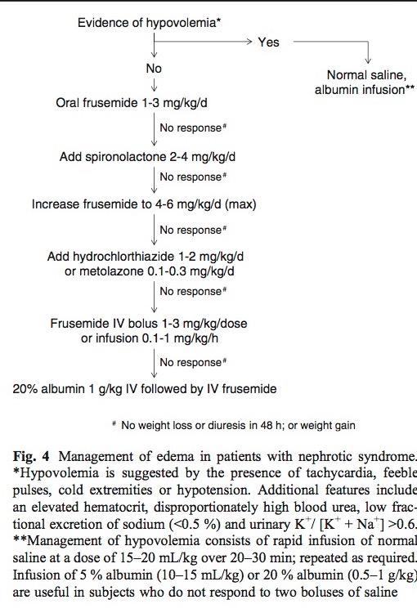

Slide 26
2. HYPOVOLEMIA-
Due to severe disease relapse or aggressive diuresis or poor oral intake or diarrhea or vomiting.
Clinical presentation-abdominal pain, lethargy leg cramps, tachycardia, hypotension, delayed capillary refill, low pulse volume and cold extremities.
On investigations- Blood urea: creatinine ratio>20, urine Na⁺ <20 meq/l, FeNa <1 %, rising hematocrit and K+ index >0.6.
*K⁺ index= urine K⁺/(urine K⁺+ urine Na⁺).
Treatment – Discontinue diuretics, increase oral fluid intake, normal saline bolus infusion, if not responding then IV albumin infusion.

Slide 27
3. HYPERTENSION-
Noted at the onset of the disease or develops due to high dose steroid.
Indication of treatment- persistent elevation of B.P. which is refractory to control of edema and persists with minimal dose of steroid.
Target B.P. is between 75th to 90th percentile.
Treatment-
  ACE inhibitor like enalapril ( 0.3 mg/kg to 0.6 mg/kg/day)
  Calcium channel blocker like amlodipine.

Slide 28
Dyslipidemia- Low fat diet with <30% calories via fats and <10% saturated fat and Dietary cholesterol < 300mg/ day.
HMGCoA Reductase inhibitor is recommended in children >5 yrs. if biochemical abnormality persists for >3-6 months, total cholesterol >200,LDL > 130 or TGs> 200.

Slide 29
5. Control of infections- If infection is suspected the blood culture should be sent prior to starting empirical antibiotics.
For SBP peritoneal fluid should be sent for culture.
Broad spectrum antibiotic for coverage of pneumococcus and Gram negative.
3rd generation cephalosporin is a common choice of i.v. antibiotic.
For suspected varicella- 7 days of acyclovir
Administration of varicella zoster immunoglobulin 400 mg/kg within 96 hrs of exposure prevents or lessens the severity of the disease in susceptible individuals.

Slide 30
6. Thromboembolism-
Risk factors- low intravascular volume, immobilization, indwelling vascular catheters, puncture of deep veins.
Clinical features-
  hematuria and flank pain- renal vein thrombosis
  venous congestion, pain and reduced mobility of limbs- deep vein thrombosis.
  Seizures, vomiting, altered sensorium- saggital sinus or cortical venous thrombosis.
Investigation- USG, Doppler or MRI brain if required.
Treatment -Anticoagulation with heparin or LMwt heparin followed by oral Warfarin for 4-6 months is therapy of choice if needed.

Slide 31
7. VACCINATION-
Live vaccines should be deferred till child is off immunosuppressive medication for min 4 weeks.
If required, vaccines can be given when child is on prednisolone <0.5 mg/kg alternate day.
Additional Vaccines to be given are as follows-
  Pneumococcal vaccine
  Varicella vaccine
  IPV

Slide 32
PARENT EDUCATION
Prior to discharge after treatment of initial episode sensitization of the parents about the disease is of extreme importance. Following should be advised.
Urine protein measurement by dipstick method. ( timing, interpretation, frequency, correct method)
Maintenance of a diary for recording the finding, any intercurrent illness and any treatment taken.
Explaining the disease prognosis and clearing that it is NOT A SOCIAL STIGMA.

Slide 33
4. Ensure normal activity and normal school attendance.
5. Bed rest is not required and could be harmful ( thrombosis).
6. Fluid restriction is not needed.

Slide 34
7. Prevention and early identification of infections to seek timely intervention.
8. Balanced diet
9. Educate regarding drug compliance and side effects of prednisolone.

Slide 35
MANAGEMENT OF RELAPSE
Identification and treatment of precipitating factor like minor infections( URTI ).
Symptomatic treatment of minor infections may result in remission of low grade proteinuria(1+/2+).
Persistence of 3+/4+ proteinuria requires treatment of relapse.

Slide 36
Steroid therapy- Prednisolone single daily morning dose @ 2mg/kg/day till remission followed by 1.5 mg/kg every alternate day for 4 weeks along with an antacid preparation.
If after 2 weeks of daily steroid therapy patient does not achieve remission the it is extended for 2 more weeks and after 4 weeks of daily therapy it is labeled as late steroid resistance.

Slide 37
MANAGEMENT OF FREQUENT RELAPSES AND STEROID DEPENDENCE
Following treatment of relapse with standard doses, dose of prednisolone is gradually tapered to 0.3-0.7 mg/kg on alternate days along with steroid sparing agents.
Maintenance dose of steroid to be continued for 9-18 months or longer if no side effects.
Break through relapses to be treated with the standard therapy of relapse.

Slide 38
Frequency of administration of prednisolone from alternate day to daily therapy during intercurrent minor infections is effective in preventing infection related relapses.
Steroid sparing agents are to be considered when
Prednisolone threshold >0.5-0.7 mg/kg alternate day
Presence of corticosteroid toxicity.

Slide 39
Side effects of prolonged steroid therapy
Cushingoid features- Obesity, hirsutism, striae
Hypertension
Impaired glucose control
Posterior subcapsular lenticular opacities
Growth retardation
G.I. perforation
Menstrual irregularities
Osteoporosis

Slide 40
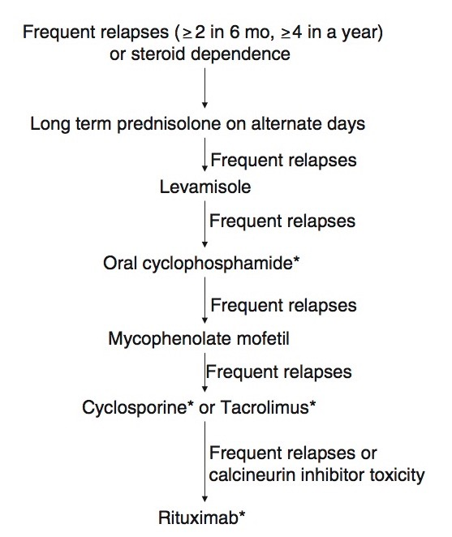
Order of steroid sparing agents to be used.

Slide 41
MANAGEMENT OF STEROID RESISTANT
Care should be taken to exclude systemic infections like peritonitis, cellulitis, respiratory tract infections which might cause persistent proteinuria.
Diagnostic renal biopsy.
Caused by FSGS (80%), MCNS or MPGN.
50 % risk of ESRD within 5 yrs. of diagnosis if partial or complete remission is not achieved.

Slide 42
Chief factor in predicting renal outcome is response to therapy rather than renal histology.
Treatment includes use of combination of immunosuppressive agent with prednisolone ( low dose alternate day therapy) and an ACE inhibitors.
First line of immunosuppressant to be used is calcinuerin inhibitors.
Others include cyclophosphamide, pulse corticosteroids with cyclophosphamide and rituximab ( in order of preference.

Slide 43
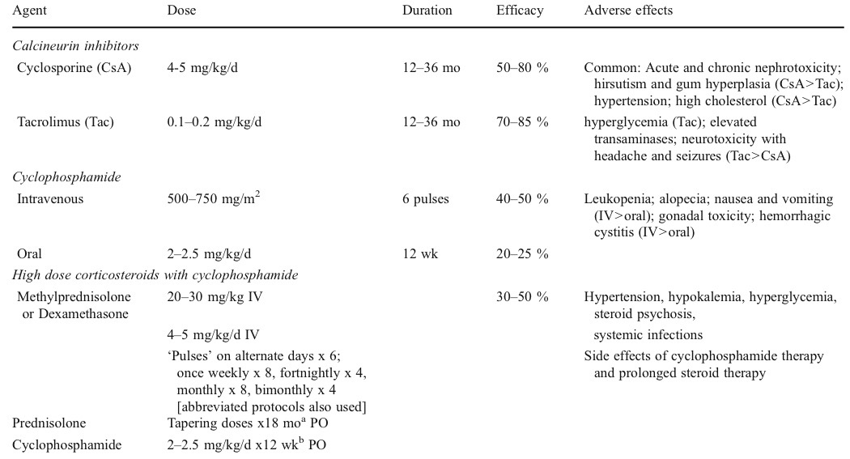

Slide 44
WHEN TO SUSPECT HEREDITARY NS
Congenital nephrotic syndrome ( onset < 3months)
Family history of steroid resistant nephrotic syndrome.
Sporadic initial steroid resistance which does not respond to Cyclophosphamide or Calcinuerin inhibitors.
Girls with steroid resistant FSGS.

Slide 45
DRUG MONITORING
Recommended for Cyclosporine and Tacrolimus.
Acceptable levels-
Cyclosporine- 80- 120 ng/ml
Tacrolimus – 4-7 ng/ml
Renal biopsy- recommended if receiving prolonged therapy with calcinuerin inhibitors(>2-3 yrs) or prolonged heavy proteinuria for >30 days.
Features- Nodular hyalinosis or striped interstitial fibrosis with tubular atrophy.

Slide 46
Stress Dose Of Steroids
Steroid supplementation during surgery, anesthesia or serious infection is required as prolonged therapy with steroids in these patients results in suppression of hypothalamo-pituitary axis.
Injectable hydrocortisone 2-4 mg/kg/day followed by oral prednisolone at 0.3- 0.6 mg/kg/day
Duration- equal to duration of stress and then tapered rapidly.

Slide 47
2nd LINE DRUGS
CYCLOPHOSPHOSPHAMIDE-
Alkylating agent of nitrogen mustard type
Interferes with DNA replication.
Used in patients with
  Significant steroid toxicity
  Severe relapses with infections and episodes of hypovolemia.
  Poor compliance and follow up
Children older than 7-8 yr, those with frequent relapses and low steroid threshold respond better to this drug.

Slide 48
2-2.5 mg/kg single daily dose for 8-12 weeks ( cumulative dose not more than 168 mg/kg) with alternate day steroid.( 1-1.5 mg/kg).prednisolone then tapered slowly over 4-6 wks.
Side effects- neutropenia, disseminated varicella, hemorrhagic cystitis, alopecia, sterility, increased risk of future malignancy.
Weekly monitoring of WBC counts, if <3000-4000/cumm withhold the drug . Fluid intake to be increased

Slide 49
2. LEVAMISOLE
Anthelminthic with Immunomodulator action.
2- 2.5 mg/kg for 12-24 months with alternate day steroid(0.75-1 mg/kg) for initial few weeks the prednisolone is tapered every 2-4 wk to a dose of 0.25- 0.5 mg/kg every alternate day.
Side effects- G.i. upset, flu like symptoms, transient neutropenia, hepatotoxicity, skin rash.
repeat CBC every 2-4 weeks.

Slide 50
3. MYCOPHENOLATE MOFETIL-
20-25 mg/kg/da in 2 divided doses for 12-36 months
steroid for 6-12 months in low doses.
Side effects- abdominal pain, diarrhea and leucopenia
CBC every 1-2 months.
4. CALCINUERIN INHIBITORS-
Tacrolimus and cyclosporine.
First line in steroid resistant Nephrotic syndrome
used in frequent relapses or steroid dependence that fail to benefit with levamisole, cyclophosphamide and/or mycophenolate mofetil.

Slide 51
Duration of therapy- for 2-3 yrs in patients showing partial or complete response followed by following options.
  Taper dose and continue at lowest dose for 1-2 yr
  Exclude nephrotoxicity
  Switch to a less nephrotoxic drug
Side effects- nephrotoxicity, hypertension, hirsutism, gum hyperplasia, hyperglycemia, tremors, headache, etc.
5. RITUXIMAB-
monoclonal Anti CD20 antibody.
Steroid dependent Nephrotic syndrome.
6-18 months remission with treatment.

Slide 52


Slide 53


