Slide 1
Introduction into Pharmacology…
By: Neha soni

Slide 2
Learning Objectives
Define the terms Pharmacology, Pharmacokinetics, Pharmacodynamics.
List the various routes of administration of drugs.
List factor effect on pharmacokinetics.
Define terms against, antagonist, dependence, therapeutic index and bioavailability.
Describe some factors that dedicate of the dose.

Slide 3
Historical Trends
Since the beginning people search to treat illness and cure disease the oldest known prescription found on a clay( 5000 years ago).
Primitive people through the Egyptian period believe that evil spirit living in the body.
Hipocrates ( fifth century) advanced idea that disease resulted from natural causes.
Monastries is the site of learning.
The arabs’ interest of in medicine, pharmacy and chimistry was reflected in hospitals and schools.

Slide 4
Historical Trends
In 1240 AD frederick || declared pharmacy to be separate from midicine.
Cordus wrote the first pharmacopeia
Paracelsus (1541) denounced humoral pathology, intrduce new remedies.
The first london pharmacopeia appeared 1618 including opium, tincture
The first pharmacopeia was the french codex 1818 followed by 1820 US pharmacopeia.

Slide 5
Historical Trends
In twenty first century, the emphasis on providing qaulity health care.
Nursing role which include administring medication in health care agency, community and home care setting, teaching client safe and effective self adminstration to better care for their clients.

Slide 6
Definitions
Pharmacology: is a science that studies the effect of the drugs on the body.
Pharmacopeias: are the total of all authorized drugs available within the country.
Medication: is a substance administered for diagnosis, cure, treatment, mitigation or prevention.
Prescription: the written direction for the preparation and the administration of the drug.

Slide 7
Cont …..
The therapeutic effect: is the primary effect intended that is the reason the drug is prescribed such as morphine sulfate is analgesia.
Side effect: secondary effect of the drug is one that unintended, side effects are usually predictable and may be either harmless

Slide 8
Cont …..
Drug toxicity: deleterious effect of the drug on an organism or tissue, result from overdose or external use.
Drug allergy: is immunological reaction to a drug.

Slide 9
Cont …..
Drug interaction: occur when administration of one drug before or after alter effect of one or both drug.
Drug misuse: Is the improper use of common medications in way that lead to acute and chronic toxicity for example laxative, antacid and vitamins.

Slide 10
Cont …..
Drug abuse: is an inappropriate intake of substance either continually or periodically.
Drug dependence: is a persons reliance on or need to take drug or substance there are two type of dependence:

Slide 11
Cont …..
Physiological dependence: is due to biochemical changes in the body tissue these tissue come to require substance for normal function.
Psychological dependence: is emotional reliance on a drug to maintain a since of wellbeing accompanied feeling of need.

Slide 12
Cont …..
  Drug habituation: denotes a mild form of psychological dependence.
  Illicit drug: also called street drug are those sold illegally.

Slide 13
basic concepts of Pharmacology
Pharmacokinetics: is a bout how the body deal with drug.
Pharmacodynamics: is effect of drug on the body.
Pharmacotherapeutics: is a clinical using of drug.
Pharmacognosy: The study of natural (plant and animal) drug sources.

Slide 14
PHARMACOGENOMICS
The effects of an individual’s genotype on the pharmacokinetics and pharmacodynamics of drug action.

Slide 15
Names of Drugs
The generic name: is given for the drug to being official name.
The official name: is the name under which its listed in one in the official publication.
The chemical name: is the name by which the chemist knows it.
The trade mark or brand name (proprietary name) : is name given by the drug manufacture
Example: hydrochlorothiazide (official name).
Esidrex (brand name)

Slide 16
Source of drugs
Plants: such as digitalis, vincristine.
Human and animals: such as epinphrine, insulin and adrenocoticotrpoic hormone.
Minirals: as iron, iodine and zinc
Synthetic and chemical substance: as sodium bicarbonate

Slide 17
Route of administration:
Oral is the most common
Advantage:
Least expensive and most convenient route for most clients.
Safe, does not break the skin.
Concoius, able to swallow.

Slide 18
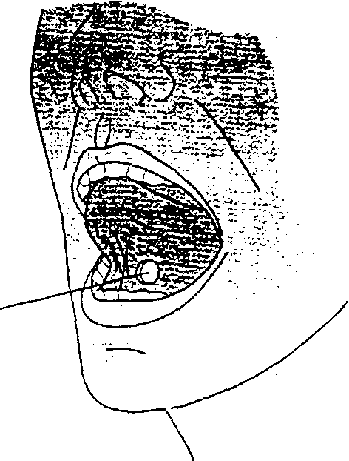
Oral medication

Slide 19
Oral Route
Disadvantage:
Inappropriate for client nausea and vomiting.
Drug may have unpleasant taste.
May cause irritation of gastro intestinal tract.
Drug may discolor teeth.
Drug can be aspirated by ill client.

Slide 20
Route of administration:
2. Sublingual: a drug placed under the tongue, where it dissolved.
Advantage:
Same as oral plus
Drug may administered for local effect.
Drug rapidly absorbed into blood stream.
More potent than oral.

Slide 21
Route of administration:
Disadvantage:
If swallowed drug may be inactive.
Drug must remain under the tongue until dissolved.
3. Baccal: pertaining to the cheeks.
3. Rectal: can be used when drug objectionable taste.
4. Translingual: on the tongue.

Slide 22
Route of administration:
5. Subcutaneous (SC): hypodermic into subcutaneous tissue, just below the skin.
Advantage: onset drug action faster than oral.

Slide 23
Route of administration:
Disadvantage: SC
  Must involve sterile technique because breaks skin barrier.
  More expensive than oral.
  Can administer only small doses.
  Slower than intramuscular injection.
  Some drug can irritate tissue and can cause pain.

Slide 24
Route of administration:
6.Intramuscular (IM): into in the muscle.
Advantage:
Pain from irritating drugs is minimized.
Can administer large volume of drug.
Drug rapidly absorbed.
Disadvantage:
breaks skin barrier.
Can be anxiety producing.

Slide 25
Route of administration:
7. Intradermal (ID): is the administrating of a drug into the dermal layer of the skin just beneath the epidermis, usually small amount of liquid is used for example 0.1ml.
Advantage: absorption is slow (this advantage test for allergy).
Disadvantage: amount of drug administered must be small.
Breaks skin barrier

Slide 26
Route of administration:
8. Intravenous (IV): allow injection of drugs and another substance directly into bloodstream through the vein.
9. Inhalation: is apply to drugs directly onto lungs.

Slide 27
10. Specialized infusion
Intrathecal: inject onto CSF.
Intrapleural: injected onto plural cavity.
Intraosseous: injected into rich vascular network of long bone.
Epidural: inject to epidural space.
Intraarticular: inject onto joint.

Slide 28
11. Topical Route
Skin (including transdermal patches)
Eyes
Ears
Nose
Lungs (inhalation)
Vagina

Slide 29
Home Work 1
Write advantages and disadvantages of each route of drug administration.

Slide 30
Testing of the new drugs before use
Not teratogenic ( causes birth defect)
Carcinogenic ( causes cancer)
Toxicity studies not harmful to body system.
It should specific in action and its mechanism of action understood as complitly as possible.
Optimal route of administration.

Slide 31
The Dose
The aim to give patient adose of the drug that achieves the desired effect with out causing with harmfull side effect.
Therapeutic index: is a measure of the danger of poisoning and the higher it is safer of drug is.
Aspirin (3.5), digoxin (2)

Slide 32
Bioavailability: Means that the drug has reached the circulation and is therefore available for all the tissues. (ex: aspirin 600 mg).
Tolerance: A decreasing response to repetitive drug doses

