Slide 1
GASTROINTESTINAL DISEASES
BY: Dr. Sheetal Chhaya
Associate Professor
Dept. of Clinical Nutrition

Slide 2
DIARRHOEA

Slide 3
Definition
Diarrhoea is characterized by the frequent evacuation of liquid stools, usually exceeding 300 ml, accompanied by an excessive loss of fluid and electrolytes, especially sodium and potassium.
It occurs when there is excessively rapid transit of intestinal contents through the small intestine, decreased enzymatic digestion of foodstuffs, decreased absorption of fluids and nutrients, increased secretion of fluids into the GI tract, or exudative losses

Slide 4
Causes
Acute diarrhea usually is caused by
Gastroenteritis
Antibiotic use
Food allergies
Food poisoning
Chronic diarrhea usually is caused by
Dietary factors
Infection
Celiac disease
Inflammatory bowel disease
Chronic diarrhoea can also be caused by anatomic disorders and disorders that interfere with absorption or digestion.

Slide 5
Types of diarrhoea
Osmotic diarrhoeas occur when osmotically active solutes are present in the intestinal tract and are poorly absorbed. Examples include the diarrhea that accompanies dumping syndrome and that which follows lactose ingestion in the person with a lactase deficiency.

Slide 6
2. Secretory diarrheasa are the result of active intestinal secretion of electrolytes and water by the intestinal epithelium, resulting from bacterial exotoxins, viruses, and increased intestinal hormone secretion.
3. Exudatiae diarrheas are always associated with mucosal damage, which leads to an outpouring of mucus, fluid,blood, and plasma proteins, with a net accumulation of electrolytes and water in the gut.
4. Medication-induced diarrheas may be caused by several medications, but especially antibiotics.

Slide 7
Medical nutrition therapy
Replacement of necessary fluids and electrolytes is the first step in managing diarrhea, using electrolyte solutions, soups and broths, vegetable juices, and other isotonic liquids.
The key objective is to limit large amounts of hyperosmotic carbohydrates that may be maldigested or malabsorbed, foods that stimulate secretion of fluids, and foods that speed the rate of GI transit.
Sugar alcohols, lactose, fructose,and large amounts of sucrose may worsen osmotic diarrhea.

Slide 8
prebiotic components such as pectin, fructose oligosaccharides , inulin, oats ,banana flakes, and chicory may actually help to control or treat diarrhea.
SCFAs in physiologic quantities serve as substrate for colonocytes, facilitate the absorption of fluid and salts, and may help to regulate GI motility.
Fibrous materials also lowers down the gastric motility.
In more severe diarrhea, dehydration can occur quickly, especially in children. Oral rehydration with fluids containing glucose, Na+, K+, Cl–, and bicarbonate or citrate is preferred in most cases to intravenous fluids.
Zinc is given along with ORS

Slide 9
DYSENTRY

Slide 10
Definition
Its infection of the intestines resulting in severe diarrhoea with the presence of blood and mucus in the faeces.
Characteristic features include:
abdominal pain and cramps,
straining at stool
frequent passage of watery diarrhea or stools containing blood and mucus.
It can be caused by a number of infectious agents ranging from viruses and bacteria to protozoa and parasitic worms;

Slide 11
It may also result from chemical irritation of the intestines. Dysentery is one of the oldest known gastrointestinal disorders.
Groups of people at increased risk of dysentery are military personnel stationed in developing countries, frequent travelers, children in day care centers and people in nursing homes.

Slide 12
Types of dysentery
Bacillary dysentery:
Amebic dysentery:
Balantidiasis, giardiasis, and cryptosporidiosis:
Viral dysentery:
Dysentery caused by parasitic worms:

Slide 13
Causes
Bacillary dysentery:
Bacillary dysentery, which is also known as shigellosis, is caused by four species of the genus Shigella.
The Shigella organisms cause the diarrhea and pain associated with dysentery by invading the tissues that line the colon and secreting an enterotoxin,
2. Amebic dysentery: Amebic dysentery, which is also called intestinal amebiasis and amebic colitis, is caused by a protozoon, Entamoeba histolytica means "tissue-dissolving.

Slide 14
3. Balantidiasis, giardiasis, and cryptosporidiosis:
These three intestinal infections are all caused by protozoa, Balantidium coli.
The disease agents may cause dysentery in children or immunocompromised individuals.
4. Viral dysentery: Viral dysentery, which is sometimes called traveller's diarrhea or viral gastroenteritis.
It is caused by several families of viruses, including rotaviruses (children) , caliciviruses (adults), astroviruses, noroviruses, and adenoviruses.

Slide 15
5. Dysentery caused by parasitic worms:
Both whipworm (trichuriasis) and flatworm (schistosomiasis) infestations may produce the violent diarrhea and abdominal cramps associated with dysentery.

Slide 16
Symptoms
In addition to the characteristic bloody and/or watery diarrhea and abdominal cramps of dysentery, the various types have somewhat different symptom profiles:
Bacillary dysentery:(BD)
The high fever
pain in the rectum and abdominal cramping.
2 complications of BD outside the digestive tract: bacteremia (bacteria in the bloodstream), which is most likely to occur in malnourished children;
and hemolytic uremic syndrome, a type of kidney failure that has a mortality rate above 50 percent.
Amebic dysentery.
diarrhea with bloody stool
It has a slow and gradual onset;
Fever is unusual with amebiasis unless the patient has developed a liver abscess as a complication of the infection.

Slide 17
fulminant or necrotizing colitis,
{which is a severe inflammation of the colon characterized by dehydration, severe abdominal pain, and the risk of perforation (rupture) of the colon.}
Dysentery caused by other protozoa: .
bloating and foul-smelling flatus,
nausea and vomiting, headaches, and low-grade fever.
The symptoms of cryptosporidiosis are mild in most patients but are typically severe in patients with AIDS.
Viral dysentery:
low-grade fever.
nausea and vomiting.

Slide 18
Dysentery caused by parasitic worms:
bloody diarrhea and abdominal pain,
these patients usually have fatigue.
An examination of the patient's colon will usually reveal areas of ulcerated tissue, which is the source of the bloody diarrhea.

Slide 19
Treatment
Bacillary dysentery:
is usually treated with such antibiotics
[as trimethoprim-sulfamethoxazole (Bactrim, Septra), nalidixic acid (NegGram), or ciprofloxacin (Cipro, Ciloxan). ]
Patients with bacillary dysentery should not be given antidiarrheal medications, because they may make the illness worse.
Amebic dysentery.:
drugs given for amebiasis are diloxanide furoate (Diloxide), iodoquinol (Diquinol, Yodoxin), and metronidazole (Flagyl).
Metronidazole should not be given to pregnant women but paromomycin (Humatin) may be used instead.

Slide 20
Dysentery caused by parasitic worm:
treated with anthelminthic
most commonly mebendazole (Vermox).
New drug : tinidazole .
Fluid replacement is given if the patient has shown signs of dehydration.
[Infalyte and Pedialyte are oral rehydration fluids formulated for infants and young children.]
supplemental zinc boosts the body's immune response during acute shigellosis.

Slide 21
MNT
Diarrhea in dysentery causes dehydration ,so foods need to be focused on replacing lost fluid.
oral hydration or saline drip with sodium and glucose will provide patient with necessary fluids and nutrients.
rehyration is important so drinking electrolyte water may help supply essential nutrient; gradually introduce tea and diluted fruit juice.
soft bland foods such as banana and apples provide essential nutrients and potassium.They have pectin ,water soluble fiber which help reduce diarrhea.
For improving colon health probiotics are given.
Traditinal medicines like ginger and peppermint are used for treating.

Slide 22
Foods to avoid:
diary products- irritate your bowels worsening disrrhea.
spicy , greasy , fried foods - trigger bowel irritation
processed foods
alcoholic beverages, carbonated and caffeinated drinks.
food that aggravate diarrhea are raw vegetable, red meat and fruits that have high amount of fiber.

Slide 23
GERD

Slide 24
INTRODUCTION
Definition:
Gastroesophageal reflux disease (GERD) is defined as a “chronic disorder
related to retrograde flow of gastro-duodenal contents into the esophagus
resulting in a spectrum of symptoms, with or without tissue damage.”
Prevalence:
The range of GERD prevalence is estimated as:
18.1%-27.8% in North America
8.8%- 25.9% in Europe
2.5%-7.8% in East Asia
8-20% in India

Slide 25
Pathophysiology:
Human body has natural anti-reflex mechanisms.
Esophageal peristalsis and lower esophageal sphincter (LES) are important
components of it.
Esophageal peristalsis is the main determinant of esophageal clearance of
refluxate ( content that rise from upper gastrointestinal tract into
esophagus).
Defective peristalsis is associated with severe GERD, both in terms of
symptoms and of mucosal damage.
LES creates a pressure zone between esophagus and stomach that prevents
reflux.
However, a normal LES pressure don’t exclude GERD because more
frequent and prolonged relaxation of LES can also contribute to GERD.

Slide 26
Causes:
Hiatal hernia ( a condition in which part of stomach moves above diaphragm)
Pregnancy
Obesity
Increased abdominal pressure
Reduced LES pressure
Delayed gastric emptying
Recurrent vomitting
Certain drugs like:
Non-Steroidal Anti-Inflammatory Drugs (NSAIDS)
Anticholinergics
Brochodilators (for asthma)
Calcium channel blockers for high blood pressure
Dopamine active drugs
Progesterone containing drugs
Sedatives

Slide 27
Symptoms of GERD:
Feeling that food is struck behind the breastbone.
Heartburn
Nausea after eating.
Bringing food back up (regurrgitation)
Difficulty swallowing
Hiccups
Hoarseness
Sore throat
Symptoms may get worse when you bend over or lie down, or after
you eat.
Symptoms may also be worse at night.

Slide 28
Medical management:
The medical treatment of GERD is directed towards reduction of acid
secretion.
Drugs used for medical treatment of GERD include:
Proton pump inhibitors
H 2 receptor antagonists
Antacids
Patients with severe gastroesophageal reflux who do not respond to the
medical therapy and repeatedly deal with symptoms and complications, can
be treated surgically with fundoplication, a procedure in which fundus of the
stomach is wrapped around the lower esophagus to limit reflux.

Slide 29
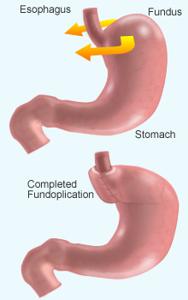
Fundoplication

Slide 30
Medical Nutrition Therapy:
Avoid large, high fat meals as the delay gastric emptying and increase acid
production.
Avoid eating 3-4 hours before retiring because it lowers LES pressure.
Avoid fried food.
Avoid smoking and alcohol.
Avoid foods with acidic ph like citrus juices, tomatoes, coffee, tea and soft
drinks.
Avoid spicy foods.
In certain conditions, harsh foods like chips, crackers, seeds, etc. may cause
perforation of esophageal mucosa.
Avoid lying down after meal.
Lose weight if overweight.
Stay upright and avoid vigorous activity after meal.

Slide 31
IBS

Slide 32
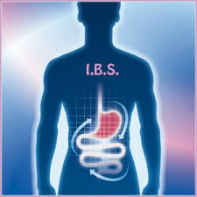
What is IBS?
Irritable bowel syndrome (IBS) is a group of symptoms—including abdominal pain and changes in the pattern of bowel movements without any evidence of underlying damage.
These symptoms occur over a long time, often years.
It has been classified into four main types depending on if diarrhoea is common, constipation is common, both are common, or neither occurs very often:
IBS-D
IBS-C
IBS-M
IBS-U

Slide 33
IBS is a functional gastrointestinal disorder.
Disorders such as anxiety, major depression, and chronic fatigue syndrome, are common among people with IBS.
Onset may be triggered by an intestinal infection, or stressful life event.

Slide 34
SIGNS AND SYMPTOMS
The primary symptoms of IBS are abdominal pain or discomfort in association with frequent diarrhoea or constipation and a change in bowel habits.
Symptoms usually are experienced as acute attacks that subside within one day, but recurrent attacks are likely.
There may also be urgency for bowel movements, a feeling of incomplete evacuation (tenesmus), bloating, or abdominal distension.
People with IBS, more commonly than others, have gastroesophageal reflux, symptoms relating to the genitourinary system, chronic fatigue syndrome, fibromyalgia, headache, backache, and psychiatric symptoms such as depression and anxiety
Patients with IBS often complain of a broad range of non-gastrointestinal symptoms. These include impaired sexual function, dysmenorrhea, dyspareunia, increased urinary frequency and urgency.

Slide 35
CAUSES OF IBS:
Post-infectious
Approximately 10 percent of IBS cases are triggered by an acute gastroenteritis infection.
Genetic defects relating to the innate immune system and epithelial barrier as well as high stress and anxiety levels appear from evidence to increase the risk of developing post-infectious IBS.
Post-infectious IBS usually manifests itself as the diarrhoea predominant subtype.
However, increased gut permeability is strongly associated with IBS regardless of whether IBS was initiated by an infection or not.

Slide 36
Stress
Psychiatric illness or anxiety precedes IBS symptoms in two-thirds of patients, and psychological traits predispose previously healthy people to developing IBS after gastroenteritis.
Bacteria
Small intestinal bacterial overgrowth occurs with greater frequency in patients who have been diagnosed with IBS compared to healthy controls.
SIBO is most common in diarrhoea-predominate IBS but also occurs in constipation-predominant IBS more frequently than healthy controls. Symptoms of SIBO include bloating, abdominal pain, diarrhoea or constipation among others.

Slide 37
ROME CRITERIA III FOR DIAGNOSIS:
The Rome III Criteria for IBS are:
Recurrent abdominal pain or discomfort at least 3 days/month in the last 3 months associated with two or more of the following:
Improvement with defecation
Onset associated with a change in frequency of stool
Onset associated with a change in form (appearance) of stool
Criterion fulfilled for the last 3 months with symptom onset at least 6 months prior to diagnosis

Slide 38
DIAGNOSIS:
The diagnostic evaluation depends upon whether the predominant symptom is diarrhoea or constipation:
Diarrhoea predominant IBS — In patients with diarrhoea as the predominant symptom, we suggest performing screening tests based upon the patient's clinical history. These include, but are not limited to, the following:
Stool cultures – There is little role for stool cultures in patients with chronic diarrhoea.
Celiac disease screening – Screening for celiac disease with serum IgA antibody to tissue transglutaminase should be performed in patients with diarrhoea-predominant IBS.
Twenty-four hour stool collection – A twenty-four hour stool collection should be considered if osmotic or secretory diarrhoea or malabsorption is suspected
Colonoscopy or flexible sigmoidoscopy and biopsy – Many causes of chronic diarrhoea such as microscopic colitis require endoscopic evaluation.

Slide 39
2. Constipation predominant IBS — In patients with constipation as the predominant symptom, performing screening tests based upon the patient's clinical history is suggested . These include, but are not limited to, the following:
Radiography – A plain film of the abdomen can detect retained stool and suggest the diagnosis of constipation.
Flexible sigmoidoscopy and colonoscopy – Sigmoidoscopy or colonoscopy should be performed if a structural lesion is suspected. Colonoscopy is preferred in patients who are older than 50 because of the increased risk of colon cancer in this age group.
3. Mixed IBS — In patients with both diarrhoea and constipation performing screening tests based upon the patient's clinical history,is suggested.

Slide 40
FODMAP DIET IN IBS:
Certain food components can cause the bowel to distend by drawing in more fluid and rapidly generating gas when they are fermented by bowel bacteria.
The main dietary components that do this are known as fermentable, poorly absorbed short-chain carbohydrates. In other words, they are indigestible sugars that provide fast food for bacteria.
Such sugars have been given the acronym FODMAP which stands for:
Fermentable — rapidly broken down by bacteria in the bowel
Oligosaccharides — fructans and galacto-oligosaccharides (GOS)
Disaccharides — lactose
Monosaccharides — fructose
And
Polyols — sorbitol, mannitol, xylitol and maltitol

Slide 41
How do FODMAPs contribute to IBS?
FODMAPs are ‘fast food’ for the bacteria that live naturally in the large bowel. The large bowel (and the lower part of the small bowel) naturally contains billions of bacteria.
The bacteria that live there see these food molecules as ‘fast food’ and quickly break them down, which produces hydrogen, carbon dioxide and methane gases.
Multiple types of FODMAPs are usually present in any one meal. Because they all cause distension in the same way once they reach the lower small bowel and colon, their effects are cumulative.
Low FODMAP diet is good in IBS.

Slide 42
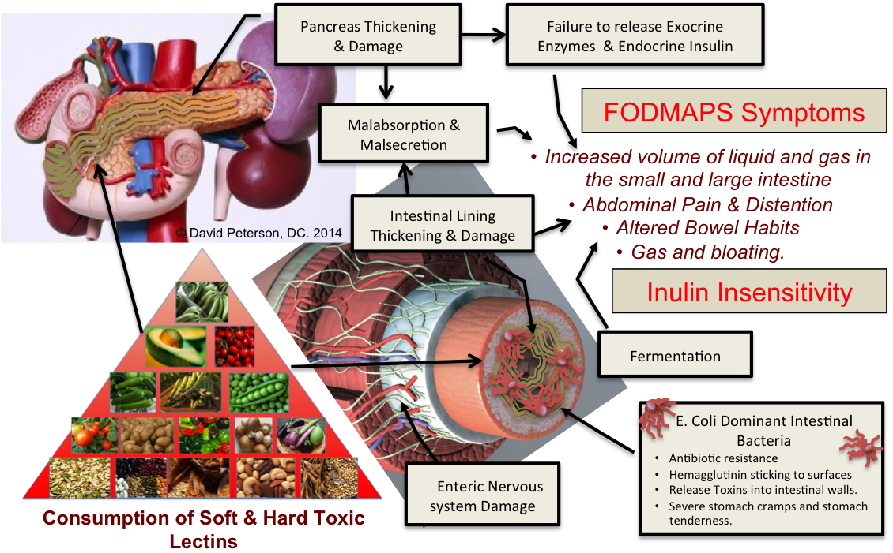

Slide 43
