Slide 1
Acute Inflammation Vascular And Cellular Events
Dept. of pathology
Sbks medical college

Slide 2
OBJECTIVES
AT THE END OF LECTURE STUDENT SHOULD BE ABLE TO ANSWER THE FOLLOWING QUESTIONS
MECHANISMS OF Acute Inflammation Vascular And Cellular Events
EXAMPLES

Slide 3
INFLAMMATION
Inflammation is a complex reaction to injurious agents or a local physiological response to cell injury
Cell injury:
  Exogenous stimuli
  Endogenous stimuli
In vascularized tissues, the stimuli provoke a host response ----inflammation

Slide 4
“CARDINAL SIGNS" OF INFLAMMATION
Described by CELSUS
Rubor – redness histamine, serotonin, C3a,
Calor – heat C5a, PGI
Tumor- swelling - histamine, bradykinin, PG
Dolor-pain – PG , bradykinins , substance P
Functio laesa (Virchow) loss of function

Slide 5
HISTORY
Celsus – described 4 clinical features of inflammation
Virchow – described functio laesa
Elie Metchnikoff 1880 - phagocytosis**
Paul Ehrlich – humoral theory**
** In 1908 Nobel Prize for describing the features of inflammmation

Slide 6
STIMULI FOR ACUTE
INFLAMMATION
Infections- bacterial, viral, parasitic etc
Trauma
Physical and chemical agents-burns, frost bite, irradiation, chemical
Tissue necrosis
Foreign bodies- sutures, splinters, dirt
Immune reactions- hypersensitivity reactions

Slide 7
INFLAMMATION
BENEFICIAL EFFECTS – prevents spread of infection
HARMFUL EFFECT – eg: abscess – SOL in brain – compresses vital structures, fibrosis in chronic inflammation distorts tissue,
hypersensitivity reactions
Inflammation – 3 components
  vascular responses
  migration and activation of leukocytes
  systemic reaction

Slide 8
ACUTE INFLAMMATION
VASCULAR CHANGES:
  Alteration in caliber & flow - vasodilatation
  Structural changes - increased vascular permeability
CELLULAR EVENTS:
  Emigration of leukocytes
  Activation

Slide 9
VASCULAR EVENTS
VASODILATATION
  earliest manifestations of acute inflammation
  increased blood flow – heat and redness
  induced by the action of several mediators on vascular smooth muscle - histamine and nitric oxide (NO)

Slide 10
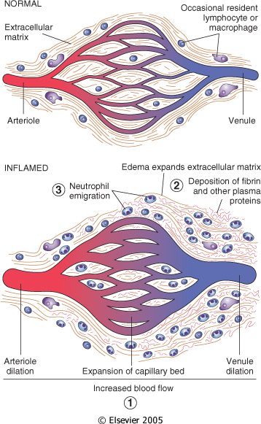
VASCULAR EVENTS IN ACUTE INFLAMMMATION
Interstitial tissue

Slide 11
INCREASED VASCULAR PERMEABILITY
IMMEDIATE, TRANSIENT RESPONSE
Endothelial cell contraction- intercellular
gaps in post-capillary venues fluid getting out through these gaps
Chemical mediators – histamine, bradykinin
C3a, C5a
IMMEDIATE, SUSTAINED RESPONSE
Severe injuries eg: burns, bacterial infections - neutrophils injure endothelial cells
We have exudation because of that

Slide 12
INCREASED VASCULAR PERMEABILITY
DELAYED, PROLONGED RESPONSE
Increased permeability begins after a delay and lasts for hours - days
Thermal injury, radiation, sunburn

Slide 13
INCREASED VASCULAR PERMEABILITY
Leukocyte mediated endothelial injury
Leakage from new blood vessels weak fragile so we can get leakage from BV
Early phase of increased vascular permeability - ↑ hydrostatic pressure – ↑ interstitial fluid –
TRANSUDATE
Later phase – exudation of protein-rich fluid -
EXUDATE – EDEMA (tumor)

Slide 14
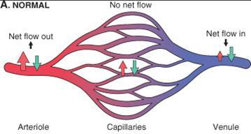
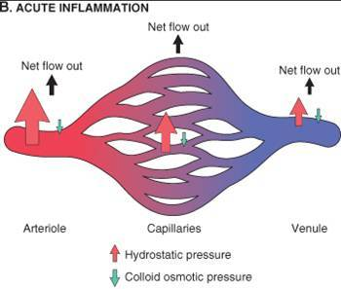
↑ VASCULAR PERMEABILITY
- EDEMA

Slide 15
EXUDATE VERSUS
TRANSUDATE
CHARACTER | TRANSUDATE | EXUDATE
Color | Transparent | Opaque (dense)
Protein content | < 2.5 Gm | > 3.5 Gm
Fibrinogen Albumin | - mostly | +++ ++
Specific gravity Cells | <1.012 Lymphocytes | >1.020 Neutrophils

Slide 16
CELLULAR EVENTS
Margination: WBCs assume a peripheral
position along the endothelial surface
Rolling: After margination, individual and then rows of leukocytes tumble slowly along the endothelium and adhere transiently
Adhesion: cells adhere to activated endothelium
Transmigration between endothelial cells
Also known as daipadeses

Slide 17
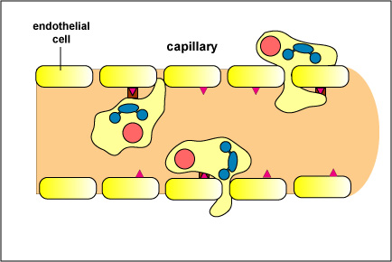
CELLULAR EVENTS
Diapedesis: Transmigration across the endothelium. Insert pseudopods in between endothelial junctions.
Migration in interstitial tissues towards chemotactic stimulus
Killing the offending agent

Slide 18
CELLULAR EVENTS
Events are regulated by binding of
complementary adhesion molecules on
leukocyte and endothelium complementary adhesion molecules
SELECTINS – E – selectin, (endothelial cells), P- selectin (endothelium & platelets)
INTEGRINS
IMMUNOGLOBULIN FAMILY
MUCIN-LIKE GLYCOPROTEINS

Slide 19
IMMUNOGLOBULIN FAMILY MOLECULES
ICAM-1 and VCAM-1
  These bind integrins on leukocytes
ICAM-1 intercellular cellular adhesion molecules: Adhesion, arrest and transmigration of leukocytes
VCAM-1 vascular: Adhesion of eosinophils, monocytes, lymphocytes
PECAM (CD31): Leucocyte migration through endothelium

Slide 20
ENDOTHELIAL/LEUKOCYTE ADHESION MOLECULES
ENDOTHELIAL MOLECULE | LEUKOCYTE RECEPTOR | MAJOR ROLE
P-SELECTIN | Sialyl-Lewis X PSGL-1 | Rolling
E-SELECTIN | Sialyl-Lewis X | Rolling, adhesion to activated endothelium
ICAM-1 | INTEGRINS | Adhesion, transmigration
VCAM-1 | INTEGRINS Chronic inflammation | Adhesion
CD31 (PECAM) | CD31 | Leukocyte migration through endothelium

Slide 21
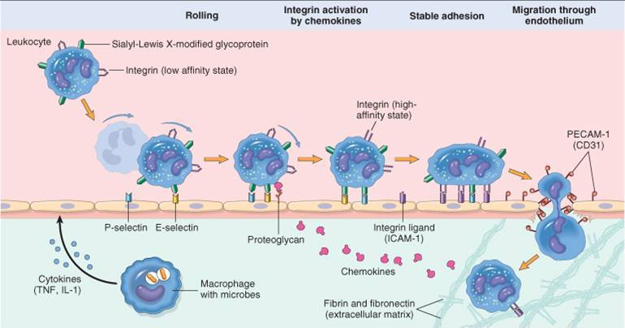
THE JOURNEY OF LEUKOCYTES FROM THE
VESSEL LUMEN
TO THE INTERSTITIAL TISSUE

Slide 22
CELLULAR EVENTS
CHEMOTAXIS chemical attractive
Transmigration of leukocytes between endothelial cells (diapedesis) towards site of
infection/injury
Chemotactic molecules – bacterial products, complement system (C5a), leukotriene B₄
_{Archidonic acid pathway}
Chemotactic attractive molecules bind to cell surface
receptors – influx of cytosolic calcium – pseudopod formation - movement of cells

Slide 23
LEUKOCYTE ACTIVATION
Production of arachidonic acid metabolites
from phospholipids leuktriens PGs
Oxygenation pathway
Degranulation and secretion of lysosomal
enzymes and activation of the oxidative burst
Secretion of cytokines, which amplify and
regulate inflammatory reactions

Slide 24
CELLULAR EVENTS
PHAGOCYTOSIS
Recognition & attachment of the particle to the ingesting leukocyte
Engulfment – formation of phagocytic vacuole
Killing & degradation of ingested material
OPSONIZATION – host proteins (C3b) coats microbes – microbes recognized by leukocytes - phagocytosis

Slide 25
CELLULAR EVENTS
PHAGOCYTOSIS
Opsonized particles bind to leukocyte
receptors – pseudopods around
the object – phagocytic vacuole – fuses with
membrane of a lysosomal granule – discharge
of granule contents – phagolysosome

Slide 26
CELLULAR EVENTS
KILLING & DEGRADATION OF
MICROBES
Microbicidal substances – reactive oxygen species (superoxide, H2o_{2,} hydroxyl ion), elastases, major basic protein (MBP)
Neutrophils undergo apoptotic death

Slide 27
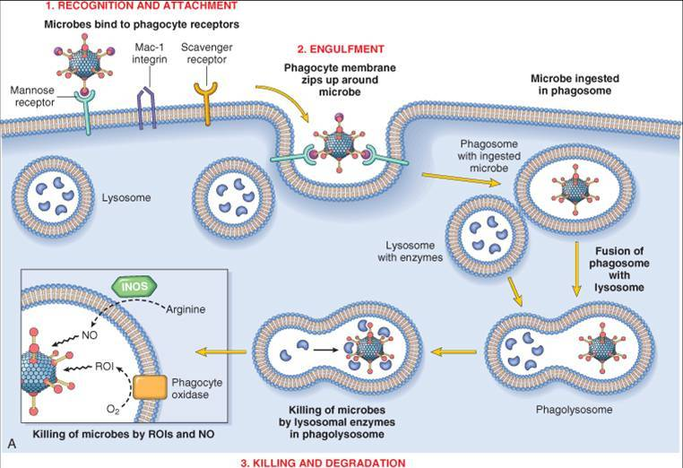

Slide 28
LEUKOCYTE DEFECTS AND DISEASES
GENETIC CAUSES
CHRONIC GRANULOMATOUS DISEASE:
  x linked, decreased oxidative burst
  NADPH oxidase coding gene defect
  CHEDIAK-HIGASHI SYNDROME CHS
  autosomal recessive, giant granules
  protein involved in organelle membrane docking and fusion
  Reduce lysosomes not combined with phagocytic particles
  albinism (reduced transfer of lysosomes to phagosomes)

Slide 29
LEUKOCYTE DEFECTS AND DISEASES
ACQUIRED
  Thermal injury
  Diabetes
  Malignancy
  Sepsis
  Immunodeficiencies

Slide 31
Apoptosis, Pyroptosis, and Necrosis: Mechanistic Description of Dead
and Dying Eukaryotic Cells
Susan L. Fink1 and Brad T. Cookson2*
Molecular and Cellular Biology Program1 and Departments of Laboratory Medicine and Microbiology,2
University of Washington, Seattle, Washington
NAME OF AUTHOR | TITLE OF STUDY & DESIGN | AIM | RESULT | CONCLUSION
Susan L. Fink1 and Brad T. Cookson2 | Apoptosis, Pyroptosis, and Necrosis: Mechanistic Description of Dead and Dying Eukaryotic Cells LEVEL 3 | wide variety of pathogenic microorganisms have been demonstrated to cause eukaryotic cell death, either as a consequence of infecting host cells or by producing toxic products. Pathogen-induced host cell death has been characterized as apoptosis in many of these systems. It is increasingly being recognized that cell death with some of the features of apoptosis may result from a variety of molecular pathways and that experimental techniques used to identify cell death often do not distinguish among these mechanisms. We propose that a clear understanding of the diversity of processes mediating cell death has been obscured by the simplicity of the nomenclature system commonly employed to describe eukaryotic cell death. This review presents a perspective on eukaryotic cell death and discusses experimental techniques used to study these processes | The study of pathogen- induced host cell death has gained attention with the recognition that this phenomenon may not be merely an incidental finding during infection but, rather, a controlled and modifiable process with significant implications for disease pathogenesis (37). Host cell death may impair normal organ function and lead to associated signs and symptoms of disease. Microbial pathogens may improve their ability to persist in infected hosts by causing the death of cells required for host defense (147). Although some intracellular pathogens may employ strategies to prevent cell death during pathogen replication, escape and dissemination to new host cells may eventually require cell lysis. | Despite the widespread use of the apoptosis and necrosis paradigm, a substantial body of literature indicates that the true biological spectrum of cell deaths is much more diverse. Apoptosis is a form of caspase-mediated cell death with particular morphological features and an anti-inflammatory outcome. Necrosis describes the postmortem observation of dead cells that have come to equilibrium with their environment. Oncosis is the prelethal process that occurs in ATP-depleted cells that manifest the morphological changes of swelling and eventual membrane permeability. Autophagy involves degradation of intracellular components within autophagic vacuoles. Pyroptosis is a pathway of cell death that inherently results in inflammation. Many techniques have been used to measure specific characteristics associated with cell death. Reporting experimental results in terms of the techniques used rather than as percent apoptosis or cell death will clearly indicate the particular feature of death being measured. By carefully examining the molecular processes that occur in dying cells and paying heed to the outcomes of cell death that influence inflammation and the development of immune responses, we will better characterize novel pathways of cell death and further our understanding of the pathologies underlying a variety of human health problems.

Slide 32
Mcqs
The anti-inflammatory properties of aspirin affects?
Vasodilatation
Chemotaxis
Phagocytosis
Leucocyte emigration
Release of leukocytes from the bone marrow

Slide 33
Leucocyte emigration from venules is influenced by
Selectins
Integrins
Chemokines
Complement C3a
Prostaglandins

Slide 34
Which cause pain in acute inflammation?
C3a
C5a
LTB4
PGE
Bradykinin

Slide 35
During acute inflammation, there is a ‘burst’ of oxygen consumption (respiratory burst) in neutrophils. This is an essential step for which of the following events?
Increased neutrophil production in the bone marrow
Attachment to the endothelial cells
Opsonization of bacteria
Phagocytosis of bacteria
Generation of microbicidal activity

Slide 36
Complement products are involved in
Chemotaxis
Increased vascular permeability
Neutrophil activation
Phagocytosis
Killing of bacteria in the phagocytic vacuol

Slide 37
Following emigration from blood vessels, leucocyte migration to the site of infection or injury is mediated by
Bradykinin
Chemokines
Complement C5a
Histamine
Prostaglandins

Slide 38
Thank you

