Slide 1
Apoptosis
Programmed cell death
  Especially during fetal development
  In response to hormonal cycles (e.g. endometrium)
  Normal turnover in proliferating tissues (e.g. intestinal epithelium)
Cells shrink, not swell
Nuclei condense and DNA fragments
Cells fragment into membrane-bound bits
Bits are phagocytosed by macrophages

Slide 2
Apoptosis—mitochondrial activation
Initiated by cellular damage or viral infection
Mitochondrial membrane permeability regulated by Bcl-2, Bcl-x, Mcl-1
Activated by BH3-only proteins which create Bax/Bak channels
Cytochrome C released to cytosol
CytC binds Apaf-1and activates caspase-9
Caspases (cysteine proteases that cleave after aspartate residues) activate a cascade of lytic enzymes
Cellular and nucleosomal fragmentation occurs
Dead cell fragments removed by phagocytes

Slide 3
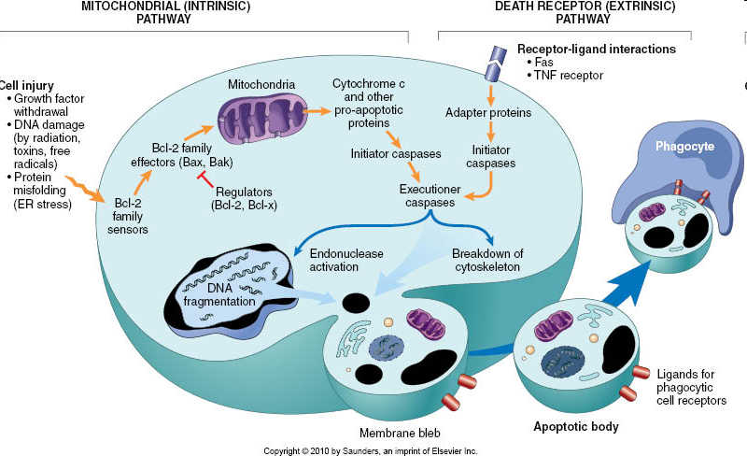
Notes:
FIGURE 1–24 Mechanisms of apoptosis. The two pathways of apoptosis differ in their induction and regulation, and both culminate in the activation of “executioner” caspases. The induction of apoptosis by the mitochondrial pathway involves the action of sensors and effectors of the Bcl-2 family, which induce leakage of mitochondrial proteins. Also shown are some of the anti-apoptotic proteins (“regulators”) that inhibit mitochondrial leakiness and cytochrome c–dependent caspase activation in the mitochondrial pathway. In the death receptor pathway engagement of death receptors leads directly to caspase activation. The regulators of death receptor–mediated caspase activation are not shown. ER, endoplasmic reticulum; TNF, tumor necrosis factor.

Slide 4
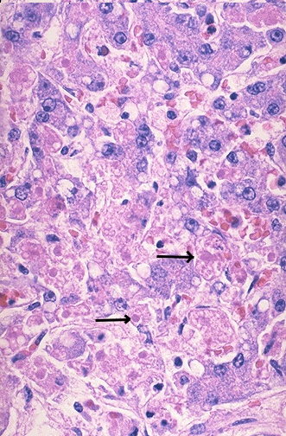
Apoptotic liver
Apoptosis is a more orderly process of cell death. Apoptosis is individual cell necrosis, not simultaneous localized necrosis of large numbers of cells. In this example, hepatocytes are dying individually (arrows) from injury through infection by viral hepatitis. The apoptotic cells are enlarged, pink from loss of cytoplasmic detail, and without nuclei. The cell nucleus and cytoplasm become fragmented as enzymes such as caspases destroy cellular components.
Notes:
http://library.med.utah.edu/WebPath/CINJHTML/CINJ014.html

Slide 5
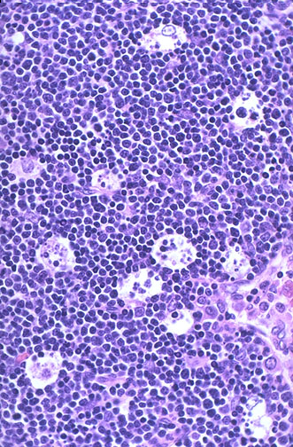
Apoptotic fetal thymus
In this fetal thymus there is involution of thymic lymphocytes by the mechanism of apoptosis. In this case, it is an orderly process and part of normal immune system maturation. Individual cells fragment and are consumed by phagocytes to give the appearance of clear spaces filled with cellular debris. Apoptosis is controlled by many mechanisms. Genes such as BCL-2 are turned off and Bax genes turned on. Intracellular proteolytic enzymes called caspases produce much cellular breakdown.
Notes:
http://library.med.utah.edu/WebPath/CINJHTML/CINJ054.html

Slide 6
Regional and Systemic Cytokine Responses to Acute Inflammation of the Vermiform Appendix
Rivera-Chavez, Fernando A. MD*; Wheeler, Herbert BSc*; Lindberg, Guy MD§; Munford, Robert S. MD†‡; O’Keefe, Grant E. MD*
NAME OF AUTHOR | TITLE OF STUDY & DESIGN | AIM | RESULT | CONCLUSION
Rivera-Chavez, Fernando A. MD*; Wheeler, Herbert BSc*; Lindberg, Guy MD§; Munford, Robert S. MD†‡; O’Keefe, Grant E. MD* | Regional and Systemic Cytokine Responses to Acute Inflammation of the Vermiform Appendix LEVEL 2 | To measure local (peritoneal fluid) and systemic (plasma) cytokine profiles in patients with infection-inflammation of the vermiform appendix, a relatively mild, localized inflammatory process | Of the proinflammatory cytokines tumor necrosis factor-alpha was present in PF but not in plasma, interleukin (IL)-1β and interferon-γ were found in low concentrations in both PF and plasma, and IL-12 (p70) was detectable in plasma but not PF. In contrast, IL-6 and IL-1 receptor antagonist (IL-1ra) were the most abundant cytokines in the PF and plasma, and the concentrations of IL-4 and IL-10 were also elevated in both compartments. Patients with more severe appendicitis had higher plasma levels of IL-6 and IL-10 and lower plasma levels of IL-12 and interferon-γ than did those with uncomplicated disease. Patient plasma inhibited LPS-induced stimulation of a monocyte cell line, and this inhibition was accentuated by complicated disease | As judged from the pattern of soluble cytokines in plasma and the effect of the plasma on monocyte activation by LPS, mild, localized infection can induce a systemic response that is predominantly anti-inflammatory.

Slide 7
1.True about Apoptosis are all except :
a) Inflammation is present
b) Chromosomal breakage
c) Clumping of chromatin
d) Cell shrinkage

Slide 8
2. Apoptosis refers to cell death and
A) is always biologically detrimental to an organism.
B) is merely the accumulation of genetic errors.
C) can be programmed and is essential to normal development.
D) is a failure in the translation or transcription mechanism.

Slide 9
3. Apoptosis
A) is programmed cell death.
B) is a process that acts to decrease the number of somatic cells.
C) works to oppose the effects of mitosis.
D) All of the above

Slide 10
4. What is the starting point of apoptosis for programme cell death is?
a)Activation of endonuclease
b)Release of enzyme
c)Accumulation of calcium
d)Destruction by macrophages

Slide 11
5. All of the following are features of Apoptosis,Except
[A]. Cellular swelling
[B]. Nuclear compaction
[C]. Intact cell membrane
[D]. Cytoplasmic eosiophilia

Slide 12
1.True about Apoptosis are all except :
Answer: A

Slide 13
2. Apoptosis refers to cell death and
Answer: C

Slide 14
3. Apoptosis
Answer:D

Slide 15
4. What is the starting point of apoptosis for programme cell death is?
Answer: A

Slide 16
5. All of the following are features of Apoptosis,Except
Answer: A

