Slide 1
EISENMENGER SYNDROME
Dr Cinosh Mathew
Associate Professor,
Department of Cardiology
Dhiraj Hospital,
Sumandeep Vidyapeeth

Slide 2
FIRST DESCRIPTION….
“The patient was a powerfully built man of 32 who gave a history of cyanosis and moderate breathlessness since infancy.He managed well enough ,until January 1894 when dyspnoea increased and edema set in. Seven months later he was admitted to hospital in a state of heart failure.He improved with rest and digitalis, but collapsed and died more or less suddenly on November 13 following a large haemoptysis. At necropsy , a 2 – to 2.5 cm defect was found in the perimembranous septum along with overriding of aorta”

Slide 3
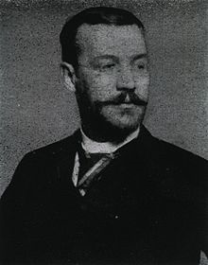
HISTORY
1897: Victor Eisenmenger
Austrian Physician
described history and postmortem details of 32 year old man with VSD and cyanosis
Notes:
“The patient was a powerfully built man of 32 who gave a history of cyanosis and moderate breathlessness since infancy.He managed well enough ,until January 1894 when dyspnoea increased and edema set in. Seven months later he was admitted to hospital in a state of heart failure.He improved with rest and digitalis, but collapsed and died more or less suddenly on November 13 following a large haemoptysis. At necropsy , a 2 – to 2.5 cm defect was found in the perimembranous septum”

Slide 4
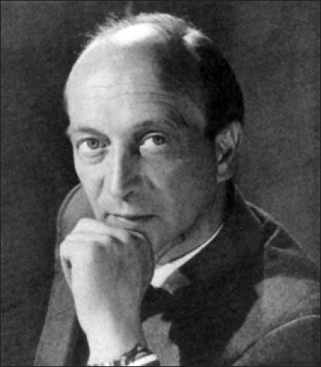
EISENMENGER SYNDROME
1958: Paul Wood’s Croonian Lectures coined the term “Eisenmenger Syndrome”
8% of first 1000 cases of CHD in WOOD’S SERIES
Prevalence decreased to 4%
in recent studies

Slide 5
Eisenmenger Syndrome
Definition:
Pulmonary hypertension at or near systemic level with reversed or bidirectional shunt between the pulmonary and systemic circulation and pulmonary vascular resistance above 800dyn/cm⁻⁵ (10 Wood Units)
Paul Wood, Br Med J, 1958

Slide 6
EISENMENGER’S COMPLEX
VSD with reversed shunt in absence of pulmonary stenosis
Reversed shunt was initially attributed to overriding of aorta
This term was coined by MAUDE ABOTT in 1927
Later found to be due to increased PVR by PAULWOOD

Slide 7
EISENMENGER REACTION
The gradual process of development of pulmonary hypertension and pulmonary vascular disease in a large left to right shunt lesions sooner or later leading to bidirectional or reversed shunt
It prevents natural process of lowering the pulmonary vascular resistance(PVR) after birth to normal

Slide 8
CAUSES OF EISENMENGER’S
PRE TRICUSPID SHUNT LESIONS
  ASD-OSTIUM SECONDUM
  OSTIUM PRIMUM
  SINUS VENOSUS
  TAPVC/PAPVC
POST TRICUSPID SHUNT LESIONS
  VSD
  PDA
  AP WINDOW
COMPLEX CCHD
  COMPLETE AVSD
  TGA WITH VSD/PDA
  TRUNCUS ARTERIOSUS
  SINGLE VENTRICLE PHYSIOLOGY WITH UNINTERRUPTED PBF

Slide 9
PHYSIOLOGICAL CHANGES AFTER BIRTH
In fetus
  there is minimal pulmonary circulation
  5 to 10% of cardiac output through lungs
  Systemic & pulmonary pressures are same and PVR is high( 8-10 wood units)
After birth
    Systemic vascular resistance increases
    PVR falls rapidly to systemic level at birth and then gradually decreases to adult level by 6 to 8 weeks

Slide 10
PHYSIOLOGICAL CHANGES AFTER BIRTH
Reasons for sudden decrease in PVR
  Breathing causes expansion of lungs & pulmonary vessels – straightening of kinked pulmonary vessels
  As blood flows through arteries to capillaries the the PVR
  Increased oxygen content reflexly produces vasodilation & PVR
  Change in elasticity of pulmonary arteries
Gradual decrease of PVR -6-8 WKS
  Due to regression of the medial muscular layer
  Due to increase in number of alveolar units

Slide 11
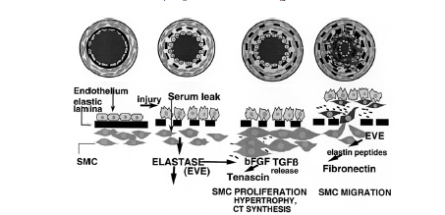
FACTORS FAVOURING EISENMENGER RN.
Failure of regression of thickened muscular arteries which are present in fetus
Persistence of long densely packed elastic fibres in large pulmonary arteries resembling aorta
Decrease arterial oxygen saturation due to any cause
Abnormal contractile response of pulmonary vasculature to increase flow
ARTERIAL REMODELLING

Slide 12
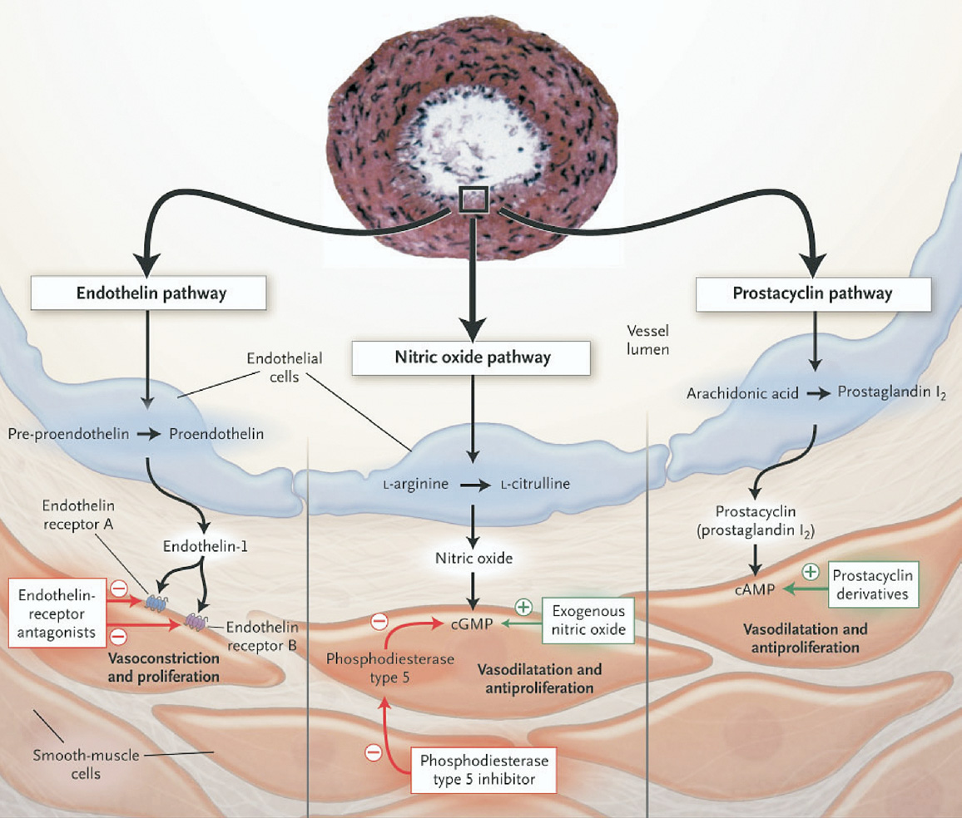
ENDOTHELIAL DYSFUNCTION
Imbalance b/w vasoconstrictor & vasodilators
Endothelins,thromboxane A2
prostacycline, NO

Slide 13
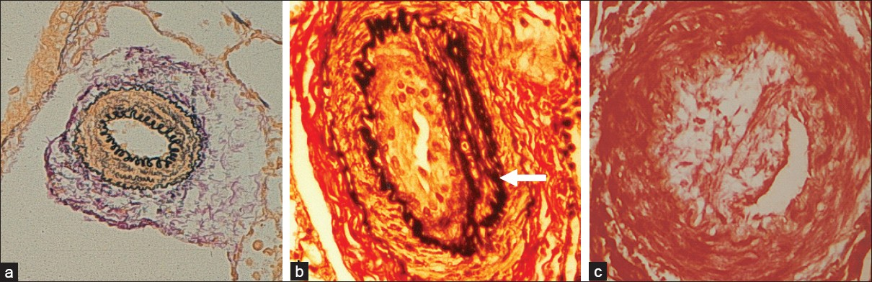
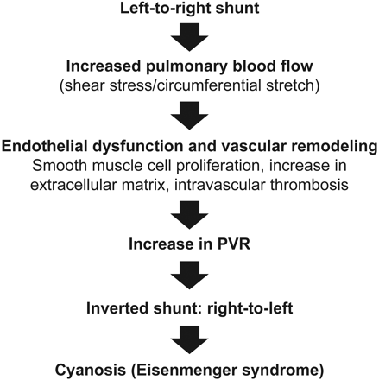
Eisenmenger Syndrome – A progressive disease

Slide 14
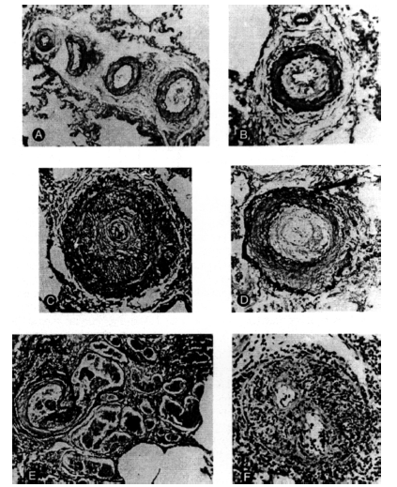
HEATH EDWARDS CLASSIFICATION OF PAH
GRADE I – Medial hypertrophy in small PA
GRADE II – Medial hypetrophy + intimal proliferation/prolifrn.
GRADE III- Progressive intimal fibrosis + lumen occlusion of smaller PA
GRADE IV- Plexiform lesions in muscular arteries & plexiform capillary channels
GRADE V – Complex plexiform l +angiomatosis & cavernous lesions
GRADE VI- Necrotizing arteritis & fibrinoid necrosis
UPTO GRADE III CHANGES ARE REVERSIBLE

Slide 15
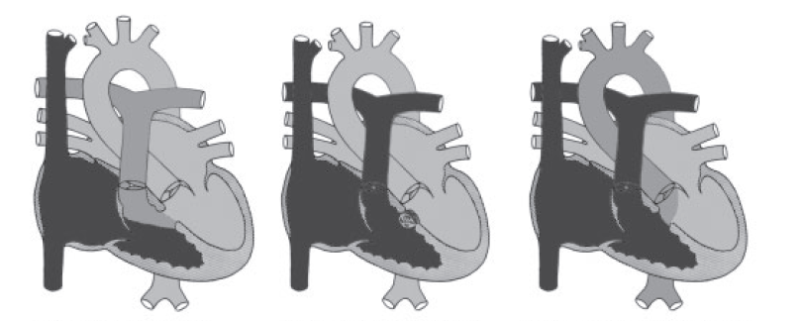
Haemodynamic stages
1)LOW PULMONARY PRESSURE
LEFT TO RIGHT SHUNT
INCREASED PULMONARY SATURATION
2) SYSTEMIC PULMONARY PRESSURE
SMALL BIDIRECTIONAL SHUNT
NO SATURATION CHANGES
3) SUPRASYSTEMIC PULMONARY PRESSURE,RT. TO LT. SHUNT CYANOSIS

Slide 16
CLINICAL CLASSIFICATION OF CONGENITAL SYSTEMIC TO PULMONARY SHUNTS ASSOC. WITH PAH
EISENMENGER SYNDROME | LARGE DEFECTS ---- PVR INCREASED- REVERSED / BIDIRECTIONAL SHUNT | Cyanosis, erythrocytosis etc
PAH ASSOCIATED WITH L-> R | MODERATE TO LARGE DEFECT WITH MILD TO MOD. PVR L →R | NO CYANOSIS
PAH WITH SMALL SEPTAL DEFECTS | VSD< 1CM & ASD < 2CM PVR | CLINICAL PICTURE SIMILAR TO IPAH
PAH AFTER CORRECTIVE SURGERY | CHD CORRECTED BUT PAH PRESENT IMMEDIATELY AFTER SURGERY OR SEVERAL MTH OR YRS AFTER SURGERY

Slide 17
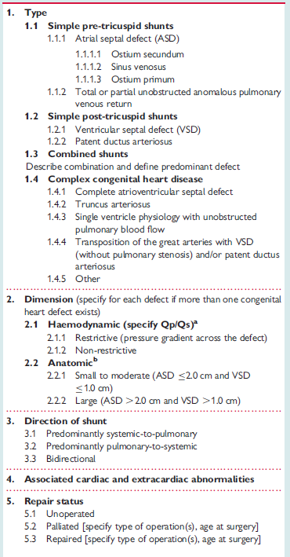
ANATOMICAL-PATHOPHYSIOLOGICAL CLASSIFICATION
OF CONGENITAL SYSTEMIC-TO-PULMONARY SHUNTS ASSOCIATED WITH PAH (MODIFIED FROM VENICE 2003)

Slide 18
TYPES OF PRESENTATION
1) CHF DURING INFANCY & CYANOSIS LATER ( POSTTRICUSPID SHUNT)
AFTER POSTNATAL FALL IN PVR
INCREASED PBF( CHF SYMPTOMS BUT NO CYANOSIS)
PULMONARY VASCULAR DISEASE
SYMPTOMS IMPROVE,MURMUR DECREASE,NO CYANOSIS
SUPRASYSTEMIC PULMONARY PRESSURE
CAUSING RT. TO LT. SHUNT
CYANOSIS, REAPPEARANCE OF MURMUR
SYMPTOMS

Slide 19
TYPES OF PRESENTATION
2)low Level Symptoms During Childhood & PAH In Adulthood
  Asymptomatic In Childhood & Dvp Symptoms Like Fatigue Cyanosis In Adulthood
  Pretricuspid Shunt
3) Cyanosis From Beginning
  Seen In Complex CCHD
  Pulmonary Atresia With Large MAPCA Etc

Slide 20
EISENMENGER SYNDROME
UNDERLYING BASIC LESIONS
Type of lesion Somerville ‘98 Daliento et al ‘98
(n=132) (n=188)
Ventricular Septal Defect 45 71
Atrial Septal Defect 6 21
Patent ductus arteriosus 12 36
Atrio ventricular septal defect 16 23
Truncus arteriosus 15 11
Single ventricle 13 9
Transposition of great arteries 5 8
Others 20 9

Slide 21
CAUSES & FREQUENCY OF EISENMENGERS SYNDROME
( BASED ON PAULWOOD’S STUDY)
DEFECT | TOTAL NO. OF CASES | NO. WITH EISENMENGER RN. | % OF CASES WITH EISENMENGER
1) PDA | 180 | 29 | 16
2) AP WINDOW | 10 | 6 | 60
3) TRUNCUS A. | 4 | 4 | 100
4) TGA WITH VSD | 12 | 7 | 58
5)CCTGA WITH VSD | 3 | 3 | 100
6) SINGLE VENTRICLE | 6 | 6 | 100
7) COMMON AV CANAL | 21 | 9 | 43
8) ASD | 324 | 19 | 6
9) PAPVC | 3 | 0 | 0
10) TAPVC | 6 | 1 | 17
11) VSD | 136 | 21 | 16
UNCERTAIN | 22 | 22
TOTAL | 727 | 127 | 17.5
Notes:
127 CASES STUDIED BY WOODS FOR 11 YRS .NEARLY ALL WERE CATHETRIZED ,ANGIOCARDIOGRAPHY DONE WHEN AND LATTERLY DYE DILUTION CURVES HAVE BEEN RECORDED.
18 DIED AND NECROPSY OBTAINED IN 15

Slide 22
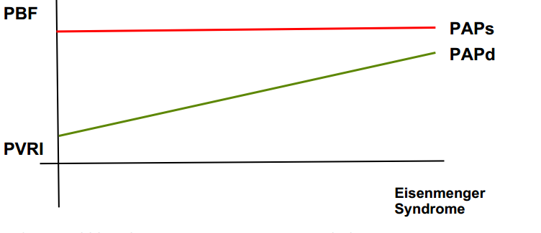
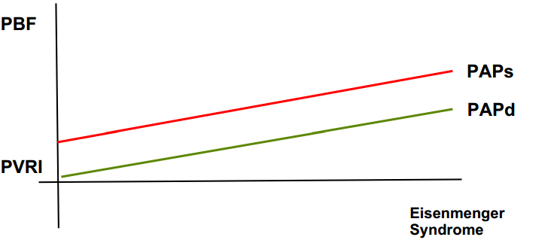
WHY EARLY ES IN POSTTRICUSPID SHUNT THAN ASD?
POST TRICUSPID SHUNT (VSD/PDA)
Pvr never comes down to normal due to high pressure flow from infancy
Regression of medial hypertrophy of smc & rvh does not occur
Dvp pah & reversal of shunt at an early age
PRETRICUSPID SHUNTS( ASD)
Direction of shunt is determined by the Right ventricular compliance so no shunt occurs till 3 months
Pvr reaches normal by 3 mths
PAH & ES occurs late in life especially in a large ASD
PAH in ASD believed to be acquired or unrelated to the defect

Slide 23
EISENMENGER –AN INDIAN SCENARIO
STUDY DONE FROM 1976-92 IN SCT TVM
201 PT, Mean age of presentation 19yr
12 anatomic lesion most common VSD(33.3%),ASD(29.85%),PDA (14.3%)
SCD (30%),CHF(25%)& HAEMOPTYSIS(15%)
5YR,10YR,15YR SURVIVAL was 86.95%,79.6%&76.9%
Prognostic factors identified were syncope, elevated rt. Sided filling pressures,SpO2 < 85%
Notes:
16 years from 1976 to 1992. One hundred nine patients were females and 92 were males — age of presentation varied from 3 months to 62 years (mean ± standard deviation 19.23 ± 12.62 years). A total of 12 different anatomic lesions were seen — the most common three being ventricular septal defect (33.33%), atrail septal defect (29.85%), and patent ductus arteriosus (14.23%). History, physical examination, chest skiagram and electrocardiogram established only the presence of pulmonary arterial hypertension except where differential cyanosis indicating ductus was discernible or the degree of splitting of second heart sound provided some clue to the level of shunt. Contrast echocardiography, completed in 25.4% established the level of shunt in all patients. In others the diagnosis was confirmed by cardiac catheterisation. Twenty patients died during a mean follow-up period of 54.6 ± 54.47 months. Sudden cardiac deaths (30%), congestive heart failure (25%) and haemoptysis (15%) were the most predominant causes of death. Only one patient died during puerperium. The acturial survival for the entire patient population at 5 years, 10 years and 15 years was 86.95%, 79.64% and 76.98%, respectively. Level of shunt (atrial, ventricular or aortopulmonary) did not influence the survival (P > 0.5). Of all the variables tested in a univariate analysis, history of syncope at presentation (P < 0.005), elevated mean right atrial pressure (8 mmHg or above) (P < 0.05) and systemic arterial desaturation below 85% (P < 0.05) were found to be important indicators of a poor prognosis. Eisenmenger syndrome is compatible with a fair intermediate term survival. History of syncope, elevated right sided filling pressure and systemic arterial oxygen saturation less than 85% indicated a poorer outcome.

Slide 24
Eisenmenger Syndrome
Natural History
Life expectancy reduced by about 20 years
Survival Pattern:
At one year 97%
At 5 years 87%
At 10 years 80%
At 15 years 77%
At 25 years 42%
In IPAH 3YR SURVIVAL < 20 – 30%

Slide 25
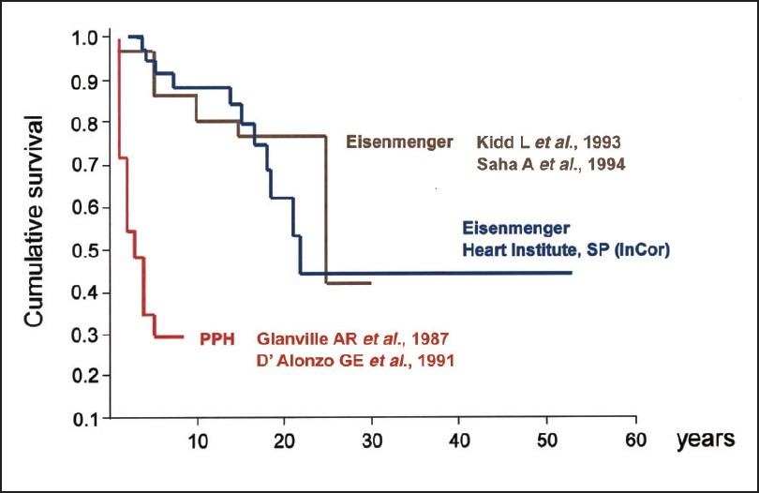
ES VS OTHER PAH
Structural changes in the pulmonary vasculature are qualitatively similar in all forms of PAH
Difference in clinical presentation
    Cerebral abcess,haemoptysis,arrythmia,CVAetc
Adult patients exhibit survival & a favourable hemodynamic profile and prognosis
cyanosis in early stages
Superior survival seen VS IPAH
  RV dysfunction occurs late
  Rt to left shunt maintains the cardiac output

Slide 26
CLINICAL FEATURES
SYMPTOM | FREQUENCY
D.O.E | 84%
INCREASED CYANOSIS | 59%
HYPERVISCOSITY | 39%
ANGINA | 13%
SYNCOPE | 10%
CHF | 8%
COMPLICATION | FREQUENCY
HAEMOPTYSIS | 20%
2. PULMONARY THROMBOEMBOLISM | 13%
3. STROKE | 8%
4. CEREBRAL ABSCESS | 4%
5.I.E | 3%

Slide 27
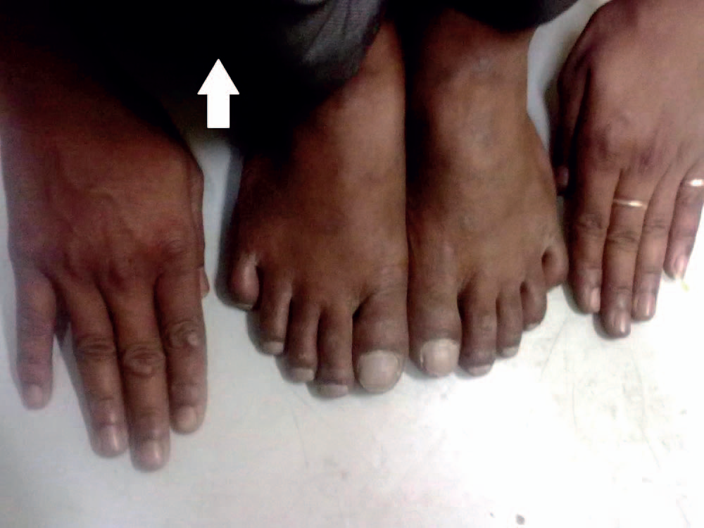

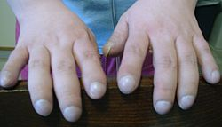
CARDIOVASCULAR FINDINGS
Central cyanosis (differential cyanosis in the case of a PDA)
Clubbing
JVP- dominant A-wave/ V wave (TR)
Precordial palpation- right ventricular heave,
palpableP2 /Loud P2
High-pitched EDM (Graham steell) of PR
Right-sided S4
Pulmonary ejection click
All shunt murmurs disappear during eisenmenger’s

Slide 28
Other findings
Respiratory - cyanosis and tachypnea.
Hematologic - bruising and bleeding; funduscopic abnormalities related to erythrocytosis include engorged vessels, papilledema, microaneurysms, and blot hemorrhages.
Abdominal - jaundice, right upper quadrant tenderness, and positive Murphy sign (acute cholecystitis).
Vascular - postural hypotension and focal ischaemia (paradoxical embolus).
Musculoskeletal - clubbing, hypertrophic osteoarthropathy
Ocular signs include conjunctival injection, rubeosis iridis, and retinal hyperviscosity change

Slide 29
DIFFERENTIAL DIAGNOSIS OF EISENMENGER SYNDROME
 | ASD | VSD | PDA
FREQUENCY | 1.5 | 3 | 2
SEX RATIO | 1: 3 | 1: 1 | 1: 2
DOE | GRADE 3 | GRADE 2 | GRADE 2
ONSET | LATE | EARLY | EARLY
CENTRAL CYANOSIS CLUBBING, POLYCYTHEMIA | 75% | 90% | 30%
DIFFERENTIAL CYANOSIS | -- | --- | 50%
DOMINANT a OR LARGE V in JVP | 1/3RD | RARE | UNUSUAL
RV LIFT | CONSIDERABLE ( NEVER ABSENT) | SLIGHT OR MODERATE (ABSENT IN 10%) | SLIGHT OR MOD. (ABSENT IN 10%)
S2 | OBVIOUSLY SPLIT | SINGLE OR CLOSE SPLIT | CLOSE SPLIT
ECG-P PULMONALE RVH Q IN V5,V6 XRAY – RAE RT SIDED AORTA LEFT SVC CALCIFIED DUCT PROMINENT AORTIC KN. | >50% 2/3RD -- 60% -- -- -- -- | <50% 1/3RD 15% 15% 16% 8% -- SEEN | UNUSUAL 1/3RD 50% 15% -- -- RARE SEEN

Slide 30
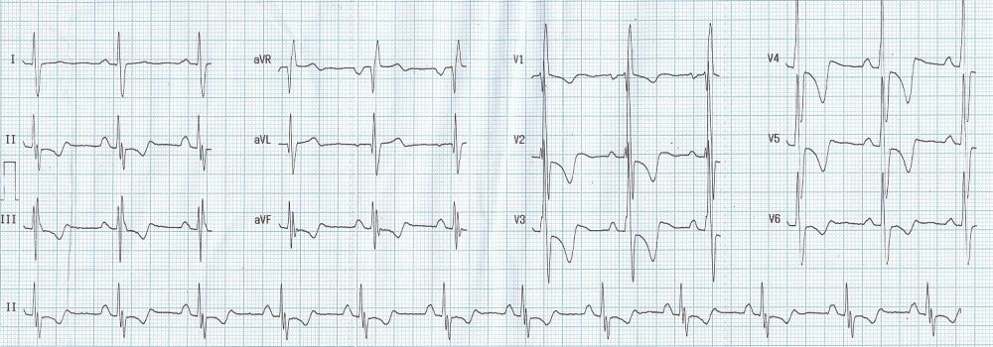
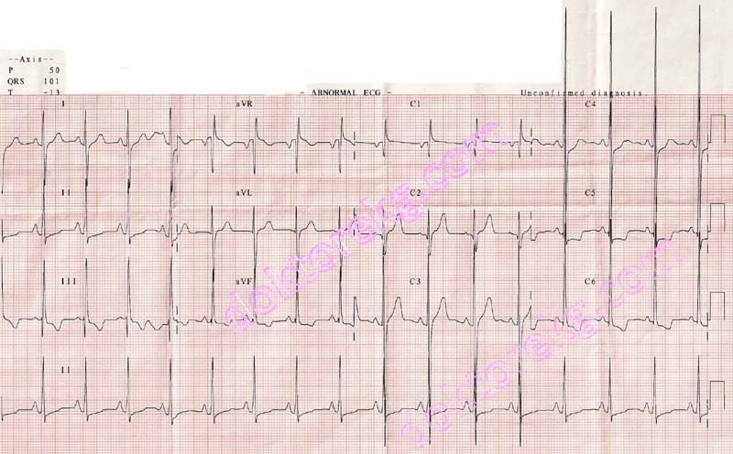
ECG
RAE,RVH – ASD ( OS SEC.)
Features OF LV Enlargement + RVH – PDA/VSD
KALTZ-WACHTEL – equiphasic QRS complexes in mid precordial leads –VSD
PAT/Flutter – seen in ASD
  Left axis deviation -ostium primum ASD.
  RV VOLTAGES ,QRS DURN. & QTc interval are poor prognostic markers

Slide 31
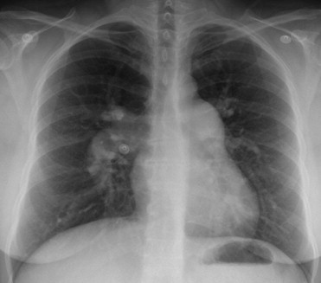
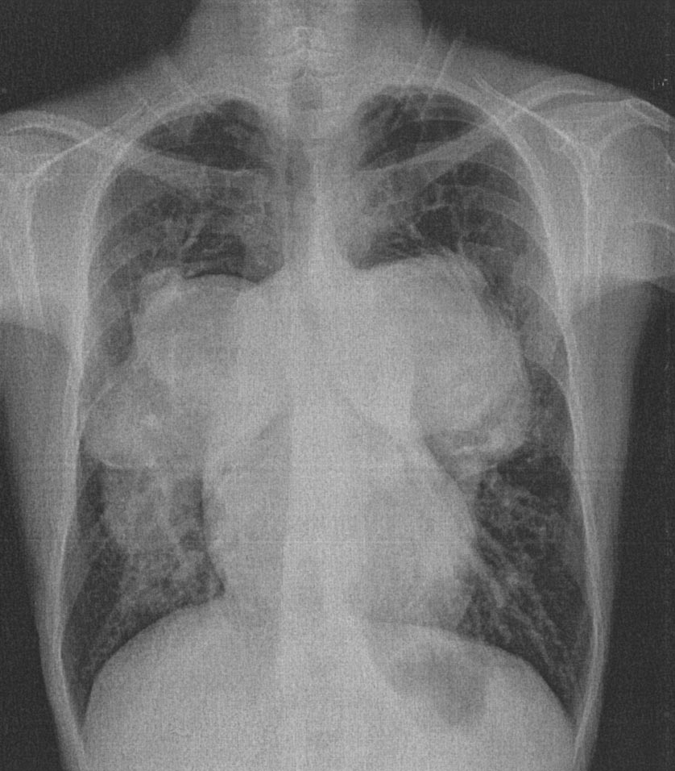
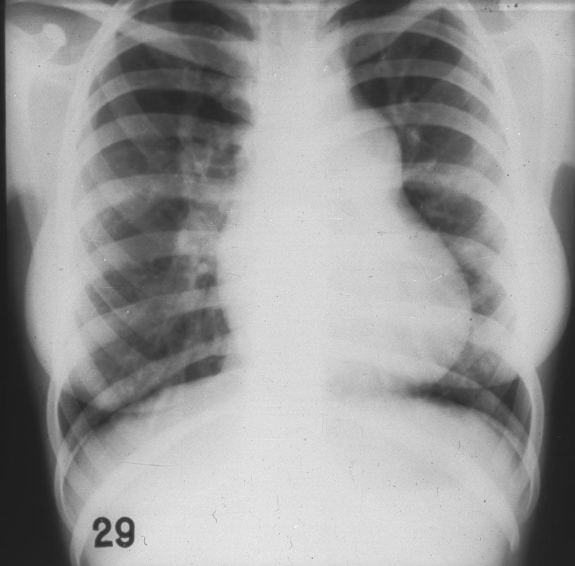
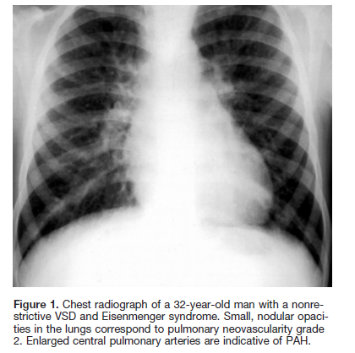
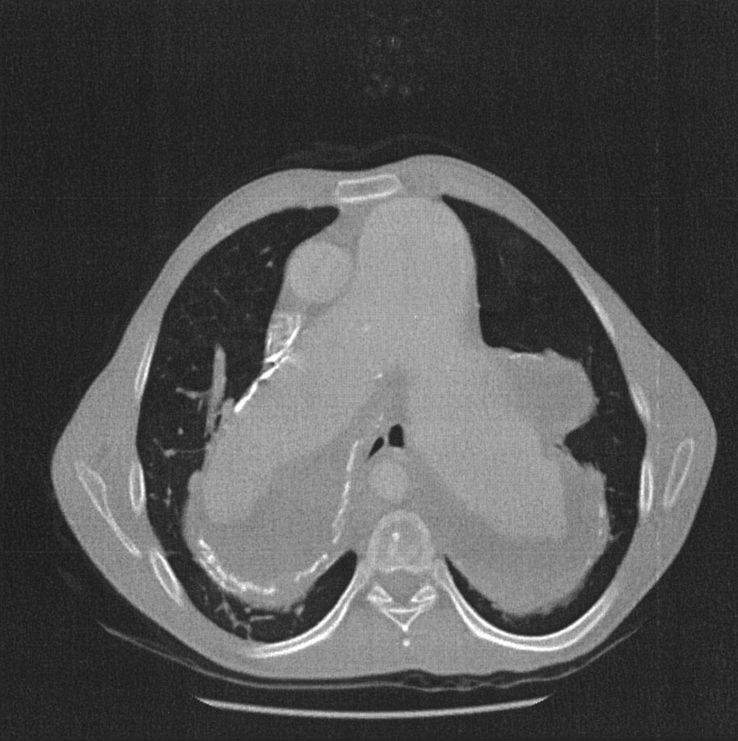
RADIOLOGY
Rt sided aortic arch – 16% of VSD
Rounded shadow overlying aortic knuckle – PDA
Calcification of the duct
Dilatation of MPA-90%
Pulmonary oligaemia
Cardiomegaly

Slide 32
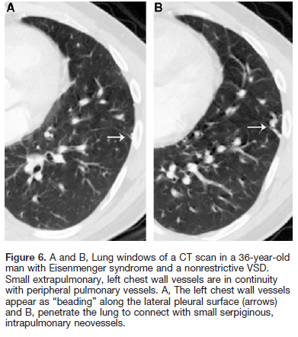
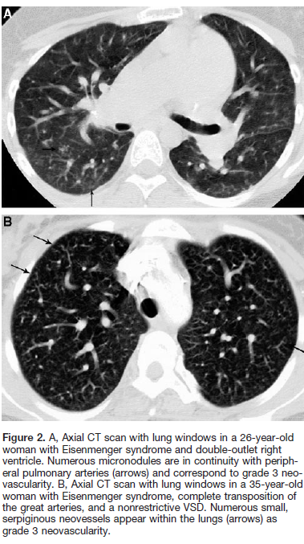
RADIOLOGY
“Pulmonary neovascularization”
it is a specific sign for eisenmenger’s
Distinctive vascular lesions on CXR &CT
correlated histologically with collateral vessels seen in posttricuspid communications.

Slide 33
Eisenmenger Syndrome
Noninvasive Evaluation
Echocardiography is very useful
Defines the large defect (PDA may be difficult)
Estimates PA pressure by TR/PR jets
Contrast echo demonstrates R L shunting
TEE is safe and may be required in adults for precise delineation of the abnormality

Slide 34
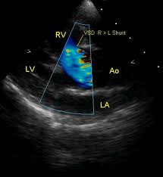
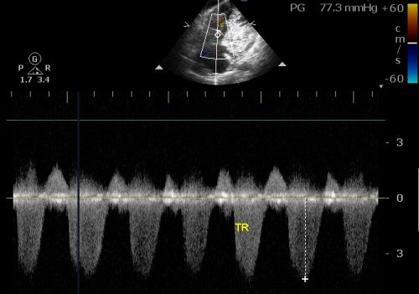
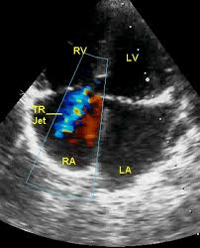
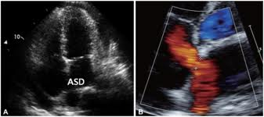
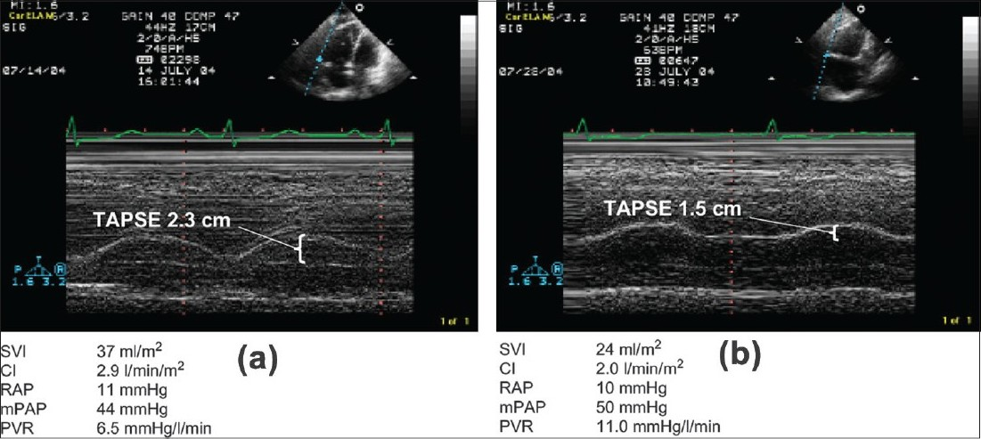
ECHO

Slide 35
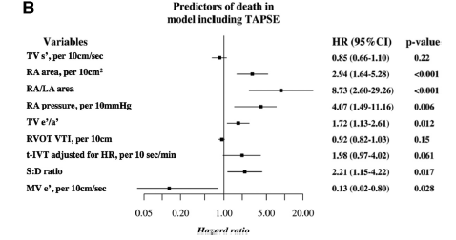
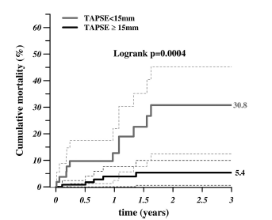
ECHO PREDICTORS
A composite score based on the strongest echocardiographic predictors of outcome, including 1 point for each of the following:
  TAPSE<15 mm
  Ratio of right ventricular effective systolic to diastolic duration> 1.5
  RA area > 25 cm2,
  Ratio of RA to left atrial area> 1.5
This score was strongly related to mortality (odds ratio, 3.69; 95% confidence interval, 2.31–5.91 by bootstrap analysis)
Notes:
Background—Eisenmenger syndrome differs significantly from other types of pulmonary arterial hypertension in its
physiology and prognosis. We sought to assess the relationship between the echocardiographic characteristics of patients
with Eisenmenger syndrome and mortality.
Methods and Results—Clinical and echocardiographic variables were assessed in 181 consecutive patients with
Eisenmenger syndrome, excluding those with complex congenital heart disease. Patients’ mean age was 39.112.8
years, 59 (32.6%) were male, 122 (67.4%) were in functional class III or higher, and 74 (40.9%) were on advanced
therapies. Mean oxygen saturation at rest was 85.17.8%, and median B-type natriuretic peptide was 55.4 ng/L. Over
a median follow-up of 16.4 months, 19 patients died; the strongest predictors of mortality were tricuspid annular plane
systolic excursion and peak systolic velocity, myocardial performance (expressed as total isovolumic time and ratio of
systolic to diastolic duration), and elevated central venous pressure (expressed as right atrial [RA] area, RA pressure,
and ratio of RA to left atrial area), even after we accounted for advanced therapies. A composite score based on the
strongest echocardiographic predictors of outcome, including 1 point for each of the following: tricuspid annular plane
systolic excursion 15 mm, ratio of right ventricular effective systolic to diastolic duration 1.5, RA area 25 cm2,
ratio of RA to left atrial area 1.5, was highly predictive of clinical outcome (area under the curve 0.900.01), with
no improvement when B-type natriuretic peptide and resting saturations were added into the model.
Conclusions—Echocardiographic parameters of right ventricular function and RA area predict mortality in Eisenmenger
patients. A new composite echocardiographic score, described herewith, may be incorporated into the noninvasive,
periodic assessment of these patients. (Circulation. 2012;126:1461-1468.)

Slide 36
Eisenmenger Syndrome: Invasive Evaluation
Cardiac cath can be safely performed
It must be done in borderline cases to assess operability
Response of pulmonary vasculature to pulmonary vasodilators like 0₂, tolazoline and nitric oxide should be assessed
Limit the use of contrast agent to minimal

Slide 37
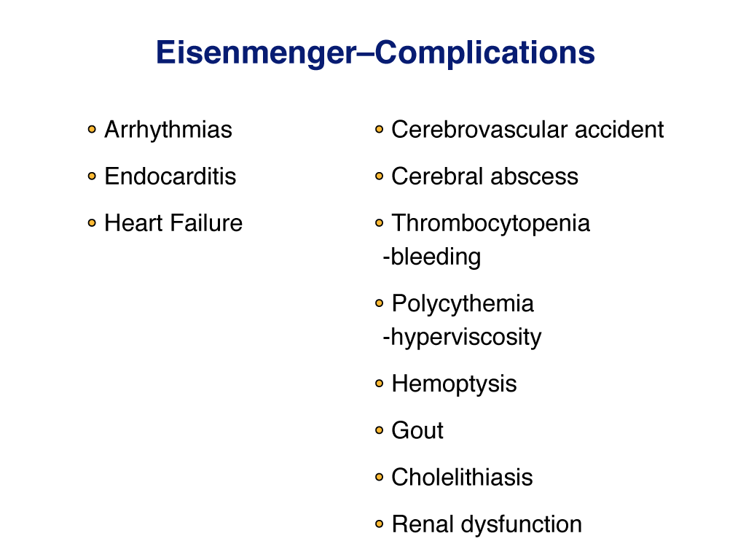
Notes:
37

Slide 38
COMPLICATIONs
HAEMATOLOGY
  Chronic hypoxia causes erythrocytosis & secondary polycythemia
  Increased iron utilization causes iron deficiancy and microcytes and hypochromia
  Increased erythrocytes & increased hematocrit – hyperviscosity
  Hyperviscosity along with dilated chambers arrythmia, prothrombotic materials –Thrombosis
  Bleeding-thrombocytopenia & decreased coagulation factors
HAEMOPTYSIS
  Pulmonary artery thrombosis causing pulmonary infarction

Slide 39
COMPLICATIONs
VASCULAR SYSTEM
  Hyperviscosity leads to shear stress causing release of NO – vasodilation & syncope
CORONARY CIRCULATION
  Increased NO causes – tortuous & large arteries
  Increased demand due to enlarged LV mass & low saturation – increased resting coronary blood flow & decreased coronary reserve
HYPERBILIRUBINEMIA
  Increased erythrocytosis causes increased RBC destruction – unconjugated hyperbilirubinemia & gall stones

Slide 40
COMPLICATIONs
RENAL DYSFUNCTION
  Hyperuricemia
  Hypoperfusion
Hyperuricemia
  decreased renal clearence & increased production of uric acid
CEREBROVASCULAR EVENTS
  Stroke or tia – hyperviscosity
  Brain abcess
  Paradoxical embolism- Rt. to Lt. shunting
HPOA/CLUBBING-
  Systemic venous megakaryocytes are shunted into the systemic arterial circulation
  PDGF & TGF-beta released promote cell proliferation ,protein synthesis, connective tissue formation & deposition of extracellular matrix
HEART FAILURE

Slide 41
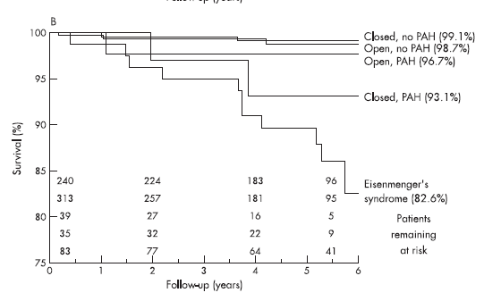
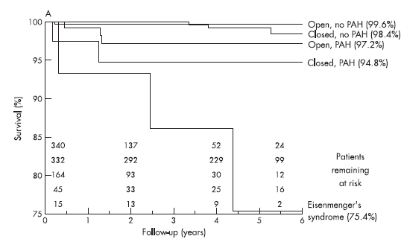
VSD WITH PAH FOLLOW UP
ASD WITH PAH FOLLOW UP
N1877
Notes:
Aim: To investigate the role of pulmonary arterial hypertension (PAH) in adult patients born with a cardiac
septal defect, by assessing its prevalence and its relation with patient characteristics and outcome.
Methods and results: From the database of the Euro Heart Survey on adult congenital heart disease (a
retrospective cohort study with a 5-year follow-up), the relevant data on all 1877 patients with an atrial septal
defect (ASD), a ventricular septal defect (VSD), or a cyanotic defect were analysed. Most patients (83%)
attended a specialised centre. There were 896 patients with an ASD (377 closed, 504 open without and 15
with Eisenmenger’s syndrome), 710 with a VSD (275, 352 and 83, respectively), 133 with Eisenmenger’s
syndrome owing to another defect and 138 remaining patients with cyanosis. PAH was present in 531 (28%)
patients, or in 34% of patients with an open ASD and 28% of patients with an open VSD, and 12% and 13%
of patients with a closed defect, respectively. Mortality was highest in patients with Eisenmenger’s syndrome
(20.6%). In case of an open defect, PAH entailed an eightfold increased probability of functional limitations
(New York Heart Association class .1), with a further sixfold increase when Eisenmenger’s syndrome was
present. Also, in patients with persisting PAH despite defect closure, functional limitations were more
common. In patients with ASD, the prevalence of right ventricular dysfunction increased with systolic
pulmonary artery pressure (OR = 1.073 per mm Hg; p,0.001). Major bleeding events were more prevalent
in patients with cyanosis with than without Eisenmenger’s syndrome (17% vs 3%; p,0.001).
Conclusion: In this selected population of adults with congenital heart disease, PAH was common and
predisposed to more symptoms and further clinical deterioration, even among patients with previous defect
closure and patients who had not developed Eisenmenger’s physiology.

Slide 42
CAUSES OF DEATH IN ES
IN WOOD’S SERIES HAEMOPTYSIS | 29%
SURGICAL REPAIR OF DEFECT- | 26%
CHF | 17%
VF | 14%
CEREBRAL ABSCESS,I.E,CEREBRAL THROMBOSIS,PREGNANCY | 5%
DALIENTO ET AL
SUDDEN DEATH | 29%
RIGHT HEART FAILURE | 23%
HAEMOPTYSIS | 11.4%
CEREBRAL ABCESS | 3.2%
I.E | 1.6%
POSTPREGNANCY | 5%
Eisenmenger syndrome Factors relating to deterioration and death L. DalientoET ALEuropean Heart Journal (1998) 19, 1845–1855

Slide 43
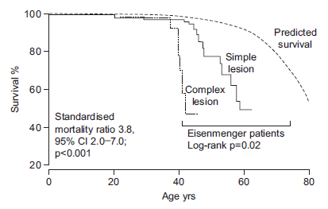
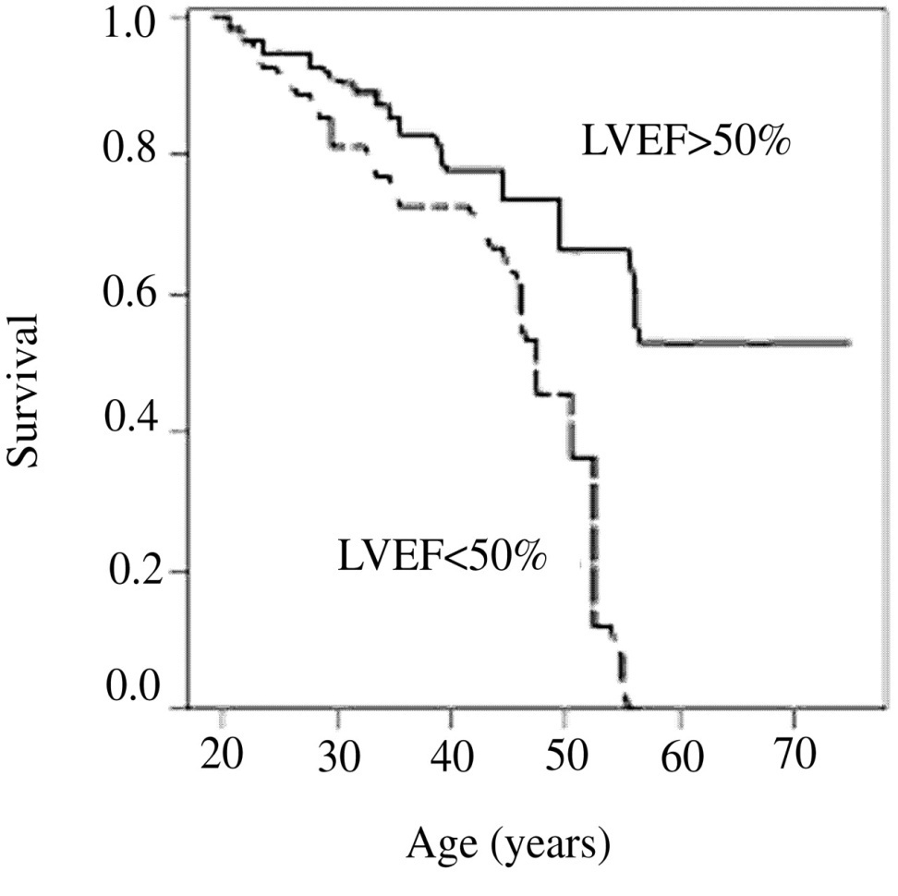
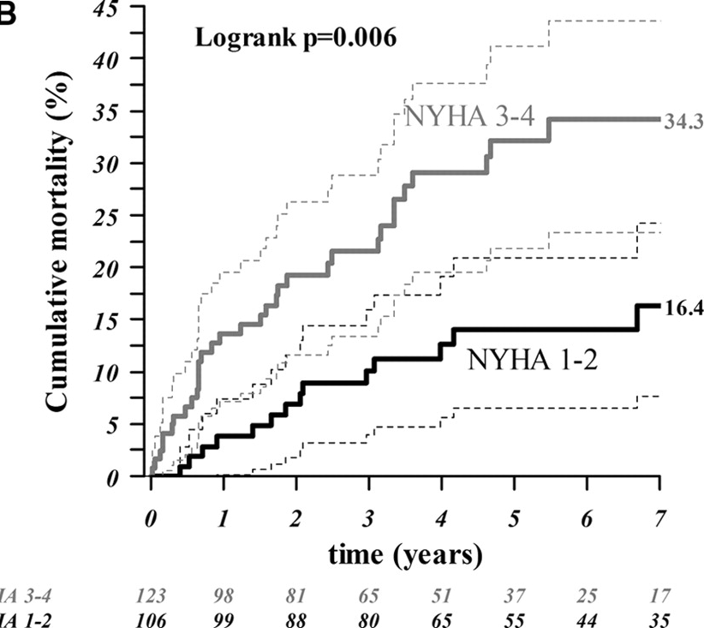
PREDICTORS OF MORTALITY IN ES
NYHA/WHO Functional class
Heart failure- clinical & lab ( impaired LFT)
FEATURES OF right heart filling pressure
Ecg features-
  voltage criteria of rvh, qrs duration, qtc
H/o arrythmia
Complex CHD
Creatinine ,uric acid
Pregnancy
Lv Dysfunction
Syncope
Notes:
Aims To characterize contemporary Eisenmenger patients at a large centre for adult congenital heart
disease, assess survival prospects, and identify predictors of death in this population.
Methods and results All Eisenmenger patients under follow-up at our centre since 2000 (n ¼ 171, mean
age 37+12 years) were included. To identify predictors of mortality, a case–control study was performed.
Data including symptoms, functional class, medication, laboratory, and electrocardiographic
and echocardiographic parameters are presented. Iron deficiency was common and strongly related
to phlebotomy (relative risk 4.1, P , 0.0001). Haemoglobin concentration was inversely related to
arterial oxygen saturations in iron-replete patients (P , 0.001) but not in iron-deficient patients.
During a median follow-up of 67 months, 20 patients died. Survival at 40, 50, and 60 years of age
was 94, 74, and 52%, respectively. When compared with healthy individuals, median survival was
reduced by 20 years in Eisenmenger patients and was worst in those with complex lesions. Predictors
of mortality included functional class, signs of heart failure, history of clinical arrhythmia, QRS duration
and QTc interval, and low serum albumin and potassium levels.
Conclusion Despite good short-term prognosis, life expectancy is markedly reduced in Eisenmenger
patients. Markers of heart failure and parameters associated with arrhythmia are of prognostic value
in terms of mortality and may guide clinicians caring for Eisenmenger patients.

Slide 44
Eisenmenger Syndrome
Management Strategies
Conventional therapy
Advanced therapy
Surgical therapy
Notes:
44

Slide 45
Conventional Therapy
Digitalis, diuretics – heart failure
Anti-arrhythmic drugs
Anticoagulants
Long term oxygen therapy
Avoidance of dehydration, high altitude, infections and IV lines
Avoidance of pregnancy
Moderate and severe strenuous exercise, particularly isometric exercise
I.E PROPHYLAXIS

Slide 46
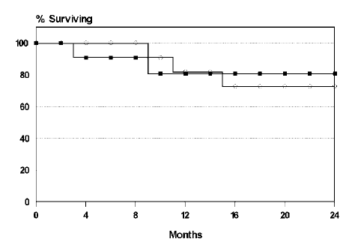
OXYGEN THERAPY
NO DIFF. IN SURVIVAL
Long-term home O2 therapy may improve symptoms
No survival benefit with N.O.T in advanced ES
Recommended in pt. with improvement in saturation & symptoms with O2 ( ESC iia C)
Open circle- patients with nocturnal O2 therapy
Closed circle – pt in control
Notes:
N-=23 ADULT PT WITH ES

Slide 47
PHLEBOTOMY
Indication for Isovolumic Phlebotomy
Symptomatic hyper viscosity (PCV >0.65) ( ESC IIa & Aha class I)
Symptomatic Hb > 20gm%)( AHA CLASS I)
Important issues to remember
Symptoms of hyper viscosity resemble those of iron deficiency
Phlebotomy may result in iron deficiency anemia and cerebrovascular accidents
Routine phlebotomies - not recommended( CLASS III AHA )
Notes:
Iron deficiency increases whole blood viscosity
because of the greater resistance of microspherocytic
red cells to deformation in the microcirculation and
because of an increase in the number of microspherocytes
Iron deficient muscle cells require anaerobic metabolism for energy needs thus increased lactate production causes fatigue
Iron deficiency impairs oxygen delivery
Effects of phlebotomy is transient
No evidence of reduction of stroke with frequent phlebotomy
Iron deficiency increases whole blood viscosity
because of the greater resistance of microspherocytic
red cells to deformation in the microcirculation and
because of an increase in the number of microspherocytes
Iron deficient muscle cells require anaerobic metabolism for energy needs thus increased lactate production causes fatigue
Iron deficiency impairs oxygen delivery
Effects of phlebotomy is transient
No evidence of reduction of stroke with frequent phlebotomy

Slide 48
TREATMENT OF ANAEMIA
Oral iron frequently results in a rapid and dramatic increase in red cell mass
Haematological parameters to be monitored regularily
Iron therapy stopped once serum ferritin and/ or transferrin saturation within normal range
Iron intolerant pt. – pulse IV iron therapy
Current Cardiology Reviews, 2010, 6, 363-372
7

Slide 49
ANTICOAGULANTS IN ES
Use of oral anticoagulant treatment in Eisenmenger’s syndrome is controversial
  A high incidence of PA thrombosis & stroke vs high incidence of bleeding & haemoptysis
In the absence of significant haemoptysis, oral anticoagulant treatment should be considered in patients with PA thrombosis or signs of heart failure( ESC IIA level c)
STRATEGIES TO DECREASE BLEEDING | STRATEGIES TO PREVENT THROMBOSIS
Meticulous INR monitoring (target inr 2-2.5) | 1) Avoidance & RX of volume depletion
2) Limitation of anticoagulation to specific indicn. | 2)Iron supplementation in pt. wit h iron def.
3)Prompt therapy of respiratory infn. | 3) Use of air filters during IV use

Slide 50
Haemoptysis
General measures
  Hospital admission - Reduction of physical activity and suppression of nonproductive cough
  Chest x-ray followed by CT thorax
  Immediate discontinuation of aspirin, NSAID, anticoagulant
  Treatment of hypovolemia and anemia
Specific diagnostic/ therapeutic aspects may be needed, if hemoptysis is severe or incessant:
  PLATELET INFUSION in the presence of thrombocytopenia
  Administration of FFP, vitamin K or coagulation factors
  Angiography with selective embolization of the artery supplying the source of blood loss
  Sputum culture and treatment of infectious disease
Risk reduction strategy:
  Immediate treatment of respiratory tract infections
  Pneumovax and annual fluvaccination

Slide 51
MANAGEMENT OF ES
Infective Endocarditis
  High risk for endocarditis with high morbidity and mortality
  Require endocarditis prophylaxis & proper oral hygiene must be emphasized to prevent endocarditis
Renal dysfunction
  poor prognostic indicator
  volume depletion & NSAID to be avoided
Gout
  Colchicine drug of choice
  Diuretics may trigger it
  Hypouricemic drugs indicated in symptomatic patients
  Allopurinol & probenicid indicated in recurrent gout
  Poor prognostic marker
Cholecystitis
  Due to gall stones
  ERCP + PAPPILOTOMY RX of choice

Slide 52
Targeted Therapy:
Pulmonary Vasodilators
Prostanoids: Epoprostenol infusion
Phosphodiesterase-5 inhibitors: Sildenafil, tadalafil
Endothelin receptor antagonists: Bosentan (BREATH-5 trial)

Slide 53
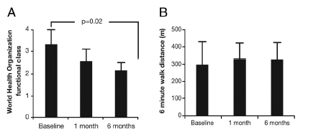
SILDENAFIL IN ES
Significant improvements( 20mg tid)
in functional class, oxygen saturation &
cardiopulmonary hemodynamics seen after 6 mth ( Chau et al Int J Cardiol 2007)
Garg et al. - optimal dose is 50mg tid
Demonstrated improvement in 6MWT, O2 saturn.& haemodynamics in both PAH ES
No significant side effects (intnl jn of cardiology 2007) (n=21)
Singh et al – dosage of 100mg tid- benefit seen in all parameters (Am Heart J 2006;151) ( n=10)

Slide 54
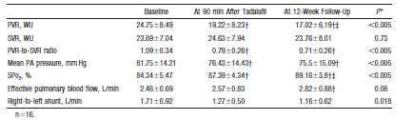
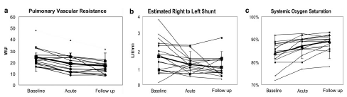
TADALAFIL IN ES
Small study n=16
Short study( 3mth)
Not a RCT
Sign. Improvement
In 6mwt , dyspnoea & PVR
Notes:
Background—Phosphodiesterase-5 inhibitors produce a significant decrease in pulmonary vascular resistance in patients
with idiopathic pulmonary arterial hypertension. We studied the effects of tadalafil, a phosphodiesterase-5 inhibitor, on short-term hemodynamics, tolerability, and efficacy over a 12-week period in patients of Eisenmenger syndrome having a pulmonary vascular pathology similar to idiopathic pulmonary arterial hypertension.
Methods and Results—Sixteen symptomatic Eisenmenger syndrome patients (mean age, 258.9 years) were assessed hemodynamically at baseline and 90 minutes after a single dose of tadalafil (1 mg/kg body weight up to a maximum of 40 mg). The same dose was then continued daily for 12 weeks, and the patients were restudied. There was a significant decrease in mean pulmonary vascular resistance immediately (24.758.49 to 19.228.23 Woods units; P0.005) and at 12 weeks (19.228.23 to 17.026.19 Woods units; P0.03 versus 90 minutes). Thirteen of 16 patients (81.25%) showed a 20% decrease in pulmonary vascular resistance and were defined as responders. The mean systemic oxygen saturation improved significantly both immediately
(84.345.47% to 87.394.34%; P0.005) and at 12 weeks (87.394.34% to 89.163.8%; P0.02 versus 90 minutes) without a significant change in systemic vascular resistance. None of the patients had a fall in systemic arterial pressure, worsening of systemic oxygen saturation, or any adverse reactions to the drug. The mean World Health Organization functional class improved from 2.310.47 to 1.250.44 (P0.0001), and the 6-minute walk distance improved from 344.56119.06 to 387.56117.18 m(P0.001).
Conclusions—Preliminary evaluation of tadalafil has shown efficacy and safety in selected patients with Eisenmengersyndrome, warranting further investigation in this subgroup of patients. (Circulation. 2006;114:1807-1810.)

Slide 55
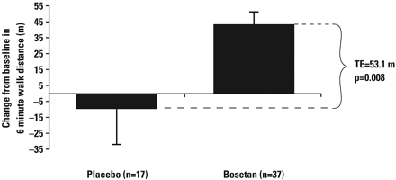
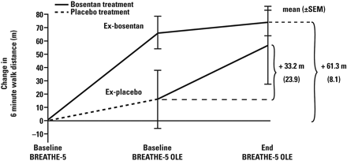
BOSENTAN IN ES(BREATHE-5)
Bosentan significantly reduced PVR
  ( Mean pap 5.5hg)
  Improved 6MWT ( 53.1M)
  Well tolerated, Spo2 not affected
  A 24-week, open-label, follow-up
  study demonstrated further
  impnt. In 6MWT& WHO class
Small studies have shown benefit with SITAXENTAN in ES
ESC – class I indication for who class iii patients
Notes:
Background—Eisenmenger syndrome is characterized by the development of pulmonary arterial hypertension with
consequent intracardiac right-to-left shunt and hypoxemia in patients with preexisting congenital heart disease. Because
Eisenmenger syndrome is associated with increased endothelin expression, patients may benefit from endothelin
receptor antagonism. Theoretically, interventions that have some effect on the systemic vascular bed could worsen the
shunt and increase hypoxemia.
Methods and Results—The Bosentan Randomized Trial of Endothelin Antagonist Therapy-5 (BREATHE-5) was a 16-week,
multicenter, randomized, double-blind, placebo-controlled study evaluating the effect of bosentan, a dual endothelin receptor
antagonist, on systemic pulse oximetry (primary safety end point) and pulmonary vascular resistance (primary efficacy end
point) in patients with World Health Organization functional class III Eisenmenger syndrome. Hemodynamics were assessed
by right- and left-heart catheterization. Secondary end points included exercise capacity assessed by 6-minute walk distance,
additional hemodynamic parameters, functional capacity, and safety. Fifty-four patients were randomized 2:1 to bosentan
(n37) or placebo (n17) for 16 weeks. The placebo-corrected effect on systemic pulse oximetry was 1.0% (95% confidence
interval, 0.7 to 2.8), demonstrating that bosentan did not worsen oxygen saturation. Compared with placebo, bosentan
reduced pulmonary vascular resistance index (472.0 dyne · s · cm5; P0.0383). The mean pulmonary arterial pressure
decreased (5.5 mm Hg; P0.0363), and the exercise capacity increased (53.1 m; P0.0079). Four patients discontinued as
a result of adverse events, 2 (5%) in the bosentan group and 2 (12%) in the placebo group.
Conclusions—In this first placebo-controlled trial in patients with Eisenmenger syndrome, bosentan was well tolerated and
improved exercise capacity and hemodynamics without compromising peripheral oxygen saturation

Slide 56
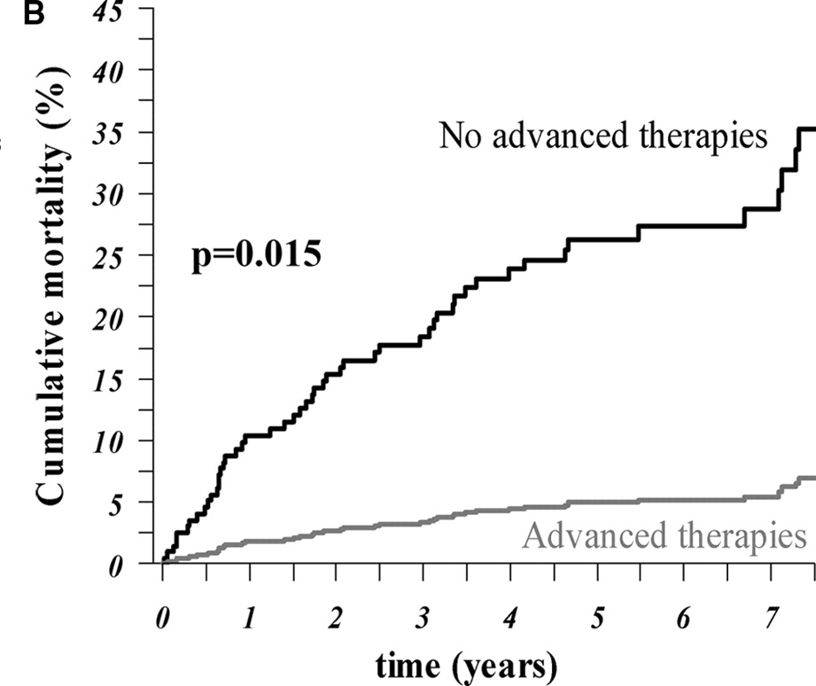
SURVIVAL IN EISENMENGER SYNDROME PATIENTS ON ADVANCED THERAPY (N=287)
Dimopoulos, K. et al. Circulation 2010;121:20-25

Slide 57
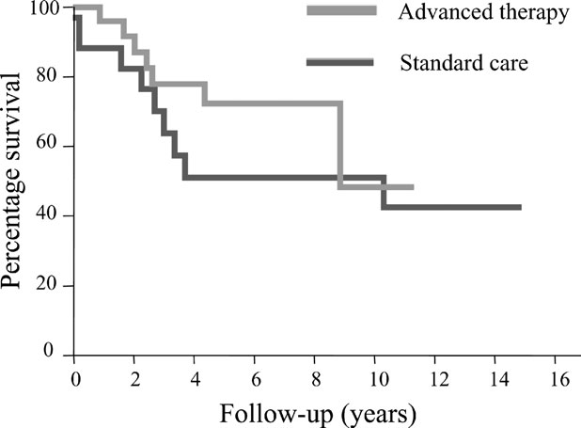
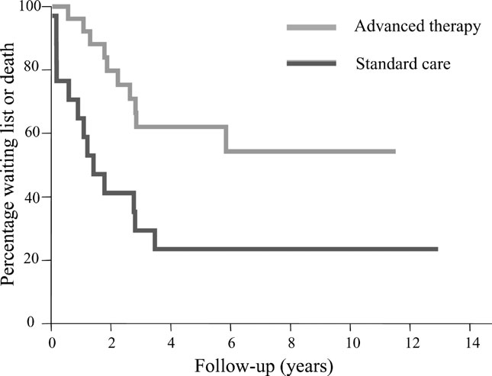
ADVANCED THERAPY CAN DELAY TRANSPLANTATION
Notes:
Advanced therapies (prostacyclin analogues, endothelin receptor antagonists) are successfully
used in the treatment of idiopathic pulmonary arterial hypertension. In addition, patients with the
Eisenmenger syndrome (ES) seem to benefit from these news drugs regarding symptoms, but there is
still no evidence for changes in outcome.
Methods and results The clinical course of 43 patients (M/F 13/30, age 34.0+12.7 years), registered
with unstable ES in our database, was retrospectively analysed. These patients were divided into two
groups: those treated with and those treated without advanced therapy. The primary endpoint was
defined as death from any cause. Death or inscription on the active waiting list of heart–lung transplantation
was considered as secondary endpoint. Kaplan–Meier survival and log rank testing were performed
to determine differences in outcome between the two groups. The total cohort was followed
for a median period of 4.9 (range 0.2–14.9) years. Mean survival time for patients treated with
(n ¼ 26) and without (n ¼ 17) advanced therapy therapies were 8.5+1.5 and 8.5+0.9 years, respectively
(log rank testing, P ¼ 0.31). However, the mean time to death or inscription on the active waiting
list was significantly longer for patients treated with advanced therapy when compared with those
without (7.8+1.0 vs. 3.4+0.9 years, P ¼ 0.006).
Conclusion For the given follow-up period, no improvement in survival time could be documented in
adult patients with unstable ES treated with advanced therapy. However, we might suggest with
these data that the need for heart–lung transplantation can be substantially delayed with new drugs.
Y axis shows mean time in the waiting list/ mean time till death

Slide 58
OTHER THERAPIES
CCB IN ES
  No clear data support the use of CCBs in patients with Eisenmenger’s Syndrome
  The empirical use of CCBs is dangerous and should be avoided ( esc class III)
PROSTACYCLIN THERAPY ( ESC CLASS Iia)
Small studies have shown benefit of prostacyclin infusion in ES
  LARGER STUDIES LACKING
  Central lines expose the patients to the risk Of paradoxical embolism and sepsis

Slide 59
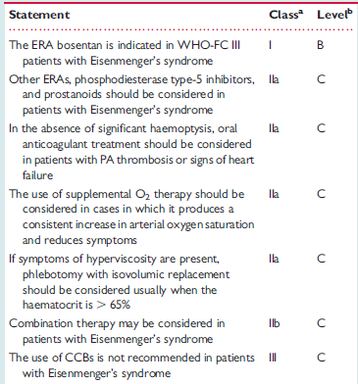
ESC RECOMMENDATIONS (2009)
All vasodilator therapy in eisenmengers is a II a recommendation in AHA 2008

Slide 60
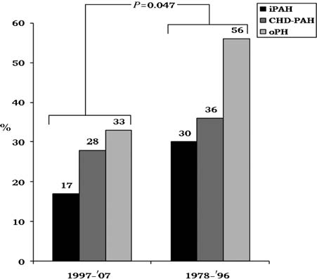
EISENMENGER SYNDROME & PREGNANCY
Initial studies demonstrated a mortality of 56%
Recent metaanalysis demonstrated a decrease in mortality from 36% to 26%
Majority of death occurred in 1st mth post delivery
Primi had greater risk of death
use of advanced therapy were not found to have an independent survival benefit

Slide 61
PREGNANCY & EISENMENGER
EFFECTS OF PREGNANCY ON EISENMENGERS
  Increase in blood volume- compromised Rv may not compensate
  Fall in SVR may cause increase in rt to left shunt
  Fixed PVR may decrease the RV cardiac output
  Hypercoagability during pregnancy -- risk of DVT, pulmonary infarction, stroke
Fetal complications
  IUGR
  Premature delivery
MATERNAL COMPLICATIONS
  Sudden Cardiac Death
  Heart Failure( RV)
  Thromboembolism
  Arrythmia

Slide 62
PREGNANCY & EISENMENGER
PRECONCEPTIONAL
ANTENATAL CARE
Thromboprophylaxis advised ( risk/benefit ratio)
Close monitoring
Bed rest after 20 weeks
Advanced therapy(individualized)
Fetal echo at 20 weeks
INTRAPARTUM CARE
Ideal mode of delivery controversial
Fluid management
Epidural analgesia preffered over GA
OXYTOCIN TO BE AVOIDED
PPH to be watched for
Pregnancy is contraindicated
Contraceptive methods to be adviced
Progesterone therapy indicated but estrogen therapy is contraindicated
Sterilization procedure is risky
Terminations to be done ideally in the first trimester
Advanced therapy may be used( bosentan c/i)

Slide 63
Perioperative Risk for Noncardiac Surgery
High risk conditions
  Pulm hypertension
  Cyanotic CHD
  NYHA class III or IV
  Severe ventricular dysfuntion (EF<35%)
  Severe left heart obstructive obstruction
Moderate risk conditions
  Intracardiac shunt lesions
ACC/AHA guidelines 2008

Slide 64
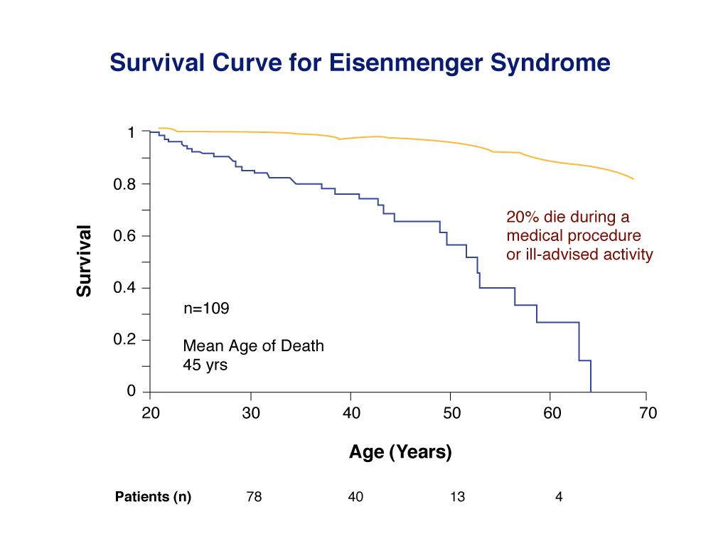
Life expectancy reduced by about 20 years
Unwarranted surgical closure hastens death
Policy of “non-intervention”, unless absolutely necessary
Avoid destabilizing the “balanced physiology”

Slide 65
Perioperative Risk for Noncardiac Surgery in Eisenmenger Syndrome
Associated with a mortality rate of 14% -19%
Local anesthesia is preferred to general anesthesia
Prolonged fasting and volume depletion should be avoided
Small air bubbles in IV lines should be removed
Early ambulation is encouraged
Antibodies given to prevent infective endocarditis

Slide 66
Management of Eisenmenger Syndrome
Transplantation
1982 : Combined heart-lung transplantation
introduced by Reitz et al
1990 : Single lung transplantation with repair of
cardiac defect successfully performed by
Fremes et al
Lung transplant has advantages of
  better donor availability
  Avoidance of cardiac allograft rejection
  Absence of coronary vasculopathy

Slide 67
Management of Eisenmenger Syndrome
Lung Transplantation
Actuarial survival rates : At 1 year 70-80%, At 4 years <50%, At 10 years <30%
Indications for transplant
History of syncope
Refractory right heart failure
Poor exercise tolerance
Severe hypoxemia
Ann Thorac Surg 2001;72:1887–91)
Notes:
One-, 5-, and 10-year survival rates for ES were 72.6%, 51.3%, and 27.6%, respectively, compared with non-ES of 74.1%, 48.1%,
and 26.0%
Heart-lung transplantation (HLT) for
Eisenmenger syndrome (ES) provides superior early and
intermediate survival when compared with other forms
of transplantation. The early risk factors and long-term
outcome of HLT for ES are less well defined.
Methods. We analyzed 263 patients who had undergone
HLT at our institution during more than 15 years.
Fifty-one consecutive patients with ES who underwent
HLT, 33 (65%) of which had simple anatomy, were compared
with 212 cases having HLT for other indications
(non-ES).
Results. Female sex and previous thoracotomy were
more prevalent in the ES group. Patients with ES had
greater postoperative blood loss and returned more frequently
to the operating room for control of bleeding.
There were 8 (16%) early deaths in the ES group compared
with 27 (13%) in non-ES (p 0.65). One-, 5-, and
10-year survival rates for ES were 72.6%, 51.3%, and
27.6%, respectively, compared with non-ES of 74.1%, 48.1%,
and 26.0%, respectively, and there was no difference in
survival overall (p 0.54). Among ES patients, previous
thoracotomy was a risk factor for hospital death. A subgroup
analysis based on simple versus complex type of ES
did not show statistically significant differences in terms of
postoperative course or early or late survival.
Conclusions. Heart-lung transplantation is a successful
procedure for ES. Despite a greater frequency of risk factors
and a more difficult operative course, early and late outcome
with HLT is comparable to non-ES recipients

Slide 68
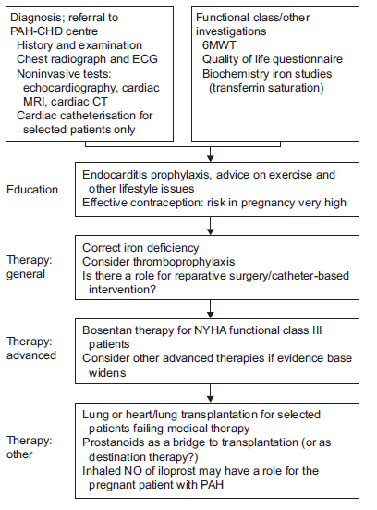
TREATMENT PROTOCOL

Slide 69
NEWER CONCEPTS IN ES
CIRCULATING ENDOTHELIAL PROGENITOR CELLS DECREASED IN ES /IPAH
  Endothelial dysfunction is a hallmark of PAH, and recent evidence suggests that bone marrow–derived cells participate in postnatal blood vessel repair and neovascularization
  The relative deficiency of circulating EPCs in PAH patients may contribute to the pulmonary vascular pathology, whereas chronic pharmacological augmentation with PDE5 inhibitors could offer a novel therapeutic strategy
TREAT & REPAIR STRATEGY
In patients with very high pvr ,treat with advanced therapy & reduce the pvr followed by repair

Slide 70
SUMMARY
Eisenmenger’s is a preventable disease
Survival better than IPAH
Advanced therapies are found to be effective
Ccb is contraindicated in management
Pregnancy is contraindicated in ES
Advanced therapy can delay heart lung transplantation
“PREVENTION IS BETTER THAN CURE”

Slide 71
BIBLIOGRAPHY
SIMKOVA IVETA :EISENMENGER SYNDROME – A UNIQUE FORM OF PAH;BRATZIL LEK LISTY 2009 110(12)
THE EISENMENGER SYNDROME OR PULMONARY HYPERTENSION WITH REVERSED CENTRAL SHUNT PAUL WOOD.;BMJ 1958
PAULWOOD;DISEASES OF THE HEART & CIRCULATION:3RD EDITION:CHAPTER 8;467- 499
M.A. Gatzoulis*, PULMONARY ARTERIAL HYPERTENSION IN PAEDIATRIC AND ADULT PATIENTS WITH
CONGENITAL HEART DISEASE. Eur Respir Rev 2009; 18: 113, 154–161
Heart-Lung Transplantation for Eisenmenger Syndrome: Early and Long-Term Results Ann Thorac Surg 2001;72:1887–91
ACC/AHA 2008 Guidelines for Adults With CHD; Circulation. 2008;118:e714-e833
HAS THERE BEEN ANY PROGRESS MADE ON PREGNANCY OUTCOMES AMONG WOMEN WITH PULMONARY ARTERIAL HYPERTENSION?EUROPEAN Heart Journal (2009) 30, 256–265
Guidelines for the diagnosis and treatment of pulmonary hypertensionEuropean Heart Journal (2009) 30, 2493–2537
Advanced therapy may delay the need for transplantation in patients with the Eisenmenger
syndrome European Heart Journal (2006) 27, 1472–1477
Improved Survival Among Patients With Eisenmenger Syndrome Receiving AdvancedTherapy for Pulmonary Arterial HypertensionCirculation. 2010;121:20-25
Gatzoulis MA, Int J Cardio 2008
Phosphodiesterase-5 Inhibitor in Eisenmenger Syndrome : A Preliminary Observational study Circulation. 2006;114:1807-1810
Sildenafil in eisenmenger syndrome a review.International Journal of Cardiology 120 (2007) 314–316

Slide 72
mcq
1. Eisenmenger complex has been described with which CHD?
A) ASD
B) VSD
C) PDA
D) AP WINDOW

Slide 73
2. Pulmonary vascular resistance required to produce eisenmenger syndrome is
A) 3 wood units
B) 5 wood units
C) 8 wood units
d) 10 wood units

Slide 74
3.initial rapid fall in PVR at birth is due to all except
A) uncoiling of the pulmonary artery
B) improvement of oxygen saturation
C) regression of medial hypertrophy of the arteries
D)Blood flow through the entire length of PA

Slide 75
4.all drugs are used in ES except
A) prostacyclin
B)Bosentan
C) sildenafil
D) nifedepine

Slide 76
5.phlebotomy is indicated in patients
A) asymptomatic with pcv> 65%
B) symptomatic with pcv> 65%
C) symptomatic with pcv < 65%
D) none of the above

Slide 77
6) which represents irreversible stage of pulmonary hypertension according to heath edwards histologic classification
A) stage1
B) stage 2
C) stage 3
D) stage 4

Slide 78
7) ALL ARE CAUSES OF ES EXCEPT
A) TRUNCUS ARTERIOSUS
B) TGA WITH VSD
C) VSD WITH PS
D) TAPVC

Slide 79
8.which is the drug with class I indication in ES
A) SILDENAFIL
B) PROSTACYCLIN
C) BOSENTAN
D) CCB

Slide 80
9.MOST COMMON CAUSE OF DEATH IN RECENT CASE SERIES OF ES
A) SUDDEN CARDIAC DEATH
B) HAEMOPTYSIS
C) INFECTIVE ENDOCARDITIS
D) HEART FAILURE

Slide 81
10. ES IS DIFFERENT FROM IPAH IN ALL EXCEPT
A) EARLY CYANOSIS
B) 5 YR MORTALITY > 85%
C) PRESENCE OF COMLPLICATIONS LIKE CEREBRALABCESS
D) HEART FAILURE IS A LATE COMPLICATION

