Slide 1
PNEUMONIA

Slide 2
OBJECTIVES
To know causes of pneumonia
To know different types of pneumonia
To know various symptoms associated

Slide 3
TYPES OF PNEUMONIA
Mainly of two types:
  Community Acquired Acute Pneumonia
  Community Acquired Atypical Pneumonia
  Other types of Pneumonia:
  Hospital Acquired Pneumonia
  Aspiration Pneumonia
  Chronic Pneumonia
  Pneumonia in Immunocompromised Host
  Lung Abscess

Slide 4
Community Acquired Acute Pneumonia: Its causes
Streptococcus pneumoniae
Haemophilus influenzae
Moraxella catarrhalis
Staphylococcus aureus
Legionella pneumophila
Enterobacteriaceae (Klebsiella pneumoniae) and
Pseudomonas spp

Slide 5
Community Acquired Acute Pneumonia: Morphology
Bacterial pneumonia has two patterns of anatomic distribution:
  Lobular bronchopneumonia and lobar pneumonia.
Patchy consolidation of the lung is the dominant characteristic of lobular pneumonia.
Lobular pneumonia and bronchopneumonia are similar terms.
And fibrinosuppurative consolidation of a large portion of a lobe or of an entire lobe defines lobar pneumonia

Slide 6
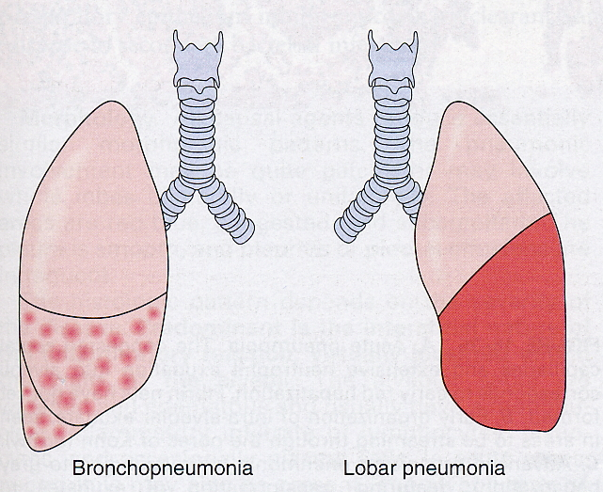

Slide 7
LOBAR PNEUMONIA
Definition:
An inflammation with sudden onset
that rapidly involves an entire pulmonary lobe
(rarely several lobes).
Left untreated, it progresses through several stages.

Slide 8
Etiologic factors
— Streptococcus pneumoniae type I (90% of all cases);
— Klebsiella (5% of all cases).
Predisposing factors include:
— protein-rich pulmonary edema (heart failure);
— compromised immune system (alcoholics and neonates

Slide 9
Morphology of lobar pneumonia:
— Initial congestion (first to second day of illness):
Hyperemic alveolar vessels produce
a protein-rich exudate that is released
into the alveolar lumen and contains hardly
any neutrophils (serous inflammation).
Macroscopic findings include a dark red,
fluid-filled soft lung.

Slide 10
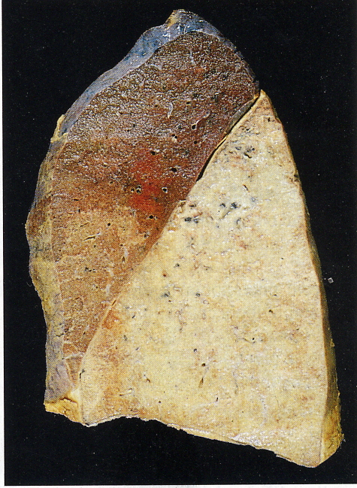

Slide 11
Red hepatization (third day of illness):
Hyperemia of the alveolar microvasculature
occurs with extravasation of blood serum
into the alveoli
Macroscopic findings
( A) include a dark red lung with a liver-like consistency
(hence the term “hepatization”). Percussion
is without resonance. Auscultatory findings
include sounds resembling rubbing leather
( B) and production of a serofibrinous exudate. Auscultatory findings include high-pitched rattling sounds.

Slide 12
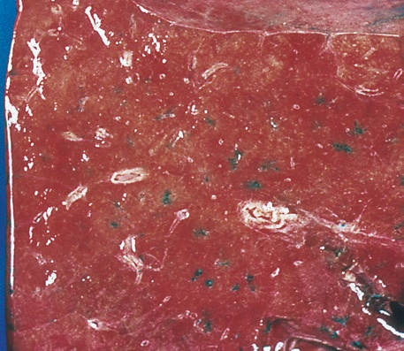
Red hepatization (lung)

Slide 13
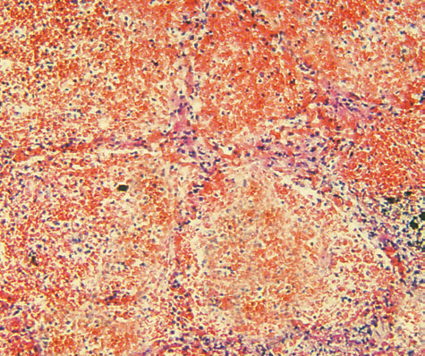
Red hepatization

Slide 14
Gray hepatization (fourth to fifth day of illness):
Massive fibrinous exudation into the
alveolar lumen is present, and macrophages
and neutrophils are found in the inflamed
area. The alveoli are lined with fibrinous lattices
( D1), and fibrin passes through open
pores of Kohn into the adjacent alveoli.
Macroscopic findings include a gray nodular
appearance of the cut surface of the lung,
which has the consistency of liver ( C).

Slide 15
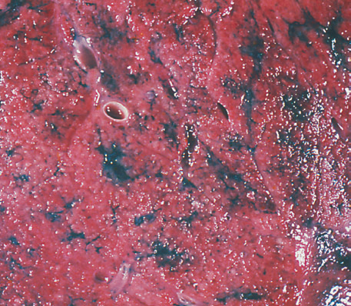
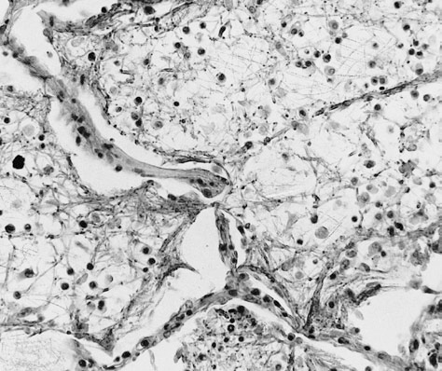
Gray hepatization (lung)

Slide 16
Yellow hepatization (seventh day of illness):
A massive suppurative inflammatory reaction
is present with large numbers of neutrophils
(see below; F). The exudate is dissolved
by proteolysis, with resulting destruction
of cells and tissue. Detritus forms
and microcirculation returns to near normal.
Macroscopic findings include a dirty yellow
appearance of the cut surface of the lung,
which still has a firm consistency ( E).

Slide 17
Resolution (between the seventh and ninth
days of illness): This involves massive fibrinolytic
dissolution of the exudate by macrophages
and neutrophils. The alveoli are
cleared, and the patient either coughs up
the dissolved exudate in the form of rust
brown sputum or it is absorbed through
the lymph system. The alveoli expand again.
Auscultatory findings include the crackling
sounds of expanding alveoli.

Slide 18
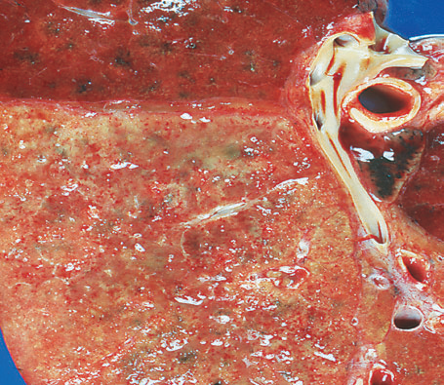
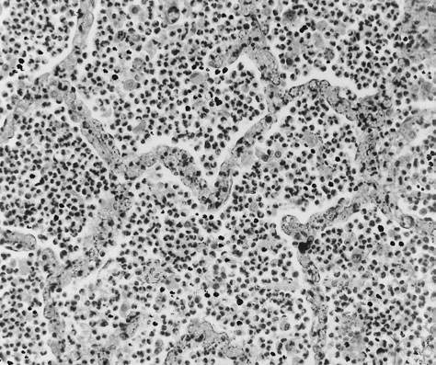
Yellow hepatization (lung)

Slide 19
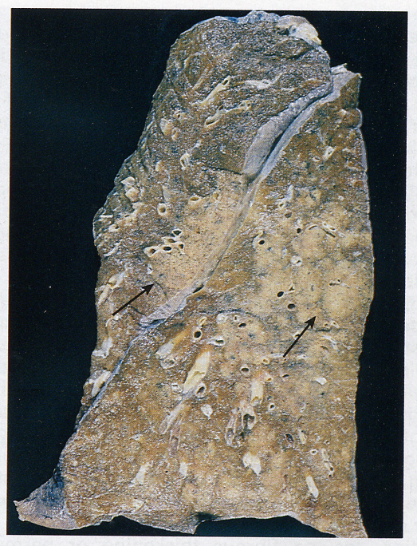

Slide 20
BRONCHOPNEUMONIA/ LOBULAR
PNEUMONIA
It is the infection of terminal bronchioles extending into
surrounding alveoli resulting in patchy consolidation of the lung.
It is more often multilobar and frequently bilateral and
basal because of tendency of secretions accumulating in
lower zones due to gravitation.
GROSSLY, there are patchy areas of red or grey
consolidation affecting as above pattern.
MICROSCOPICALLY,
Acute bronchiolitis
Infiltration by neutrophils in bronchi and bronchioles.

Slide 21
COMPLICATIONS OF CAAcP
Tissue destruction and necrosis, causing abscess formation (particularly common with type 3 pneumococci or Klebsiella infections);
Spread of infection to the pleural cavity, causing the intrapleural fibrinosuppurative reaction known as empyema; and
Bacteremic dissemination to the heart valves, pericardium, brain, kidneys, spleen, or joints, causing metastatic abscesses, endocarditis, meningitis, or suppurative arthritis

Slide 22
CAAcP: CLINICAL COURSE
The major symptoms of community‐acquired acute pneumonia are –
  abrupt onset of high fever,
  shaking chills,
  cough productive of mucopurulent sputum;
  occasional patients may have hemoptysis.
The identification of the organism and the determination of its antibiotic sensitivity are the keystones to appropriate therapy.
Death may occur as a result of predisposing factors (chronic alcoholism)

Slide 23
COMMUNITY ACQUIRED ATYPICAL
PNEUMONIA: CAUSATIVE AGENTS
Mycoplasma pneumoniae
Chlamydia spp. (C. pneumoniae, C. psittaci, C.trachomatis)
Coxiella burnetii (Q fever)
Viruses:
  Respiratory syncytial virus,
  Parainfluenza virus (children);
  Influenza A and B (adults);
  Adenovirus (military recruits);
  SARS virus

Slide 24
CAAtP: MORPHOLOGY
All causal agents produce essentially similar morphologic patterns.
The affected areas are red‐blue and congested.
Predominant is the interstitial nature of the inflammatory reaction, virtually localized within the walls of the alveoli.
The alveolar septa are widened and edematous and usually have a mononuclear inflammatory infiltrate of lymphocytes, macrophages, and occasionally plasma cells.
In acute cases neutrophils may also be present.
Eradication of the infection is followed by reconstitution of the normal architecture of the lung.

Slide 25
CAAtP: CLINICAL COURSE
The clinical course of CAAtP is extremely varied, resulting from mild symptoms to severe upper respiratory tract infections.
Cough may be absent, and the major manifestations may consist only of ‐
  fever,
  headache,
  muscle aches,
  and pains in the legs.
The ordinary sporadic form of the disease is usually mild with a low mortality rate below 1%

Slide 26
HOSPITAL ACQUIRED PNEUMONIA
DEFINITION: Hospital‐acquired pneumonias are defined as pulmonary infections acquired in the course of a hospital stay.
INFECTED INDIVIDUALS: They are common in patients with‐
  Severe underlying disease,
  Immunosuppression,
  Prolonged antibiotic therapy, or
  Invasive access devices such as intravascular catheters.
  Patients on mechanical ventilation are at particularly high risk

Slide 27
HAP: CAUSATIVE AGENTS
Pseudomonus
Staphylococcus
Enterobacteriacae

Slide 28
ASPIRATION PNEUMONIA:PATHOGENESIS
Aspiration pneumonia occurs in markedly debilitated patients or those who aspirate gastric contents either while unconscious (e.g., after a stroke) or during repeated vomiting.
These patients have abnormal gag and swallowing reflexes that predispose to aspiration.
The resultant pneumonia is partly chemical because of the extremely irritating effects of the gastric acid, and partly bacterial (from the oral flora).
Typically, more than one organism is recovered on culture, aerobes being more common than anaerobes.
This type of pneumonia is often necrotizing, pursues afulminant clinical course, and is a frequent cause of death.

Slide 29
ASPIRATION PNEUMONIA: CAUSATIVE AGENTS
Anaerobic oral flora
  Bacteroides,
  Prevotella,
  Fusobacterium,
  Peptostreptococcus,
Admixed with aerobic bacteria
  Streptococcus pneumoniae,
  Staphylococcus aureus,
  Haemophilus influenzae, and
  Pseudomonas aerugenosa

Slide 30
LUNG ABSCESS
DEFINITION:
  The term “pulmonary abscess” describes a local suppurative process within the lung, characterized by necrosis of lung tissue.
  A: CAUSATIVE AGENTS
Although under appropriate circumstances any pathogen can produce an abscess, the commonly isolated organisms include aerobic and anaerobic streptococci, S. aureus, and a host of gram‐negative organisms.
Anaerobic organisms normally found in the oral cavity, including members of the Bacteroides, Fusobacterium, and Peptococcus species, are the exclusive isolates in about 60% of cases.

Slide 31
LUNG ABSCESS: PATHOGENESIS
Aspiration of infective material (the most frequent cause): This is particularly common in acute alcoholism, coma, anesthesia, sinusitis, gingivodental sepsis, and debilitation in which the cough reflexes are depressed.
Antecedent primary lung infection: Post‐pneumonic abscess formations are usually associated with S. aureus, K. pneumoniae,and the type 3 pneumococcus. Posttransplant or otherwise immunosuppressed individuals are at special risk.
Septic embolism: Infected emboli from thrombophlebitis in any portion of the systemic venous circulation or from the vegetations of infective bacterial endocarditis on the right side of the heart are trapped in the lung.
Neoplasia: Secondary infection is particularly common in the bronchopulmonary segment obstructed by a primary or secondary malignancy (postobstructive pneumonia)

Slide 32
LUNG ABSCESS: MORPHOLOGY(1)
SIZE: Abscesses vary in diameter from lesions of a few milimeters to large cavities of 5 to 6 cm.
DISTRIBUTION:
Pulmonary abscesses due to aspiration are more common on the right (because of the more vertical right main bronchus) and are most often single.
Abscesses that develop in the course of pneumonia or bronchiectasis are usually multiple, basal, and diffusely scattered.
Septic emboli and pyemic abscesses are multiple and may affect any region of the lungs.

Slide 33
LUNG ABSCESS: MORPHOLOGY(2)
The cardinal histologic change in all abscesses is suppurative destruction of the lung parenchyma within the central area of cavitation.
Continued infection leads to large, green‐black, multilocular cavities with poor demarcation of their margins, designated as “gangrene of the lung”.
In chronic cases considerable fibroblastic proliferation produces a fibrous wall.

Slide 34
LUNG ABSCESS: CLINICAL COURSE
The manifestations of pulmonary abscesses are much like those of bronchiectasis and are characterized principally by cough, fever, and copious amounts of foul‐smelling purulent or sanguineous sputum. Fever, chest pain, and weight loss are common.
Clubbing of the fingers and toes may appear within a few weeks after the onset of an abscess.
Diagnosis of this condition can be only suspected from the clinical findings and must be confirmed radiologically.
Whenever an abscess is discovered in older individuals, it is important to rule out an underlying carcinoma, because this is present in 10% to 15% of cases.
Complications include extension of the infection into the pleural cavity, hemorrhage, the development of brain abscesses or meningitis from septic emboli and (rarely) secondary amyloidosis (Type AA)

Slide 35
CHRONIC PNEUMONIA
CAUSATIVE AGENTS:
Nocardia
Actinomyces
Granulomatous:
Mycobacterium tuberculosis and atypical
mycobacteria,
Histoplasma capsulatum,
Coccidioides immitis,
Blastomyces dermatitidis

Slide 36
Daniel Caldeira, Joana Alarcão, , António Vaz-Carneiro, João Costa
BMJ 2012; 345 Published 11 July 2012
Author | Study name , design & LEVEL OF EVIDENCE | AIM | RESULT | Conclusion
Daniel Caldeira, Joana Alarcão, , António Vaz-Carneiro, João Costa | Risk of pneumonia associated with use of angiotensin converting enzyme inhibitors and angiotensin receptor blockers: systematic review and meta-analysis | The systematic review was carried out in accordance with the meta-analysis of observational studies in epidemiology and preferred reporting items for systematic reviews and meta-analyses statements.²⁵²⁶ Our primary outcome was the incidence of pneumonia. We considered cases of pneumonia, lower respiratory tract infections, and admissions to hospital due to lower respiratory tract infections. Data were extracted irrespective of whether they had been reported as predefined outcomes or as adverse effects. | 37 eligible studies were included. ACE inhibitors were associated with a significantly reduced risk of pneumonia compared with control treatment (19 studies: odds ratio 0.66, 95% confidence interval 0.55 to 0.80; I²=79%) and ARBs (combined direct and indirect odds ratio estimate 0.69, 0.56 to 0.85). In patients with stroke, the risk of pneumonia was also lower in those treated with ACE inhibitors compared with control treatment (odds ratio 0.46, 0.34 to 0.62) and ARBs (0.42, 0.22 to 0.80). ACE inhibitors were associated with a significantly reduced risk of pneumonia among Asian patients (0.43, 0.34 to 0.54) compared with non-Asian patients (0.82, 0.67 to 1.00; P<0.001). Compared with control treatments, both ACE inhibitors (seven studies: odds ratio 0.73, 0.58 to 0.92; I²=51%) and ARBs (one randomised controlled trial: 0.63, 0.40 to 1.00) were associated with a decrease in pneumonia related mortality, without differences between interventions. | Conclusions The best evidence available points towards a putative protective role of ACE inhibitors but not ARBs in risk of pneumonia. Patient populations that may benefit most are those with previous stroke and Asian patients. ACE inhibitors were also associated with a decrease in pneumonia related mortality, but the data lacked strength. ping and B+ by serum typing at room temperature. However, his serum displayed weak anti-B (1+) reaction at low temperature (4 ). He was confirmed as having the O/O allele by genetic study. These findings indicate a weakening of serum antibodies, suggesting that hypogammaglobulinemia was a possible cause of the discrepancy

Slide 37
MCQs
1) 90% of all cases of lobar pneumonia are caused by:
    Streptococcus pneumoniae type 1
    Klebsiella
    Mycoplama pneumoniae
    Staphylococcus aureus

Slide 38
2) Clubbing of fingers and toes may appear within a few weeks after onset of lung abscess;
  True
  False

Slide 39
3) All of the following are complications of community acquired acute pneumonia except:
  Abscess formation
  Empyema
  Meningitis
  Rheumatoid arthritis

Slide 40
4) All of the following are stages of inflammatory response in lobar pneumonia except:
  Congestion
  Red hepatization
  Black hepatization
  Gray hepatization
  Resolution

Slide 41
5) Lobular Pneumonia is also known as:
  Lobar Pneumonia
  Chronic Pneumonia
  HAP
  Bronchopneumonia

Slide 42
MCQs with Answers
1) 90% of all cases of lobar pneumonia are caused by:
    Streptococcus pneumoniae type 1
    Klebsiella
    Mycoplama pneumoniae
    Staphylococcus aureus

Slide 43
2) Clubbing of fingers and toes may appear within a few weeks after onset of lung abscess;
  True
  False

Slide 44
3) All of the following are complications of community acquired acute pneumonia except:
  Abscess formation
  Empyema
  Meningitis
  Rheumatoid arthritis

Slide 45
4) All of the following are stages of inflammatory response in lobar pneumonia except:
  Congestion
  Red hepatization
  Black hepatization
  Gray hepatization
  Resolution

Slide 46
5) Lobular Pneumonia is also known as:
  Lobar Pneumonia
  Chronic Pneumonia
  HAP
  Bronchopneumonia

Slide 47
THANK YOU

