Slide 1
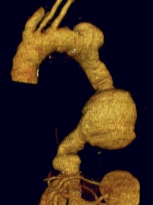
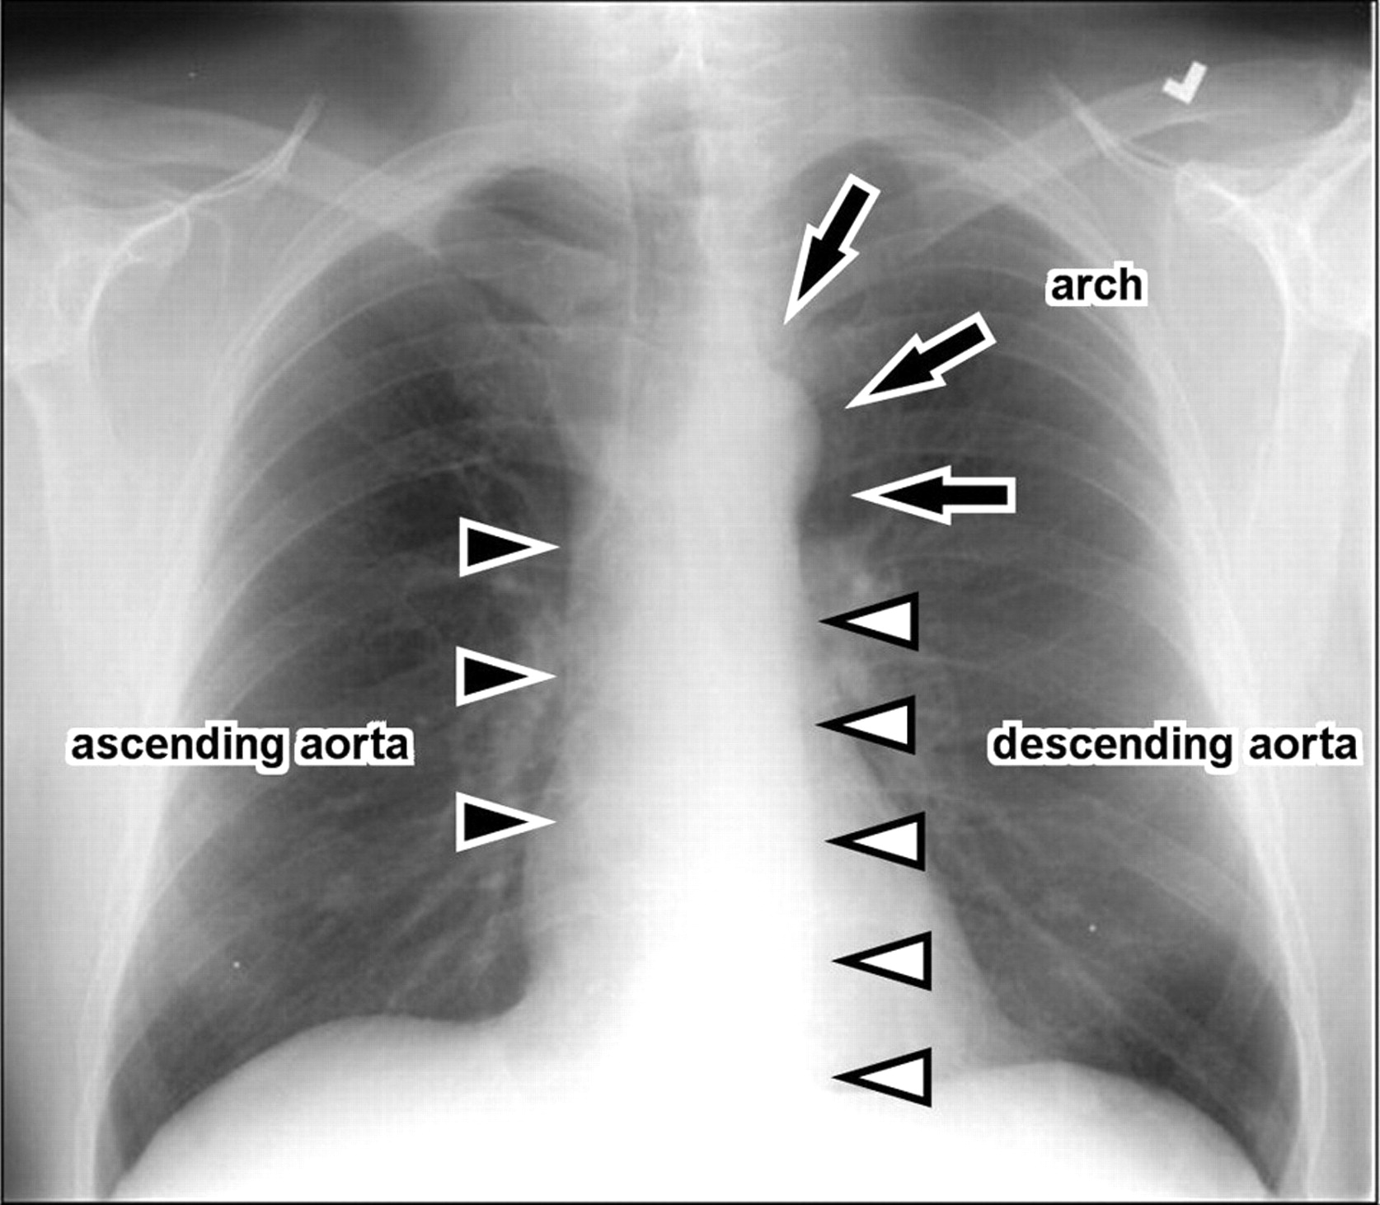
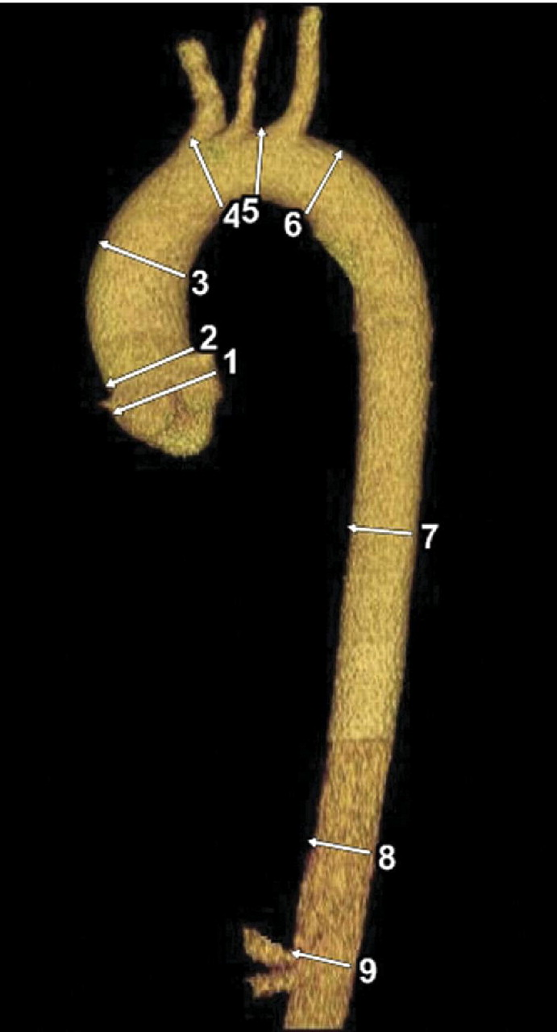
Aortic Disease
THE LOST WORLD
CONGENITAL
ACQUIRED
INFLAMATORY
DEGENERATIVE
ATHEROSCLEROTIC
TRAUMATIC
Dr. Cinosh Mathew
Associate professor
Dept of Cardiology
SBKS MI & RC

Slide 2
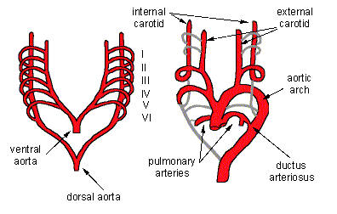
I & IInd arch involute
IIIrd arch and cephalad ventral aorta forms the carotid arteries
Dorsal aorta between 3rd and 4th arch involutes
4th arch on right side forms proximal RSA and definite aortic arch on left side
5th arch involutes completely
Aortic sack divides into Asc Ao and MPA
6th arch forms proximal pulmonary arteries B/L and ducts arteriosus distally
7th cervical intersegmental arteries form distal RSA and entire LSA after migrating cephalad
Dissolution of Rt dorsal aorta beyond 4th arch

Slide 3
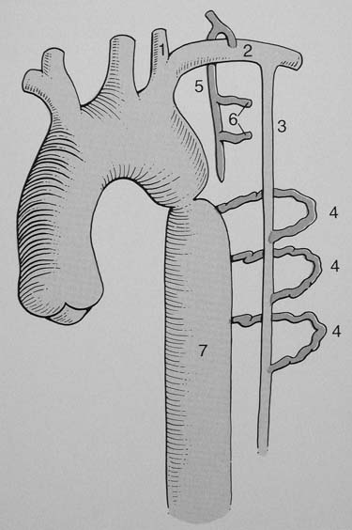

COARCTATION
5% OF CONGENITAL HEART DISEASE
POSTDUCTAL
    ADULT TYPE
    COARCTATION DISTAL TO DUCTUS OR LIGAMENTUM ARTERIOSUM
JUXTADUCTAL
    INFANTS AND CHILDREN
    HYPOPLASIA OF TRANSVERSE AORTIC ARCH AND AORTIC ISTHMUS.
    DUCTUS AT AREA OF COARCTATION
AORTIC ARCH INTERRUPTION
    95% HAVE PDA, 50% HAVE VSD

Slide 4
Surgery
COARCTATION
Balloon Dilatation
Widely accepted treatment of CoA
Sub-optimal results
  Tight CoA \ Mild stenosis
  Long segment stenosis
  Isthmic hypoplasia \ Diffuse stenosis of arch
Major concerns
  Restenosis ( High in Infants < 3 months)
  Aneurysm
  Dissection of aorta
Successful for native CoA
Surgical repair for persistent and recurrent CoA
  Technically difficult
  High recurrence
  High morbidity and mortality
Indications of Stenting in CoA
Adults with mild CoA
Hypoplastic transverse arch or isthmus
Long segment coarctation
Tortuous coarctation with malalignment of proximal with distal aortic segment which is difficult to treat with balloon dilatation
Small aneurysm or dissection following surgery/ balloon angioplasty
Criteria for successful dilatation
Increase in coarctation diameter by >30%
Residual peak systolic gradient across coarctation segment < 20mmHg.
No major complication as death, aortic tear or stroke.

Slide 5
Inflammatory Diseases
Giant Cell Arteritis
Syphylis
Mycotic aneurysm due to endocarditis
Takayasu Aortoarteritis
Rheumatoid and Psoriatic arthritis

Slide 6
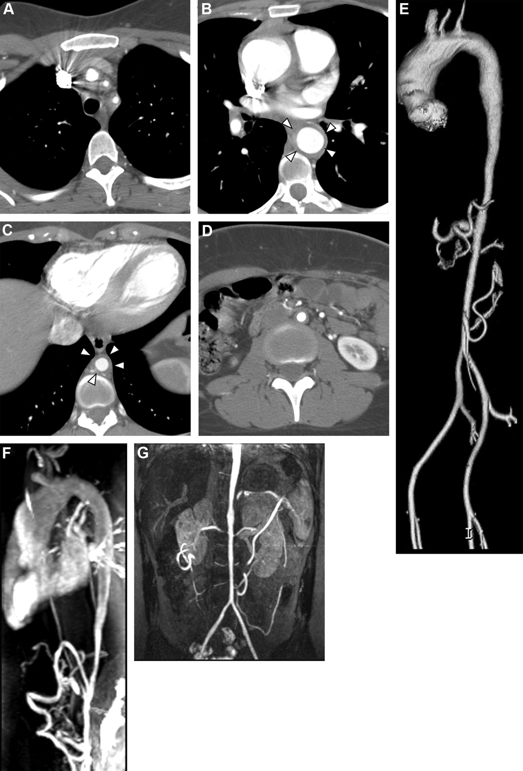
Aortoarteritis
inflammatory disease of unknown origin involving aorta, its primary branches and pulmonary artery.
stenosis, occlusion or dilatation of involved vessels
predominantly disease of young adults in second and third decades of life.
female preponderance.
HLA B-52, DR-2, B-5.
debated relationship to tuberculosis( heat shock protein(HSP)-65).

Slide 7
Ishikawa criteria (1988)
Proposed by Ishikawa on the basis of study of 108 pts.
Obligatory criteria:
Age<40 yrs at diagnosis or onset of disease.
Major criteria:
Left & right mid-subclavian artery lesions.
Minor criteria:
High ESR (>20mm/h) 2.CCA tenderness
3. HTN 4.AR or annuloaortic ectasia
5. Lesions in PA 6.Left mid CCA lesions
7. Distal brachiocephalic trunk involvement
8. Descending Thoracic aorta & 9.Abdominal aorta involvement
High possibility
1) two major criteria in addition to obligatory criterion
2) one major plus two or more minor criteria
3) four or more minor criteria
Sensitivity =84%, specificity=95% in Japanese pt.
In Indian series, Sensitivity :60.4%. Specificity :95%

Slide 8
Classification: According to vascular region involvement
Type I (Schimizu Sano)- Aortic arch & its branches.
Type II ( Kimoto)- Thoraco-abdominal aorta & its branches.
Type III (Inada)- Mixed Type I & II.( Ueno, 1967)
Type IV (Lupi-Harrera, 1975)- Additional Pulmonary artery involvement.
Type V ( Panja et al, 1997)- Additional coronary artery involvement.

Slide 9
Immuno-suppressive therapy for Takayasu arteritis
NIH prtotocol:
Prednisolone :
1mg/Kg, max of 60 mg/day for 1-3 M.
-Tapered to A/D schedule during next 4-8 wks if disease
remains inactive.
-Further tapered & discontinued over next 6-12 M if disease
remains inactive.
-If steroid tapering unsuccessful or relapse occurs, add daily
cyclophosphamide (2 mg/Kg) or weekly Methotrexate (0.15-0.35
mg/Kg) or azathioprine (100 mg/day).
Patients on steroid therapy are monitored by weekly ESR

Slide 10
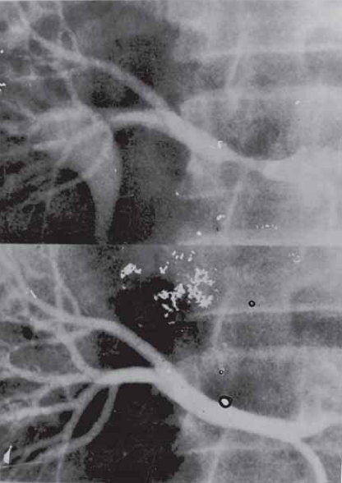
Aortoarteritis Treatment
HT with critical RAS
Extremity claudication limiting activities of daily living
Cerebrovascular ischaemia
Moderate AR
Cardiac ischaemia with confirmed CA involvement
.Percutaneous transluminal balloon angioplasty (PTA)
-Safe, effective procedure with low risk.
-Logical substitute to surgical therapy, especially to the high surgical risk patients.
-Most commonly performed for stenosis in aorta , carotid subclavian and renal arteries.
-Restenosis can be tackled with repeat angioplasty.
-Flow limiting dissections, suboptimal results can be managed with stent implantation.

Slide 11
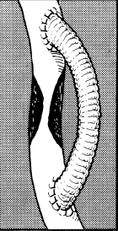
Surgical/Operative Treatment
Surgical modalities available
Resection of narrowed segment and replacement with interposition graft
Patch aortoplasty for short segmental lesion
Endarterctomy
Bypass of obstructed vessel

Slide 12
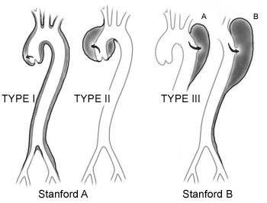
Aortic dissection
Age
Hypertension (62- 78 %)
Connective tissue disorders
Prior cardiac surgery ( 18 % )
Iatrogenic trauma ( 5 % )
Type ( A) AD
- mortality without intervention very high
25% at 24 hrs
50% at 1 week
75% at 1 month 90% at 1 yr
Type ( B) AD
-Uncomplicated
30 day mortality 10%
- Complicated
20% by day 2
25% by day 30
Initiation
intimal tear or intramural hematoma in media
Propagation of dissection
hydrodynamic forces in the blood stream

Slide 13
Complications
Type A Dissections
Aortic Regurgitation
Myocardial Infarction
Cardiac Tamponade
SVC Syndrome
Aortic obstruction
Left to right shunt
Heart Block
Type B Dissections
Pleural effusion.
Rupture into the chest. (Most common cause of death).
Branch artery compromise.
  Bowel ischaemia / infarction.
  Renal ischaemia / infarction.
  Paraplegia(2%) (Involvement of intercostals and lumbar arteries)
  Lower limb ischaemia.
Location of Tear Site of rupture
Ascending aorta >Intra pericardial(70%) Lt. Pleura (6%).
Arch >Intra pericardial(35%) Lt. Pleura (32%).
Descending aorta >Intra Pericardial (12%) Lt. Pleura (44%).

Slide 14
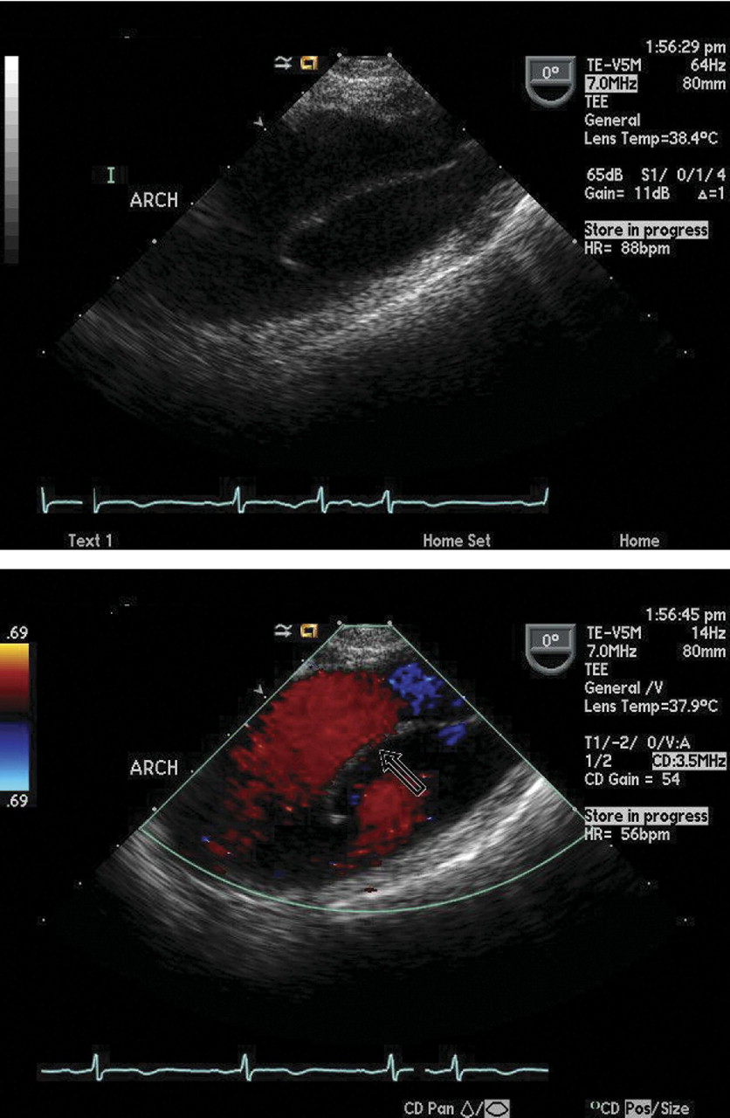
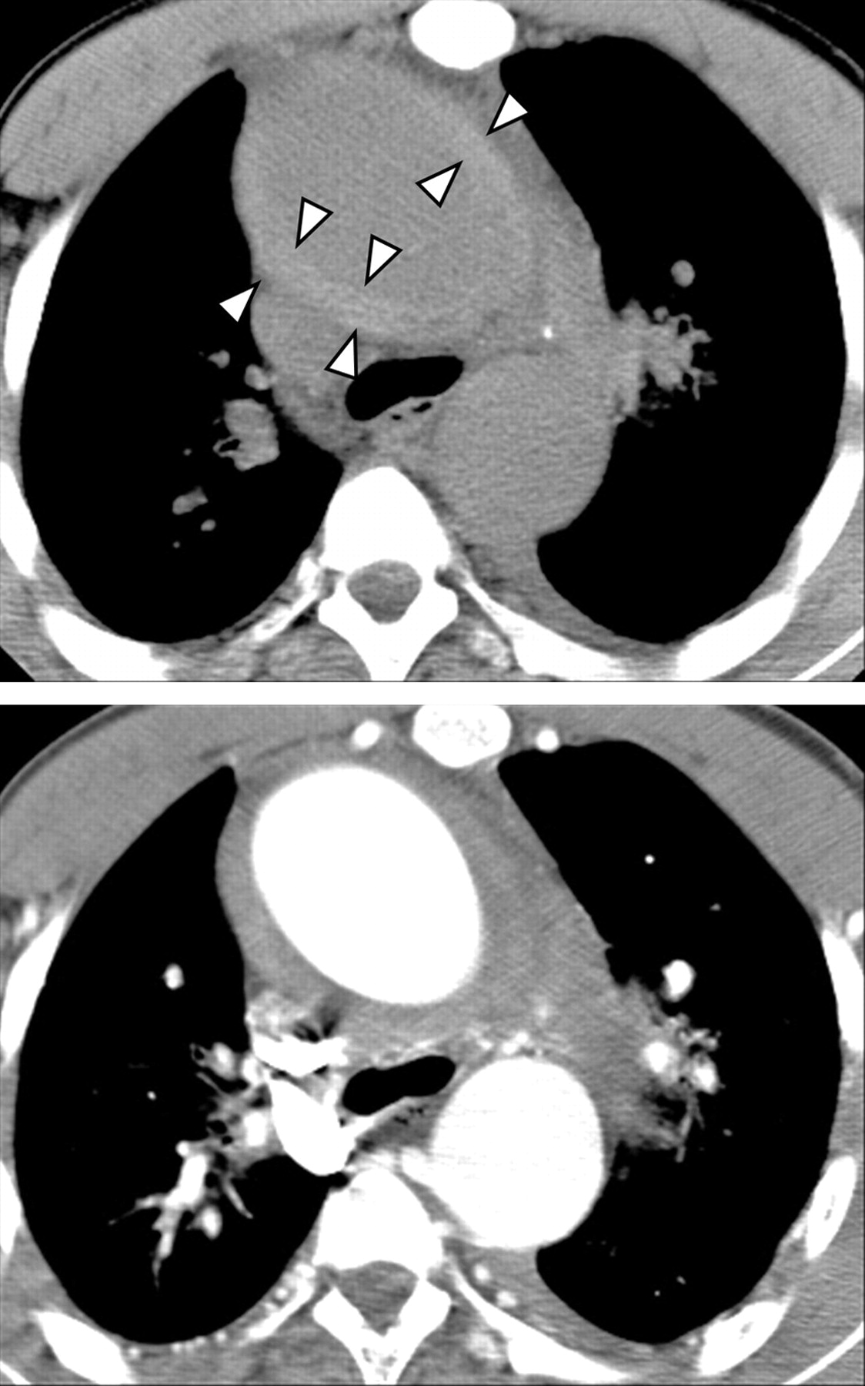
Arch aneurysm with dissection flap
Axial CT images demonstrating
the value of noncontrast images

Slide 15
 | TEE | CT | MRI | Angiography | IVUS
Sensitivity | 99% | >90% | >90% | 90% | 99%
Specificity | 89% | >85% | 99% | >95% | 99%
Classification | +++ | ++ | ++ | + | ++
Tear localization | +++ | ---- | ++ | + | +
Aortic regurgitation | +++ | __ | ++ | ++ | __
Pericardial effusion | +++ | ++ | ++ | __ | __
Mediast. hematoma | ++ | +++ | +++ | __ | +
Side branch inv. | + | ++ | ++ | +++ | +++
Coronary artery inv. | ++ | __ | + | +++ | ++
Follow up | ++ | ++ | +++ | __ | __
Intra operative availability | +++ | __ | __ | + | +

Slide 16
Definitive
Treatment
Medical :
- acute type B uncomplicated
- aortic arch dissection uncomplicated
Surgery :
- type A dissection
- acute type B complicated
-> compromised vital organ / limb perfusion
> rupture or threatened rupture
> retrograde dissection to AA or AoV regurgitation
> persistent pain or hypertension
Endovascular intervention :
- unstable type B
Arch involvement
> absence of arch entry tear - anastomosis of graft & conjoined aortic wall at junction of ascending aorta & arch
> in presence arch tear ( 30 % ) – subtotal or total arch replacement with reconstruction of some or all supra-aortic vessels to the graft
> dissection extending to downstream aorta
Elephant trunk Procedure
> Isolated Aortic Arch dissection -- no guideline exists
approached on case by case heavily influenced by
- surgeon, s experience
- patients age , patients personal preference
- hemodynamic & co-morbid status
Resection of region of intimal tear
replaced by interposition graft & origin of FL excluded by prox. & distal suturing of the edges of aorta
Aortic valve reconstruction
Aortic root replacement
> MFS , EDS , obvious SOVA
> extension of both the tear & dissection to the aortic
valve annulus
Coronary artery involvement
> ostium involved but vessel not disrupted – button hole anastomosis to the tube graft
> ostium torn - > CABG

Slide 17
Endovascular Intervention INDICATIONS
patient success mortality conversion survival
no. ( procedure) to Sx long term
Dake al et 19 100 % 16 % --- ----
1999
Ninebar 12 100% nil ---- -----
1999
Palma et al 70 92 % 3 % 7% 92% at 29 ms
2002
Alves et al 49 87 % 8.16% ----- -----
2002
Enio Buffolo 191 91 % 10 % 4 % 87+/-2.9 %
2002
Complicated type B
- acute (contained) rupture
- symptomatic ischemic branch vessel involvement (SIBVI)
- early aortic expansion
- unrelenting pain
- uncontrolled hypertension
Uncomplicated type B ?
Stent graft placement
- reconstruction of aortic segment by sealing the proximal tear
- releive static obstruction of a branch by putting a stent across the vessel origin
Fenestrations
-releive critical malperfusion before Sx by creating a tear in the distal flap , thereby restoring flow to the true lumen
- rarely to create a reentry tear for the false lumen to prevent thrombosis

Slide 18
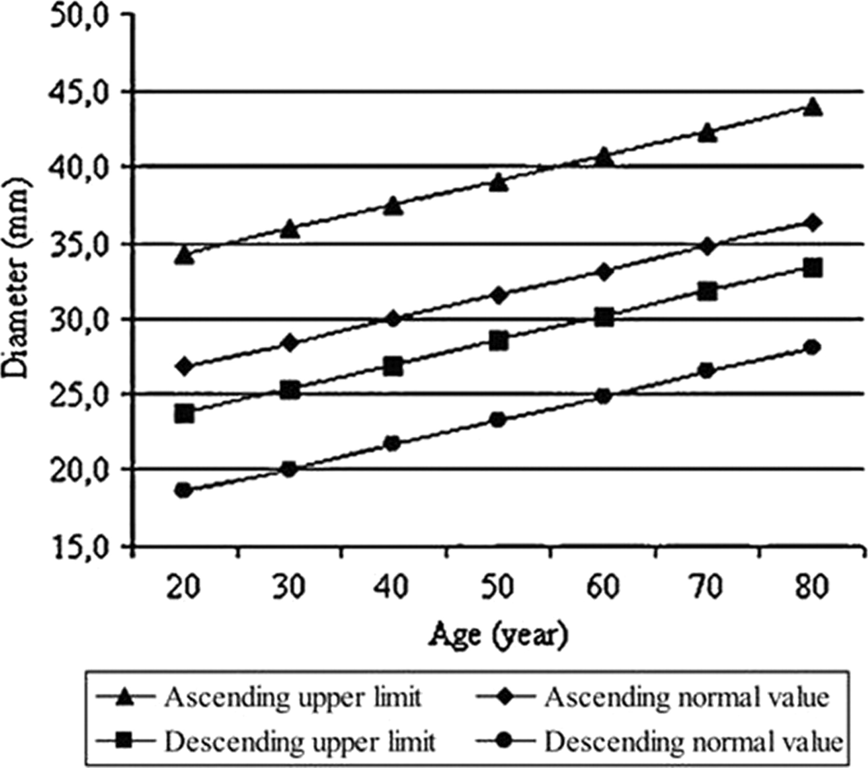
Aortic Aneurysm
Ascending aneurysms: begin above the aortic valve to the innominate artery (60%)
Aortic arch: involves any of the brachiocephalic vessels (10%)
Descending aorta: thoracic aorta below the left subclavian (40%)
Thoracoabdominal aorta (10 %)
Cystic medial degeneration leading to weakening of the aortic wall
Associated with normal aging.
Associated with Atherosclerosis
Associated with connective tissue disorders when found in younger age patients

Slide 19
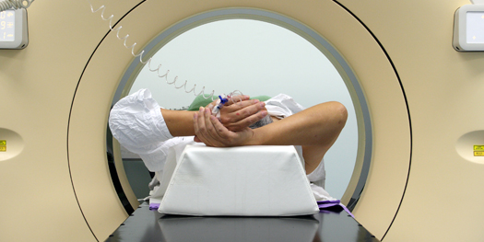
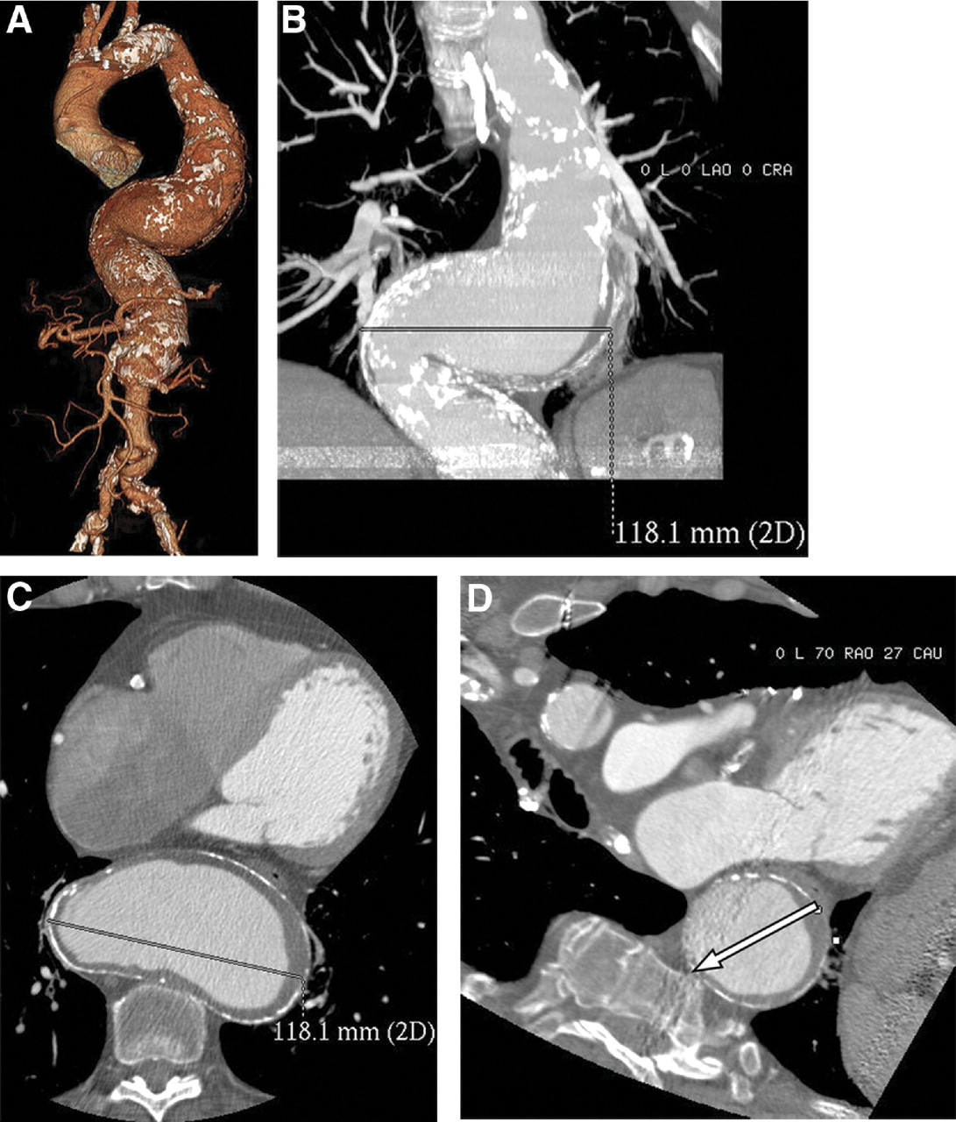
TAA
Definition
Diameter of the thoracic aorta 1.5 times greater than normal
(or larger)
Imaging
CT – the definitive exam
MRI
Chest x-ray
Aortogram
TEE
Occurrence
25% Ascending aorta
25% Aortic arch
50% Descending aorta

Slide 20
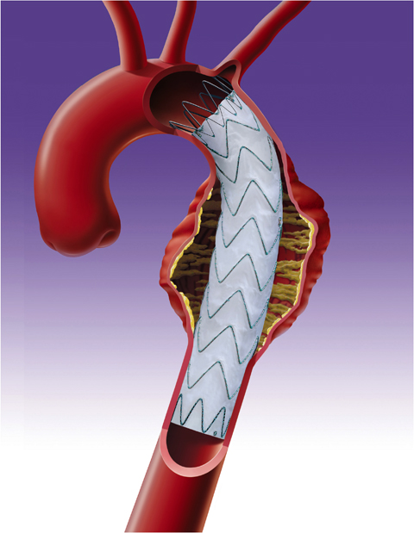
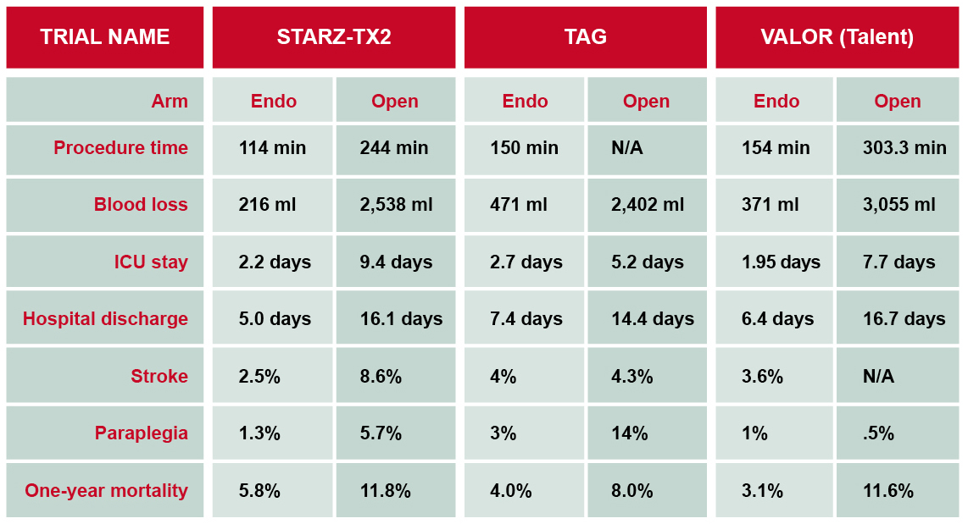
ENDOVASCULAR STENT GRAFT TRIALS

Slide 21
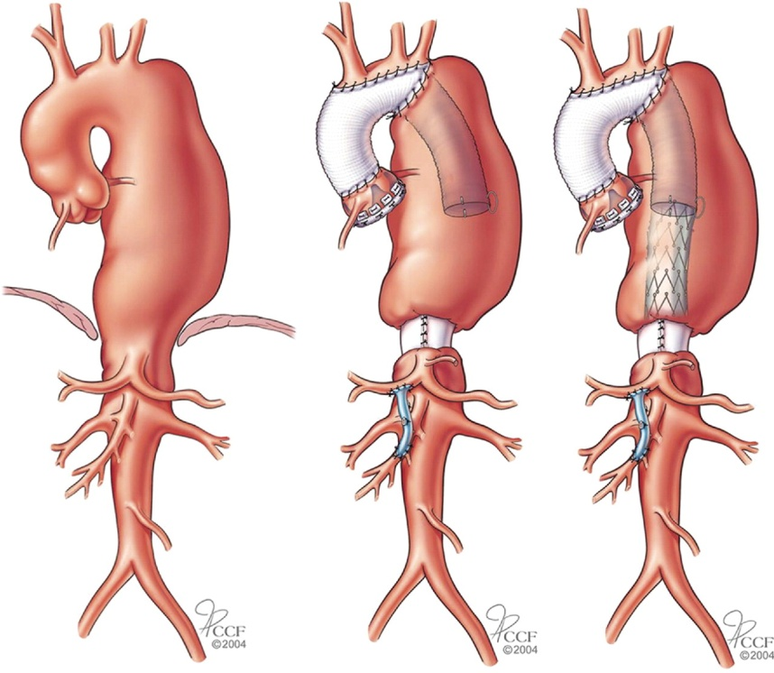
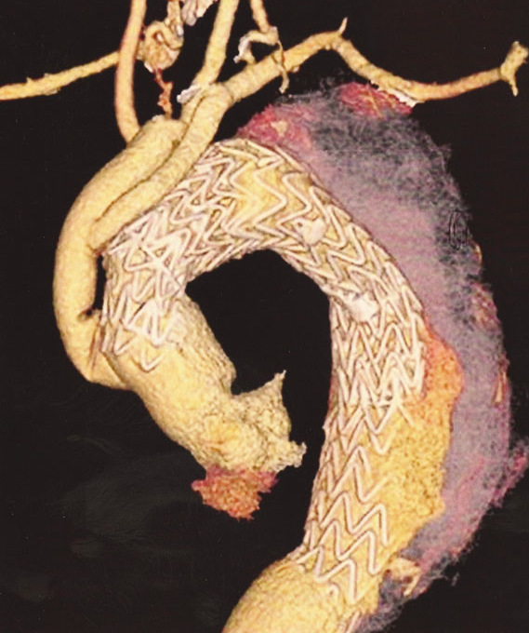
ARCH INTERVENTIONS
Elephant trunk procedure

Slide 22
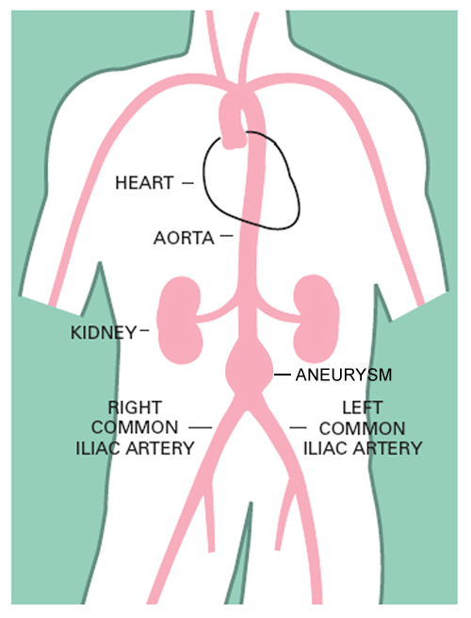
AAA ESSENTIALS
Definition
Diameter of the aorta 1.5 times
greater than normal.
Most are infrarenal, and a significant
number extend down into one or
both iliac arteries.

Slide 23
DIAGNOSIS
Physical examination of abdomen
    Abdominal tenderness may indicate an AAA
Bruit over the aorta
Palpable mass
    Not effective in obese patients and/or those with an AAA under 2 cm in diameter
Usual: abdominal ultrasound >80% accurate
As required: MRI, CT or other imaging systems
Angiography rarely indicates

Slide 24
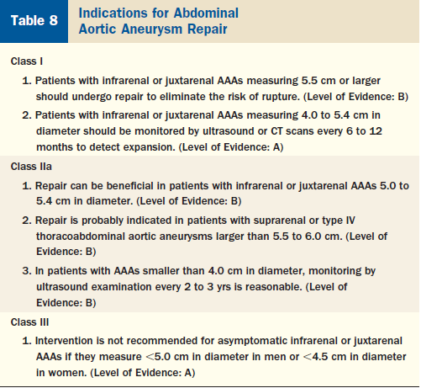

Slide 25
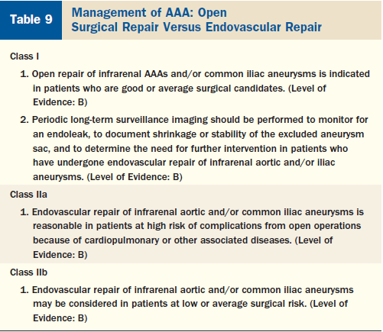

Slide 26
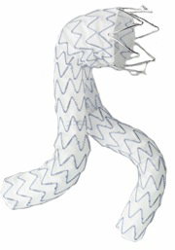
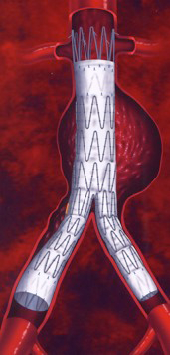
Devices in use
Endurant
Zenith

Slide 27
Atherosclerotic Stenosis
Manifests as hip, thigh or leg claudication
Leriche syndrome: Claudication of thighs/buttocks, erectile dysfunction, ↓ femoral pulses.
Earlier management of TASC A, B lesions: Endovascular. TASC C,D lesions: Surgery
Now, endovascular approach have long term patency rates comparable to surgery in TASC C, D lesions
Balloon expandable stents: Ostial, focal, calcified lesions.

Slide 28
THANK YOU

