Slide 1
Rheumatoid Arthritis

Slide 2
WAT IS ARTHRITIDES?
Group of conditions causing inflammation of joints
100 different forms

Slide 3
Common forms of Arthridites
Rheumatoid Arthritis
Rheumatic Arthritis
Osteoarthritis
Gout

Slide 4
Rheumatoid Arthritis

Slide 5
WHAT IS RHEUMATOID ARTHRITIS?
Chronic multisystem autoimmune inflammatory disease of unknown cause
The characteristic feature is persistent inflammatory synovitis, usually involving peripheral joints in a symmetric distribution.

Slide 6
The potential of the synovial inflammation to cause cartilage damage and bone erosions and subsequent changes in joint integrity is the hallmark of the disease.

Slide 7
ETIOLOGY
Response to an infectious agent in a genetically susceptible host.
Possible causative agents- Mycoplasma, Epstein-Barr virus (EBV), cytomegalovirus, parvovirus, and rubella virus.
The process by which an infectious agent cause chronic inflammatory arthritis - unknown.

Slide 8
Clinical presentation
  Prodromal syndrome of malaise, weight loss and periarticular pain and stiffness seen
  The joint involvement is characteristically symmetric with associated stiffness, warmth, tenderness and pain

Slide 9
Clinical Features
  Stiffness is characteristically worse in the morning and improves during the day.
  Usual joints affected by rheumatoid arthritis are the metacarpophalangeal jts, the proximal interphalangeal , the wrists, knees, ankles and toes.

Slide 10
1987 American College of Rheumatology Revised criteria for the diagnosis of Rheumatoid Arthritis:
  At least four of the following
    Morning stiffness > 1hour
    Synovitis in three joints simultaneously
    Synovitis in wrist or hand MCP or PIP joints
    Symmetrical arthritis (some joint areas on both sides of the body)
    Rheumatoid nodules
    Serum rheumatoid factor
    Radiographic changes typical of Rheumatoid Arthritis

Slide 11
Pathophysiology
Disease comprises 3 pathological processes:
Inflammation
Synovial proliferation
Joint tissue destruction

Slide 12
Earliest lesion-vasculitis
Cause edema of synovium and infiltration with mononuclear cells,macrophages,lymphocytes,plasma cells
Activated macrophages,lymphocytes,fibroblasts produce –cytokines cause further synovial proliferation and inflammation

Slide 13
Synovial fluid contain-PGs,TNF-alpha,luekotreiene B4,interleukins(IL-1,IL-6)
TNF-alpha,interleukins(IL-1,IL-6) –central mediators of active rhuematoid process-cause joint destruction

Slide 14
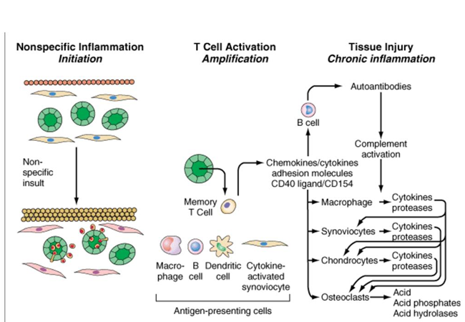

Slide 15
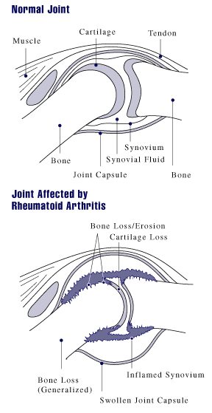

Slide 16
DIAGNOSIS
  Rheumatoid factor, an IgM antibody is seen in the sera of 75% of patients with rheumatoid arthritis.
  Antinuclear antibody

Slide 17
  The ESR is elevated both in the acute and chronic phases of the disease
  A moderate anemia
  The white count is normal or slightly increased but leukopenia may occur, often in presence of splenomegaly (e.g., Felty’s syndrome)
  The platelet count is often elevated in proportion to the degree of joint inflammation

Slide 18
Joint fluid examination is valuable. The fluid is translucent to opaque and has between 3000 and 50,000 WBCs /microL. There are 50% or more polymorphonuclear leukocytes.
X-rays
  Soft tissue swelling and juxta-articular demineralization
  Joint space narrowing and erosions .

Slide 19
Rheumatoid Arthritis
  Goal of treatment
    reduce inflammation and pain,
    preservation of function, and
    prevention of deformity.

Slide 20
Nonpharmacologic treatment
    Education and emotional factors
    Exercise
    Heat and cold
    Assistive devices like splints,raised toilet seat and/or crutches or walker
    Weight loss

Slide 21
ANTIRHEUMATIC DRUGS
A..NSAIDS-Aspirin,Ibuprofen,Neproxen,Diflunisal
B.DISEASE MODIFYING ANTIRHEUMATIC DRUGS(DMARDs)
1. Immunosupressants: Methotrexate, azathioprine,cyclosporine,chlorambucil,cyclophpsphamide
2. Sulfasalazine
3. Chloroquine or hydroxychroquine
4. Leflunomide
5. Gold salts

Slide 22
C.BIOLOGICAL RESPONSE MODIFIERS
1.TNF-α inhibitors:Etanercept,infliximab,adalimumab
2.IL-1 antagonist:anakinra
D.ADJUVANT DRUGS:
Corticosteroids: prednisolone and others

Slide 23
Nonsteroidal Anti-Inflammatory Drugs
Inhibition of biosynthesis of prostaglandins

Slide 24
NSAIDs -mainly symptomatic relief
Reduce inflammation and the pain, often preserve function, but they have little effect on the progression of bone and cartilage destruction

Slide 25
Aspirin
  Usually given in a dose of 2-4 gm daily in divided doses in acute cases
  Enteric coated aspirin to reduce GI irritation
  GI irritation may also be reduced by taking the aspirin with meals or antacids.

Slide 26
NON SELECTIVE COX INHIBITORS
Diflunisal-250 to 500 mg is administered twice daily; maintenance dosage should not exceed 1.5 g per day
Three to four times more potent than aspirin
Clearance depends on renal function
Does not produce auditory side effects and appears to cause fewer and less intense gastrointestinal side effects than aspirin.
Etodolac-more selective for COX-2,Dose 200-400 mg

Slide 27
Propionic Acid Derivatives
Flurbiprofen – also affect TNF –α and NO synthesis.
Dose – 200-400mg
Ibuprofen
-Low dose – analgesic
-High dose- anti-inflammatory (2400mg/day)
-More effective with aspirin
OTHERS
Neproxen,piroxicam,sulindac

Slide 28
  Ibuprofen, naproxen, sulindac and other NSAIDs - effective though they are associated with a number of side effects including
    GI irritation and peptic ulcers
    Kidney damage
    Liver damage

Slide 29
SELECTIVE COX-2 INHIBITORS
Celecoxib(100 mg once daily)
Etoricoxib – highest selectivity. (90 mg once daily )
Meloxicam – “preferentially” selective than highly selective(7.5 mg/d)

Slide 30
DISEASE MODIFYING ANTIRHEUMATIC DRUGS(DMARDs)
Evidence is that the initiation of DMARDs therapy early in the course of RA clearly has a major impact on the development of bone erosions and the progression to disability.
Which DMARDs should be the drug of first choice remains controversial

Slide 31
Methotrexate(DIHDROFOLATE REDUCTASE INHIBIOTOR)
first choice to treat rheumatoid arthritis and is used in up to 60% of patients.

Slide 32
Mechanism of Action
Methotrexate has direct inhibitory effects on proliferation in immune-inflammatory cells.
Also related to inhibition of cytokine production,leading to decreased inflammation

Slide 33
Pharmacokinetics
70% absorbed after oral administration .
Methotrexate's concentration is increased in the presence of hydroxychloroquine, probenecid, aspirin
This drug is excreted principally in the urine, but up to 30% may be excreted in bile.

Slide 34
Indications
In rheumatoid arthritis -7.5–25 mg weekly given either orally in divided doses or, if necessary, SC or IM to avoid gastrointestinal toxicity
Methotrexate and have indicated that its onset of action is more rapid than other DMARD

Slide 35
Maximal improvement is observed after 6 months.
In juvenile chronic arthritis, psoriasis,psoriatic arthritis,ankylosing spondylitis,
Polymyositis,dermatomyositis,
Systemic lupus erythematosus and vasculitis.
folic acid 1-4 mg/day

Slide 36
Adverse Effects
Nausea and mucosal ulcers - most common
Liver function abnormalities
Hepatotoxicity, cirrhosis rare
A rare "hypersensitivity" lung reaction with acute shortness of breath
Contraindicated in pregnancy

Slide 37
Cyclosporine
Chlorambucil
Azathioprine

Slide 38
Sulfasalazine
Mechanism of Action
Metabolized to sulfapyridine and 5-aminosalicylic acid-sulfapyridine is probably the active moiety when treating rheumatoid arthritis
In treated arthritis patients, IgA and IgM rheumatoid factor production are decreased.
Suppression of T cell responses and inhibition of B cell proliferation

Slide 39
Pharmacokinetics
Only 10–20% of orally administered absorbed
A fraction undergoes enterohepatic recirculation - to liberate sulfapyridine and 5-aminosalicylic acid.
Some sulfasalazine excreted unchanged in the urine-sulfapyridine is excreted after hepatic acetylation and hydroxylation.
Sulfasalazine's half-life is 6–17 hours.

Slide 40
Indications
in rheumatoid arthritis
in juvenile chronic arthritis and ankylosing spondylitis
The usual regimen is 2–3 g/d.
Adverse Effects
Common-nausea, vomiting, headache, and rash.
Hemolytic anemia and methemoglobinemia
Neutropenia
Thrombocytopenia
Pulmonary toxicity
Reversible infertility occurs in men, but sulfasalazine does not affect fertility in women.
Not teratogenic.

Slide 41
Chloroquine & Hydroxychloroquine
Mechanism of Action
Unclear. Taken up by macrophages and lymphocytes and inhibit phagocytosis
Pharmacokinetics
Rapidly absorbed but only 50% protein-bound in the plasma.
Extensively tissue-bound, particularly in melanin-containing tissues such as the eyes.
The drugs are deaminated in the liver and have blood elimination half-lives of up to 45 days.

Slide 42
Indications
Rheumatoid arthritis, but they are not considered very efficacious DMARDs.
6.4 mg/kg/d hydroxychloroquine or 200 mg/d chloroquine
for the treatment of the skin manifestations, serositis, and joint pains of systemic lupus erythematosus,Sjögren's syndrome
Periodic eye check up

Slide 43
Adverse Effects
Ocular toxicity may occur at dosages greater than 250 mg/d for chloroquine and greater than 6.4 mg/kg/d for hydroxychloroquine
Ophthalmologic monitoring every 6–12 months is advised.
Dyspepsia, nausea, vomiting, abdominal pain, rashes, and nightmares.
safe in pregnancy.

Slide 44
Gold
Gold compounds were first proved to be effective in 1960.
Because of their toxicity, they are used infrequently today.
Their intramuscular formulations (aurothiomalate and aurothioglucose) contain 50% elemental gold.
The oral formulation (auranofin) contains 29% elemental gold.

Slide 45
Leflunomide
Mechanism of Action
Pyrimidine synthesis inhibitor
Undergoes rapid conversion, both in the intestine and in the plasma, to its active metabolite, A77-1726.
Inhibits dihydroorotate dehydrogenase, leading to a decrease in ribonucleotide synthesis and the arrest of stimulated cells in the G₁ phase of cell growth.
Consequently,inhibits T cell proliferation and production of autoantibodies by B cells.

Slide 46
Pharmacokinetics
Completely absorbed and has a mean plasma half-life of 19 days.
A77-1726 is subject to enterohepatic recirculation and is efficiently reabsorbed.
Cholestyramine can enhance leflunomide excretion and increases total clearance by approximately 50%.

Slide 47
Indications
Leflunomide is as effective as methotrexate in rheumatoid arthritis, including inhibition of bony damage
100mg daily for 3 days, maintenance dose10-20 mg/d
Adverse Effects
Diarrhea or loose bowels
Elevation in liver enzymes .
Mild alopecia, weight gain, and increased blood pressure.
Leukopenia and thrombocytopenia .
Contraindicated in pregnancy.

Slide 48
TNF-ALPHA–Blocking Agents
TNF-α affects cellular function via activation of specific membrane-bound TNF receptors (TNFR₁, TNFR₂).
Administered soluble TNF receptors protein or antibody by combining with soluble TNF-α ,inhibit the effects of the endogenous cytokine.
Monoclonal anti-TNF antibodies can cross-link TNF receptors on the cell surface and inhibit T cell and macrophage function

Slide 49
Adalimumab
Mechanism of Action
Adalimumab is a fully human IgG₁ anti-TNF monoclonal antibody.
Complexes with soluble TNF- and prevents its interaction with p55 and p75 cell surface receptors.
This results in down-regulation of macrophage and T cell function.
Pharmacokinetics
Given subcutaneously and has a half-life of 10–20 days.
Its clearance is decreased by more than 40% in the presence of methotrexate

Slide 50
Indications
Rheumatoid arthritis
Effective both as monotherapy and in combination with methotrexate and other DMARDs.
The usual dose is 40 mg every 2 weeks
In psoriasis, Crohn's disease, and juvenile chronic arthritis.
Ankylosing spondylitis, and psoriatic arthritis.

Slide 51
Adverse Effects
The risk of macrophage-dependent infection (including tuberculosis and other opportunistic infections)
Patients should be screened for latent or active tuberculosis before starting adalimumab or other TNF- blocking agents.
Rare leukopenias and vasculitis
Lymphomas

Slide 52
Infliximab
Mechanism of Action
Infliximab is a chimeric (25% mouse, 75% human) IgG₁ monoclonal antibody that binds with high affinity to soluble and possibly membrane-bound TNF
Its mechanism of action probably is the same as that of adalimumab.
Pharmacokinetics
Infliximab is given as an intravenous infusion at the usual dose is 3–5 mg/kg every 8 weeks.
The terminal half-life is 9–12 days

Slide 53
Indications
Rheumatoid arthritis
Ankylosing spondylitis, Crohn's disease, and psoriatic arthritis. psoriasis, ulcerative colitis, juvenile chronic arthritis, Wegener's granulomatosis, giant cell arteritis, and sarcoidosis.
In rheumatoid arthritis, a regimen of infliximab plus methotrexate decreases the rate of formation of new erosions more than methotrexate alone over 52–104 weeks

Slide 54
Adverse Effects
Upper respiratory tract infections, nausea, headache, sinusitis, rash, and cough- common
As a potent macrophage inhibitor, infliximab can be associated with activation of latent tuberculosis, and patients should be screened for latent or active tuberculosis before starting therapy.
Lymphomas
Because rare demyelinating syndrome- patients with multiple sclerosis should not use infliximab.
Rare cases of leukopenia, hepatitis, activation of hepatitis B, and vasculitis

Slide 55
Etanercept
Mechanism of Action
Etanercept is a recombinant fusion protein consisting of two soluble TNF p75 receptor moieties linked to the Fc portion of human IgG₁; it binds TNF- molecules .
Pharmacokinetics
Given subcutaneously in a dosage of 25 mg twice weekly or 50 mg weekly.
The drug is slowly absorbed, with peak concentration 72 hours after drug administration. Etanercept has a mean serum elimination half-life of 4-5 days.

Slide 56
Indications
Rheumatoid arthritis, juvenile chronic arthritis, psoriasis, psoriatic arthritis, and ankylosing spondylitis.
It is used both as monotherapy and with methotrexate background; over 70% of patients taking etanercept are also using methotrexate.
it is being used in many rheumatic syndromes such as scleroderma, Wegener's granulomatosis, giant cell arteritis, and sarcoidosis.

Slide 57
Adverse Effects
The incidence of activation of latent tuberculosis and tuberculosis screening is appropriate before starting this medication.
Lymphomas
Injection site reactions occur in 20–40% of patients

Slide 58
Rituximab
Chimeric monoclonal antibody that targets CD20 B lymphocyte
Rheumatoid arthritis refractory to other antiTNF agents.
It is given as two IV infusions 2 weeks apart
Abatacept
Fusion protein of cytotoxic T-lymphocyte antigen-4 linked to IgG that inhibits the activation of T cells
Given IV slowly on day 1 then repeated at 2 and 4 weeks thereafter

Slide 59
IL-1 ANTAGONIST
Anakinra:
Recombinant IL-1 receptor antagonist
Clinically less effective than TNF inhibitors
Used in cases who failed on one or more DMARDs
DOSE: 100 mg s.c. daily
Adverse effects
Local reaction and chest infection

Slide 60
New target
tocilizumab (anti-interleukin 6 receptor)
Monoclonal antibody

Slide 61
Glucocorticoid Drugs
Action:
Potent immunosuppressant and anti-inflammatory activity
Symptomatic relief is prompt, do not arrest rheumatoid process
Indications
Rheumatoid arthritis-capable of slowing the appearance of new bone erosions.
Corticosteroids may be administered for certain serious extra-articular manifestations of rheumatoid arthritis such as pericarditis or eye involvement or during periods of exacerbation.

Slide 62
When prednisone is required for long-term therapy, the dosage should not exceed 7.5 mg daily (Usual 5-10 mg) and gradual reduction of the dose should be encouraged.
Useful include vasculitis, systemic lupus erythematosus, Wegener's granulomatosis, psoriatic arthritis, giant cell arteritis, sarcoidosis, and gout.

Slide 63
Intra-articular corticosteroids are often helpful to alleviate painful symptoms(once in three months)
Adverse Effects
Prolonged use of these drugs leads to serious and disabling toxic effects
There is controversy over whether many of these side effects occur at doses below 7.5 mg prednisone daily

Slide 64
Dietary Manipulation of Inflammation
Arachidonic acid is an eicosatetraenoic acid that is metabolized by the cyclooxygenase and lipoxygenase pathways, yielding several mediators
Dietary manipulation that substitutes unsaturated fatty acids (such as eicosapentaenoic acid, found in marine fish) .
They diminish the activities of the eicosatetraenoic mediators by competing with them for shared target-cell receptors.

Slide 65
The results of clinical studies suggest that therapy with dietary eicosapentaenoic acid decreases both morning stiffness and the number of tender joints in patients with rheumatoid arthritis
2–4 g/d of eicosapentaenoic acid may be a beneficial addition to conventional treatment of rheumatoid arthritis.

Slide 66
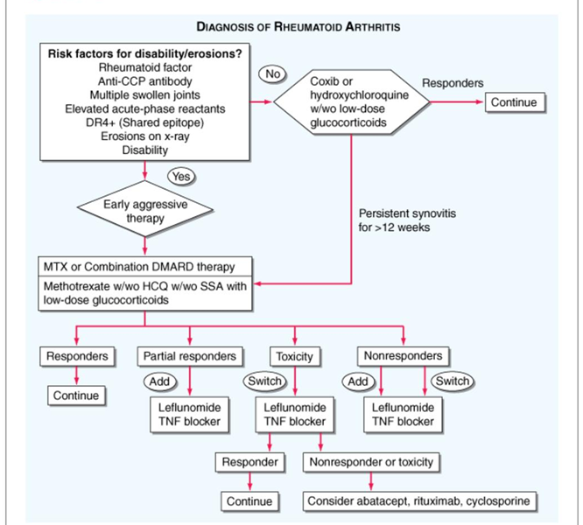

Slide 67
References
Tripathi KD, Essentials of medical pharmacology, 6th edition, Jaypee publication New Delhi
Goodman and Gilman's the Pharmacological Basis of Therapeutics. 11th ed. New York, NY: McGraw-Hill; 2006

Slide 68
Author | Results | Journal
prof Josef S Smolen MD a b , Daniel Aletaha MD a, Marcus Koeller MD a, Michael H Weisman MD c, Prof Paul Emery MD d | New therapies for treatment of rheumatoid arthritis | The lancet

Slide 69
THANK YOU

