Slide 1
Ervilla Dass
Assistant Professor
Department of Pharmacology
S. B. K. S. Medical Institute and Research Centre
Sumandeep Vidyapeeth, Piparia.

Slide 2
PARASYMPATHETIC
NERVOUS SYSTEM
Ervilla Dass

Slide 3
ACTIONS
OF
ACETYLCHOLINE
AT
ORGAN
SITES

Slide 4
PARASYMPATHETIC INNERVATION TO THE EYE

Slide 5
PARASYMPATHETIC CONTROL OF ACCOMODATION
Parasympathetic stimulation allows contraction of the ciliary muscle.

Slide 6
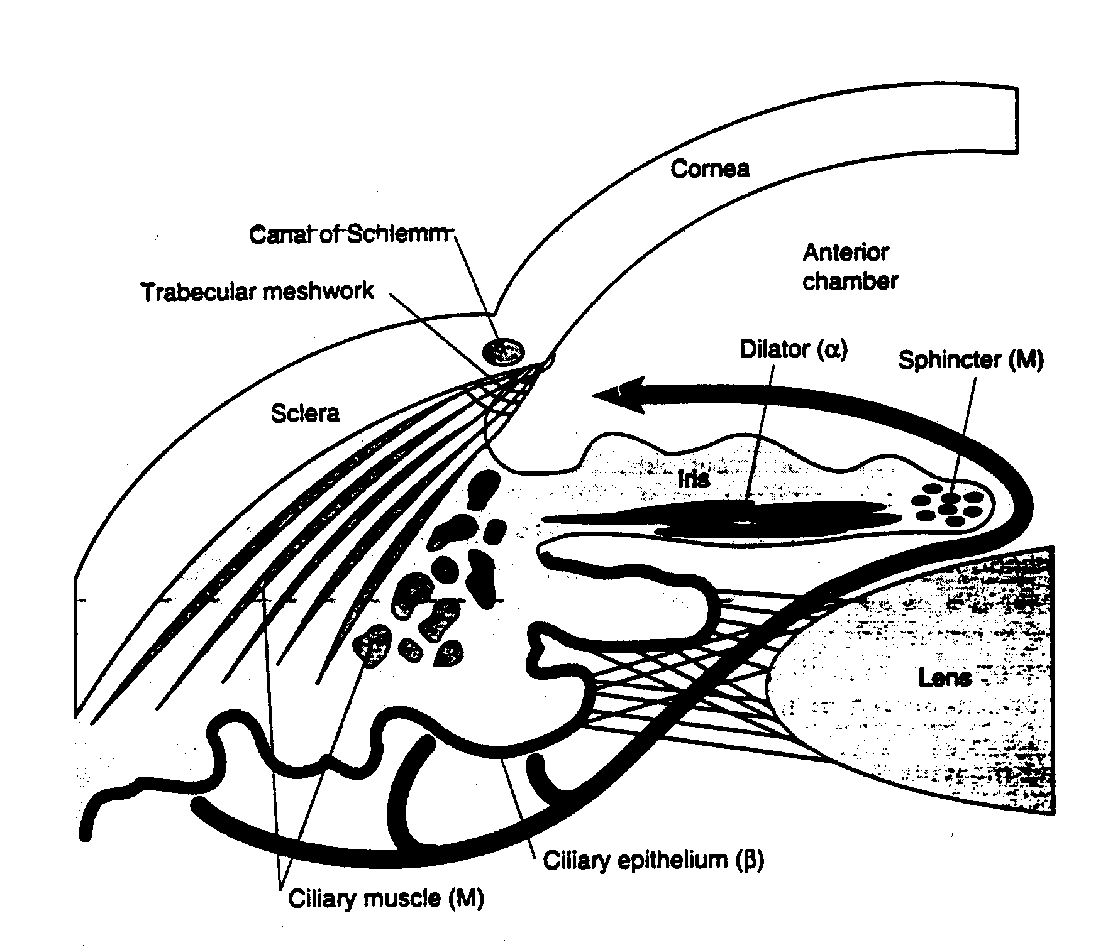
FLOW OF AQUEOUS FROM THE EYE

Slide 7
PARASYMPATHETIC FUNCTION AT ORGANS SITES (1)
Gastrointestinal tract
  Longitudinal muscles
  Circular muscles
  Sphincter muscles
Bile duct
Gall bladder
Urinary tract
  Ureters
  Detrusor muscle of the bladder
  Trigone
  Sphincter muscle of the bladder
Bronchial smooth muscles

Slide 8
Parasympathetic Function at Organs Sites (2)
Lacrimal glands
Pharyngeal glands
Salivary glands
Mucus glands
  Respiratory tract
  Esophagus
Intestinal glands
Gastric glands
Pancreas

Slide 9
PARASYMPATHETIC CONTROL OF THE CARDIOVASCULAR SYSTEM
SA Node
Atrial muscle
AV node
Purkinje fibers
Ventricles
Blood vessels

Slide 10
NITRIC OXIDE MEDIATED VASODILATION

Slide 11
NEURONAL AND HORMONAL CONTROL OF BLOOD PRESSURE

Slide 12
CARDIOVASCULAR RESPONSES TO LOW AND HIGH DOSES OF ACH

Slide 13
SITES OF DOMINANCE IN THE ANS
Adapted from Goodman and Gilman’s The Pharmacological Basis of Therapeutics

Slide 14
EVIDENCE

Slide 15
K. D. Tripathi M.D., Essentials of Medical Pharmacology , 7th dition , 2013, pg. 102 to 104
Source of Information | Chapter | Author | Information | Level of evidence
K. D. Tripathi Essentials of Medical Pharmacology, Jaypee Brothers Medical Publishers (P) LTD, NEW DELHI 7th edition, 2013 | Section II DRUGS ACTING ON AUTONOMIC NERVOUS SYSTEM Chapter 7 cholinergic system and drugs | Dr. K. D. Tripathi M.D. Ex-Director Professor and head of Pharmacology Maulana Azad Medical College and Associated LN B Pant Hospitals, New Delhi | Neurohumoral transmitter , action at various organs | Level of evidence - Grade one

Slide 16
Satoskar & Bhandarkar, Pharmacology and Pharmacotherapeutics , Revised 23rd Edition , 2013, pg . 286 to 289
Source of Information | Chapter | Author | Information | Level of evidence
Pharmacology and Pharmacotherapeutics – R. S. Satoskar, S. D. Bhandarkar, Nirmala N. Rege POPULAR PRAKASHAN, Mumbai. Revised 23rd Edition, 2013 | Section IV AUTONOMIC NERVOUS SYSTEM Chapter 18 Cholinergic drugs | Satoskar & Bhandarkar | Neurohumoral transmitter , action at various organs | Level of evidence - Grade one

Slide 17
Source of Information | Chapter | Author | Information | Level of evidence
FEBS Lett. 2003 Nov 27;555(1):91-5. | Structure and action of the nicotinic acetylcholine receptor explored by electron microscopy. | Unwin N. | Acetylcholine The nicotinic acetylcholine (ACh) receptor is the transmitter-gated ion channel at the nerve/muscle synapse.

