Slide 1
DRUGS ACTING ON UTERUS

Slide 2
Introduction
Drugs acting on uterus primarily affect endometrium or myometrium
Myometrium receives both sympathetic and parasympathetic innervations, autonomic drugs affect its motility
The most important drugs affecting endometrium are estrogen, progestins and their antagonists

Slide 3
UTERINE STIMULANTS
CLASSIFICATION
Posterior Pituitary Hormones-
  Oxytocin
  Desamino oxytocin
Ergot alkaloids-
  Ergometrine
  Methylergometrine
Prostaglandins -
  PGE2,PGF2alpha,Misoprostol
Miscellaneous -
  Ethacridine, Quinine

Slide 4
Oxytocin
Peptide hormone secreted by the posterior pituitary along with vasopressin
Pituitary extract first used in labour in 1909
Both are released by stimuli-
  Oxytocin- coitus,parturition, suckling
  Vasopressin-water deprivation, haemorrhage

Slide 5
  It participates in labour and delivery, and also elicits milk ejection in lactating women
  During the second half of pregnancy, uterine smooth muscle shows an increase in the expression of oxytocin receptors and becomes increasingly sensitive to the stimulant action of endogenous oxytocin
  Estradiol stimulates oxytocin secretion, whereas the ovarian polypeptide relaxin inhibits release

Slide 6
HOW DOES IT SECRET?
Synthesized within nerve cell bodies in supraoptic paraventricular nuclei of hypothalamus
Rapidly converted by proteolysis to the active hormone and its neurophysin, packaged into secretory granules as an oxytocin-neurophysin complex
Then transported down the axon and stored in the nerve endings

Slide 7
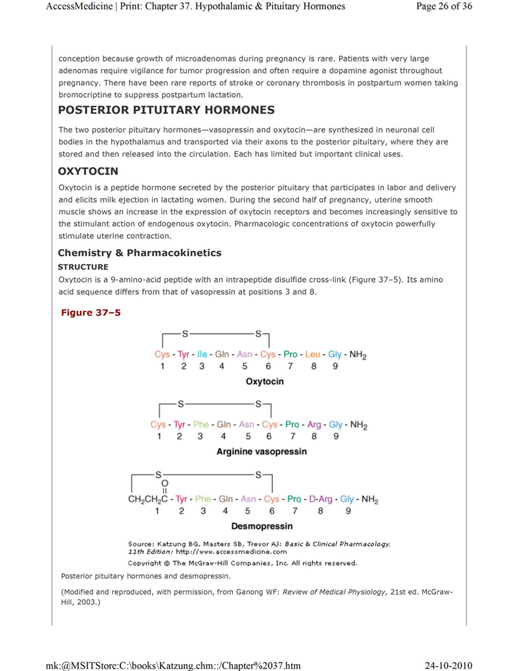
Chemistry
9-amino-acid peptide with an intrapeptide disulfide cross-link
Its amino acid sequence differs from that of vasopressin at positions 3 and 8

Slide 8
Pharmacokinetics
Absorption, Metabolism, and Excretion
Being peptide, oxytocin is inactive orally
Administered intravenously for initiation and augmentation of labor
Also can be administered intramuscularly for control of postpartum bleeding
Not bound to plasma proteins
Eliminated by the kidneys and liver
Half-life of 5 minutes
Pregnant uterus and placenta elaborate a specific aminopeptidase- oxytocinase, detected in maternal plasma

Slide 9
Pharmacodynamics
Mechanism of action
Acts through G protein-coupled oxytocin receptors and the phosphoinositide-calcium second-messenger system to contract uterine smooth muscle
Stimulates the release of prostaglandins and leukotrienes that augment uterine contraction

Slide 10
Physiological Roles of Oxytocin
UTERUS
An eightfold increase in uterine sensitivity to oxytocin occurs in the last half of pregnancy, mostly in the last 9 weeks
  Accompanied by a thirtyfold increase in oxytocin receptor number between early pregnancy and early labour
Uterine responsiveness to oxytocin highly dependent on estrogen, which increases the expression of the oxytocin receptors
Increases force and frequency of uterine contractions

Slide 11
Breast
Plays an important physiological role in milk ejection
  Stimulation of the breast through suckling or mechanical manipulation induces oxytocin secretion, causing contraction of the myoepithelium that surrounds alveolar channels in the mammary gland
CVS
Conventional doses-have no effects on BP
Higher doses-fall in BP, reflex tachycardia
KIDNEY
Conventional doses- no effect
In high doses-urine output decreased

Slide 12
Clinical Uses of Oxytocin
Induction of Labor
Uterine inertia
Postpartum haemorrhage
Breast engorgment
Oxytocin challenge test

Slide 13
Adverse effects
Injudicious use
  Maternal and foetal soft tissue injury
  Rupture of uterus
  Foetal asphyxia
  Death
Water intoxication
  Because of ADH like effect of large doses, given along with i.v. fluids

Slide 14
Ergot Alkaloids
Ergot alkaloids are produced by Claviceps purpurea, a fungus that infects grasses and grains—especially rye—under damp growing or storage conditions
Ergot had been used to quicken labour in the 19th centaury
But its dangers were recognized and its given only after delivery
Dale and burger isolated ergot alkloids in 1906
Ergometrine was isolated in 1935

Slide 15
Natural Ergot Alkaloids
AMINE ALKLOID
Ergometrine (Ergonovine)
AMINO ACID ALKLOID
Ergotamine
Ergotoxine

Slide 16
OTHER SEMISYNTHETIC DERIVATIVES
DIHYDROERGOTAMINE
BROMOCRIPTINE
METHYLSERGIDE

Slide 17
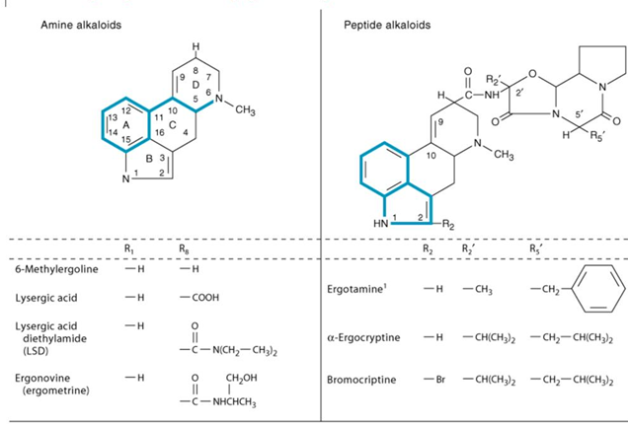
Chemistry
Tetra cyclic indole containing compounds (derivative of lysergic acid)

Slide 18
Pharmacokinetics
In contrast to amino acid alkaloids, ergometrine and methylergometrine-rapidly and nearly completely absorbed from oral route
The onset of uterine action is:
  Oral-15 mins
  i.m.-5 mins
  i.v.-almost immediate
Partly metabolized by liver
Excreted in urine
Plasma half life-1 to2 hrs
Effect of single dose-3 to 4 hrs

Slide 19
Pharmacodynamics
Mechanism of Action
Partial alpha adrenoceptor agonist
Partial serotonin Receptor (5-HT₂) agonist
Powerful uterine Smooth Muscle Stimulation

Slide 20
Physiological Roles of ERGOMETRINE
Uterine Smooth Muscle
Sensitivity of the uterus to the stimulant effects of ergot increases dramatically during pregnancy,
  because of increasing dominance of alpha₁ receptors as pregnancy progresses
As a result, the uterus at term is more sensitive to ergot than earlier in pregnancy

Slide 21
CVS
Weaker vasoconstrictor than ergotamine
Though they can rise BP, not significant at doses in obstetrics
GIT
High doses- increase peristalsis

Slide 22
ADVERSE EFFECTS
Nausea, vomiting
Rise in BP
High dose-decrease milk secretion
Ergometrine should be avoided:
  Patients with hypertension, vascular disease
  Presence of sepsis
  Liver and kidney disease
Contraindicated during pregnancy and before 3rd stage of labour

Slide 23
USES
Postpartum Haemorrhage
After cesarean section/ instrumental delivery-to prevent uterine atony
To ensure normal involution

Slide 24
Prostaglandins
Potent uterine stimulants
  PGF_{2alpha}
  15-methyl PGF_{2alpha}
  PGE₂
Effects on uterus
Uniformly contract uterus, pregnant as well nonpregnant
Sensitivity increase with progress of pregnancy
Increase tone and amplitude of uterine contractions

Slide 25
Animal studies demonstrate a role for PGE2 and PGF₂ in early reproductive processes such as ovulation, and fertilization.
Uterine muscle is contracted by PGF₂, TXA₂, and low concentrations of PGE₂
PGI2 and high concentrations of PGE₂ cause relaxation
PGF₂, together with oxytocin, is essential for the onset of parturition

Slide 26
USES
Abortion
Facilitation of Labour

Slide 27
Abortion
Dinoprostone, a synthetic preparation of PGE2, stimulates the contraction of the uterus throughout pregnancy
As the pregnancy progresses, the uterus increases its contractile response
Its approved for,
  Inducing abortion in the second trimester of pregnancy
  For benign hydatidiform mole
  For ripening of the cervix for induction of labor in patients at or near term

Slide 28
2).Facilitation of Labor
No difference in the efficacy of PGE₂ and PGF₂ when they are administered intravenously
The most common usage is local application of PGE₂ analogs (dinoprostone) to promote labor through ripening of the cervix
Oral PGE₂ is superior to the oral oxytocin
PGE2 and PGF₂ should be superior to oxytocin for inducing labor in women with preeclampsia-eclampsia or cardiac and renal

Slide 29
3) Dysmenorrhea
Primary dysmenorrhea is attributable to increased endometrial synthesis of PGE2 and PGF₂ during menstruation, with contractions of the uterus that lead to ischemic pain. NSAIDs successfully inhibit the formation of these prostaglandins and so relieve dysmenorrhea in 75–85% of cases. Some of these drugs are available over the counter. Aspirin is also effective in dysmenorrhea, but because it has low potency and is quickly hydrolyzed, large doses and frequent administration are necessary. In addition, the acetylation of platelet COX, causing irreversible inhibition of platelet TXA₂ synthesis, may increase the amount of menstrual bleeding

Slide 30
Also directly affects the collagenase of the cervix, resulting in softening
Metabolized in local tissues and on the first pass through the lungs (about 95%)
The metabolites are mainly excreted in the urine
The plasma half-life is 2.5–5 minutes
Antiprogestins (eg, mifepristone) have been combined with an oral synthetic analogue of PGE1 (misoprostol) to produce early abortion
An analogue of PGF_{2alpha} ,Carboprost tromethamine (15-methyl-PGF_{2apha}) is used to induce second-trimester abortions and to control postpartum hemorrhage

Slide 31
ETHACRIDINE (rivanol)
Acridine derivative
Its antiseptic used in solution of 0.1%
Used in 2nd trimester abortion
Up to 150ml of 0.1% solution is instilled extra-amniotically using foley catheter
Effect after 20 to 40 hrs

Slide 32
UTERINE RELAXANTS(TOCOLYTICS)
Decrease uterine motility
Used to delay or postpone labour, arrest threatened abortion, in dysmenorrhea
Suppression of labour is nedeed,
  To allow fetus to mature
  To initiate glucocorticoid therapy
  To transfer mother in labour to a centre with proper facilities
To delay premature labour is likely to succeed only if cervical ripening is less than 4 cm

Slide 33
Should not be given,
  If membrane have ruptured
  Antepartum haemorrhage
  Toxaemia of pregnancy
  Foetal death

Slide 34
CLASSIFICATION
b₂-Selective Agonists
Ritodrine ,Buphenine, Fenoterol, Terbutaline
Oxytocin antagonist
Atociban
Myosin inhibitor
Magnasium sulfate
Prostaglandin inhibitors
Indomethacin

Slide 35
b₂-Selective Agonists
Ritodrine
Selective b₂ receptor agonist that was developed specifically for use as a uterine relaxant
Rapidly but incompletely (30%) absorbed following oral administration
90% of the drug is excreted in the urine as inactive conjugates; about 50% is excreted unchanged after intravenous administration.
The pharmacokinetic properties of ritodrine are complex and incompletely defined, especially in pregnant women

Slide 36
Adverse Effects
Cardiovascular complications
  Hypotension
  Tachycardia
  arrythmia
Metabolic complications
  Hypergycemia
  Hypokalemia
Feelings of restlessness, apprehension, and anxiety, particularly oral or parenteral administration

Slide 37
Therapeutic Uses
Suppress premature labour
To delay delivery in case of acute foetal distress

Slide 38
Calcium channel blockers
Reduce the tone of myometrium and oppose contractions
These drugs, especially nifedipine, prominent smooth muscle relaxant action
In a multicenter trial comparing nifedipine with ritodrine, nifedipine was associated with a longer postponement of delivery, fewer maternal side effects, and fewer admissions to the neonatal intensive care unit

Slide 39
Adverse Effects
Tachycardia and hypotension
Reduced placental perfusion- placental hypoxia

Slide 40
Oxytocin Antagonist
Atosiban is an antagonist of the oxytocin receptor that has been approved as a treatment for preterm labor (tocolysis).
Modified form of oxytocin that is administered by IV infusion
In a small number of published clinical trials, it appears to be as effective as – beta adrenoceptor-agonist tocolytics and to produce fewer adverse effects.
In 1998, the FDA decided not to approve atosiban based on concerns about efficacy and safety

Slide 41
Magnasium sulfate
Myosin inhibitor
Given i.v. to suppress uterine contractions
Use to delay preterm labour
Higher infant mortality rate and perinatal mortality
Toxicity include, arrhythmia, muscular paralysis, respiratory depression

Slide 42
Tripathi KD, Essentials of medical pharmacology, 6th edition, Jaypee publication New Delhi
Goodman and Gilman's the Pharmacological Basis of Therapeutics. 11th ed. New York, NY: McGraw-Hill; 2006

Slide 43
Author | Results | Journal | level
el de Heus, Eduard J H Mulder, Gerard H A Visser | Management of preterm labor: atosiban or nifedipine? | International Journal of Women's Health | Level 2

