Slide 1
Opportunistic parasitic infections
Dr. Sucheta J Lakhani
Professor
Department of Microbiology

Slide 2
Opportunistic Coccidian parasites
Toxoplasma gondii
Cryptosporidium species
Cyclospora species
Cystoisospora species
Sarcocystis species

Slide 3
Classification
Kingdom: Protozoa
Subkingdom: Neozoa
Phylum: Apicomplexa
Class: Coccidea
Order: Eimeriida
Genus:
  Toxoplasma
  Cryptosporidium
  Cyclospora
  Cystoisospora
  Sarcocystis

Slide 4
Toxoplasma gondii

Slide 5
History
Toxoplasma gondii is an obligate intracellular parasite affecting a wide range of mammals and birds including humans.
Charles Nicolle and Louis Manceaux (1908) were the first to discover T. gondii in Tunisia from a North African rodent called as Ctenodactylus gundi.
The name Toxoplasma is derived from a Greek word “Toxon” meaning arc or bow referring to the curved shape of the trophozoites (tachyzoites).

Slide 6
Morphology
It exists in 3 morphological forms
  Two asexual forms (tachyzoite and tissue cyst)
  One sexual form (oocyst).

Slide 7
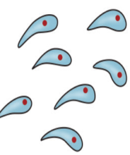
Tachyzoite
It is an actively multiplying form (trophozoite), in acute infection.
Crescent shaped, having a pointed anterior end and a rounded posterior end.
4–8 µm in length and 2–3 µm in breadth; contains a round nucleus situated between center and posterior end.
At the anterior end, the tachyzoites contain special organelles like rhoptries, and micronemes which are crucial for the adhesion and invasion into the host cell.
Inside the host cell, tachyzoites are surrounded by a parasitophorous vacuole within which they divide asexually by a process called as internal budding or endodyogeny by which daughter trophozoites are formed within the parent cell.
Host cell becomes distended by the proliferating tachyzoites and appears as pseudocyst. They are not strongly PAS positive.

Slide 8
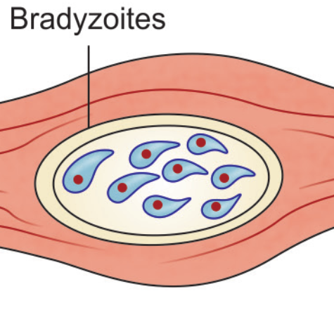
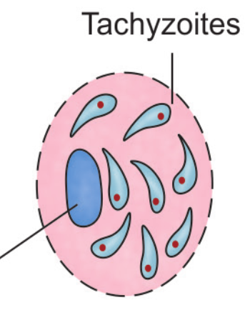
Tissue cyst
It is the resting stage of the parasite, seen in chronic infections.
Tissue cysts measures 2–5 µm in size and contain few bradyzoites.
Bradyzoites: They measure 7 µm in length and 1.5 µm in breadth
More slender, crescent shaped with a nucleus situated posteriorly
Contains several strongly periodic acid-Schiff stain (PAS) positive amylopectin granules
Multiply slowly with long generation time
Seen in chronic infection
Conversion of the tachyzoites to bradyzoites can be triggered by many factors like interferon-g (IFN-g), nitric oxide (NO), heat shock proteins, pH, and temperature changes
Most common site of the tissue cysts—muscles and brain (can be found in any organs)
Tissue cyst
Pseudocyst

Slide 9
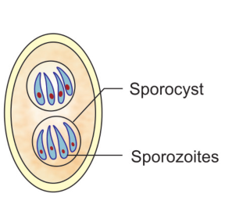
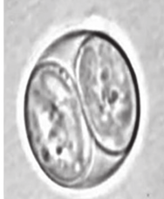
Oocyst
Sexual form of the parasite found in cats and other felines.
It measures 11–14 µm long and 9–11 µm wide;surrounded by a refractile, double layered colorless cyst wall
Unsporulated oocyst excreted in cat’s feces is noninfectious
In the environment, they transform into sporulating oocyst containing two sporocysts (8 µm × 6 µm) each containing four elongated sporozoites (6–8 µm × 1–2 µm).
Sporulated oocyst (in cat筑s feces)

Slide 10
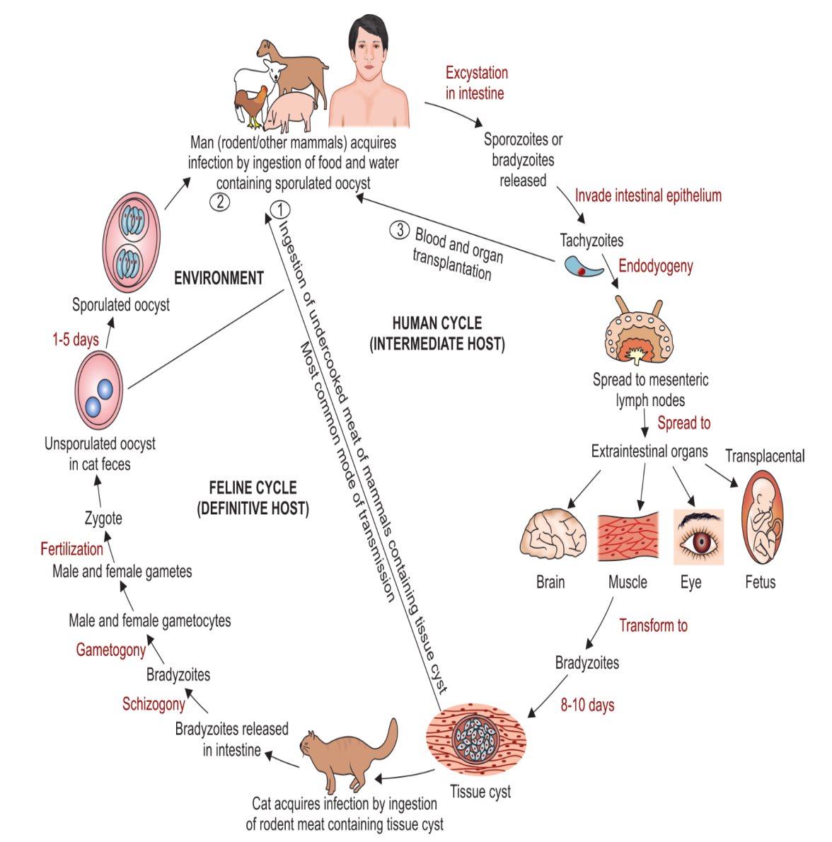
Life Cycle
Host: The life cycle involves two hosts:
1. Definitive hosts are cat and other felines; where the
sexual cycle takes place.
2. Intermediate hosts are man and other mammals (goat, sheep, pig, cattle and certain birds); where the asexual
cycle takes place.

Slide 11
Epidemiology
Prevalence: Global prevalence is about 25–30%
Various risk factors for infection are:
The geographical area (cold area, hot arid climatic conditions, high altitudes are associated with a low prevalence)
Age: It commonly affects elderly and fetus
Exposure to cat and cat’s feces
Food habits: Ingestion of uncooked cat and other animal meat - at higher risk
Immune status: Patients associated with HIV, malignancies and immuno compromised conditions are at high risk
Patients undergoing blood transfusion, and organtransplantations are at higher risk.
Genetic factor: HLA DQ3 is associated with encephalitis in AIDS patient and hydrocephalus in fetus infected with Toxoplasma.

Slide 12
Pathogenesis
It involves the following steps
(1) Rhoptries, and micronemes present at the anterior end of sporozoites help in attachment to the host intestinal cells
(2) leads to internalization into the host cell
(3) resides inside parasitophorous vacuoles
(4) prevents phagolysosome fusion
(5) transforms to tachyzoites
(6) spreads to adjacent cells by actin myosin filaments

Slide 13
Clinical manifestation
Immunocompetent Patients
  Usually asymptomatic and self-limited
  Lymphadenopathy: Most common manifestation is cervical lymphadenopathy.
  Other lymph nodes suboccipital, supraclavicular and inguinal nodes enlargement
  Other symptoms include headache, malaise, fatigue and fever
  Rare complications are maculopapular rash, pneumonia, myocarditis and encephalopathy
Immunocompromised Patients
  In patients infected with HIV, heart and bone marrow transplant recipients, malignancies or in fetus, the clinical manifestations are more severe due to the lack of the immune system to control the infection.
  Tachyzoites are disseminated to a variety of organs, particularly lymphatic tissue, skeletal muscle, myocardium, retina, placenta and CNS.

Slide 14
Toxoplasmosis in Patients with HIV
One of the common opportunistic parasitic infections in patients with AIDS (15–40%)
Infection occurs either due to reactivation of latent infection
It mainly targets CNS leading to Toxoplasma encephalitis (TE).
  Most common areas involved in TE are the brainstem, basal ganglia, pituitary gland and corticomedullary junction
  It develops when the CD4+ T cell count falls below 100/µL
  Pathogenesis is due to the direct invasion by the parasite leading to necrotizing encephalitis and also due to secondary pressure effects on the surrounding area of the CNS
  Present with altered mental status, seizures, sensory abnormalities, cerebellar signs and focal neurologic findings including motor deficits, cranial nerve palsies and visual-field loss.
Other manifestations include pulmonary infections and chorioretinitis.

Slide 15
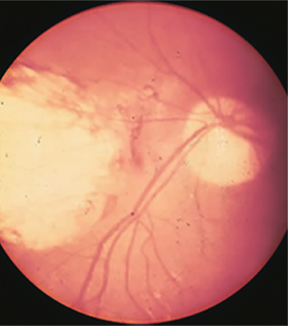
Congenital Toxoplasmosis
Gestational age: It is the main factor influencing the fetal outcome. As the gestation proceeds, the chance of transmission increases but the severity of the infection declines.
Incidence of transplacental infection during the first trimester is lowest (15%), but the disease in the neonate is most severe.
Classical triad of chorioretinitis, hydrocephalus, and intracranial calcifications
Other manifestations include stillbirth, psychomotor disturbance and microcephaly
Ocular involvement: occurs at 2nd-3rd decade, when the cysts ruptures.
  Bilateral chorioretinitis with visual impairment, blurred vision, scotoma, photophobia, strabismus and glaucoma
The incidence of congenital toxoplasmosis is 1 per 1000 live births.
Chorioretinitis
seen in toxoplasmosis

Slide 16
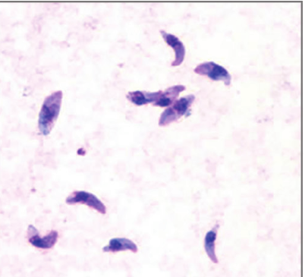
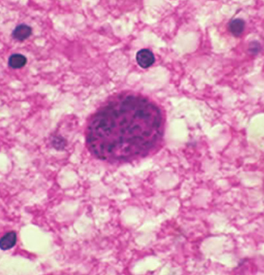
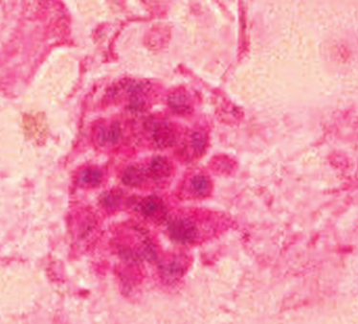
Laboratory diagnosis
1) Direct microscopic Examination
Specimens:
  Peripheral blood, body fluids, lymph node aspirate, bone marrow aspirate, CSF and BAL for HIV infected patients, biopsy material from spleen, liver and brain.
  These specimens are stained with Giemsa, PAS, silver stains, immunoperoxidase stain.
Direct fluorescent antibody test (DFA):
  Tachyzoites can be detected by using fluorescein conjugated antibody against T. gondii surface antigens.
  Comma-shaped tachyzoites -in the smear made from blood, body fluid and tissue; indicates acute infection.
  Tissue cyst containing strongly PAS positive bradyzoites in brain or muscle
Giemsa stain showing tachyzoites in blood smear
HPE of brain shows pseudocyst (with tachyzoites)
Tissue cyst containing
bradyzoites

Slide 17
Antibody detection
1) IgG antibody detection-IgG-ELISA widely used for demonstration of IgG antibodies to T. gondii.
  IgG appears 4 weeks after the infection, peaks at 6–8 weeks and declines slowly
  A fourfold rise in IgG titer is necessary for diagnosis of acute febrile toxoplasmosis.
2) IgM Ab detection-Specific IgM normally develops early, within 1–2 weeks after primary infection.
  The detection of IgM antibodies (as they do not cross placenta) useful for diagnosis of congenital infection.
  Methods used to detect IgM - IgM-capture ELISA, IgM-IFA and IgM immunosorbent agglutination assay (IgM-ISAGA)

Slide 18
IgG avidity test
It is a much reliable indicator of recent infection.
It is of much use in first four months of pregnancy during which a high avidity ratio excludes the possibility of recent T. gondii infection.
Both ELISA and ELFA (enzyme-linked immunofluorescence assay) based methods are available.
IgA antibody detection
It may be detected in sera of acutely infected adults.
IgA detection is useful for diagnosis of congenital toxoplasmosis.
IgE antibody detection is useful in-
Toxoplasma encephalitis in HIV infected patients
Congenital infection including chorioretinitis
Identifying recently acquired infections.

Slide 19
Other diagnostic methods
Sabin-Feldman dye test-
  specific, but cannot differentiate recent and past infection
Detection of Toxoplasma antigen by ELISA
Molecular diagnosis (e.g. PCR)-
  useful for diagnosis (for acute, congential infection) and for genotyping
Animal inoculation-intraperitoneal inoculation into mice
Tissue culture- murine alveolar and peripheral macrophage cell line
Imaging methods-
  CT and MRI to detect Toxoplasma encephalitis.

Slide 20
Diagnosis of congenital Toxoplasmosis
Antenatal diagnosis-
Ultrasonography of fetus should be done at 20–24 weeks of gestation and repeated every 2–4 weeks for detecting the lesions of congenital infection
PCR and/or isolation: Amniotic fluid sample is collected, centrifuged and the pellet is subjected to PCR and/or isolation in mouse or tissue culture
Postnatal diagnosis
Isolation of the parasite at delivery from amniotic fluid, placenta and cord leukocyte
IgM and IgG: Newborn and maternal sera are subjected to detection IgG or IgM by IFA or ELISA
Newborn and maternal sera are subjected to detection IgG and IgM
IgG titer of more than or equal to 1,000 in neonate, Indicates possible diagnosis which should be followed by IgM testing.
IgM titer of neonate more than or equal to 1:4 after 2 weeks of age indicates probable diagnosis and guides the clinicians to initiate treatment to the neonate.

Slide 21
Treatment
Immunocompetent patients
With only lymphadenopathy do not require specific therapy.
Patients with ocular toxoplasmosis are usually treated for 1 month with pyrimethamine plus either sulfadiazine or clindamycin.
Congenital toxoplasmosis
Neonates are treated with daily oral pyrimethamine and sulfadiazine with folinic acid for 1 year.
Immunocompromised patients
Primary prophylaxis: Cotrimoxa zole is the drug of choice
Secondary prophylaxis: Should be started if the CD4+ T lymphocyte count decreases to less than 200/µL.

Slide 22
Prevention
Consumption of thoroughly cooked meat.
Proper hygiene maintenance and hand washing.
Regular prenatal and antenatal screening to detect
Toxoplasma infection in women of child bearing age
Avoiding cat’s feces (oocyst) contaminated materials
Screening of blood banks or organ donors for antibody to T. gondii

Slide 23
Cryptosporidium species
It causes self-limiting acute diarrhea in immunocompetent healthy individuals;
In immunocompromised -causes chronic persistent life-threatening diarrhea.
It belongs to the family Cryptosporidiidae.
It is confined to an intracellular extracytoplasmic location. All the sexual and asexual stages of development take place within a parasitophorous vacuole that lies just below the cellmembrane of the brush border epithelium of the small intestine.
Cryptosporidium parvum and C. hominis are human pathogens.

Slide 24
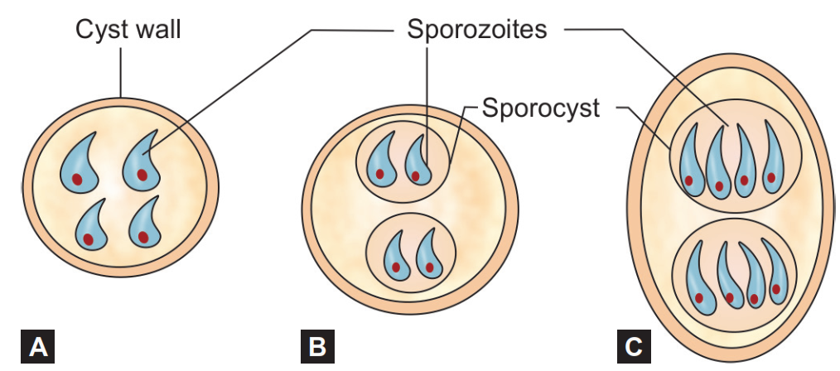
Morphology
Oocyst-
It is the infective form to man as well as the diagnostic form excreted in the feces.
Round, small, 4–6 µm in size, surrounded by a cyst wall and bears four sporozoites
Two types of oocysts are demonstrated—(1) thick walled and (2) thin walled
Sporulated oocysts of (A) Cryptosporidium;
(B) Cyclospora; (C) Cystoisospora

Slide 25
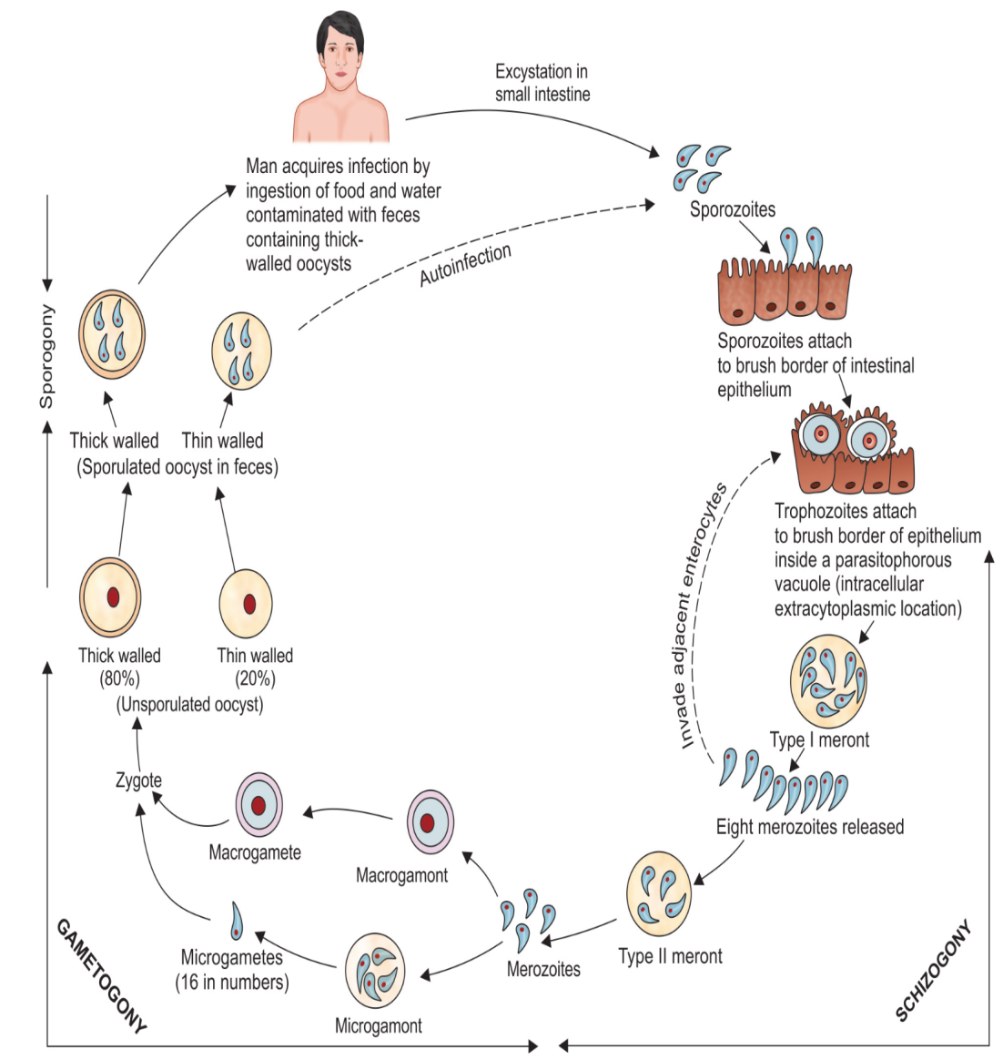
Life cycle

Slide 26
Epidemiology
Cryptosporidiosis is a zoonotic disease.
C. parvum is common in rural area; transmission is associated with contact with animals and exposure to surface water.
Subtype IIc commonly infects man
Seasonality: C.parvum infection is common in spring, whereas C. hominis in autumn
Source of infection includes rain water lodges and swimming pool recreational water.
Prevalence: Cryptosporidiosis is found in most region of the world except Antarctica.
In immunocompetent people, the prevalence in developing countries like India varies from 2.4 to 15%; where as in the western countries it is 1.4–6%.

Slide 27
Pathogenesis
The pathogenesis involves the following steps.
1) Excystation: Following infection, the oocysts undergo excystation in small intestine releasing four sporozoites.
2) Attachment: Sporozoites attach to the brush border epithelium of the small intestine (ileum) with the help of a unique protein called as CP47 Cryptosporidium protein.
3) Penetration:
Discharges from the apicomplex (rhop tries, micronemes and dense granules) present in the anterior end of the sporozoites help in invasion
Following penetration, the parasite forms a parasitophorous vacuole near the Microvilli surface of the host cells (intracellular extracytoplasmic location).
The parasite activates the host cell kinase signalling pathway that liberates proinflammatory cytokines like TNF- alfa, IL-8, prostaglandins, etc.
Cytokines released from the inflammatory site can activate the phagocytes; attract fresh leukocytes which in turn liberate soluble factors
These factors increase intestinal secretion of chloride and water and decrease the sodium absorption coupled to glucose transport.

Slide 28
Clinical Features
Immunocompetent Hosts
Usually the infection is asymptomatic
Sometimes, patient develops self-limiting watery nonbloody frothy diarrhea 5–6 times a day
Other features like abdominal pain, nausea, anorexia, fever, and/or weight loss may be present.
Immunocompromised Hosts
Disease is more severe in immuno compromised hosts especially in patients with AIDS having CD4+ T cell counts less than 100/µL
It produces a chronic, persistent remarkably profuse diarrhea (1–25 L/day), leading to significant fluid and electrolyte loss
Severe weight loss, wasting and abdominal pain may be seen
Autoinfection by thin-walled oocyst is a key factor for the chronic diarrhea which maintains the infection.

Slide 29
Laboratory diagnosis
1) Direct microscopy (Stool examination)-shows round 4-6 µm size oocyst containing four sporozoites
Direct wet mount
Wet mount after concentration- Sheather’s sugar floatation technique is preferred
Acid fast staining and calcofluor white staining
Direct fluorescent antibody staining.
2) Antigen detection from stool ELISA, ICT (Triage parasite panel detecting protein disulfide isomerase Ag)
3) Antibody detection from serum ELISA
4) Molecular diagnosis by PCR detecting 18S rRNA and tubulin gene
5) Histopathology of intestinal biopsy specimen appears as blue beads.

Slide 30
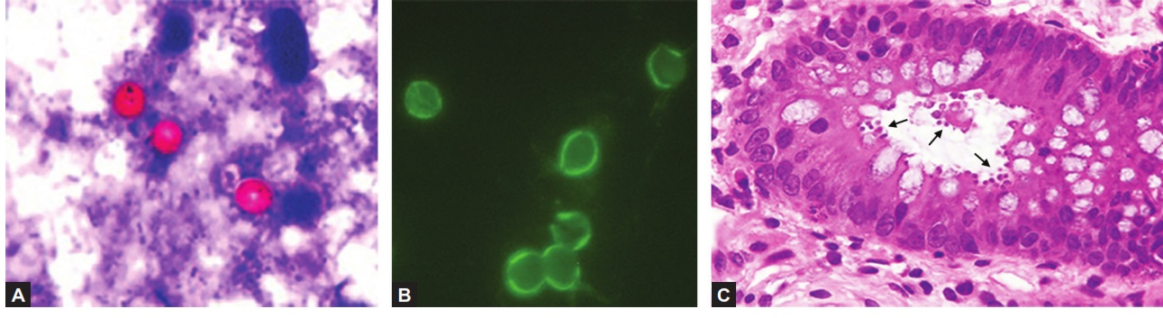
Direct microscopy
Cryptosporidium species (A) Acid fast stain shows red color oocyst against blue back ground; (B) Direct fluorescent antibody staining shows brilliant green fluorescent oocysts; (C) Hematoxylin and eosin stain of intestinal biopsy shows numerous oocysts at the luminal surface of the intestinal crypt (marked by arrows)

Slide 31
Treatment
Mild cases are self-limited, requires fluid replacement like ORS, with lactose-free gluta mine supplemented diet.
Severe cases: Nitazoxanide is given to adults (500 mg twice daily for 3 days). It is not effective in HIV infected patient.
Paromomycin and Macrolide antibiotics can be given as an alternate.

Slide 32
Cyclospora cayetanensis
Cyclospora cayetanensis is the most recently described coccidian parasite as human intestinal pathogen.
life cycle-Humans are the only known host. Man gets infection by ingestion of food and water contaminated with sporulated oocyst in soil.
Life cycle similar to that of Cryptosporidium except-
  The oocysts released in the human feces are unsporulated
  The sporulation of oocyst takes place in the soil.

Slide 33
Clinical Features-
It causes self-limiting diarrhea.
Disease is more severe with biliary tract involvement in HIV positive patients.
Epidemiology
Disease is prevalent in Central and South America and South Asia (India and Nepal)
Food-borne outbreaks of cyclosporiasis have been linked to various types of imported foods including raspberries, basil and mesclun lettuce.

Slide 34
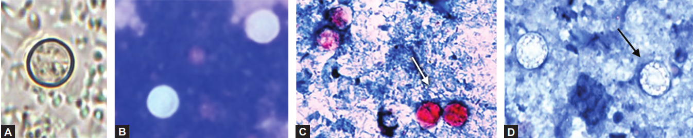
Laboratory diagnosis
Stool Examination- Multiple stool specimens are examined by direct microscopy or stained by acid fast stains or fluorescent stains.
  Cyclospora oocysts are round, 8–10 µm size and variably acid fast
  Autofluorescence of the oocysts under ultraviolet epifluorescence microscopy is both rapid and sensitive, although not specific.
Cyclospora species (A) Saline mount preparation showing unsporulated oocyst; (B) Epifluorescence microscopy showing autoflourescent oocysts; (C) Acid fast oocysts; (D) Non-acid fast oocysts (variable acid-fastness)

Slide 35
Molecular Diagnosis
Conventional PCR and nested PCR targeting small subunit rRNA and 70-kDa heat shock protein (HSP70) of Cyclospora.
  Sensitivity of 62%.
PCR-RFLP.
BioFire Film Array Gastrointestinal Panel can be used.
Flow cytometry-alternate methodof diagnosis.
Serology
Antibodies to Cyclospora can be detected.
Histopathology
Biopsy specimens from the intestine show villous atrophy, acute and chronic inflammatory changes in the lamina propria. Inside the enterocytes, Cyclospora is supranuclear in location.

Slide 36
Treatment of Cyclosporiasis
Cotrimoxazole for 7 days).
HIV infected patients may require long-term suppressive maintenance therapy
Patients who cannot tolerate cotrimoxazole may be treated with ciprofloxacin or nitazoxanide.

Slide 37
Cystoisospora (Isospora) belli
Oocyst
The sporulated oocyst is oval/elliptical, 20–33 µm × 10–19 µm in size
Contains two sporocysts, each with four sporozoites.
It is surrounded by a thin, smooth, two layered cyst wall.
Sporulated oocysts of (A) Cryptosporidium;
(B) Cyclospora; (C) Cystoisospora

Slide 38
Life cycle
Man gets infection by ingestion of food and water contaminated with sporulated oocyst in soil.
In the proximal small intestine, eight sporozoites are released from each oocyst. They invade the duodenal and jejunal epithelium and transform into trophozoites.
Trophozoites multiply and transform into schizont, undergo asexual multiplication to produce merozoites.
Merozoites again attack fresh enterocytes to repeat the asexual cycle.
Some of the merozoites transform into microgametocyte and microgametocyte (gametogony).
Eventually, they form macrogametes and microgametes which fuse to form the zygote (fertilization)
Zygotes secrete the cyst wall and develop into immature oocysts, excreted in the feces.
In the soil, the sporulation occurs within 3–4 days and immature oocyst transform into sporulated oocyst which bears two sporocysts each containing four sporozoites.

Slide 39
Epidemiology
C.belli is found worldwide but predominantly in tropical and subtropical climates, especially in South America, Africa, and Southeast Asia including India.
Humans are the only host; there is no other animal reservoir.
It is frequently associated in AIDS patients.
Clinical Feature
Acute infections can begin abruptly with fever, abdominal pain, and watery non bloody diarrhea and can last for weeks or months.
Disease is less severe and outbreaks are less common compared to cryptosporidiosis
In immunocompromised or HIV positive patients, disease is more severe and extraintestinal infections such as involvement of biliary tract.

Slide 40
Laboratory diagnosis
1) Stool examination—demonstration of characteristic oval oocyst in patient’s stool by:
Saline wet mount of stool
Acid fast stained smears: The oocyst is uniformly acid fast, oval/elliptical, 20–33 µm × 10–19 µm in size, surrounded by a thin, smooth, two layered cyst wall.
Fluorescent stained smears: By auramine rhodamine stain
Autofluorescence can be seen under 330–380 nm ultraviolet filter.
Phase contrast microscopy is also useful
2) Stool concentration by Sheather’s sugar floatation technique
3) Examination of small bowel specimens (e.g. duodenal aspirates)
4) Other tests: Peripheral blood eosinophilia
5) Molecular methods
6) Histopathologic examination

Slide 41
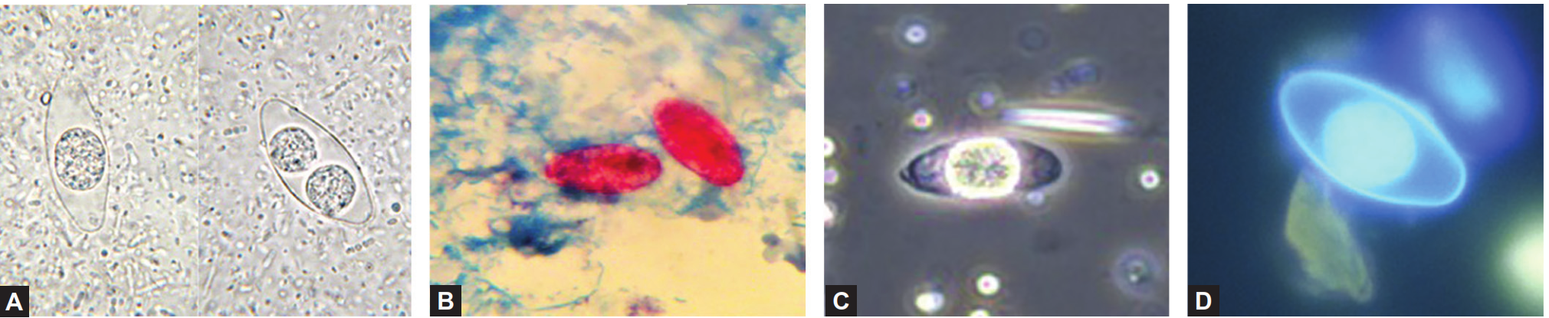
Laboratory diagnosis continued..
Cystoisospora belli (A) Saline mount preparation shows left unsporulated oocyst and right sporulated oocyst; (B) Modified acid fast stain showing unsporulated oocyst; (C) Phase contrast microscopy showing unsporulated oocyst; (D) Fluorescent
stained smears showing unsporulated oocyst

Slide 42
Treatment
Cotrimoxazole is the treatment of choice for 10 days.
Patients with HIV infection usually require longer courses but have more chance of relapse.
Alternative treatment: Pyrimethamine together with folinic acid or ciprofloxacin for 7 days followed by suppressive therapy three times weekly.
Nitazoxanide has also been used successfully.

Slide 43
Sarcocystis species
Two well-described species are S. hominis (infects cattle) and S. suihominis (infects pigs).
They produce two types of human infection:
  (1) intestinal sarcocystosis and
  (2) muscular sarcocystosis
It exists in three morphological forms
  Oocyst
  Sarcocyst
  Sporocyst

Slide 44
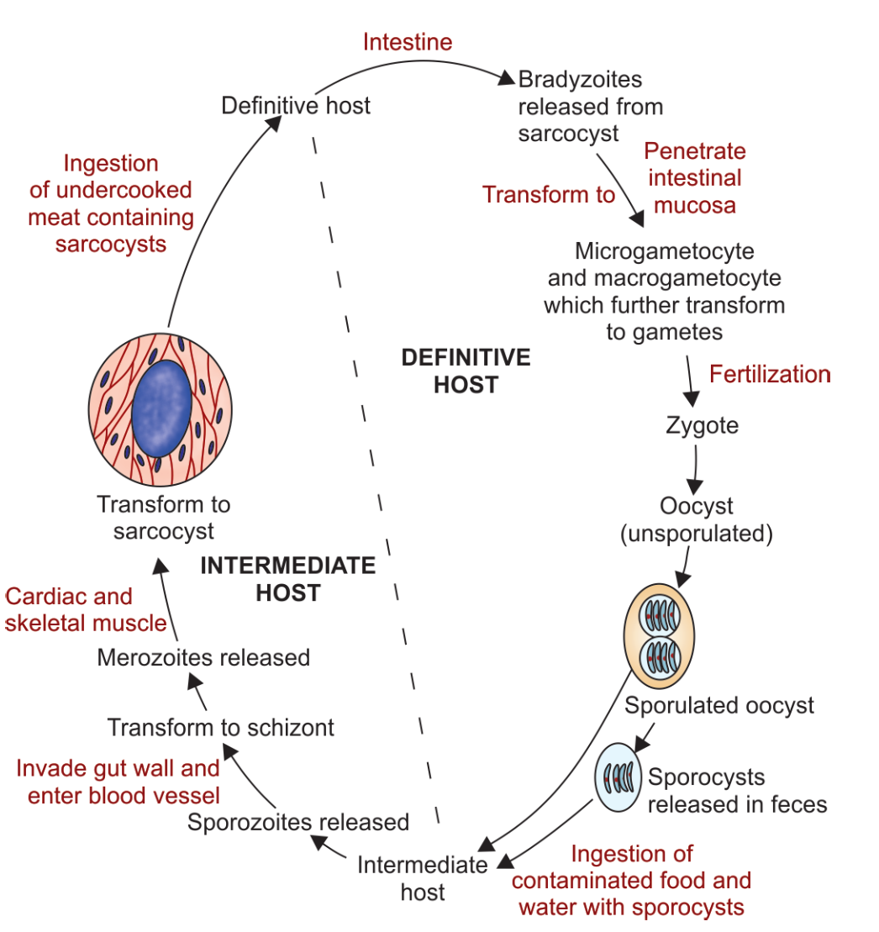
Life cycle

Slide 45
Clinical Features
Intestinal Sarcocystosis
It is usually asymptomatic but patient may develop nausea, vomiting, abdominal pain and diarrhea.
Symptoms appear early after ingestion of beef (3–6 hours) than pork (24 hours).
Prevalence is 2–10% throughout the world, including India.
Muscular Sarcocystosis
It is also usually asymptomatic; symptoms depend on the size of the muscle cysts that varies from 50 µm to 5 cm.
Larger cysts can cause muscle pain, weak ness in muscle or rarely focal myositis and eosinophilic myositis.
Myocarditis and pericarditis occur rarely
It has been associated with malignancies, primarily involving the tongue and nasopharynx.

Slide 46
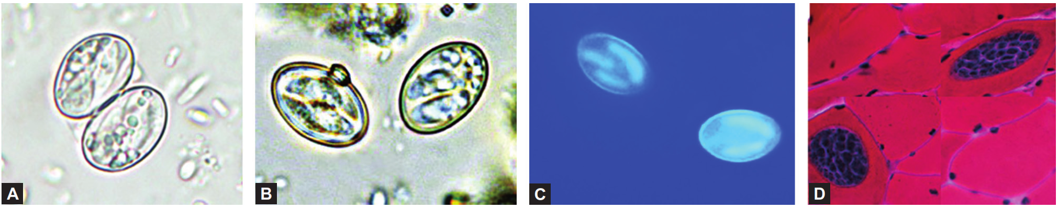
Laboratory diagnosis
Intestinal Sarcocystosis
Stool examination- demonstrating the sporocysts or sporulating oocysts of Sarcocystis. Zinc sulfate flotation is done if parasite count is low.
Muscular Sarcocystosis
histological examination- They measure 100–325 µm in size, con tain numerous PAS positive bright red bradyzoites measuring 7–16 µm.
(A) Oocyst containing two sporocysts in saline mount; (B) Sporocysts containing sporozoites in saline mount; (C) Sporocysts autofluoresce under UV (D) Sarcocysts in skeletal muscle biopsy

Slide 47
Treatment
No specific treatment for Sarcocystis infection is known.
Infection, if symptomatic, is generally self-limited.
Cotrimoxazole, furazolidone and albendazole are used, but their efficacy is doubtful.
Corticosteroids may provide symptomatic relief in cases of eosinophilic myositis.

