Slide 1
ANTIBIOTIC SENSITIVITY TESTS
MS SANGITA VASAVA

Slide 2
What is the goal of Antibiotic Sensitivity testing?
The goal of antimicrobial susceptibility testing is to predict the in vivo success or failure of antibiotic therapy. Tests are performed in vitro, and measure the growth response of an isolated organism to a particular drug or drugs. The tests are performed under standardized conditions so that the results are reproducible. The test results should be used to guide antibiotic choice. The results of AST should be combined with clinical information and experience when selecting the most appropriate antibiotic for our patients.

Slide 3
Introduction
Antibiotic sensitivity test: A laboratory test which determines how effective antibiotic therapy is against a bacterial infections.
The main purpose of AST is:
  As a guide for treatment
    Sensitivity of a given micro organism to known concentration of drugs.
    Its concentration in body fluids or tissues.
  As an epidemiological tool
    The emergence of resistant strains of major pathogens (e. g. Shigella, Salmonella typhi)
    Continued surveillance of the susceptibility pattern of the prevalent strains (e. g. Staphylococci, Gram-negative bacilli)

Slide 4

Types of AST :
  Diffusion tests: (filter disc, or a porous cup/a bottomless cylinder containing measured quantity of drugs on the a solid medium
  that has been seeded with test bacteria)
Kirby-Bauer disk diffusion method.
Strokes disk diffusion method.
  Dilution method tests: (vary amount of
  antimicrobial substances incorporated
  Into liquid or solid media )
Broth dilution method.
Agar dilution method.
Diffusion and Dilution test:
E test.

Slide 5
Kirby-Bauer method:
A commonly used method in basic laboratories.
Kirby-Bauer antibiotic testing is a test which uses antibiotic-impregnated wafers to test whether particular bacteria are susceptible to specific antibiotics
How to perform Kirby- Bauer testing:
The basics are easy: The bacterium is swabbed on the agar and the antibiotic discs are placed on top. The antibiotic diffuses from the disc into the agar in decreasing amounts the further it is away from the disc. If the organism is killed or inhibited by the concentration of the antibiotic, there will be NO growth in the immediate area around the disc: This is called the zone of inhibition .

Slide 6



Disk diffusion method
Incubate plate
18-24 hr, 35 C
Measure and record zone of inhibition around each disk
Inoculation on a
Muller -Hilton agar
Plate.
Place disks
on agar plate

Slide 7
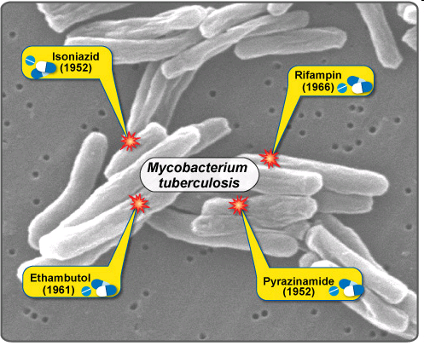
Limitation of Disk Diffusion Methods
Disk diffusion methods are not suitable for slow growing bacterial pathogens
The great limitation being for testing on Mycobacterium tuberculosis which needs varied, technically demanding methods

Slide 8
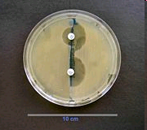
Stokes’ Method
In original Stokes’ method the inoculum of the control strain is evenly spread over the upper and lower thirds of a plate and that of the test strain over the central third; uninoculated gaps 2 – 3 mm wide are left to test from the control areas.

Slide 9
Control strains in Stokes’ Method
The Microbiology laboratories should always practice to test the quality control of their work with the use of standard strains in Stokes method with following standard strains and results are compared
1 Escherichia coli NCTC 10418
2 Pseudomonas aeruginosa NCTC 10662
3 Staphylococcus aureus NCTC 6571

Slide 10
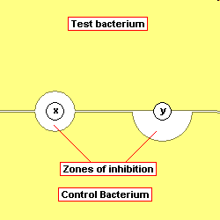
Stokes Method for Antibiotic Sensitivity testing
In the Stokes controlled sensitivity test, a control organism is inoculated on part of a plate and the test organism is plated on the remainder. Disks are placed at the interface and the zones of inhibition are compared. The use of a sensitive control shows that the antibiotic is active, so that if the test organism grows up to the disk it may safely be assumed that the test organism is resistant to that drug.

Slide 11
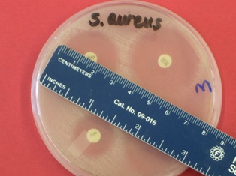
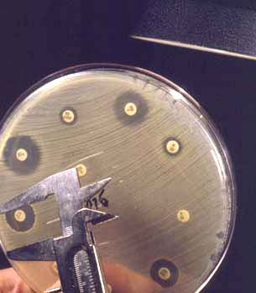
Reporting the Results
Interpretation of results
  By comparing with the diameters with “standard tables”
  Susceptible
  Intermediate susceptible
    Low toxic antibiotics: Moderate susceptible
    High toxic antibiotics: buffer zone btw resistant and susceptible
  Resistant

Slide 12
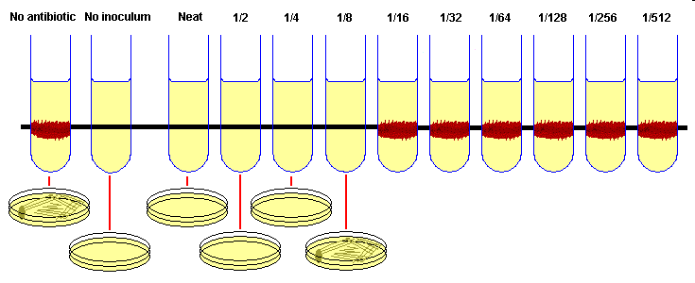
Dilution Method
Minimum Inhibition Concentration (MIC)
  The lowest concentration of antimicrobial agent that inhibits bacterial growth/ multiplication
Minimum Bactericidal Concentration (MBC) or Minimum Lethal Concentration (MLC)
  The lowest concentration of antimicrobial agent that allows less than 0.1% of the original inoculum to survive

Slide 13
Broth Dilution Method
Procedure
Making dilutions (2-fold) of antibiotic in broth
Mueller-Hinton, Tryptic Soy Broth
  Inoculation of bacterial inoculum, incubation, overnight
  Controls: no inoculum, no antibiotic
  Turbidity visualization → MIC
  Sub culturing of non-turbid tubes, overnight
  Growth (bacterial count) → MBC
Disadvantages :
  Only one antibiotic & one organism can be tested each time
  Time-consuming

Slide 14
Agar Dilution Method
Procedure:
  Making dilutions of antimicrobial agent in melted media and pouring plates
    One concentration of antibiotic/ plate
    Possible for several different strains/plate
  Inoculation of bacterial inoculum (McFarland No. 0.5)
    Using a replicating inoculator device called “A Steers-Foltz replicator”
    Delivers 0.001 ml of bacterial inoculum
  Incubation
  Spot of growth
MIC
32 ug/ml

Slide 15
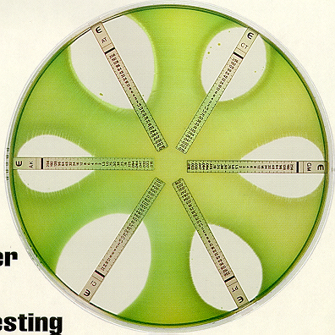
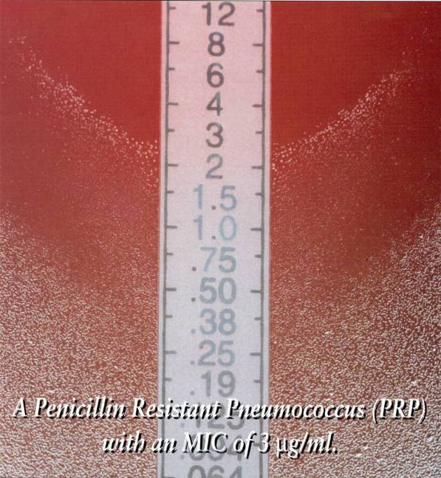
The gradient technique
E-test:
E-test is a well established AST method in microbiology laboratories around the world. The Etest technique comprises a predefined gradient of antibiotic concentrations on a plastic strip, and can be used to determine the Minimum Inhibitory Concentration (MIC) of antibiotics, antifungal agents and antimycobacterial agents.

Slide 16
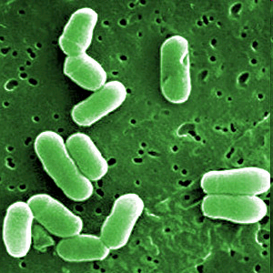
Multiple drug resistant organisms
Multiple drug resistant organisms are resistant to treatment with several, often unrelated, antimicrobial agents as described above in Shigella. Some of the most important types of multiple drug resistant organisms that have been encountered.

Slide 17
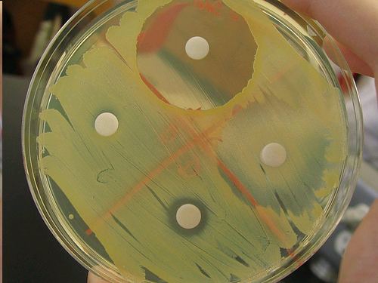
Examples of Bacteria of Clinical Importance.
MRSA - methicillin/oxacillin-resistant Staphylococcus aureus
VRE - vancomycin-resistant enterococci
ESBLs - extended-spectrum beta-lactamases (which are resistant to cephalosporins and monobactams)
PRSP - penicillin-resistant Streptococcus pneumoniae.
Methicillin resistance in Staphylococcus aureus

Slide 18
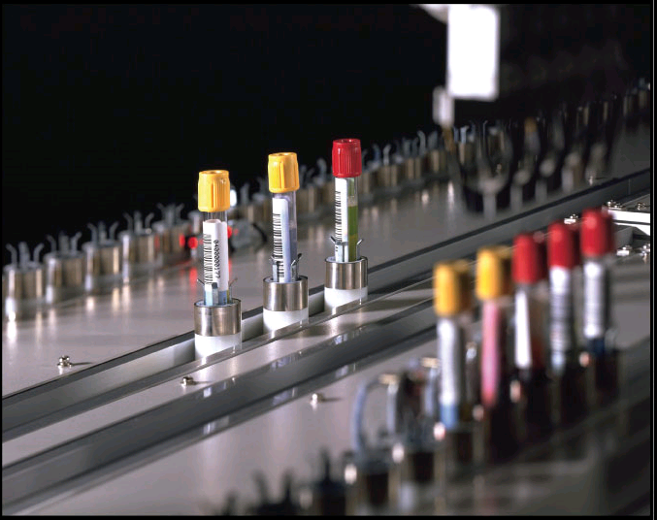
References
1)Usanee Anukool (Ph.D.) Clinical Microbiology,AMS,
Chiang Mai University
2)National Committee For Clinical Laboratory Standards. 1998. NCCLS document M100 - S8 . Performance Standards for Antimicrobial Susceptibility Testing. 8th edition, NCCLS, Waynae, Pa.

Slide 19


