Slide 1
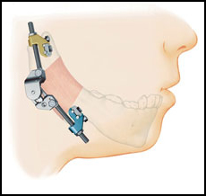
DISTRACTION
OSTEOGENESIS
Dr. Priyank Katwala
Assistant Professor
Department of Plastic Surgery

Slide 2
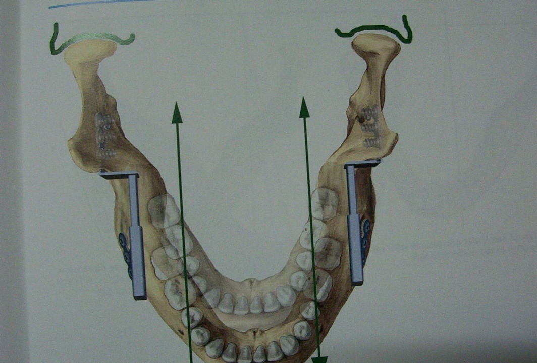
Definition:
Distraction osteogenesis is a biologic process of new bone formation between the surfaces of bone segments that are gradually separated by incremental traction.

Slide 3
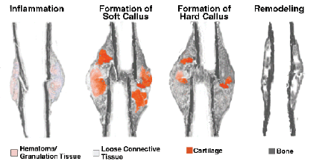
The process initiated when a traction force is applied to bone segments and continues as long as the callus tissue are stretched.
Distraction forces applied to bone also create tension in the surrounding soft tissues, initiating a sequence of adaptive changes termed distraction histiogenesis

Slide 4
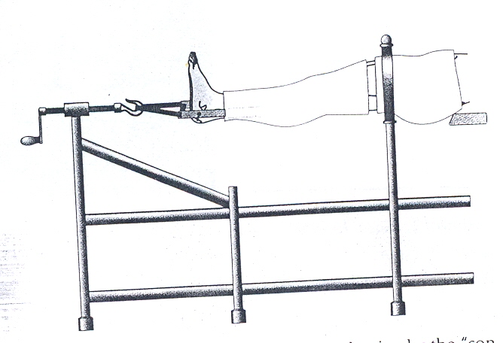
History
Banon, in 1826, is credited with being the first to perform a surgical division of bone, or osteotomy.
Codivilla combined these techniques to perform the first limb lengthening using external skeletal traction after an oblique osteotomy of the femur.

Slide 5
A significant contribution was made by the Russian surgeon Gavril Ilizarov 1951.
He designed a new apparatus for bone fixation consisting of two metal rings joined together with three or four threaded rods.
Mc Carthy and collegues applied this technique to craniofacial skeleton in 1989.

Slide 6
Distraction techniques:
1927 Rosenthal performed first mandibular osteodistraction
1937 Kazanjian performed mandibular osteodistraction with incremental traction
Crawford 1948 – gradual incremental traction to fracture callus of mandible
Kole 1959 described method of surgically correcting anterior open bite
In 1973 Snyder introduced Ilizarov’s principles to craniofacial skeleton

Slide 7
Principles of distraction
Bone seperated into segments– osteotomy/corticotomy
Latency period
Gradual distraction with device (Activation period)
rhythm of 0.25mm four times/day
Consolidation

Slide 8
Osteotomy
is the surgical separation of a bone into two segments.
is the period from bone division to the onset of traction and represents the time required for reparative callus formation between the osteotomized bone segments.
Latency

Slide 9
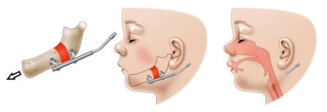
is that time when a traction force is applied to bone segments, and new bone, or distraction regenerate, is formed within the intersegmentary gap.
The distraction period

Slide 10
Types of distraction osteogenesis
Unifocal
Bifocal
Trifocal
Transosteotomy/transcorticotomy distraction
Transsutural distraction

Slide 11
Histologic Analysis
Central fibrous zone– longitudinally oriented fibrous bundles
Transistion zone
Remodelling zone
Mature bone zone

Slide 12
Biomechanics
The mechanical environment in the distraction zone is determined by the following factors:
the rigidity of the distraction device,
the applied distraction forces,
the inherent physiologic loading (muscle action), and
the properties of all of the local soft tissues.

Slide 13
Tensile strain is defined as the amount of elongation as a fraction of the original bone length.
The process by which mechanical forces are converted to cellular signals is termed mechanical transduction.
It is integrin mediated signal transduction cascade.

Slide 14
Mandible Distraction
Accessible bone in which changes can be documented by radiographic and occlusal changes.
Advantages over classical osteotomies:
No need of bone grafts/ plates or screws
Reduced infection/blood transfusion
Reduced relapse rate
Less need of lengthy surgeries
Reduced overall hospital stay

Slide 15
Indications:
Craniofacial Microsomia
Developmental Micrognathia
Treacher Collins syndrome
Postablative mandibular defects
TM joint ankylosis
Alveolar ridge distraction

Slide 16
Devices:
Intraoral (Buried)
Extraoral– more successful and consistent
Advantages
Disadvantages
Incision– Submandibular (transcutaneous)
Intraoral

Slide 17
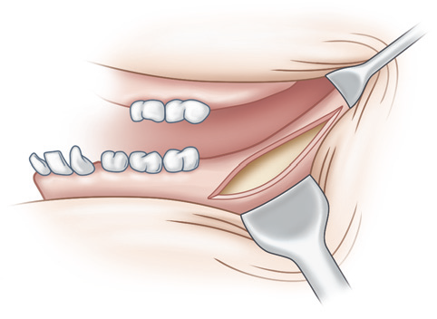
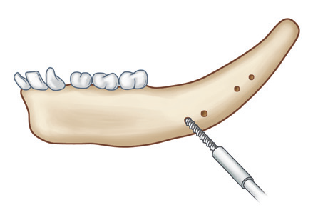
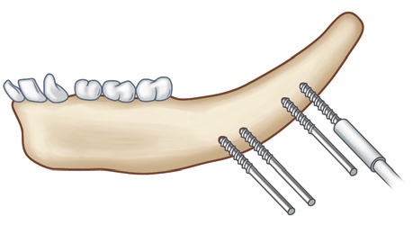

Slide 18
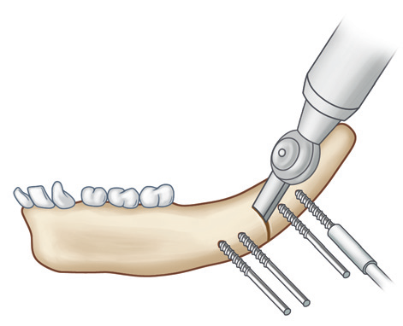
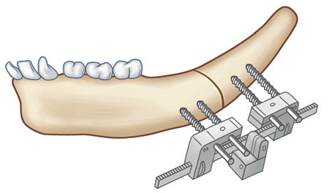
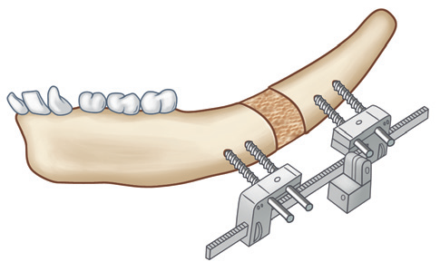

Slide 19
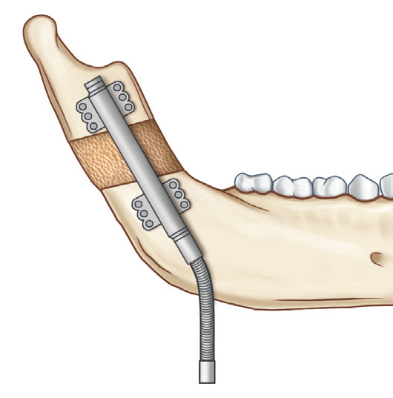
Internal/semiburied mandibular distraction device. The device is shown in the consolidation phase after completing activation.

Slide 20
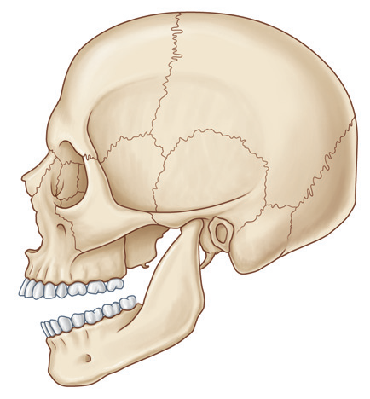
Technique
Approach– Incision
Choice of vector–
Vertical
Horizontal
Oblique

Slide 22
Unilateral distraction
Bilateral distraction
Treatment end point:--
in unilateral
In bilateral

Slide 23
Maxillary Distraction
Indications:
Maxillary retrusion in cleft lip and palate
Maxillary deformity in craniofacial microsomia
Advantages:
Can be done in child at young age with respiratory obstruction or severe malocclusion
Low relapse rate
Greater advancement can be achieved (15mm)

Slide 24
Devices:
External head frame
Buried or intraoral
Incision—Maxillary degloving along Le Fort 1
Vector– forward and downwards
End point--- class 2 malocclusion or overjet
Consolidation period– 2 months.

Slide 25
Midface/subcranial Distraction
Indications:
Syndromic craniofacial synostosis
Orbitofacial clefts
Second procedure may be required after child attains skeletal growth.

Slide 26
Advantages:
No need of bone grafts/ plates or screws
Reduced infection/blood transfusion
Reduced relapse rate
Less need of lengthy surgeries
Reduced overall hospital stay
Better aesthetic results due to more zygomatic projection
Greater degree of distraction can be achieved (20mm)
Expansion of nasopharyngeal space with relief of obstrutive sleep apnea

Slide 27
Devices:
External head frame
Buried or intraoral
Vector– anterior along plane parallel to maxillary occlusal plane
End point--- class 2 malocclusion or overjet and maximal orbitozygomatic advancement
Consolidation period– 2 months.

Slide 28
Frontofacial (Monobloc) distraction
Similar to midface distraction
Superior part of orbit and frontal bones distracted
Indications:
Severe exorbitism
Raised ICT for expansion of anterior cranial vault
Neurosurgeon required

Slide 29
Advantages:
Does not create intracranial dead space
Reduce risk of infection and CSF leakage

Slide 30
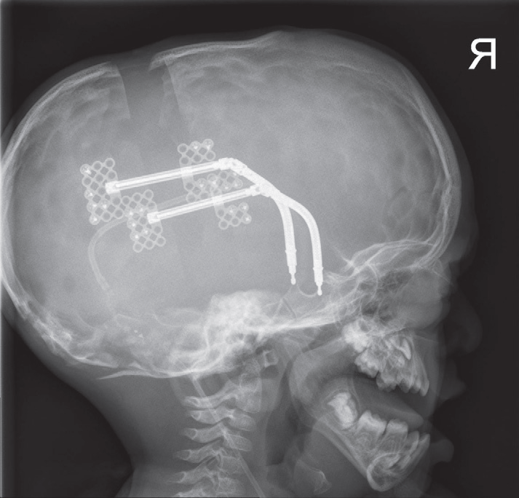
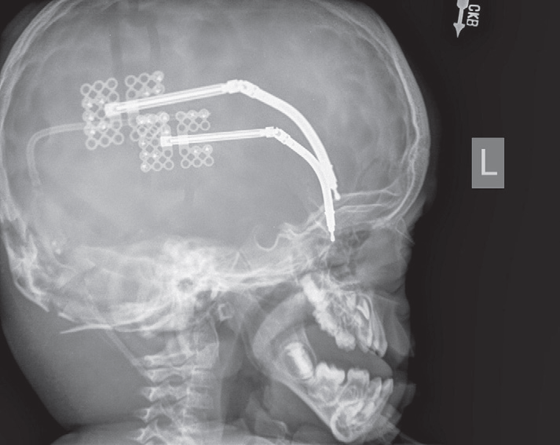
Cranial distraction
Form of bifocal or trifocal distraction
For single suture synostoses
For fronto-orbital deformities and biparietal narrowness

Slide 31
Complications
Skin infection and inflammation
Device dislodgement
Device deformation or breakage

Slide 32


